Slide 1
Economic Assessment of Lake Pend Oreille Water Management
Sponsored by
the Lakes Commission
and the
University of Idaho
Presentation to the Lakes Commission
May 8, 2026

Slide 2


Principal Investigators
Steven Peterson, Co-PI
B.S., Business Administration (Lewis Clark State College)
M.S., Economics (University of Idaho)
stevenp@uidaho.edu
Mr. Peterson is a regional economist and Associate Clinical Faculty member at the University of Idaho. He has worked extensively throughout Idaho and has conducted impact assessments on nearly every industry in Idaho including studies on energy, education, health care, tribal studies, manufacturing, agriculture, recreation, tourism, occupational analyses, and state budgeting analyses.
Timothy Nadreau, Co-PI
B.S., Pure Mathematics (University of Idaho)
M.S., Applied Agricultural Economics (University of Idaho)
Ph.D., Economics (Washington State University)
timothyn@uidaho.edu
Dr. Nadreau is a regional economist with 20-years of experience doing impact and investment analysis for higher education throughout the U.S., U.K., Canada, and Australia. He worked as a senior economist at Emsi (Lightcast) for nearly nine years where he conducted education impact analysis in every state. He is now an Assistant Professor at UofI.

Slide 3
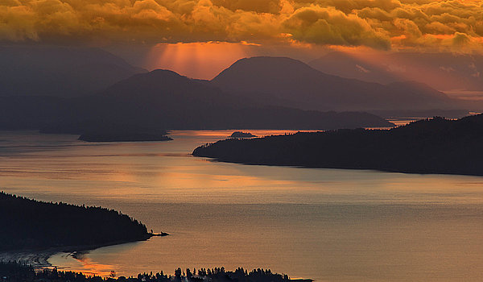
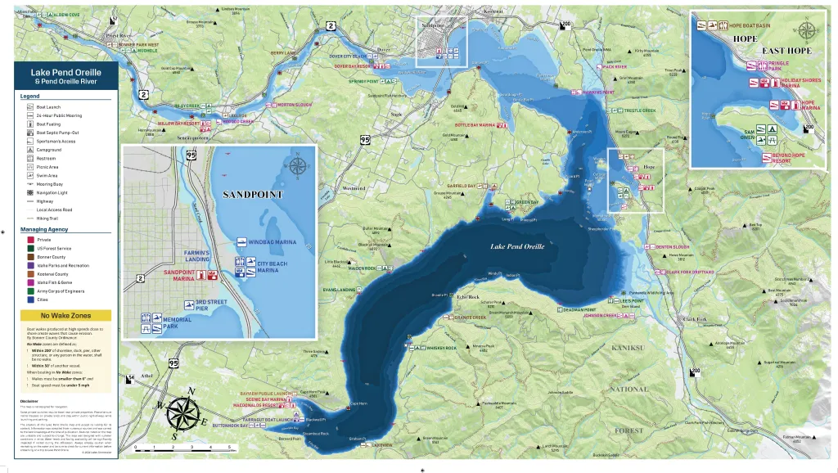
Background

Slide 4
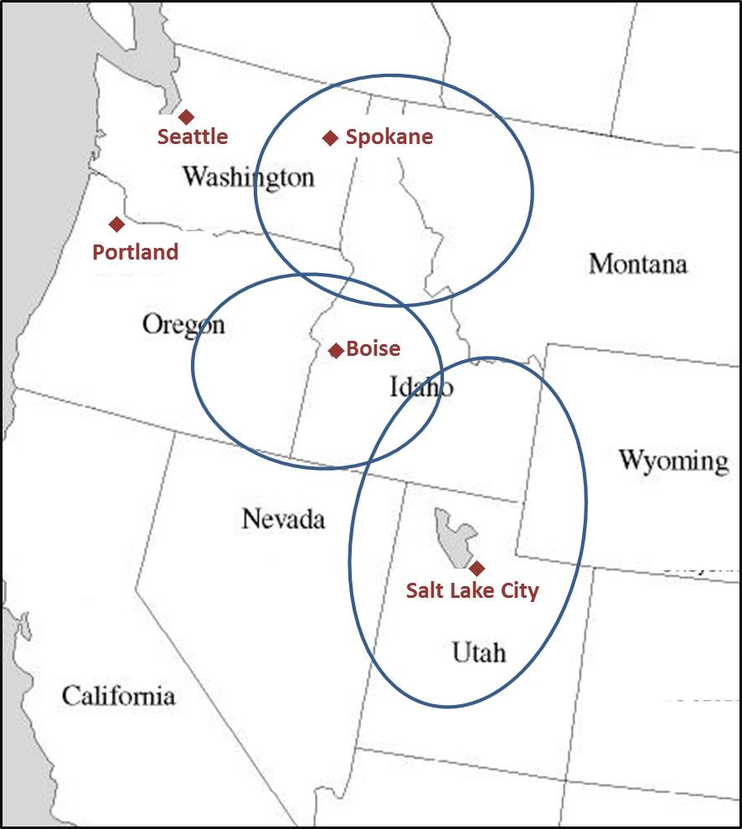
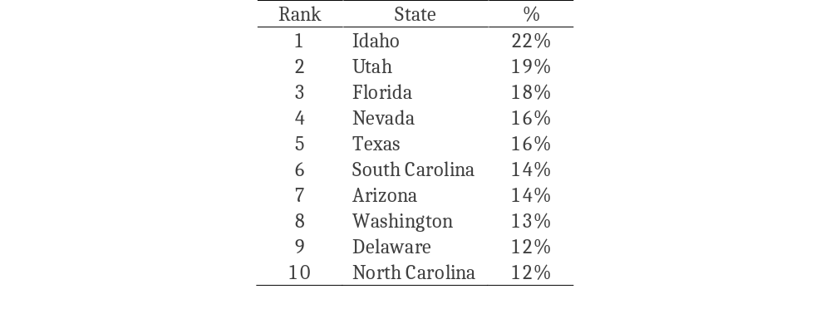
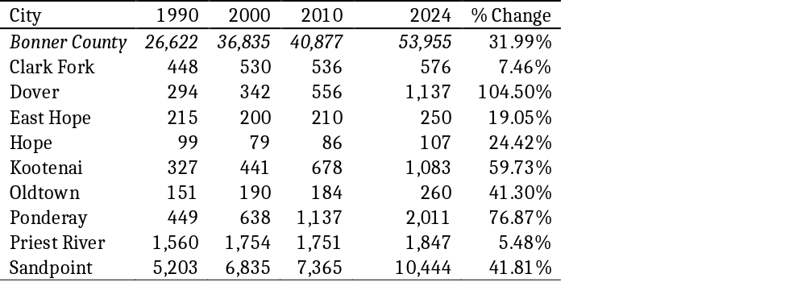
Economy of Bonner County
Idaho: A Fast-Growing State
Bonner County: A Fast-Growing County
Cumulative Population Growth 2014-2024
Cumulative Population Growth 2010-2024

Slide 5
Recent Idaho Rankings…
2015-2025
1st in Construction
2015-2025
1st in Retail Trade
2015 – 2025
1 st in Accommodation and Food Service
Rank | State | %
1 | Idaho | 91%
2 | Arizona | 66%
3 | Utah | 64%
4 | Nevada | 52%
5 | Florida | 49%
Rank | State | %
1 | Idaho | 13%
2 | Utah | 12%
3 | South Carolina | 11%
4 | North Carolina | 9%
5 | Arizona | 8%
Rank | State | %
1 | Idaho | 35%
2 | Utah | 29%
3 | Texas | 23%
4 | Arizona | 21%
5 | Montana | 20%
Source: Lightcast., BEA
Source: Lightcast/BEA
Source: Lightcast/BEA
2015-2025
5th in Manufacturing Employment Growth
2015 -2025
3rd in Professional and Scientific Services
Growth has changed from historic quality-of-life migrants… to recent households attracted to Idaho by living wage jobs
Rank | State | %
1 | Nevada | 58%
2 | Florida | 26%
3 | Utah | 25%
4 | Arizona | 23%
5 | Idaho | 22%
Rank | State | %
1 | South Carolina | 53%
2 | North Carolina | 50%
3 | Idaho | 48%
4 | Florida | 47%
5 | Utah | 47%
Source: Lightcast., BEA
Source: Lightcast/BEA

Slide 6
North Idaho 2024 Employment
Industry | Bonner | Kootenai | Spokane | Total
Crop and Animal Production | 335 | 601 | 1,822 | 2,758
Mining | 199 | 190 | 358 | 746
Utilities | 136 | 374 | 388 | 898
Construction | 2,015 | 8,936 | 17,504 | 28,456
Manufacturing | 2,108 | 5,570 | 16,930 | 24,608
Wholesale Trade | 276 | 2,243 | 11,234 | 13,753
Retail Trade | 2,588 | 10,087 | 27,656 | 40,330
Transportation and Warehousing | 487 | 1,624 | 11,976 | 14,087
Information | 334 | 823 | 3,010 | 4,167
Finance and Insurance | 429 | 2,355 | 10,452 | 13,236
Real Estate and Rental and Leasing | 486 | 1,701 | 5,397 | 7,584
Professional, Scientific Services | 1,007 | 4,276 | 14,366 | 19,650
Management | 132 | 289 | 2,950 | 3,370
Waste Management | 599 | 3,699 | 14,915 | 19,213
Educational Services | 241 | 1,144 | 7,933 | 9,318
Health Care and Social Assistance | 1,661 | 13,556 | 50,418 | 65,636
Arts, Entertainment, and Recreation | 580 | 2,848 | 4,561 | 7,989
Accommodation and Food Services | 1,992 | 8,771 | 20,918 | 31,681
Other Services | 1,278 | 3,975 | 13,491 | 18,744
Government | 2,577 | 9,050 | 42,909 | 54,536
Total | 19,460 | 82,116 | 279,188 | 380,764
Source: Lightcast

Slide 7
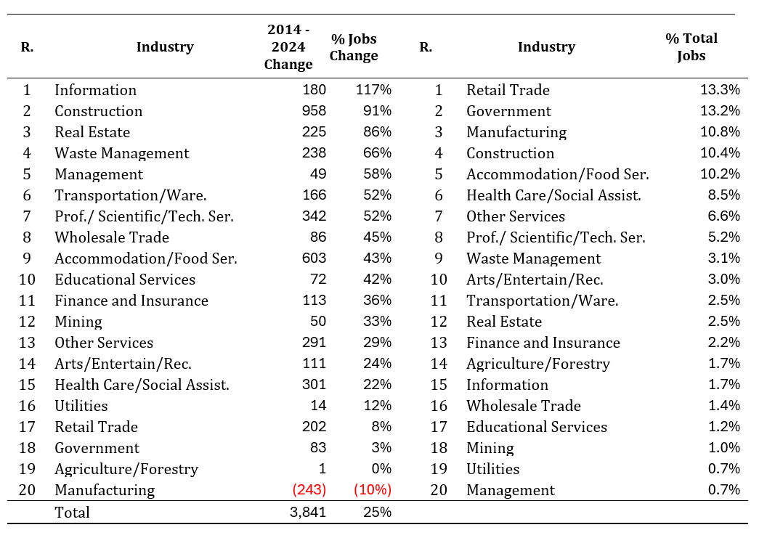
Bonner County Employment Growth and Magnitude by Industry
Source: Lightcast

Slide 8
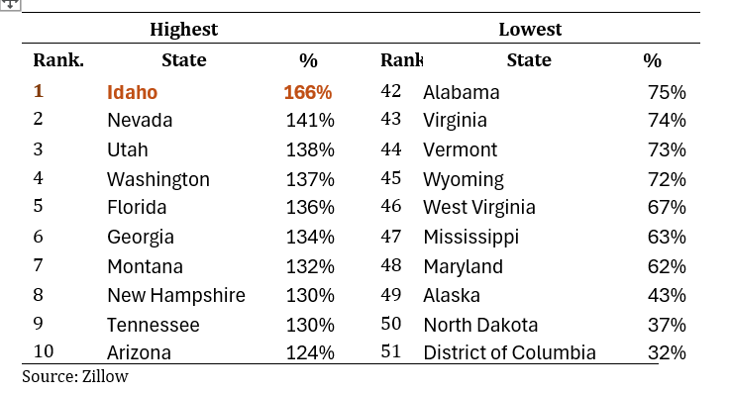
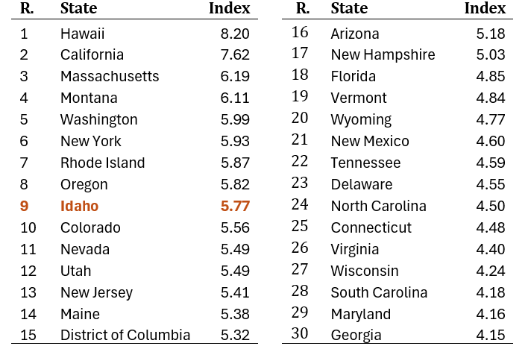
A State and Regional Housing Crisis
Top Ten Highest and Lowest Median House Price Increases (Jan. 2014 to September 2025)
Ninth Least Affordable State in the U.S.

Slide 9
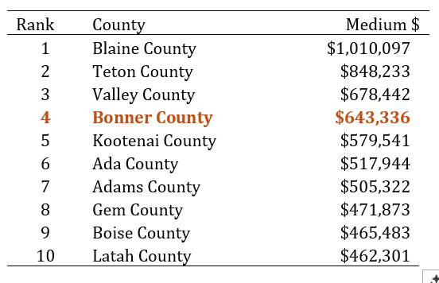
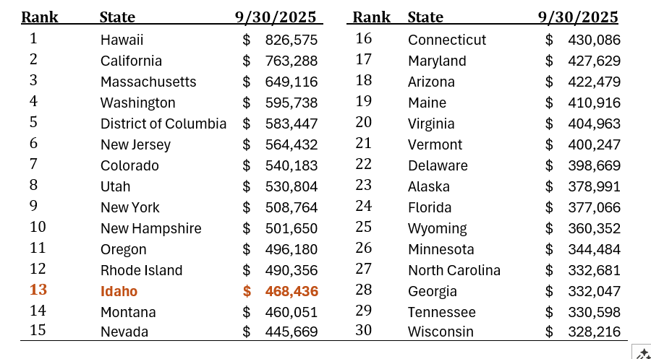
A State and Regional Housing Crisis
Bonner County Ranked Fourth in Median Housing Prices in Idaho in September 2025
Idaho Ranked Thirteenth in Median Housing Prices in September 2025
Bonner County Would Rank Fourth……
Median Housing Prices in Bonner County 2009-2025

Slide 10
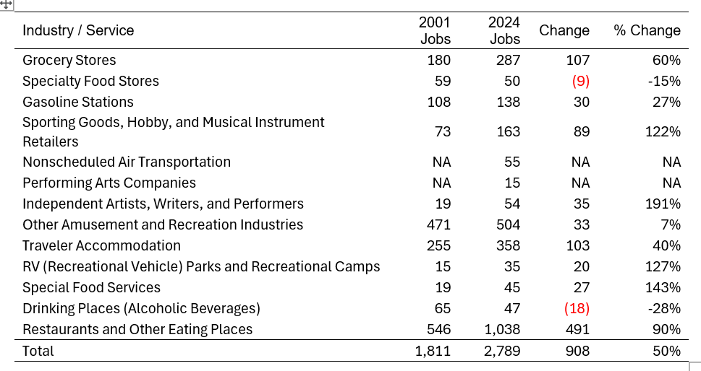
Tourism Base of Bonner County

Slide 11
Tourism Base of Bonner County
Direct Tourism Job Comparison Bonner Vs. Kootenai Counties

Slide 12
Top 10 Idaho Counties by Tourism Concentration
2025 employment concentration ratio (1.00 = U.S. average for the tourism sector)
Rank | County | Concentration Ratio | Job Growth (2015–2025)
1 | Boise | 2.970 | 41.9%
2 | Valley | 2.859 | 52.3%
3 | Custer | 2.352 | 19.2%
4 | Blaine | 2.053 | 8.2%
5 | Teton | 1.806 | 60.5%
6 | Lemhi | 1.525 | 34.8%
7 | Bonner | 1.523 | 35.2%
8 | Shoshone | 1.508 | 77.2%
9 | Bear Lake | 1.421 | 5.9%
10 | Adams | 1.375 | 35.4%
Bonner County ranks #7 of 45 Idaho counties — tourism employment is ~52% more concentrated here than the U.S. average.
Source: Lightcast / EMSI tourism-sector data, Bonner County rankings (2015–2025).

Slide 13
Top Idaho Counties by National Ranking
Dividends, Interest & Rent as % of Personal Income (2024)
National Rank | Idaho County | DIR as % of Personal Income
3 | Blaine | 66.9%
40 | Valley | 37.8%
65 | Bonner | 35.2%
101 | Teton | 32.4%
153 | Adams | 29.3%
219 | Kootenai | 26.8%
227 | Ada | 26.5%
241 | Washington | 26.1%
244 | Custer | 26.0%
246 | Idaho | 26.0%
259 | Lemhi | 25.9%
300 | Boise | 25.0%
369 | Latah | 23.9%
550 | Boundary | 21.7%
566 | Elmore | 21.5%

Slide 14
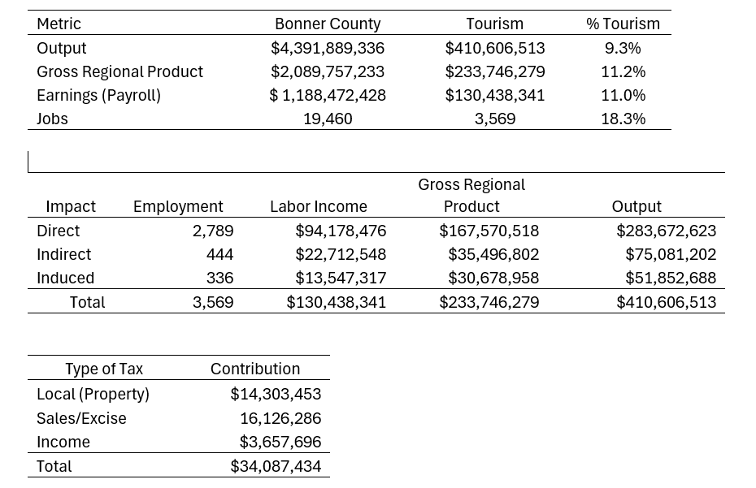
Tourism Base of Bonner County

Slide 15
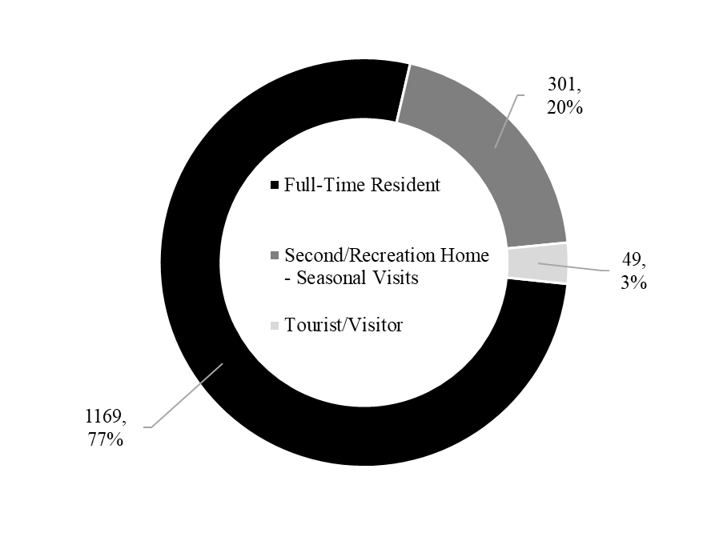
Preliminary SURVEY RESULTS
Total Respondents to Survey: 1,519

Slide 16
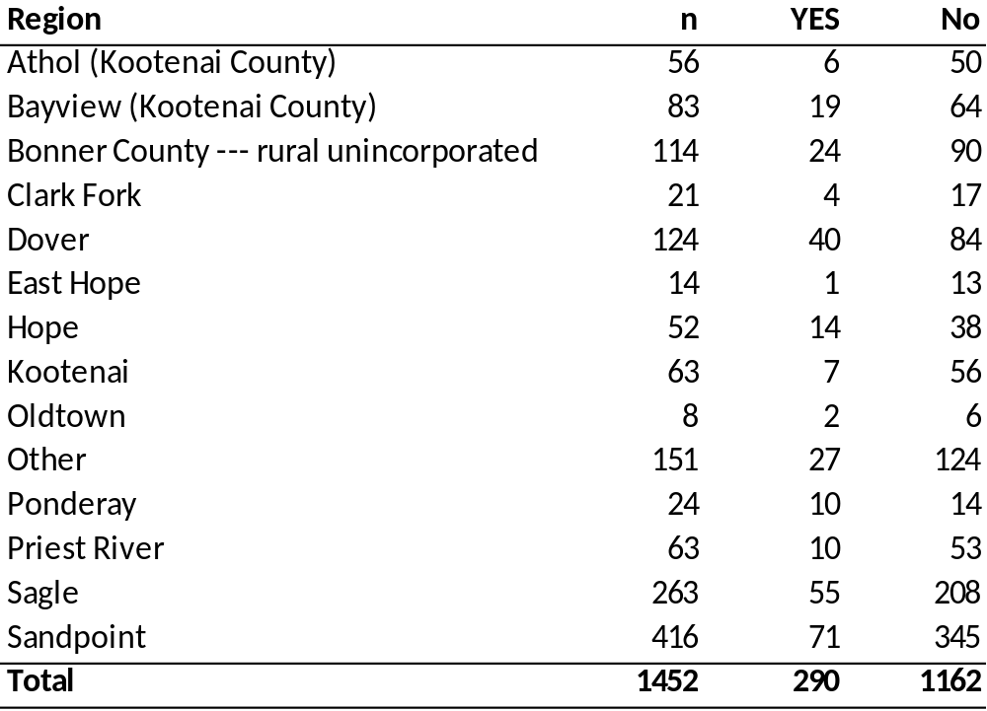
Survey Results
Have you moved to the area recently? 20% Yes, 80% No

Slide 17
Survey Results
In a typical year, how many weeks do you recreate on Lake Pend Oreille?

Slide 18
Economic Assessment of Lake Pend Oreille Water Management
Research Questions
What would the size of the 2025 Bonner County Economy have been if the lake level operated under the proposed management strategy?
We are not asking what the consequences of a different management strategy would mean for:
  Shore erosion
  Fish habitat
  Future economic growth rates
  Etc.
We want to know what the annual consequences of the strategy were over the past year.

Slide 19
Differences IN Management Strategy
– 171 days of full summer pool vs. 111 days

Slide 20
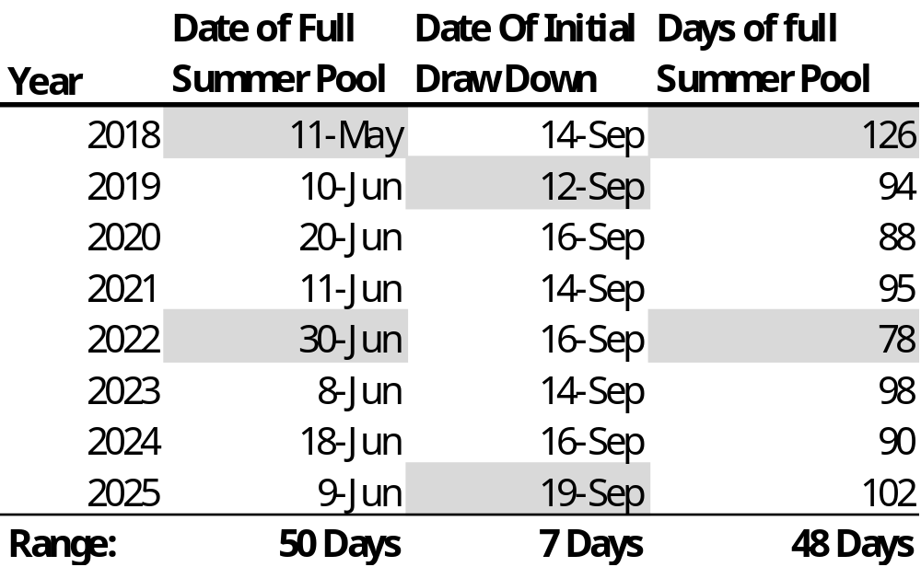
Differences IN Management Strategy
Uncertainty of Full summer pool

Slide 21
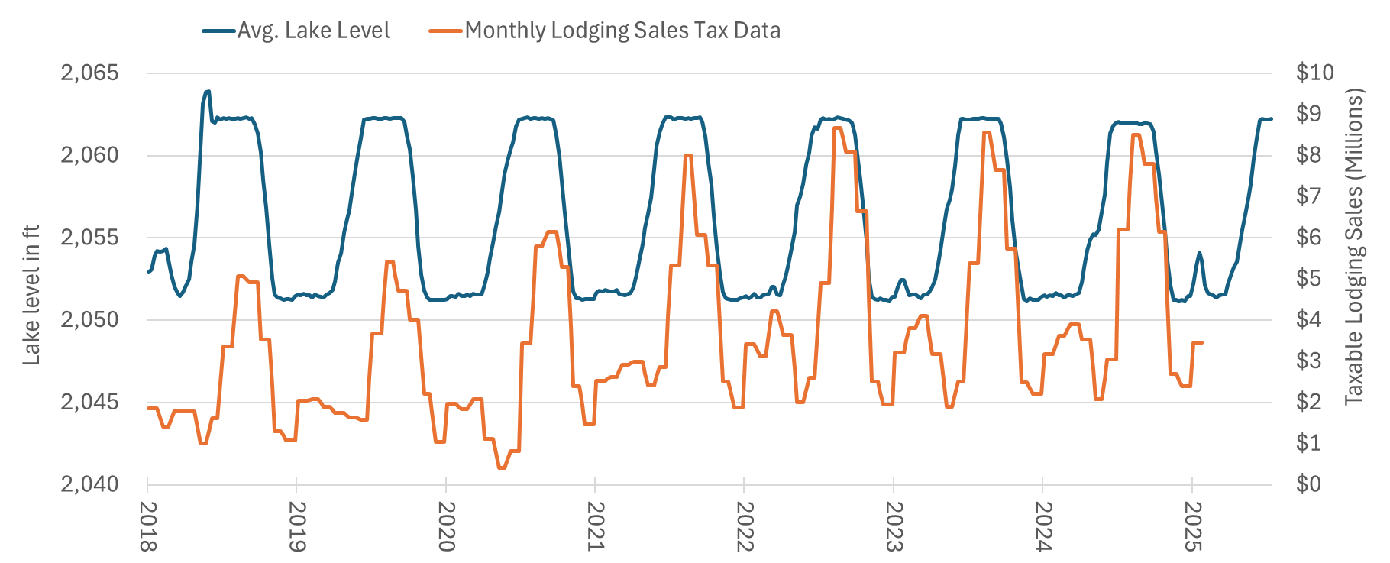
Lake Level and Tourism IV Data

Slide 22
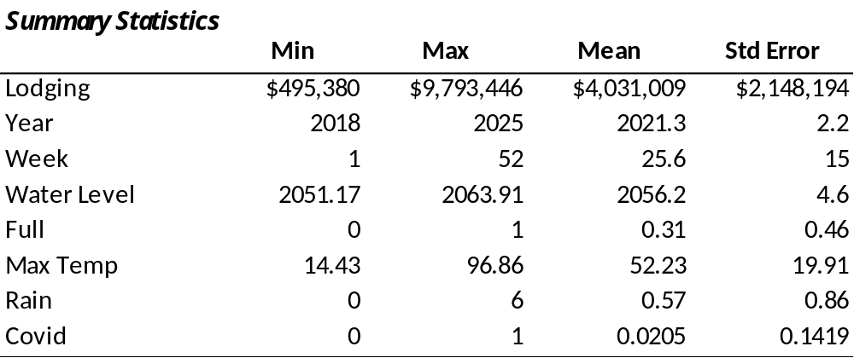
Economic Assessment of Lake Pend Oreille Water Management
Regression and Spending estimation

Slide 23
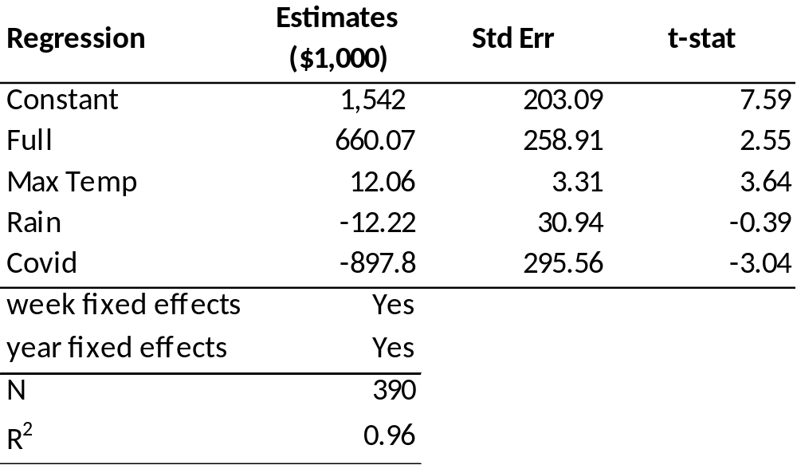
Economic Assessment of Lake Pend Oreille Water Management
Regression and Spending estimation

Slide 24
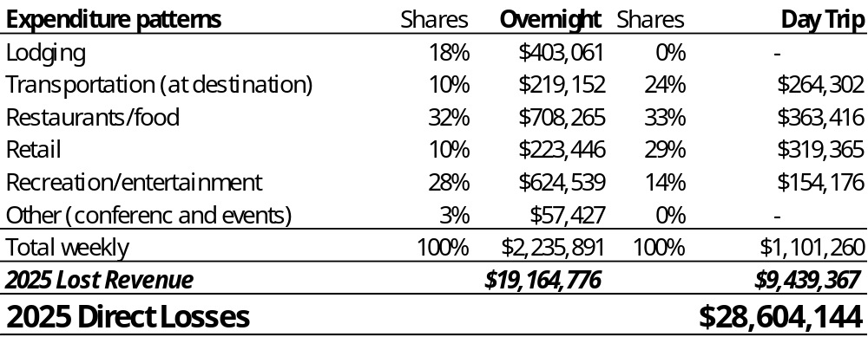
Economic Assessment of Lake Pend Oreille Water Management
Regression and Spending estimation

Slide 25
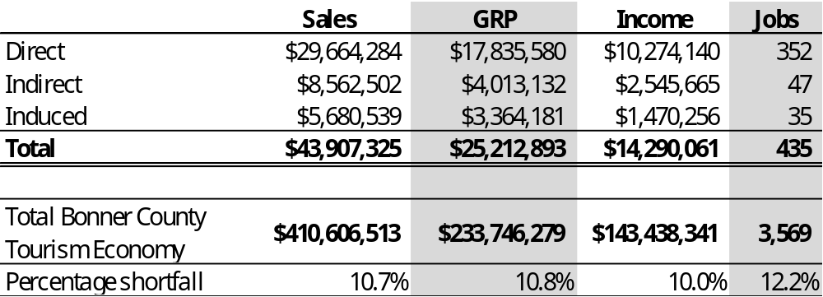
Economic Assessment of Lake Pend Oreille Water Management
2025 Economic Losses From Current Management Strategy

Slide 26
Any Questions?

