Slide 1
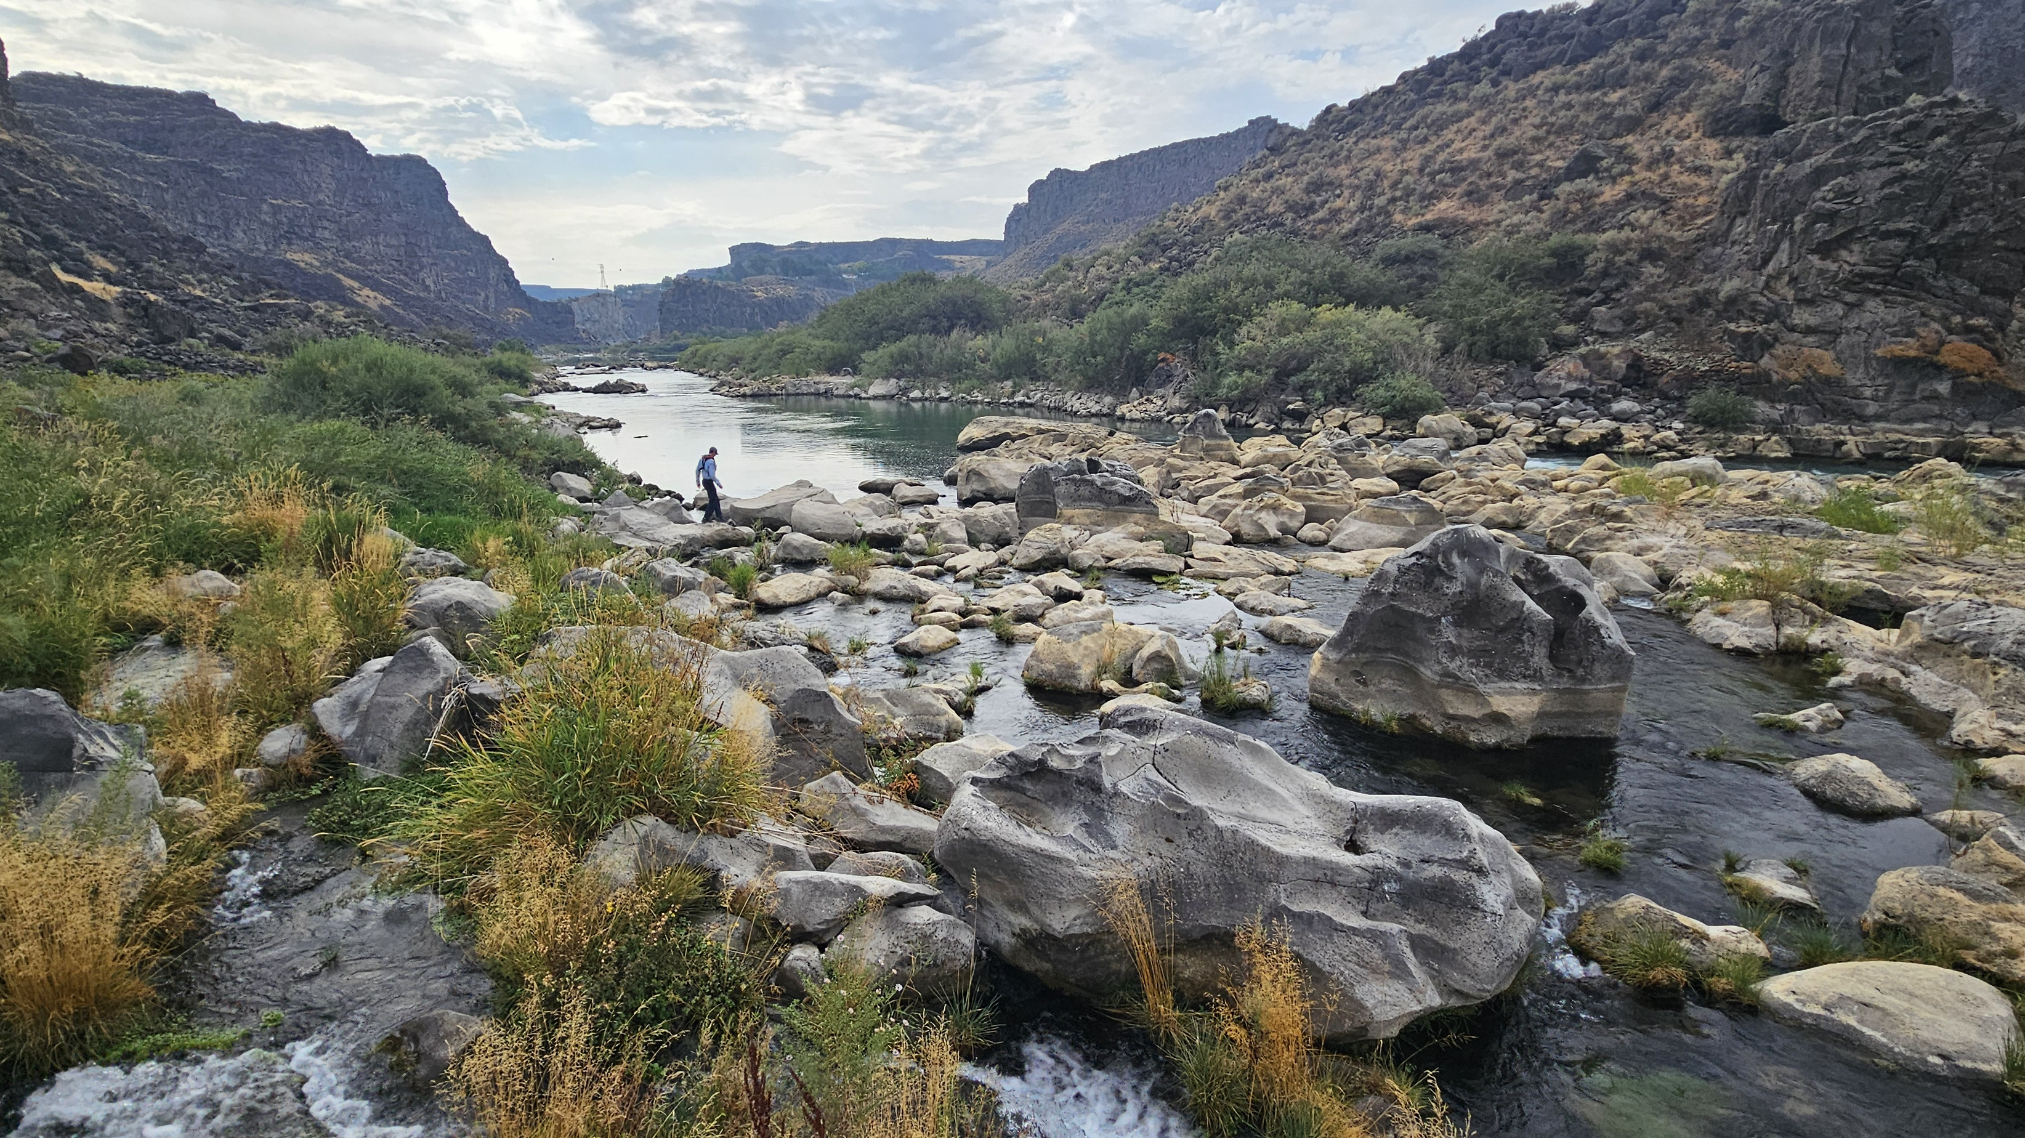
Idaho Invasive Species Program
Mid-Snake River Response

Slide 2
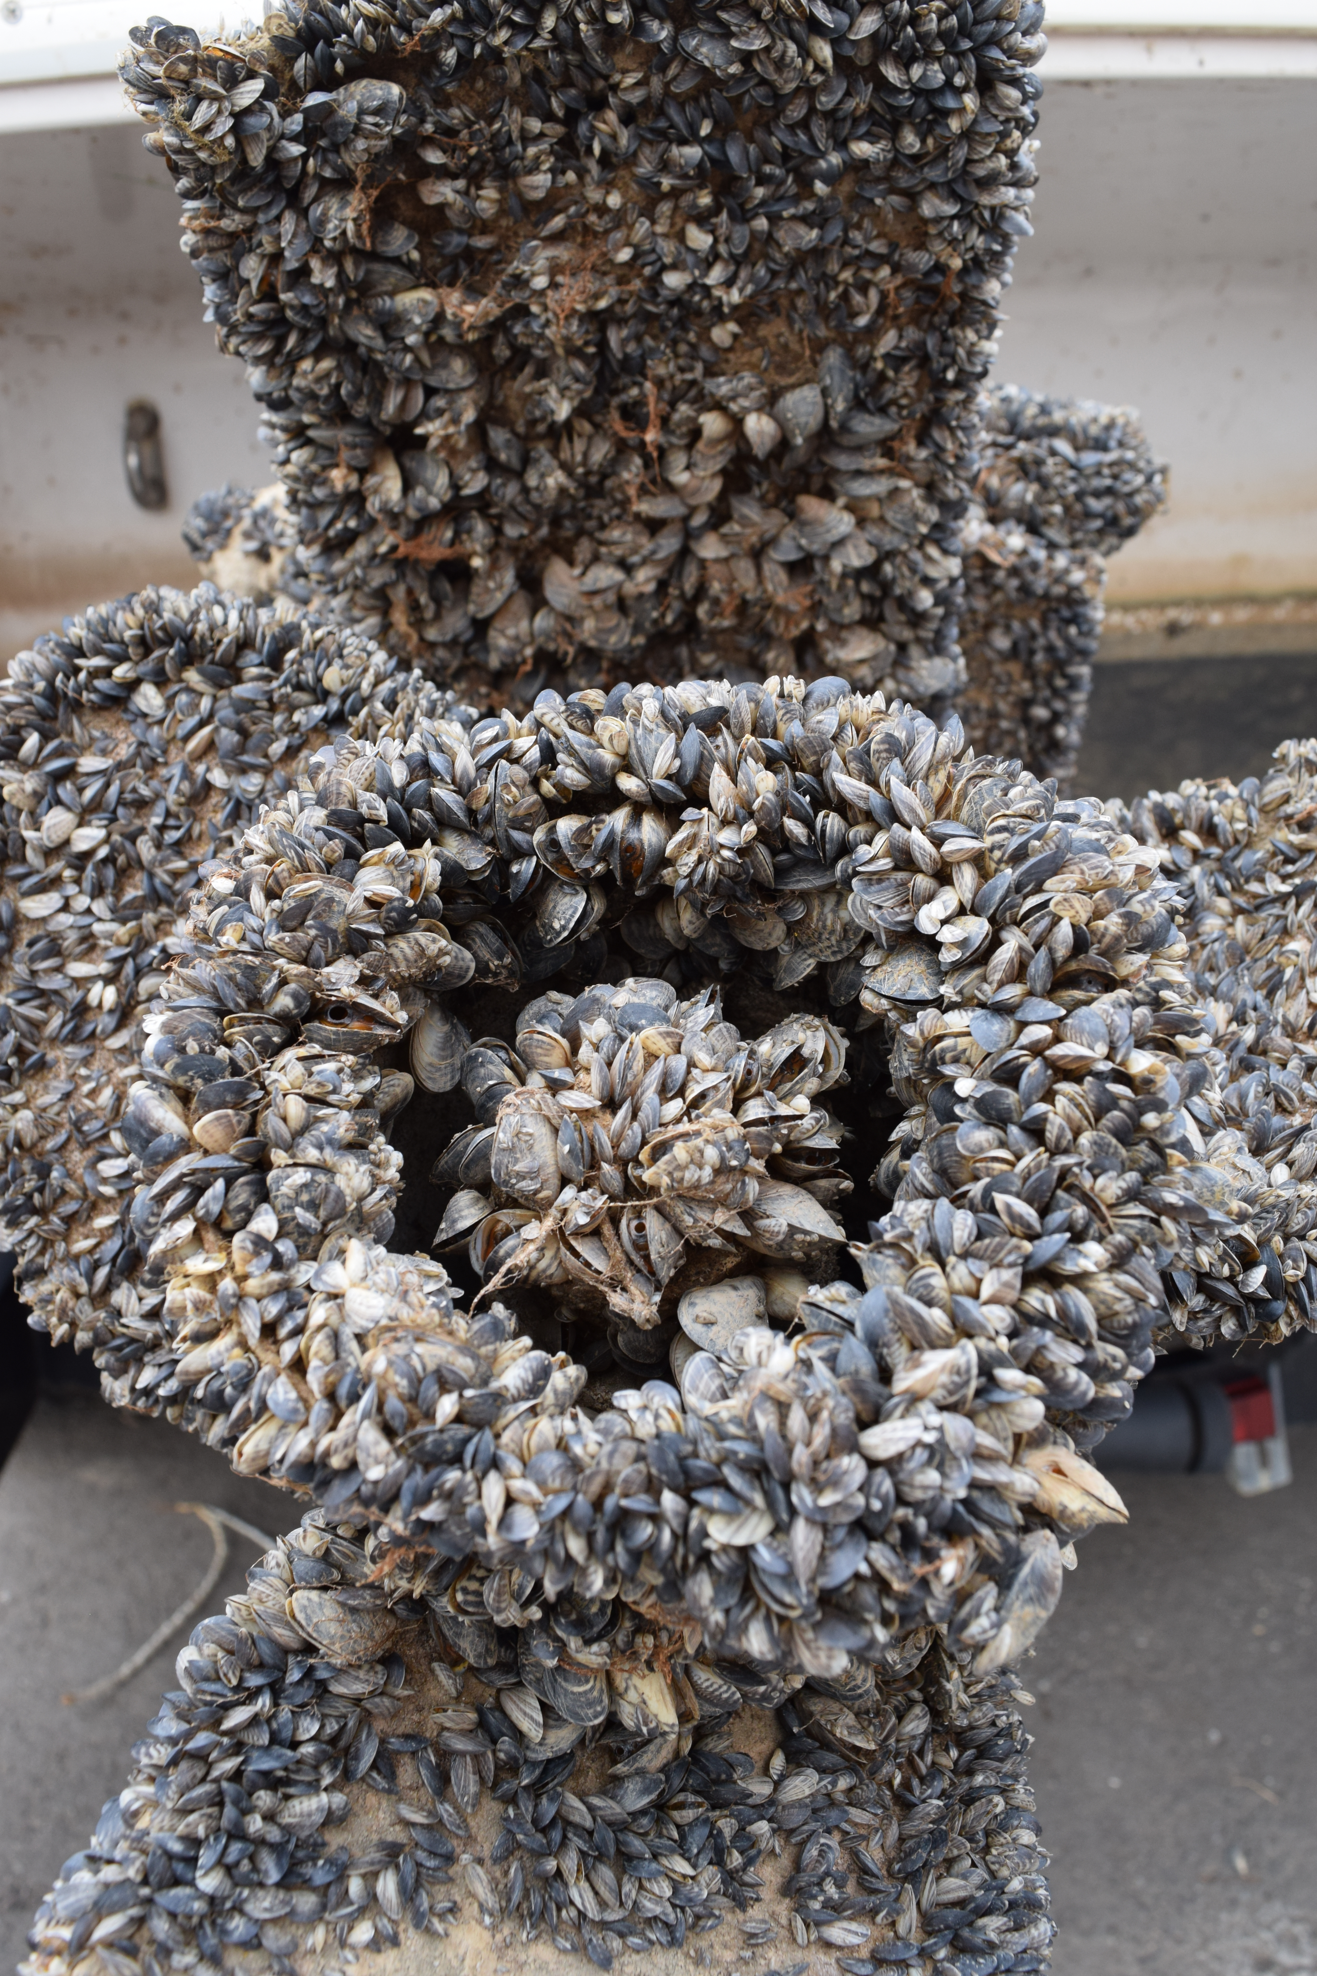
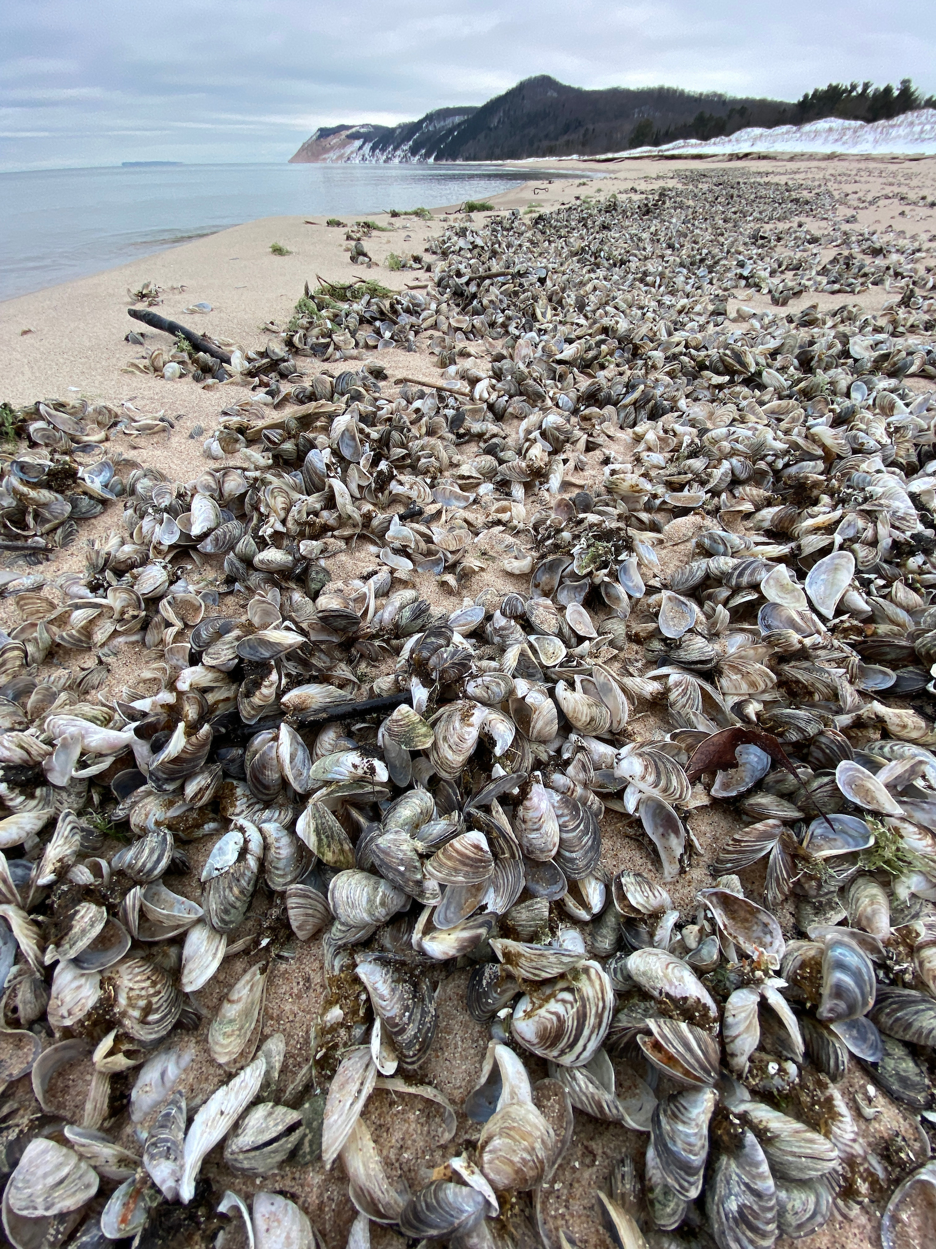
Invasive Mussels
One mussel can produce 30,000 to 1,000,000 veligers per year.
  82 to 2739 per day
These veligers will move downstream with currents for up to 30 days as a veliger before it settles.
Hair-like byssal threads allow them to attach to surfaces.
Filter-feeders that consume nutrients at a rapid rate.
Extreme disruption to the base of the food web, reducing some populations to such low levels that they can no longer survive or fulfill their role in the ecosystem.

Slide 3
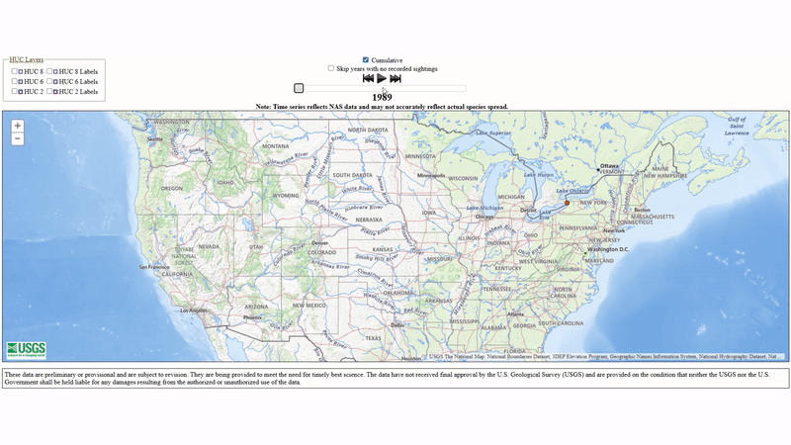
Quagga Mussel Spread

Slide 4
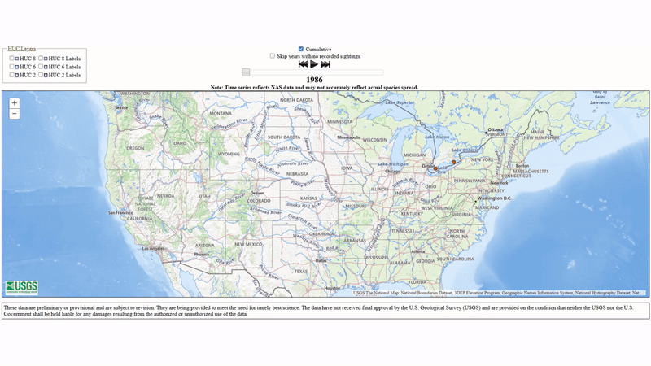
Zebra Mussel Spread

Slide 5
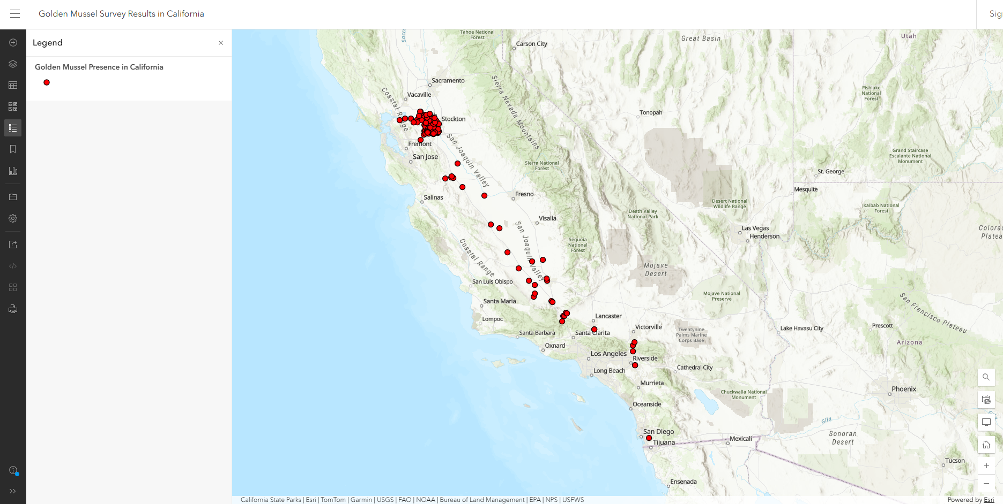
Golden mussel Distribution (March 2026)
October 2024
June 2025
March 2026

Slide 6
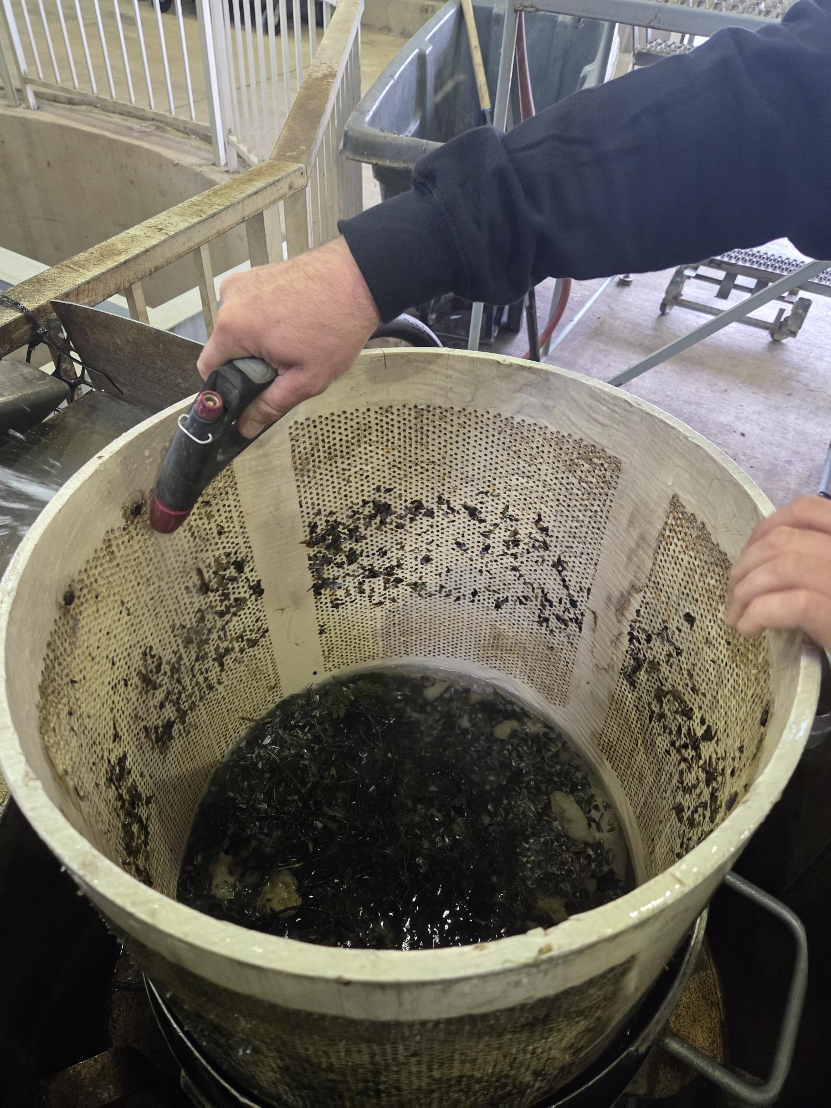
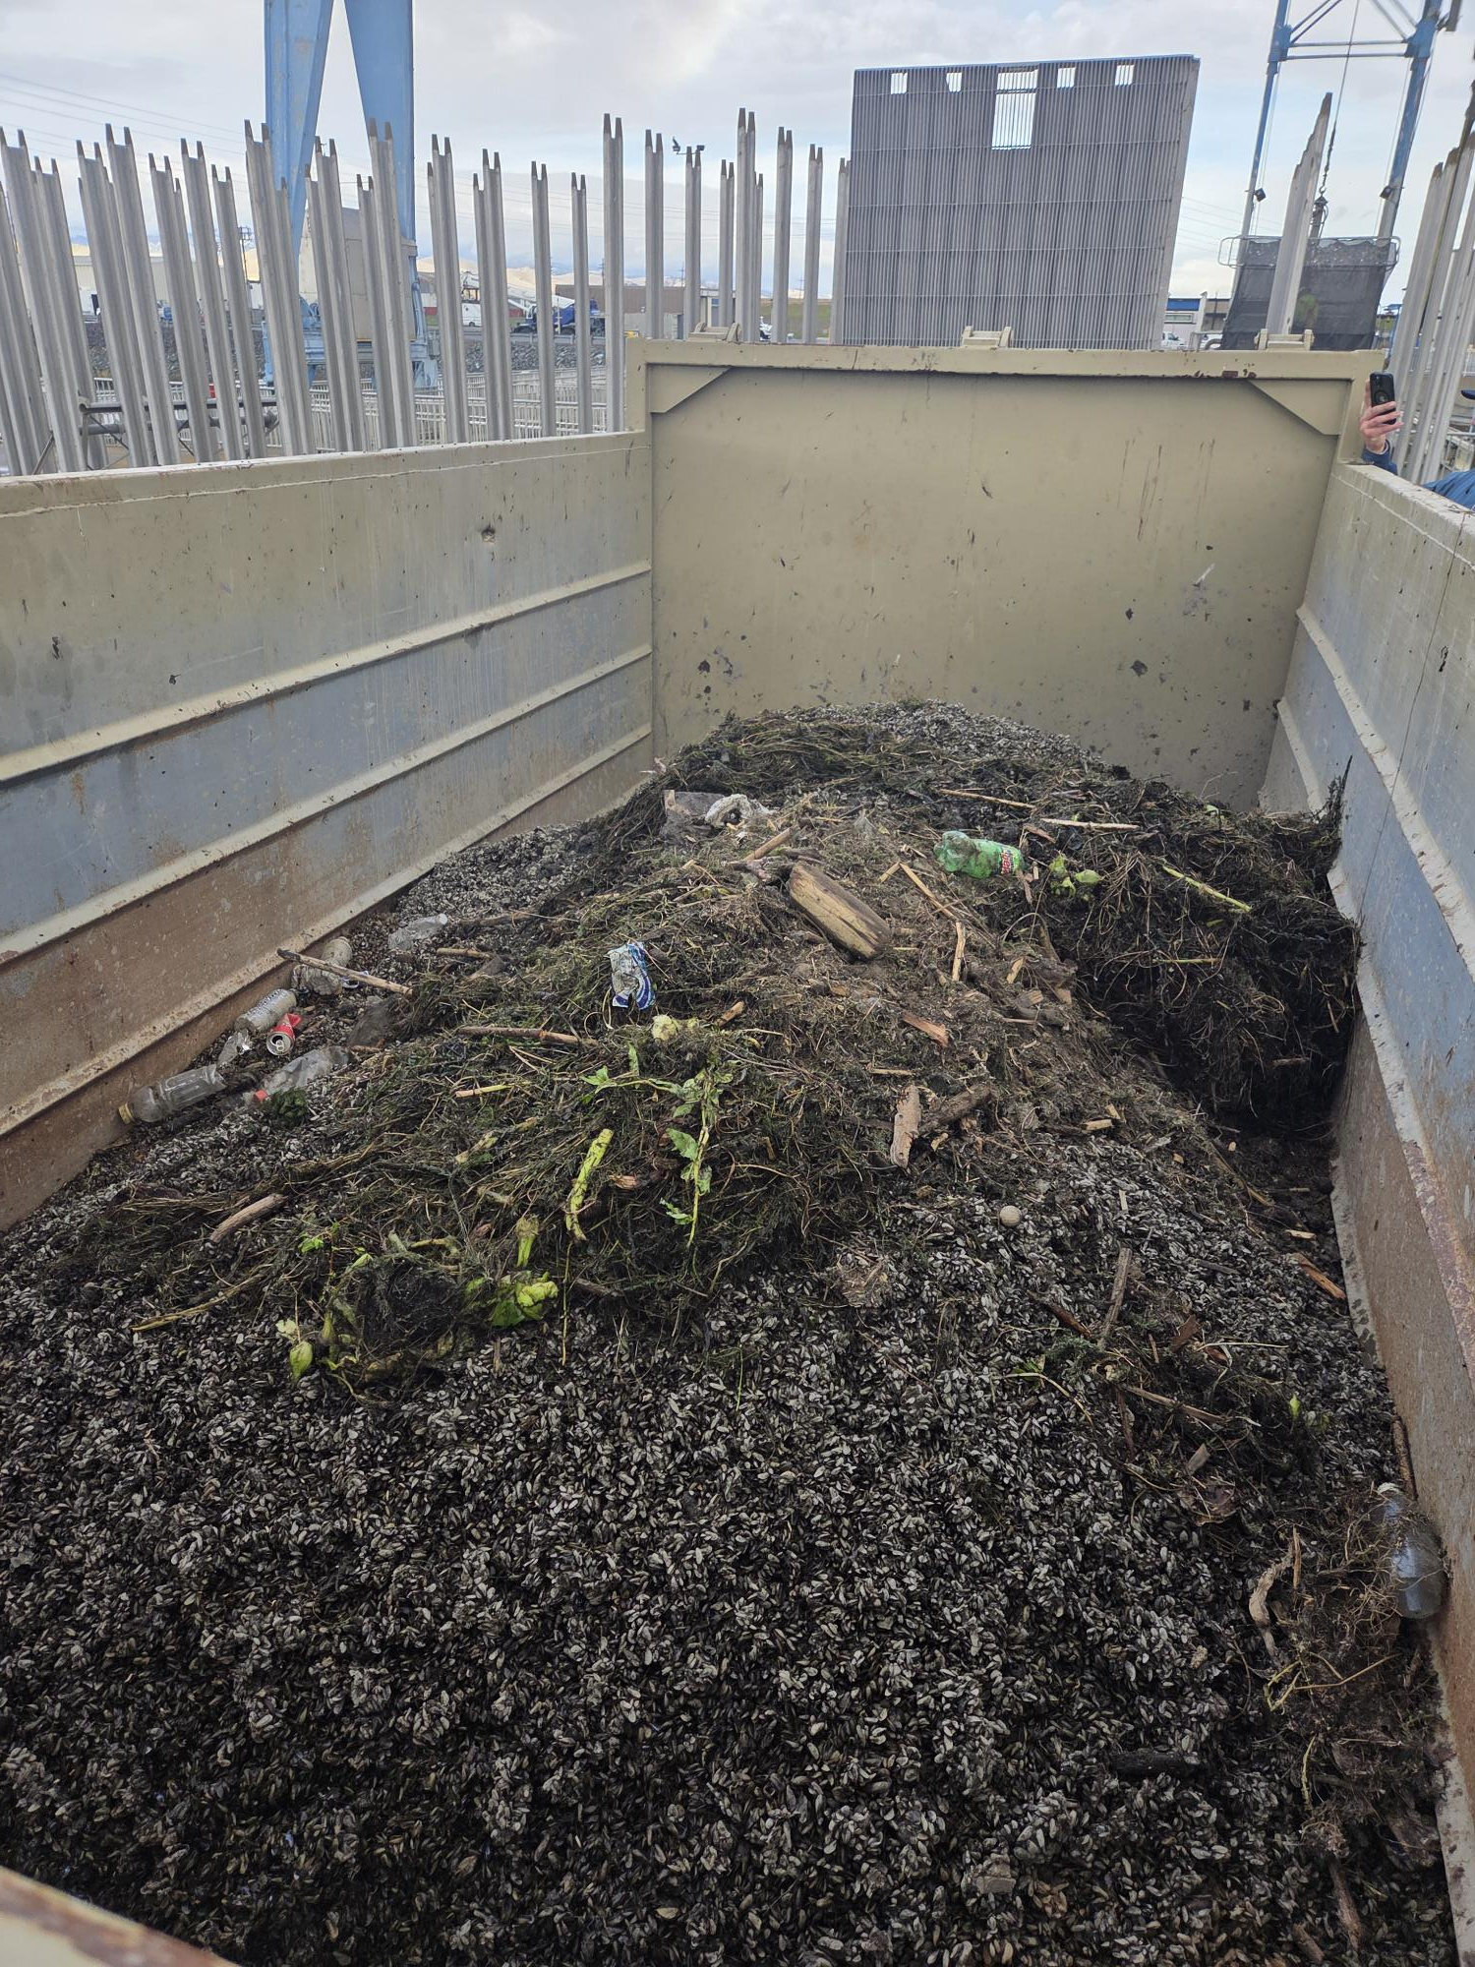
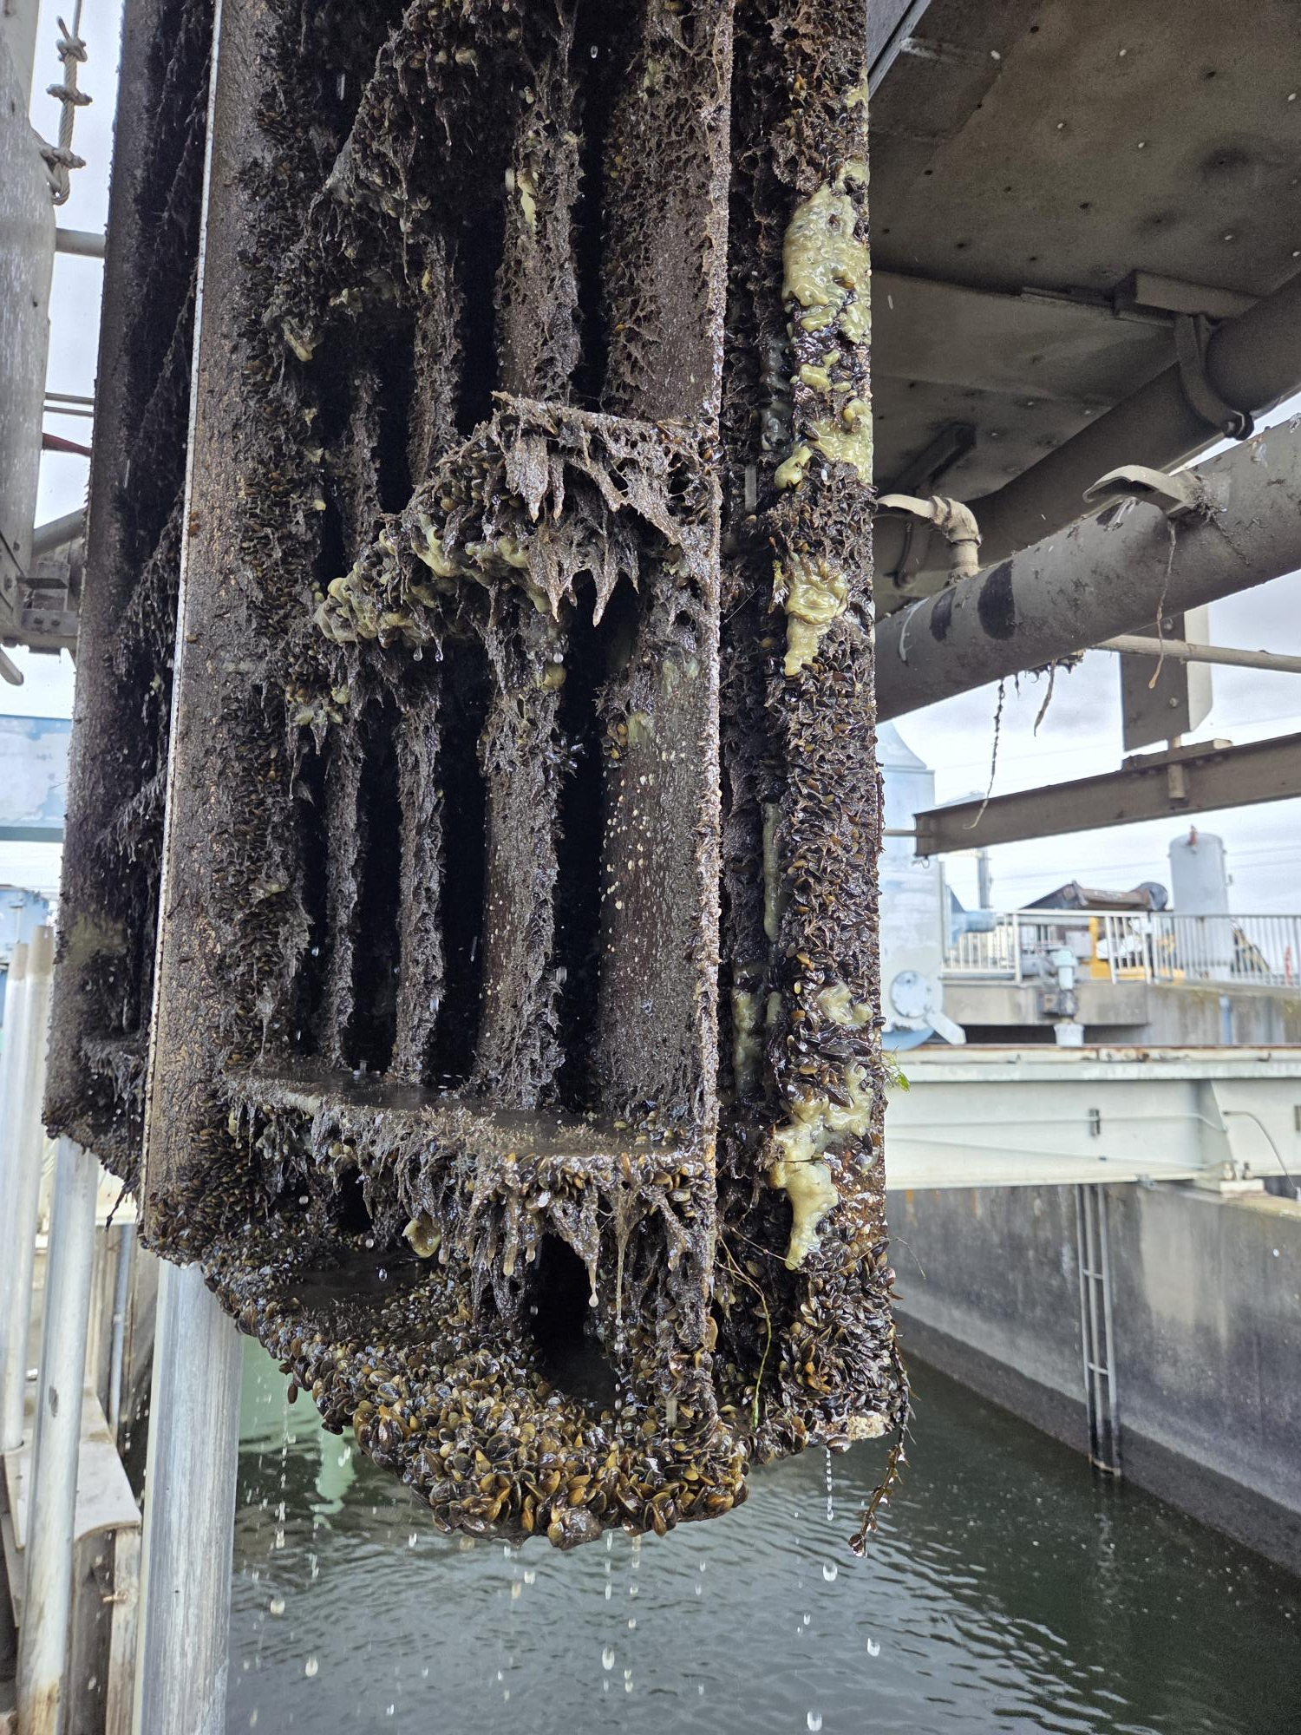
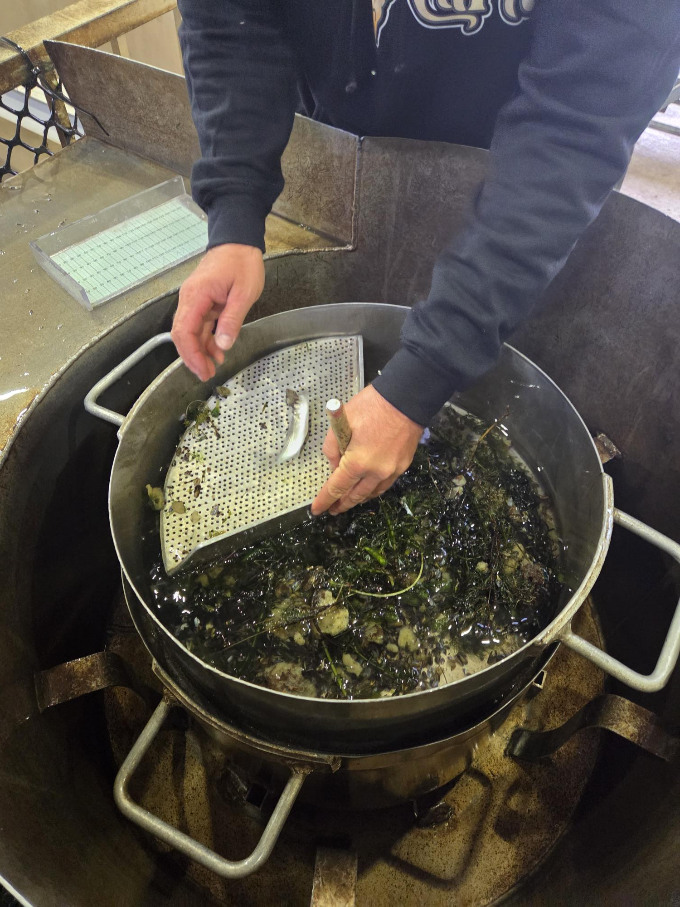
Golden mussel

Slide 7
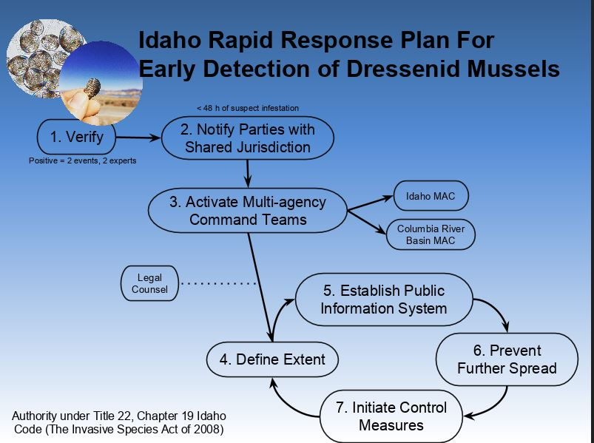
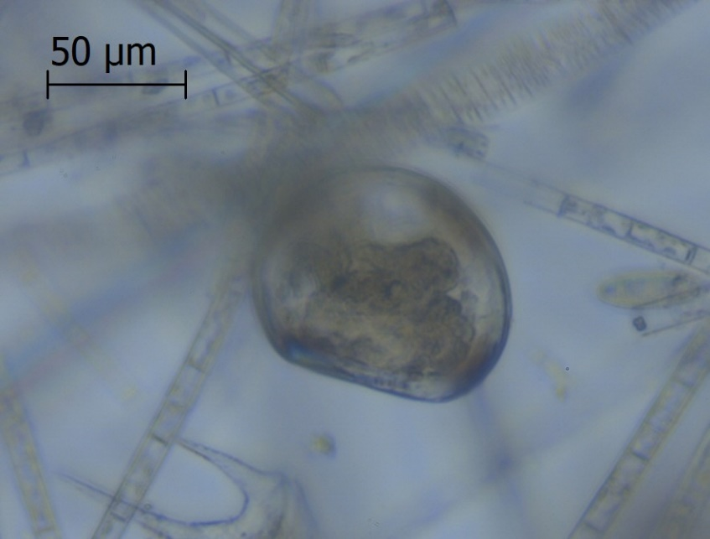
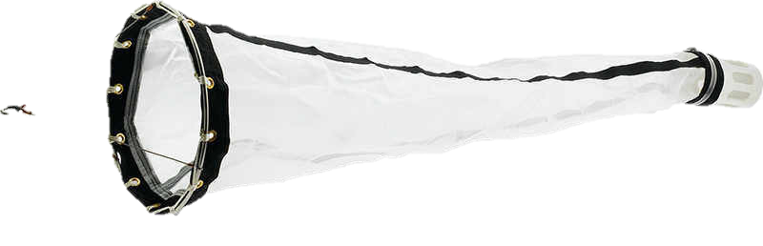
Detection Verification
Invasive Mussel Verification
  Multiple sample events
  Multiple specimens per sample
  qPCR genetic verification

Slide 8
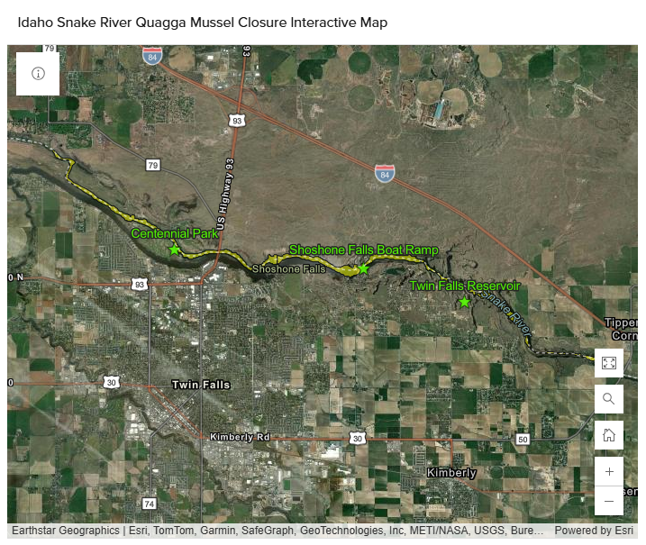
Containment
Mandatory Decontamination for all watercraft accessing Snake River between Hanson Bridge and Broken Bridge (Yingst Grade)
Mid-Snake Stations (year-round)
  Twin Falls Park- Idaho Power
  Shoshone Falls- City of Twin Falls
  Centennial Park- Twin Falls County
Hours of operation when Park is open to public
Uniform Minimum Protocols and Standards (UMPS IV-2021)

Slide 9
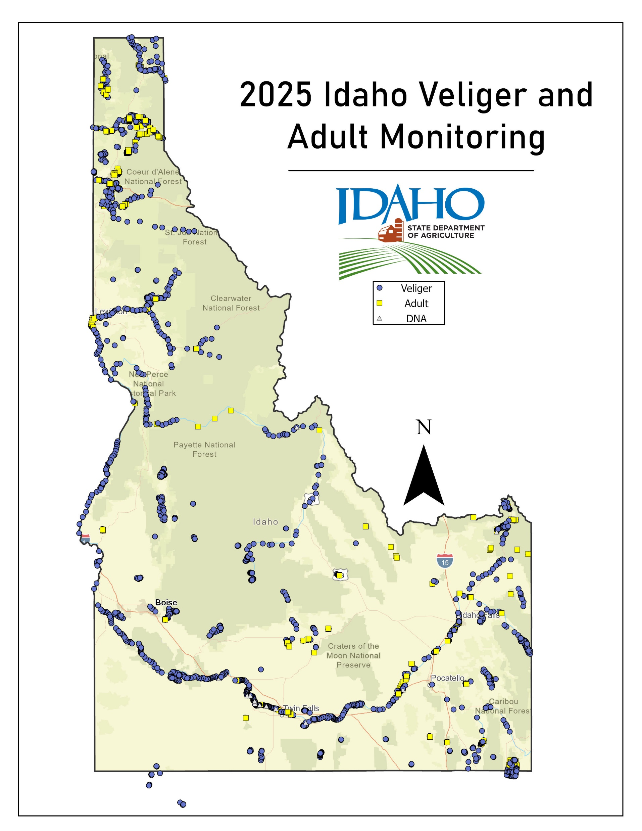
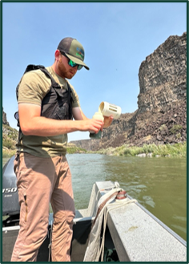
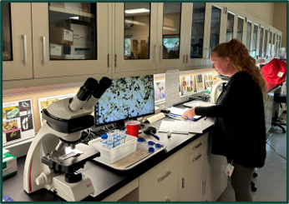

Slide 10
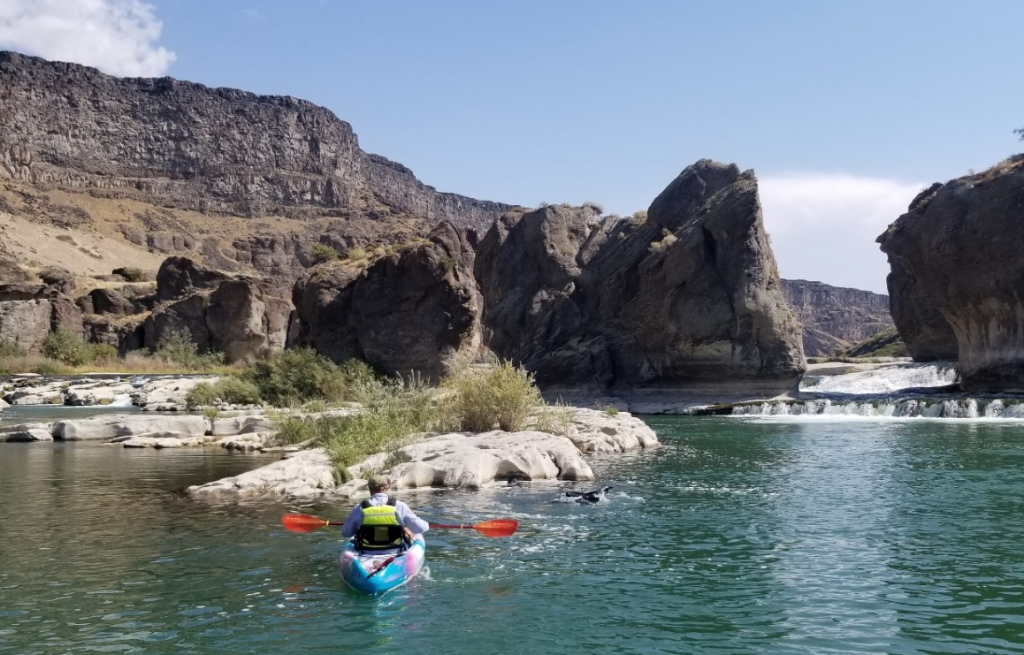
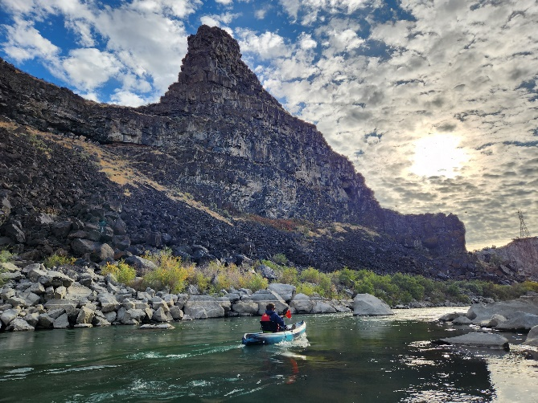
  Delimiting Surveys
Initial veliger plankton tow delimit from Twin Falls Reservoir to Centennial Park
  Start upstream, new net, tow across flow
Extended delimit upstream to American Falls
  Is there anything upstream?
Extended delimit downstream to CJ Strike
  Downstream movement?

Slide 11
Expanded Lab Capacity
Cross Polarized Light Microscopy (CPLM)
  Aquaticus (Chiefland, Florida)
  Eco Analyst (Moscow, Idaho)
  ISDA Bureau of Labs (Boise/Twin Falls, Idaho)- New for 2025
Visual confirmation
  Multiple subject matter experts
Molecular confirmation
  Pisces Molecular (Boulder, Colorado)
eDNA
  Pisces Molecular (Boulder, Colorado)
  Cramer Fish Sciences (West Sacramento, CA)- New for 2026
  University of Idaho Aquatic Research Institute (Hagerman, Idaho)

Slide 12
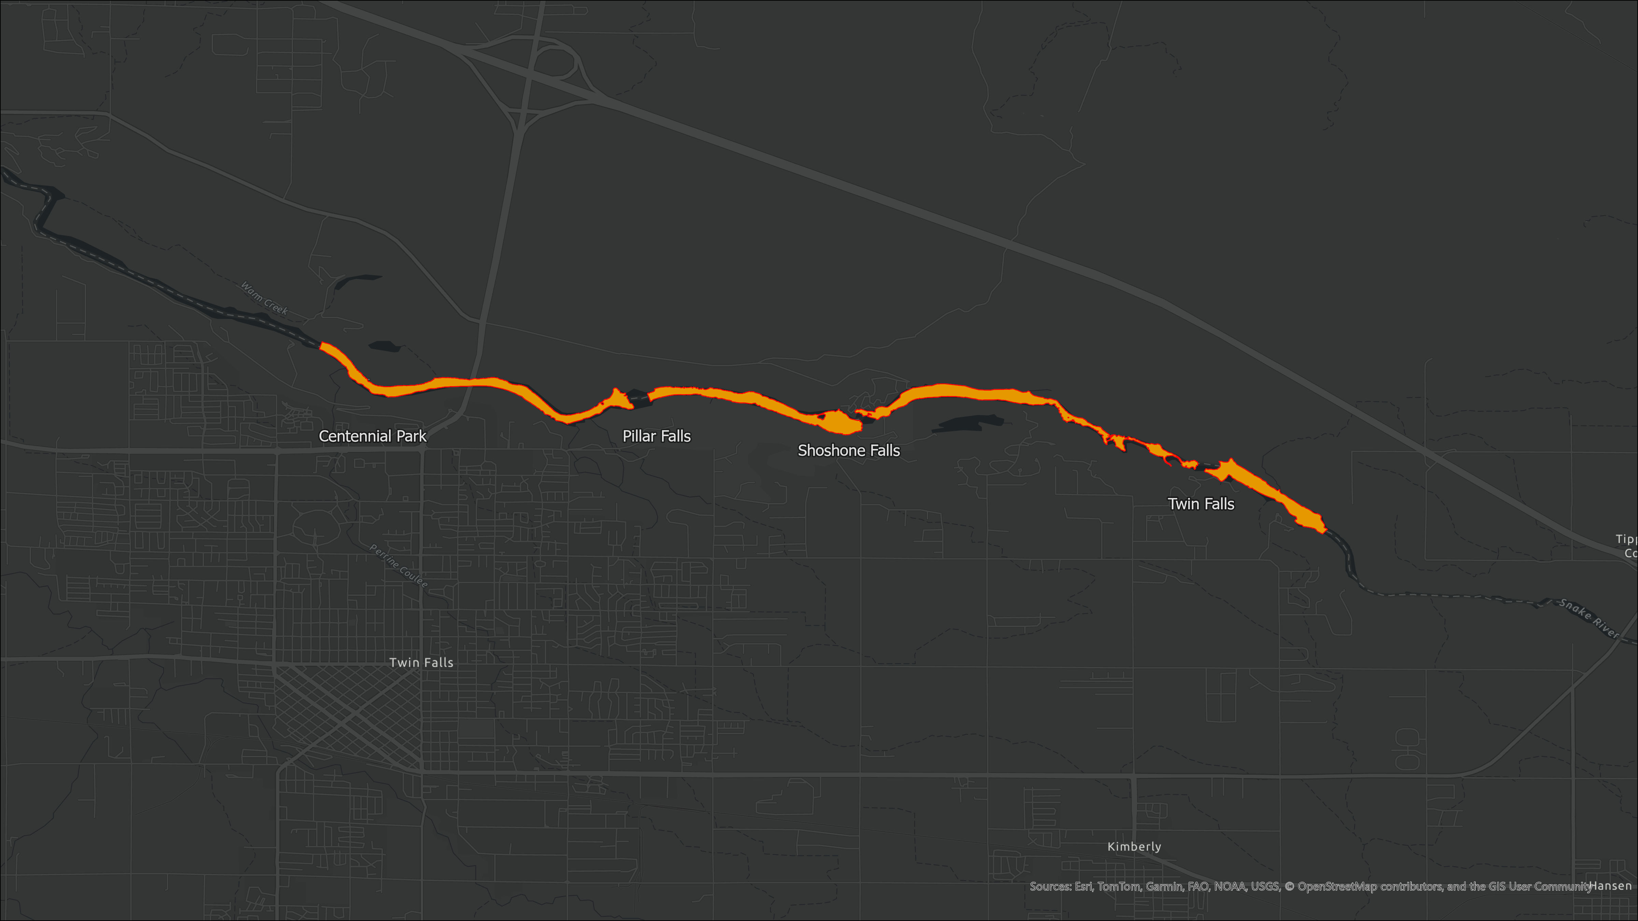

2024 Areas of Active Veliger Presence

Slide 13
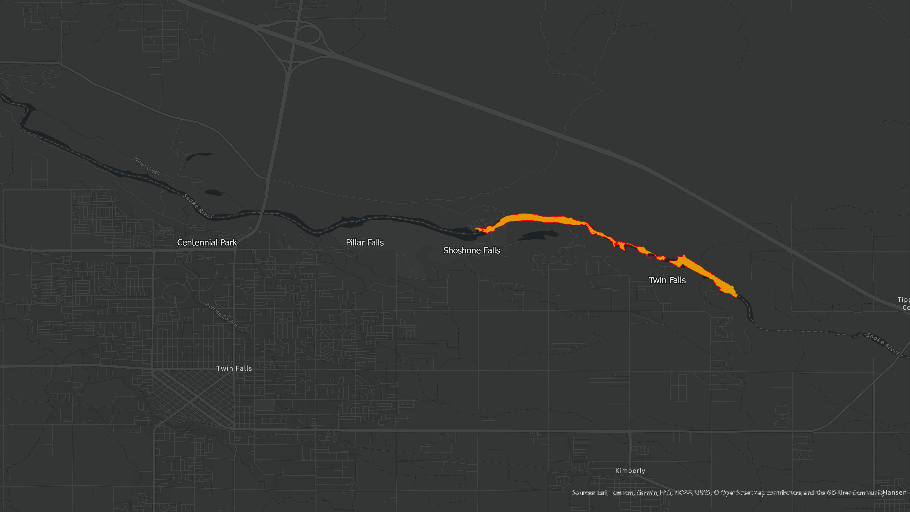
2025 Areas of Active Veliger Presence

Slide 14
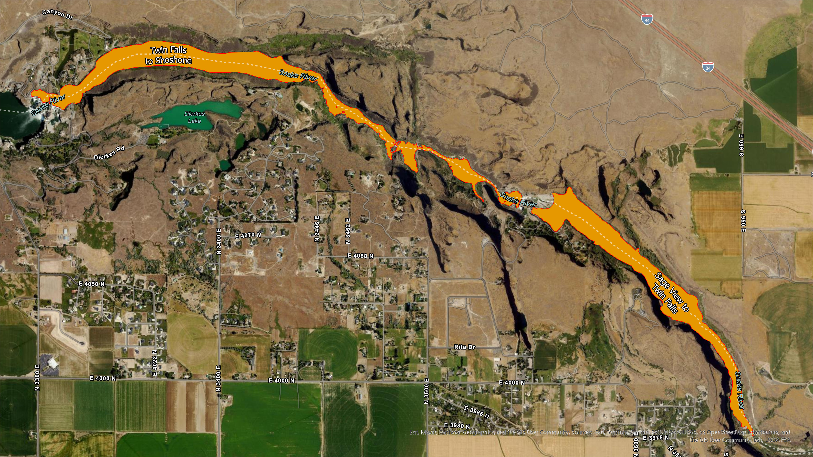

2025 Quagga Treatment
River Flow Direction
Sage View to Twin Falls – 83.32 Acres
Twin Falls to Shoshone Falls – 113.74 Acres

Slide 15
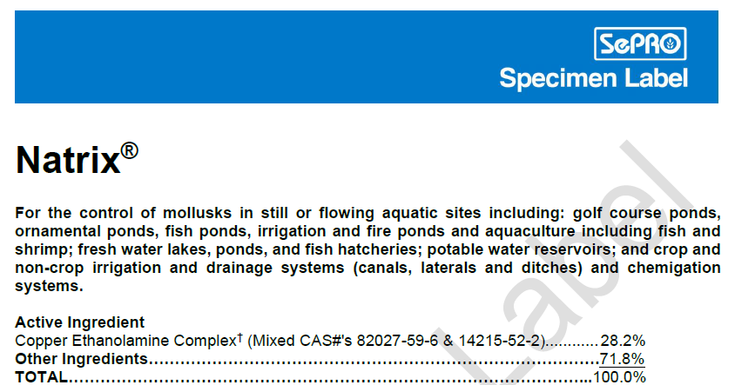
Notes:
Yeah so when ISDA was collecting information on the different treatment options they had available, they reached out to us to ask about Natrix. Natrix is approved for use in flowing and non flowing sites. It has a max label rate of 1 ppm and there are no restrictions for irrigation or potable water when within the 1 ppm max rate.
Natrix is a copper based molluscicide. Copper is a naturally occurring element that is found in many everyday things such as fertilizer, multivitamins, and even dark chocolate. However, when it is concentrated at higher and higher rates, copper can become toxic to different organisms. You all are likely familiar with copper sulfate which is often used in canals to treat plants and algae. When quagga mussels are exposed to copper it can affect oxygen transfer across their gill sites. Meaning they cannot successfully take in enough oxygen from the surrounding area which leads to cell damage, metabolic stress, and eventual mortality. Now the copper in Natrix is a little bit different type of copper. Natrix has a chelated copper which is an important characteristic for here in Southern Idaho. Out here you guys have very hard water. The snake river when measured was over 200 ppm. The reason water hardness is important to measure is because hard water will precipitate out copper sulfate making it unavailable for uptake by the organism. With chelated copper, we have this protective chelation surrounding the copper ions which helps repel the bicarbonate and keeps the copper available. When more copper is available, less copper is needed, and there is better uptake into the organism. In terms of uptake, Natrix is lethal to all life stages of quagga but at varying rates and exposure times. When Quagga sense contaminants in the water, they have the ability to close up and hold their breath for extended periods of time which can make getting copper into the mussels difficult. For that reason, we often have to maintain a specific level of Natrix in the water column until the mussel reopens and takes in that Natrix. Veligers are easier to control since they don’t have the same ability we can control them at lower levels.

Slide 16
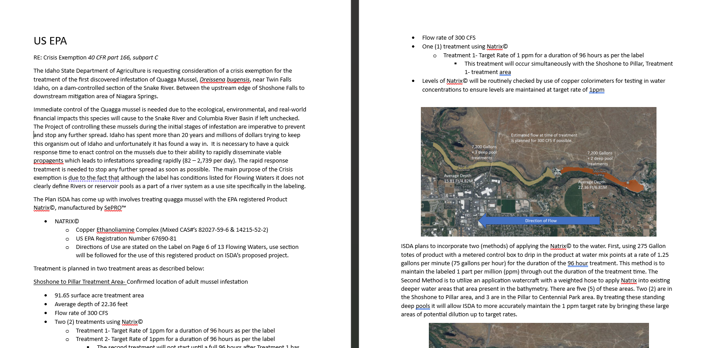
EPA Doublecheck for Labeling and Use
Existing Labeling and treatment plan is covered by established labeling, Clear to proceed as planned!

Slide 17
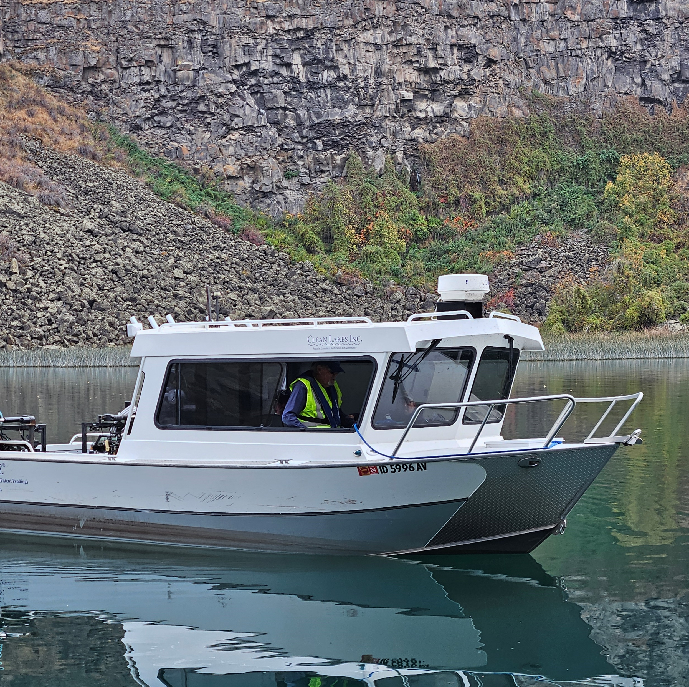
Applicator Services
Clean Lakes Inc.
Contracted for application of Natrix to treatment areas
Responsible for:
  Ordering and delivery of Natrix, to treatment areas
  Application through metered totes or watercraft applications
  Triple rinsing and coordination of recycling empty product totes
Was a part of the ‘23 &’24 quagga treatments

Slide 18
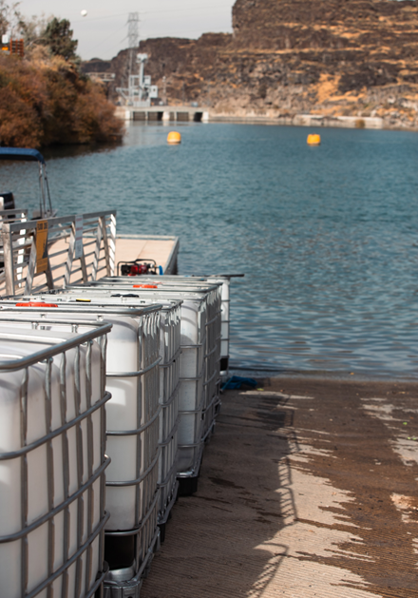
2025 Quagga Treatment
Treatment Started September 30, 2025
200 Hour Exposure period targeting 1ppm
Treatment Completed October 12, 2025
Total Natrix Applied 63,525 gallons

Slide 19
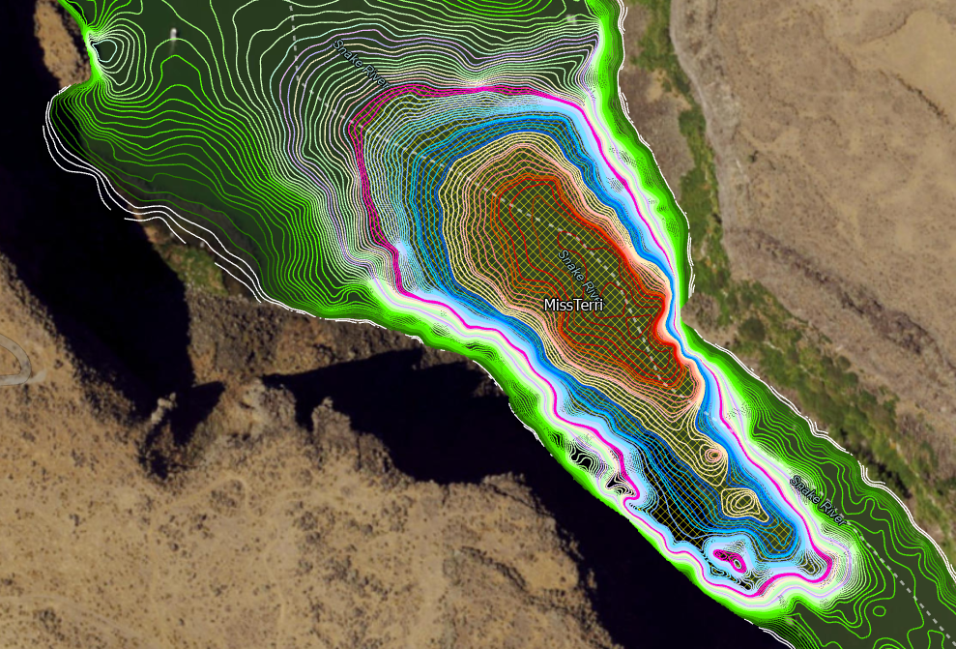
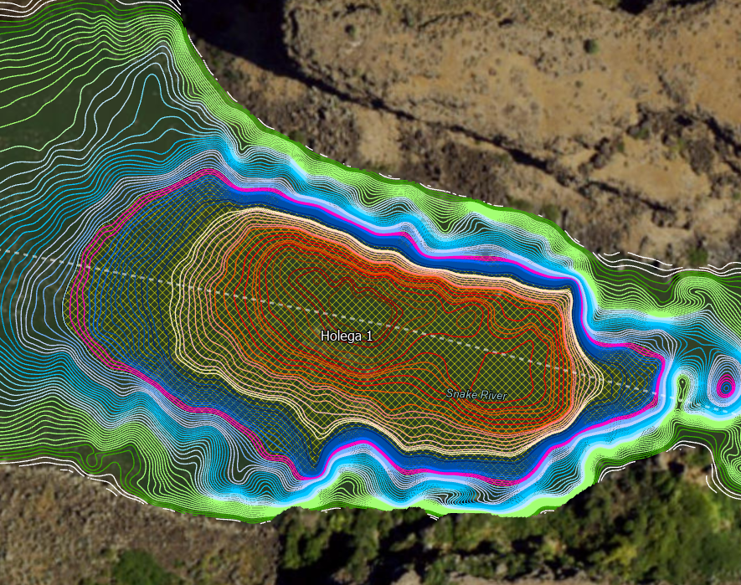
Laminar flow creating a friction layer not conducive to mixing with bottom bathymetry
Main River Run of CU Treated Water
Friction between Layers
Preventing full exchange of CU

Slide 20

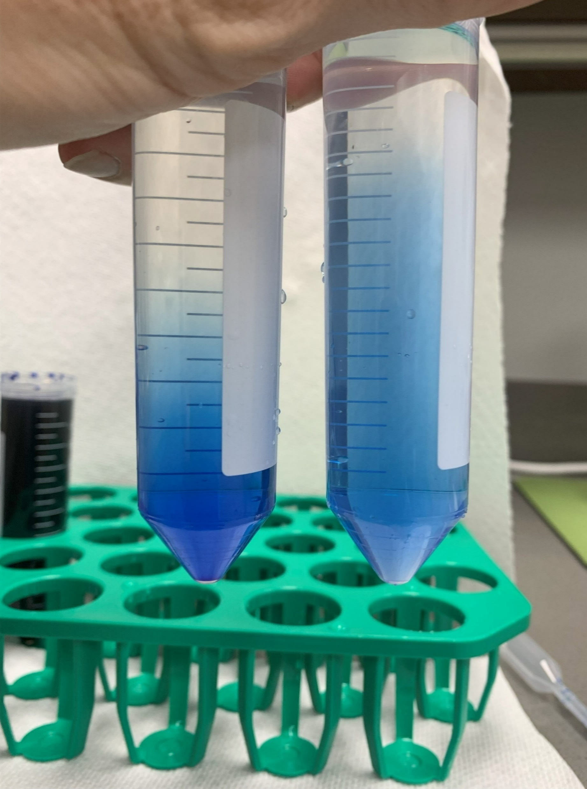
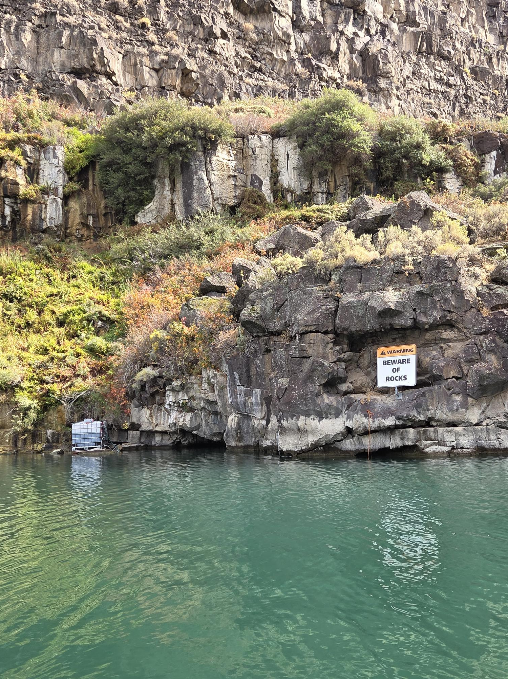
Deep Hole Pump Injection
Tote
Pump
Application tote placement on shoreline
A pump driven system to compensate for pressure differential, injecting product.
An anchored Underwater Boom Sprayer to deliver to target band at a 70/30 mix of Natrix and water at a target depth.
Anchored Dispersion
Tote
Pump
Anchored Dispersion

Slide 21
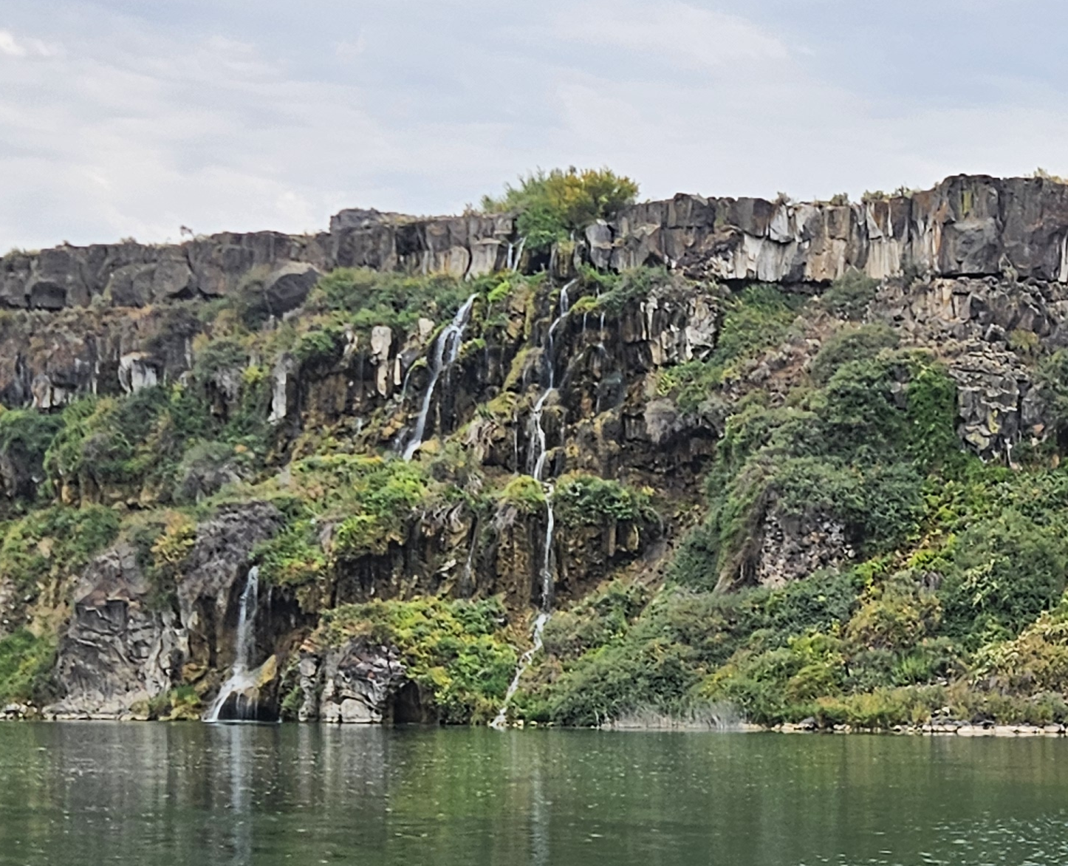
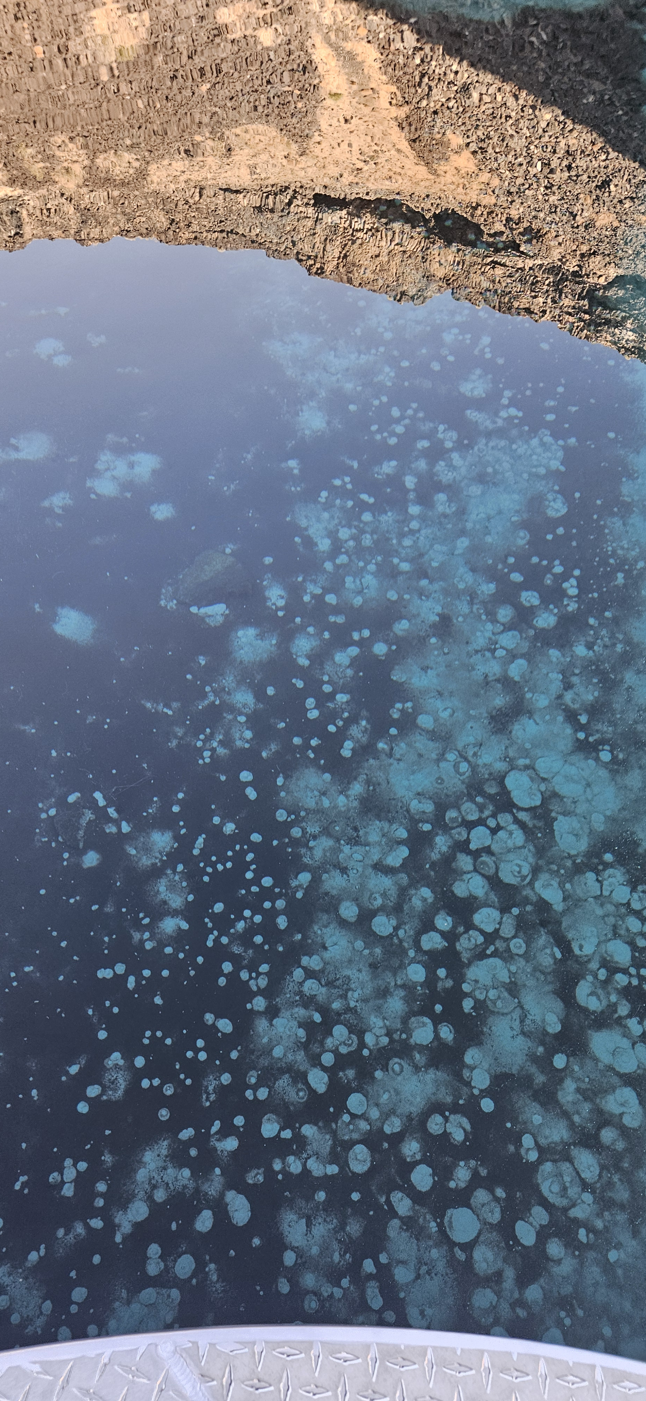

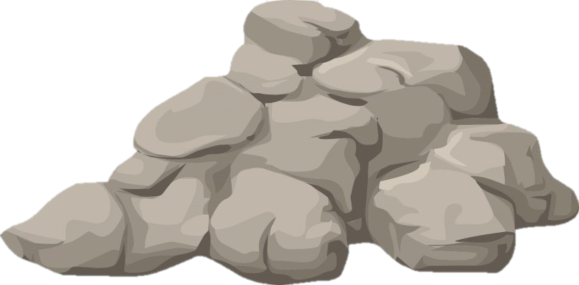
Springs above and below river’s surface providing points of dilution in active treatment areas
Spring input-Point of dilution
Potential “Safe Harbor”
Main River Run of CU Treated Water

Slide 22
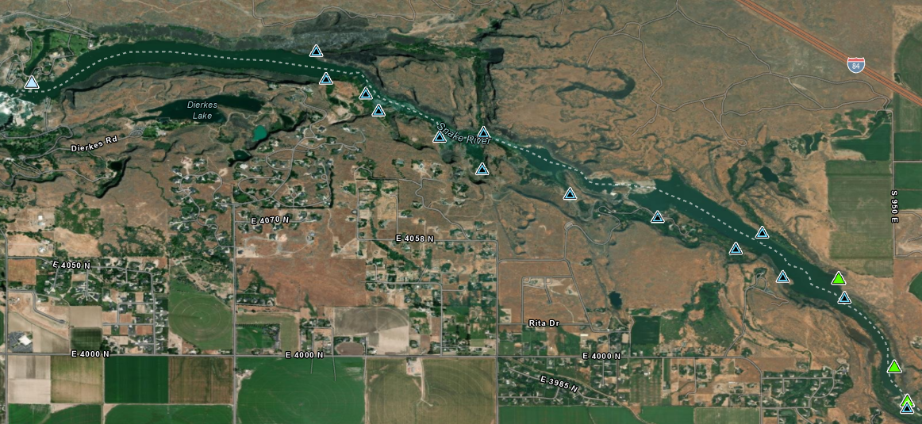
Springs = Dilution
A total of 18 springs have been identified as potential sources of dilution for the treatment areas
  3 Irrigation returns
  1 Controlled spring
  14 Natural springs

Slide 23
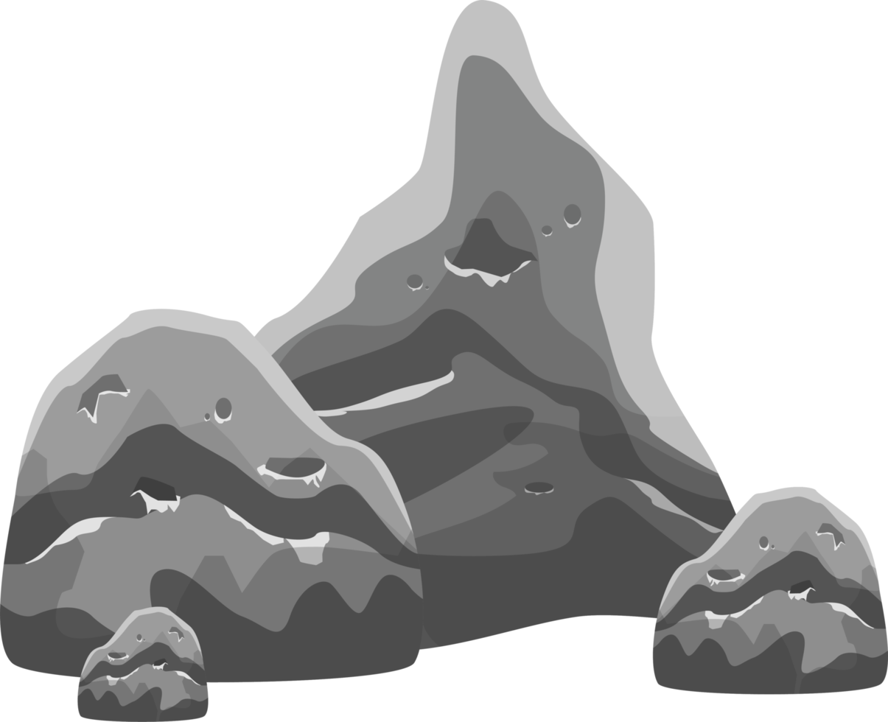
High Organic sediments able to sorb high volumes of CU
Main River Run of CU Treated Water
CU
CU
CU
Organic Sediments
Potential “Safe Harbor”
CU

Slide 24
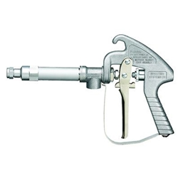
Shoreline Treatments
Shoreline treatments every 24 hours after pre-treatment and initial turn on of metered totes.
After initial application shorelines where monitored, areas falling below target levels where bump treated every 24 hours.
Treatments will target 1ppm at a mix of 50/50 Natrix and Water. All applications will take place below the highwater mark as an aquatic application.
Application will be a 2-part process.
  Directed application of mix to Shoreline waters edge along rocks, cliffs, and organic vegetation
  Flush of river water to just above the waterline to wash any overspray back into water to ensure all areas of low exchange receive targeted treatment to prevent additional “Safe harbors.”

Slide 25
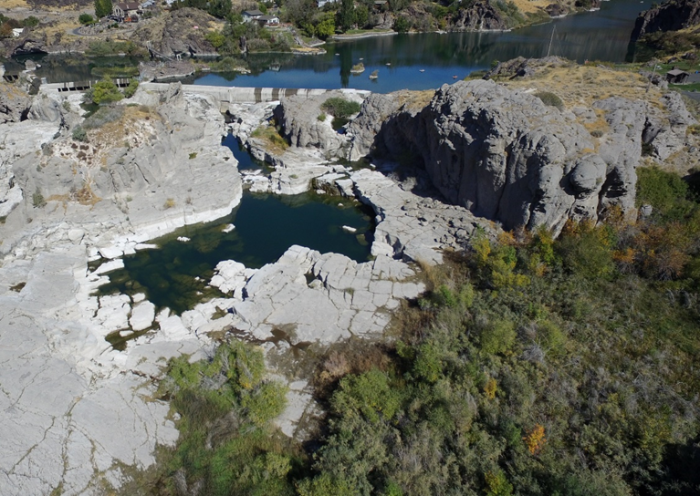
Pothole Treatments
Isolated ponds in the treatment area are a unique geologic feature of the Snake River Canyon. These ponds are left when high water recedes and disconnects these ponds from the river.
These ephemeral ponds were treated earlier in 2025 with potash, during which treatments specific ponds were identified as not having any connectivity between them and the river.
These sites are at Twin Falls, Shoshone Falls, and Pillar Falls. Treatment at 1ppm.

Slide 26
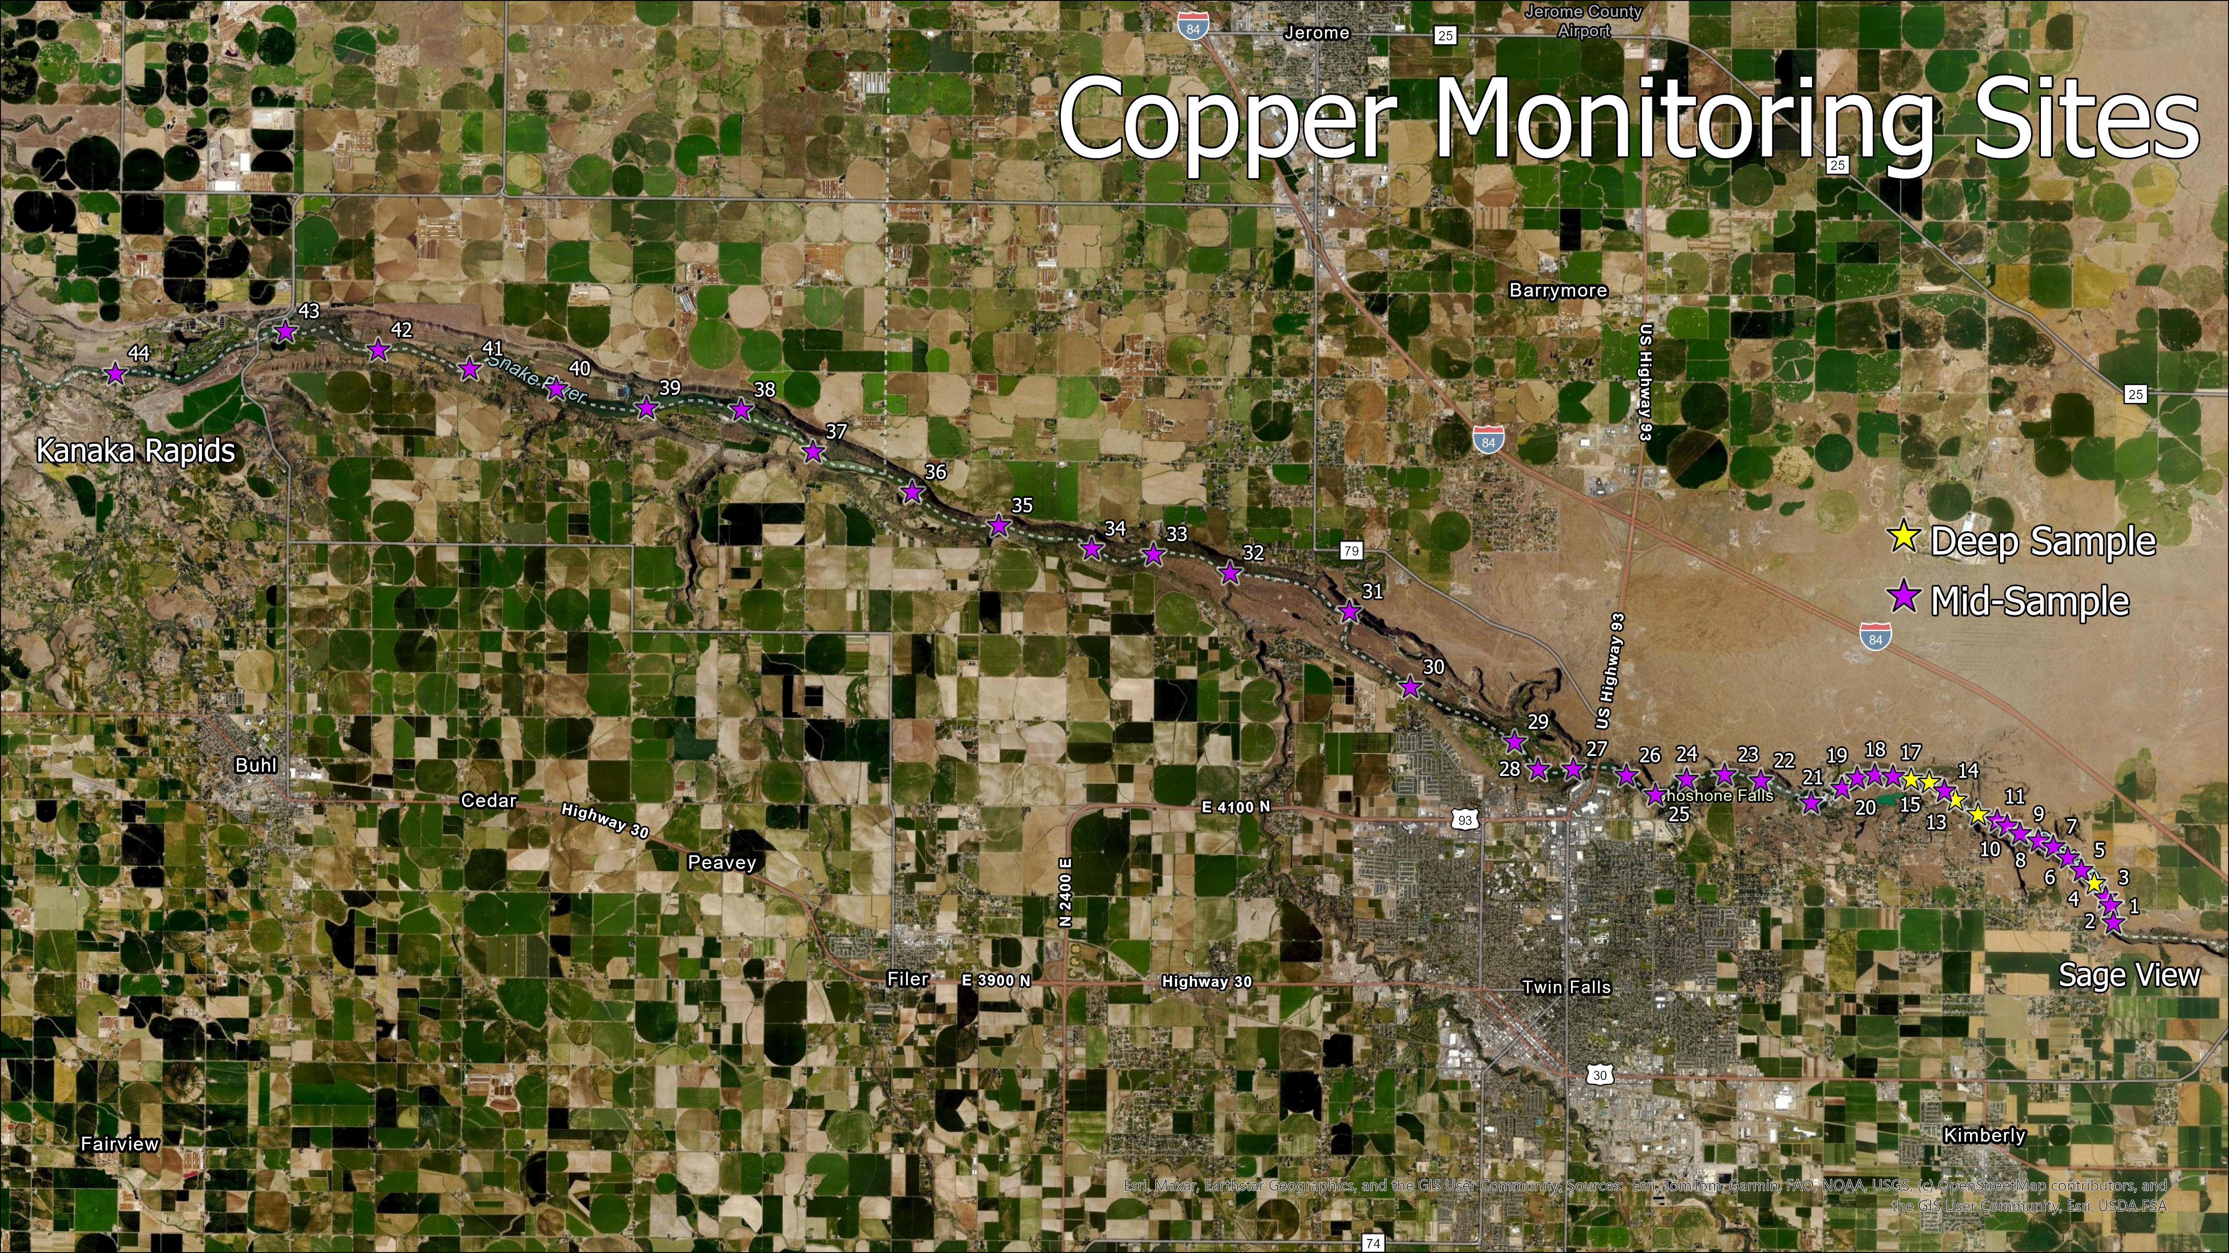
Target Concentration- 1 ppm
Copper Sampling in Active Treatment Area
  Run of River- 44 samples, every 24 hours
  Deep hole sampling every 12 hours
  Shoreline sampling every 24 hours
Quagga Mussel Monitoring
Downstream Copper Sampling for ESA

Slide 27
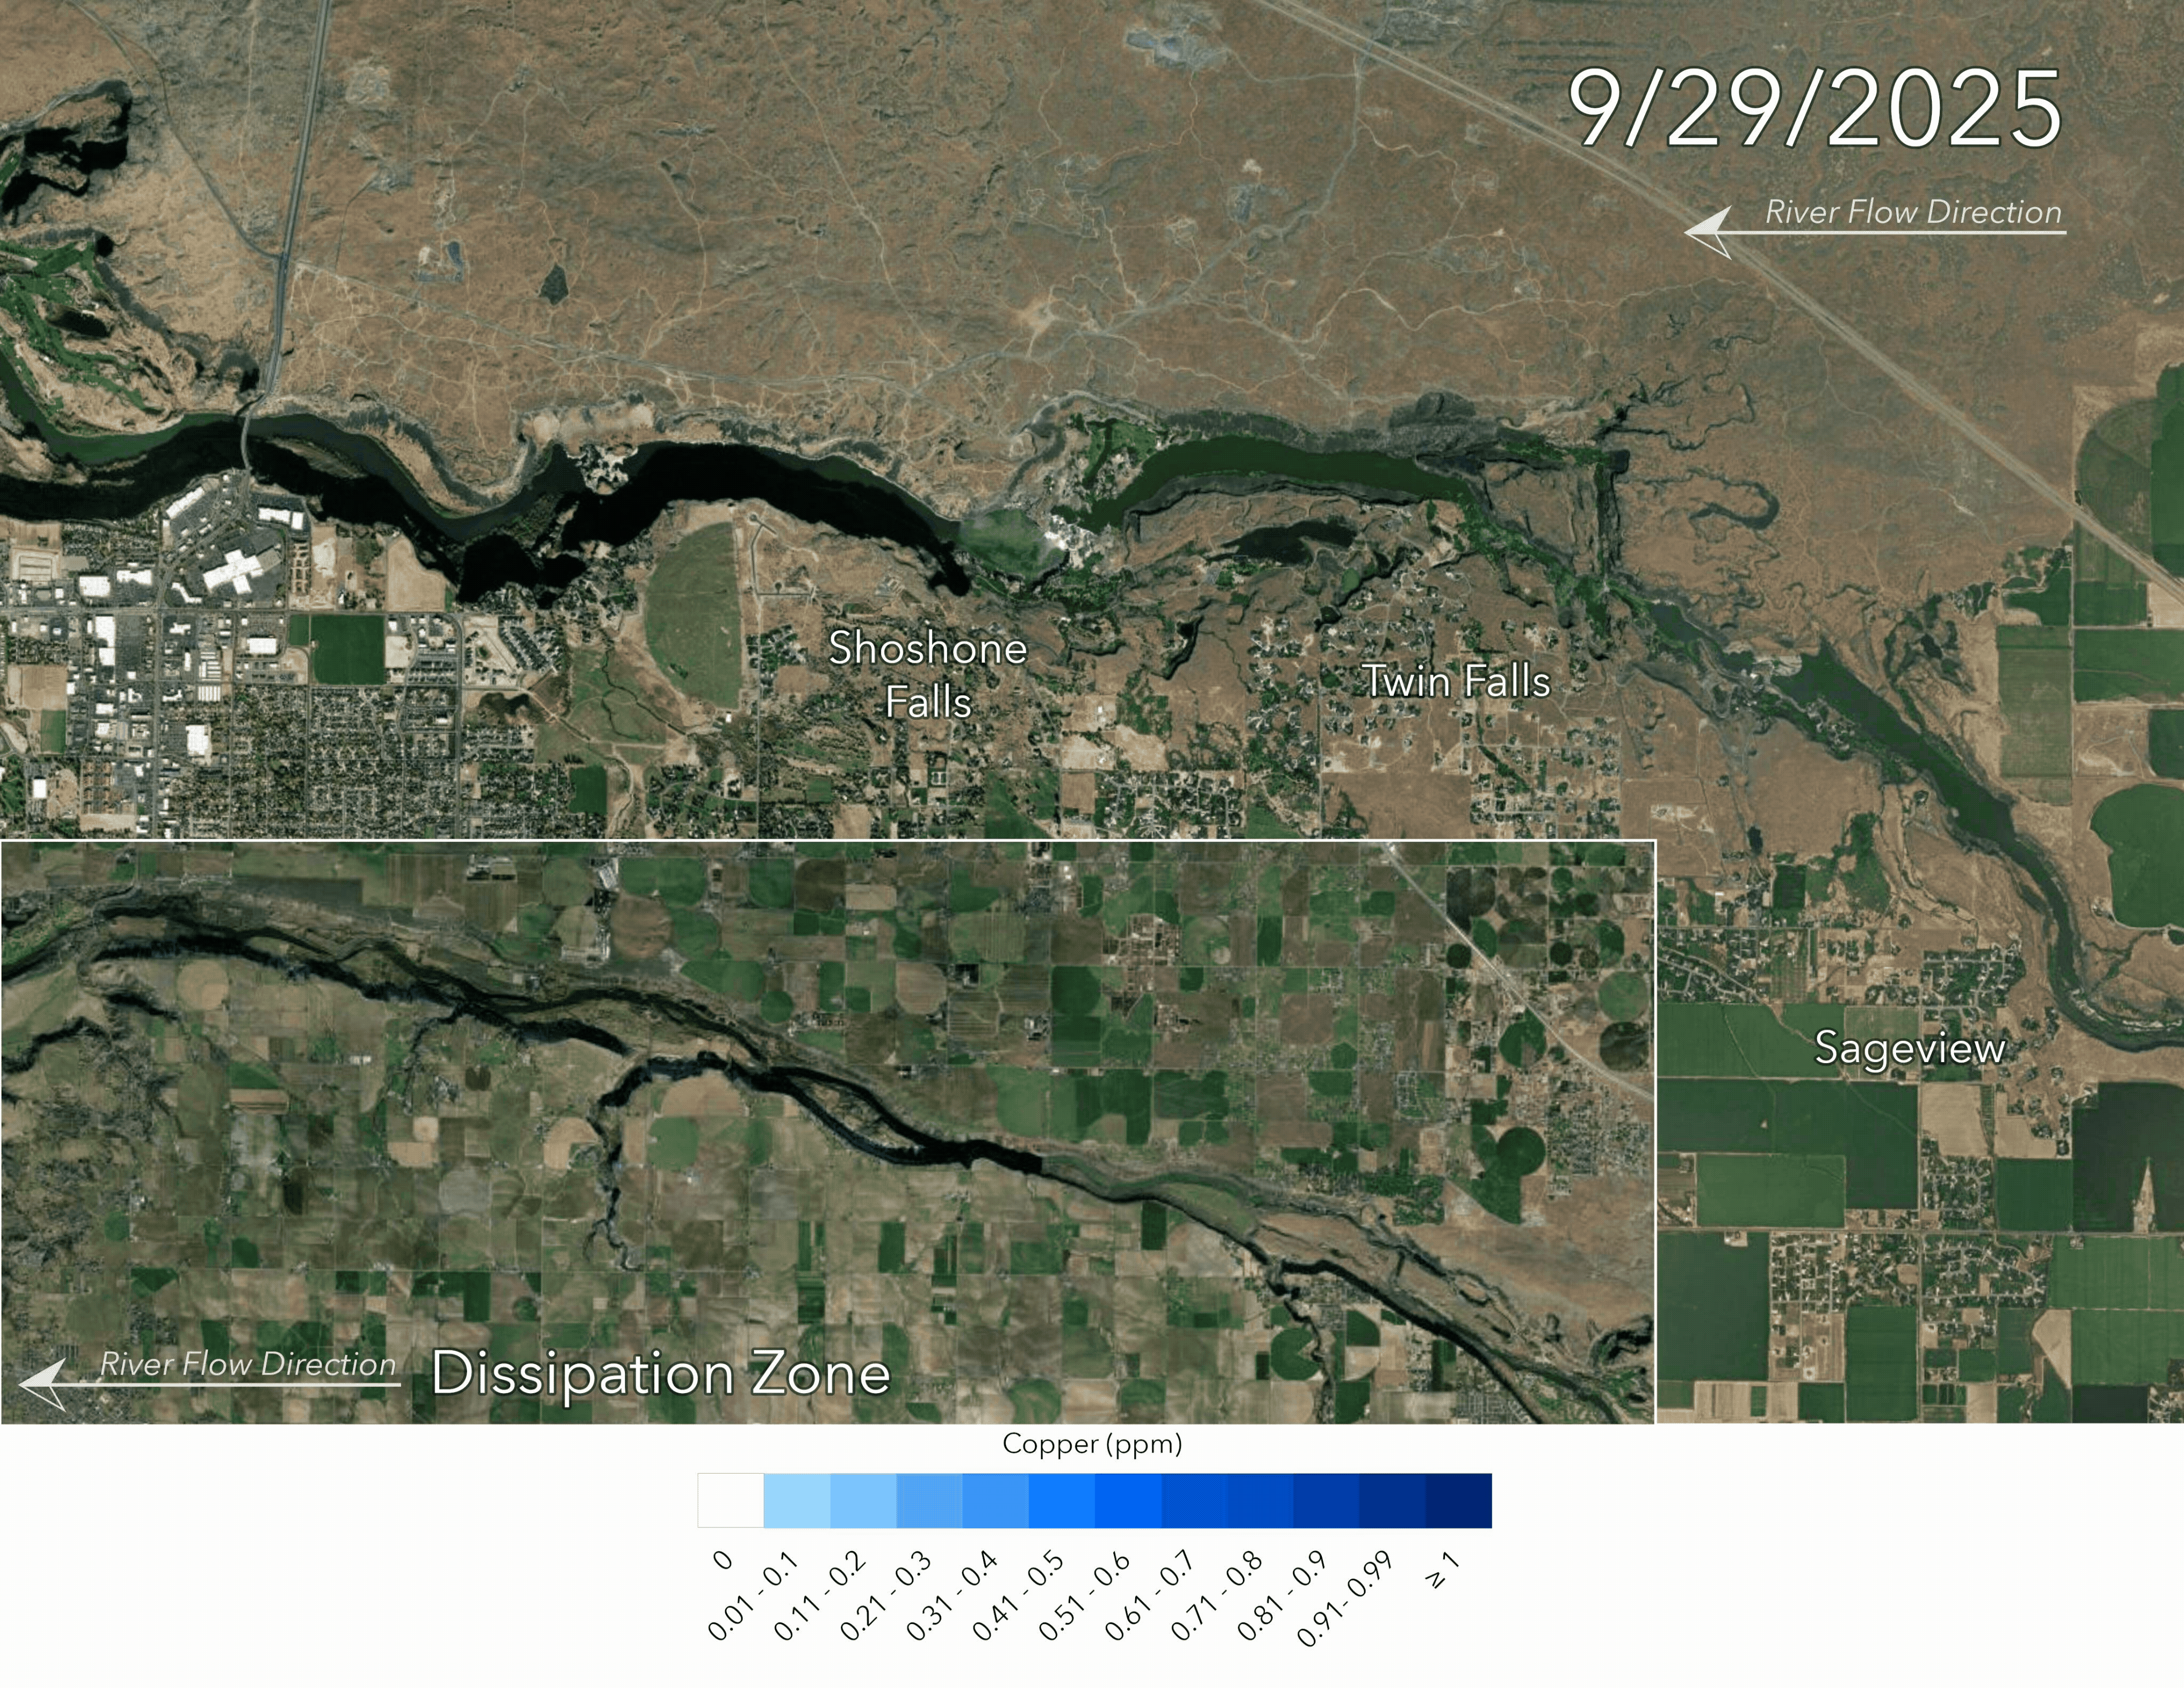

Slide 28
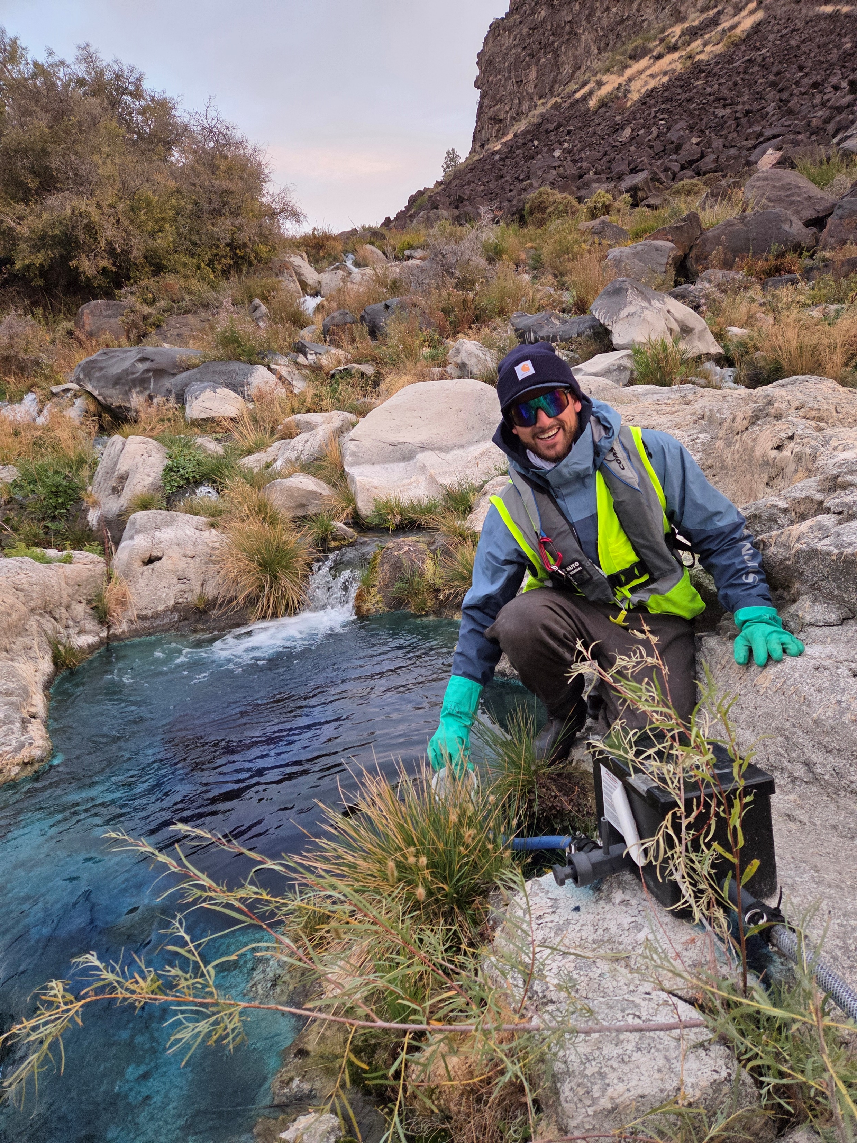
Lessons learned
Value of local stakeholder group
Technical advisory group
EPA & USFWS Consultation
  Label and permitting
  ESA
Emergency Declaration- Is it needed?
Contract and procurement
  Roles and Responsibilities – Who is doing what?
  Funding
Workload and Scheduling- Short and Long Term
Monitoring the Treatment product
  In field, in house, contractor
  Maintaining target concentrations in dynamic systems
Monitoring Quagga (in-house & contracting)
  Veliger
  Adult
  eDNA

Slide 29








