Slide 1



Lake Pend Oreille Adaptive Reservoir Management Case Study
Idaho Water Resources Research Institute
Meg Wolf, Ph.D. Hydrology, IWRRI Assistant Director
Grace Peven, Ph.D. Hydrology, IWRRI Research Scientist

Slide 2

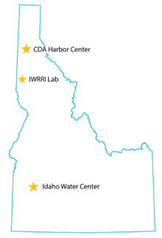
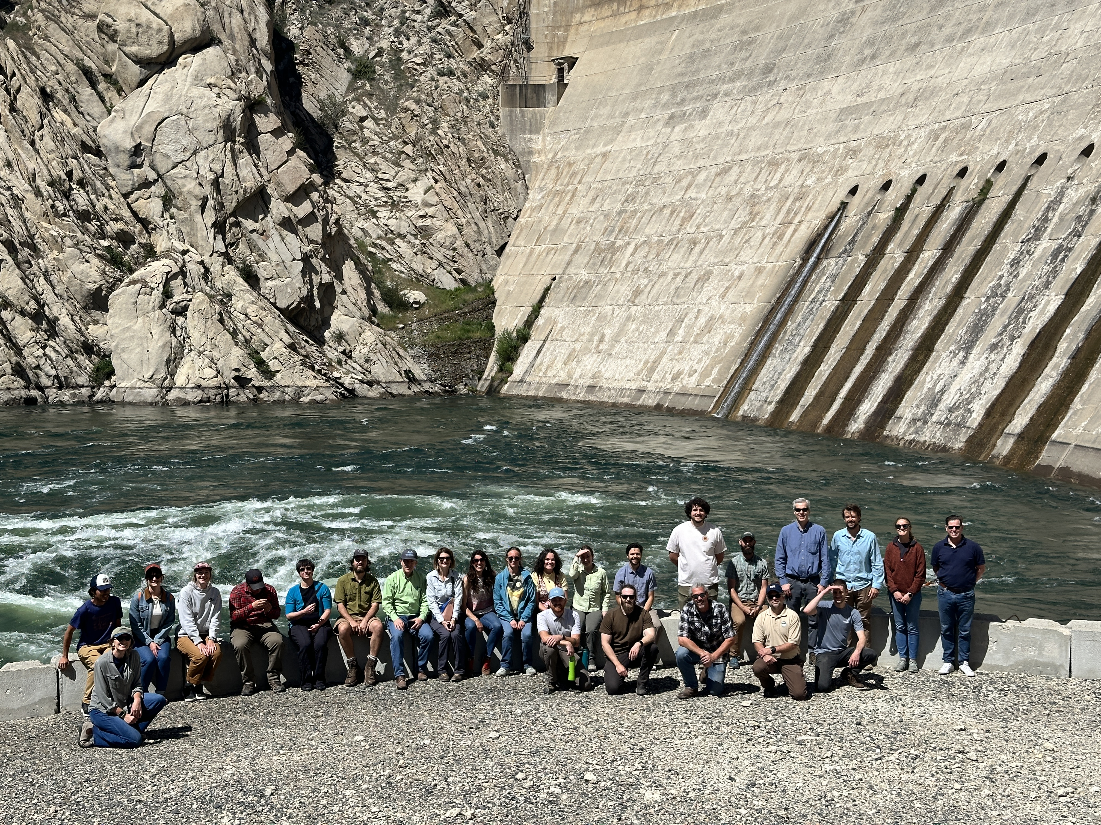
IWRRI connects stakeholders, students and researchers
Research complex & urgent questions
Teach the next generation of water leaders
Translate knowledge to make findings actionable
Notes:
IWRRI’s mission is to address state, regional, and national water issues by conducting critical research needs to support the water resource needs of the state, northwest region and nationally, sharing current information, and supporting the development of a multi-disciplinary water workforce.
We are one of 54 WRRIs across the country – established by an act of congress in 1964
Here in Idaho we are working to Build relationships, become a hub that connects stakeholders, students and researchers

Slide 3

Research Approach
Identify water research priorities across Idaho
Coordinate and conduct research across institutions
Engage with stakeholders to ensure outcomes are actionable
Notes:
IWRRI’s work is funded with federal, state and grant money.
We have a research advisory committee with 32 participants that span from municipalities, to agricultural and industry representatives; this year they identified over 90 potential water research projects and the Executive Board approved 12 priority topics for us to focus on
We are engaging stakeholders and partners from the outset of the projects to ensure that outcomes are relevant and actionable

Slide 4
Statewide Research Prioritization Process Outcomes
Pend Orielle Specific- Project Identification
Case study proposed for Lake Pend Oreille to Adaptative Reservoir management in-light of uncertainty
Related research-
  Snowpack visualization in Idaho
  Data integration via a Water Data Portal
  Westwide coordination with NIDIS and other states on data visualization
  Groundwater studies
Lake Pend Oreille | IWRRI, University of Idaho
Notes:
The state of Idaho is interested in Broader Adaptative Reservoir management in-light of uncertainty
North Idaho RAC representatives have shown an interest into integrating this lake level study into additional research regards SVRP

Slide 5
Lake Pend Oreille Case Study- Initial engagement
  Lakes commission requests
  Evaluate scenarios' for modified operations to support varying beneficial uses
  Quantify Inflow-Flood Relationships to Support Flexible Lake Level Management
    Consider Fish and Wildlife habitat
    Consider recreation- varying summer/ winter pool
  UI Economic team
  Understanding the decision points used for economic impact study
2
3
5
6
7
Lake Pend Oreille | IWRRI, University of Idaho
Notes:
Matthew Yourek, Michael Brady

Slide 6
Lake Pend Orielle Case Study Project Outline and Workplan
Research Objectives
Phase 1: Summary of historical watershed conditions
Phase 2: Evaluate the impact of spring runoff conditions on Lake Pend Oreille elevation response at different winter pool elevations.
Stakeholder engagement
  Identify deliverables that are useful and relevant
    Year 1: The Lakes Commission → Serves the State of Idaho
2
3
5
6
7
Lake Pend Oreille | IWRRI, University of Idaho
Notes:
65 years of data

Slide 7
Year 1 timeline
Spring 2026
Summer- Fall 2026
Winter 2027
Historical watershed conditions data compilation and analysis
Synthesize and visualize Albeni Falls rule curve and management
Write technical report summarizing key findings
Develop non-technical educational materials for distribution
Coordinate with Lakes Commission and other stakeholders for potential continuation
Run inflow-lake elevation model to determine what conditions lead to flooding
Summarize historical and future likelihood of flooding frequency
Lake Pend Oreille| IWRRI, University of Idaho

Slide 8
Data Products in Phase 1
Dataset | Source | Data Availability | Metrics
LPO elevation | Hope USGS gauge | 1960-current | historic flooding frequency
Clark Fork streamflow | Cabinet Gorge/ Noxon USGS gauge | 1997-Current/ 1960-1997 | center of mass timing
 |  |  | peak flow timing
 |  |  | total seasonal streamflow volume
Headwater precipitation | All SNOTEL sites in LPO basin | 1980-Current | total annual SWE
 |  |  | day of peak SWE
 |  |  | rain-on-snow event frequency
 |  |  | SWE : P
Albeni Falls historic rule curve | Albeni Falls water management plan |  | Scenario thresholds
Albeni Falls proposed rule curve | UI Economic Impacts study |  | Scenario thresholds
Albeni Falls outflow | USACE Hydromet Data Query | (1960- Current) | Annual variability
2
3
5
6
7
Lake Pend Oreille | IWRRI, University of Idaho
Notes:
Map instead for data
Outflows out of hungry horse into the flathead-
Pend Oreille river at Newport
Outflow of the dam at Albeni falls

Slide 9
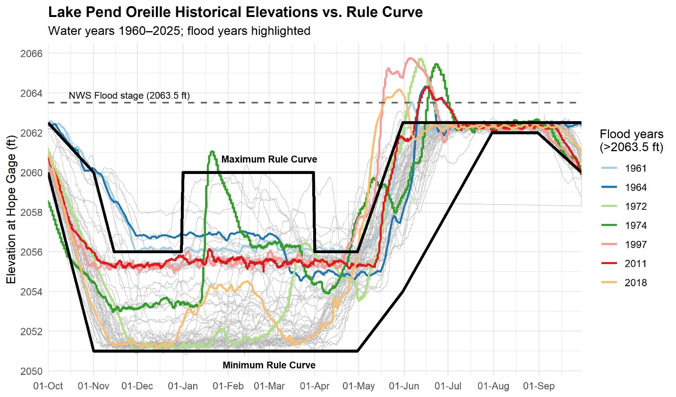
Initial Data Analysis: Phase 1: Historical Lake Pend Oreille Level Elevations
2
Visualize variability from year to year
Visualize rule curve
7/65 years exceeded 2063.5 NWS flood stage
3
5
6
7
Lake Pend Oreille | IWRRI, University of Idaho | Preliminary Figure
Notes:
7/65 years exceeded 2063.5 NWS flood stage

Slide 10
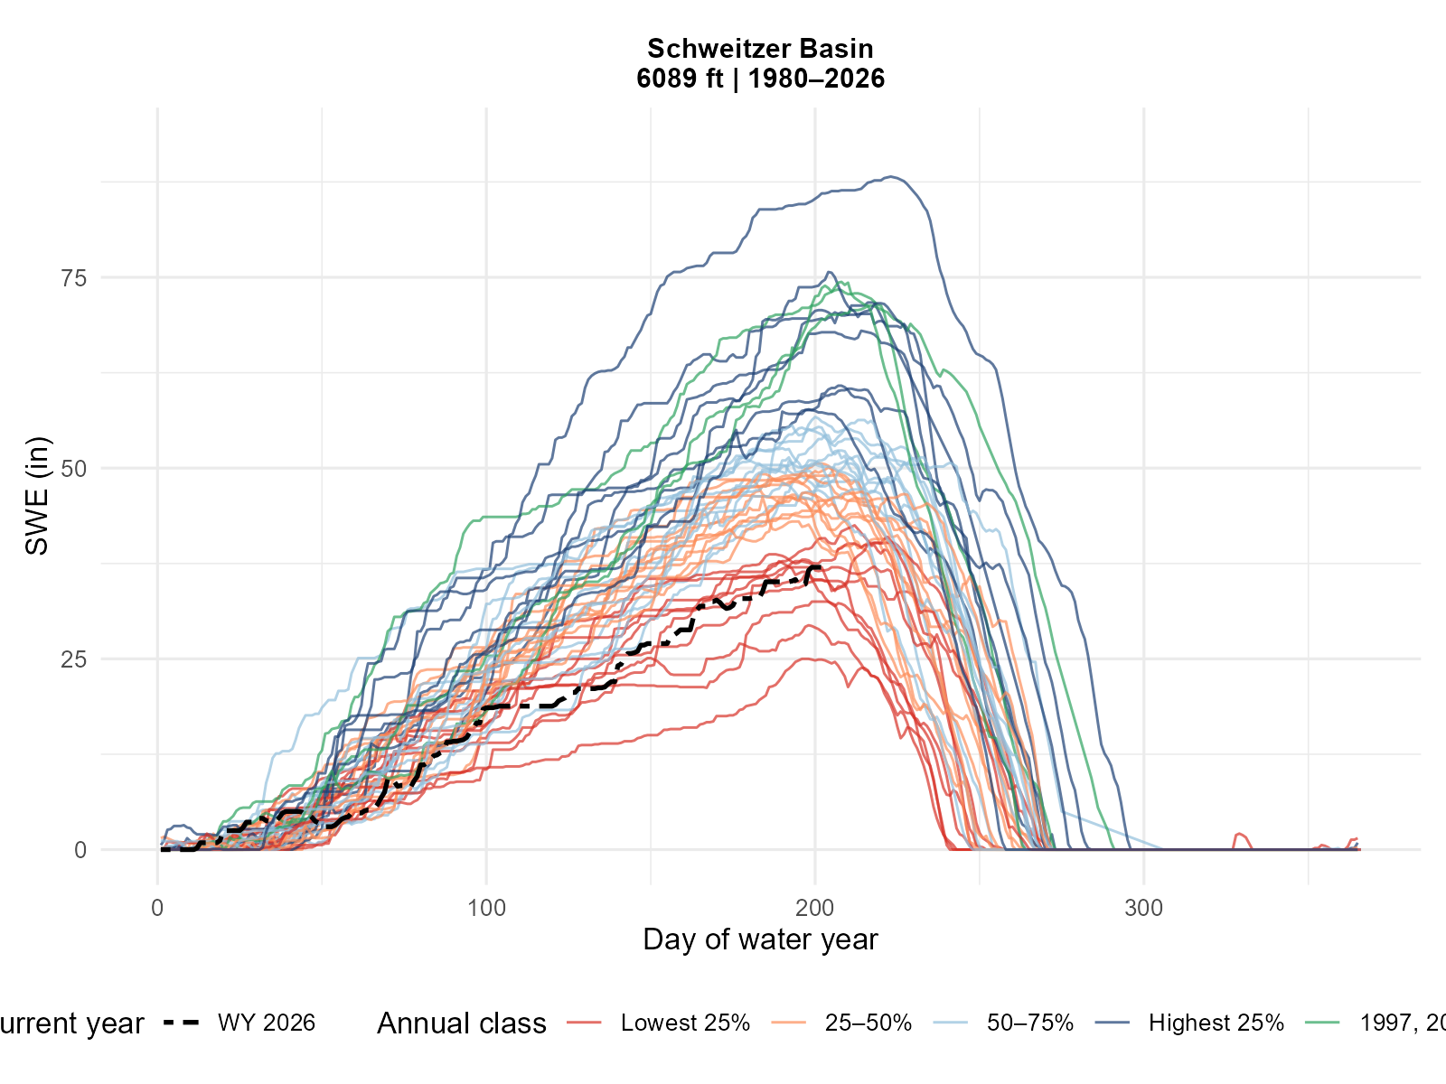
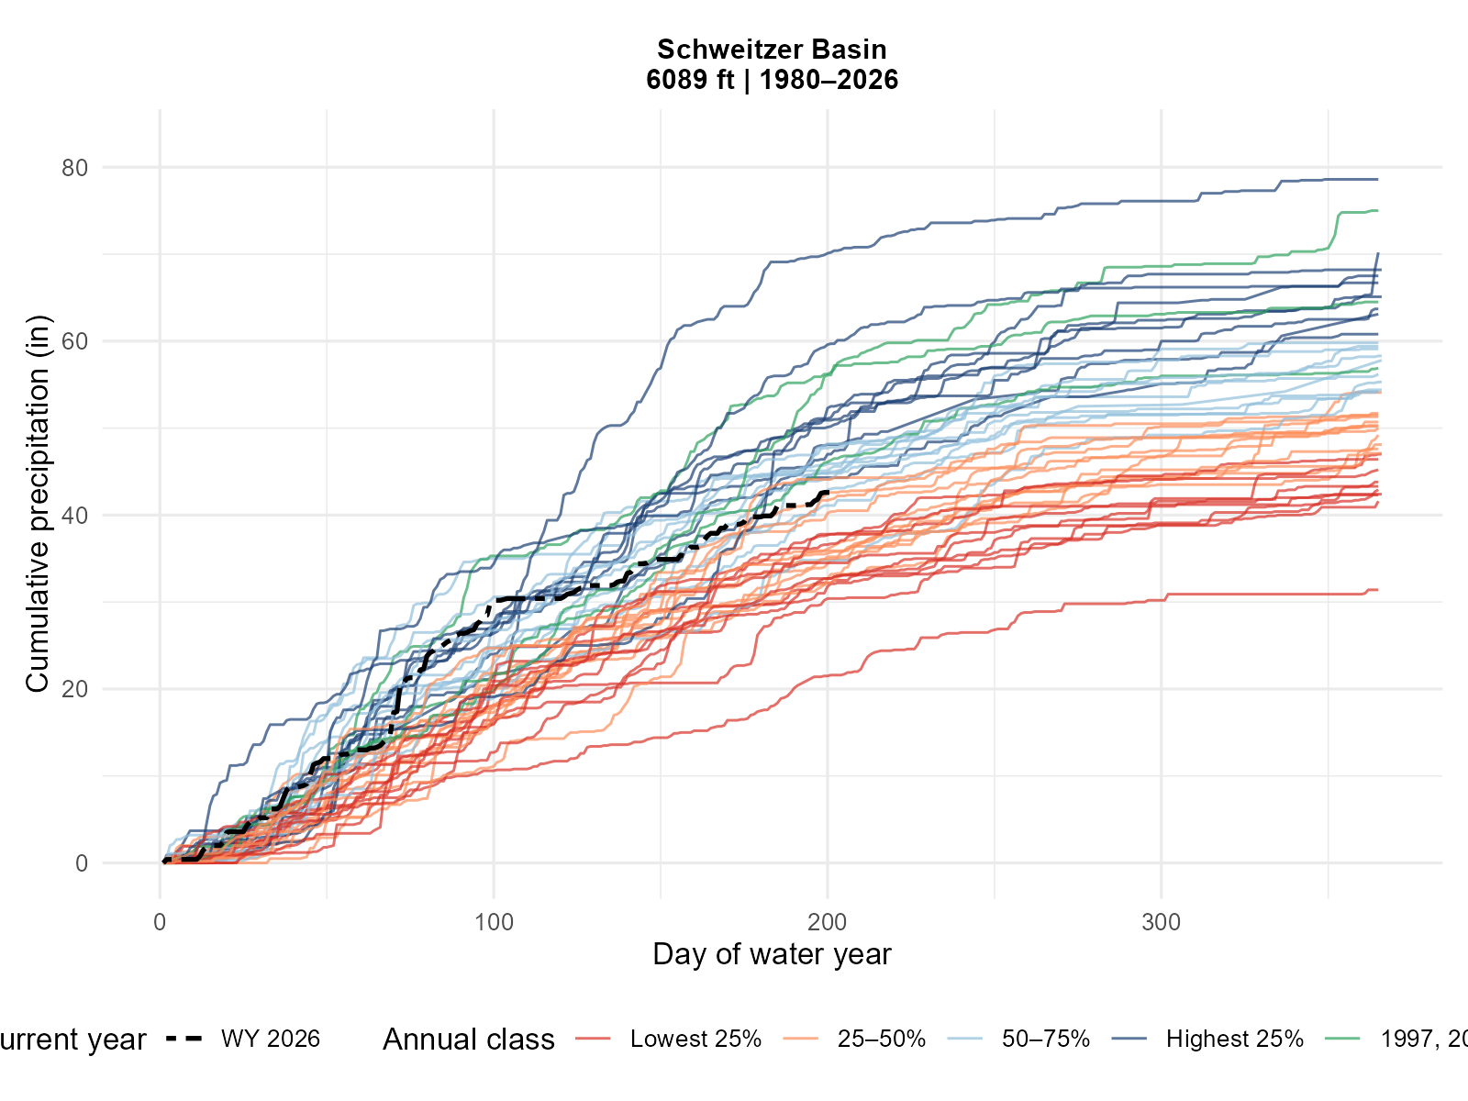
Initial Data Analysis: Phase 1: Historical Precipitation
2
3
5
6
Current Year
1997,
2011,
2018
Current Year
1997,
2011,
2018
7
Lake Pend Oreille | IWRRI, University of Idaho | Preliminary Figure (Created 5/5/2026)
Notes:
Headwater precipitation and how it progresses into downstream conditions

Slide 11
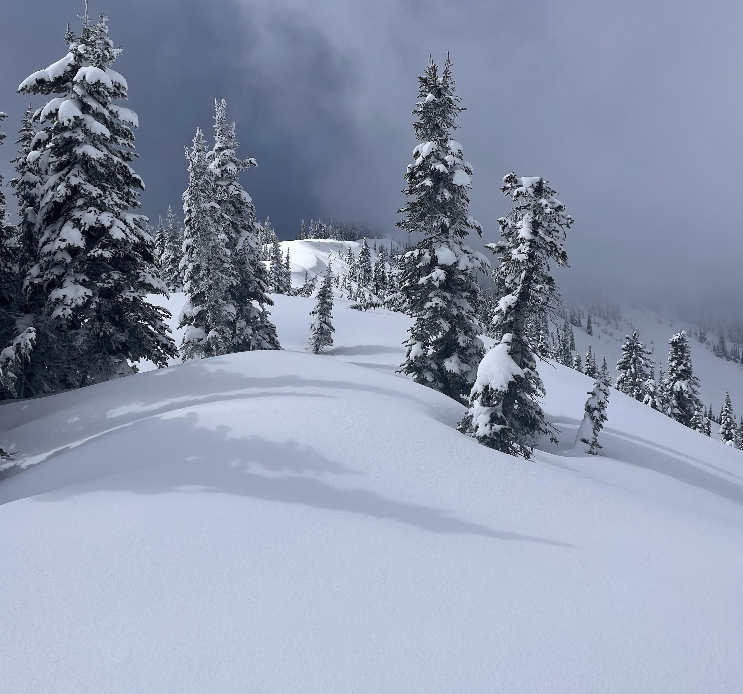
Questions?
2
3
Meg Wolf, mawolf@uidaho.edu
Grace Peven gpeven@uidaho.edu
5
6
7
Lake Pend Oreille | IWRRI, University of Idaho
Notes:
1997-208

Slide 12
Spring 2026
(Apr–Jun)
Lake Pend Oreille| IWRRI, University of Idaho

Slide 13
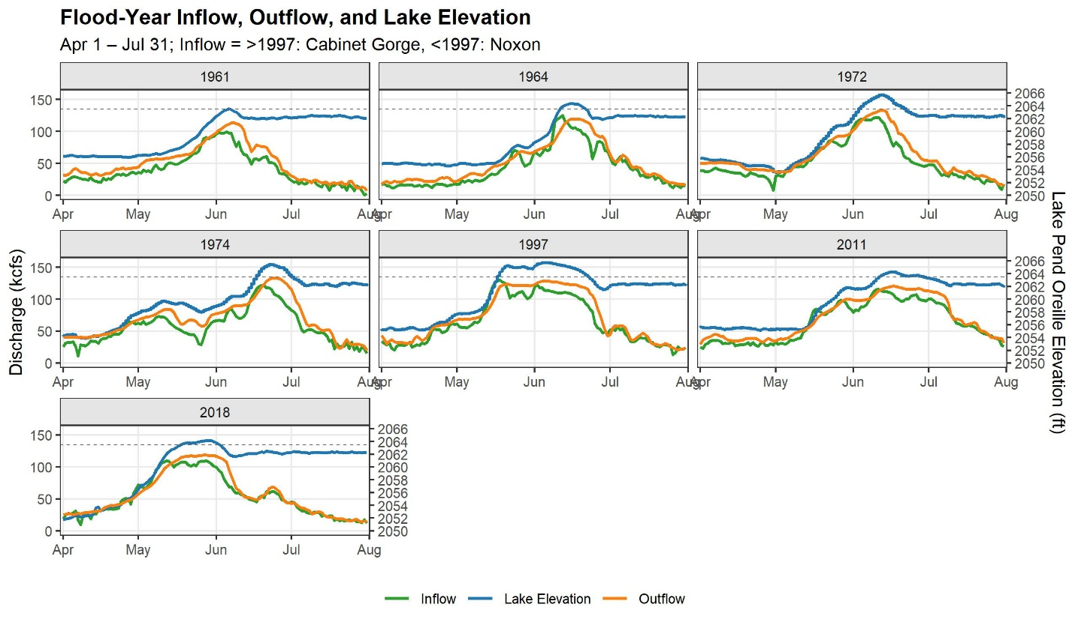
Additional Slides: Initial Data Analysis
2
3
5
6
7
Lake Pend Oreille | IWRRI, University of Idaho
Notes:
7/65 years exceeded 2063.5 NWS flood stage- from 1960- now
NWS indicates 2063.5 as flood level
1997-208

Slide 14
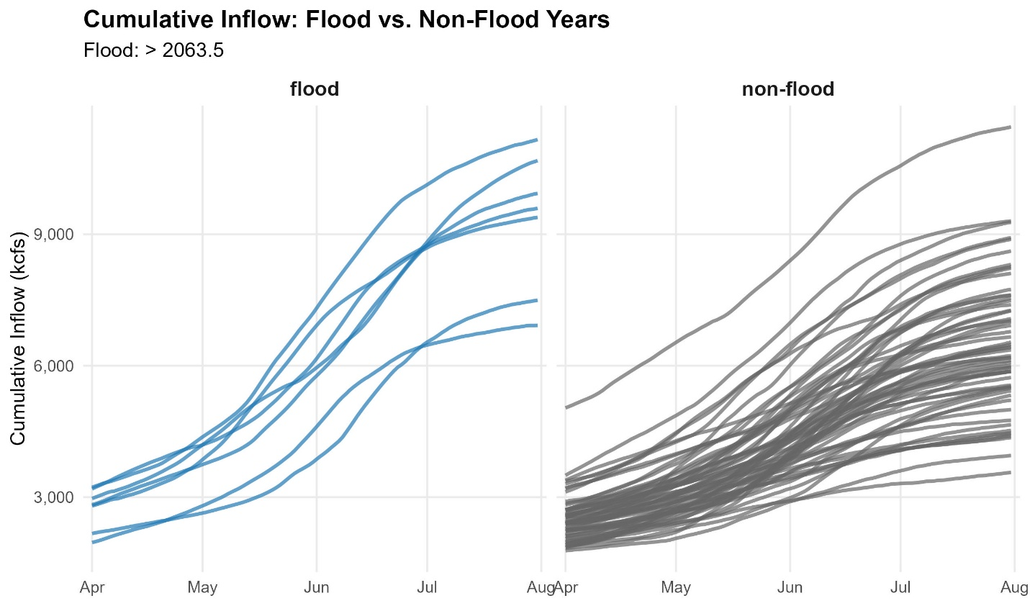
Additional Slides: Initial Data Analysis
2
3
5
6
7
Lake Pend Oreille | IWRRI, University of Idaho

