Slide 1
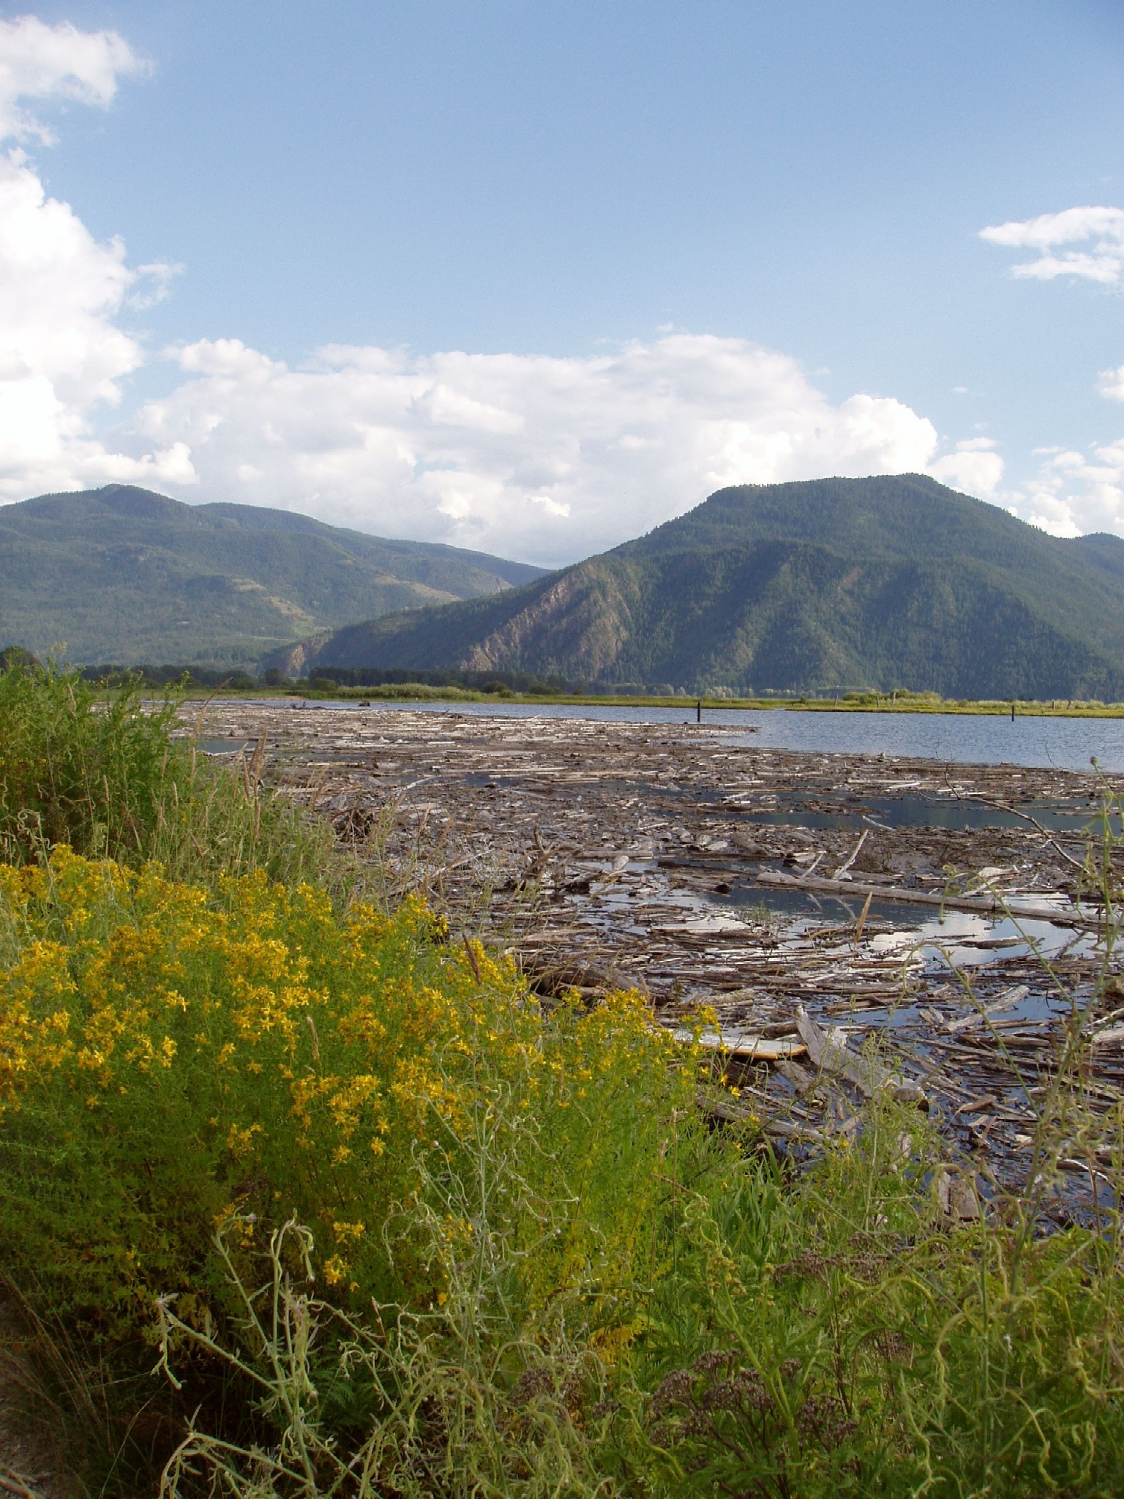
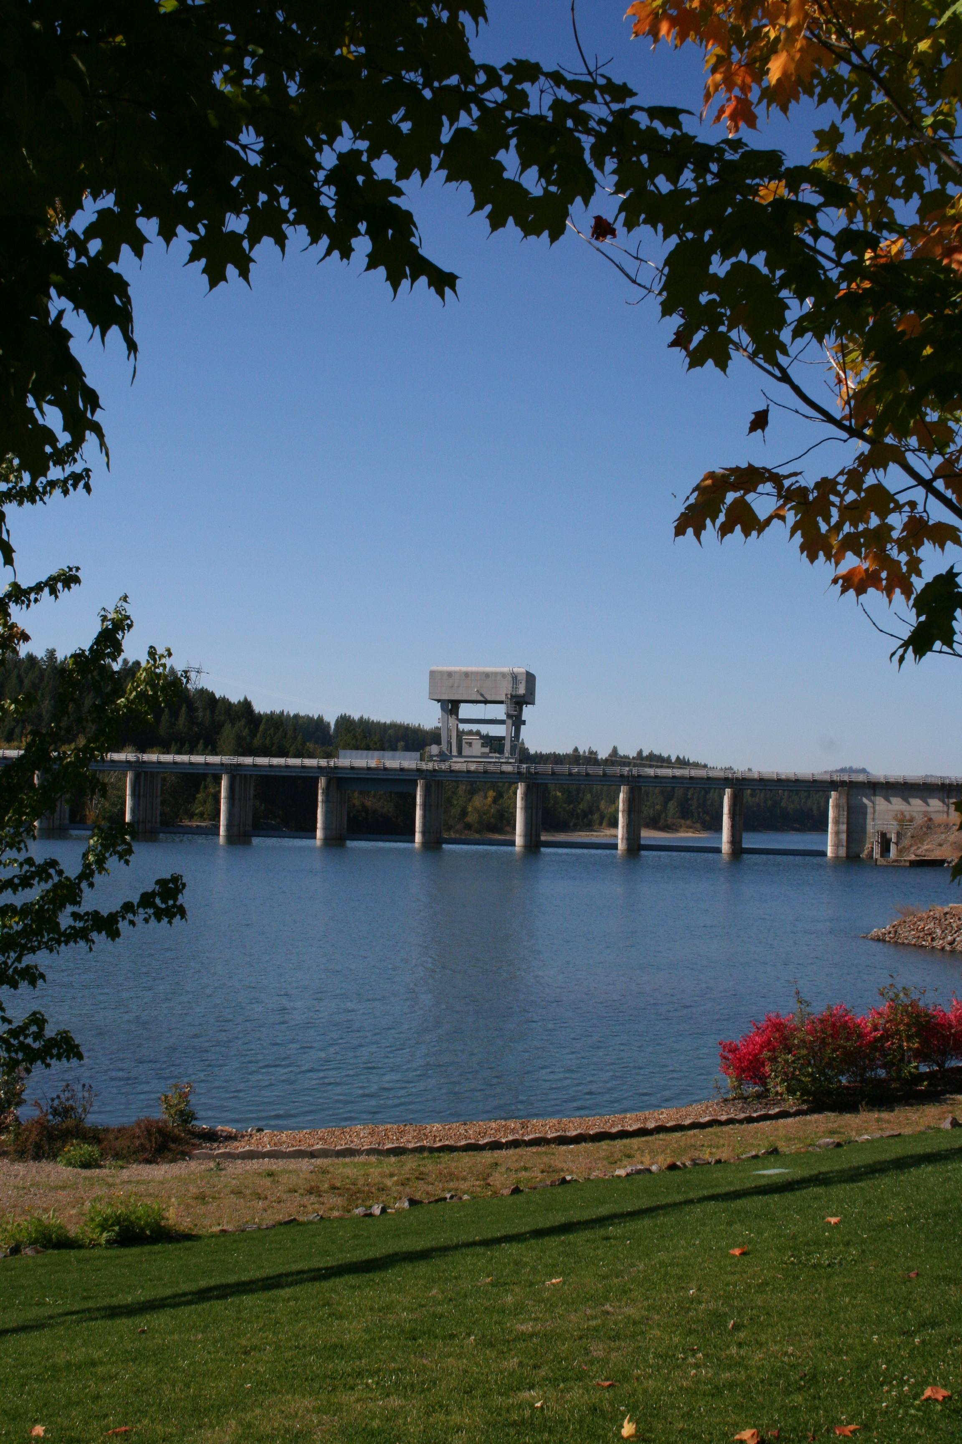
Albeni falls Dam and lake pend Oreille
08 May 2026
David Varner
Upper Columbia Senior Water Manager
Taylor Johnson
Chief, Natural Resources
Albeni Falls Dam Update
Pend Oreille Lakes Commission

Slide 2
Lake Pend Oreille 2026
Expected Operations
Upstream
Expect to be at 2056.0' over this weekend.
Goal for intermediate 2060.0’ level by the end of May.
Goal for summer pool 2062.0’ by June 19.
Operate to our normal one-half foot summer range (2062.0-2062.5 feet)
Subject to change, depending on weather conditions affecting runoff quantity and intensity.
Downstream
Will most likely look like normal operations.

Slide 3
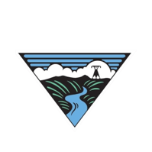
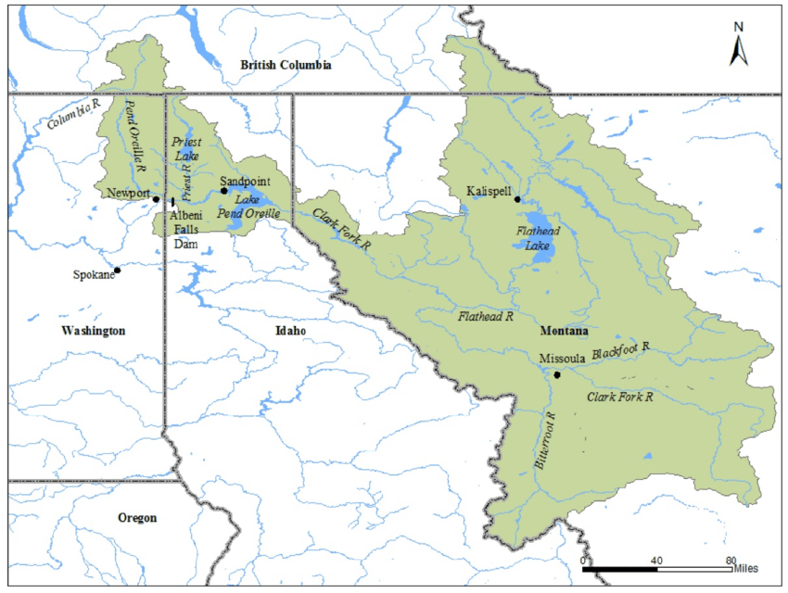
Lake Pend Oreille Basin (~24,200 sq. miles)
Sandpoint
Notes:
The Pend Oreille basin is vast, reaching from Fernie, British Columbia to the north, to Butte, MT to the south. This area is around the size of West Virginia. Water that falls within this area will travel through the Flathead, Bitterroot, Clark Fork, and Priest rivers (among other rivers and creeks) before passing through Lake Pend Oreille and Albeni Falls Dam.
As a comparison, the Lake Coeur D'Alene basin to the south is around 4,000 square miles, about one-sixth the area of this basin.

Slide 4
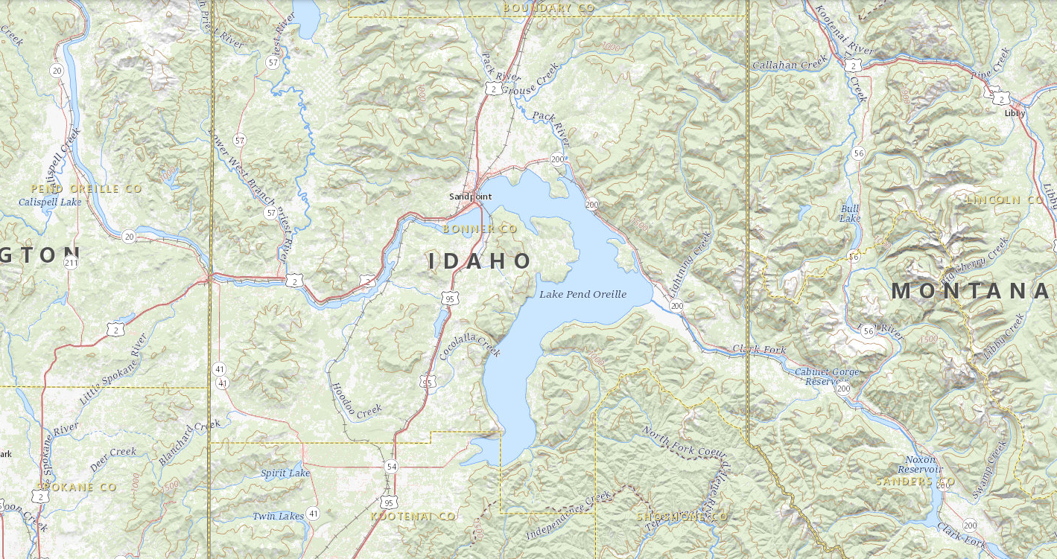
Albeni Falls Dam and Lake Pend Oreille
Dover, location of transition from Lake to River.
Hope, where Lake elevation is measured.
Albeni Falls Dam is ~27 miles downstream from Hope.
Notes:
Next is a closer view at Lake Pend Oreille. The Corps measures the elevation of Lake Pend Oreille at a station near Hope, ID, as shown on the rightmost arrow. Moving westward, Lake Pend Oreille transitions from a Lake to a River at Dover. This point is also constricts flow, which we will discuss later.

Slide 5
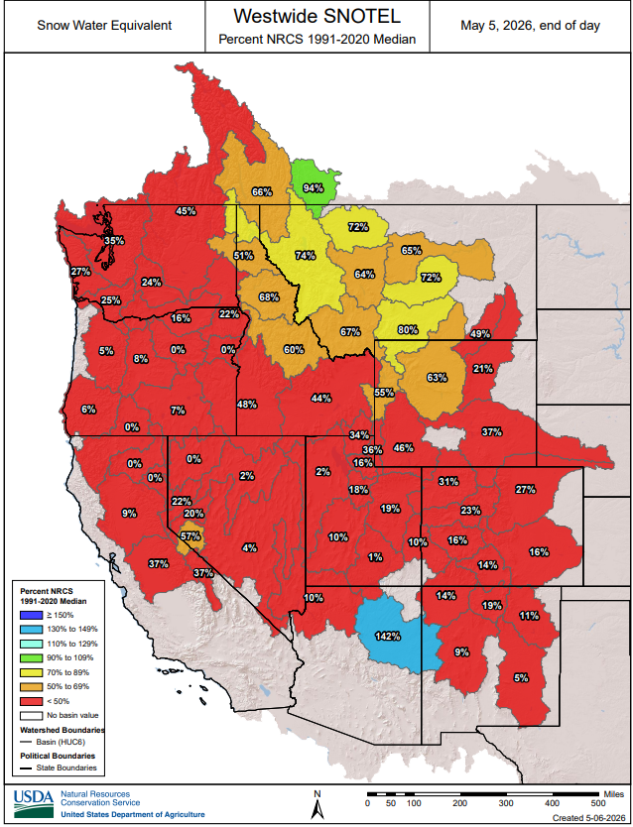
Mid-April snowpack is below average this year for all basins in the Western US.
The Pend Oreille Basin has higher snowpack than more southern and western basins.
In addition to snowpack, other factors including fall soil moisture, spring temperature, and rainstorms all affect runoff volume and timing.

Slide 6
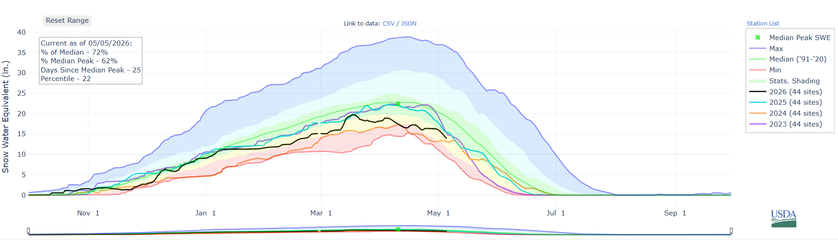
2026
April 10, Median Peak
Median
2025
2024
2023

Slide 7
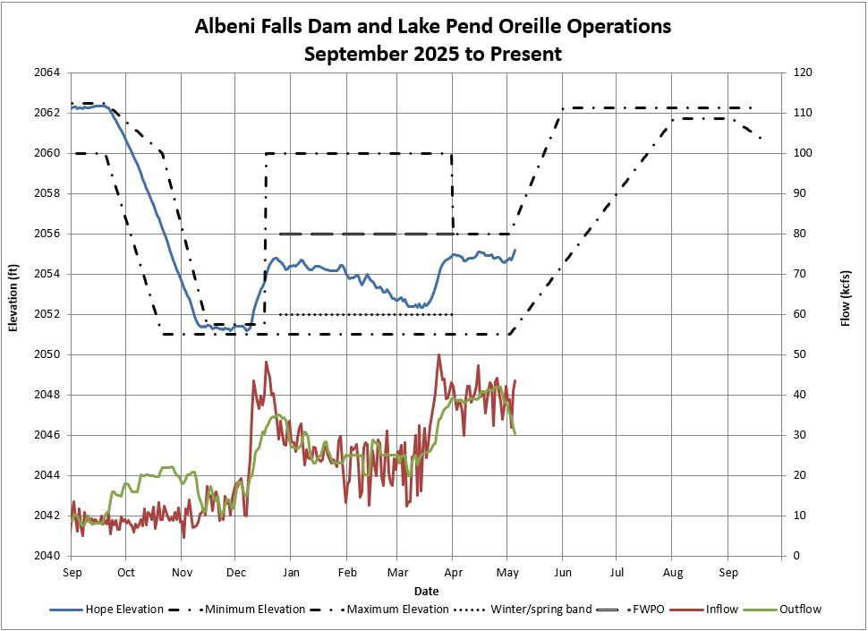
Started Fall Draft Sept 23rd
Finished Fall Draft Nov 11th
Flexible Winter Power Operations
2052’ – 2055.0’
Kept Lake in 2051.0’-2051.5’ band Nov 11th – Dec 17th for Kokanee spawning.
Winter Band
2051.0’ – 2052.0’

Slide 8
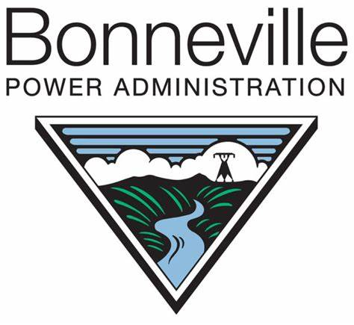
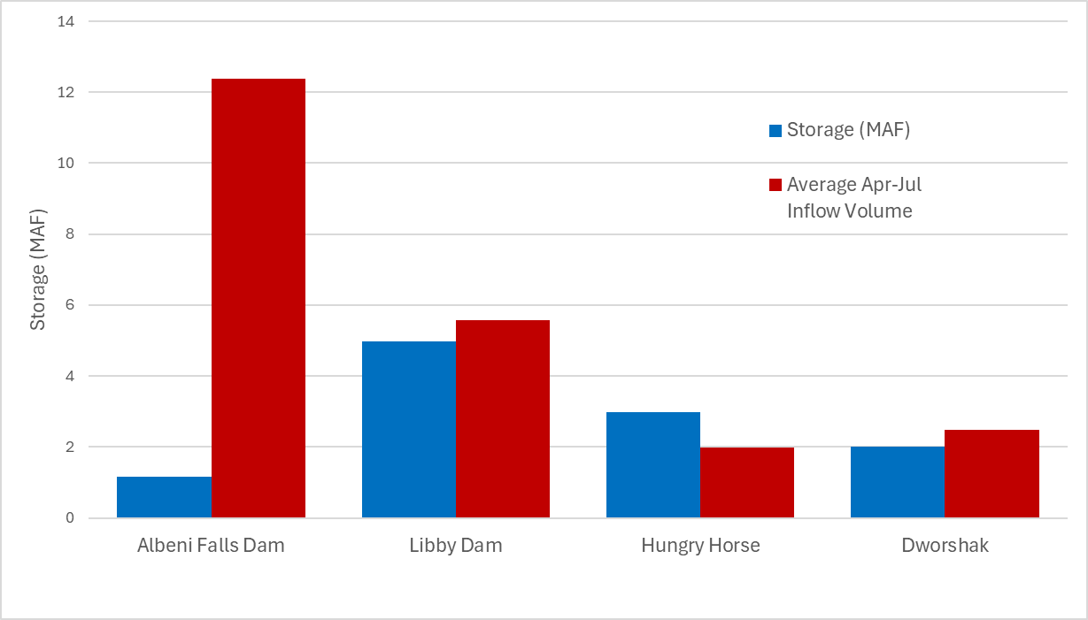
Columbia River Projects Storage vs Spring Runoff
Forecast inflow April-July 2026 (5/5/26)
10.0 MAF – 81% of normal
WY 2025 inflow April-July 8.4 MAF – 68% of normal
Notes:
Here is a figure showing the storage and average April to July runoff for a few sample projects in the Columbia River System. The storage for each project is shown in blue, and the average inflow volume is shown in red. Libby and Dworshak usually receive enough inflow in this time period to fully refill just over one time. Hungry Horse, on average, doesn't receive enough inflow from April to July to fully refill. Albeni Falls, in contrast, experiences inflow around 12 times as much as it requires as storage. In WY2025, observed runoff in this time period was 68% of normal, but Lake Pend Oreille refilled nonetheless.
Find values here: https://www.nwrfc.noaa.gov/water_supply/ws_forecasts.php?id=ALFW1

Slide 9
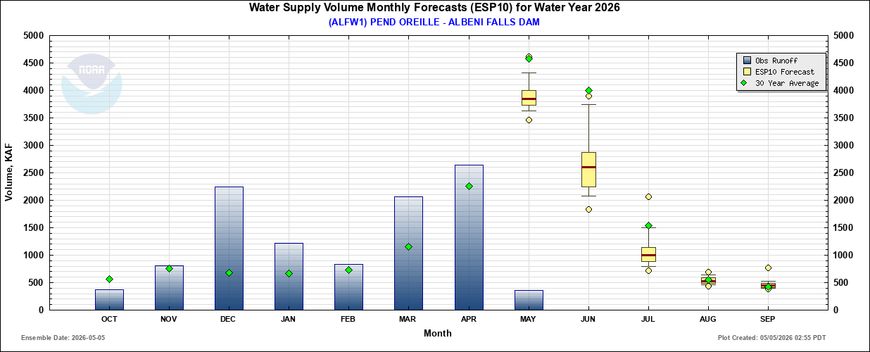
Monthly volumes
Observed runoff was above average for March and above average for April.
Peak runoff forecast to occur in May
Mean runoff volume in May is forecast at 4MAF, enough to fill LPO four times
April-July Forecast 10.0 MAF and 81% average
Notes:
Here's a graphic showing monthly runoff volumes. The blue vertical bars denote observed runoff, green diamonds show the 30-year average runoff, and the yellow bars show the forecast runoff with confidence intervals. The red lines in the current and future months are the mean forecast runoff. December, January, and March were above average, and runoff is forecast to be above average in April, too. Runoff is forecast to be less than average through the summer before returning to the average in August and September. It is noteworthy that the mean predicted runoff for May alone can fully fill Lake Pend Oreille four times.
Source: https://www.nwrfc.noaa.gov/water_supply/monthly/monthly_forecasts.php?id=ALFW1

Slide 10
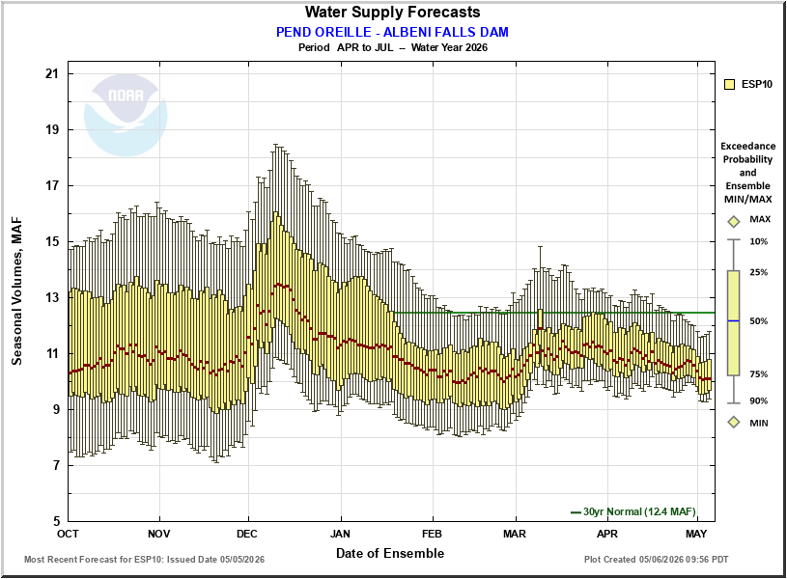
Constantly changing Forecasts
Notes:
This slide shows daily April to July water supply forecasts issued by the Northwest River Forecast Center. This graphic shows the 30-year normal water supply of 12.4 MAF using the horizontal green line. The box and whisker plot shows the likelihood of volume that could pass through the basin, with the mean (average) value shown in red. Looking at the mean, the forecasts were nearly constant through October and November before rising in December, likely due to the high rainfall experienced in the basin. Continuing through December and January, the forecast steadily declined before stabilizing in February, then increasing again in March. As we move further in time, the forecasts will give a clearer picture of what we can expect in the coming months.
Source: https://www.nwrfc.noaa.gov/water_supply/ws_forecasts.php?id=ALFW1

Slide 11
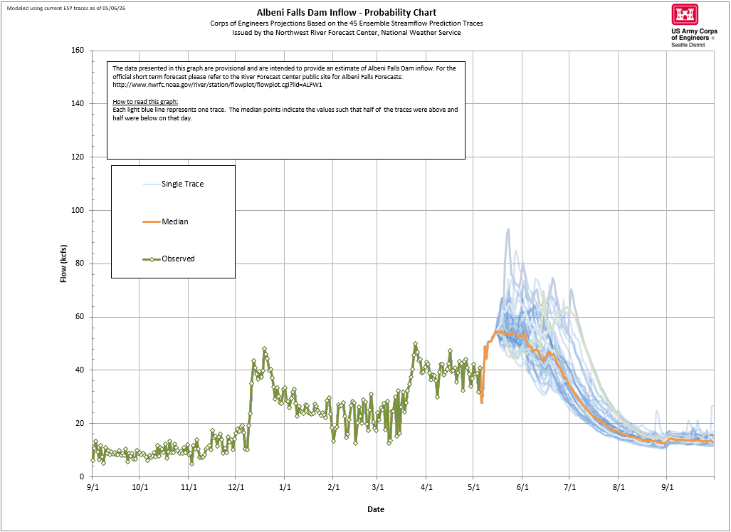

Slide 12
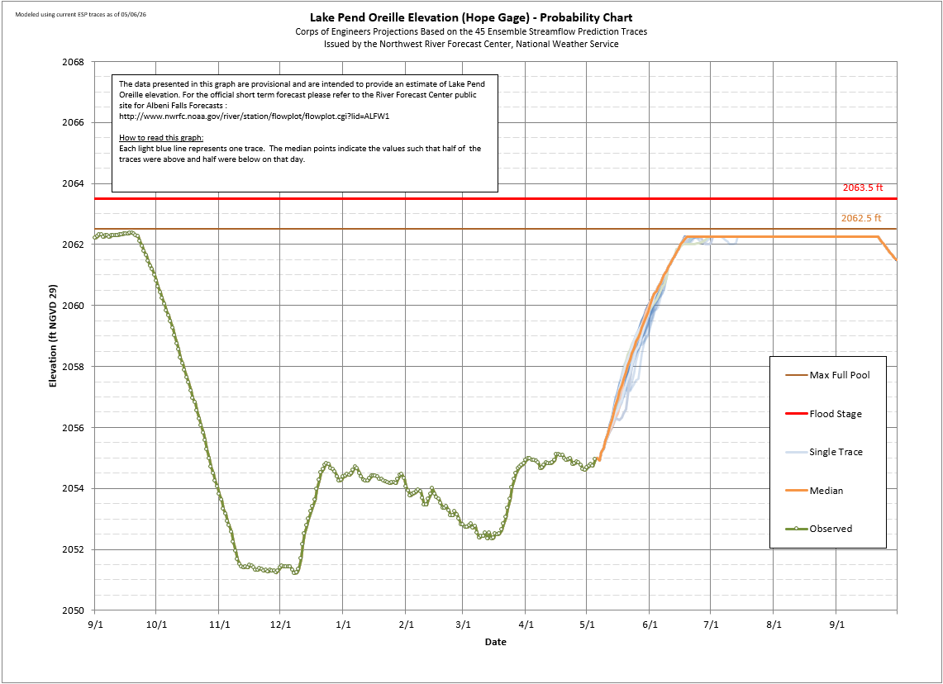

Slide 13
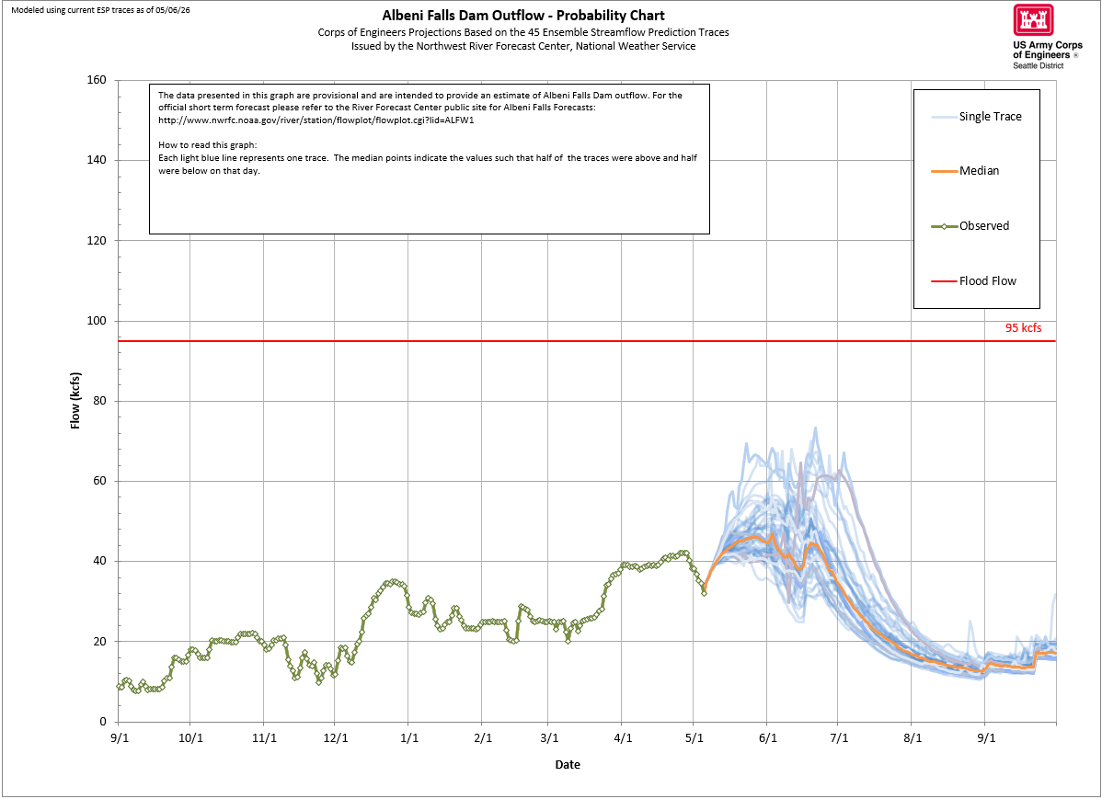

Slide 14
Albeni Falls Control - Summer Example
Half foot water surface elevation difference between Hope and Dam
Clark Fork
Albeni Falls
Dam
Dover
Constriction
Pend Oreille River begins
Hope
Dover Constriction Control - High Spring Outflow Example
10-foot water surface elevation difference between Dover and Dam
Clark Fork
Albeni Falls
Dam
Dover
Constriction
Pend Oreille River begins
Hope
Notes:
Quick orientation to this image. Albeni Falls Dam is shown as the large gray shape circled on the top. The Dover constriction is shown circled in the bottom graphic. Hope, and Lake Pend Oreille, are on the right side of this image, and the Pend Oreille River is to the left.
The constriction at Dover can create large differences in elevation between the Pend Oreille River and Lake Pend Oreille. In the summertime when flows are low, there is usually a half a foot difference between the Lake and the river as measured at the Dam. In the spring, when flows are much higher, there can be as much as a ten-foot difference between the lake and the dam.

Slide 15
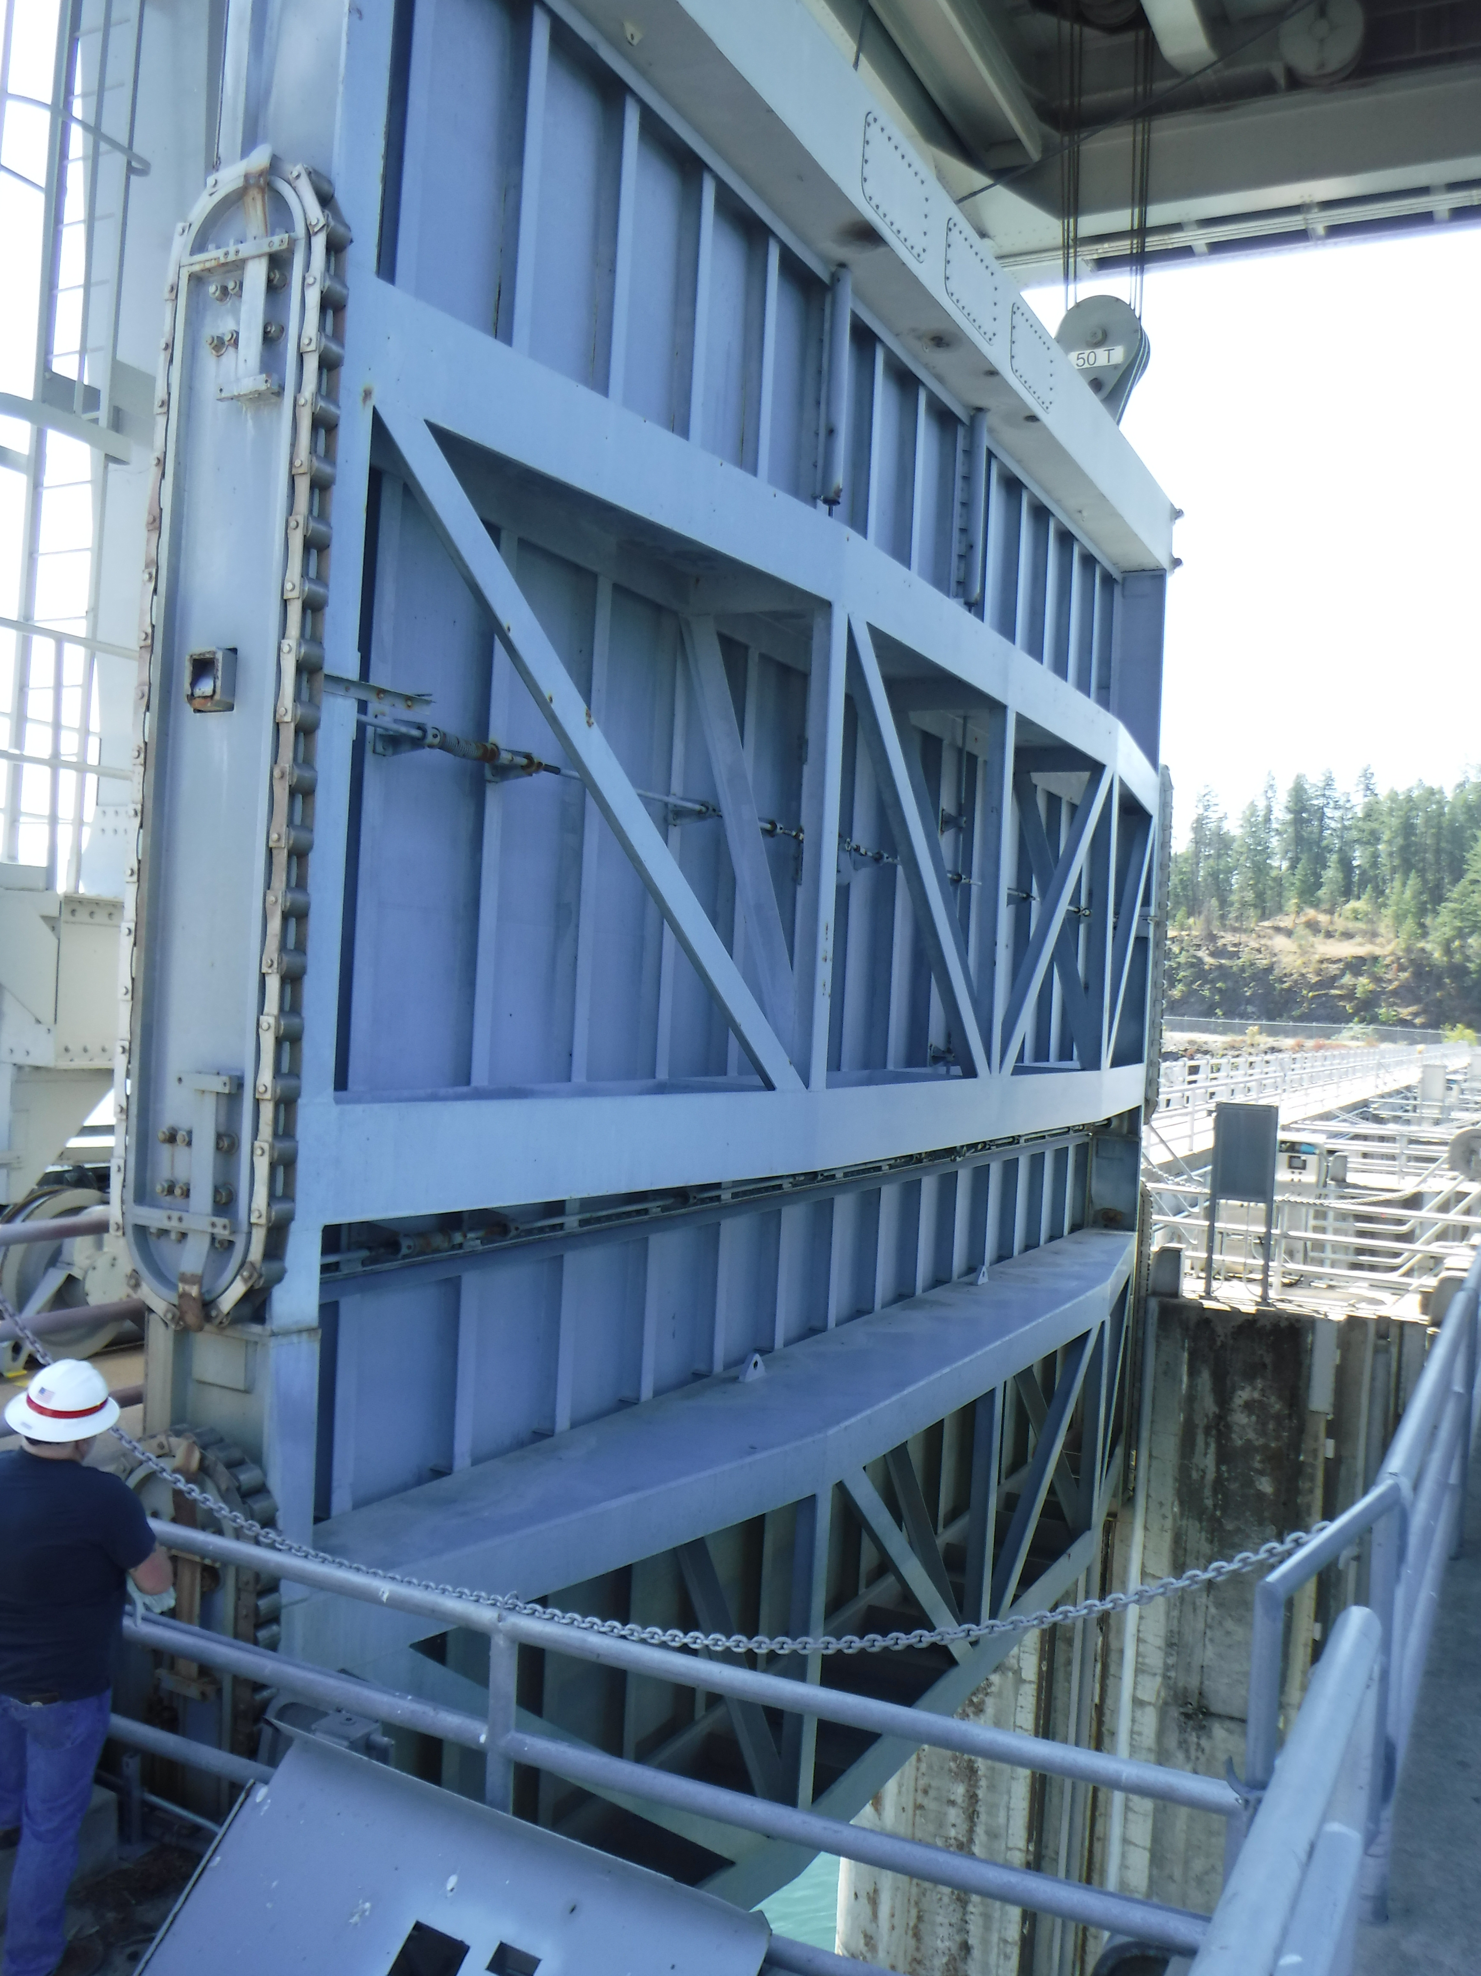
Spillway Gate Restrictions
Spillway gates needed to hold lake level / pass high outflows.
Delaminations in gate discovered in April 2024.
Restrictions on use of spillway gates in place.
Public safety not a concern as a result of these defects.
Notes:
TAYLOR - READ BULLETS
BULLET 1 : Spillway gates needed to hold lake level / pass high outflows to prevent upstream flooding. Generally, outflows below 30k cfs can be managed through the PH.
BULLET 2: Initiated routine rehabilitation contract in 2023 on gate 3, discovered delaminations/cracked welds in April 2024.
BULLET 3: Restrictions on use of gates were put in place which include minimal/no movement of gates with our crane.
BULLET 4: No public safety concerns as a result of these defects. Concern over movement of gates and potential gate failure, crane/operator/other infrastructure damage which would inhibit our ability to meet our mission. We are operating in a manner to mitigate for that. Loss of ability to open/close gates would hamper our ability to manage lake levels.

Slide 16
Spillway Gate Replacement PLan
The fiber reinforced polymer (FRP) was completed on Gate 3 and the gate returned to service in August 2025. Spare gate returned as spare.
Restricted operations remain in place until all gates are replaced.
New gate design completed July 2025, two months ahead of schedule.
USACE awarded a replacement contract for 11 new spillway gates in February 2026, one month ahead of schedule.
First gate expected to arrive onsite in mid-2027, with subsequent gates arriving in 6-month intervals, as confirmed with the contractor.
Notes:
TAYLOR

Slide 17
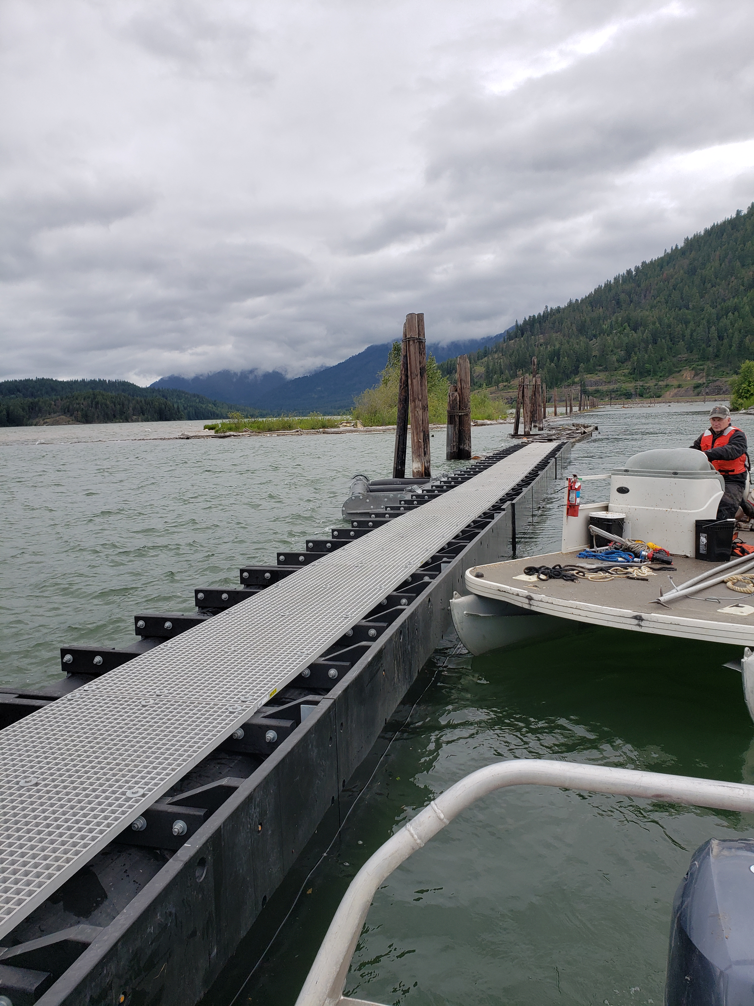
Clark Fork Driftyard
2025
Replaced 100’ of A Boom and installed two wing braces.
2026
Received delivery of 150’ of boom section into C and two wing braces. Anticipate install summer 2026.
Notes:
TAYLOR

Slide 18
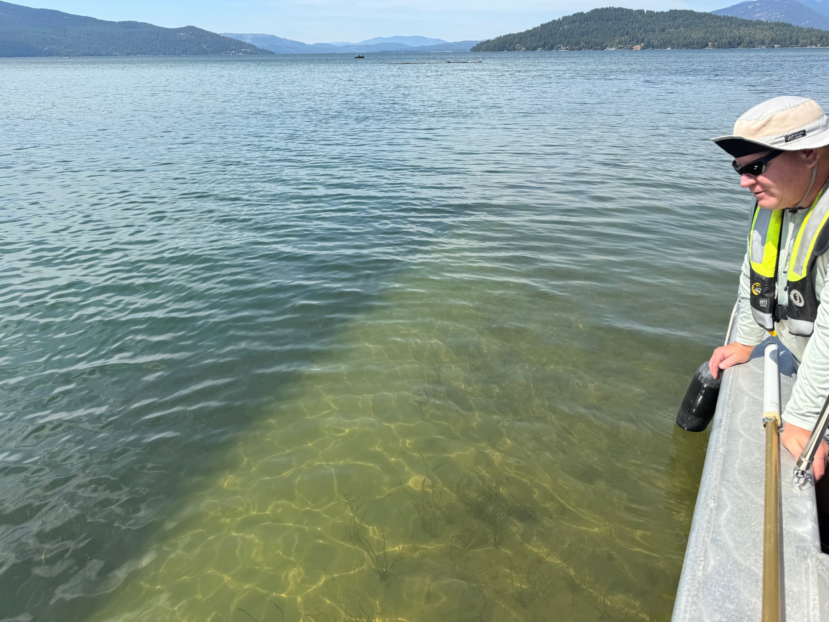
Aquatic Herbicide Application
2026 Flowering Rush Treatments (SUBMERGED and DEWATERED):
2025: (14.48 acres, Riley, Morton, Pack, Oden, CFDY, Hoodoo E & Mallard)
2025: (30.83 acres, Oden N, Morton Slough, Riley Creek)
2026: (Surveyed 63.2 acres, targeted 36.6 acres, and treated 17.4 acres, Oden N, Oden E, Hoodoo W, Riley, Priest River)
August 2026: (Oden E and Morton Slough estimated to be 19.9 acres)
Public Workshop with ISDA and Bonner County held April 2026
In-Water Work Window 7/15-8/31 for bull trout
Only treating USACE property
Notes:
TAYLOR
Aquastrike & Reward: Flowering Rush
Imazapyr: Bare Ground Flowering Rush/Milfoil

Slide 19
Recreation / Natural Resources
  Albeni Cove, Priest River and Springy Point:
  May 16 – September 13, 2026
  Riley Creek: May 9 – September 20, 2026
  Trestle Creek: April 1 – October 31, 2026
  Visitor Center open Mon – Thurs through Memorial Day 2026
  Reservations available through Recreation 1 Stop www.recreation.gov
  Shelters and Campsites by reservation only
  Interested in Volunteering for the 2026 season? www.volunteer.gov
Notes:
TAYLOR
Reservations can be made 6 months in advance from the day you want to camp or same day.

Slide 20
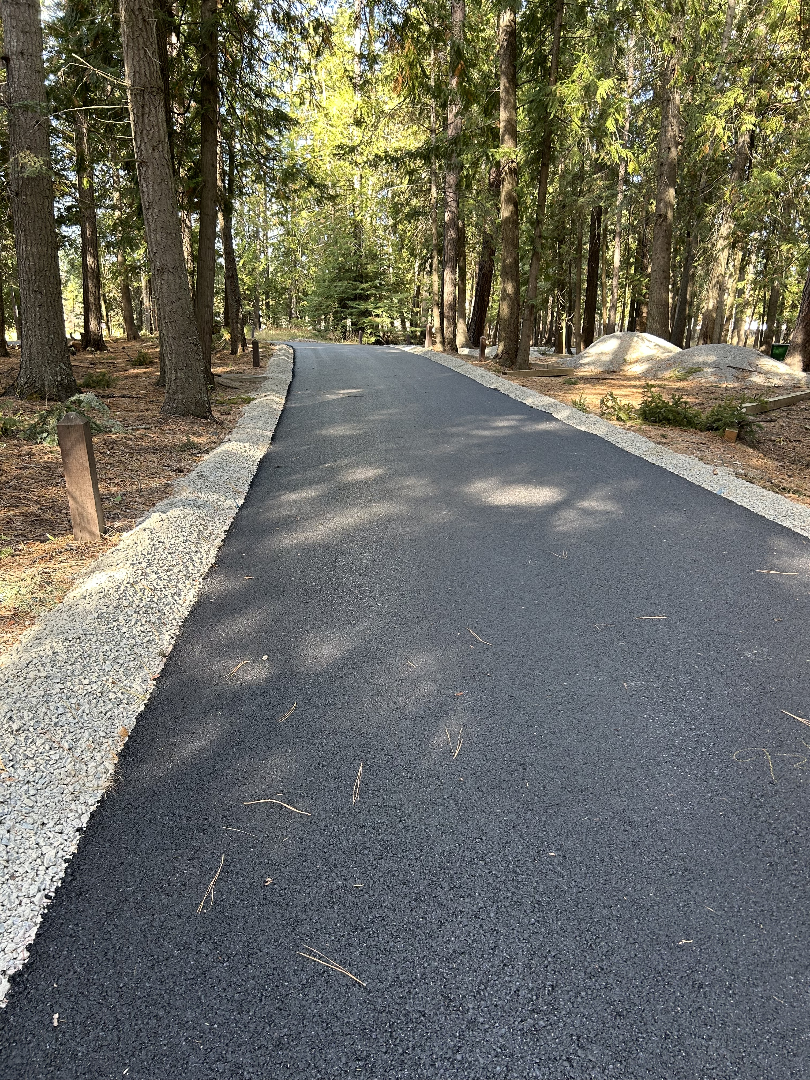
Recreation / Natural Resources
Swim Lessons at
Riley Creek and Springy Point
Master Plan Update
Notes:
TAYLOR
Partnership w Pend Oreille River Paddling Association / Long Bridge Swim.
Natural Resource Master Plan went out for public comment Jan 26, closed Feb 27, held a public scoping meeting in summer of 2024. Plan is for long-term strategic management/development of our public lands. No relation to lake levels, water rights, fish passage etc.

Slide 21
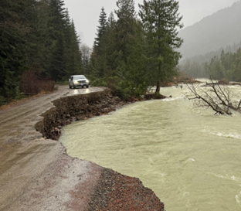
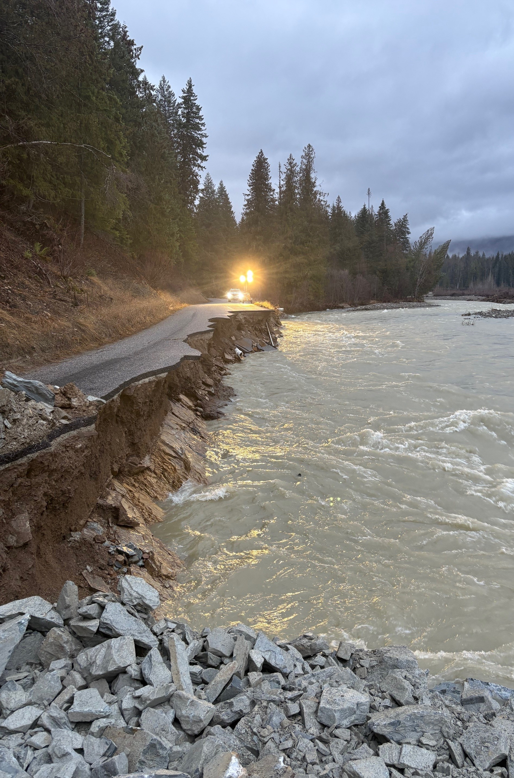
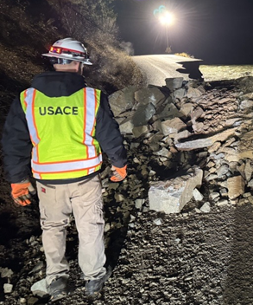
Lightning Creek Flood response
Local Albeni Falls Dam Flood Team activated Dec. 11-19, 2025 after request from Bonner County
(PL 84-99).
Provided technical expertise, 5,000 sandbags, contracted an emergency contractor (Woods Crushing and Hauling) to lay 8,100 CY of riprap, 420 CY of ¾ minus, and restore over 2,300 feet of shoreline and roadway.
USACE flood team spent 240+ hours out onsite providing QA/QC oversight for the contractor.
Restored access to 300+ homes by working straight 36 hours from Friday (Dec.12) morning through Saturday (Dec.13) evening to repair and restore access to the East Spring Creek Road.
USACE H&H surveys took place March 26.

Slide 22
How can YOU stay informed?
Subscribe to receive updates about release changes and lake levels: UpperColumbiaWM@usace.army.mil
Have general questions? Call us at 206-554-1894 or 208-437-3133
Check our district water management data webpage: https://water.usace.army.mil/office/nws
Facebook: https://www.facebook.com/AlbeniFallsDam/
Public website: https://www.nws.usace.army.mil
Recreation One Stop: www.recreation.gov
Send input on how restricted operations is affecting you to AFDpublicinput@usace.army.mil
Take a tour! Public tours of the dam are offered year-round. Call the Visitor Center at 208-437-4617 for more information.
Expect another public meeting in fall 2026.

