Slide 1

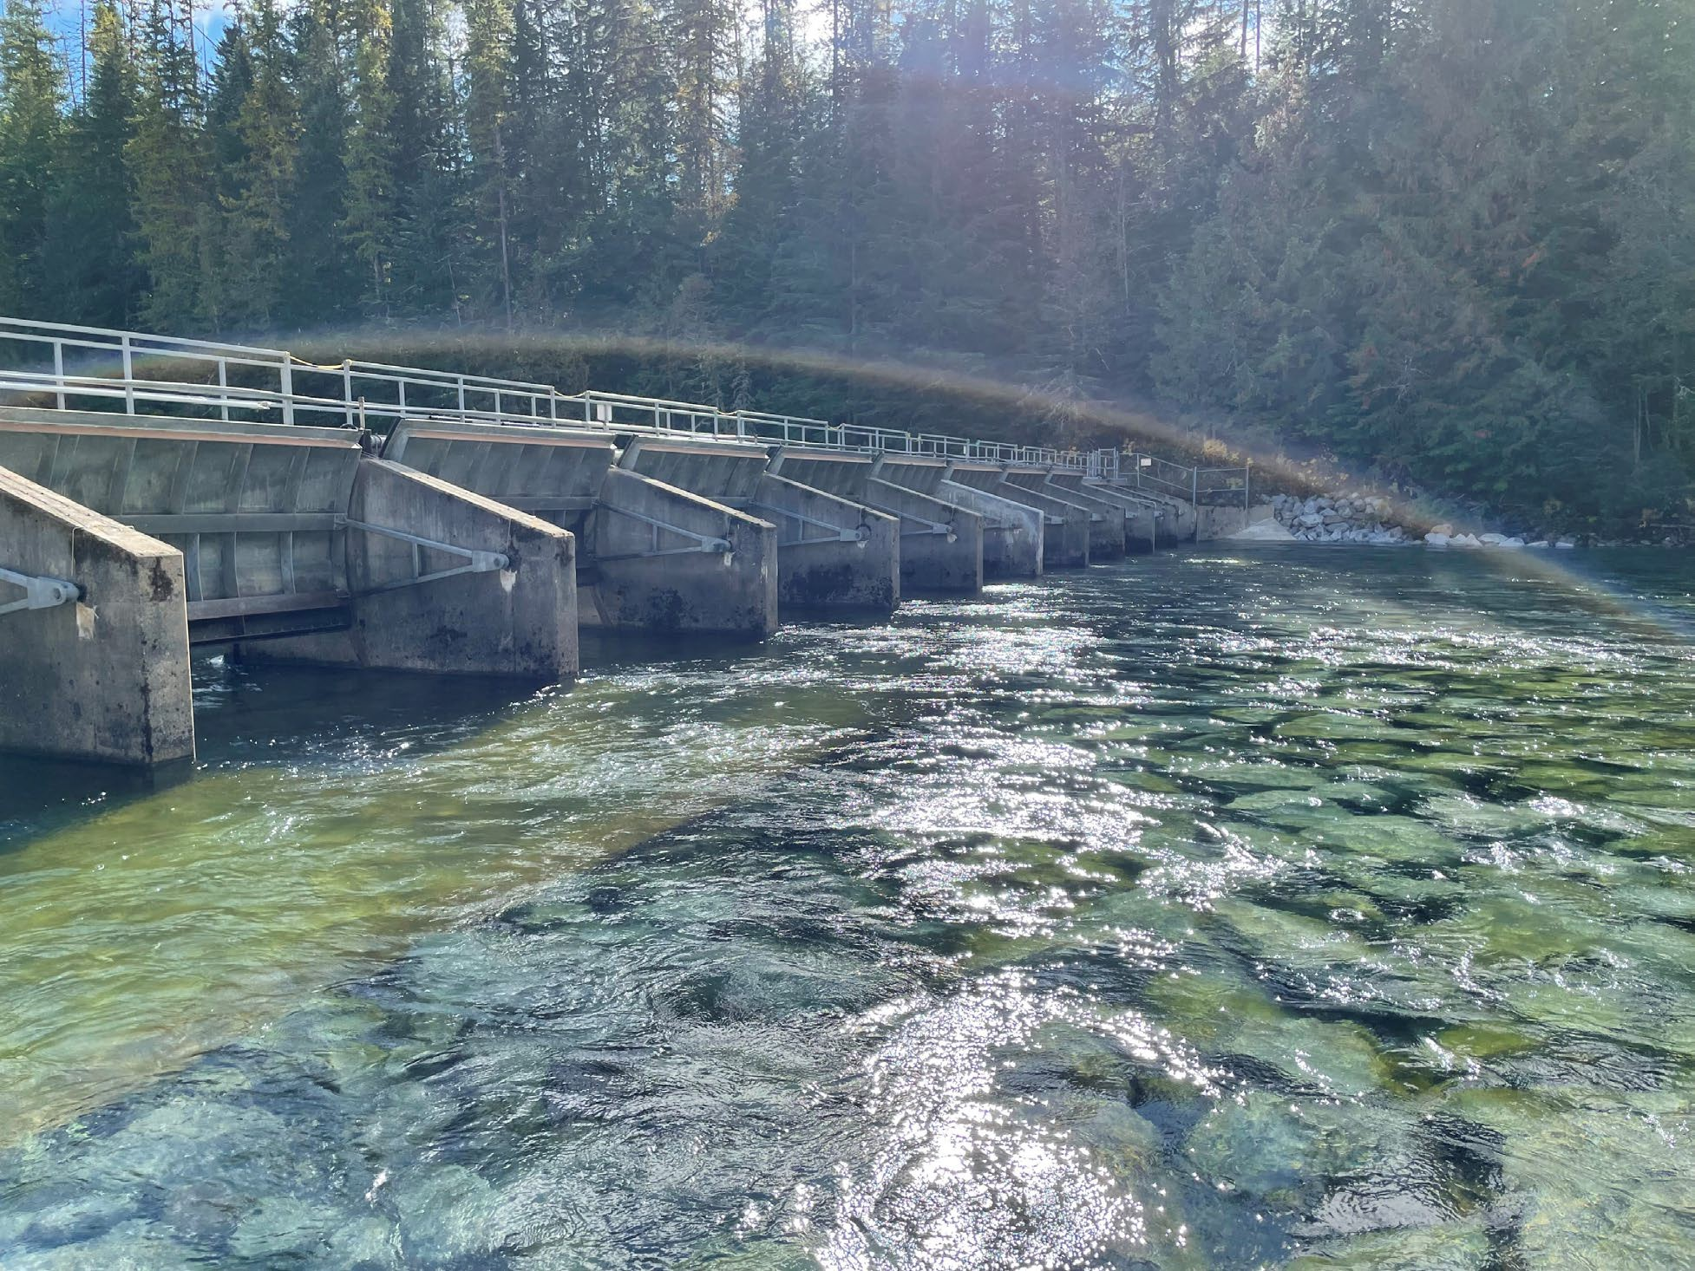

Priest Lake Dam 2025 Operations Overview
Michelle Richman Bill Cresse October 30, 2025

Slide 2


Purpose – To Discuss:
Recreation Season 2025 Dam Operations
Fall Drawdown 2025 Stakeholder Feedback Monitoring Efforts Next Steps

Slide 3
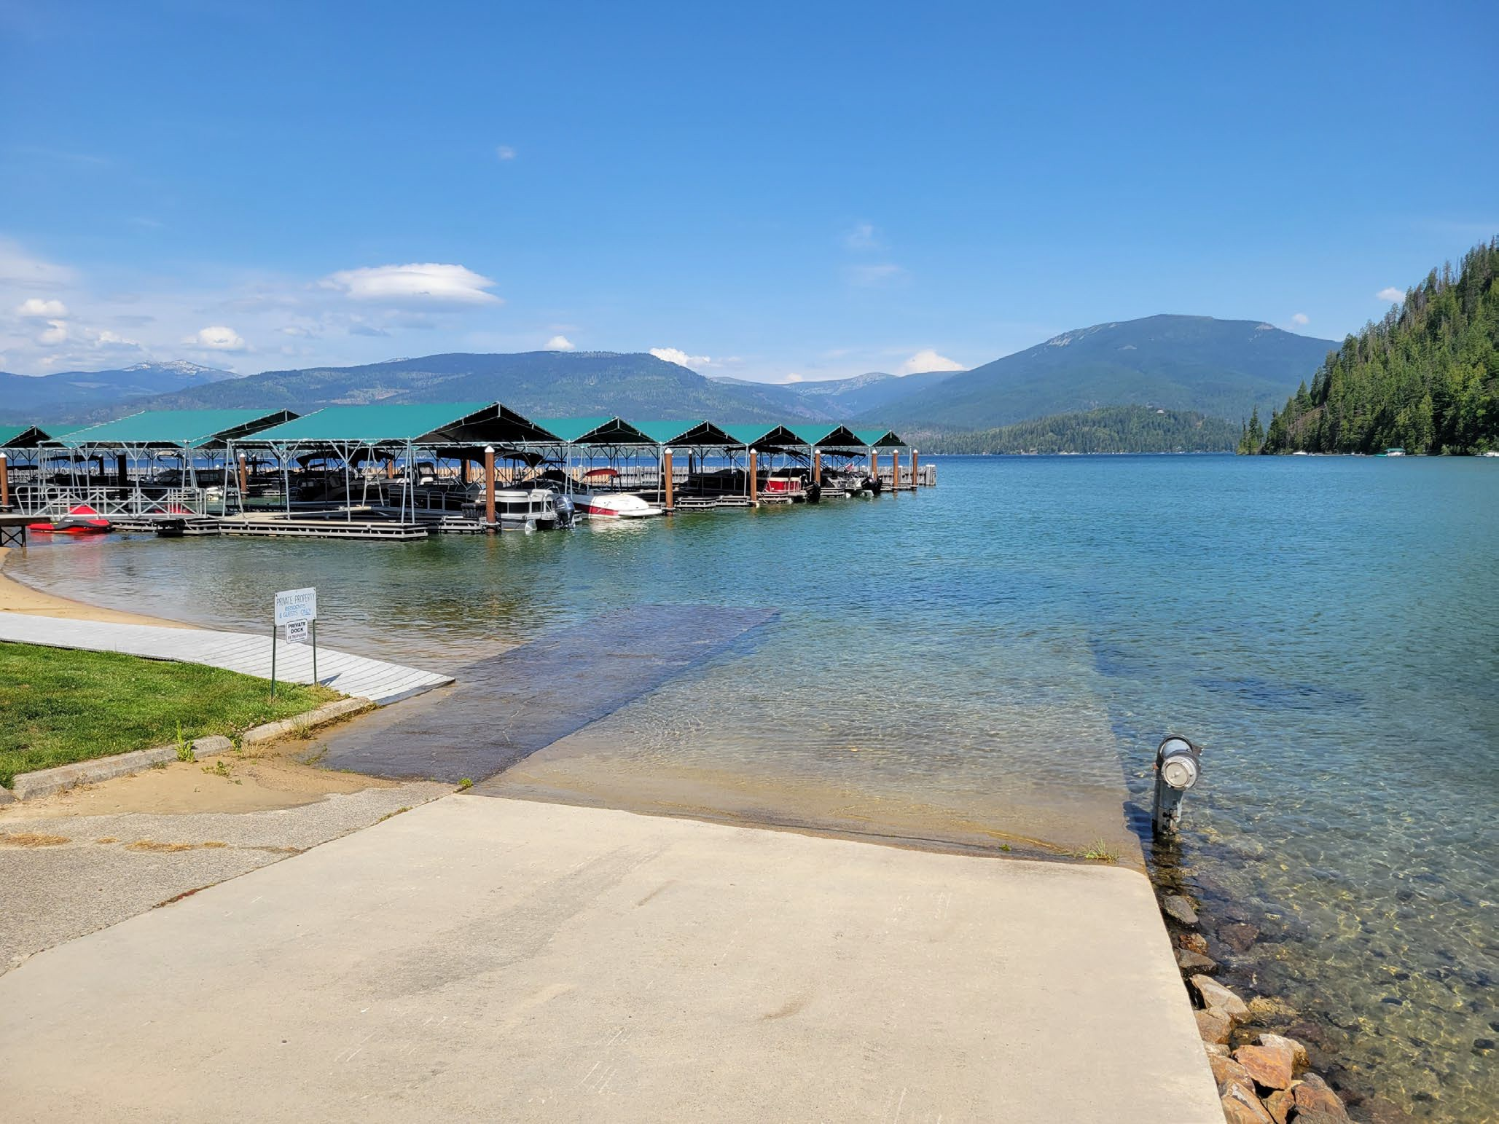
Lake Operations – Recreation Season - 2025
Idaho Code §70-507
Dry year
Maintain pool 3.0’-3.5’
Bring lake up to 3.0’ by Memorial Day

Slide 4
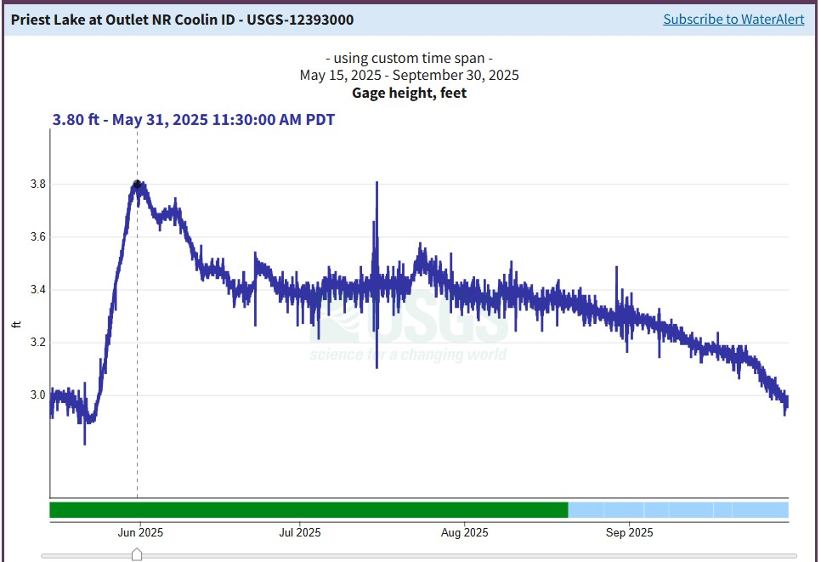
Lake Level – Recreation Season - 2025
Peak: 3.8’ May 31st
Stabilized, 3.5’ by June ₁₅th
3.35’ on August 4th
3.0’ October 1st

Slide 5
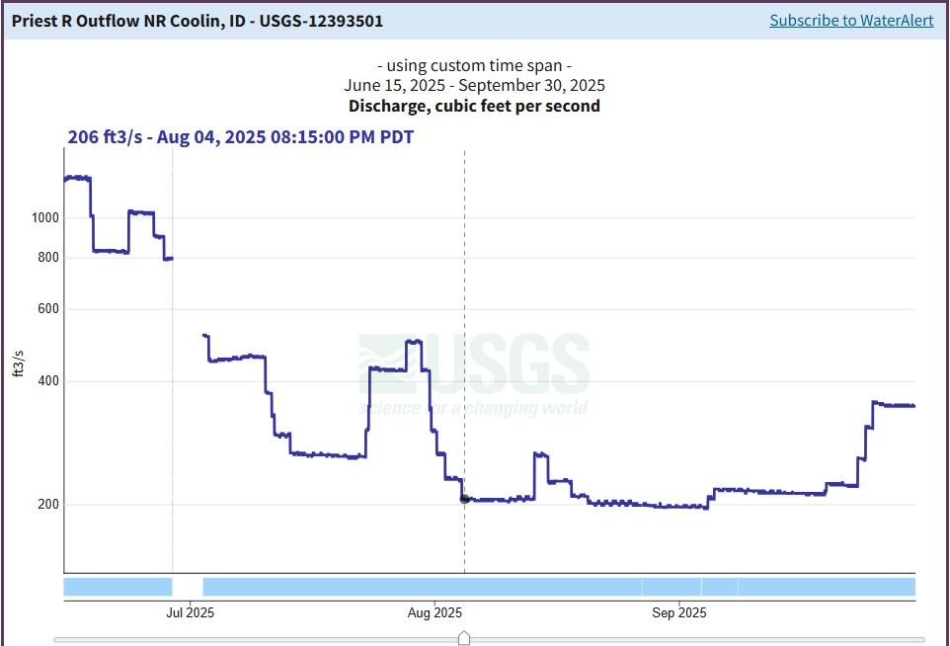
Priest River – Recreation Season 2025
Peak: 3,820 CFS May 30th
300 CFS July 31st
200 CFS Minimum flow
Rain events
200 cfs minimum

Slide 6
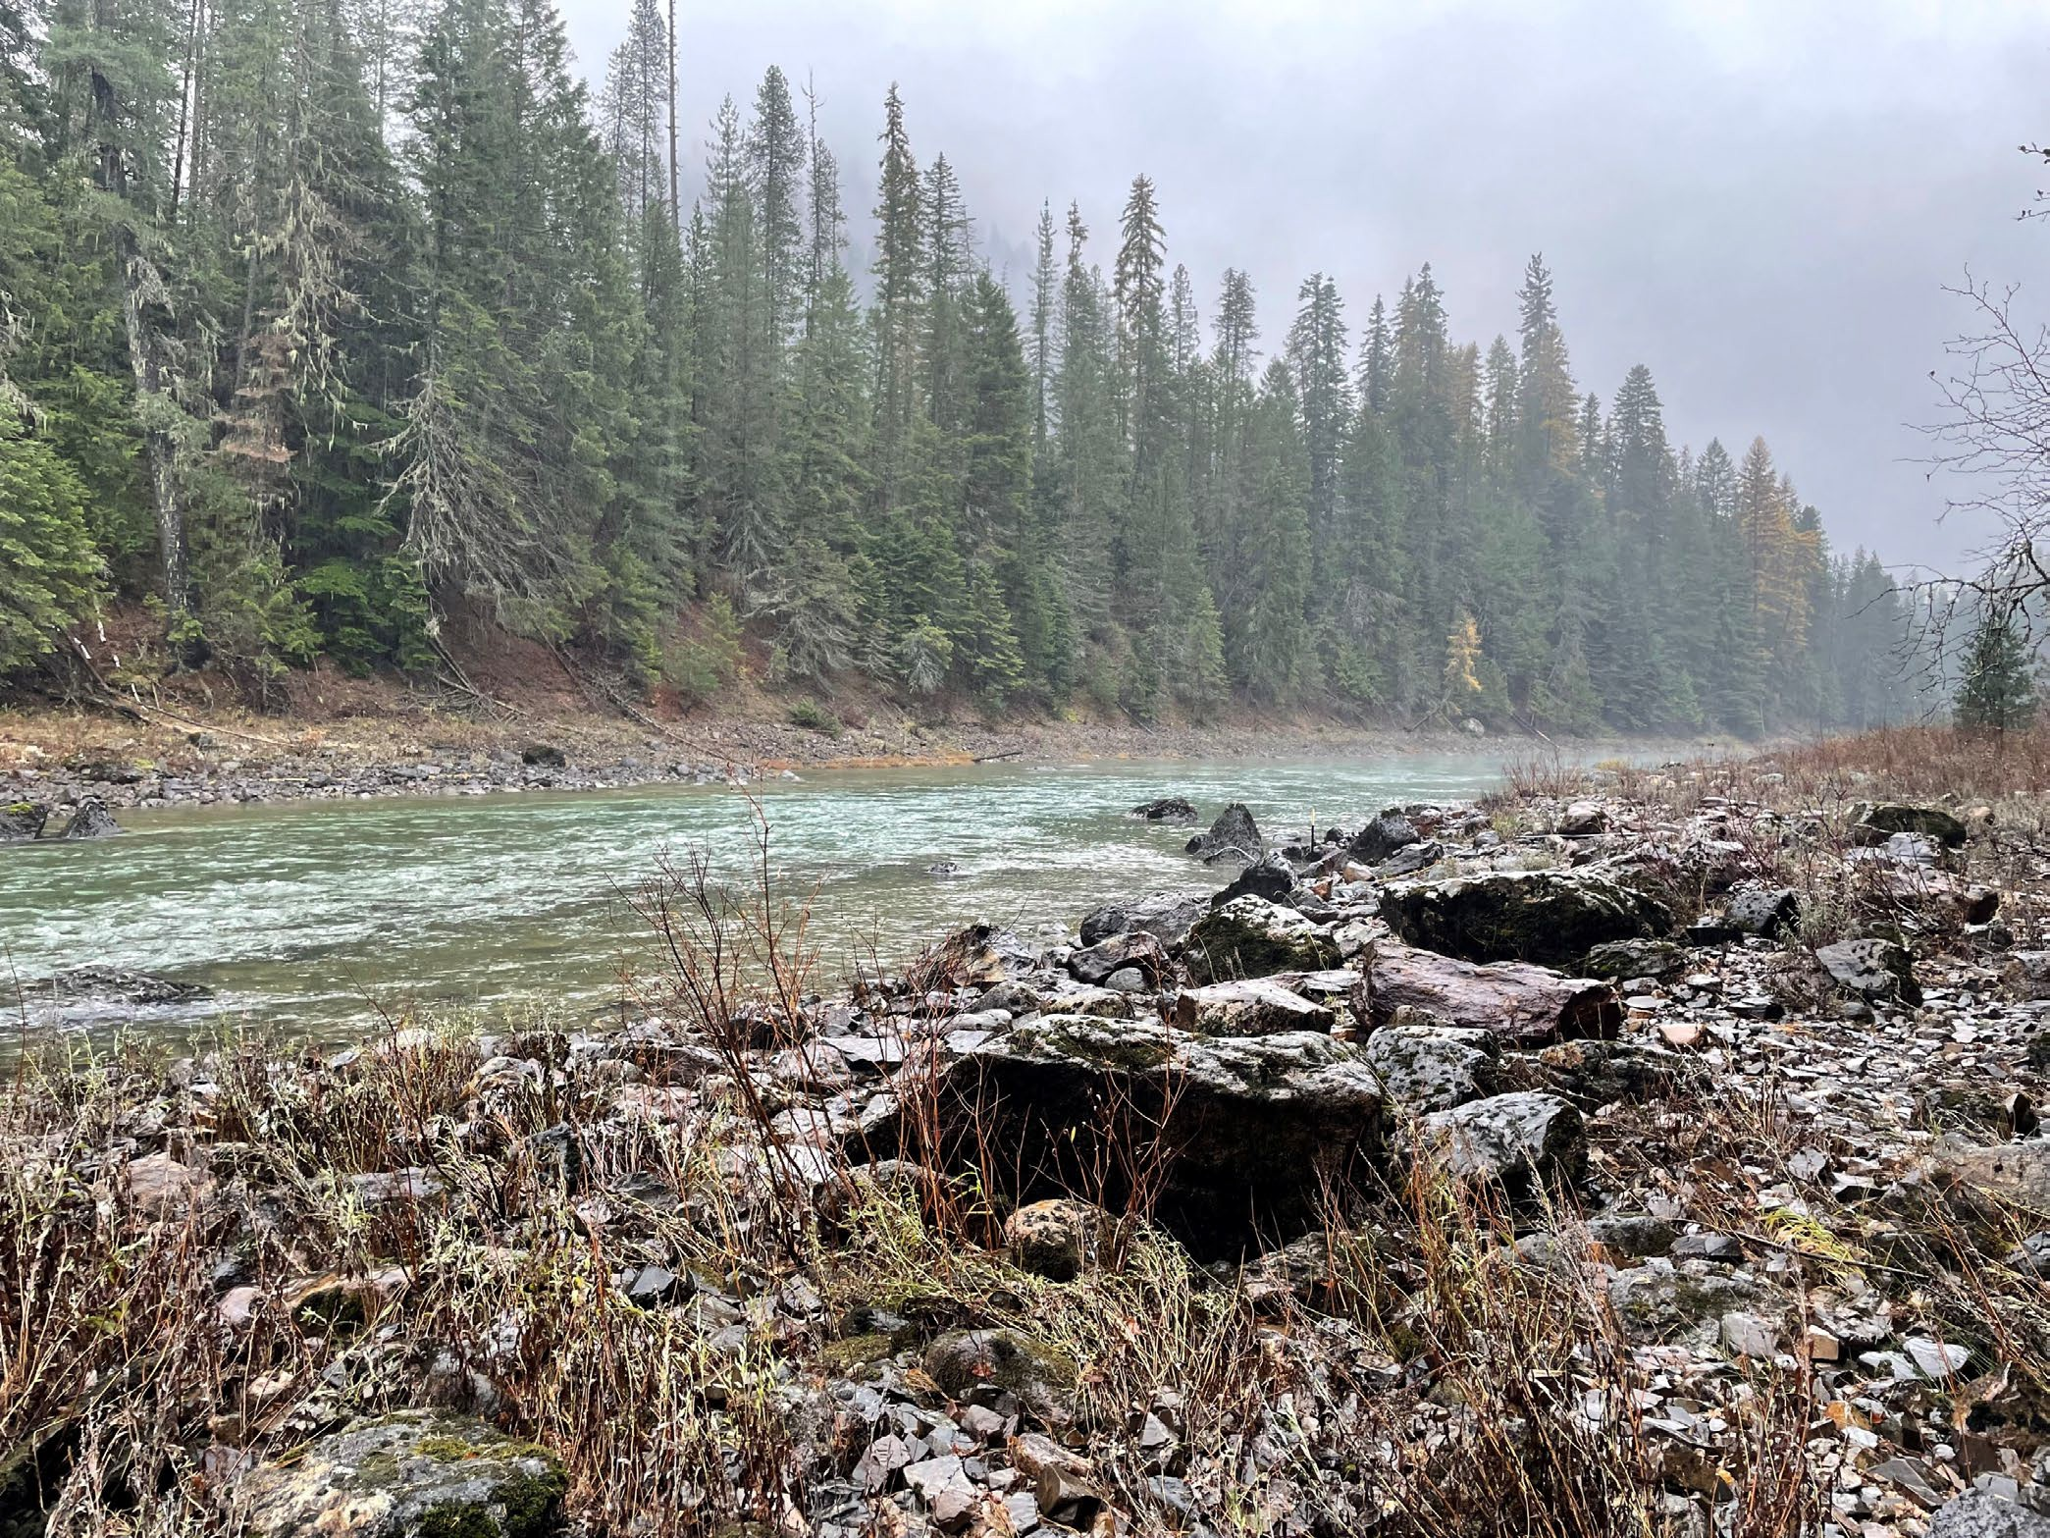
Evaluation – Recreation Season 2025
Functioned as planned
Sustained 200 cfs or more in Priest River through Sept. 30th
Higher lake level early in the recreation season – 3.4’
Rain helped

Slide 7
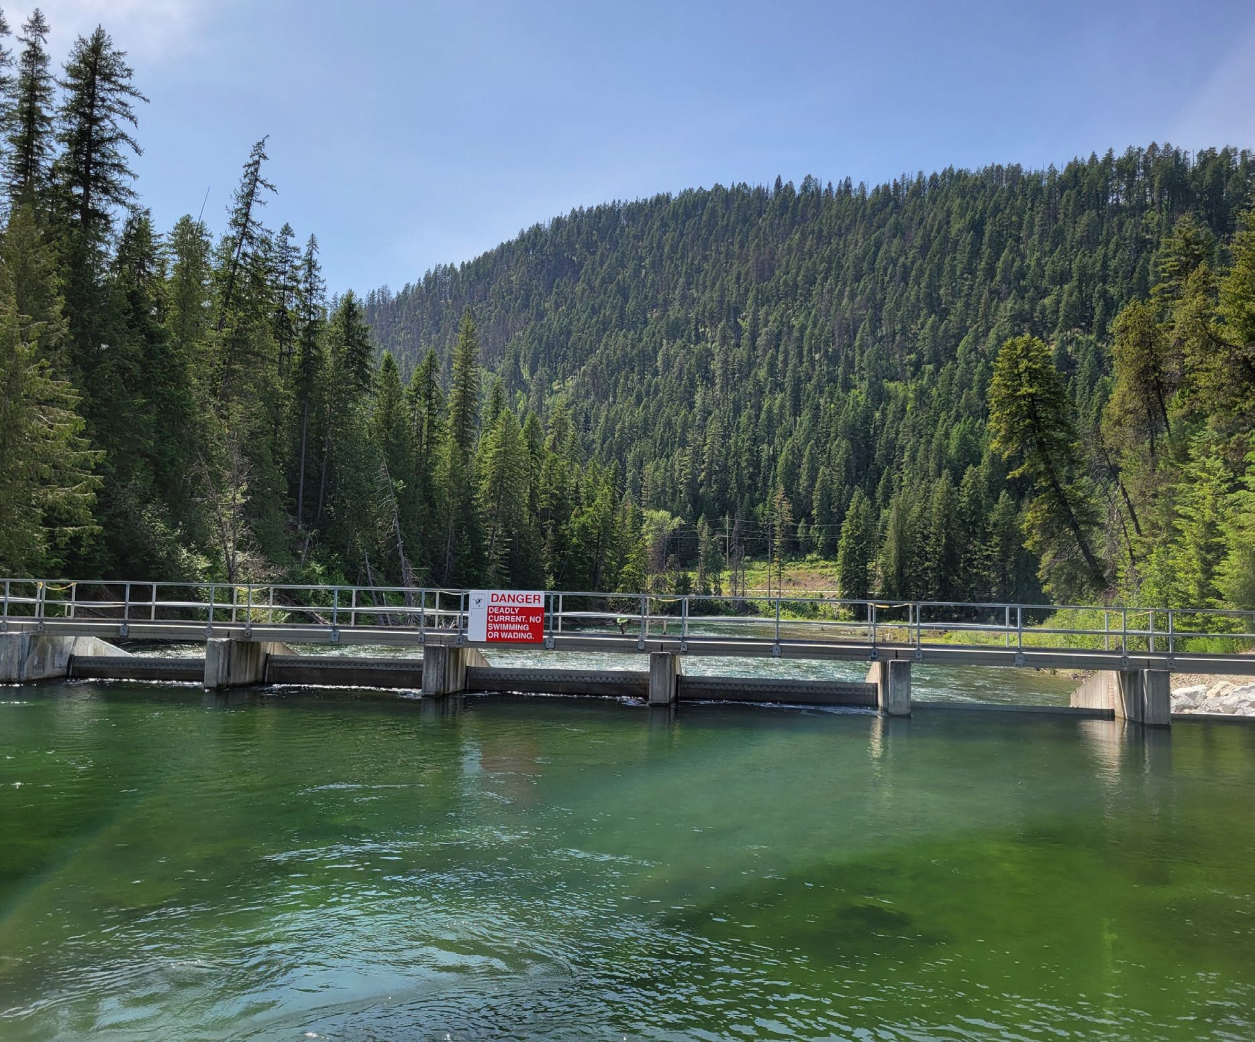
Lake Operations – Fall Drawdown
Starting at 3.0’ by 10/1
Fall Drawdown 10/1 to 10/31
0.1’ minimum per §70-507
Complete by Nov. 1 for Kokanee

Slide 8
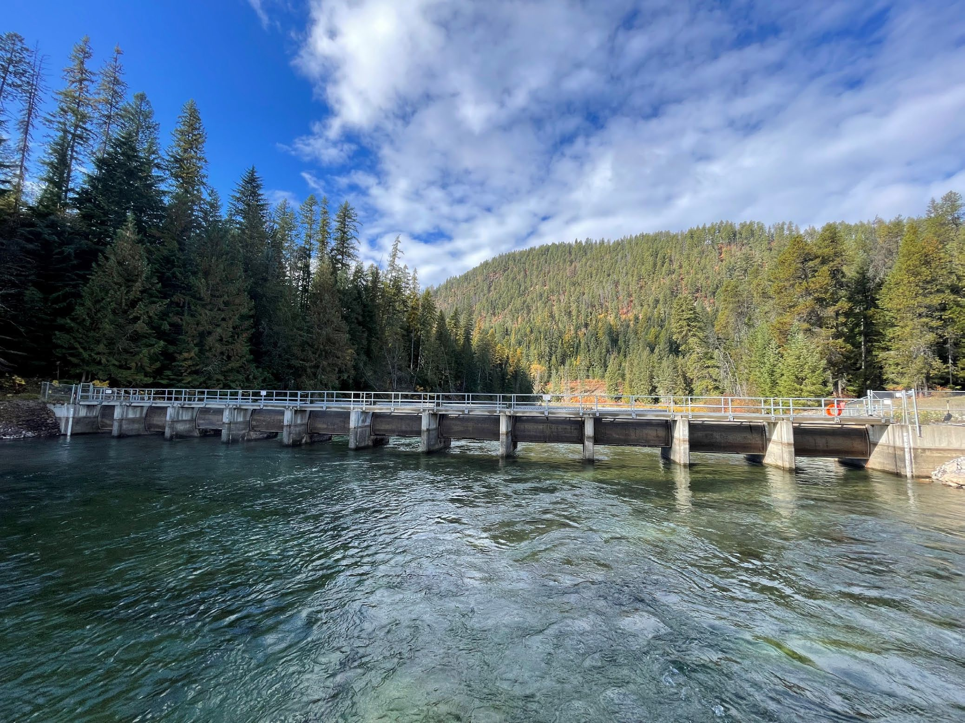
Fall Drawdown – Historic Practices
Open the gates and drain the lake
*1,000 CFS in Priest River Basin Plan

Slide 9
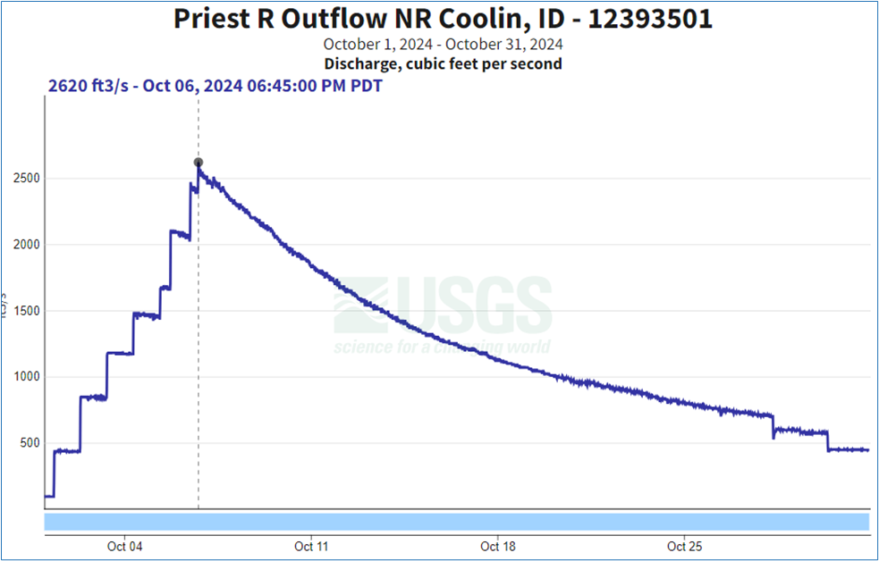
Historic Practice - Fall Drawdown - 2024
Increase the flow incrementally
Peak flow 2600 cfs+

Slide 10
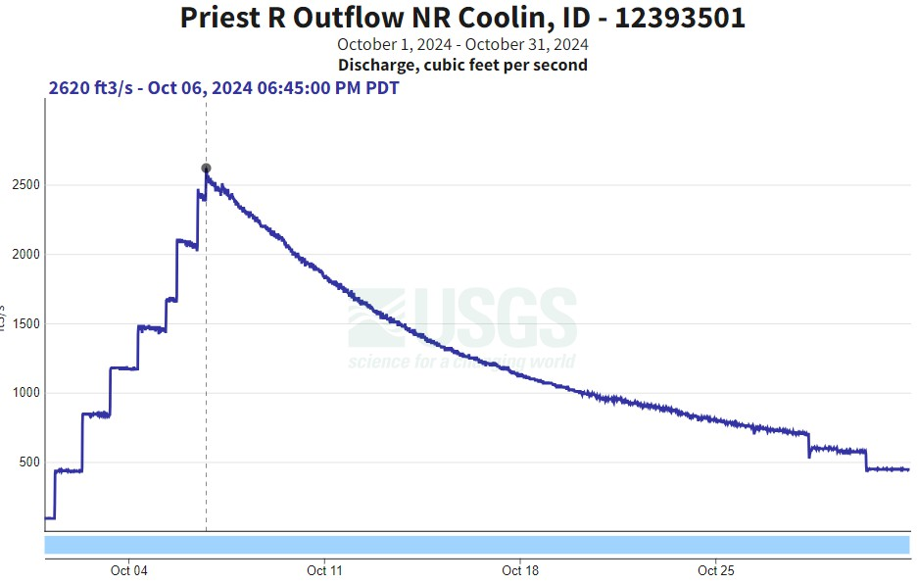
Fall Release Best Practices
Capped flow
Original announcement: cap the flow at 1000 cfs, 1.0’ minimum lake level
Priest River Basin Plan
Capped Flow

Slide 11
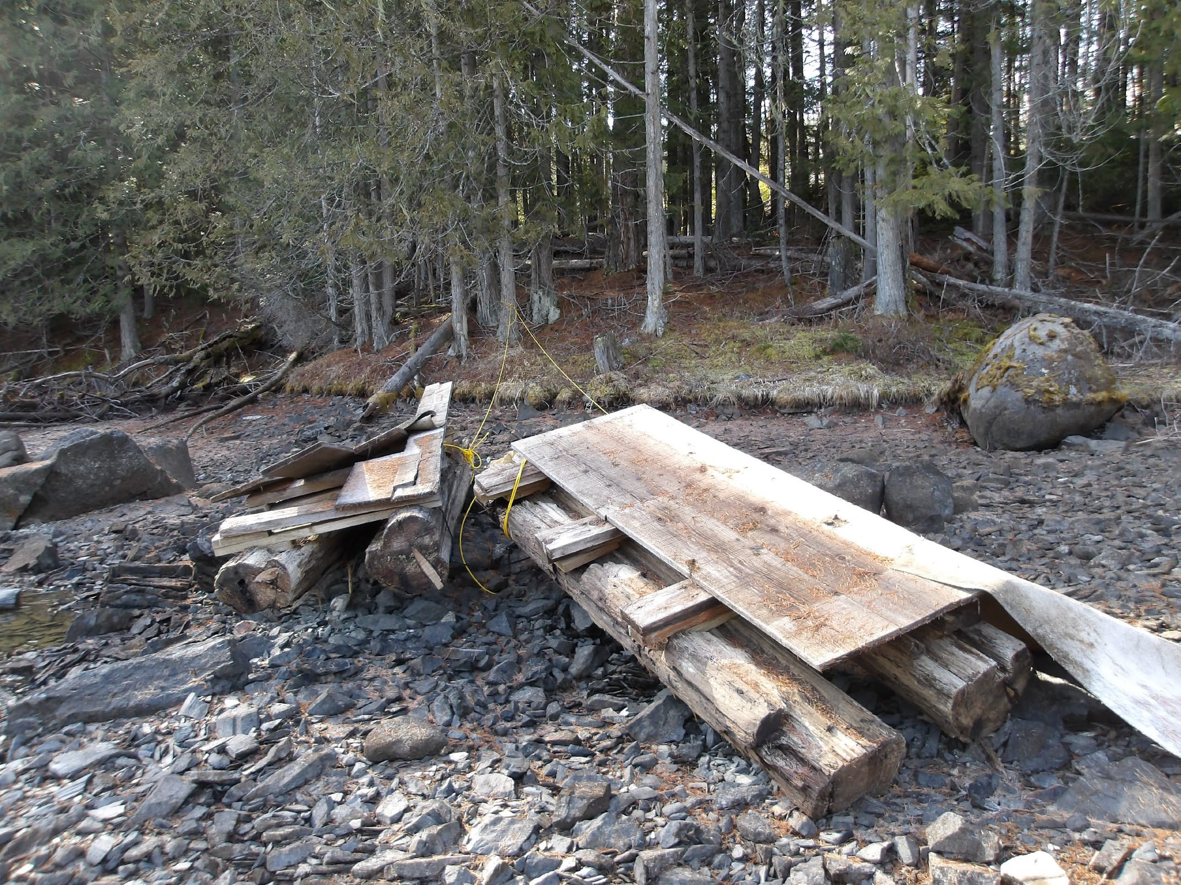
Fall Drawdown – Stakeholder Feedback
Docks and infrastructure
Floating debris
Safety issues

Slide 12
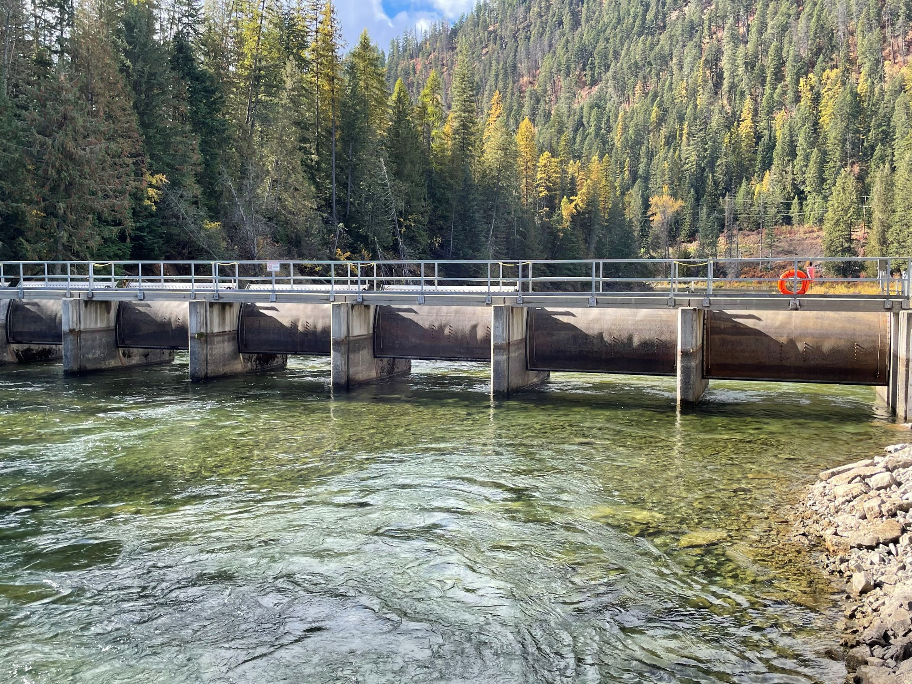
Gate Damage
Visible damage
Revised 2025 target to bring minimum lake below 1.0’
Damage
12

Slide 13
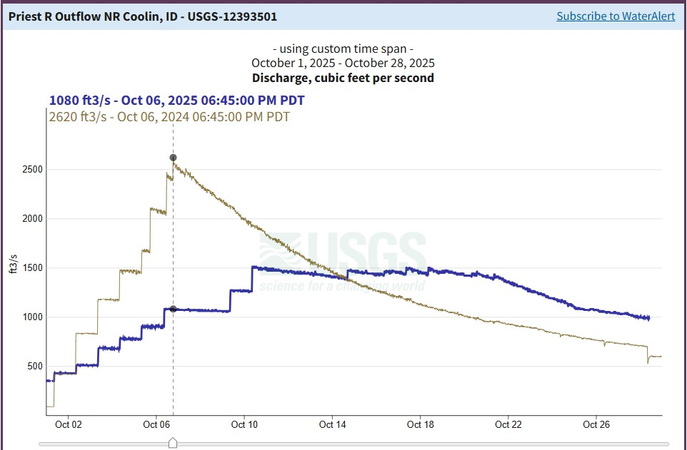
Fall Drawdown – Revised Cap on Flow
2024 and 2025
comparison
1000 cfs maximum
1.0’ lake level
1500 cfs maximum
0.4’ lake level
Revised announcement
in September

Slide 14
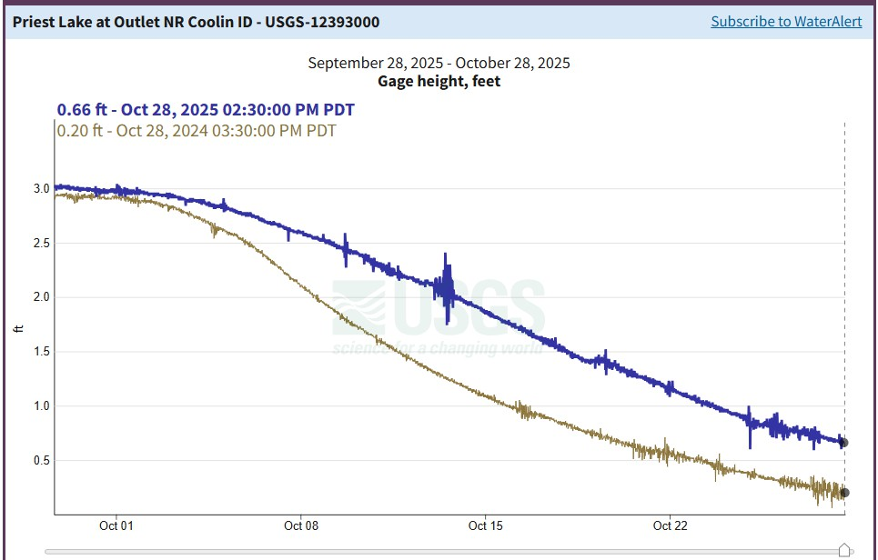
Fall Drawdown – Lake Level Comparison
2024 and 2025 comparison
Lake level 2.59’ on Oct 8
Extends recreation on the lake
More gradual change in lake level
Target 0.4’ by November 1st

Slide 15
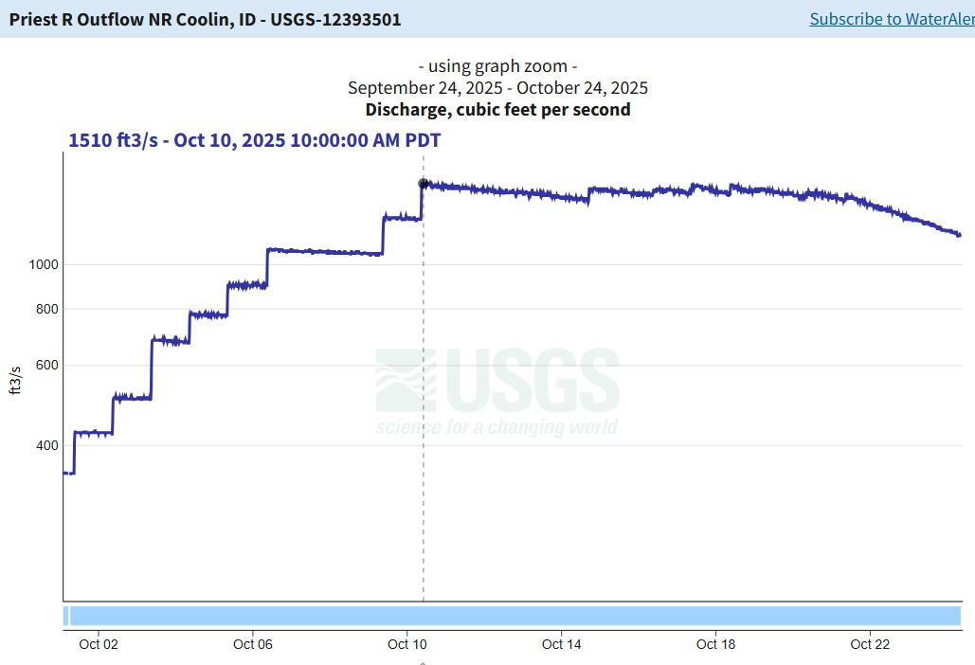
Benefits Current Drawdown Method Relative to Historic Practices
Priest Lake Drawdown
1,600
1,400
1,200
1,000
800
600
400
200
0
9/30/2025
10/2/2025
10/4/2025
10/6/2025
10/8/2025
10/10/2025
10/12/2025
10/14/2025
10/16/2025
10/18/2025
10/20/2025
10/22/2025
10/24/2025
10/26/2025
10/28/2025
10/30/2025
Outflow (cfs)
Gradual more predictable lake level reduction
Boats extra week on lake
Almost 2 full weeks high flow river recreation
Dam safety
Reduced flow rate in Priest River
Complete by Nov. 1st
Fish habitat (Kokanee)
15

Slide 16
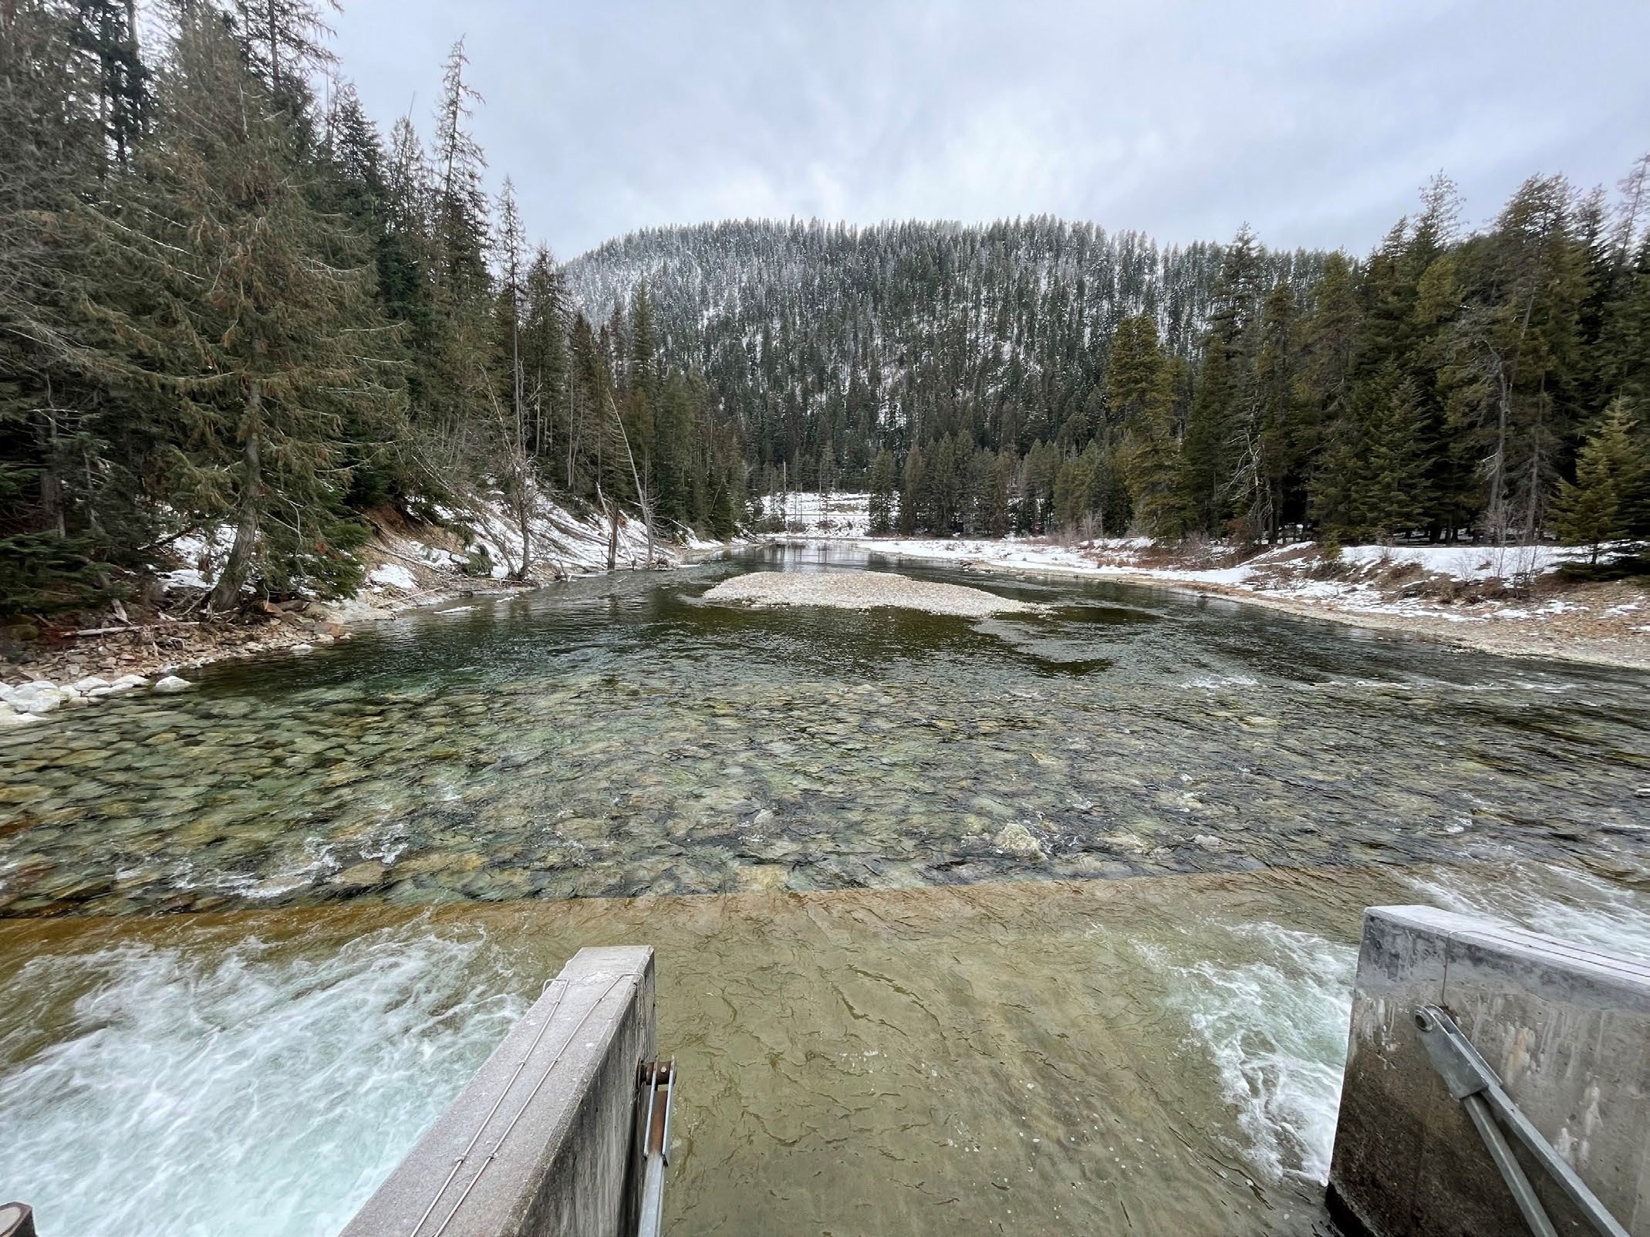
Best Practices
3.0’-3.5’ dry summer
Higher summer river flows
Limit changes to 20% of flow
Cap flow during drawdown
Drawdown done by Nov. 1st
Winter lake level > 0.1’
16

Slide 17
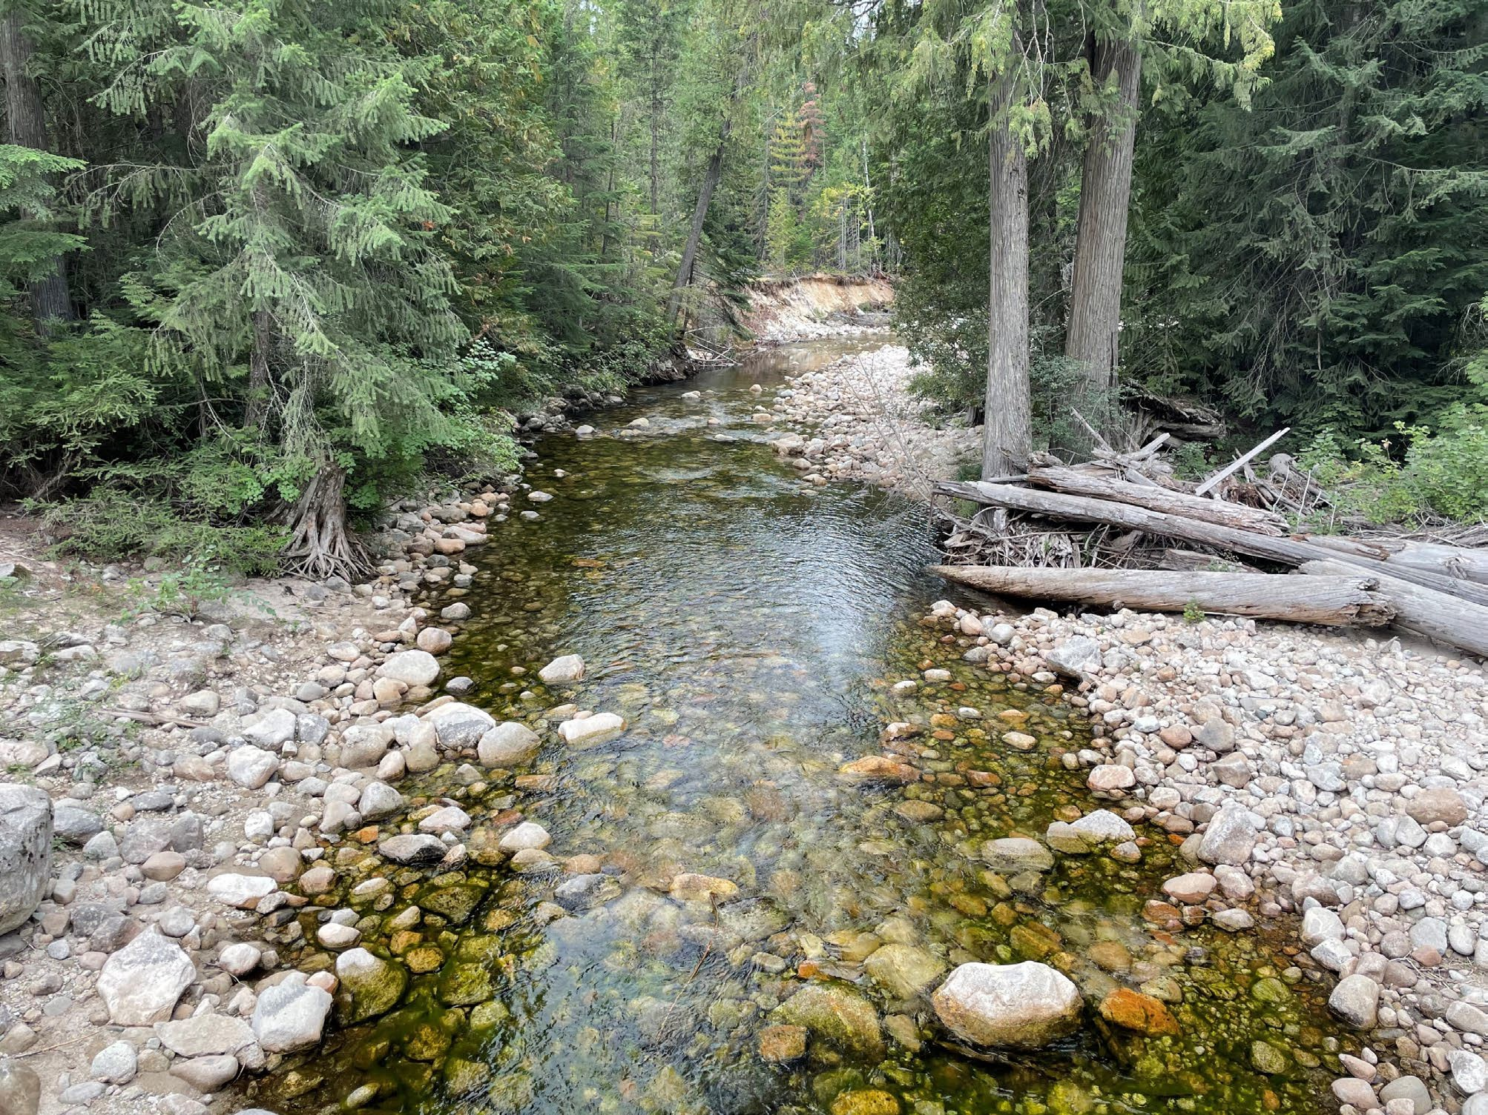
Stakeholder Feedback
IDFG
Copper Bay Construction
Elkins Resort
Kayakers
Inland Northwest Fishing Guys
Lakes Commission
Priest River Watershed Group
Selkirk Conservation Alliance
IDEQ
IDOL
Lion Head Creek
17

Slide 18
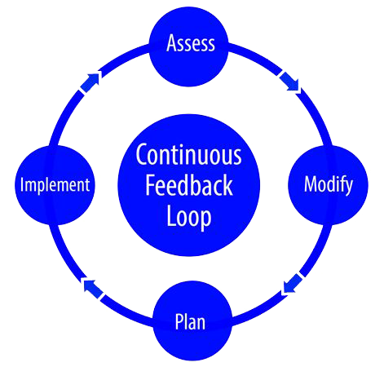
Operations – Feedback Loop
2025 operations are the beginning of an iterative process
Continue to gather feedback
IWRB stakeholder meeting
18

Slide 19
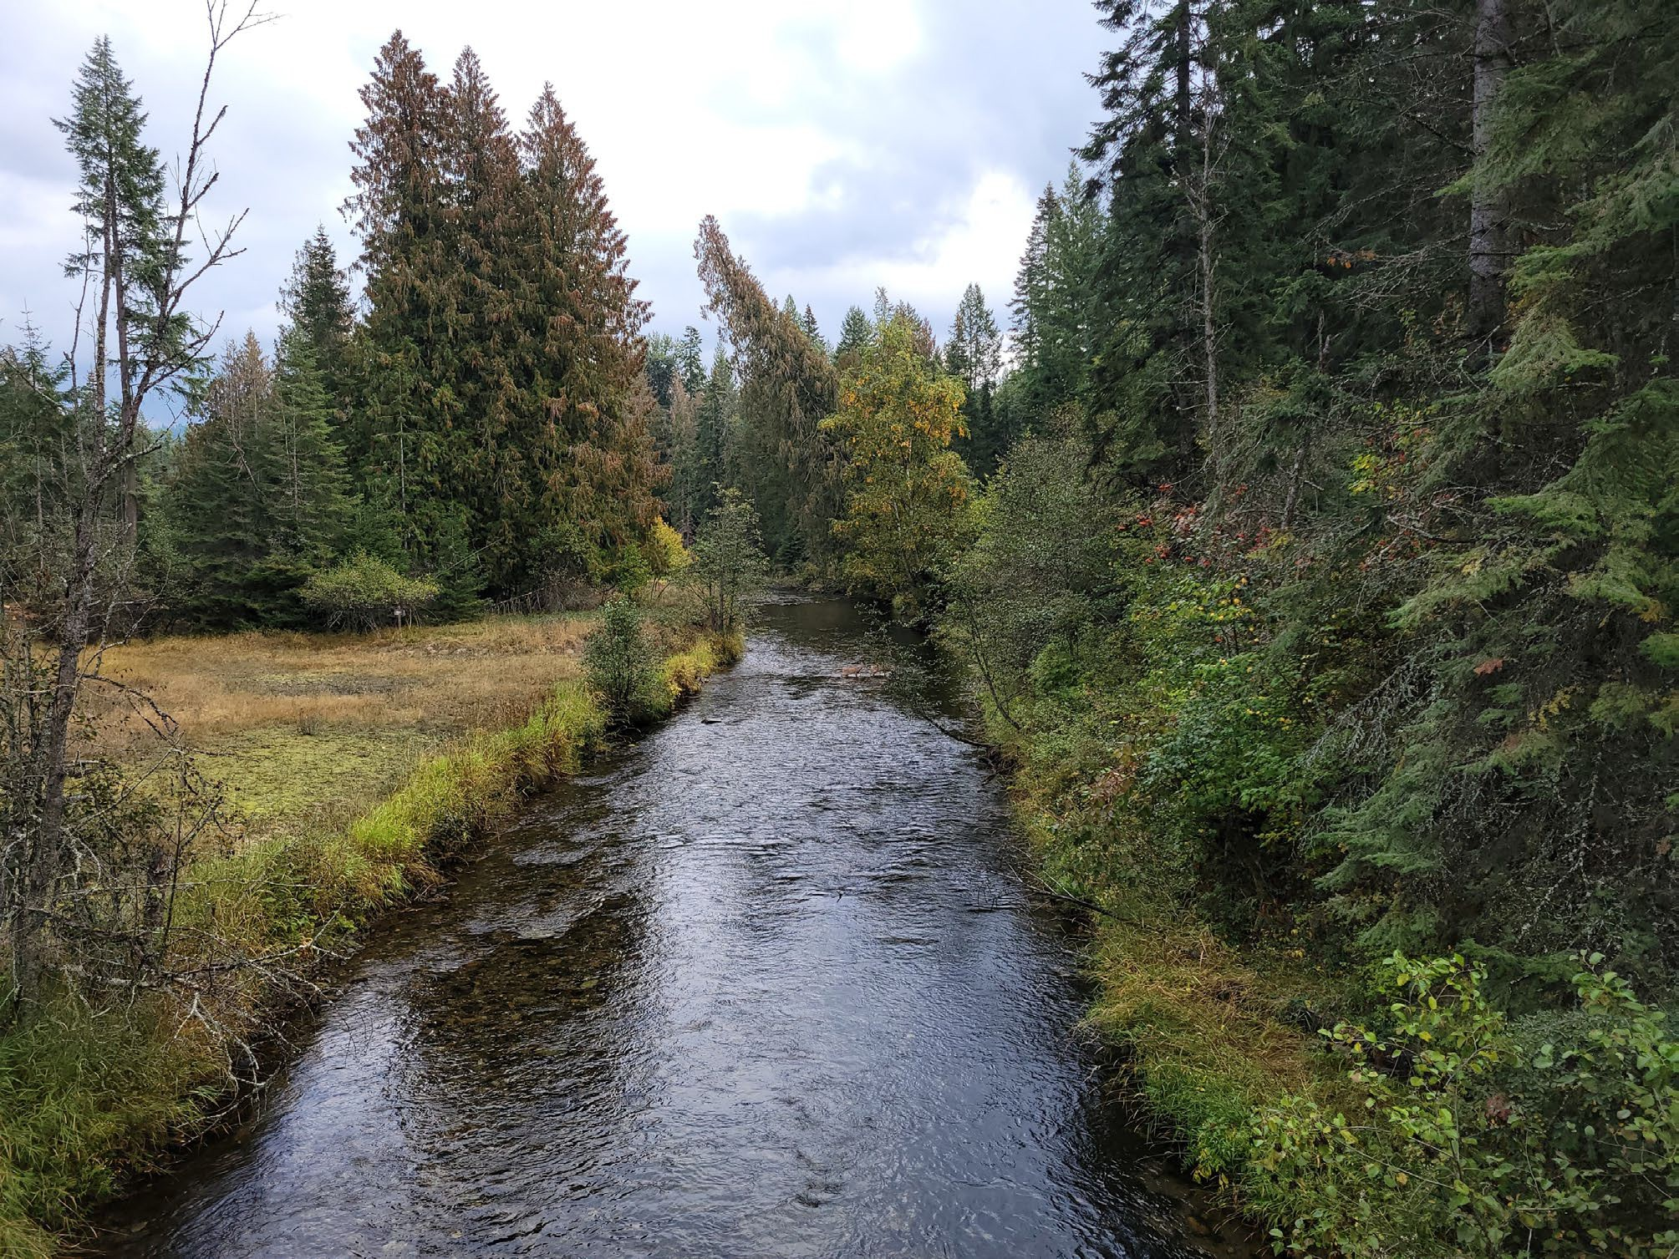
Best Practices - Monitoring
Monitor NOAA for Rain, Heat
Monitor USGS stage & flow
Monitor inflow - tributaries
Granite Creek looking downstream at Reeder Bay Road crossing
19

Slide 20
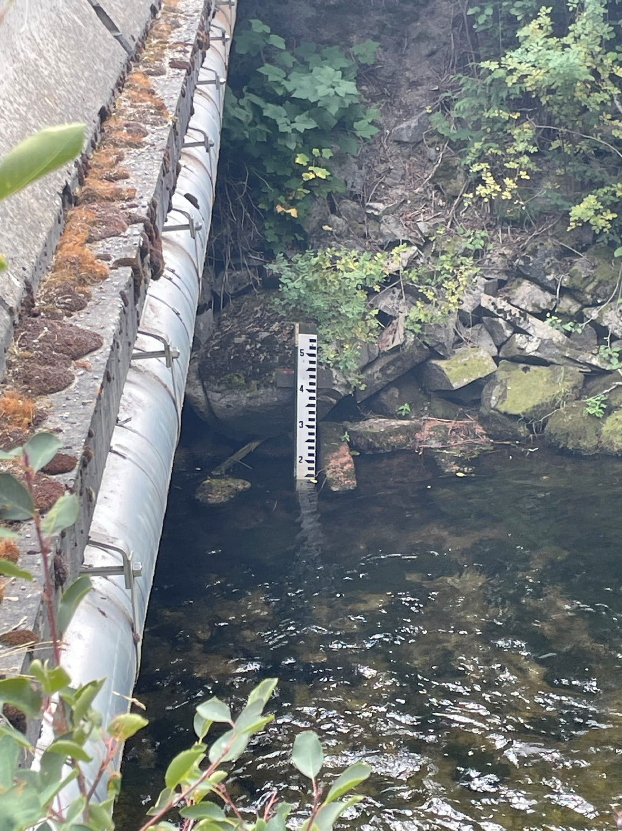
Inflow Monitoring
New monitoring sites
  New staff gage on Granite Creek
  New staff gage on Upper Priest River
  New pressure transducer planned for Hunt Creek
20

Slide 21
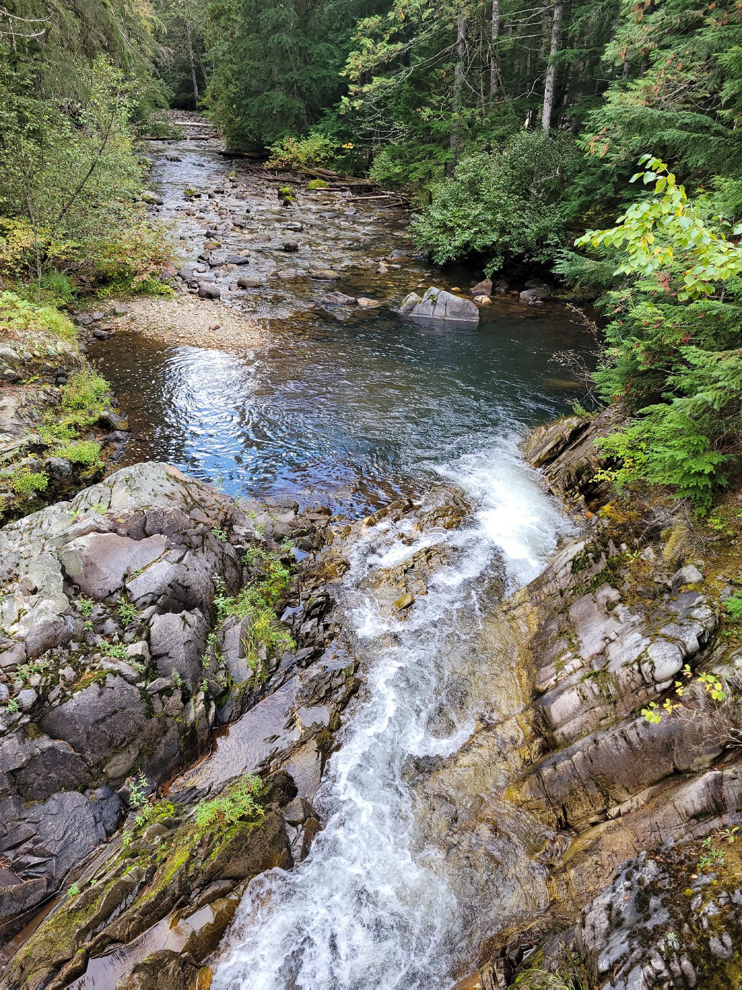
Tributary Inflow Measurements
Difficult to manage gate operations without knowledge of tributary inflows, inflow quantities, and inflow timing
Hughes Fork just South of Gold Creek Road (NF-1013)
21

Slide 22
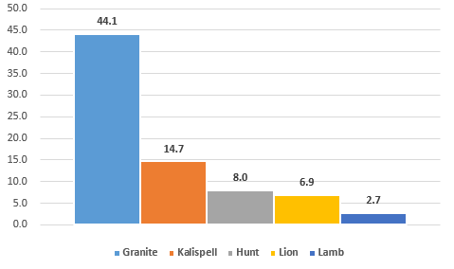
Inflow Measurements (CFS)
Upper Priest River into Upper Priest Lake: 30.7 CFS

Slide 23
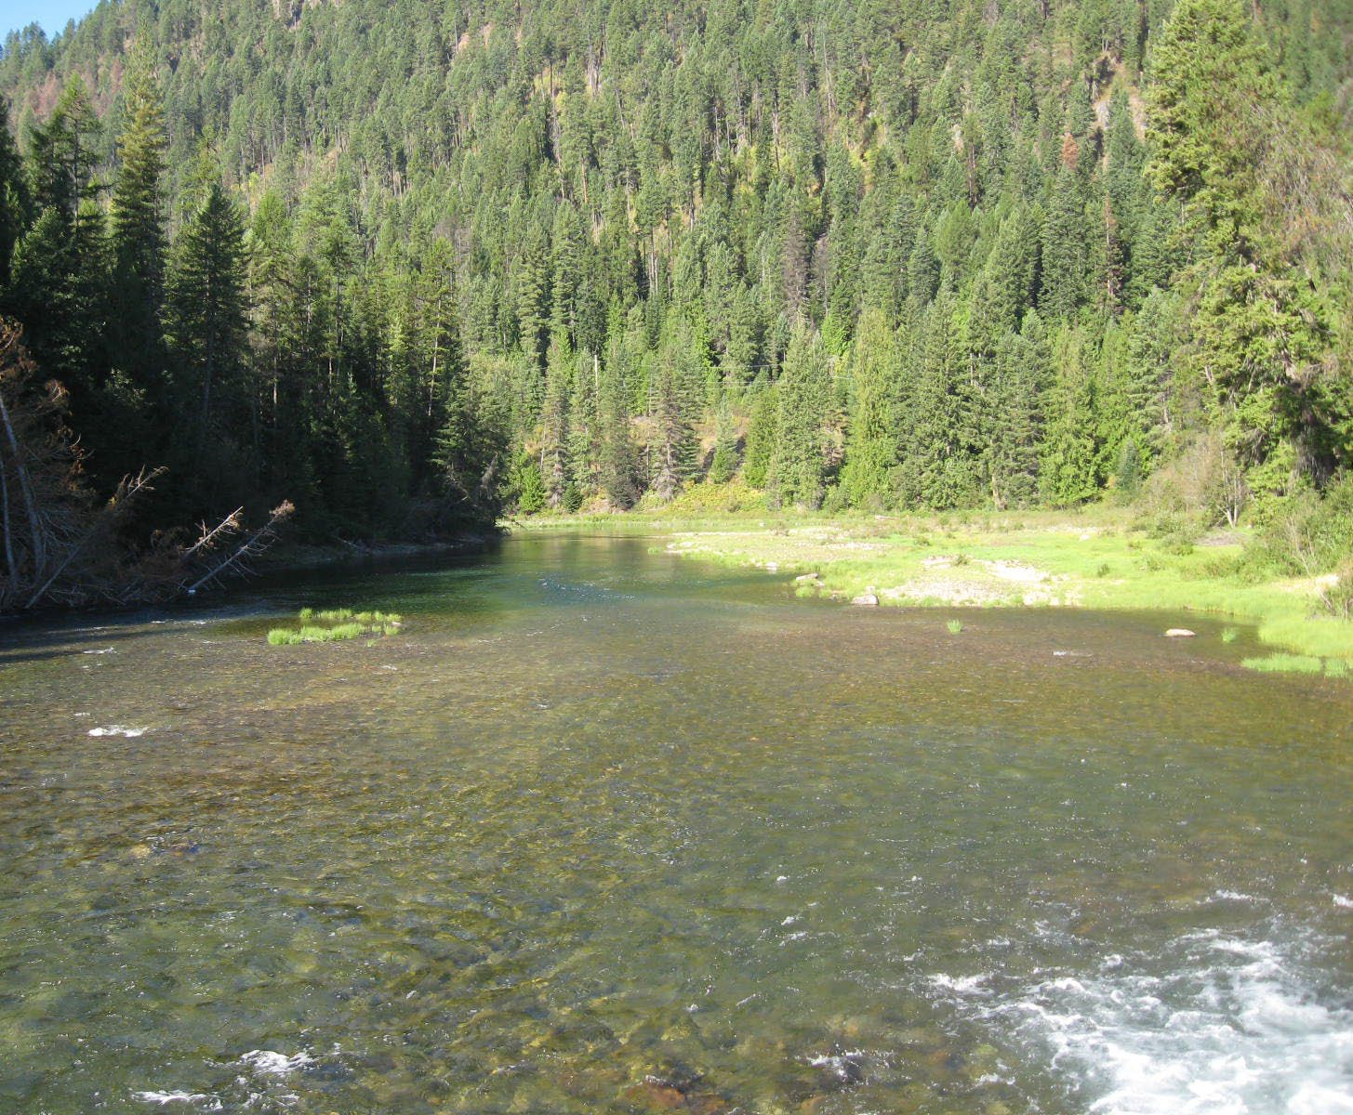
Next Steps
Stakeholder feedback
Lessons learned
  Iterative process
  Applied to future operations
2026 operations
IWRB meeting

Slide 24

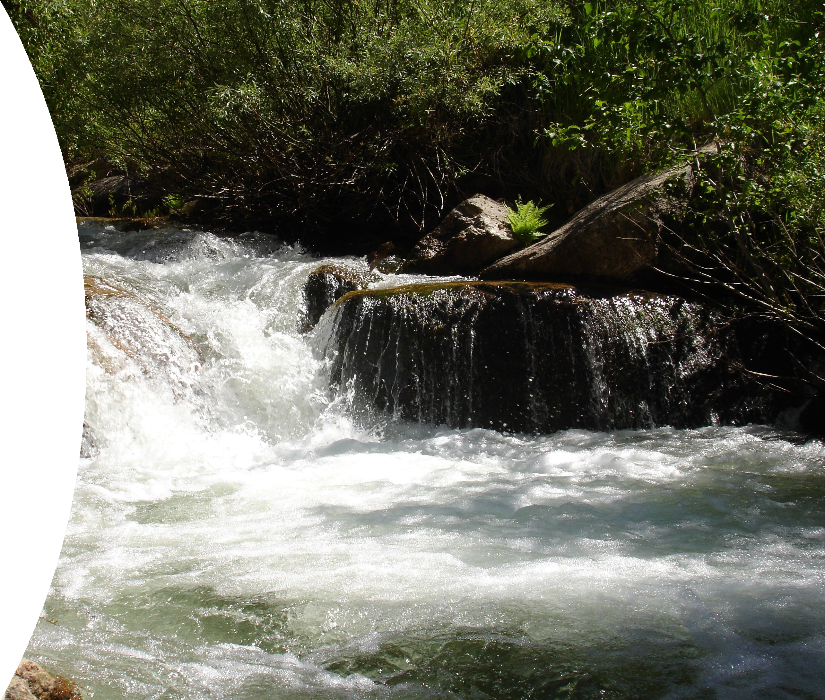

Questions?
Michelle Richman Bill Cresse
northerninfo@idwr.Idaho.gov 208-762-2800

Slide 25
Fall Release Best Practices
2024
2025
Cap at 1,500 CFS
Cap at 1,500 CFS

Slide 26
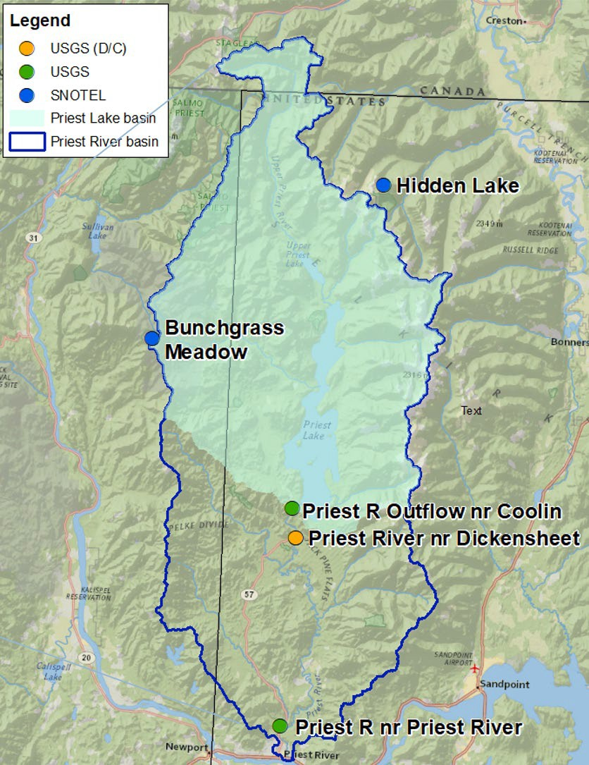
Best Practices - Monitoring
Monitor NOAA for Rain, Heat
Monitor USGS stage & flow
Monitor staff gages
  Granite Creek (43%)

Slide 27
Natural inputs
Rain storm Oct. 18-19
  Net zero (0) outflow
•
Qwerty

Slide 28
Stakeholder Feedback
How do we decide appropriate actions?
  Example: IDFG 1,000 CFS max during drawdown (Kokanee)
    Discussed concept of mimicking nature with IDFG
      Gradual more predictable lake level reduction, that better mirrors natural drawdown, without sharp peaks in discharge from dam
    Need 1,500 CFS to get lake level down by 10/31
    Higher lake level associated with 1,000 CFS can create dam safety issue

