Slide 1
Economic Assessment of Lake Pend Oreille Water Management
Sponsored by
the Lakes Commission
and the
University of Idaho
Presentation to the Lakes Commission
October 30, 2025

Slide 2


Principal Investigators
Steven Peterson, Co-PI
B.S., Business Administration (Lewis Clark State College)
M.S., Economics (University of Idaho)
stevenp@uidaho.edu
Mr. Peterson is a regional economist and Associate Clinical Faculty member at the University of Idaho. He has worked extensively throughout Idaho and has conducted impact assessments on nearly every industry in Idaho including studies on energy, education, health care, tribal studies, manufacturing, agriculture, recreation, tourism, occupational analyses, and state budgeting analyses.
Timothy Nadreau, Co-PI
B.S., Pure Mathematics (University of Idaho)
M.S., Applied Agricultural Economics (University of Idaho)
Ph.D., Economics (Washington State University)
timothyn@uidaho.edu
Dr. Nadreau is a regional economist with 20-years of experience doing impact and investment analysis for higher education throughout the U.S., U.K., Canada, and Australia. He worked as a senior economist at Emsi (Lightcast) for nearly nine years where he conducted education impact analysis in every state. He is now an Assistant Professor at UofI.

Slide 3
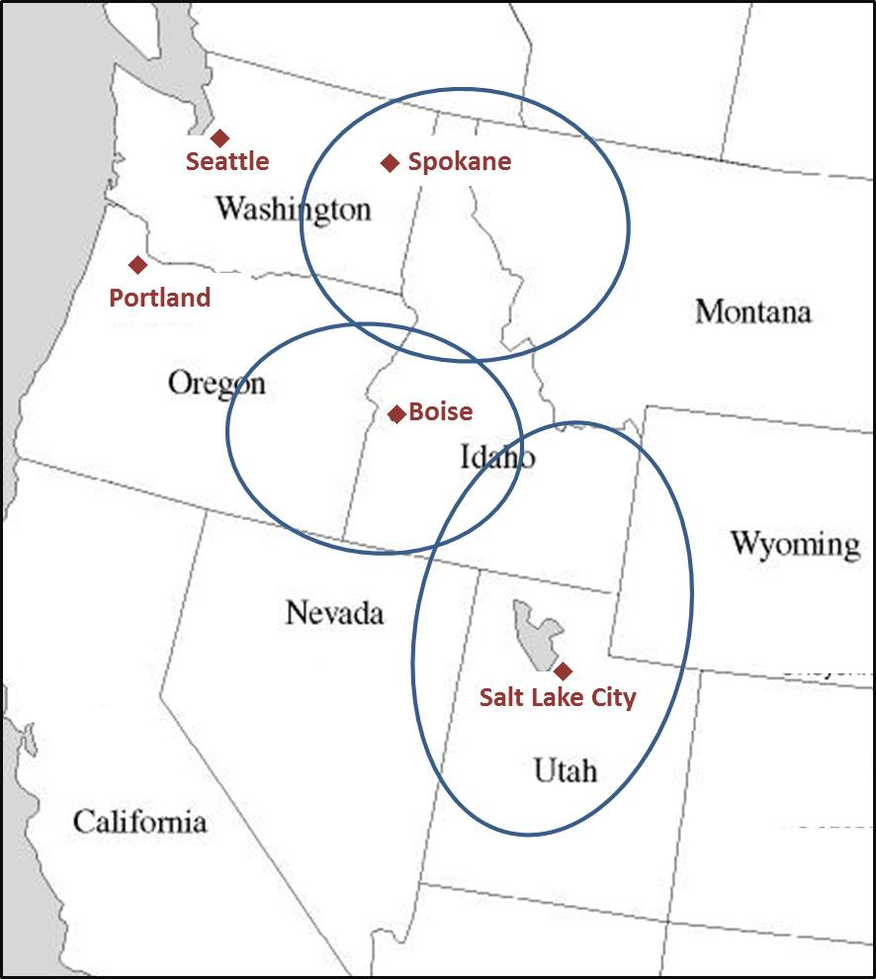
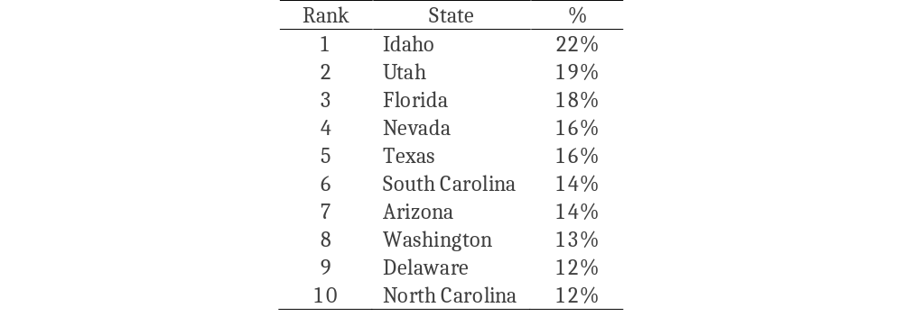
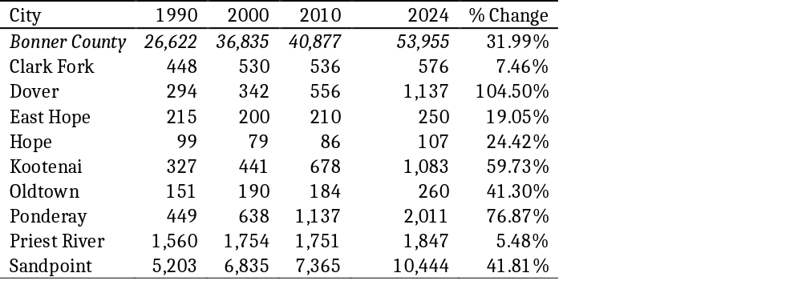
Economy of Bonner County
Idaho: A Fast-Growing State
Bonner County: A Fast-Growing County
Cumulative Population Growth 2014-2024
Cumulative Population Growth 2010-2024

Slide 4
North Idaho 2024 Employment
Industry | Bonner | Kootenai | Spokane | Total
Crop and Animal Production | 335 | 601 | 1,822 | 2,758
Mining | 199 | 190 | 358 | 746
Utilities | 136 | 374 | 388 | 898
Construction | 2,015 | 8,936 | 17,504 | 28,456
Manufacturing | 2,108 | 5,570 | 16,930 | 24,608
Wholesale Trade | 276 | 2,243 | 11,234 | 13,753
Retail Trade | 2,588 | 10,087 | 27,656 | 40,330
Transportation and Warehousing | 487 | 1,624 | 11,976 | 14,087
Information | 334 | 823 | 3,010 | 4,167
Finance and Insurance | 429 | 2,355 | 10,452 | 13,236
Real Estate and Rental and Leasing | 486 | 1,701 | 5,397 | 7,584
Professional, Scientific Services | 1,007 | 4,276 | 14,366 | 19,650
Management | 132 | 289 | 2,950 | 3,370
Waste Management | 599 | 3,699 | 14,915 | 19,213
Educational Services | 241 | 1,144 | 7,933 | 9,318
Health Care and Social Assistance | 1,661 | 13,556 | 50,418 | 65,636
Arts, Entertainment, and Recreation | 580 | 2,848 | 4,561 | 7,989
Accommodation and Food Services | 1,992 | 8,771 | 20,918 | 31,681
Other Services | 1,278 | 3,975 | 13,491 | 18,744
Government | 2,577 | 9,050 | 42,909 | 54,536
Total | 19,460 | 82,116 | 279,188 | 380,764
Source: Lightcast

Slide 5
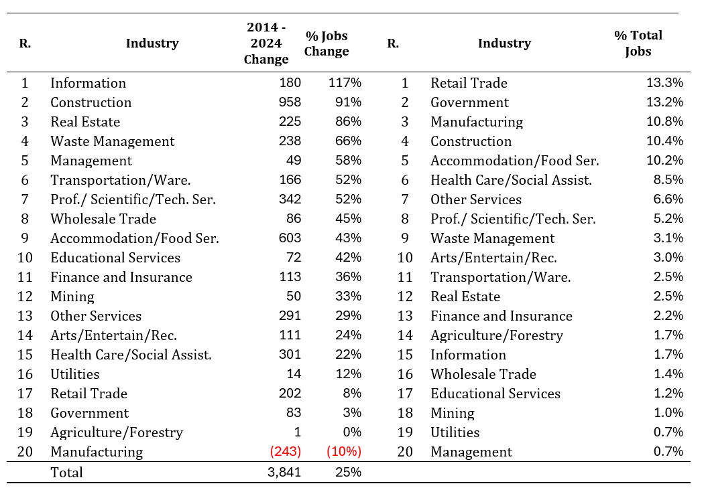
Bonner County Employment Growth and Magnitude by Industry
Source: Lightcast

Slide 6
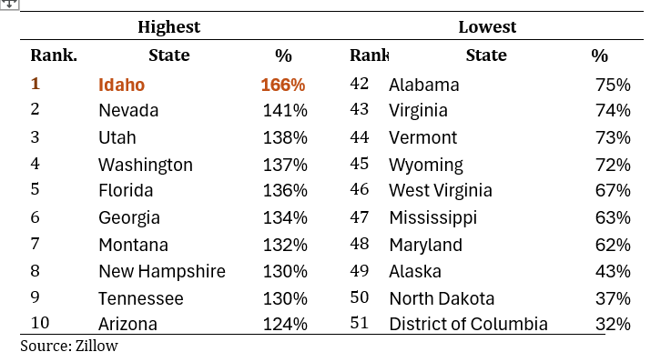
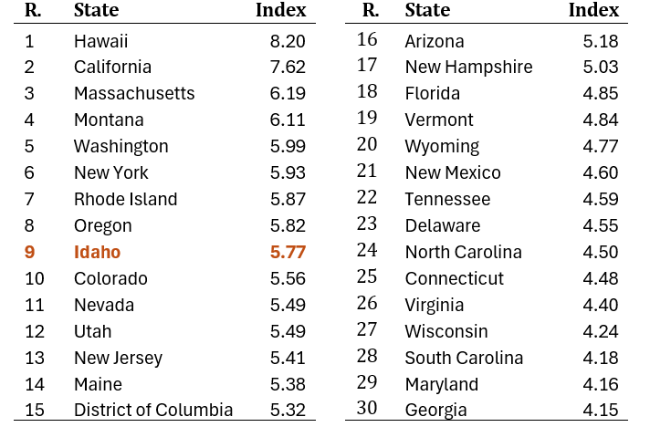
A State and Regional Housing Crisis
Top Ten Highest and Lowest Median House Price Increases (Jan. 2014 to September 2025)
Ninth Least Affordable State in the U.S.

Slide 7
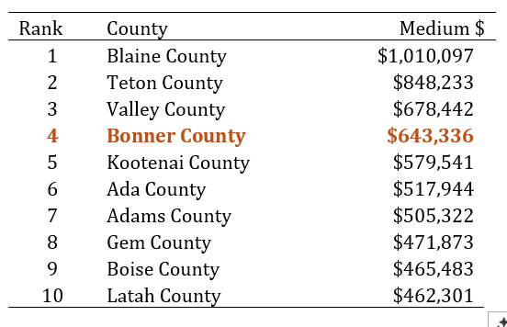
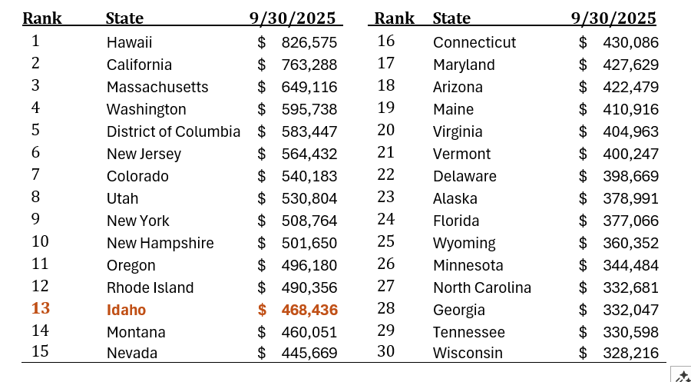
A State and Regional Housing Crisis
Bonner County Ranked Fourth in Median Housing Prices in Idaho in September 2025
Idaho Ranked Thirteenth in Median Housing Prices in September 2025
Bonner County Would Rank Fourth……
Median Housing Prices in Bonner County 2009-2025

Slide 8
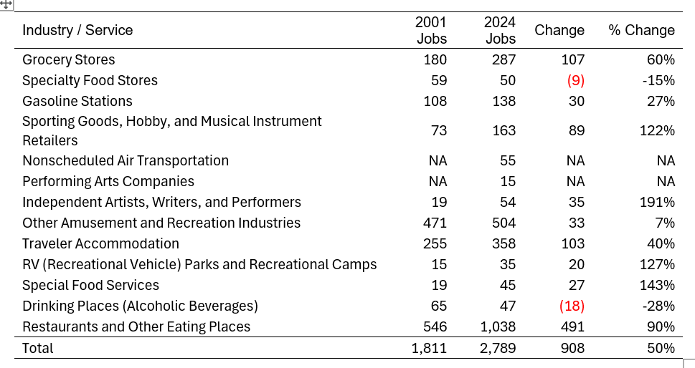
Tourism Base of Bonner County

Slide 9
Tourism Base of Bonner County
Direct Tourism Job Comparison Bonner Vs. Kootenai Counties

Slide 10
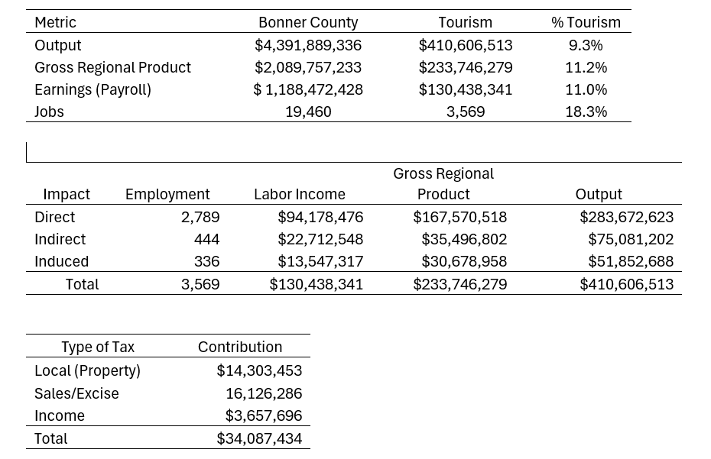
Tourism Base of Bonner County

Slide 11
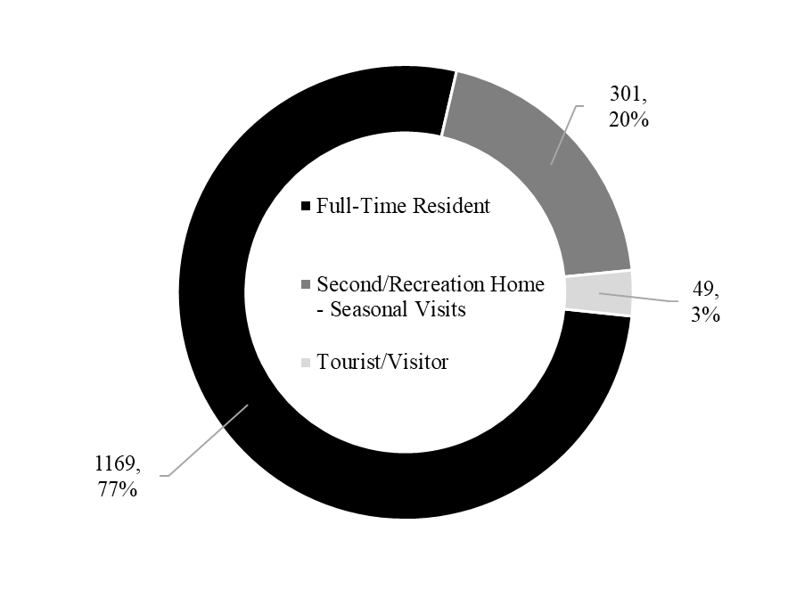
Preliminary SURVEY RESULTS
Total Respondents to Survey: 1,519

Slide 12
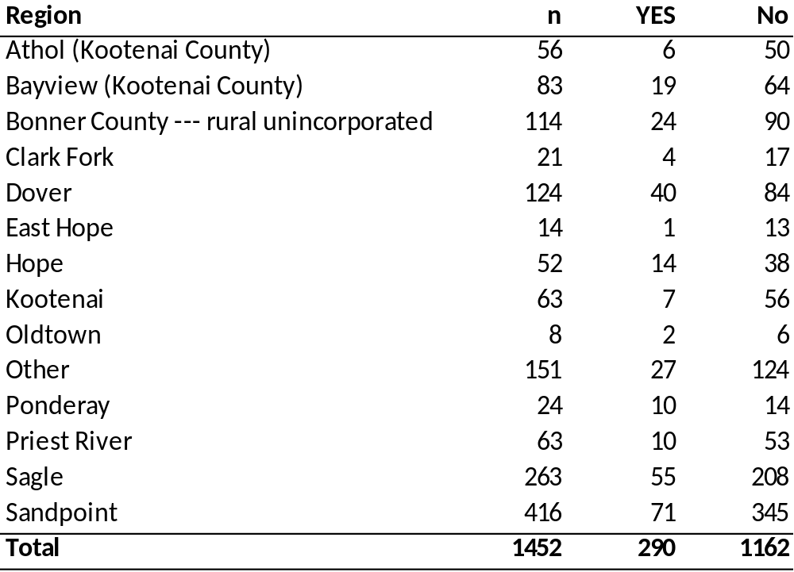
Survey Results
Have you moved to the area recently? 20% Yes, 80% No

Slide 13
Survey Results
In a typical year, how many weeks do you recreate on Lake Pend Oreille?

Slide 14
Economic Assessment of Lake Pend Oreille Water Management
Research Questions
What would the size of the 2025 Bonner County Economy have been if the lake level operated under the proposed management strategy?
We are not asking what the consequences of a different management strategy would mean for:
  Shore erosion
  Fish habitat
  Future economic growth rates
  Etc.
We want to know what the annual consequences of the strategy were over the past year.

Slide 15
Differences IN Management Strategy
– 171 days of full summer pool vs. 111 days

Slide 16
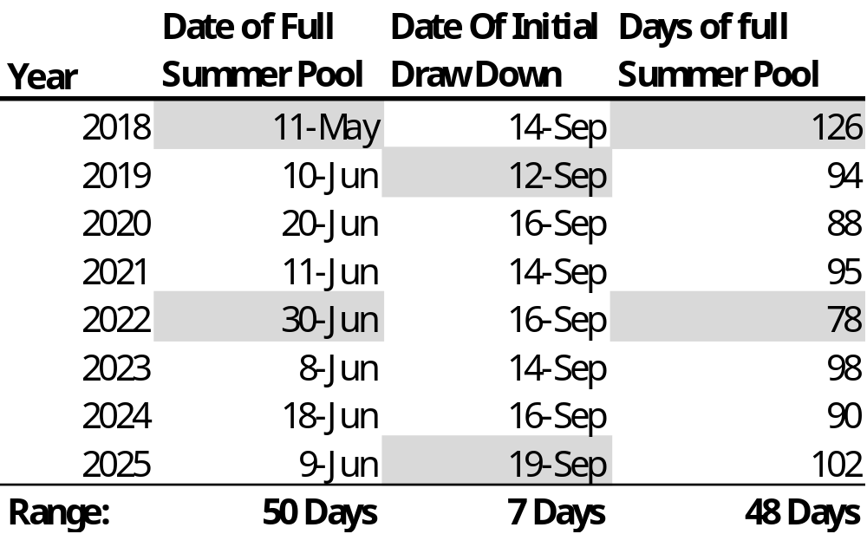
Differences IN Management Strategy
Uncertainty of Full summer pool

Slide 17
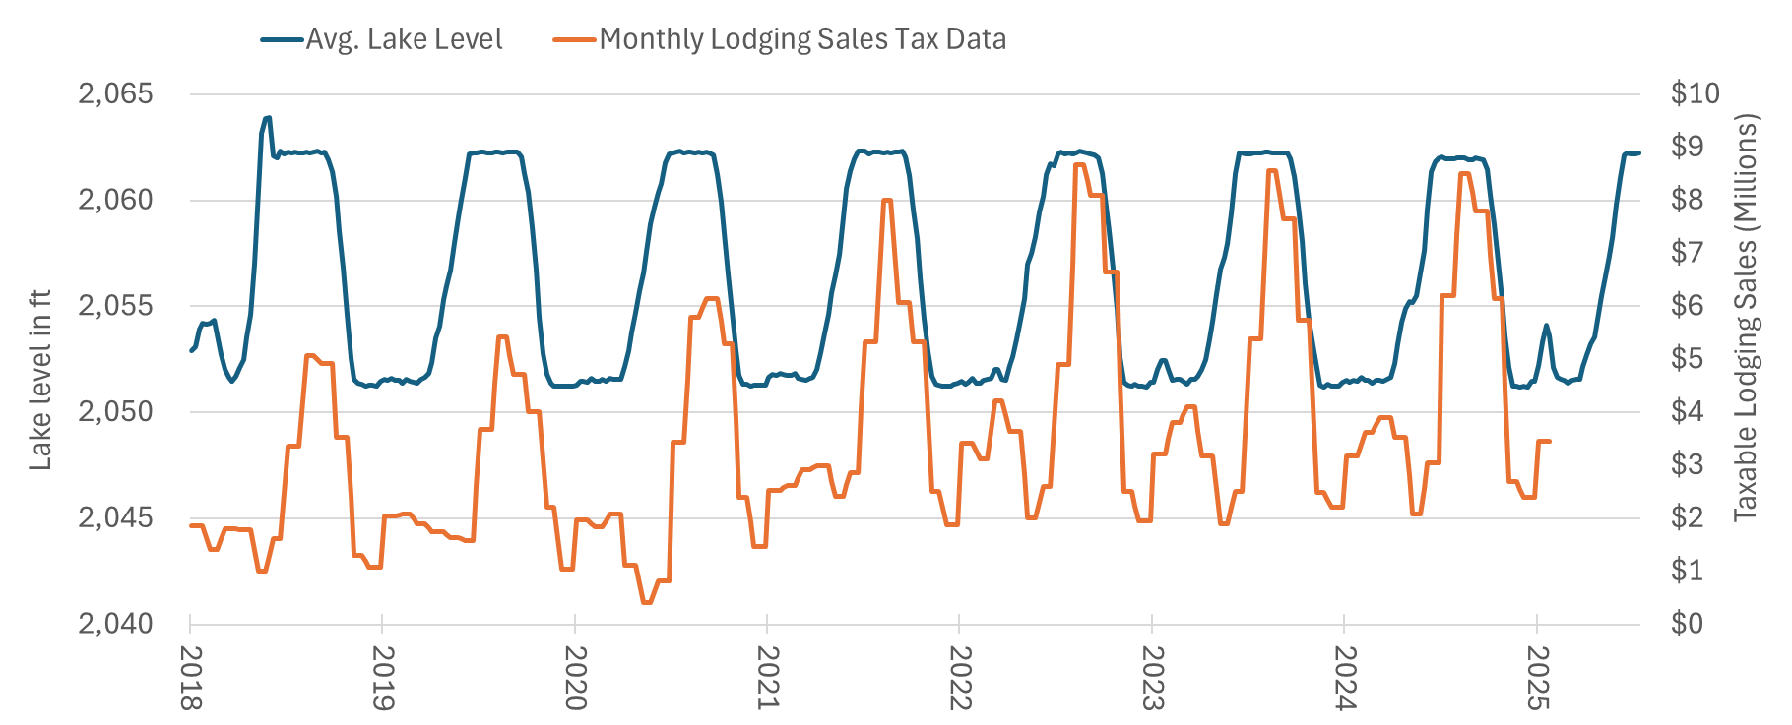
Lake Level and Tourism IV Data

Slide 18
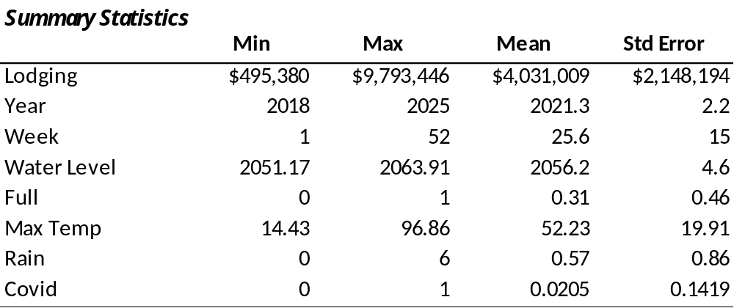
Economic Assessment of Lake Pend Oreille Water Management
Regression and Spending estimation

Slide 19
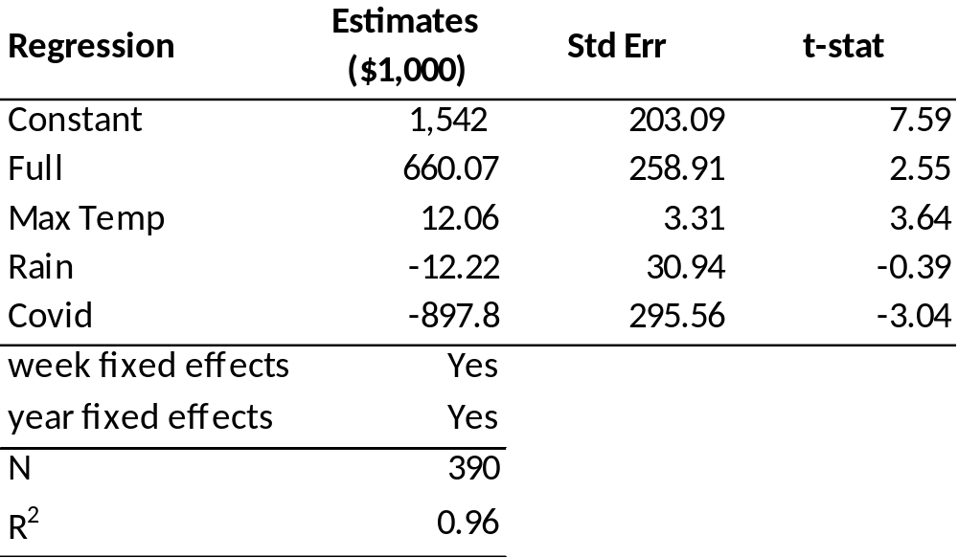
Economic Assessment of Lake Pend Oreille Water Management
Regression and Spending estimation

Slide 20
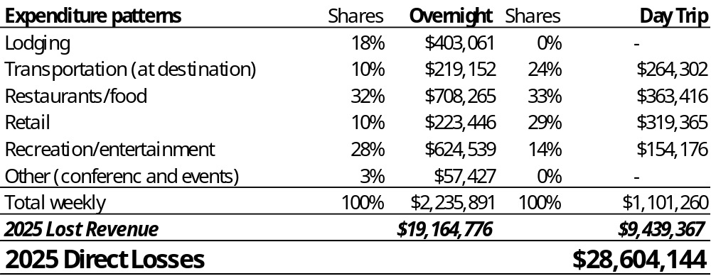
Economic Assessment of Lake Pend Oreille Water Management
Regression and Spending estimation

Slide 21
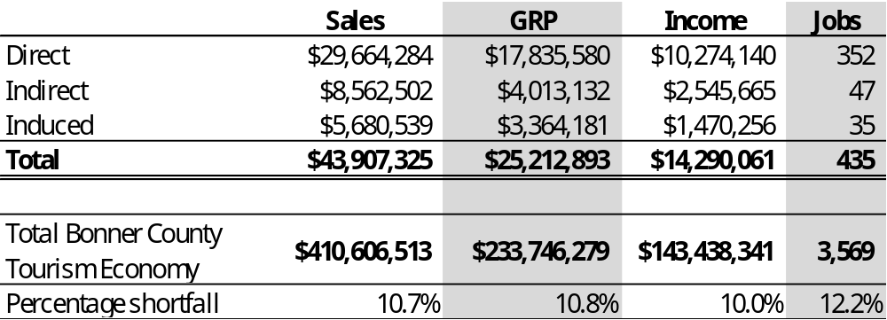
Economic Assessment of Lake Pend Oreille Water Management
2025 Economic Losses From Current Management Strategy

Slide 22
Any Questions?

