Slide 1
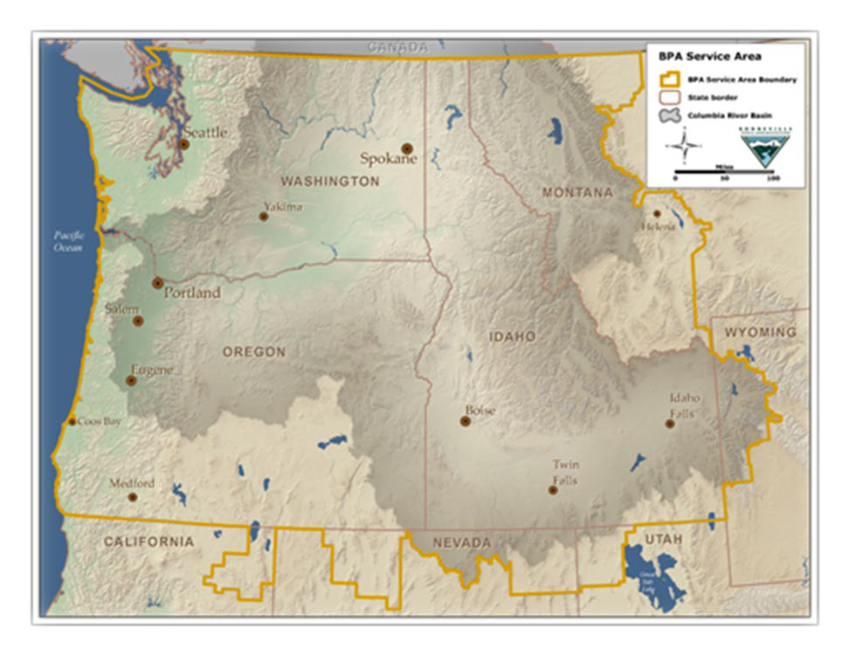
BPA Overview/History
B O N N E V I L L E P O W E R A D M I N I S T R A
T I O N
B O N N E V I L L E P O W E R A D M I N I S T R A T I O N
Created in 1937 by Congress as 1st “Public Marketing Administration” (now under US Dept. of Energy)
Electrify rural PNW, sell wholesale power to public utilities (‘preference customers”) in the Columbia River Basin (MT, ID, WA, OR)
Maximize the value of the river for the people of the Pacific Northwest
Close cooperation with USACE, Bureau of Reclamation, all CRB states & Tribes + Canada/BC
Self-funded by ratepayers (electricity + transmission); no federal appropriation
~140 preference customers (PUDs & electric cooperatives)
Three key areas of work:
  1) power contracts;
  2) fish and wildlife mitigation;
  3) high voltage transmission

Slide 2
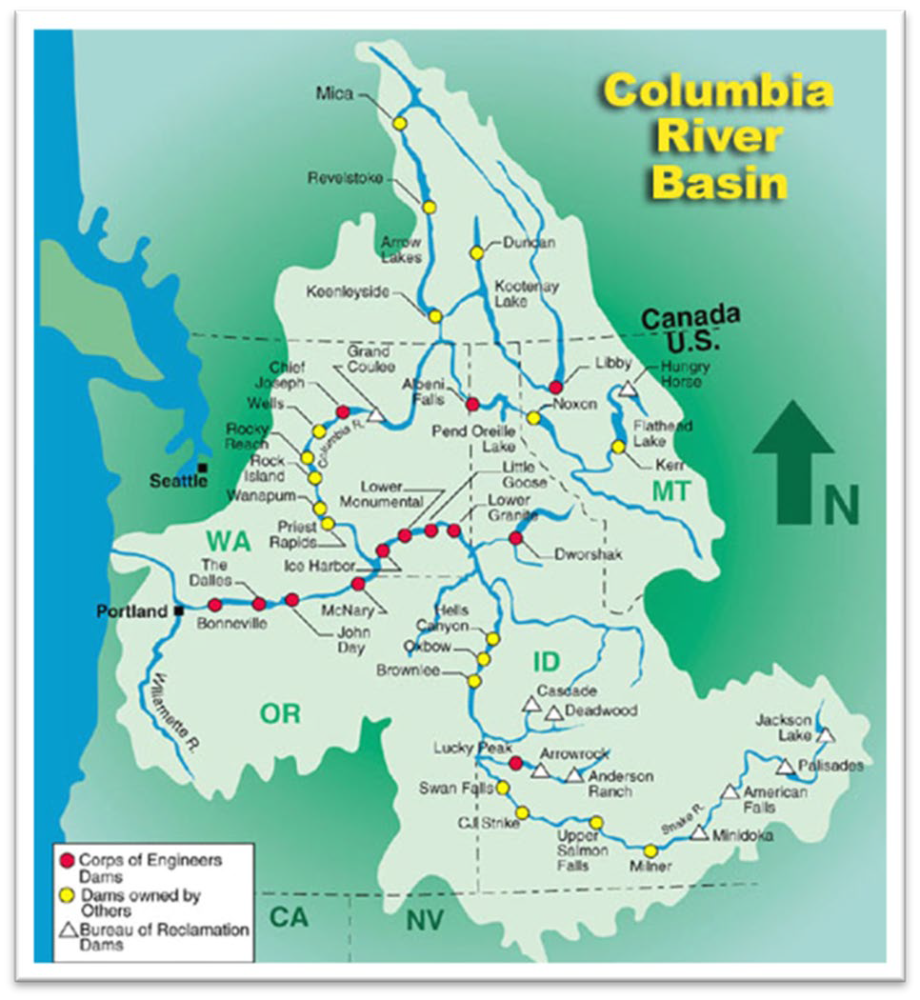
Columbia River System
B O N N E V I L L E P O W E R A D M I N I S T R A T I O N
B O N N E V I L L E P O W E R A D M I N I S T R A T I O N

Slide 3
Albeni Falls Dam Power Generation
B O N N E V I L L E P O W E R A D M I N I S T R A T I O N
B O N N E V I L L E P O W E R A D M I N I S T R A T I O N
Albeni Falls Dam and Grand Coulee Dam are the only federal storage projects where storage and release of water can be managed for power purposes
BPA is required to market the power from the Columbia River System for Congressionally-designated purposes, including assuring the Pacific Northwest of an adequate, efficient, economical, and reliable power supply, while adhering to all applicable legal requirements.
The Flexible Winter Power Operation allows BPA to more effectively meet winter power demands in the Pacific Northwest.

Slide 4
B O N N E V I L L E
P O W E R
A D M I N I S T R A T I O N
B O N N E V I L L E P O W E R A D M I N I S T R A T I O N
2011 NEPA Analysis
The 2011 Albeni Falls Dam Flexible Winter Power Operations Final Environmental Assessment documents the evaluation of the effects the operation across a range of environmental, social and economic resources.
The evaluation included the potential impact of the maximum potential use of FWPO (4 fill/draft cycles) within the upstream and downstream ramp rates.
The Environmental Assessment concluded that the use of FWPO would not result in in any new significant impacts to the human environment within the meaning of the National Environmental Policy Act.

Slide 5
B O N N E V I L L E
P O W E R
A D M I N I S T R A T I O N
B O N N E V I L L E P O W E R A D M I N I S T R A T I O N
Flexible Winter Power Operations (FWPO)
Available: Late December – End of March
Available Range: 2051-2056 ft.
FWPO Storage is valuable: 1 foot of Lake Pend Oreille Storage
  Equivalent to ~1 foot of Grand Coulee Storage
  Generates ~4,200 MW at all downstream dams
  Generates ~1,100 MW at Grand Coulee Dam
  Store during periods of low prices and release to support regional energy needs and lower rates for BPA customers

Slide 6
How does BPA Utilize the Flexibility
B O N N E V I L L E P O W E R A D M I N I S T R A T I O N
B O N N E V I L L E P O W E R A D M I N I S T R A T I O N
Once kokanee spawning is declared complete by IDFG, BPA can request that the Corps reduce discharge and store into FWPO
  The Corps evaluates ice related conditions on the Lake and downstream of the dam when approving requests to store or release water
  The changes in discharge and Lake elevation must fall within the required limits of the project
When the water is needed downstream of Albeni Falls Dam BPA can request the Corps increase discharge to release the stored volume
  BPA uses this flexibility to shape generation into periods of higher value
  The value of water released from Albeni Falls Dam is amplified by the generation it produces downstream as it flows through Columbia River System

Slide 7
Historical Use of FWPO
B O N N E V I L L E P O W E R A D M I N I S T R A
T I O N
B O N N E V I L L E P O W E R A D M I N I S T R A T I O N
Year | Amount Stored | Notes
2011 | ~0.2’ | 2055 Decision Tree Year – BPA requested fill to the top of the operating Range in early January – Stored water release in the 3rd week.
2012 | ~1.9’ | Kokanee spawning complete ~mid-Dec – FWPO 2 periods of fill and draft
2013 | 0’ | 2055 Decision Tree Year
2014 | NA | Not Available Due to Habitat Restoration Work
2015 | NA | Not Available Due to Habitat Restoration Work
2016 | ~3’ | BPA Request FWPO – Stored up to 2054.7 across the
2017 | NA | Not Available Due to Habitat Restoration Work
2018 | ~4’ | Stored ~4’ starting end of December then Released in Late January
2019 | 0’ | Available but not requested
2020 | NA | Not Available Due to Habitat Restoration Work
2021 | ~0.5’ | Stored ~0.5’ into FWPO then released by mid-March
2022 | ~0.5’ | Stored 0.5’ into FWPO the week of March 3rd and Released the week of March 21
2023 | ~1’ | Filled 1’ into FWPO in early January and Released in Late January early February
2024 | 0’ | Available but not requested
2025 | ~4’ | Stored ~4’ from the end of kokanee spawning through Jan 19 then released across remainder of January.

Slide 8
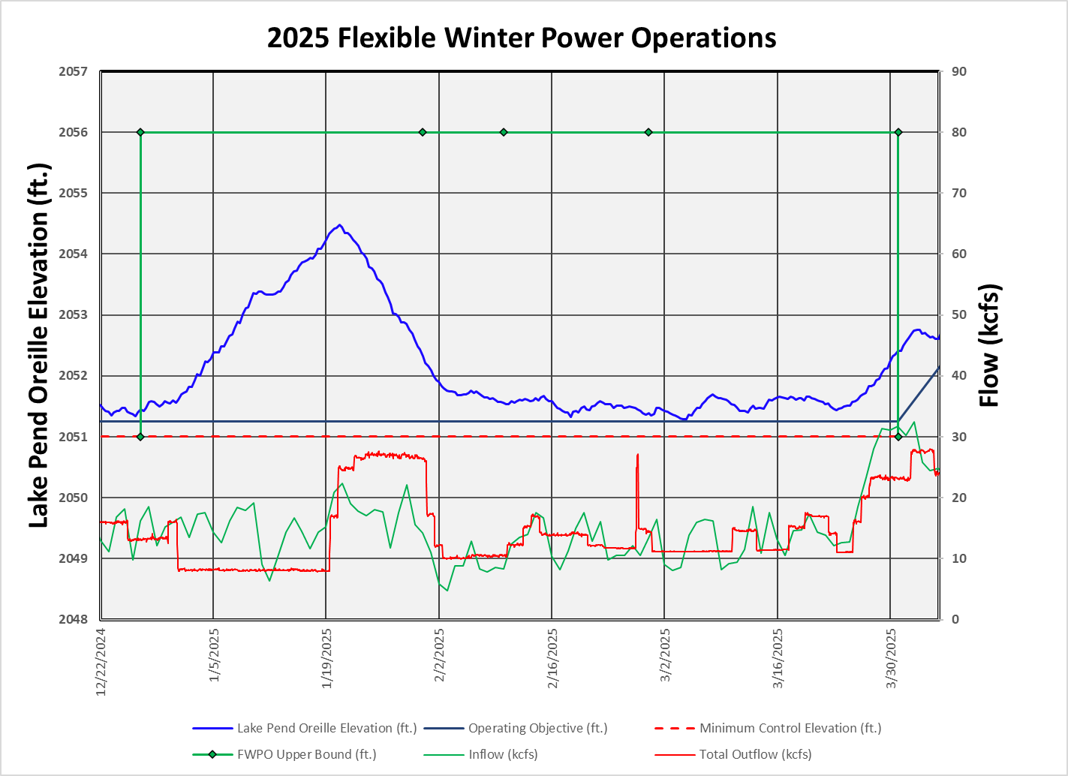

FWPO use in 2025
B O N N E V I L L E P O W E R A D M I N I S
T R A T I O N
B O N N E V I L L E P O W E R A D M I N I S T R A T I O N

Slide 9
FWPO Environmental Assessment
B O N N E V I L L E P O W E R A D M I N I S T R A T I O N
B O N N E V I L L E P O W E R A D M I N I S T R A T I O N
https://www.bpa.gov/learn-and-participate/public- involvement-decisions/project-reviews/albeni- falls-dam-flexible-winter

