Slide 1
Economic Assessment of Lake Pend Oreille Water Management
Sponsored by
the Lakes Commission
and the
University of Idaho
Presentation to the Lakes Commission
June 3, 2025

Slide 2


Principal Investigators
Steven Peterson, Co-PI
B.S., Business Administration (Lewis Clark State College)
M.S., Economics (University of Idaho)
stevenp@uidaho.edu
Mr. Peterson is a regional economist and Associate Clinical Faculty member at the University of Idaho. He has worked extensively throughout Idaho and has conducted impact assessments on nearly every industry in Idaho including studies on energy, education, health care, tribal studies, manufacturing, agriculture, recreation, tourism, occupational analyses, and state budgeting analyses.
Timothy Nadreau, Co-PI
B.S., Pure Mathematics (University of Idaho)
M.S., Applied Agricultural Economics (University of Idaho)
Ph.D., Economics (Washington State University)
timothyn@uidaho.edu
Dr. Nadreau is a regional economist with 20-years of experience doing impact and investment analysis for higher education throughout the U.S., U.K., Canada, and Australia. He worked as a senior economist at Emsi (Lightcast) for nearly nine years where he conducted education impact analysis in every state. He is now an Assistant Professor at UofI.

Slide 3
Economic Assessment of Lake Pend Oreille Water Management
purpose
Economic tradeoff between energy, flood control, and recreation
Variable lake elevation affects:
  Tourism season and industry activity
  Long-run regional economic growth rates
  Flood control and energy production
Focus is on:
  Sandpoint (Bonner County) economy
  Injections and leakages
  Economic Metrics: Output (sales), gross regional product, total compensation, jobs

Slide 4
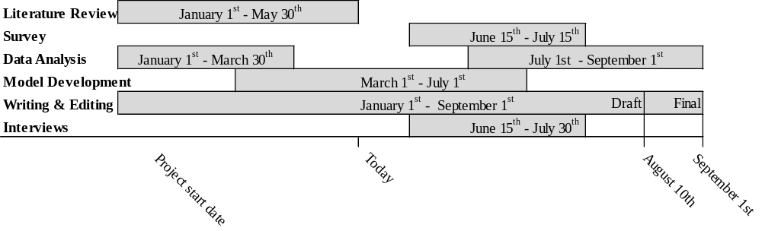
Economic Assessment of Lake Pend Oreille Water Management
Current Timeline

Slide 5
Economic Assessment of Lake Pend Oreille Water Management
Draft outline
    Introduction and Purpose of the Study
    Lake Management and Tradeoffs
    Regional Economic Profiles
      Idaho Economy Overview
      Bonner County Economy Overview
      Lake level and tourism analysis
    Economic Data and Survey Summary
    Economic Model
      Regression analysis (Direct Effects)
      Input-output analysis
    Results and Implications

Slide 6
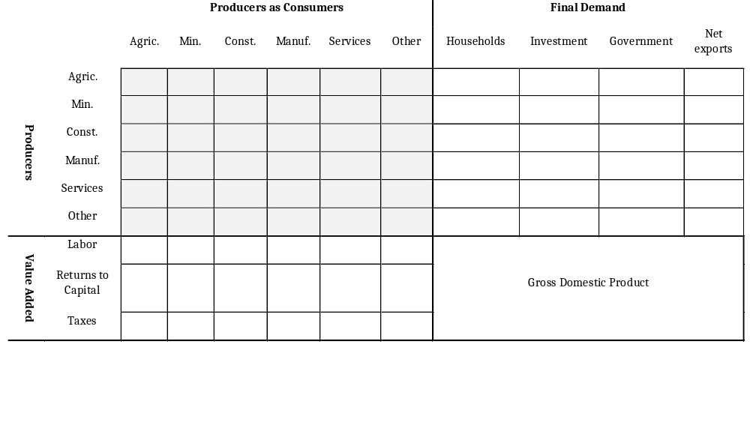
Economic Assessment of Lake Pend Oreille Water Management
Input-Output Models

Slide 7
Economic Assessment of Lake Pend Oreille Water Management
Limitations
    The focus of this study is primarily on the economics due to budget and very short time limitations
    The goal is to establish a benchmark study that can be built upon in the future
    Topical limitations
      Wildlife habitat
      Fisheries
      Other

Slide 8
Any Questions?

