Slide 1
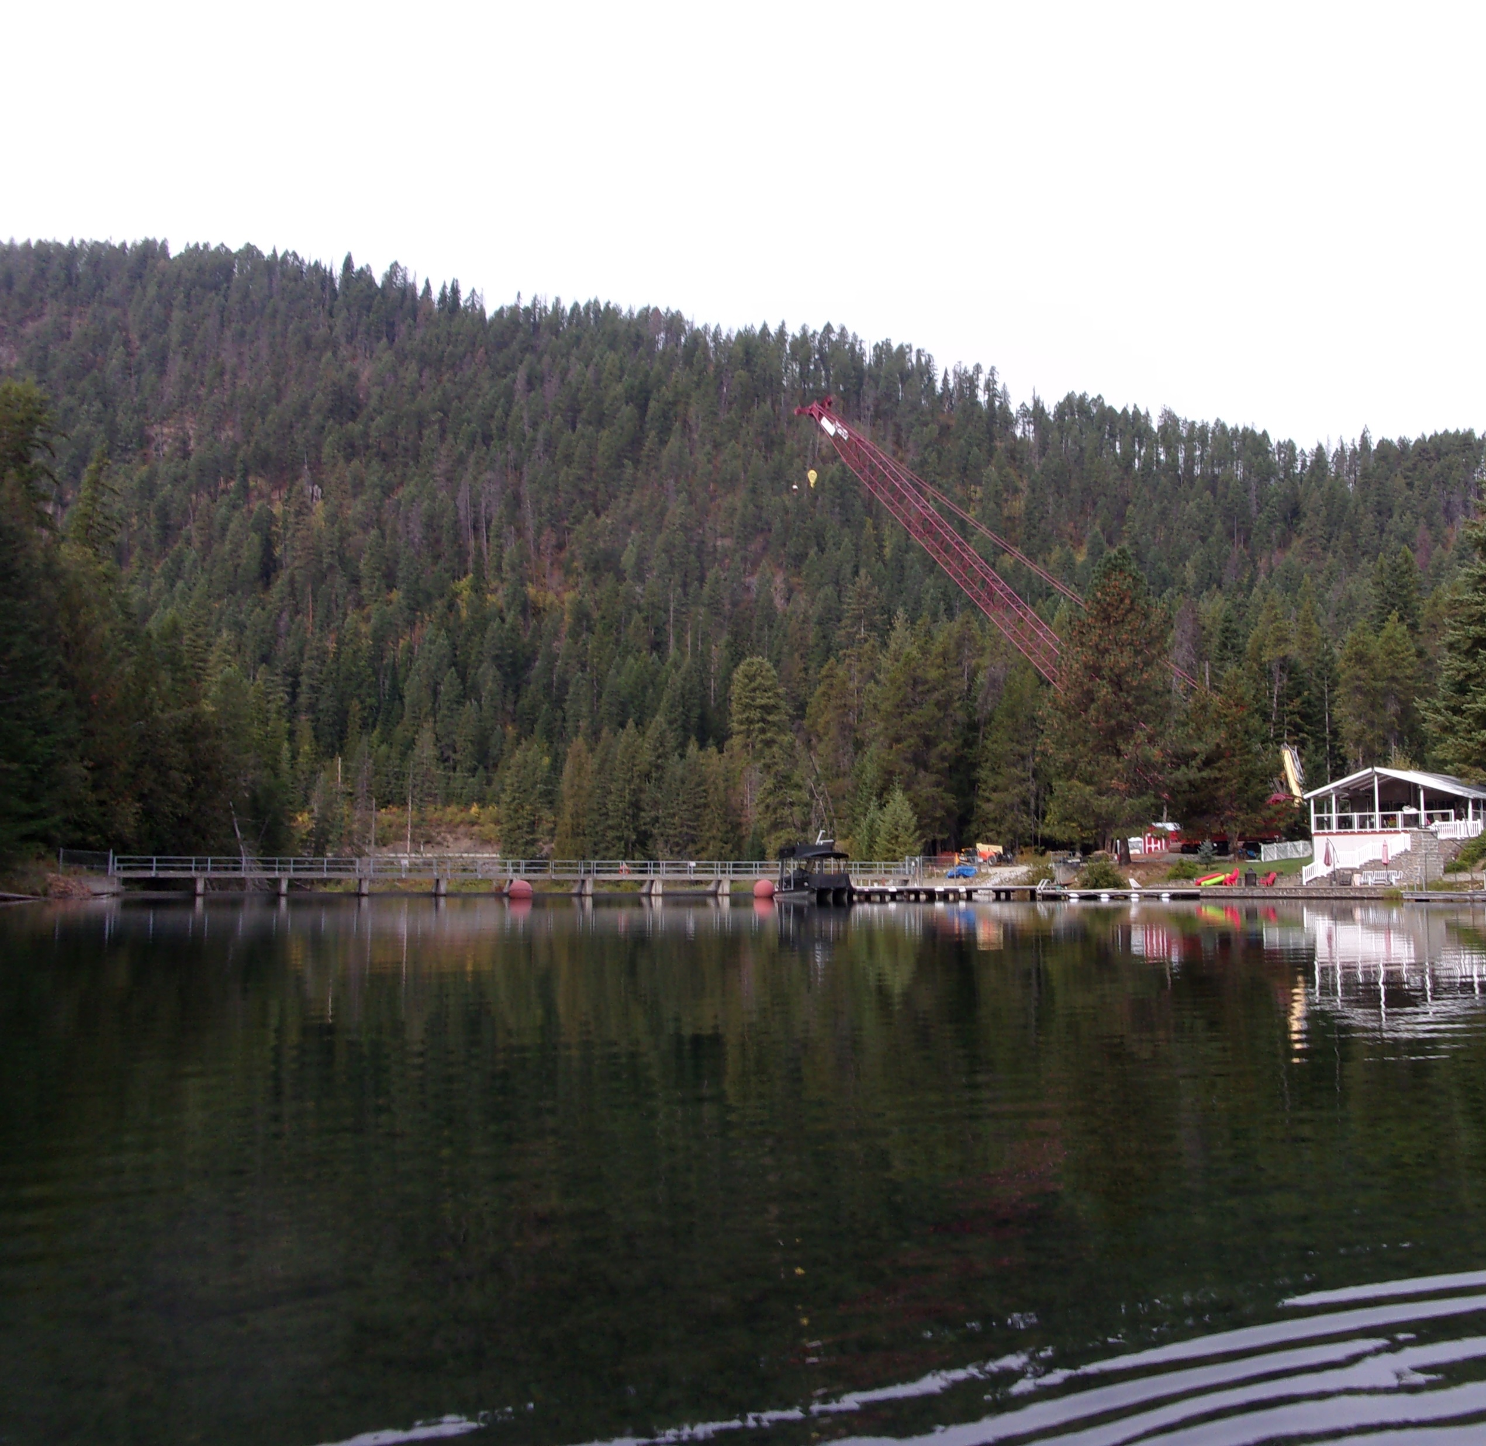

Priest Lake Dam Operations Overview
Michelle Richman
June 3, 2025

Slide 2
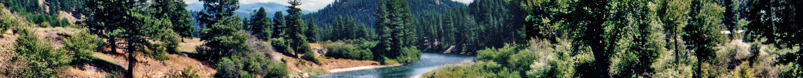

Purpose – To Discuss:
How dam operation decisions are made
How to manage the river and lake as a system
Data gaps
FAQs

Slide 3
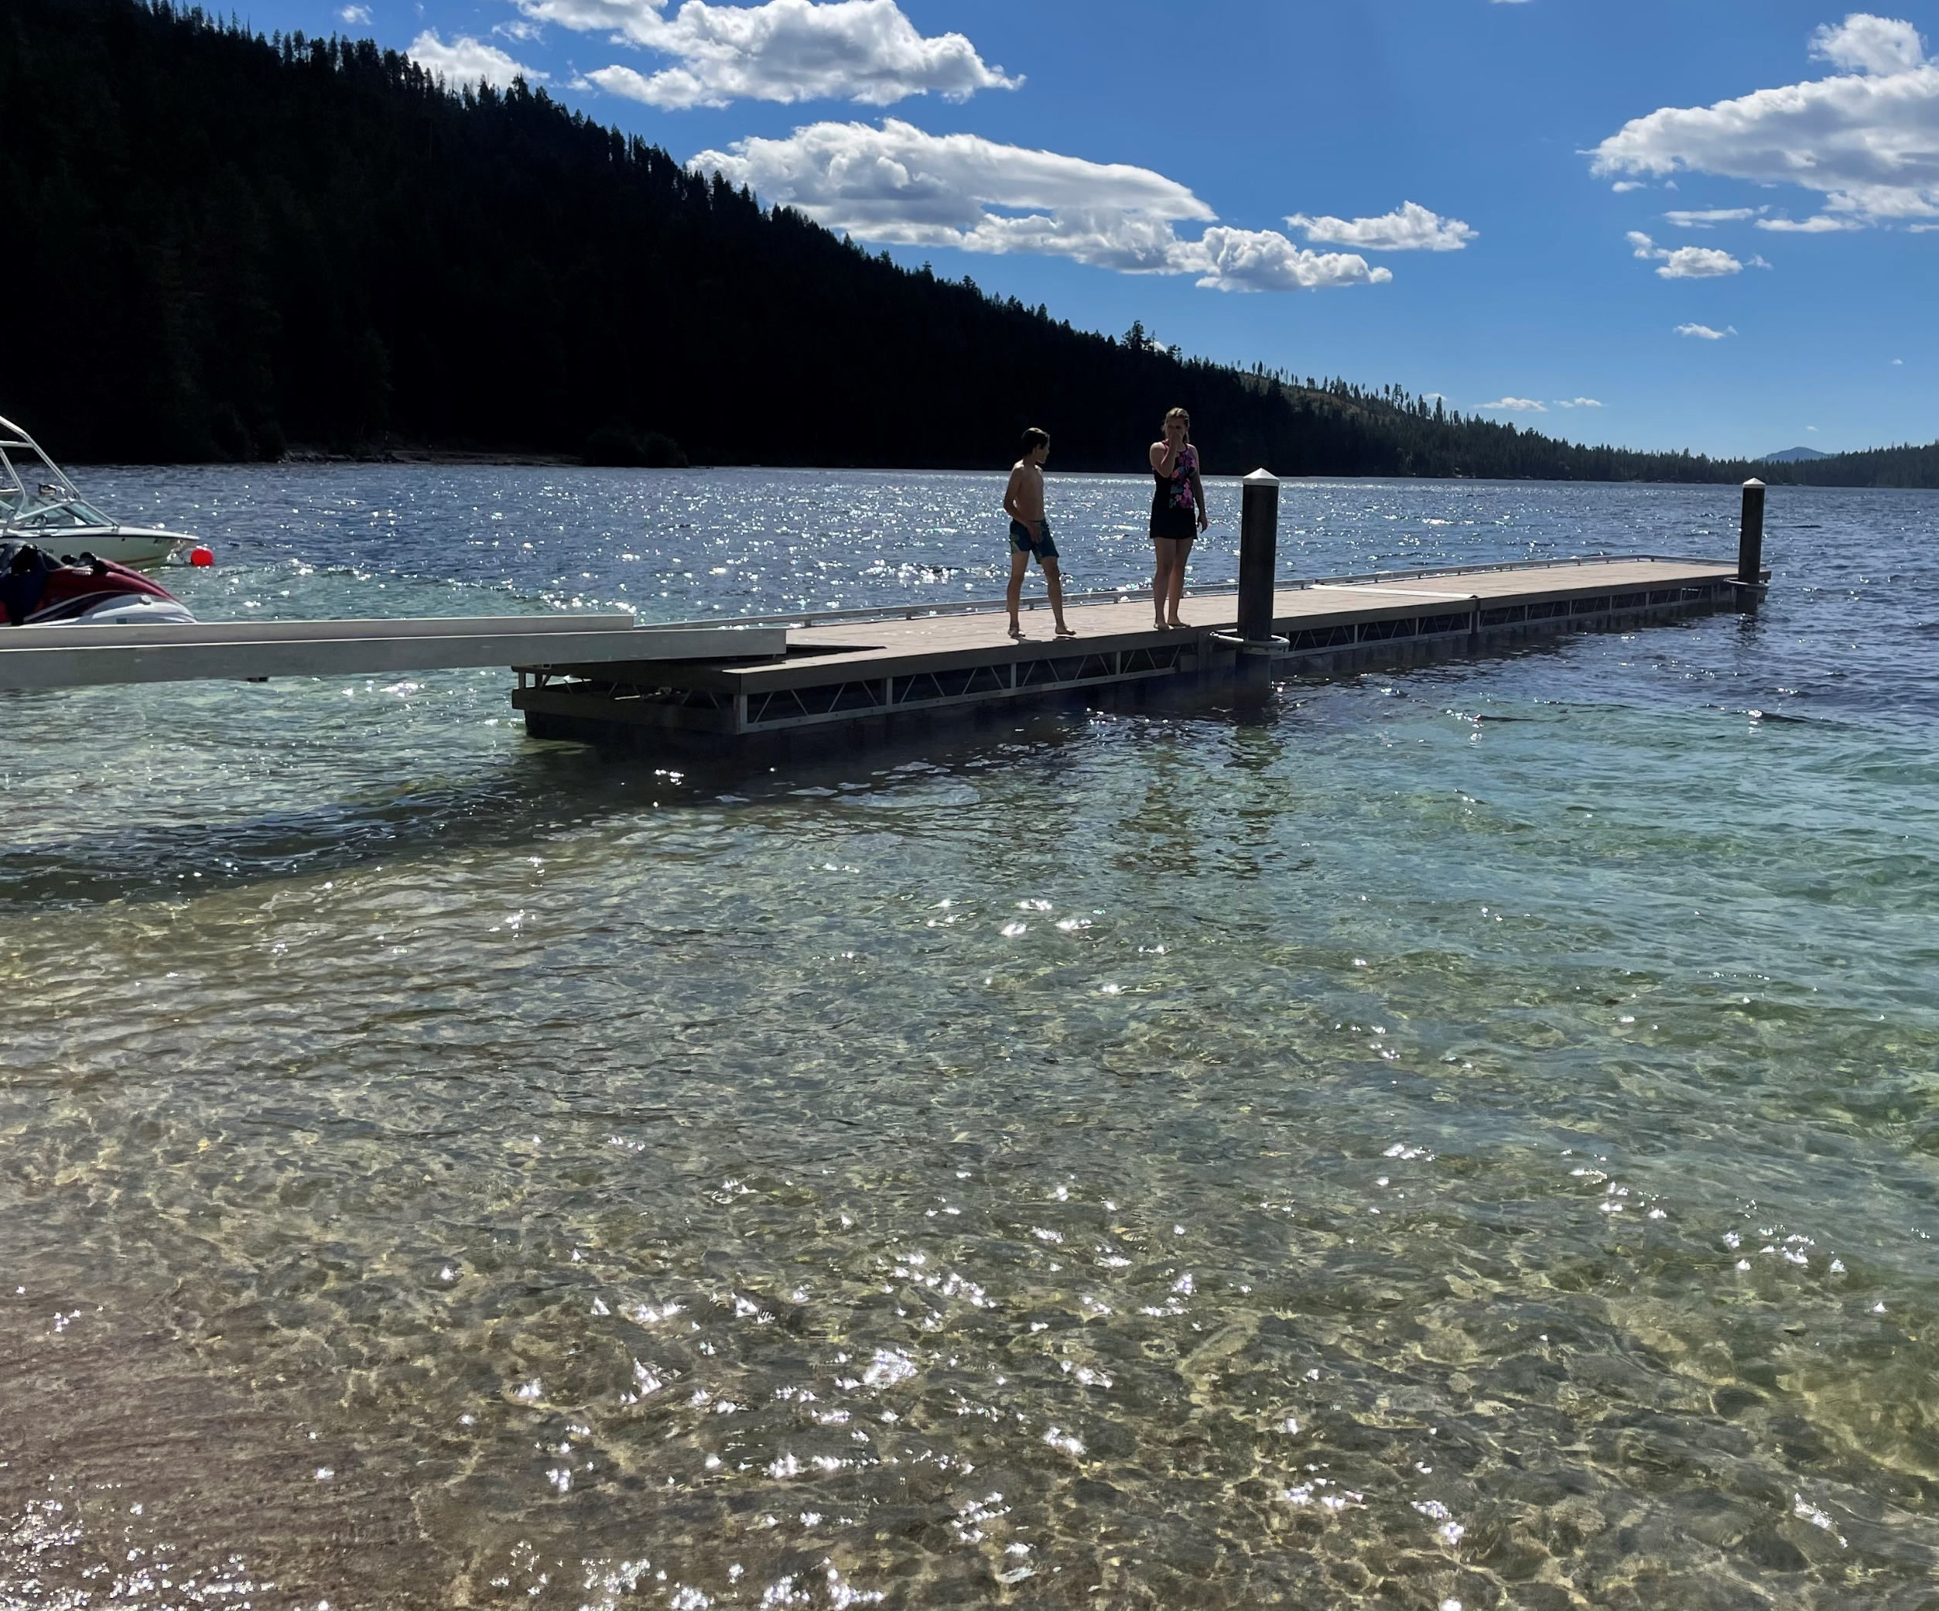
Topics
Context
Goal – Strike a balance
Framework for decisions
Seasonal operations

Slide 4
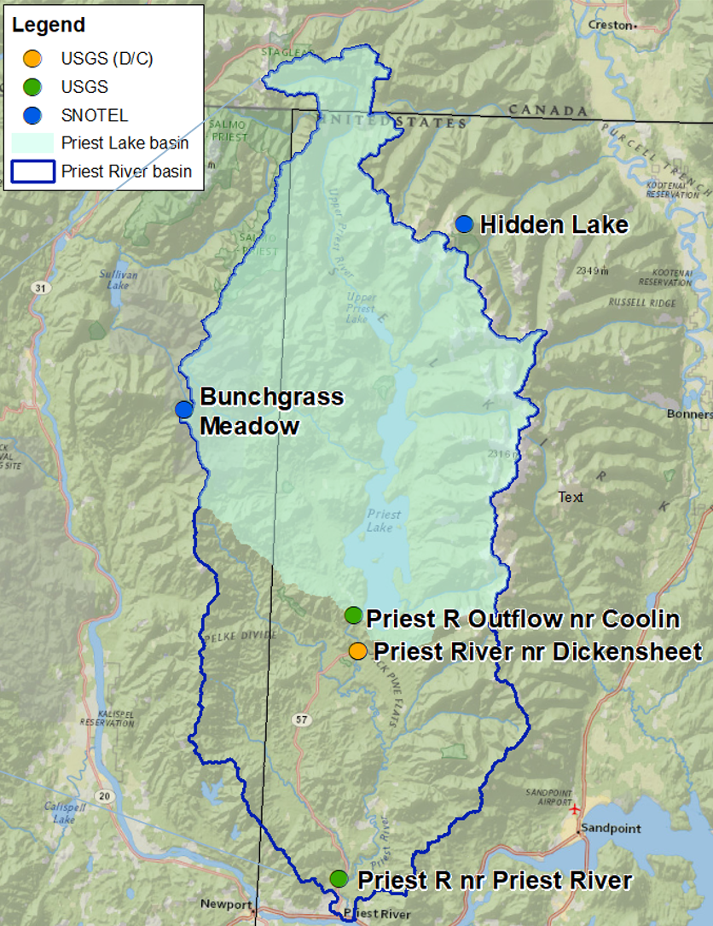
Framework for Dam
Operation Decisions
Written Guidance
Stakeholder Input
Natural Inputs
Basin Characteristics
Monitoring Information
Physical Configuration of the Dam

Slide 5
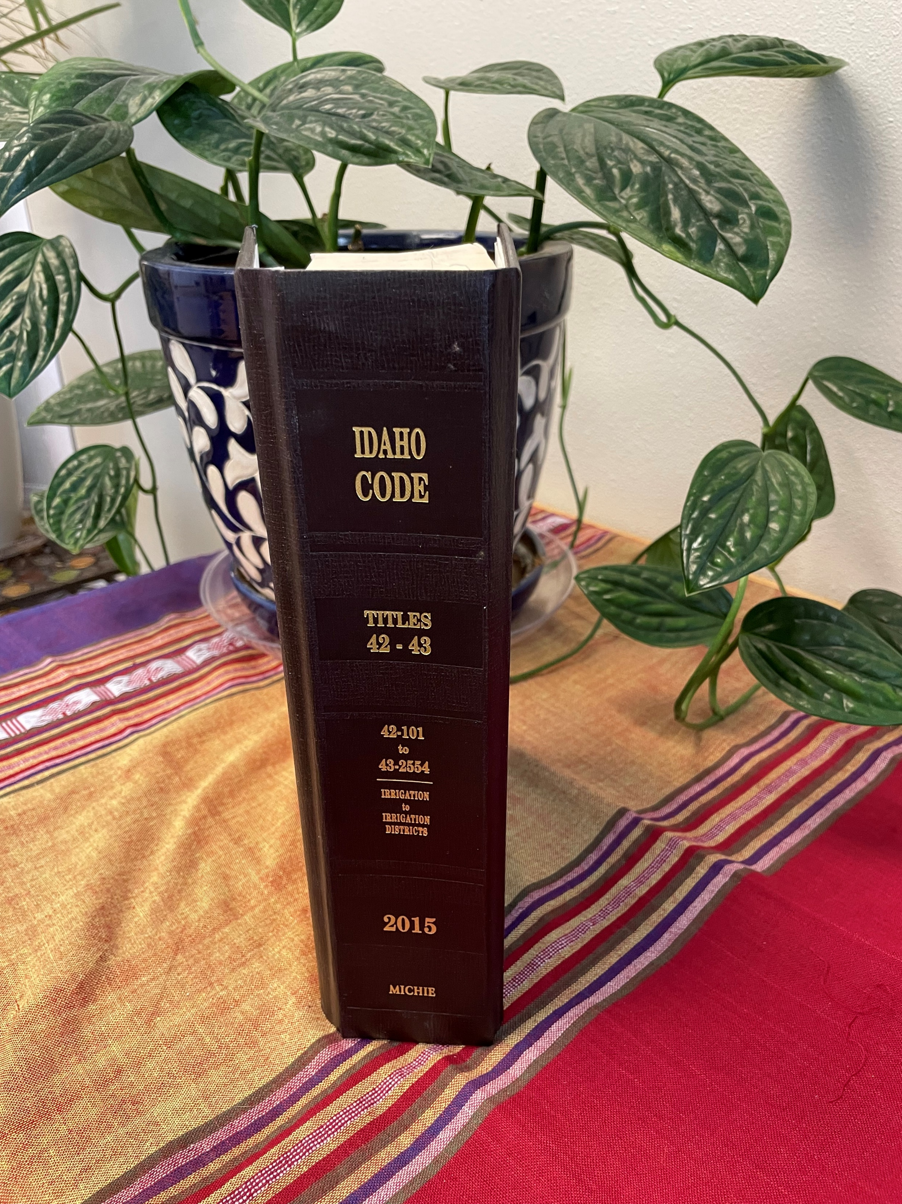
Overarching Guidance - Idaho Code §70-507
Recreation Season
  Wet to normal years – 3.0 feet
  Dry to very dry – 3.0 to 3.5 feet
Fall Release
  After close of main recreation season
  Not below 0.1 feet
Lake & Quantity-focused

Slide 6
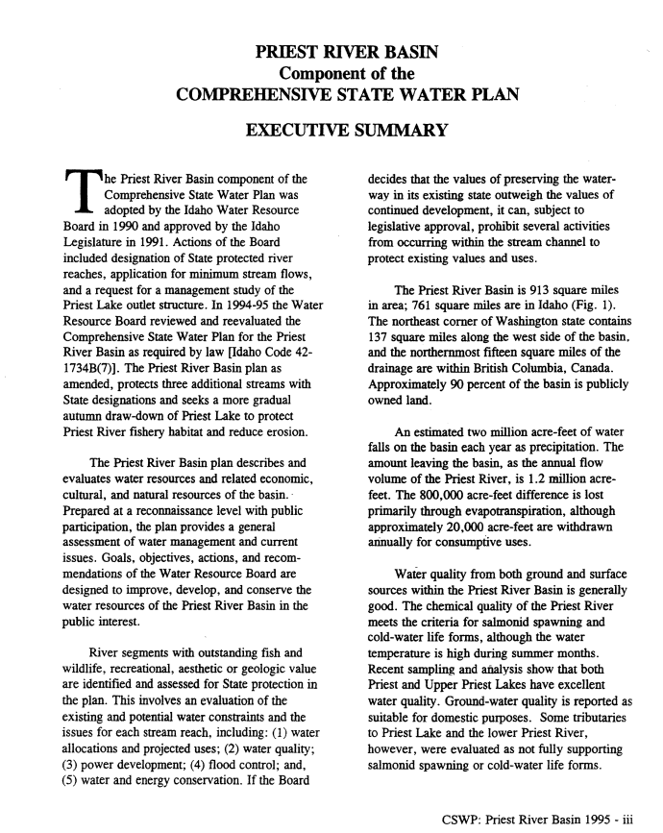
Supporting Guidance
Priest River Basin Plan – 1995, 2003
Minimum Stream Flow Water Right - 1997
8/1 – 10/31: 300 cfs
Stakeholder Input
  Lower Priest River Instream Flow Study ~ IF&G
Governor’s WR – 800,000 AF – 1927
Historic agreements

Slide 7
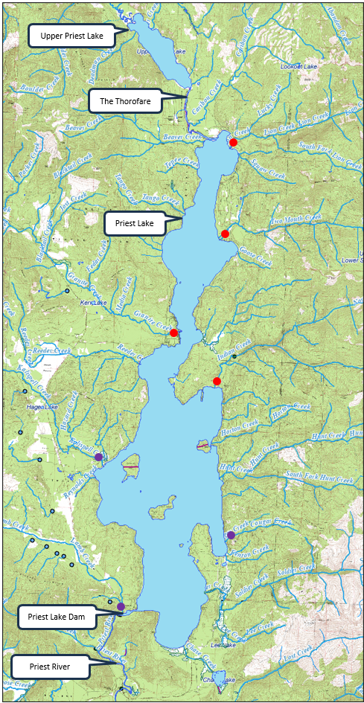
Natural Inputs,
Basin Characteristics
Tributaries & Thorofare
Weather
Collaboration

Slide 8
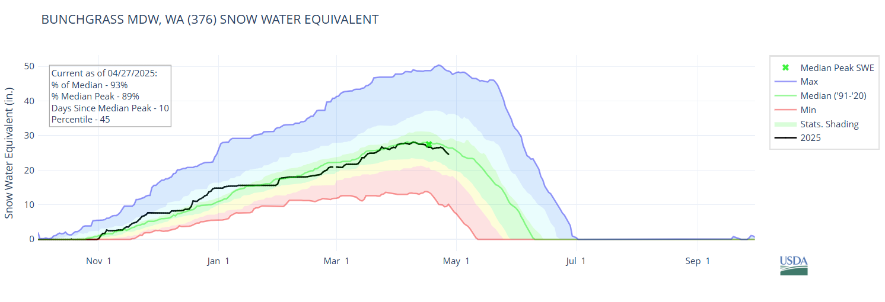
Monitoring Information - Spring
NRCS SNOTEL
NRCS Water Supply Forecasts
Drought Monitor

Slide 9
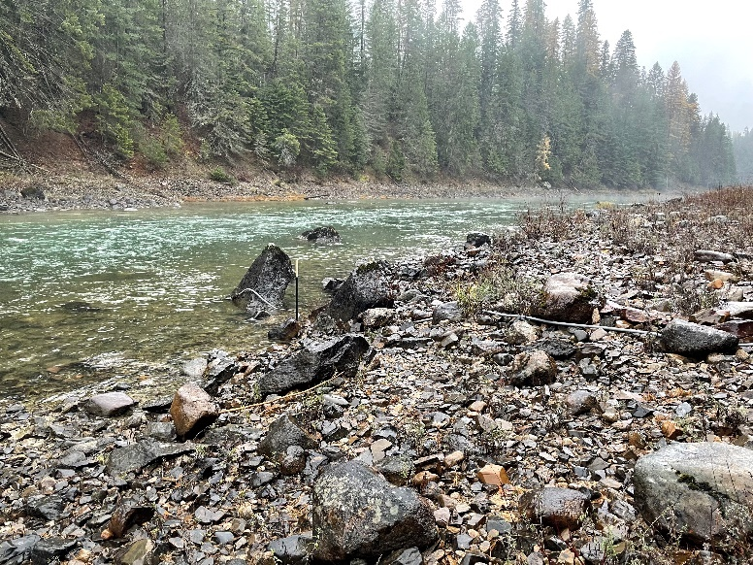
Monitoring Information – Year-round
USGS Stations (3)
USGS Priest River nr Coolin

Slide 10
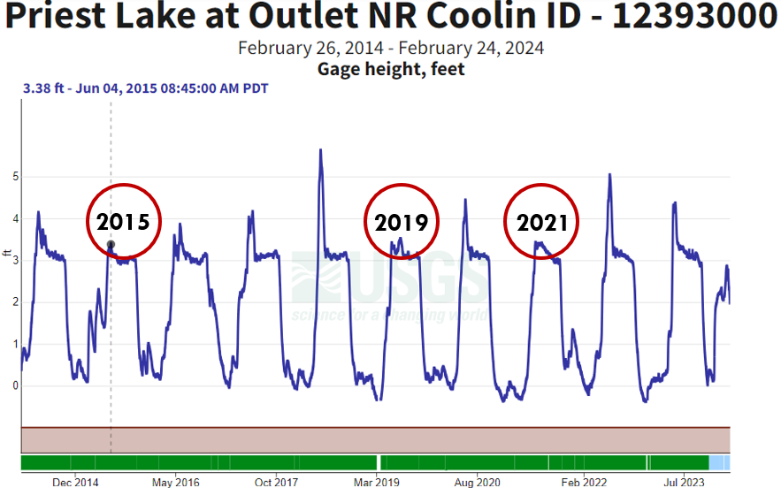
Spring – Dam Operations
First Decision
  Catch from peak
  Bring lake level up

Slide 11
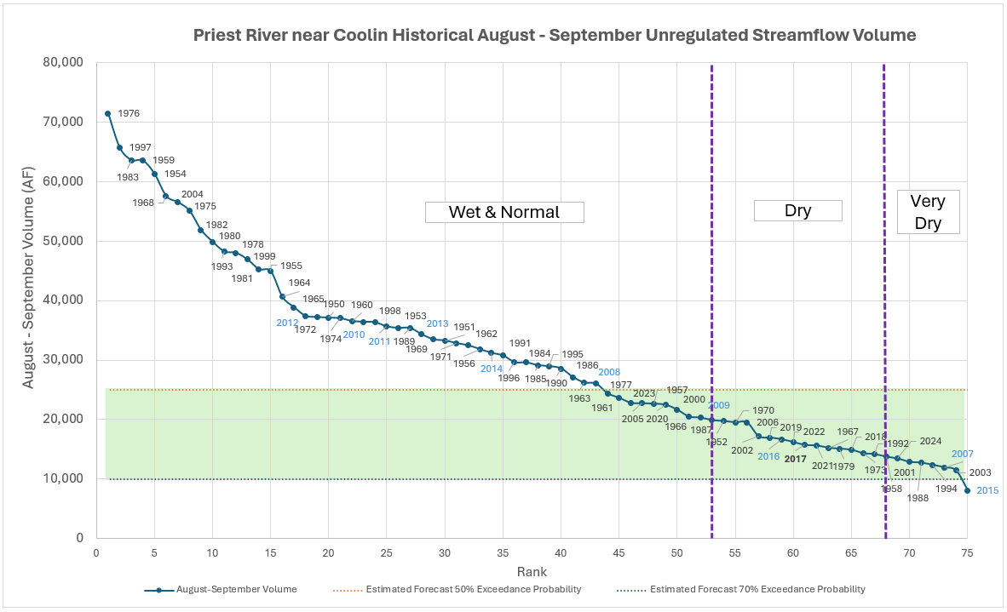
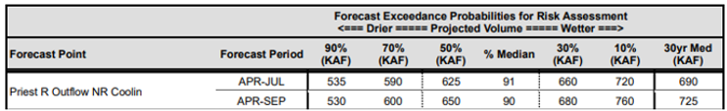
Spring – Type of Year
  Dry vs. Wet
  Determines lake level
    Wet – 3.0 feet
    Dry – 3.0 to 3.5 feet

Slide 12
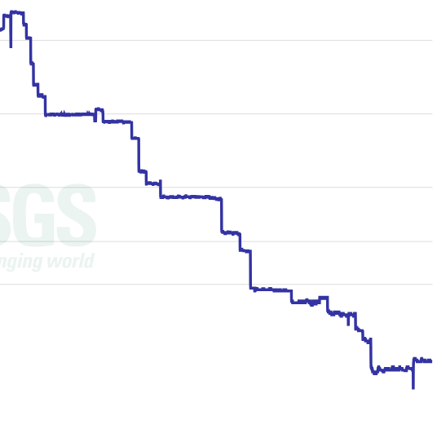
Spring – Daily Operations
G
2500 cfs, early June
Hold lake at a specified level
Match estimated inflow
  Hydrology calculation
  Granite Creek calculation
200 cfs, early July
Rapidly falling inflow – 2021

Slide 13

Gate Change Calculation
Dynamic system – hours to days lag in response

Slide 14
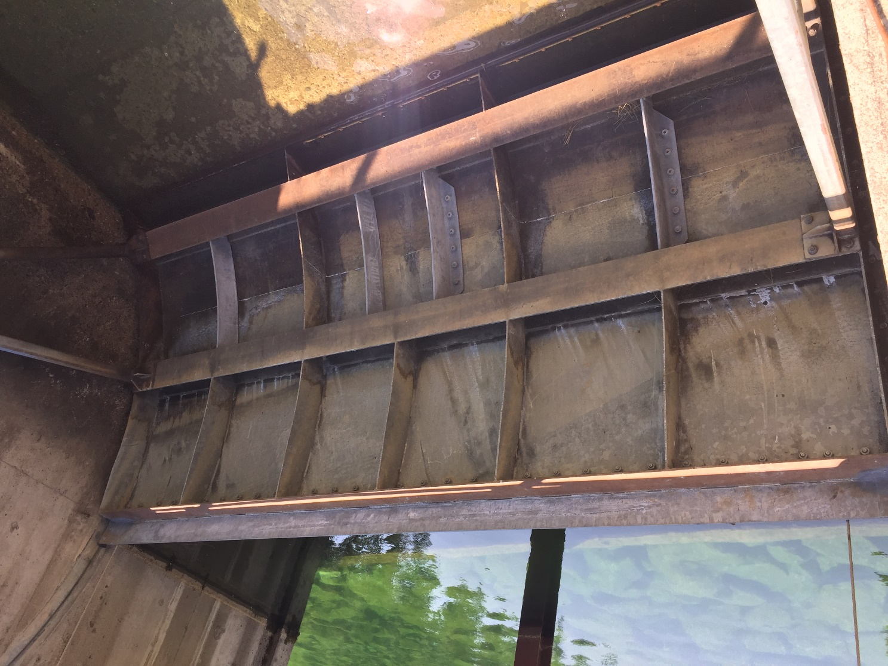
Summer Operations
6-inch Radial Gate Extension
Held at 3.0 feet 1951 to 2022
Last 3 years
  2022
  2023
  2024

Slide 15
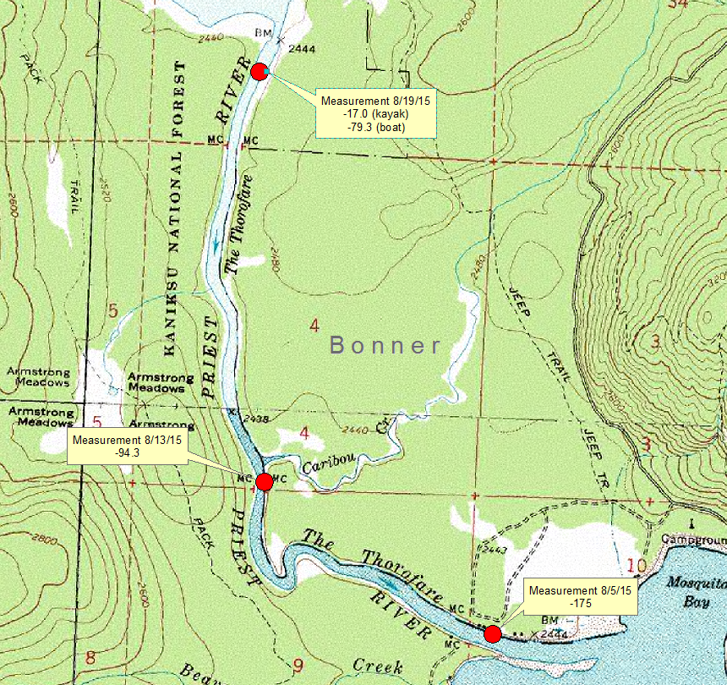
Summer – 2015
USGS Flow Measurements August 4-5, 2015
  Inflowing Tributaries = 118.5 cfs
  Thorofare = -175 cfs
  Combined = -56.5 cfs
OUTFLOW from DAM 44.6 cfs
Net outflow = 101 cfs
Collaboration

Slide 16
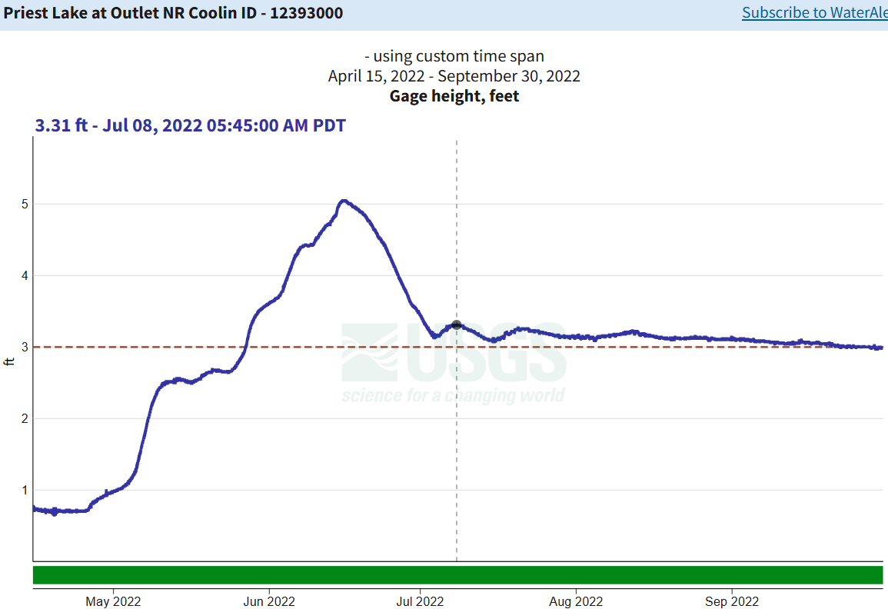
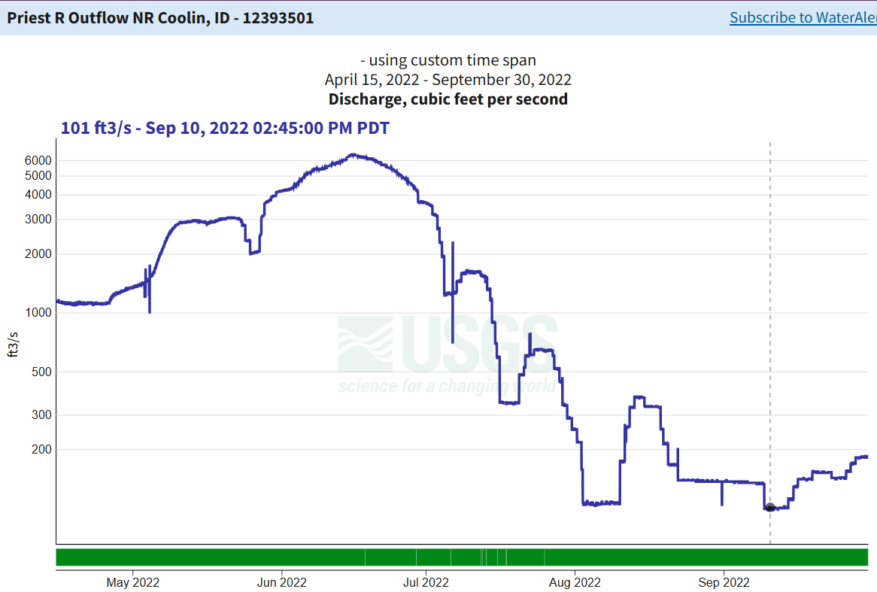
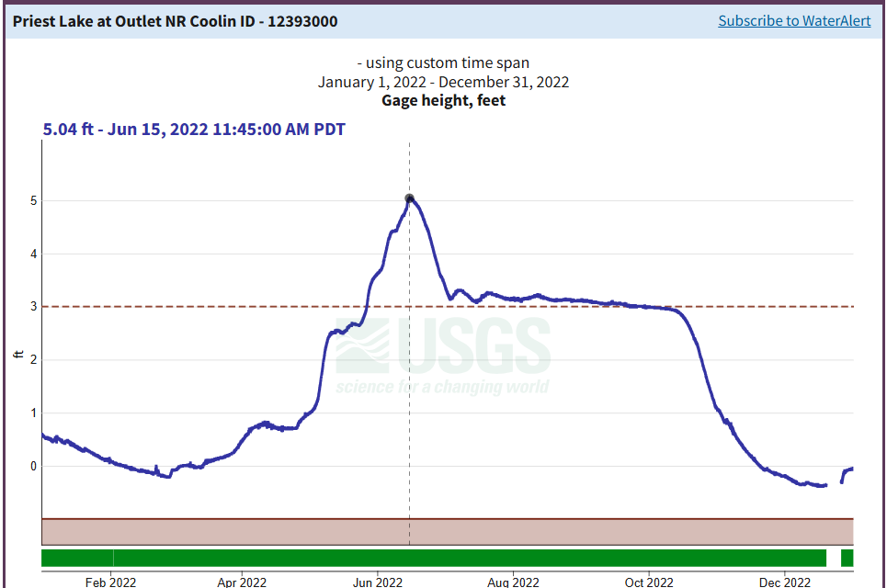
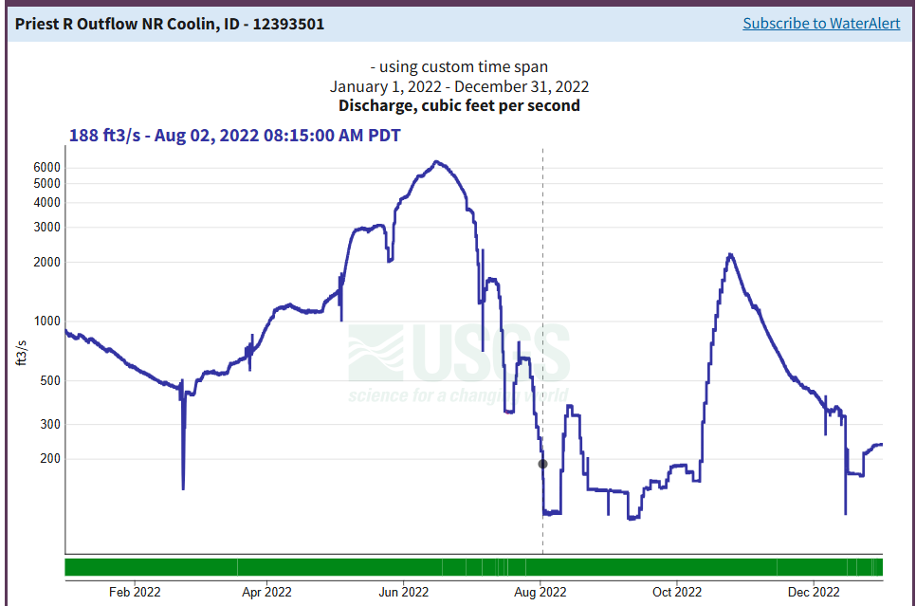
Summer - 2022
Hold lake at ~3.2’
Takeaways – river fluctuation when hold lake level constant

Slide 17
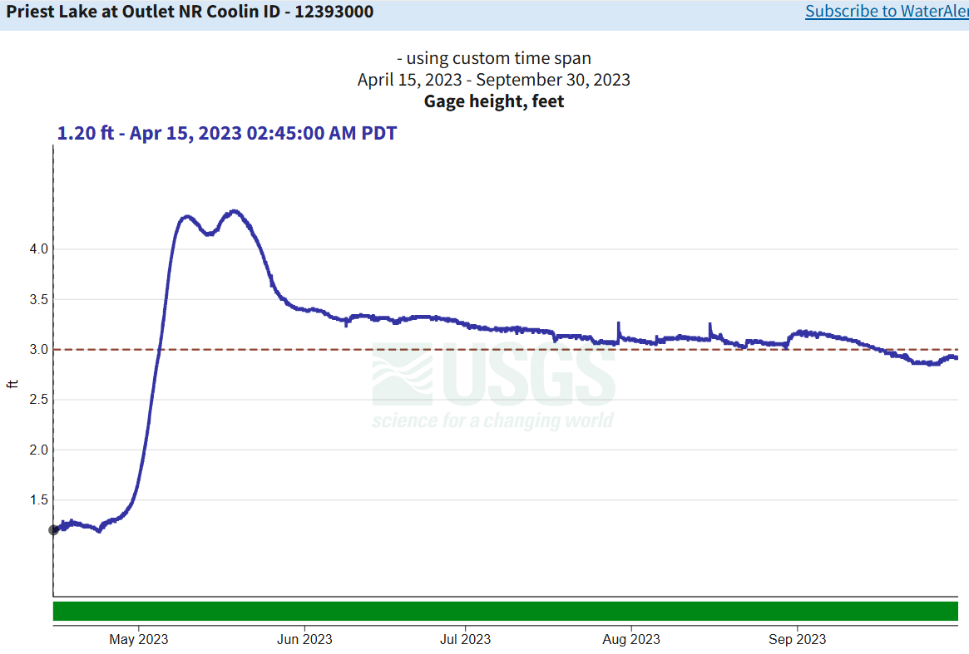
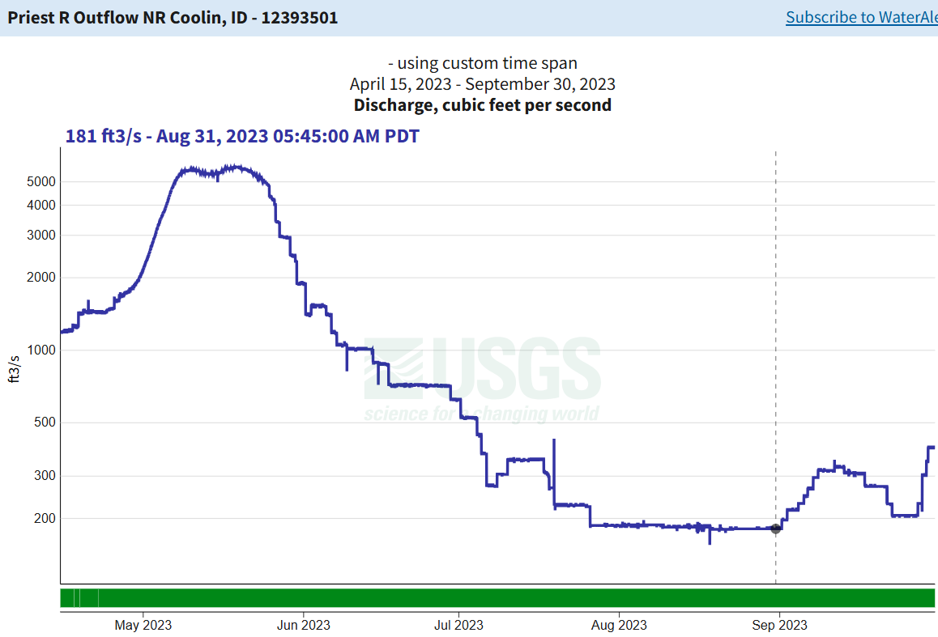
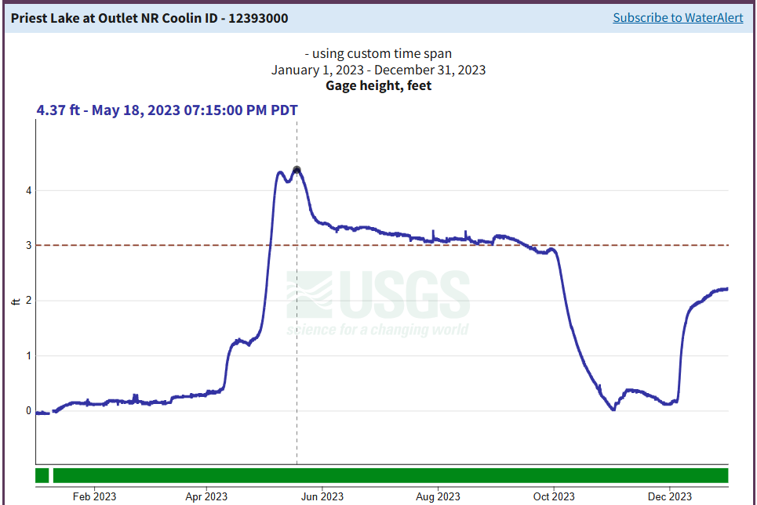
Summer - 2023
Hold river at 184 cfs, (7/26-9/1)
Takeaways – Priest River Flow down to 230 cfs

Slide 18
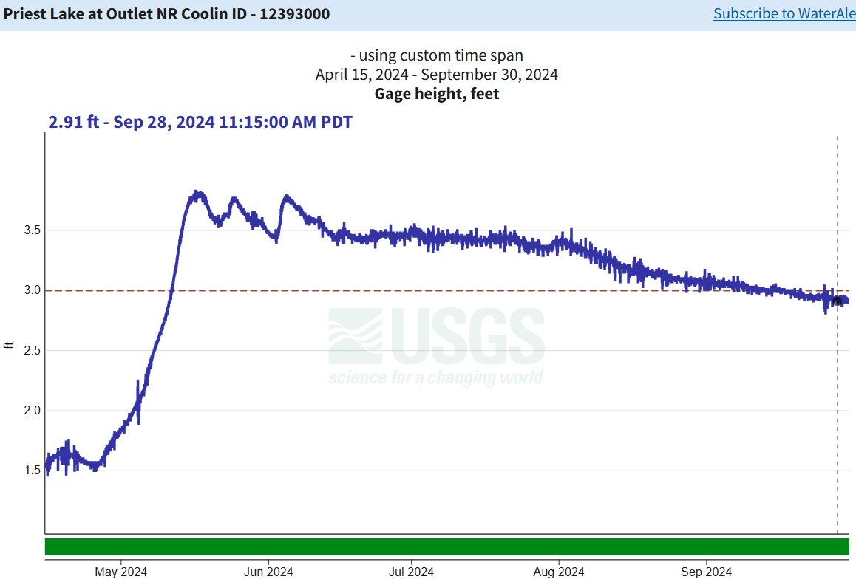
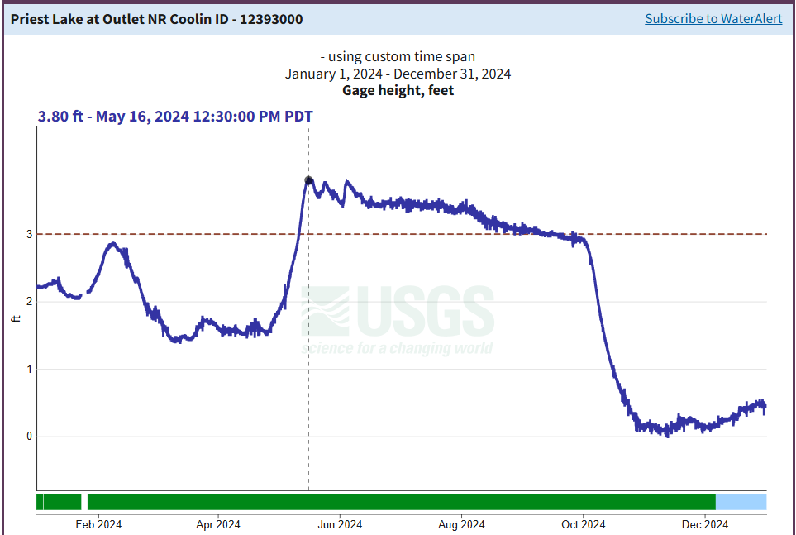
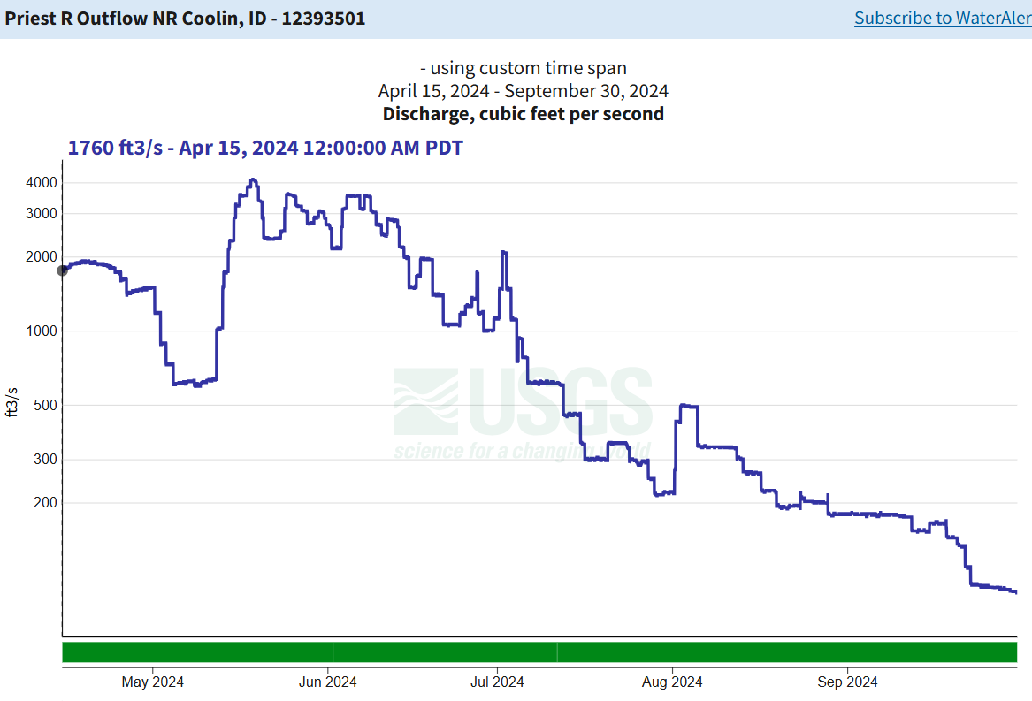
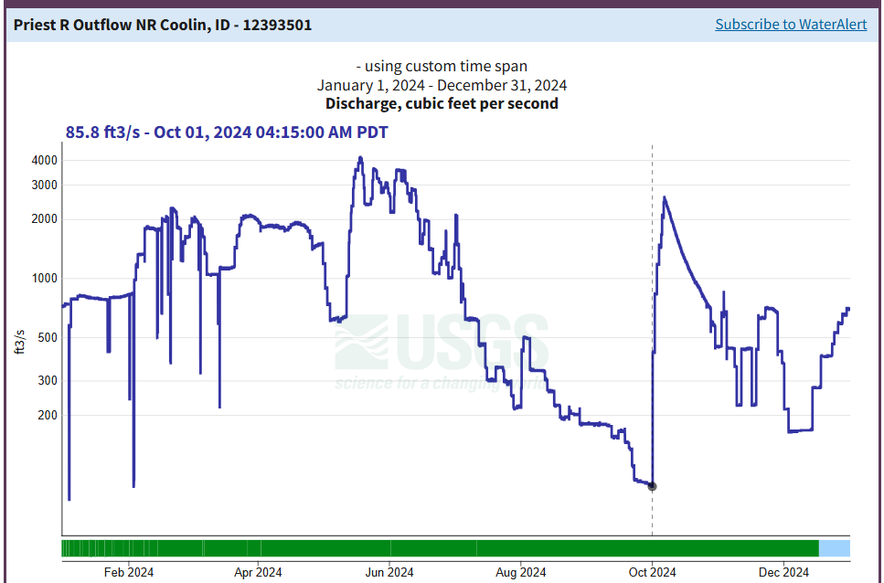
Summer - 2024
Hold lake at 3.43 ft, then release to 3.0
Takeaway – slow the release down to bring lake to 3.0 ft by 9/30

Slide 19
Supporting Guidance
IF&G
  200 cfs minimum from 8/1 to 10/31
  400 cfs ideal
IWRB
  MSF 300 cfs (8/1 to 10/31)

Slide 20
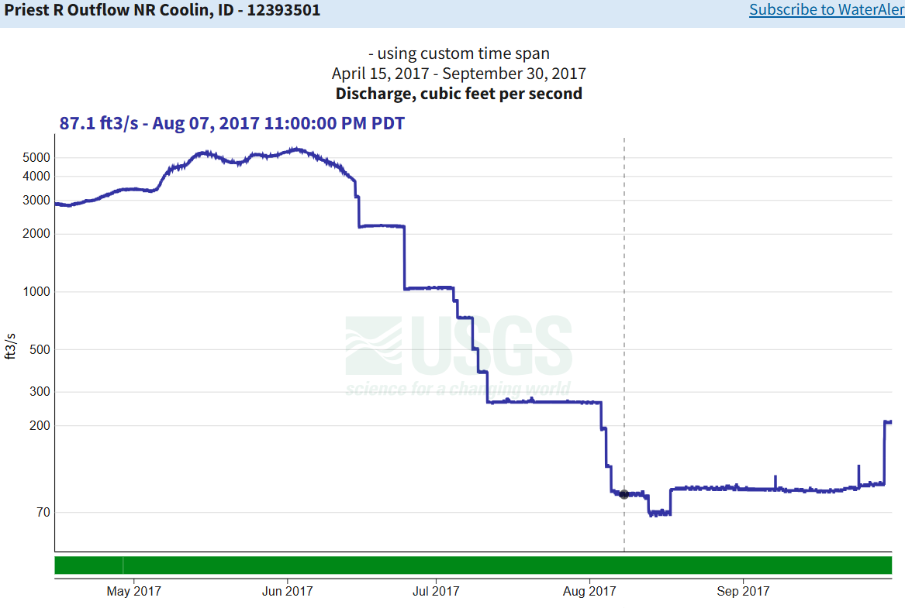
2017
Sustained low
flow
Target Flow Rate
Volume Deficit

Slide 21
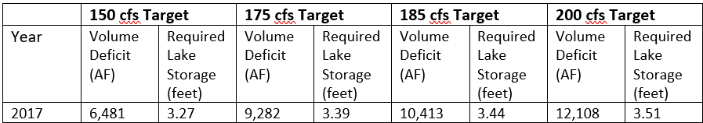
Targets
2017

Slide 22
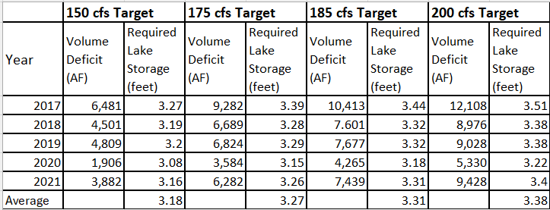
Targets
Average of 2017-2021
Why not 400 cfs?

Slide 23
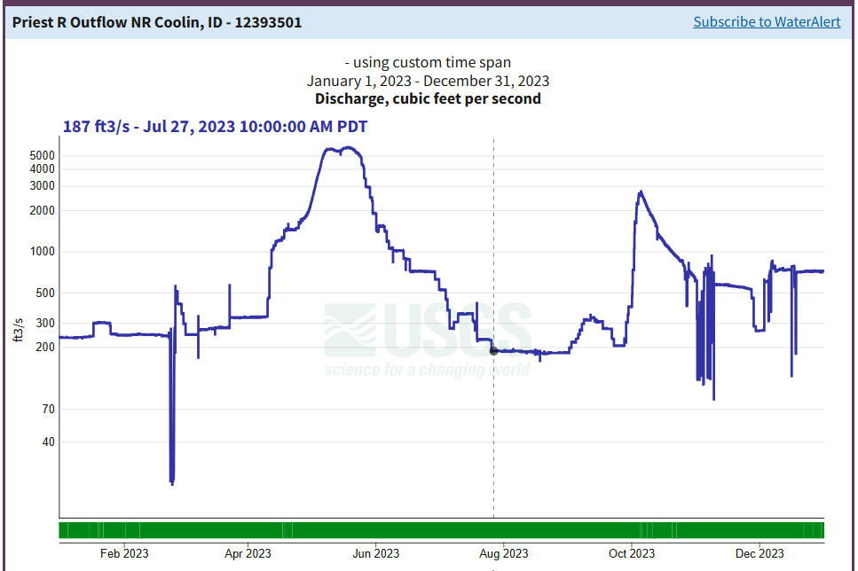
Recommended Best Practices – Dry Years
Hold lake to 3.31-3.44 feet
Target flow rate of 200 cfs
Flow will fall below target in
some dry years
Wet years – no change

Slide 24
Dates Flow Drops
Target Flow:
200 cfs
Date Drop Below 200 cfs
2017 | 8/3/2017
2018 | 8/9/2018
2019 | 8/10/2019
2020 | 8/13/2020
2021 | 7/8/2021

Slide 25



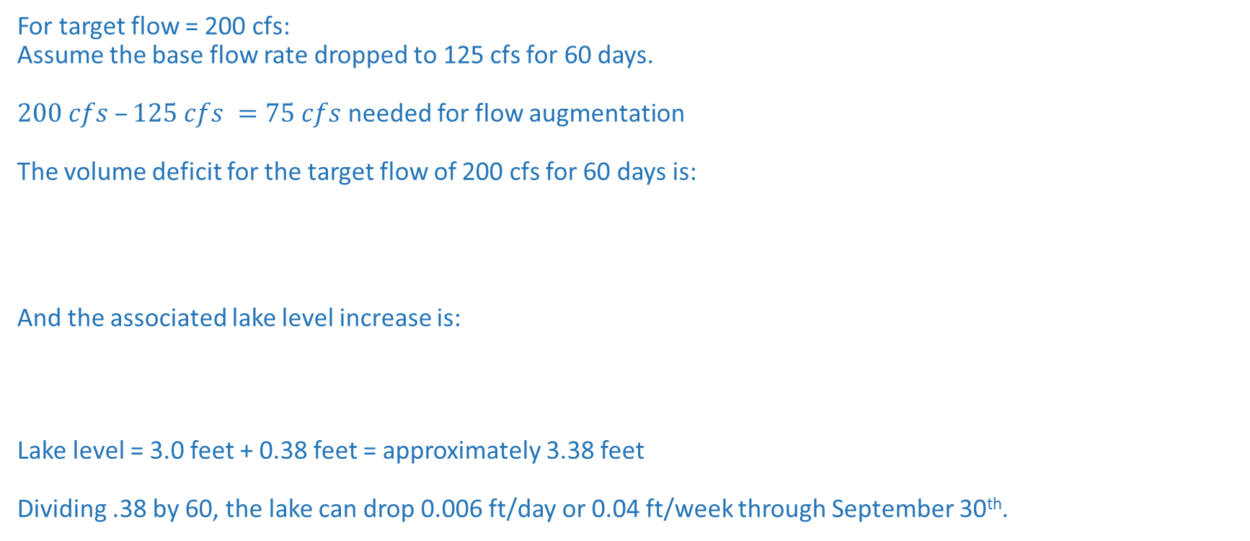
Target Flow & Lake Level Calculations
The following shows a sample calculation to reach the values in Table 8 above.
Assume the base flow rate dropped to 97 cfs for 60 days. The flow augmentation would be 88 cfs to bring the flow back up to 185 cfs.
$185 cfs – 97 cfs = 88 cfs$ needed for flow augmentation
The volume deficit for the target flow of 185 cfs for 60 days is:
$$88 cfs ∗ (1.9835 AF/day)/1 cfs = 174.5 AF/day ∗ 60 days = 10,473 AF$$
And the associated lake level increase is:
$$10,473 AF ∗ (.1 ft/2380 AF) = 0.44 ft$$
Therefore, the lake level during the recreation season would need to be held at:
Lake level = 3.0 feet + 0.44 feet = approximately 3.44 feet
For target flow = 200 cfs:
Assume the base flow rate dropped to 125 cfs for 60 days.
$200 cfs –125 cfs =75 cfs$ needed for flow augmentation
The volume deficit for the target flow of 200 cfs for 60 days is:
And the associated lake level increase is:
Lake level = 3.0 feet + 0.38 feet = approximately 3.38 feet
Dividing .38 by 60, the lake can drop 0.006 ft/day or 0.04 ft/week through September 30th.

Slide 26
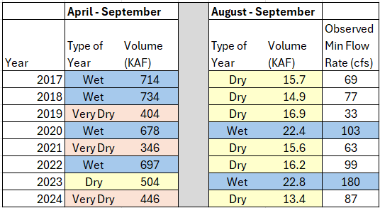
End of Summer vs Spring Volumes

Slide 27
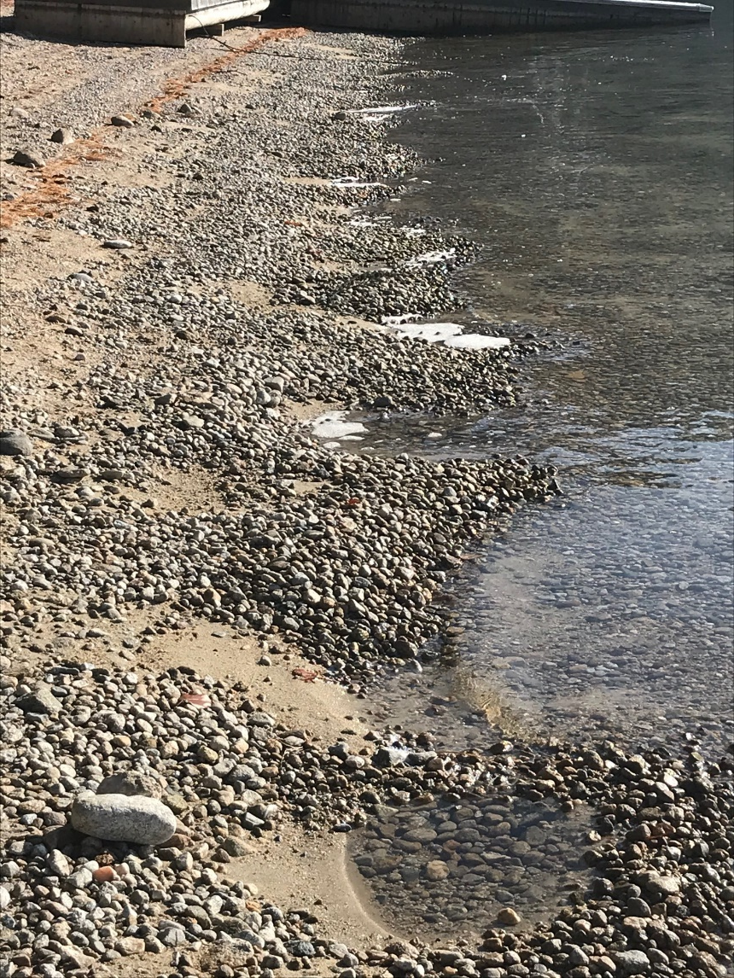
Fall Release supporting Guidance
Statute: Close of main recreation season
IF&G: Complete by Nov. 1
IF&G: >600 cfs, negative impact
IF&G: 1000 cfs max
Photo – Craig Hill, Nov. 12, 2019

Slide 28
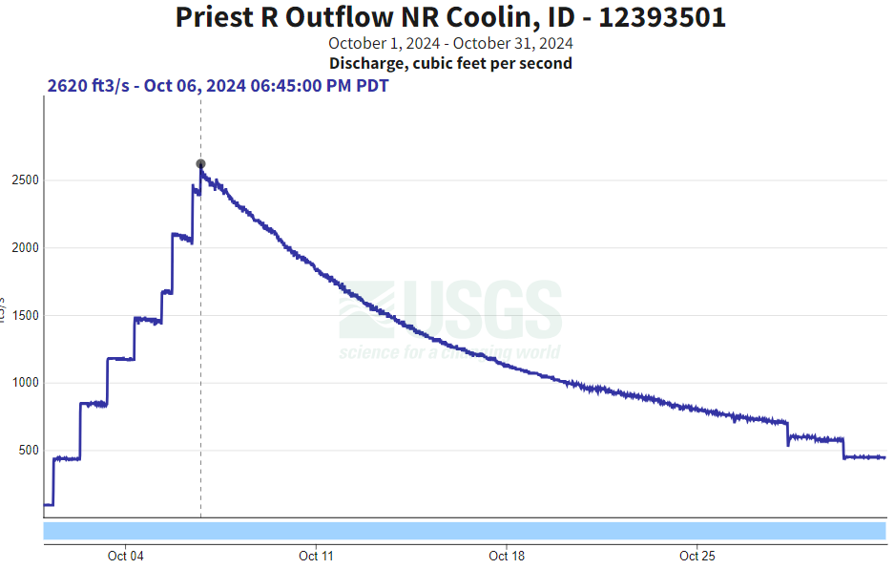
Fall Release Past Practices
WWP/Avista operated for water releases in Fall for downstream power production
Incrementally open gates
Lake drains
Flow exceeded 2000 cfs

Slide 29
Fall Release Best Practices
No current agreements for power production = opportunity
Incrementally open gates on Oct. 1
Cap at 1000 cfs
Instead of dropping 3 feet, lake drops 2 feet
To ~1.0 foot by Nov. 1 & Hold
Leaves room for spring runoff

Slide 30
Fall Release Best Practices
Cap at 1000 cfs

Slide 31
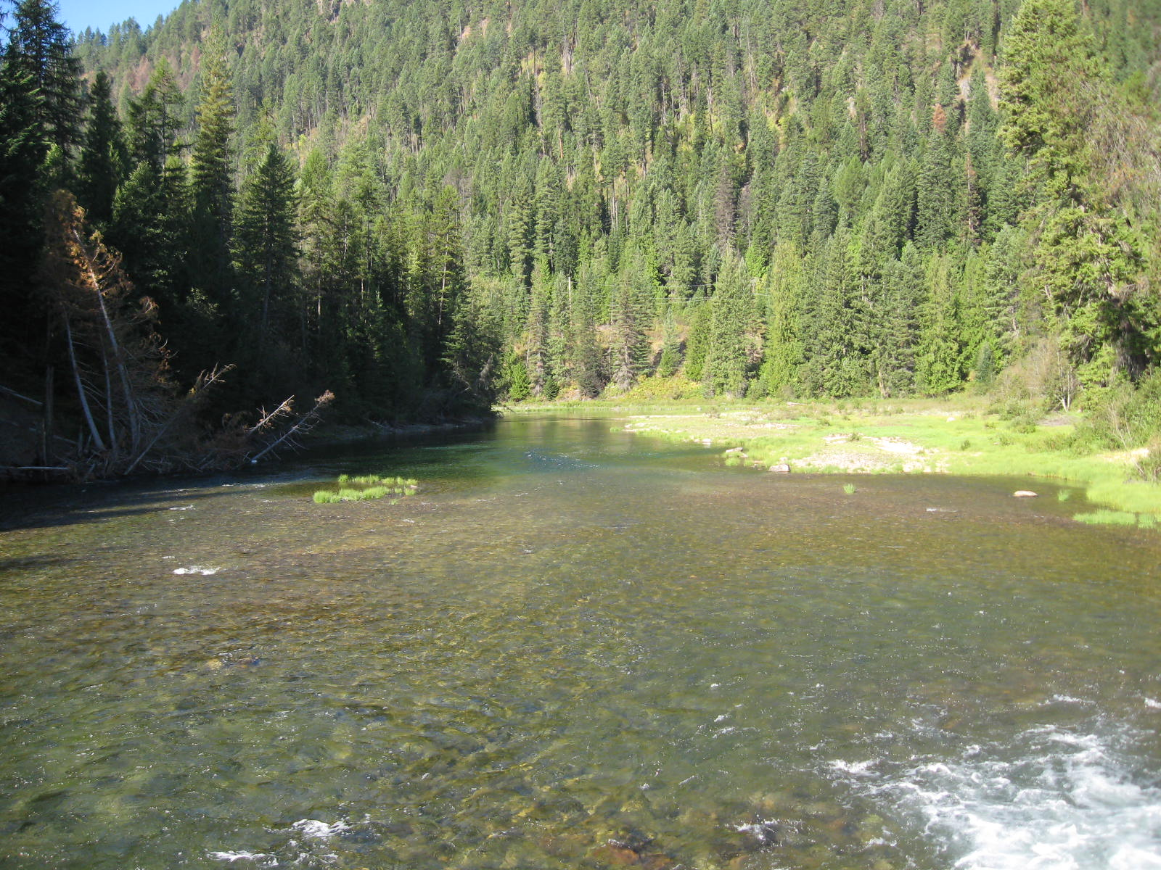
Next Steps
Data collection
Informed decisions
Stakeholder input
Communication

Slide 32
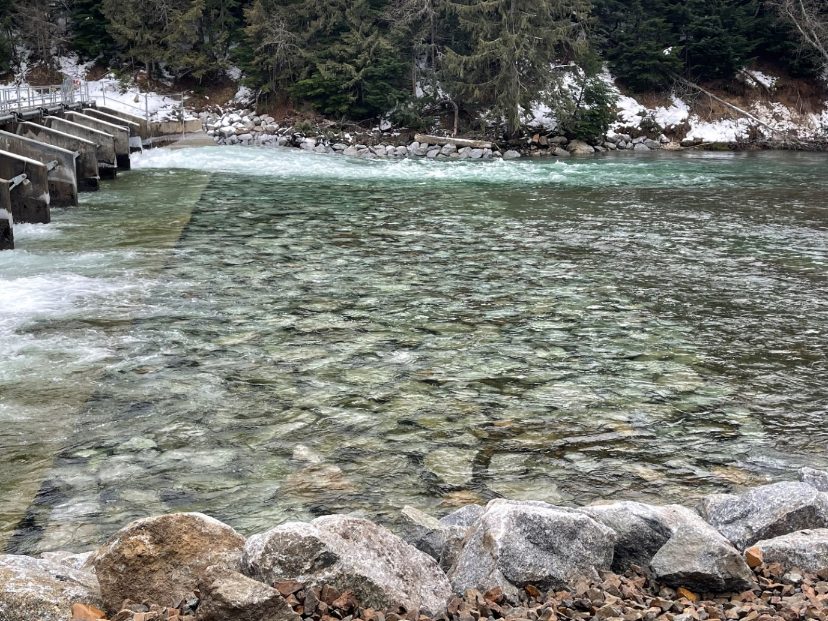
Conclusions
Planning for the future
Striking a balance to manage
the lake and river as a system

Slide 33
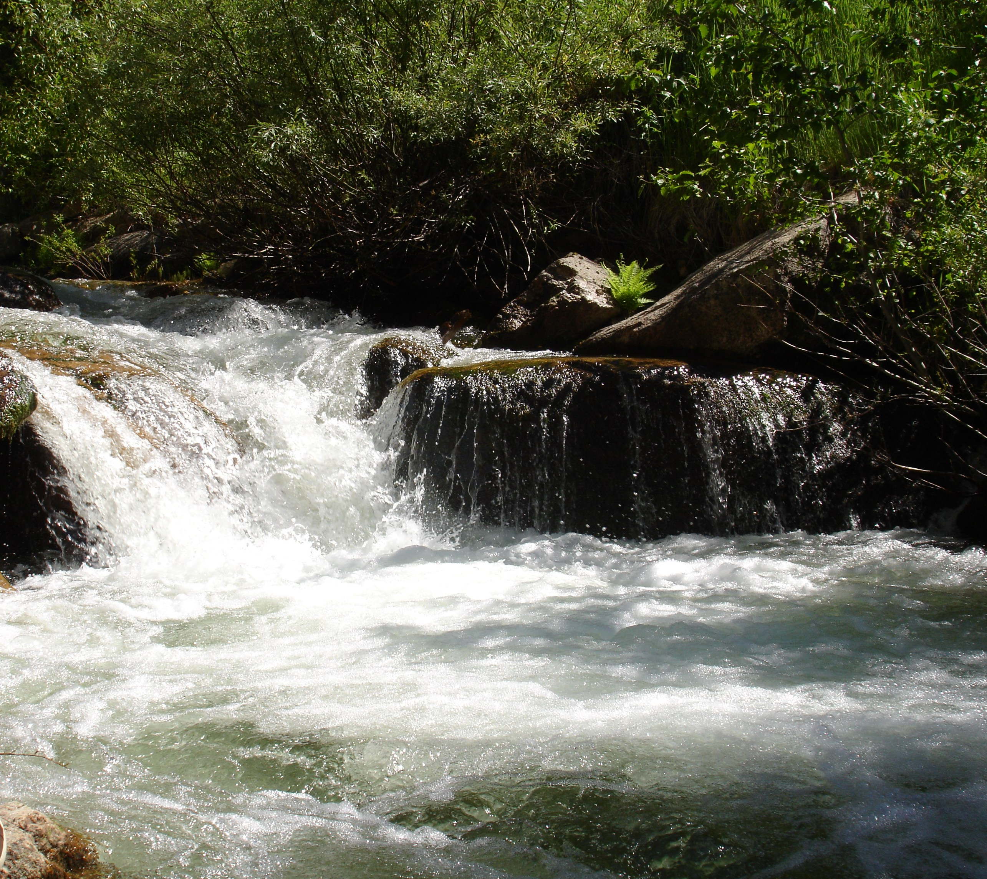
Questions?
Michelle Richman
northerninfo@idwr.Idaho.gov
208-762-2800

Slide 34
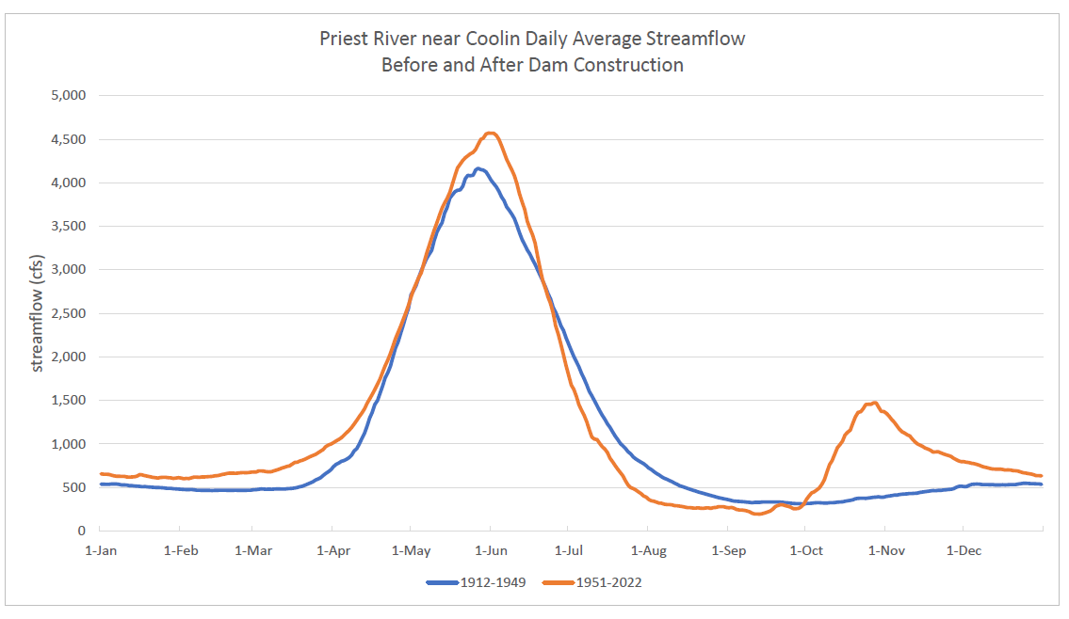
Average River Flow Before & After Dam Built
Before dam
Average flow met
MSF water right
in September
After dam
Average flow did not
meet MSF water right

Slide 35
Average Lake Level Before & After Dam Built
Hydrograph – Lake

