Slide 1
Avista’s Clark Fork River Operations
Eric Oldenburg and Monica Ott
June 3, 2025

Slide 2
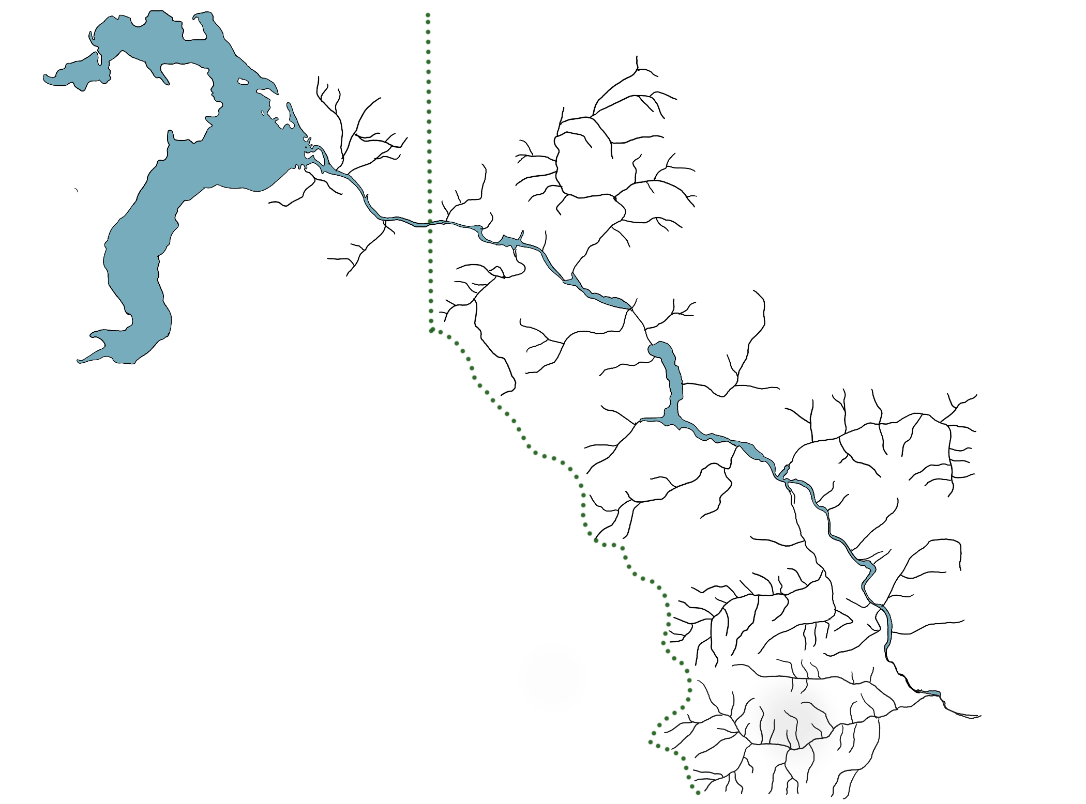
Albeni Falls
Noxon Rapids
Cabinet Gorge
Thompson Falls

Slide 3
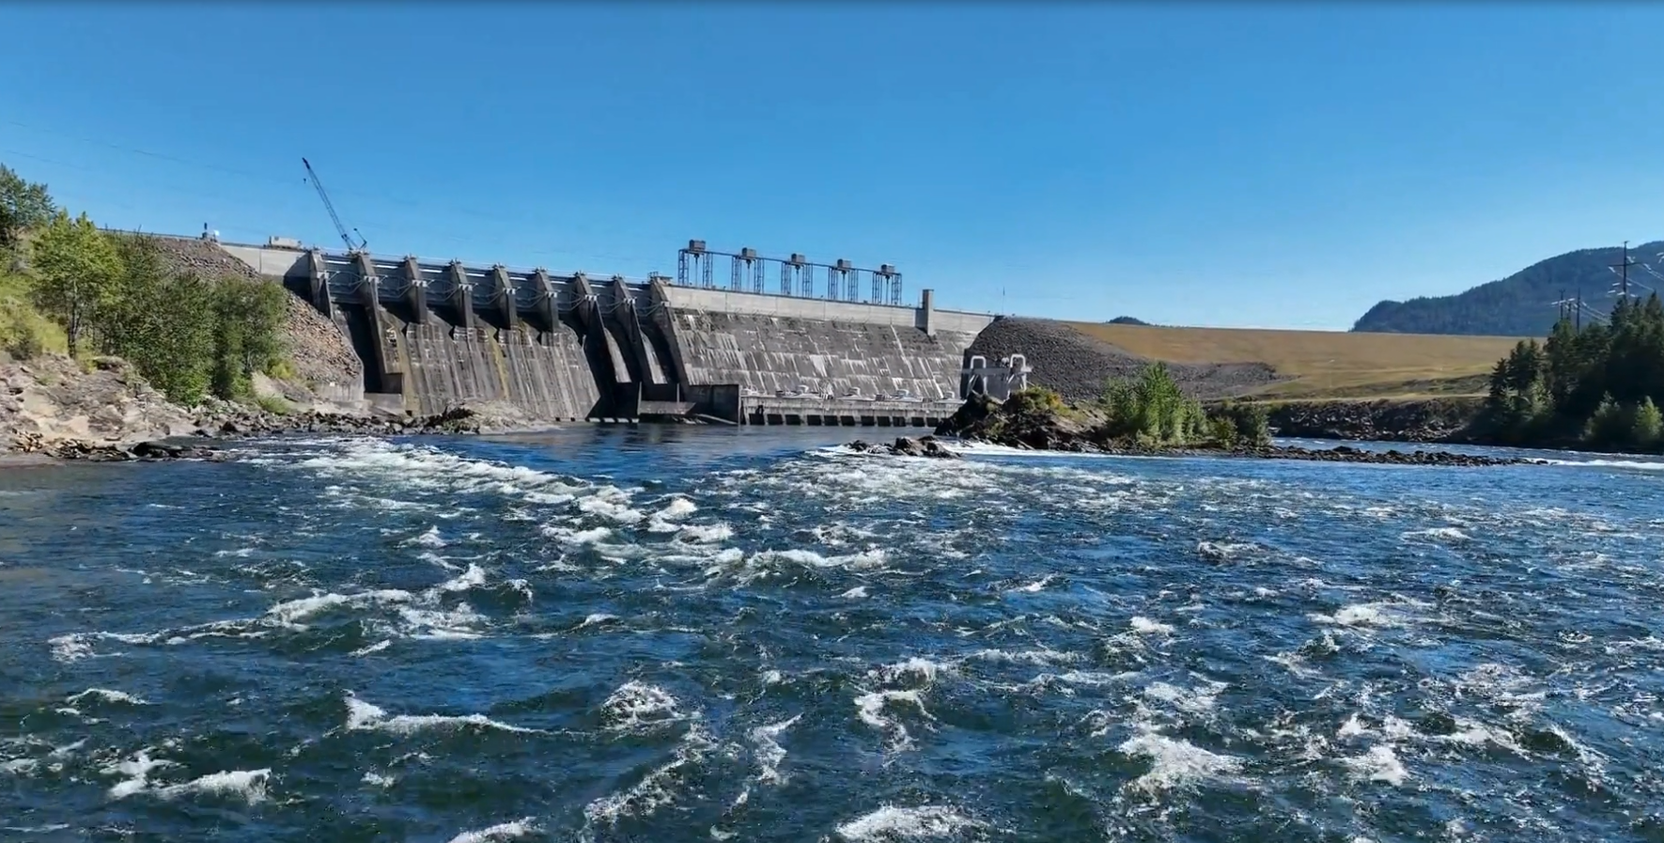
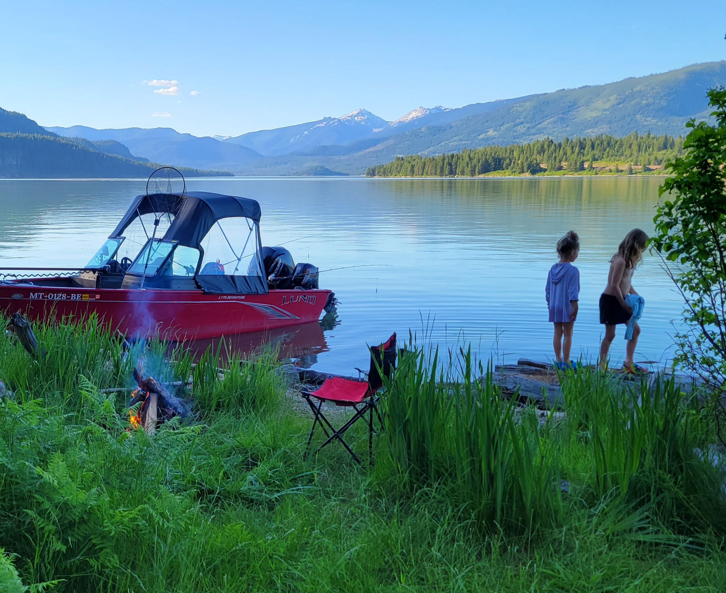
Noxon Rapids Dam and Reservoir
Dam
Completed in 1959
260 feet high
562 megawatts
Reservoir
36 miles long
95 miles of shoreline
225 feet maximum depth
12.2 square miles surface area
400,000 acre feet

Slide 4
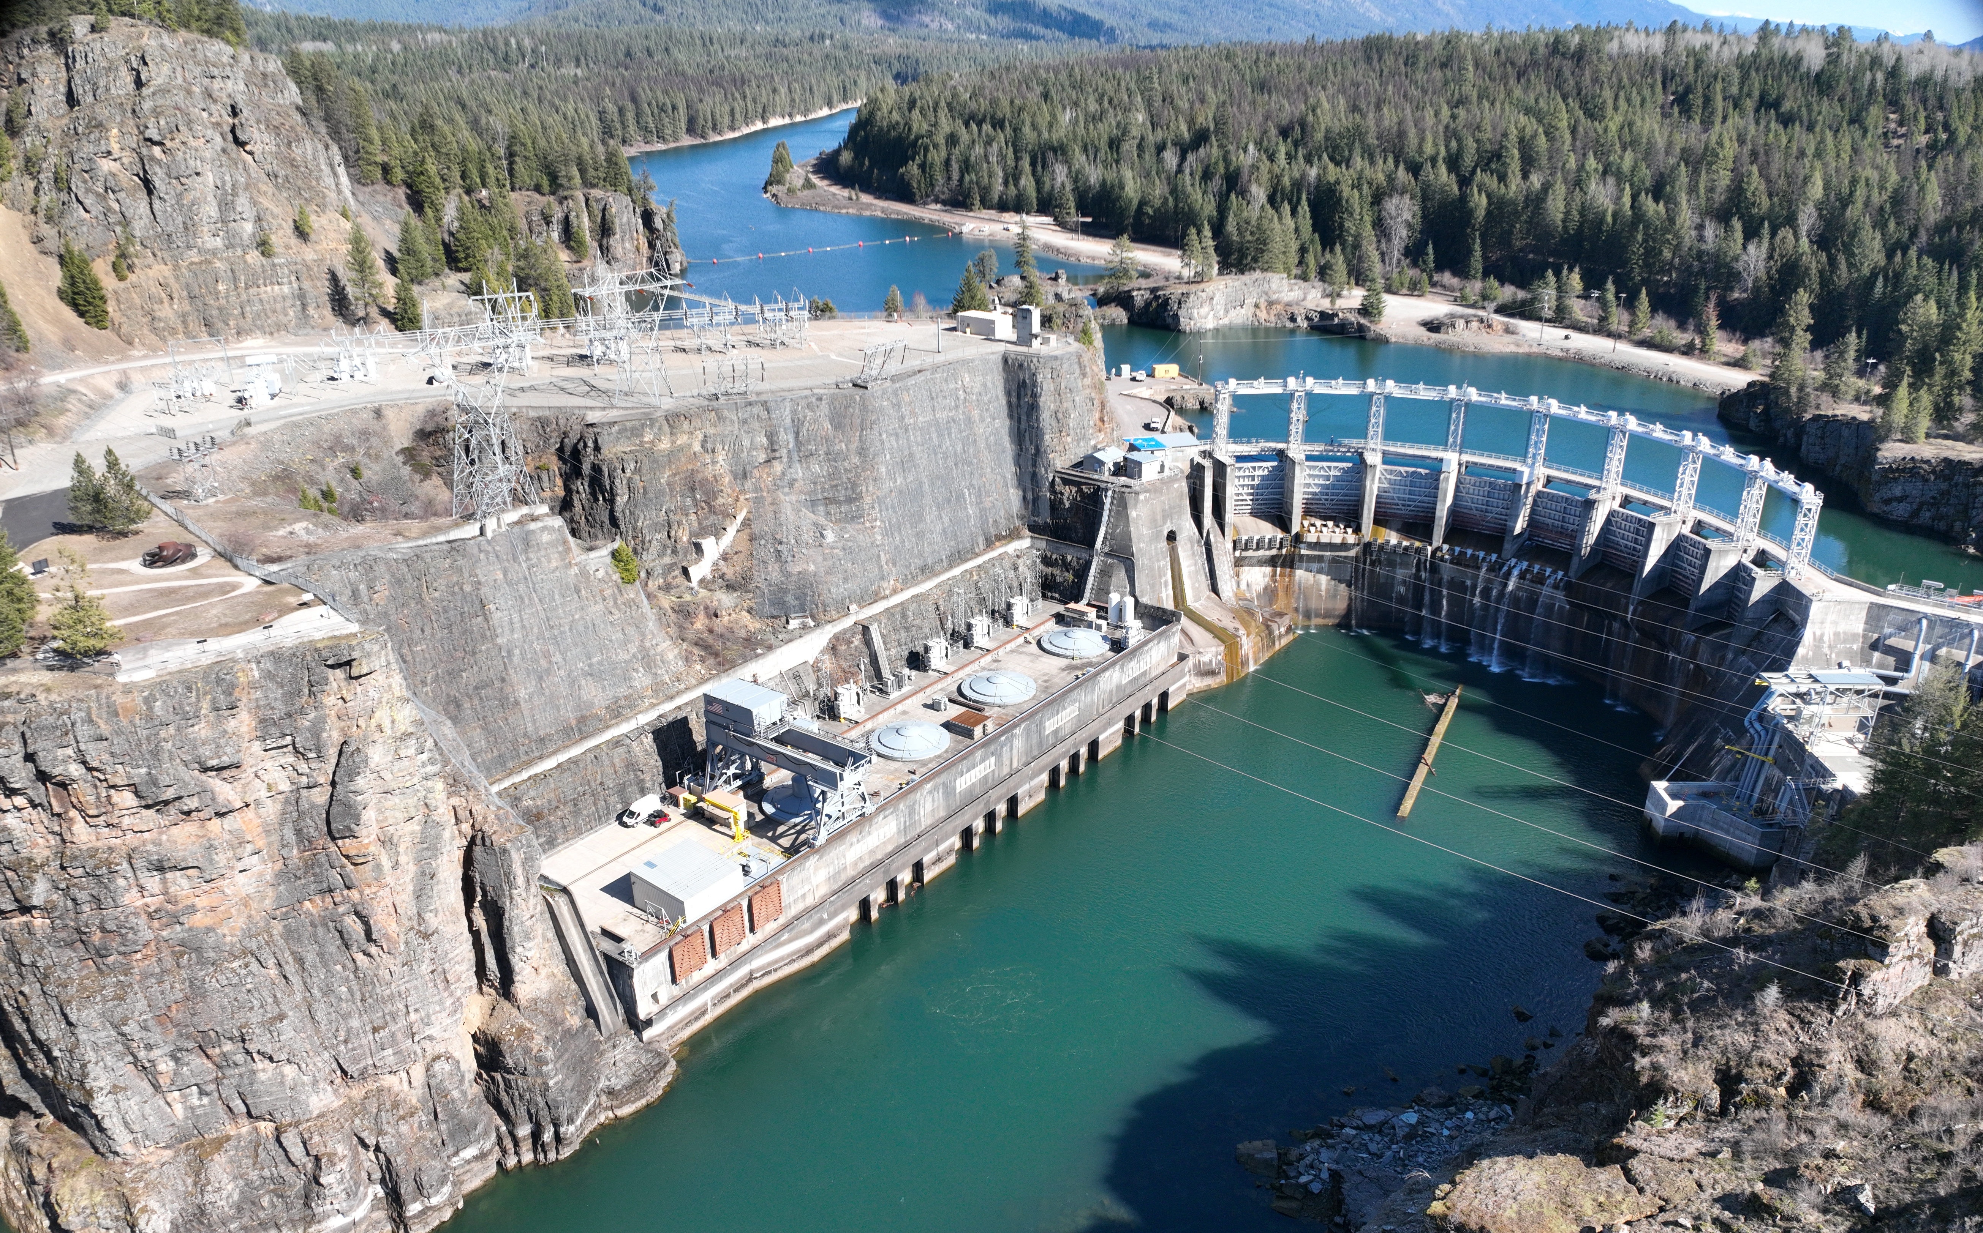
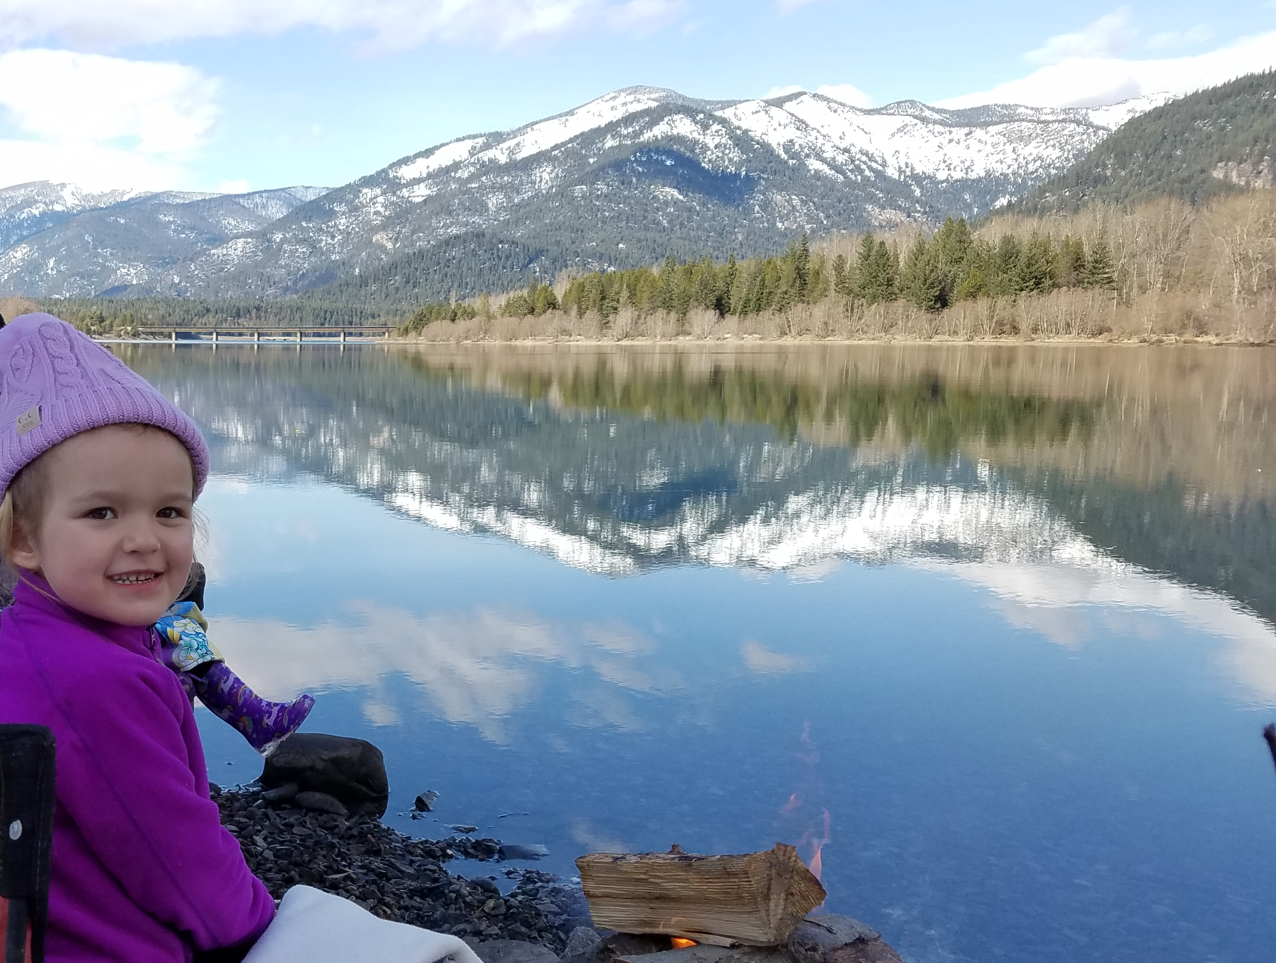
Cabinet Gorge Dam and Reservoir
Dam
Completed in 1952
208 feet high
273 megawatts
Reservoir
19 miles long
47 miles of shoreline
4.6 square miles in area
160 feet maximum depth
105,000 acre feet

Slide 5
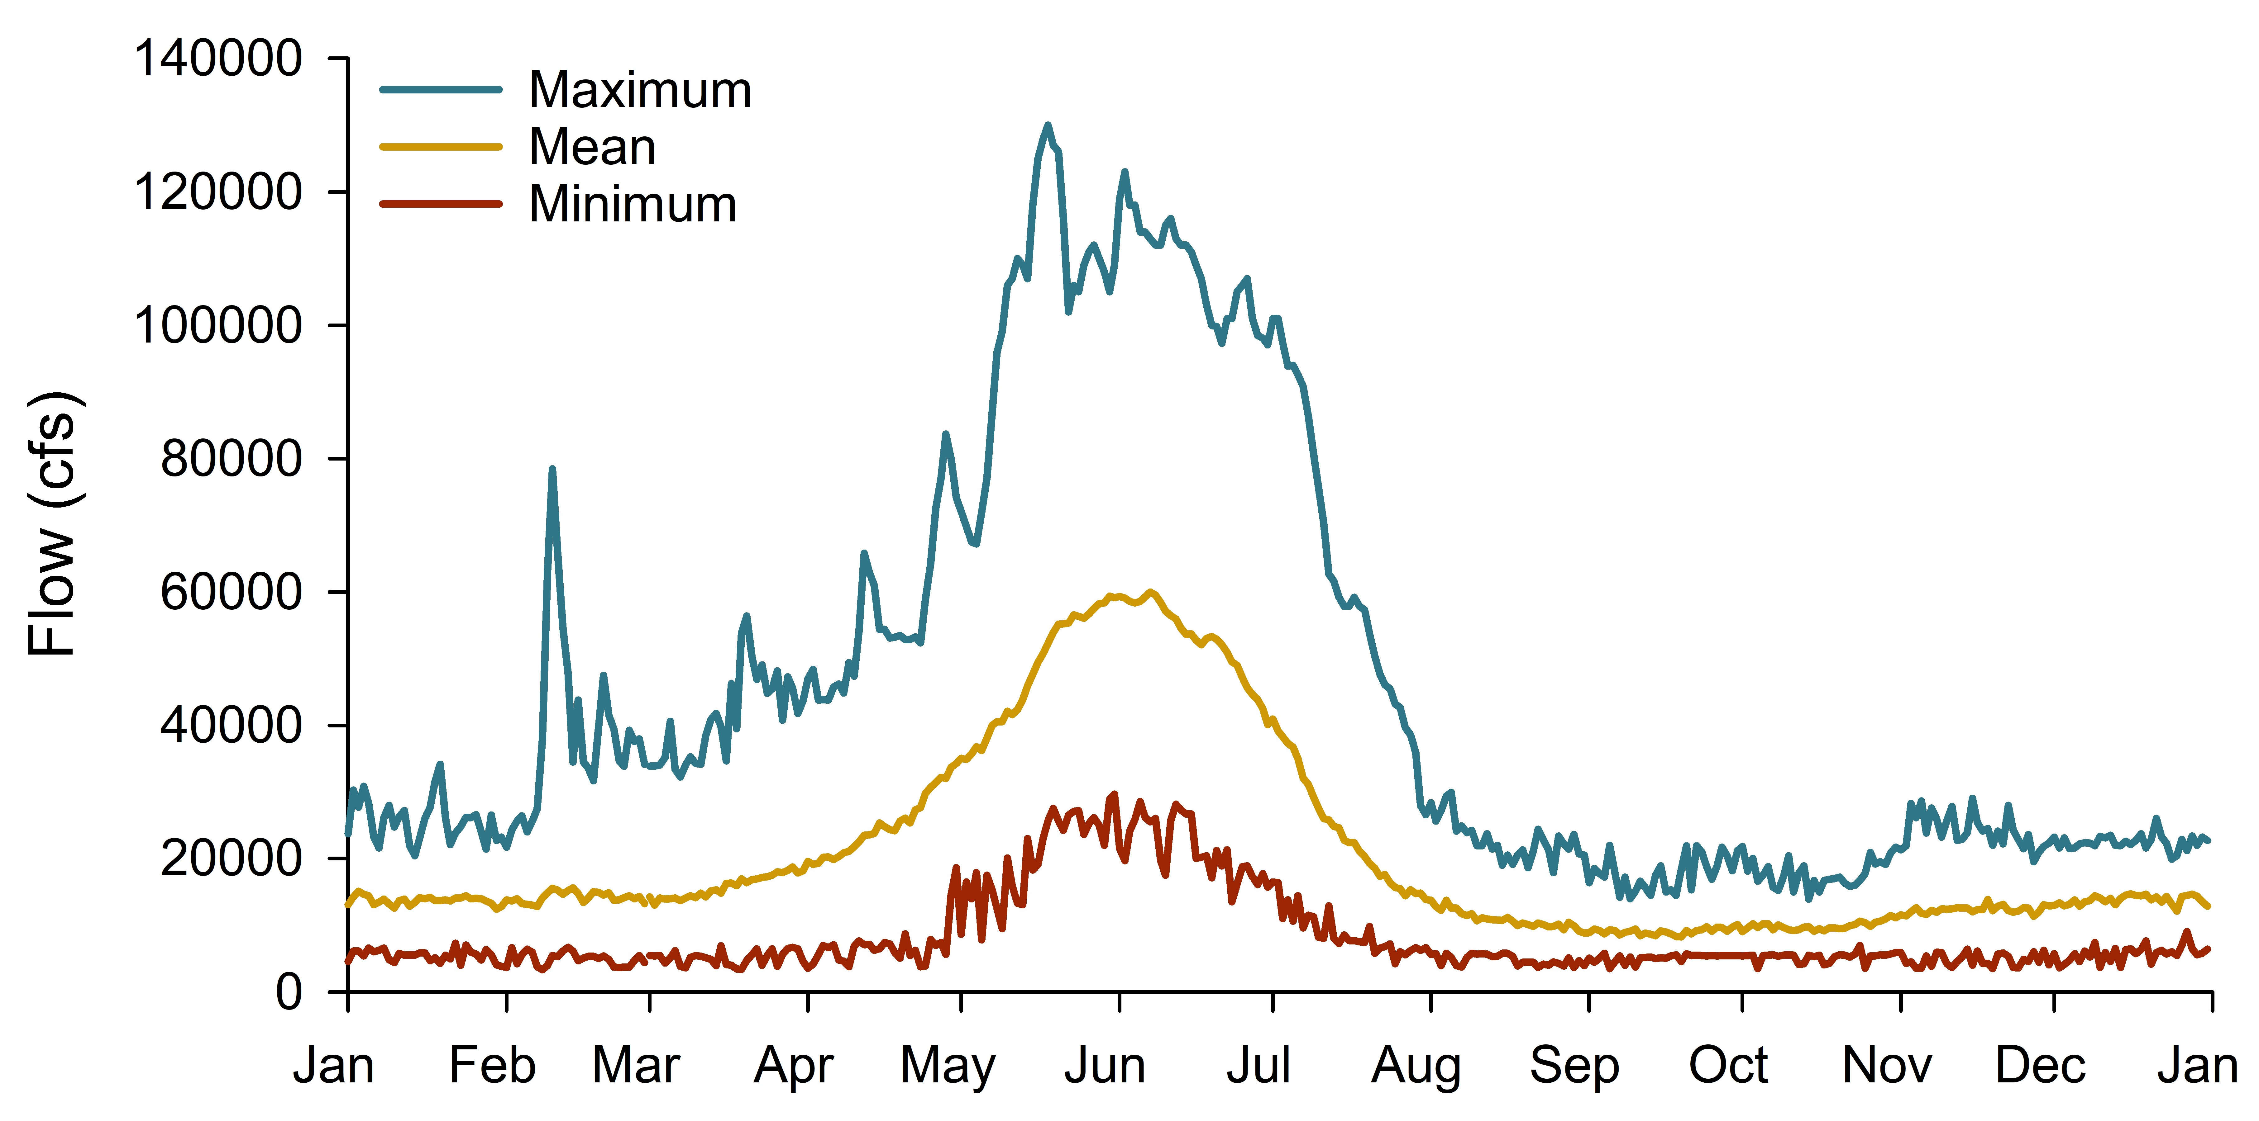
Clark Fork River flows

Slide 6
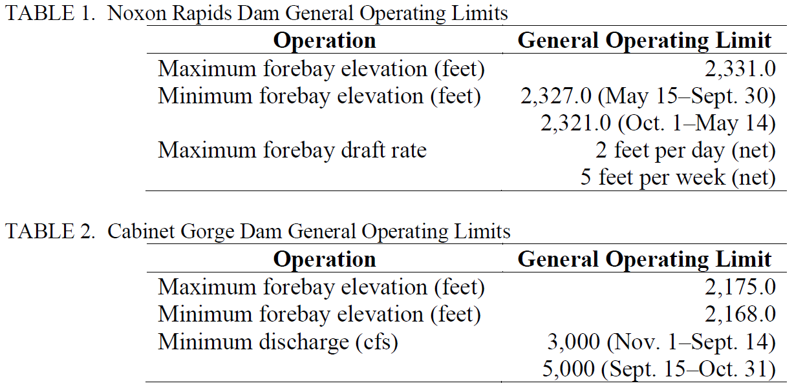
Operational constraints
General Operating Limits, total dissolved gas reduction, Fish Passage Facility operation

Slide 7
Waterbody volumes and active storage
Active storage
Total waterbody volume
Lake Pend Oreille (43 million AF)
Top 11.5’ = 1 million AF
Top 6” = 47 kAF
Cabinet Gorge (105 kAF)
Top 7’ = 22 kAF
Noxon Rapids (400 kAF)
Top 10’ (non-rec) = 74 kAF
Top 4’ (rec) = 31 kAF

Slide 8
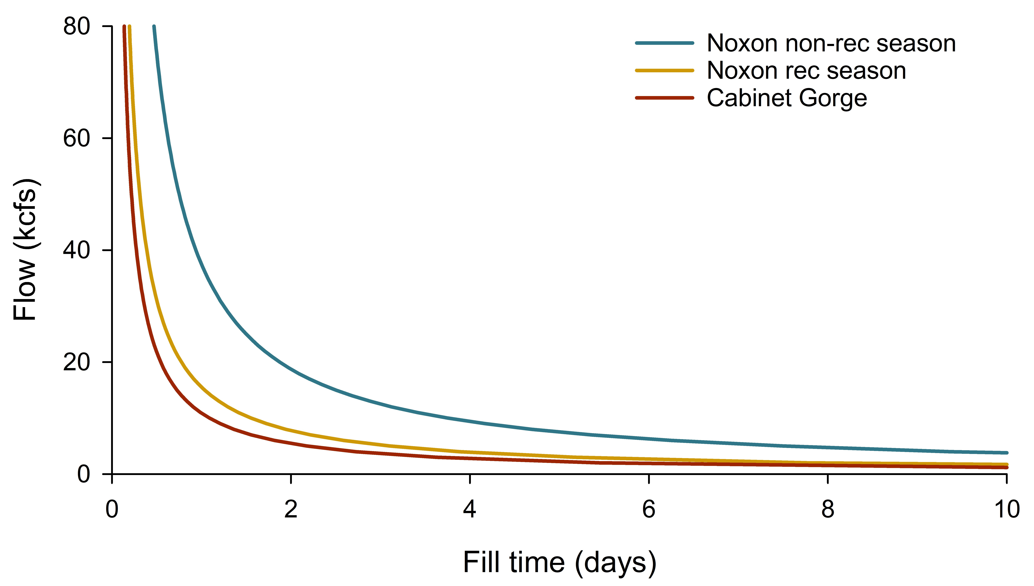
Time to fill active storage
60 kcfs = 15 hours
5 kcfs = 7.5 days

Slide 9
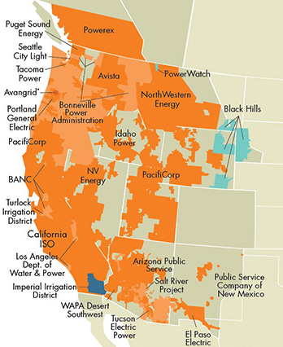
Power supply
Western Energy Imbalance Market (EIM)
  Participants commit resources which are centrally dispatched effectively and efficiently
  Reliability, affordability, efficient use and integration of renewables
Ensuring FERC compliance
  Resources committed to minimize risk
  Avista can opt out to ensure compliance
Within regulatory requirements, power is generated to maximize affordability and reliability

Slide 10
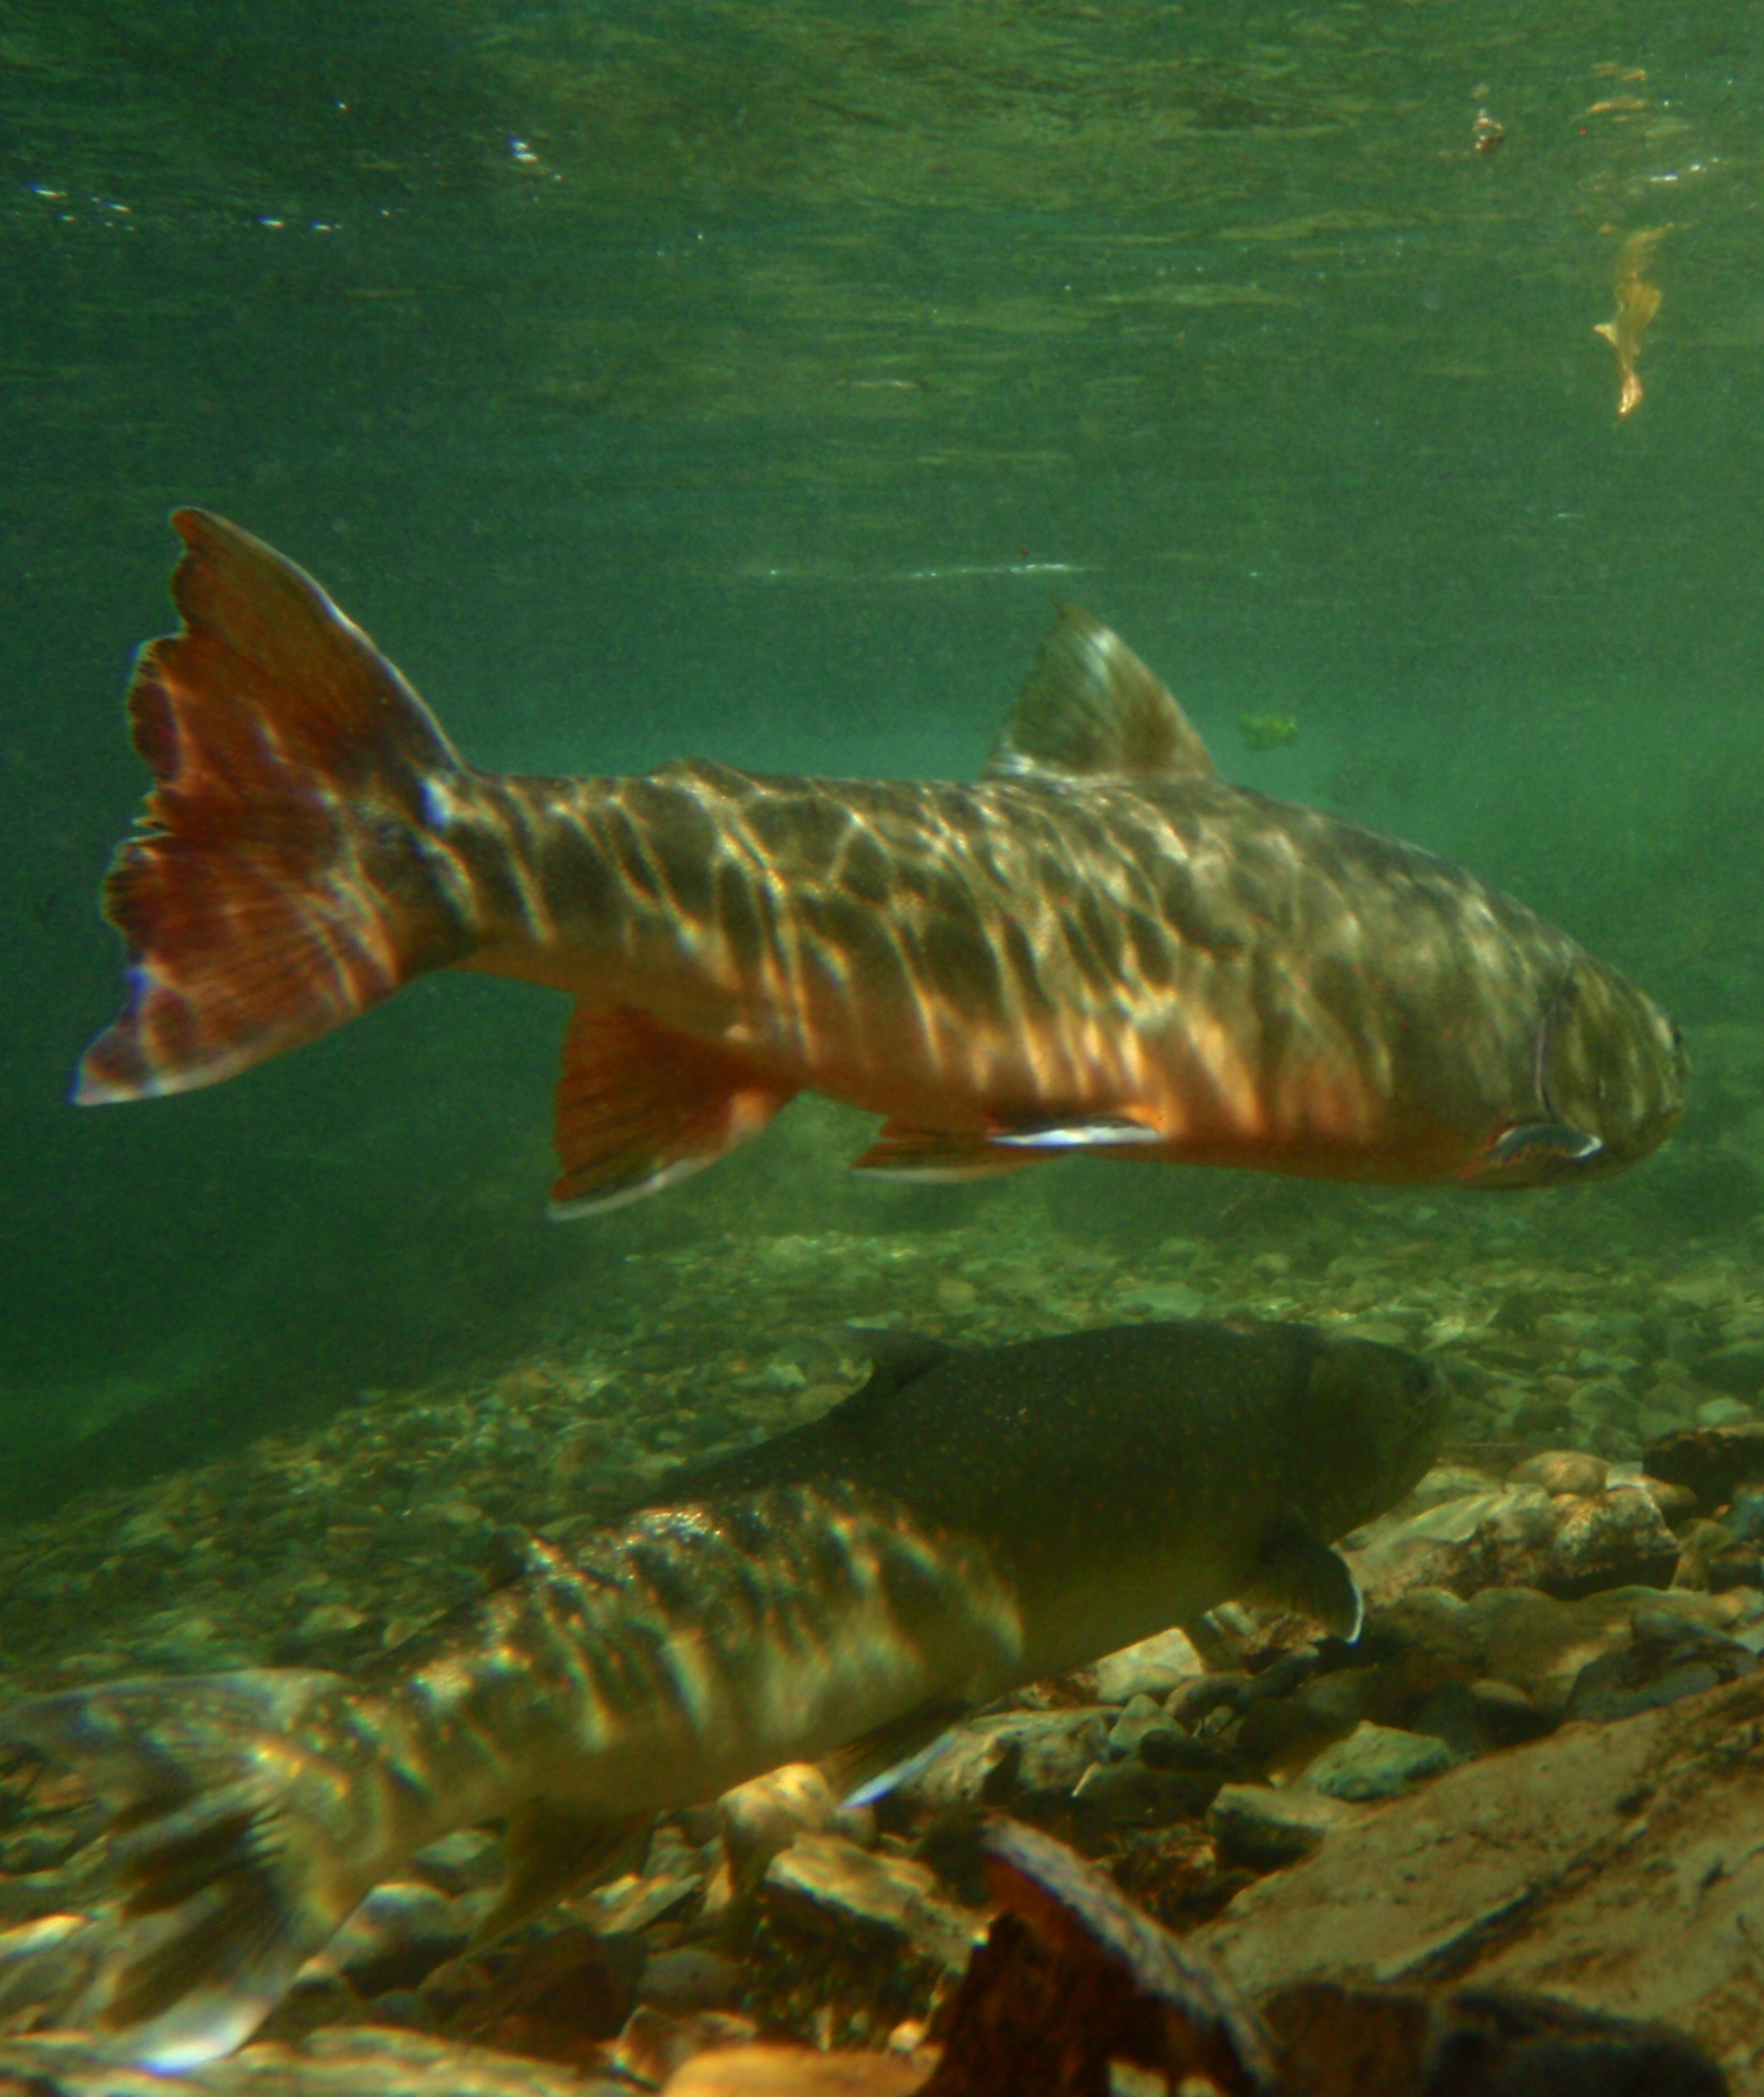
Earning the right to operate
Impeding fish passage
Fluctuating flows and water surface elevations
  Aquatic
  Terrestrial
Water quality
Land use and recreation resources

Slide 11
Avista’s FERC License for the Clark Fork Project
Previously two Licenses
Relicensing in late 90s
  Clark Fork Settlement Agreement
    Governed by a Management Committee
    Made funding available to achieve resource goals
    Defined process for evaluating projects and decision making
License issued in 2001 – 45-year term
  Incorporated the Settlement Agreement terms and conditions

Slide 12
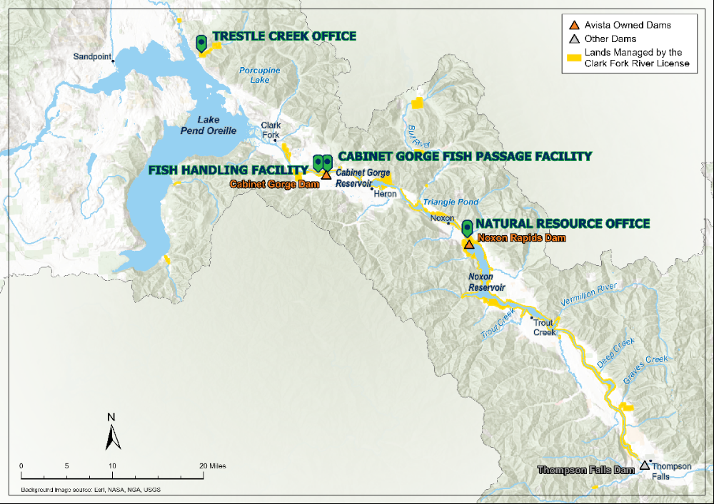

Slide 13
Eric Oldenburg
Paul Kusnierz
Shana Bernall
Sean Moran
Will Bass
Ben Birdsall
Robert Jakubowski
Mack Woodruff
Josh Storaasli
Kevin Duffy
Tim Tholl
Dylan Gollen
(Seasonal x4)
Arthur Potts
Jeremy Stover
Shawn Wilkinson
Davina Brown
(Seasonal)
Lisa Johnson

Slide 14
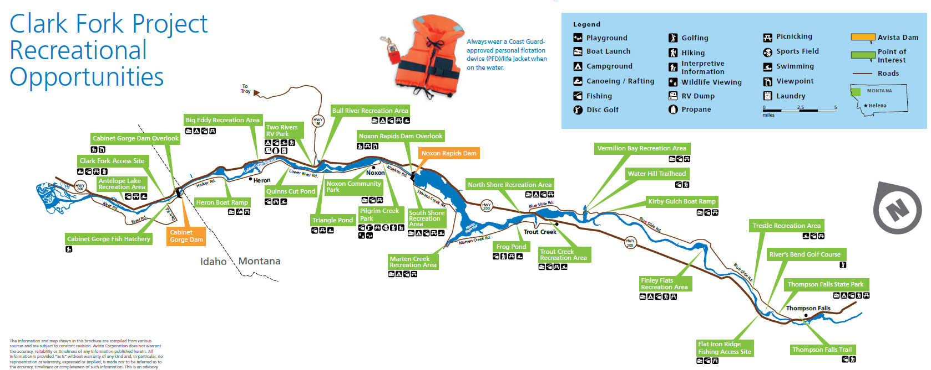
Recreation
Notes:
2022 Derr Island completed – project plan in 2022

Slide 15
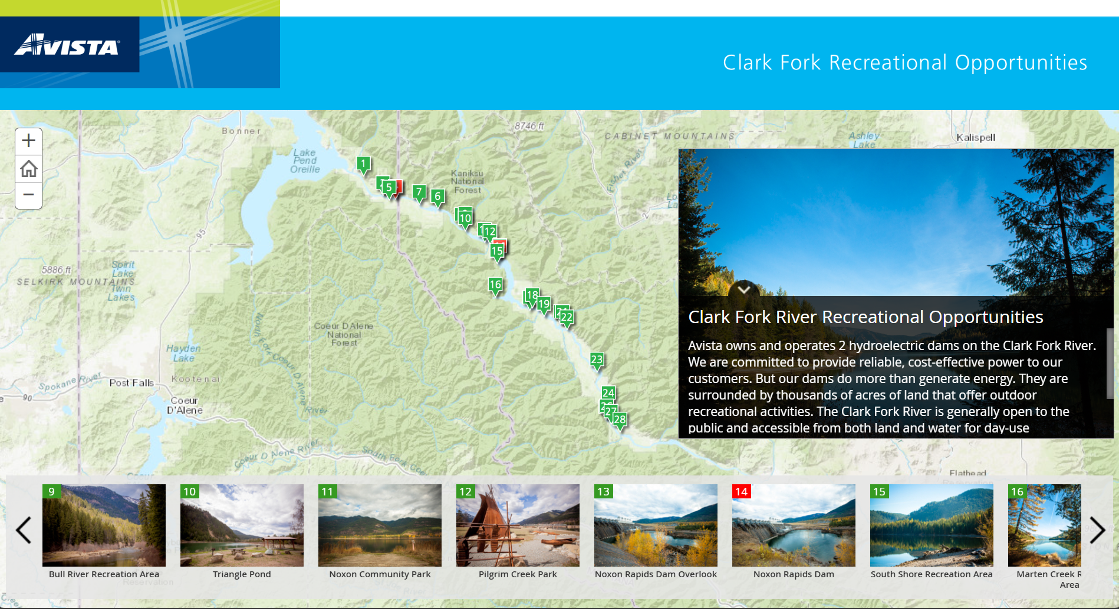
Recreation
https://www.myavista.com/storymap/clarkforkriver/index.html

Slide 16
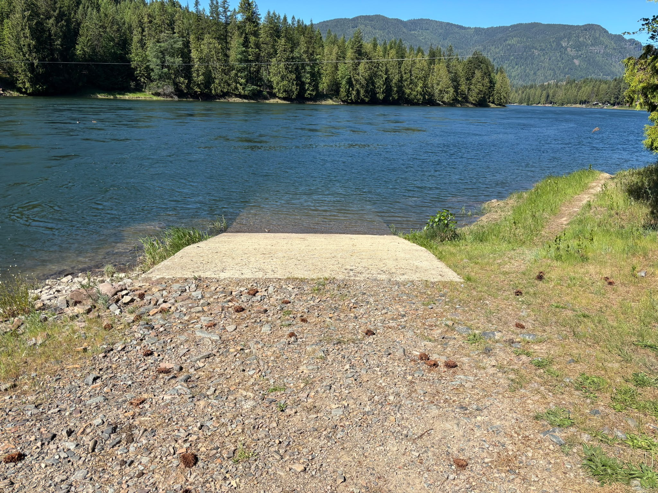
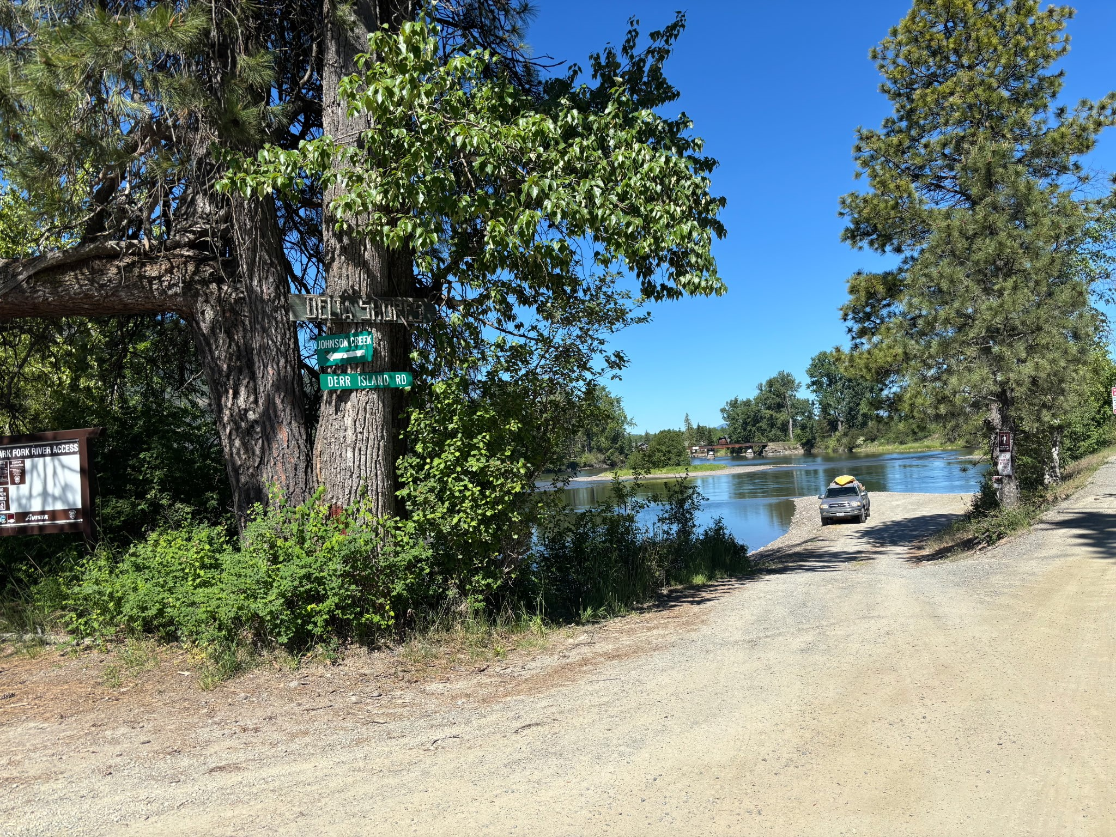
Recreation
Boat ramps and river access
  Clark Fork Access Site
  Derr Island launch
Notes:
2022 Derr Island completed – project plan in 2022

Slide 17
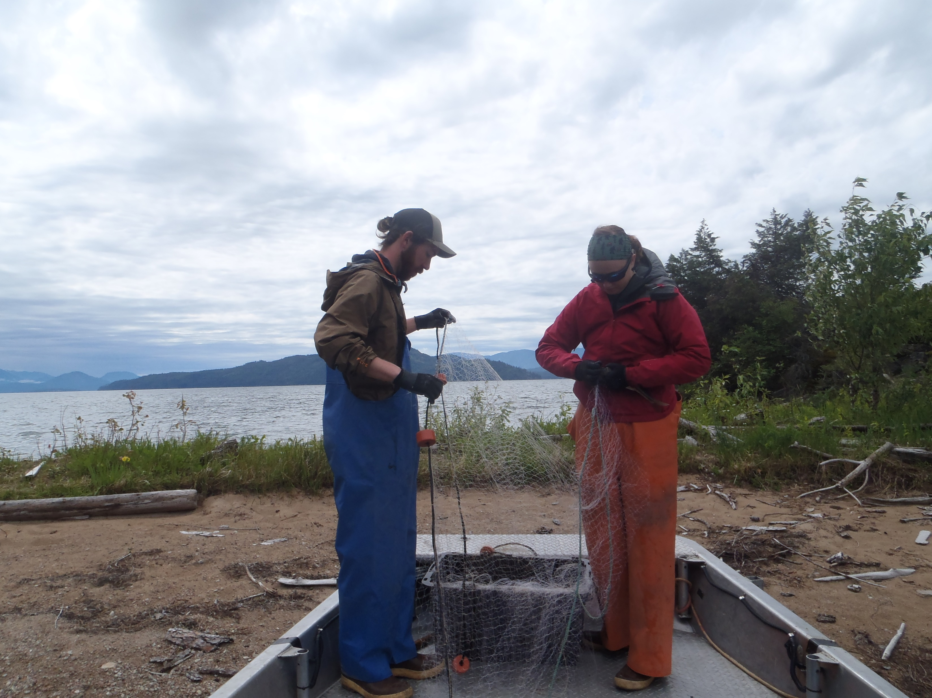
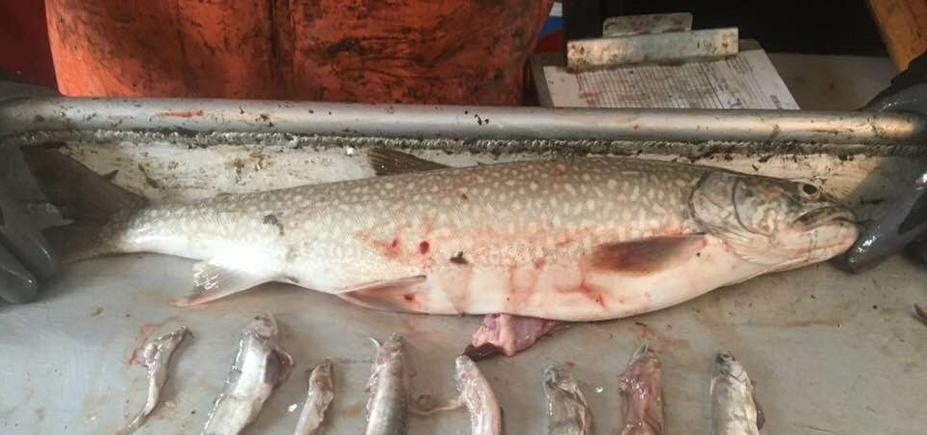
Fisheries
  Walleye netting
  Lake Trout netting
  Walleye angler incentive program
  Lake Trout angler incentive program

Slide 18
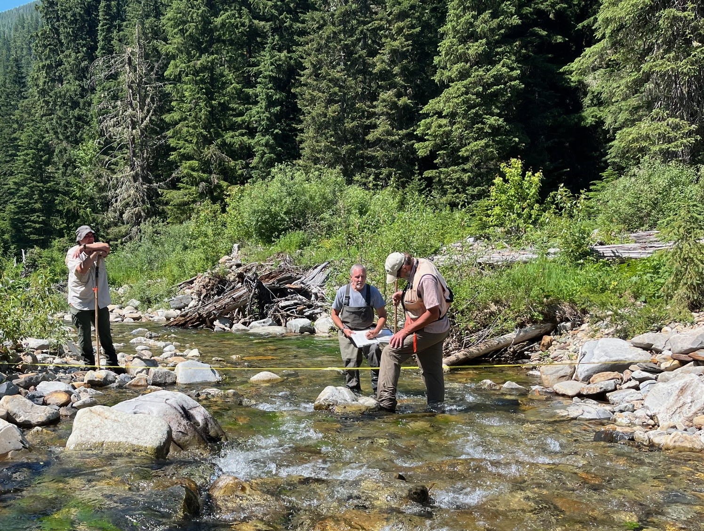
Fisheries
Habitat enhancement
Habitat acquisition and protection
Applied research and monitoring
Bull Trout education, outreach, enforcement

Slide 19
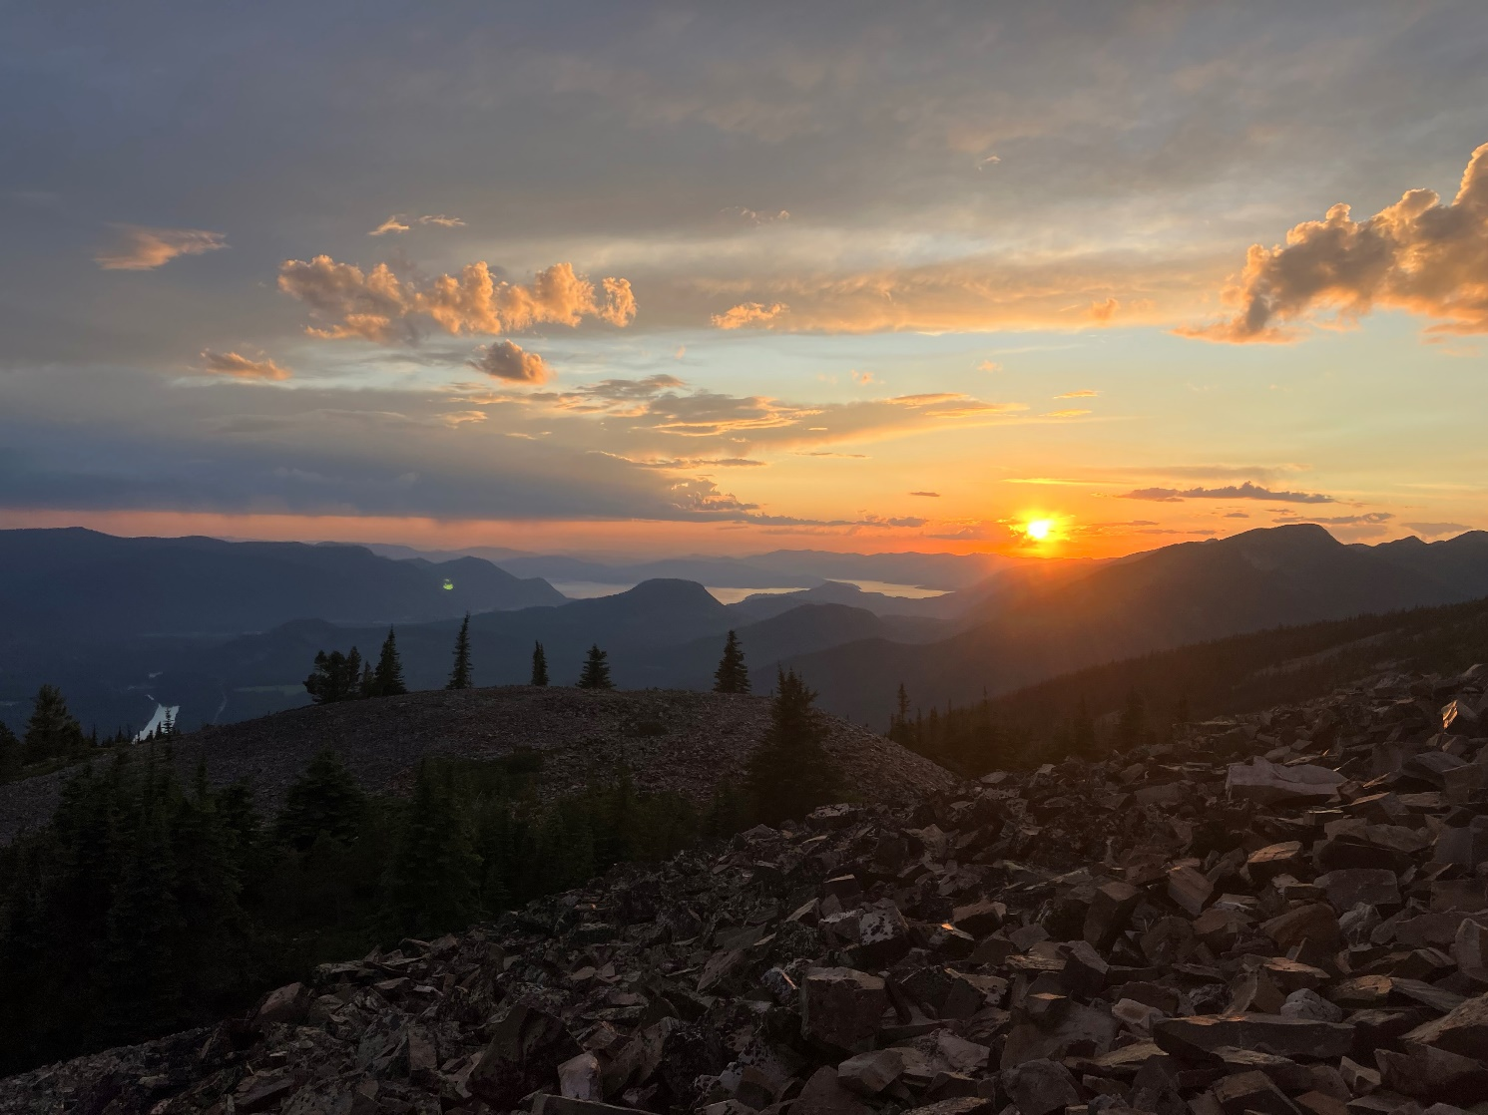
Questions and Contacts
Arthur Potts
Terrestrial Program Manager
Arthur.potts@avistacorp.com
(406) 847-1283
Monica Ott
Clark Fork License Manager
Monica.ott@avistacorp.com
(406) 847-1281
Eric Oldenburg
Aquatic Programs Manager
Eric.oldenburg@avistacorp.com
(406) 847-1290

