Slide 1
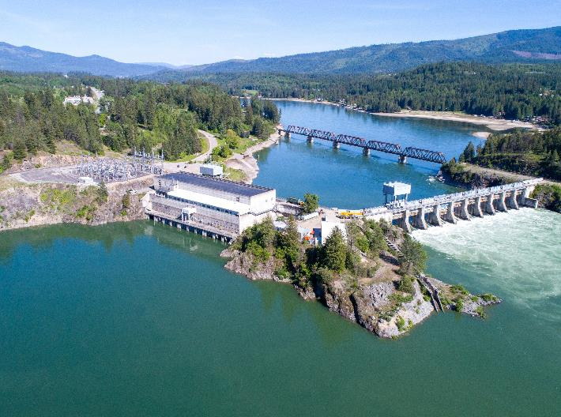


Albeni falls Dam and lake pend Oreille
June 3, 2025
Leon Basdekas
Upper Columbia Senior Water Manager
Taylor Johnson
Chief, Natural Resources – Albeni Falls Dam
Spring / Summer Operations

Slide 2
Lake Pend Oreille 2025 Expected Operations
Current Hope elevation 2060.34 ft, outflow 34 kcfs, inflows have recently ranged 40 - 45 kcfs.
Targeting around 2061.0 ft by Saturday morning.
Goal for summer pool 2062.0 ft. before June 20.
Operate to our normal one-half foot summer range (2062.0 - 2062.5 ft)
Refill timing subject to change, depending on weather conditions affecting runoff quantity and intensity.
We are operating with our requirement to minimize spillway gate movements.

Slide 3
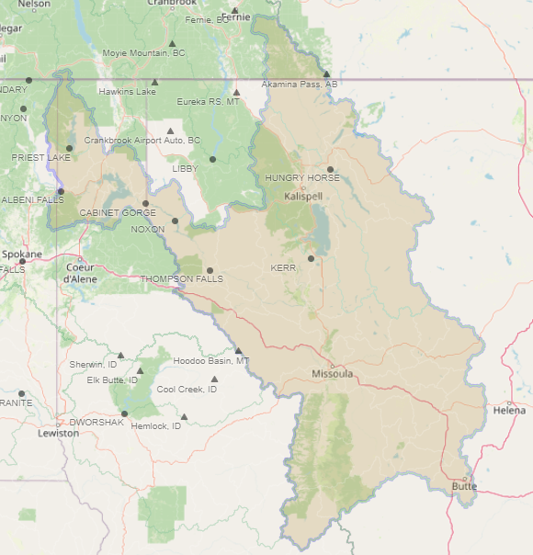
Lake Pend Oreille Basin (~24,200 sq. miles)
Sandpoint

Slide 4
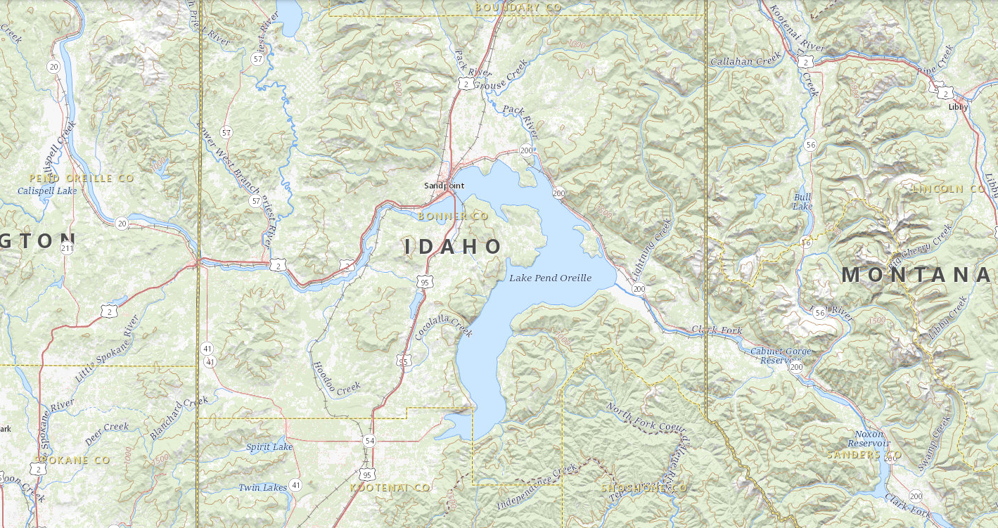
Albeni Falls Dam and Lake Pend Oreille
Dover, location of transition from Lake to River.
Hope, where Lake elevation is measured.
Albeni Falls Dam is ~27 miles downstream from Hope.

Slide 5
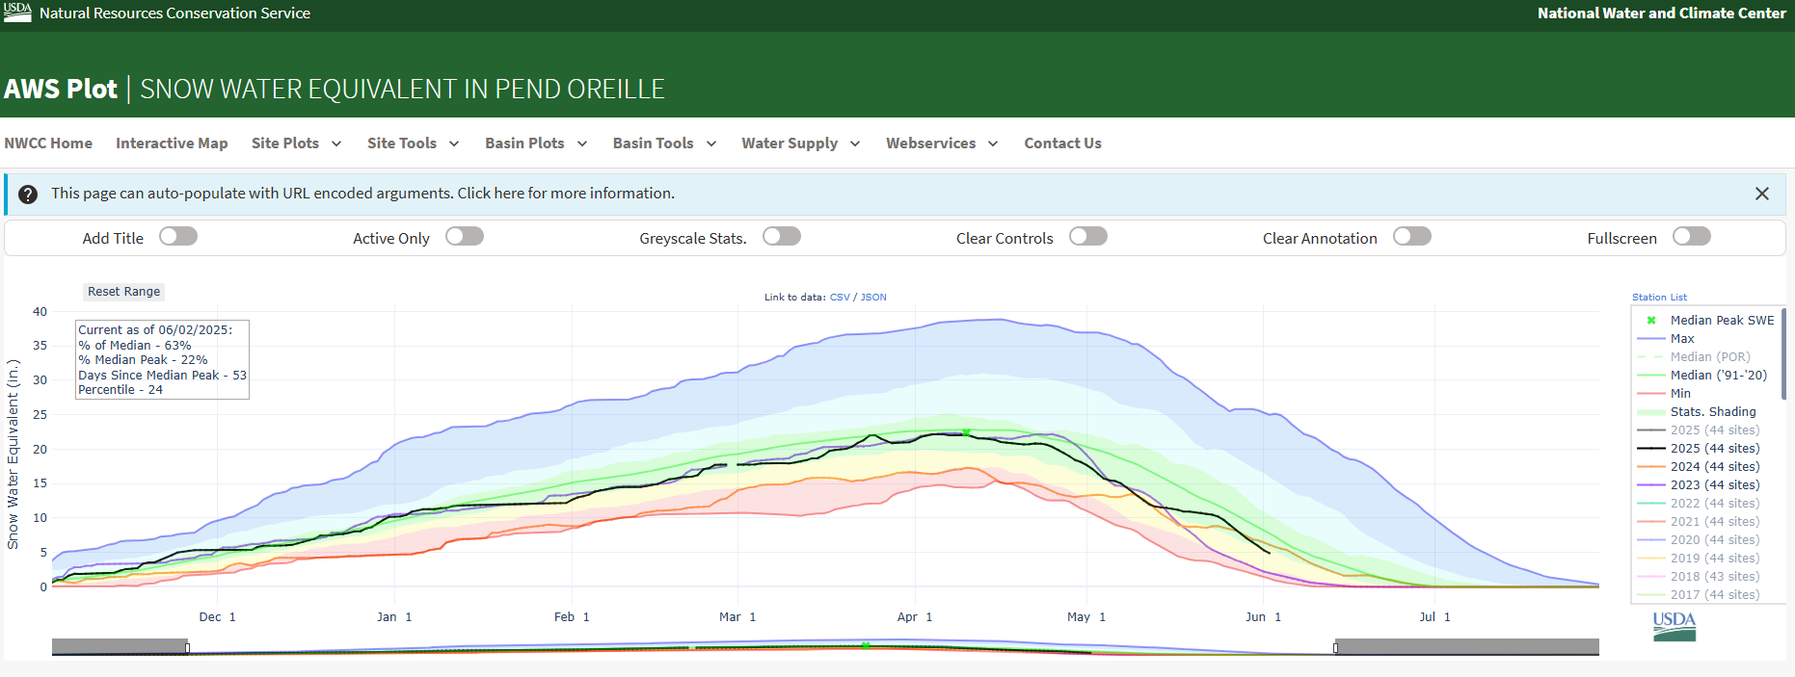
Current conditions
April 10, Median Peak
Median
2024
2025
2023
For this time of year, we are between 2023 and 2024 snowpack

Slide 6
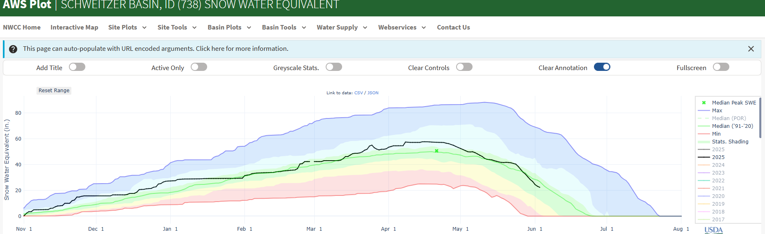
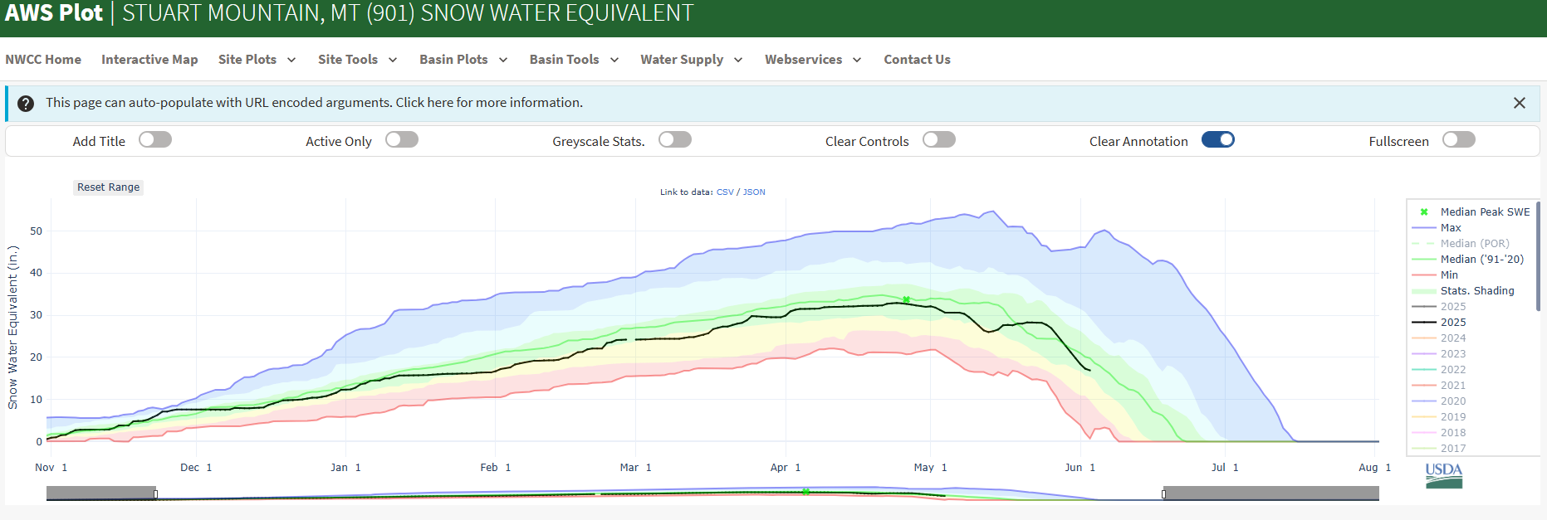
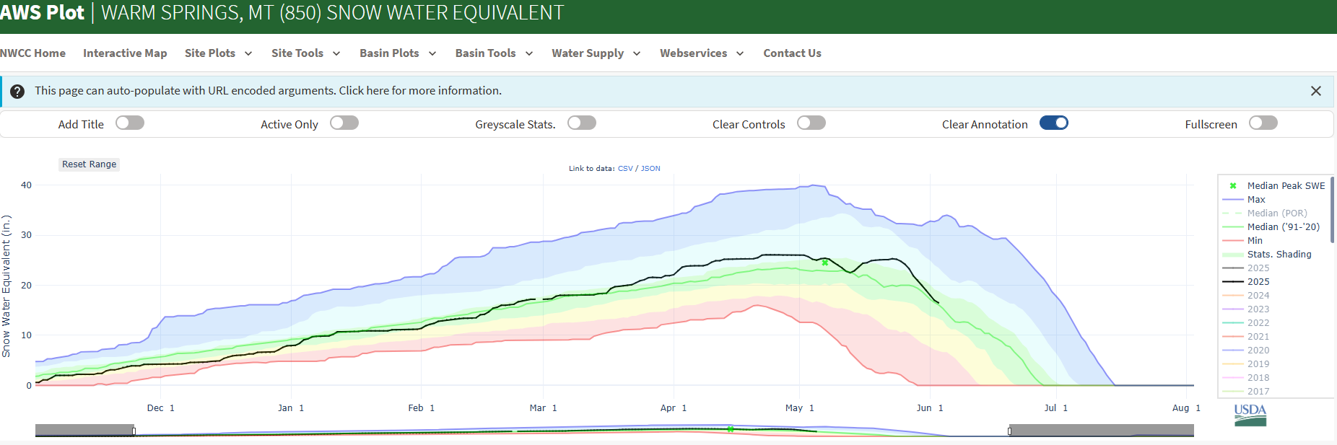
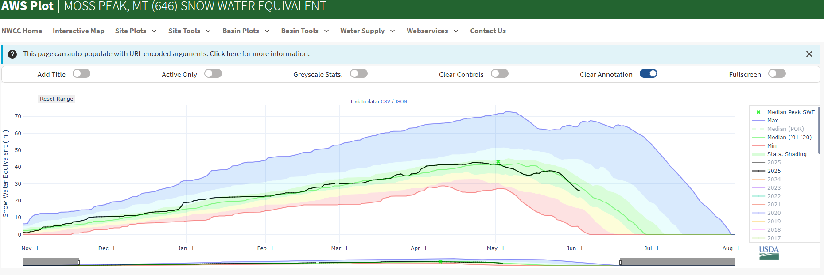
Current conditions

Slide 7
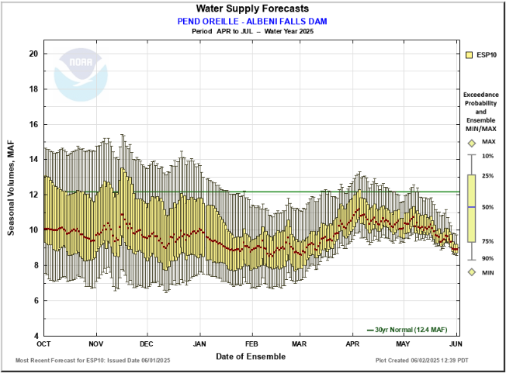
Constantly changing Forecasts
Notes:
Since early May forecast dropped about 1.5 maf

Slide 8
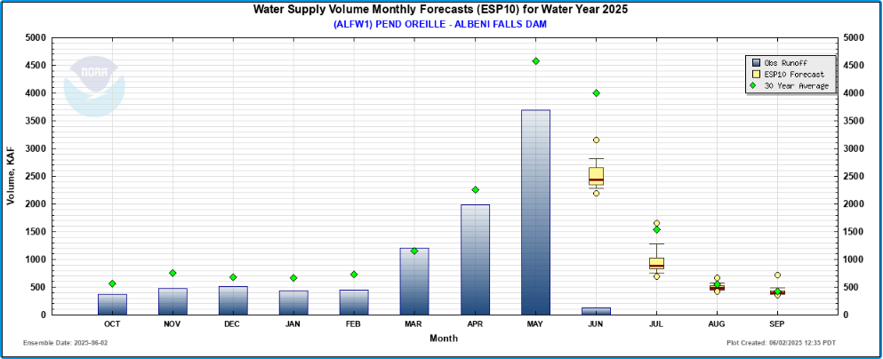
Monthly volumes
Observed runoff was average for March, a little below average for April and below average for May.
Predicted runoff for June is well below average.
June 01, April-July Forecast 9.1 Maf and 74% average

Slide 9
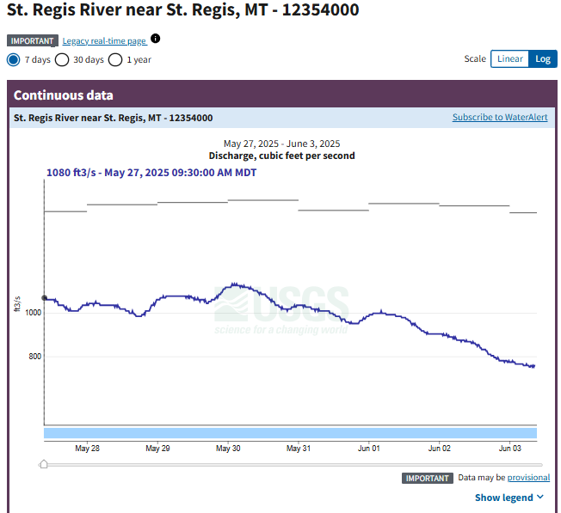
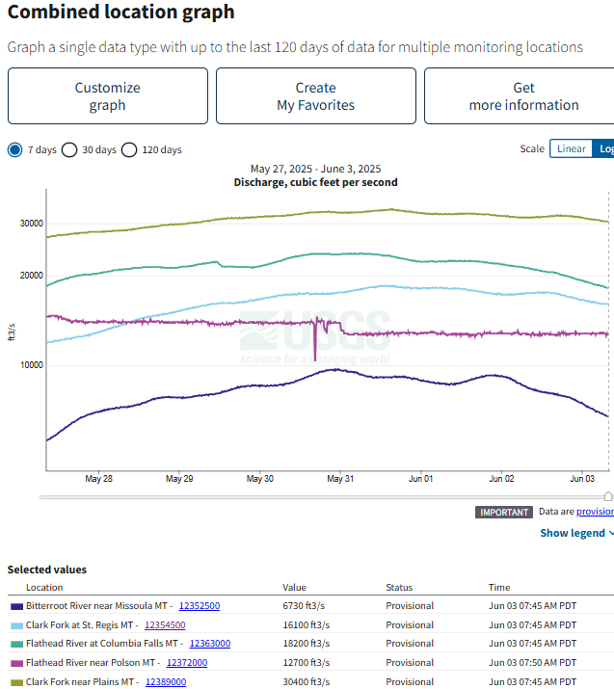
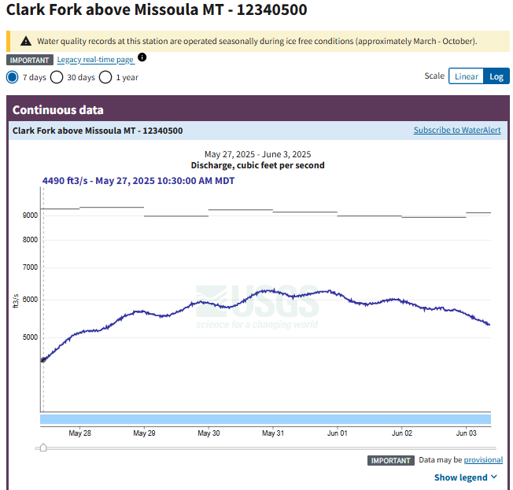

Slide 10

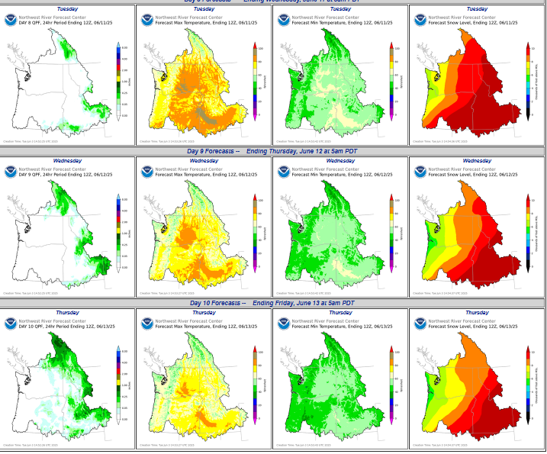
Next week

Slide 11
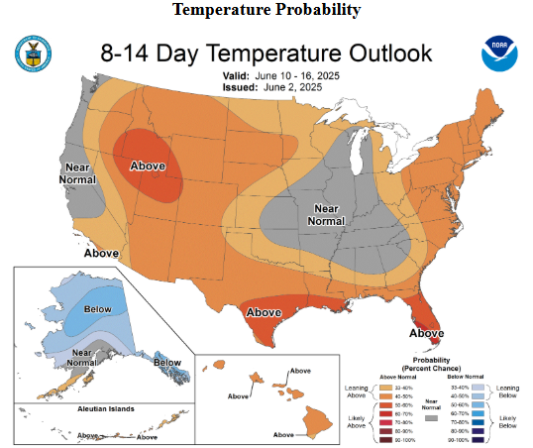
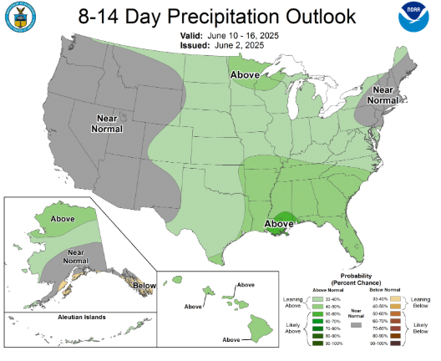

Slide 12
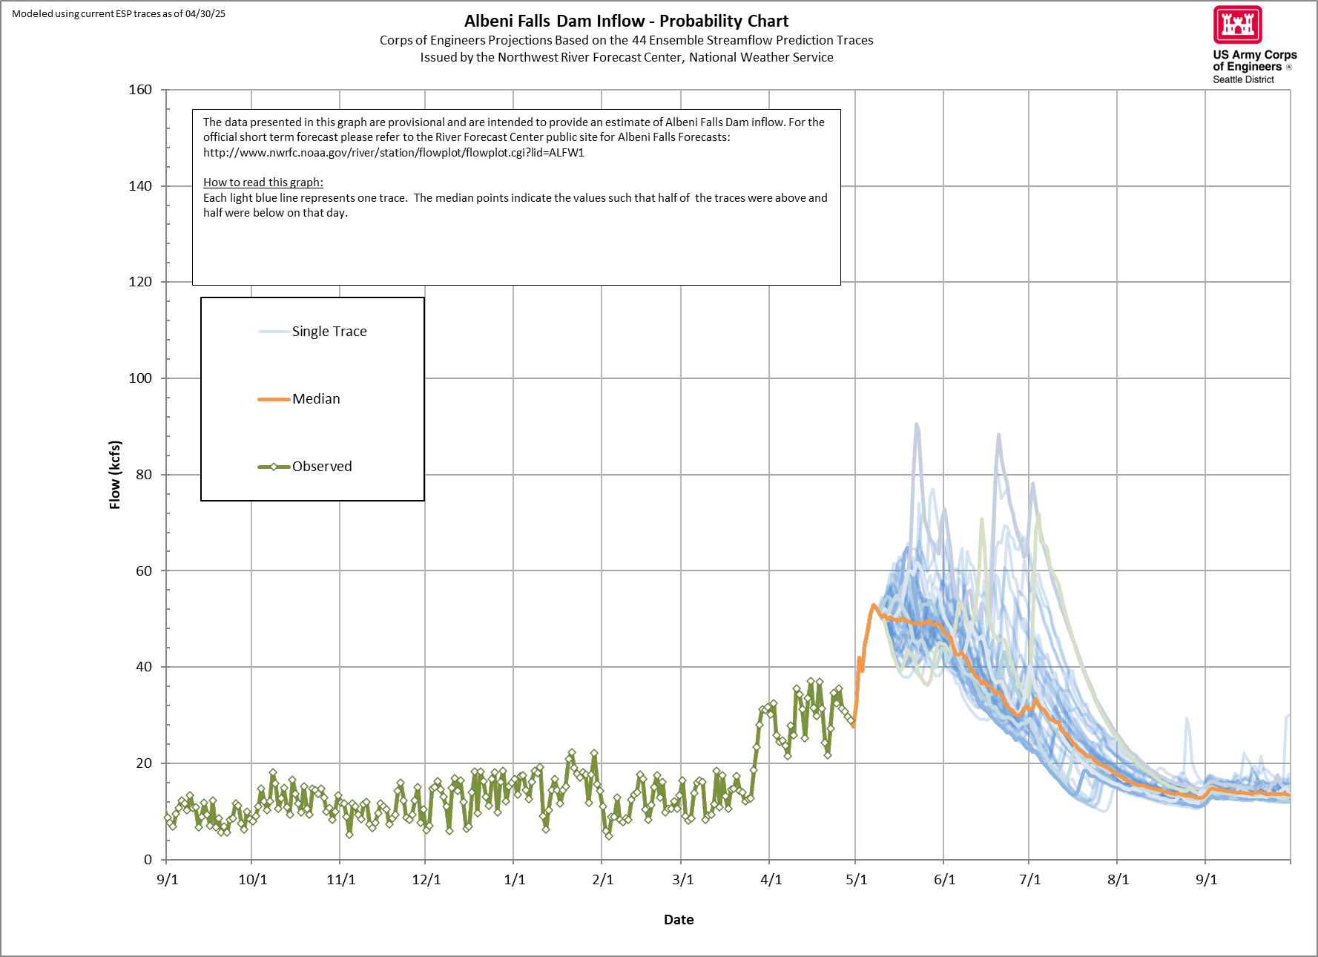
April 30 data

Slide 13
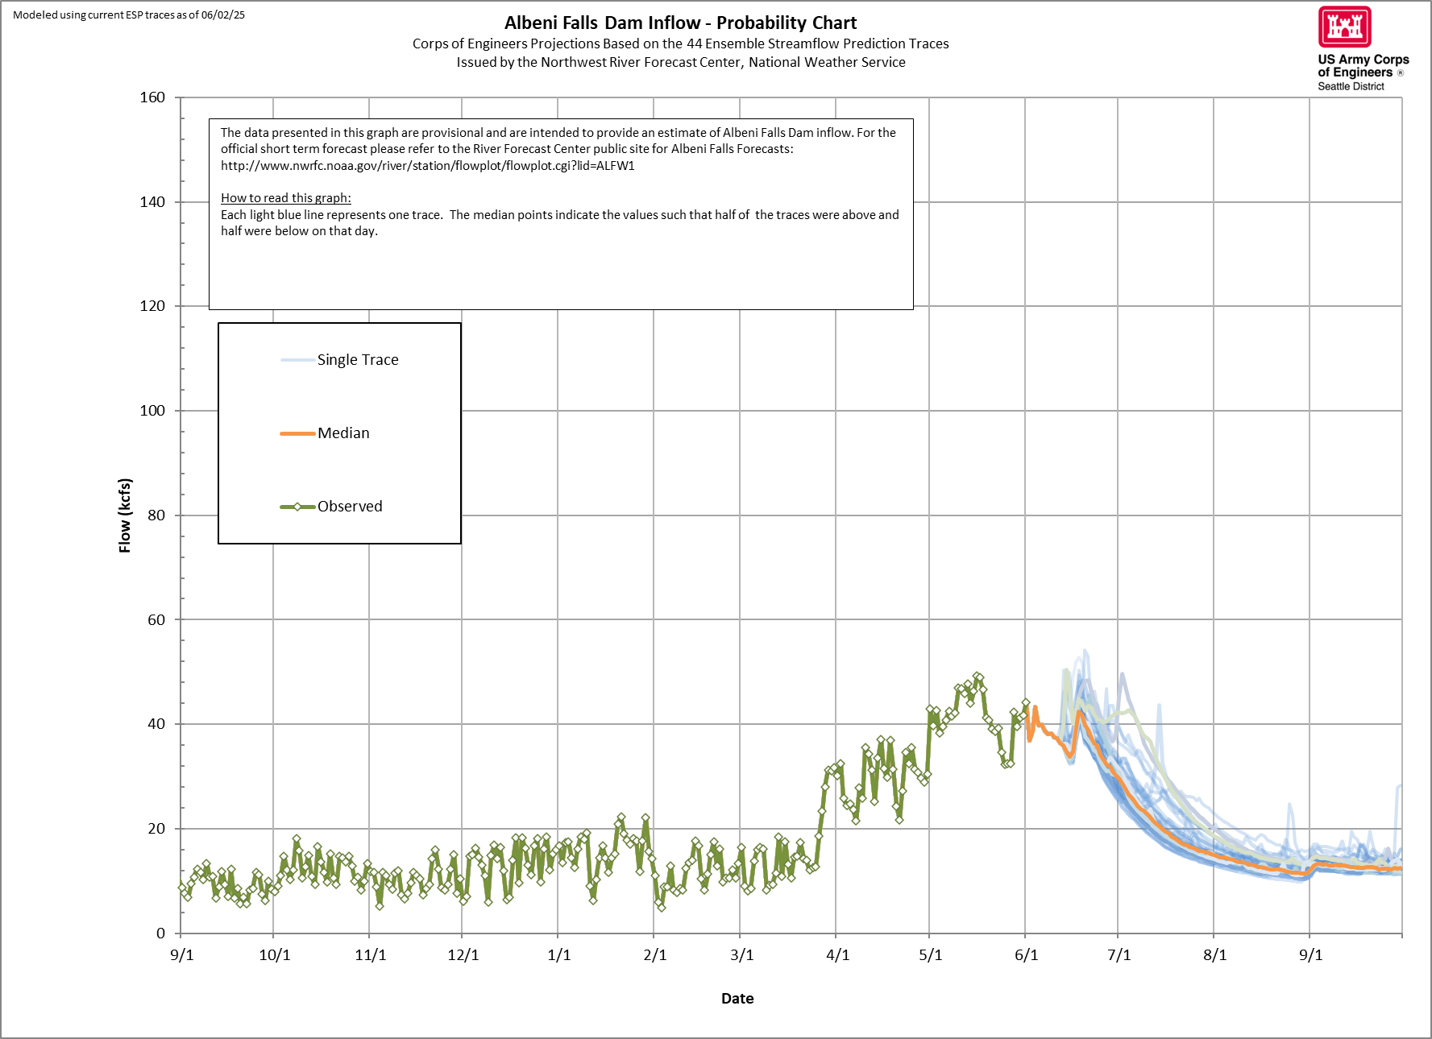
June 02 data
Current outflow capacity with one currently open spillway gate and maximum powerhouse is ~ 42 kcfs

Slide 14
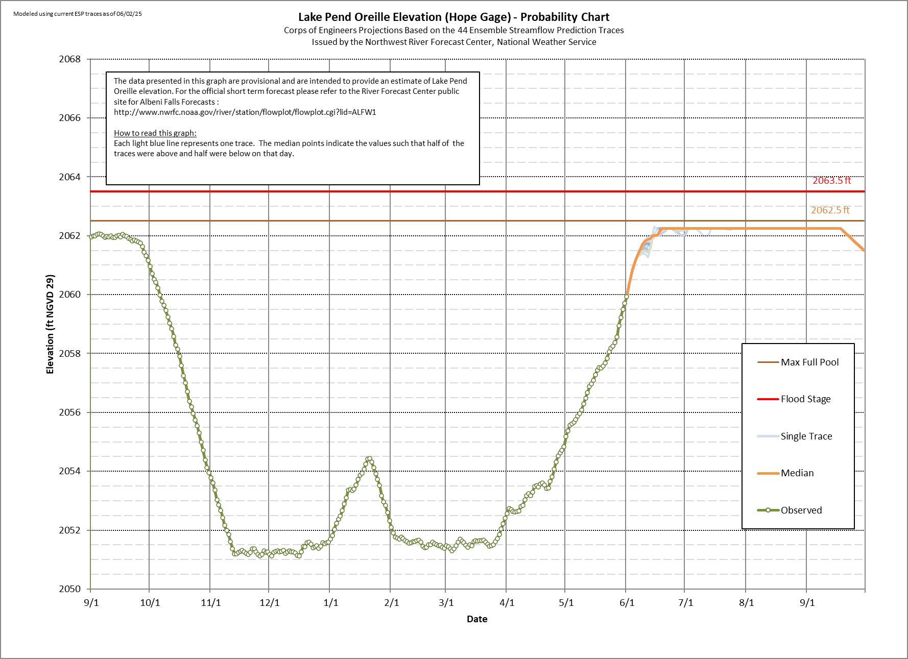

Slide 15
Albeni Falls Control - Summer Example
Half foot water surface elevation difference between Hope and Dam
Clark Fork
Albeni Falls
Dam
Dover
Constriction
Pend Oreille River begins
Hope
Dover Constriction Control - High Spring Outflow Example
10-foot water surface elevation difference between Dover and Dam
Clark Fork
Albeni Falls
Dam
Dover
Constriction
Pend Oreille River begins
Hope

Slide 16
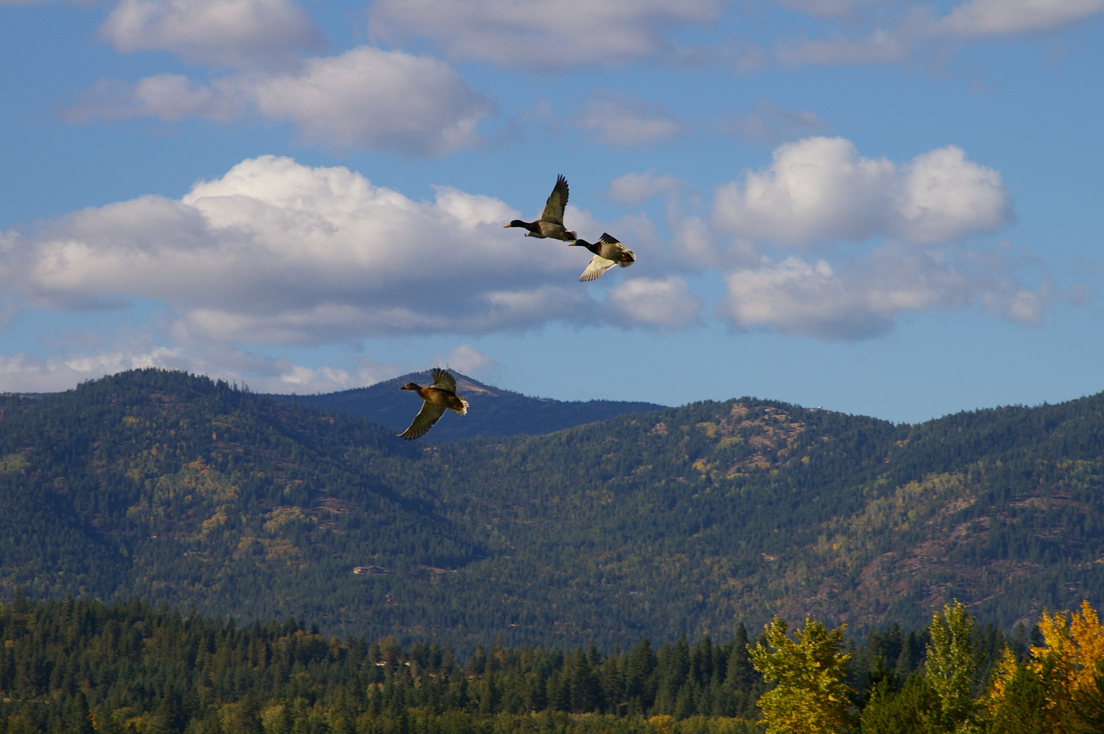
Natural resource management /
Spillway Gate Replacement update
Taylor Johnson
Chief, Natural Resources
Albeni Falls Dam
Andrew Huddleston
Fisheries Biologist
Albeni Falls Dam

Slide 17
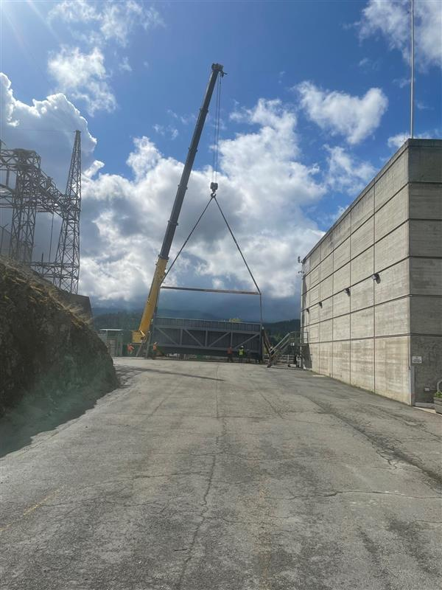
Long-Term Outlook for Repair/Replacement
Working toward a temporary repair to Gate 3 with expected return to service in August. Gate was delivered onsite May 12. Fiber Reinforced Polymer application beginning soon. We are following restricted gate movements until remaining gates are inspected/replaced.
New gate design is making great progress and expected to be complete next month, two months earlier than originally anticipated.
Expect to advertise the contract for new gates late 2025, and award contract by March 2026.
The first gate would arrive onsite in 2027 and subsequent gates arriving in 6-month intervals, dependent on industry capability at the time.
Confirmed timeline with interested contractors during Industry Day, Jan. 29-30, 2025.
Notes:
TAYLOR

Slide 18
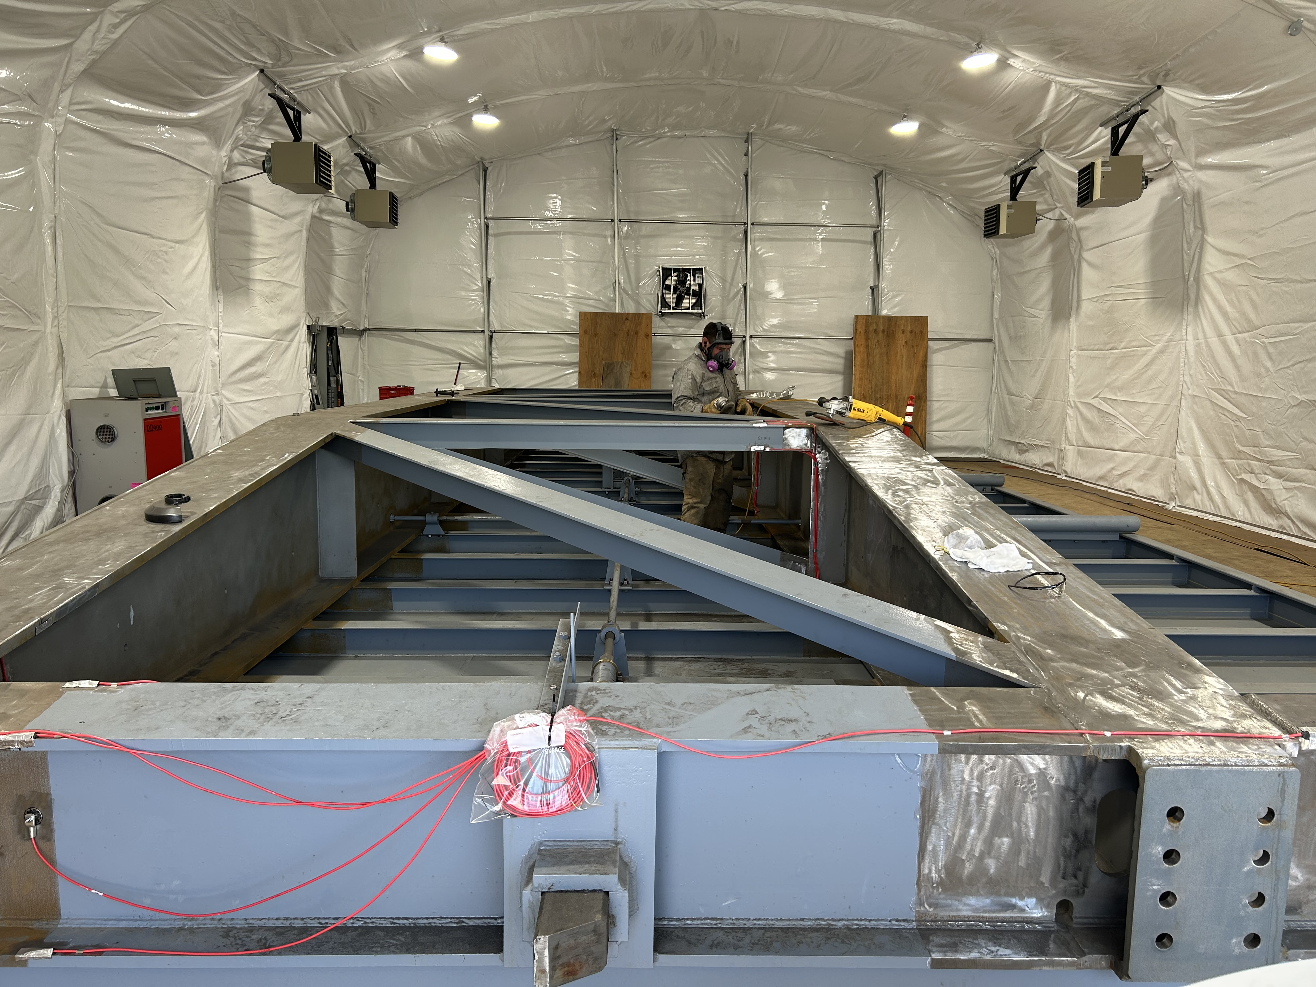
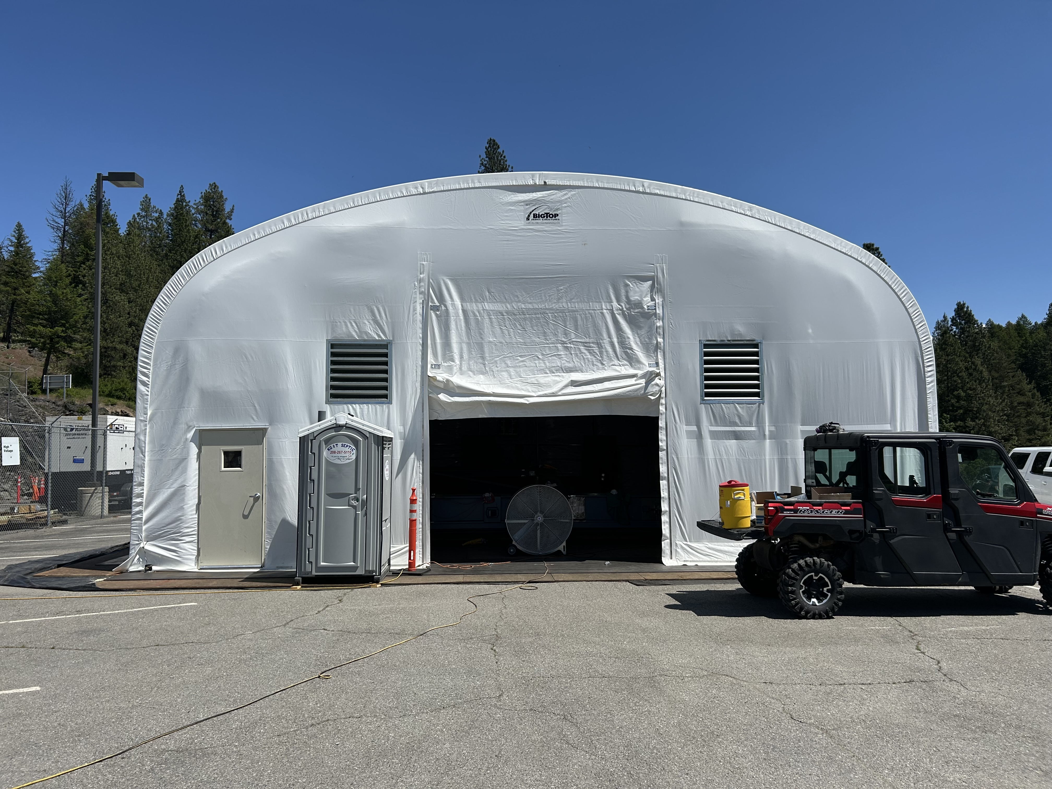
Notes:
TAYLOR
Lots of activity in the last few weeks/months. Gate was delivered, one of our mechanics prepping one of the leafs. Tent erected to apply FRP. Strain gauges installed

Slide 19
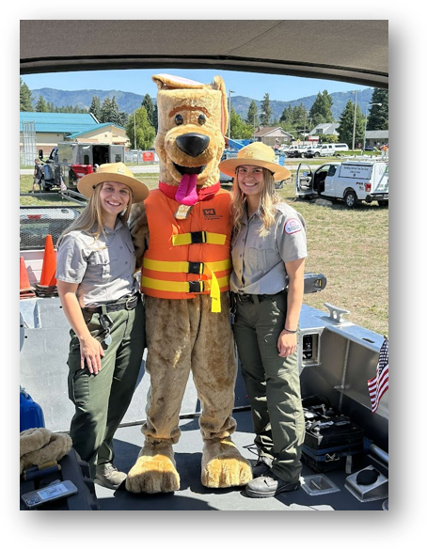
Natural resource management overview
Staff Count: 18
Eight permanent staff members:
Natural Resource Specialists and Maintenance Mechanics.
Hire 10 seasonals during the summer season.
An additional 12 volunteer couples necessary to operate our recreation areas.
Team conducts management activities on over 4,300 acres of public land around the lake and river.
Project hosts over 450,000 visitors on average annually.
Economic impact: Approximately $18 million in spending around Lake Pend Oreille.
Notes:
Current 5 perm (of 8), 6 seasonal (of 10), 6 volunteer couples (of 12).

Slide 20

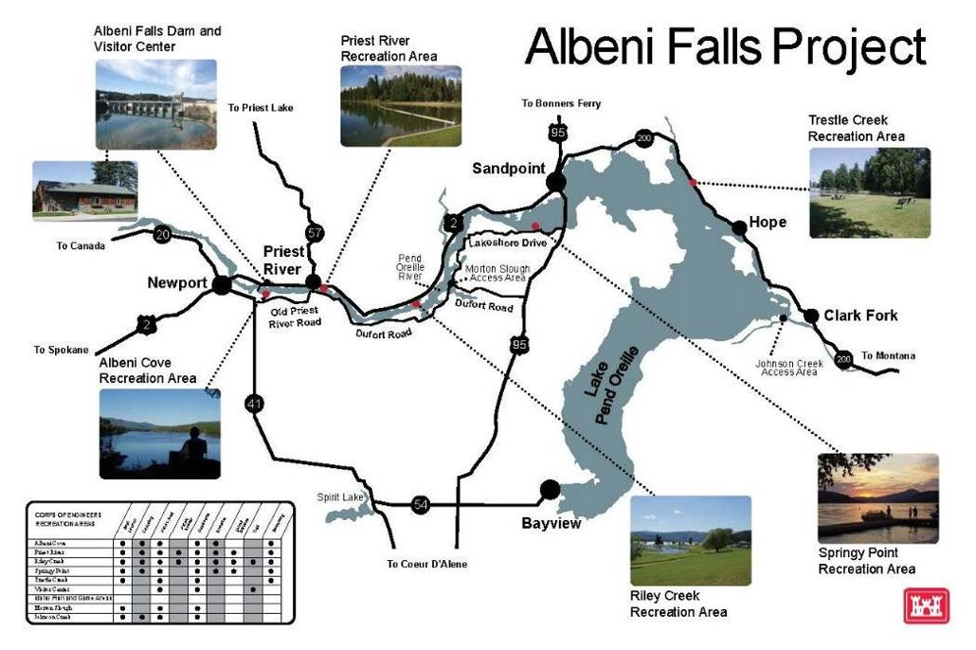
Natural resource management overview
Notes:
Rangers - Enforces rules and regulations (Title 36) to ensure safety and protection of visitors and their public lands. Conduct land management activities - boundary/resolving encroachments, fish/wildlife habitat improvements/surveys, GIS mapping, invasive species, cultural resource protection. Includes outreach-dam tours, outdoor education, partnerships, managing volunteers, water safety.
Maintenance maintains 139 campsites, 10 restrooms, utilities - power, drinking water and sewer, docks, boat ramps, trails and associated equipment. Driftyard too.

Slide 21
2025 recreation season changes
Vista Recreation Area – Open Year-Round
  Visitor Center unstaffed Monday – Thursday
Albeni Cove and Priest River “The Mudhole” Recreation Areas – Opened May 17, close Sept. 14.
  Reduced preventative maintenance
  Unforeseen major maintenance may result in closure
  Reduced Ranger Patrols
  Reduced Janitorial Services
Trestle Creek Recreation Area – Opened April 1, closes Oct. 31
  Above Reductions
Riley Creek – Opened May 10, closes Sept. 21
  Above Reductions
  Closure of the Playground Restroom
  No Shelter Reservations during weekdays
Springy Point Recreation Area
  CLOSED FOR SEASON
Notes:
Due to staffing shortages, we made the difficult decision to reduce services at several Corps-managed facilities on the Pend Oreille and electing to not open Springy Point Recreation Area for the season.
No outdoor ed, public outreach or water safety. Reduced land management activities. Critical maint at Driftyard.
We don’t take this decision lightly, recognize the effect it has on your ability to access the water, impact of the loss of visitation on local economy. Without proper staffing levels can’t ensure safety of public/its resources.
Green Bay / Bonner Park West. Low staffing agency-wide.

Slide 22
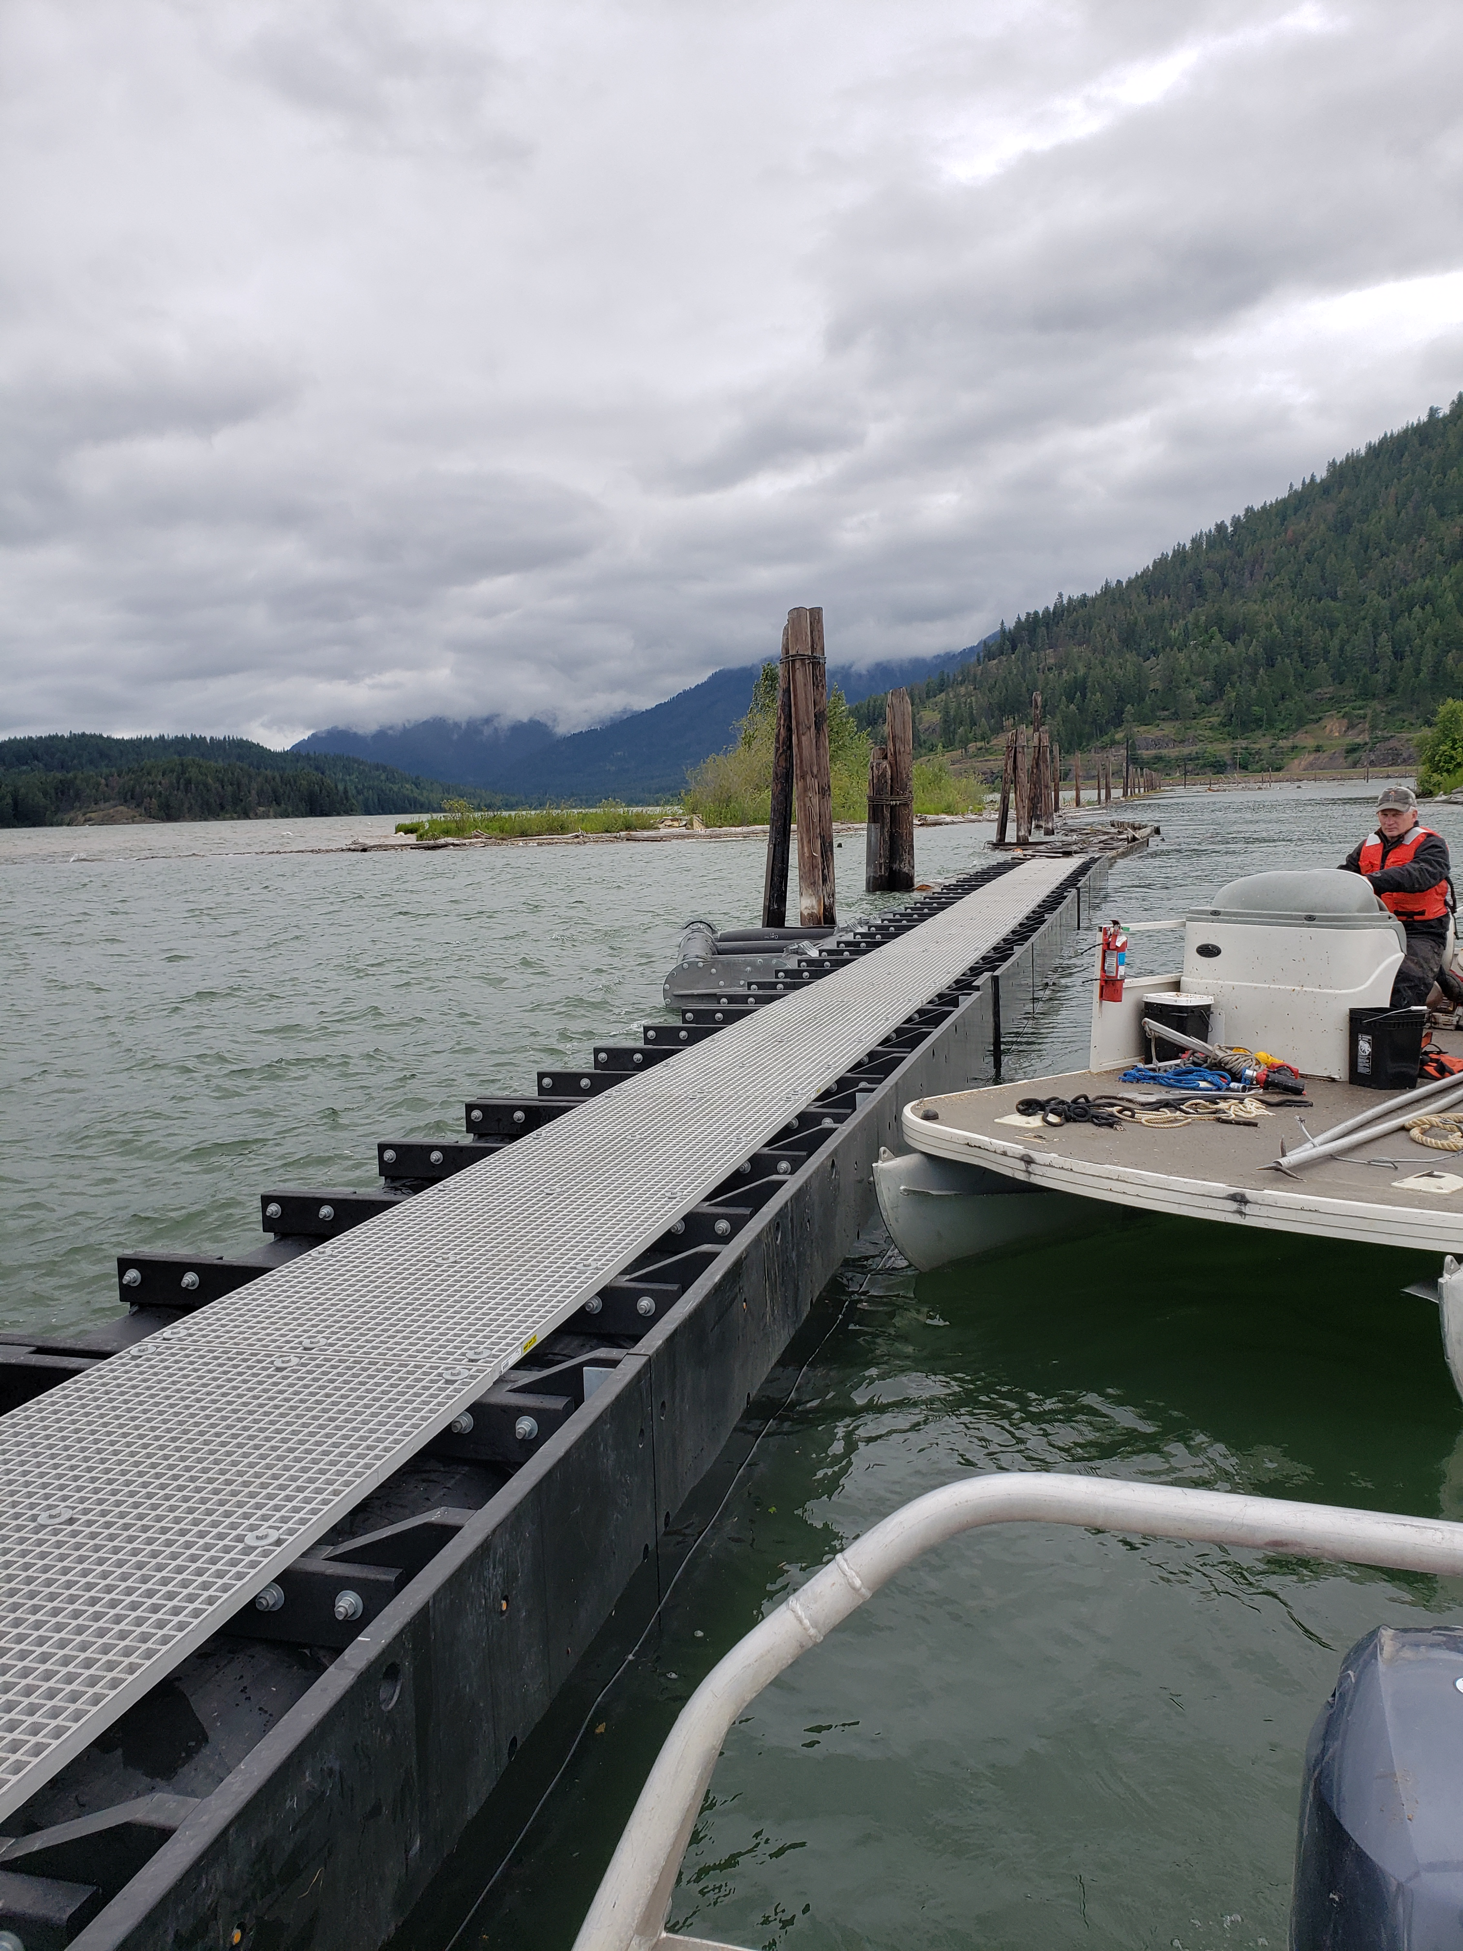
Clark Fork Driftyard
2025
Received delivery of 150’ of boom section and one wing brace in April. Anticipate install summer 2025.
Design at 65% for breakwater.
Notes:
TAYLOR

Slide 23
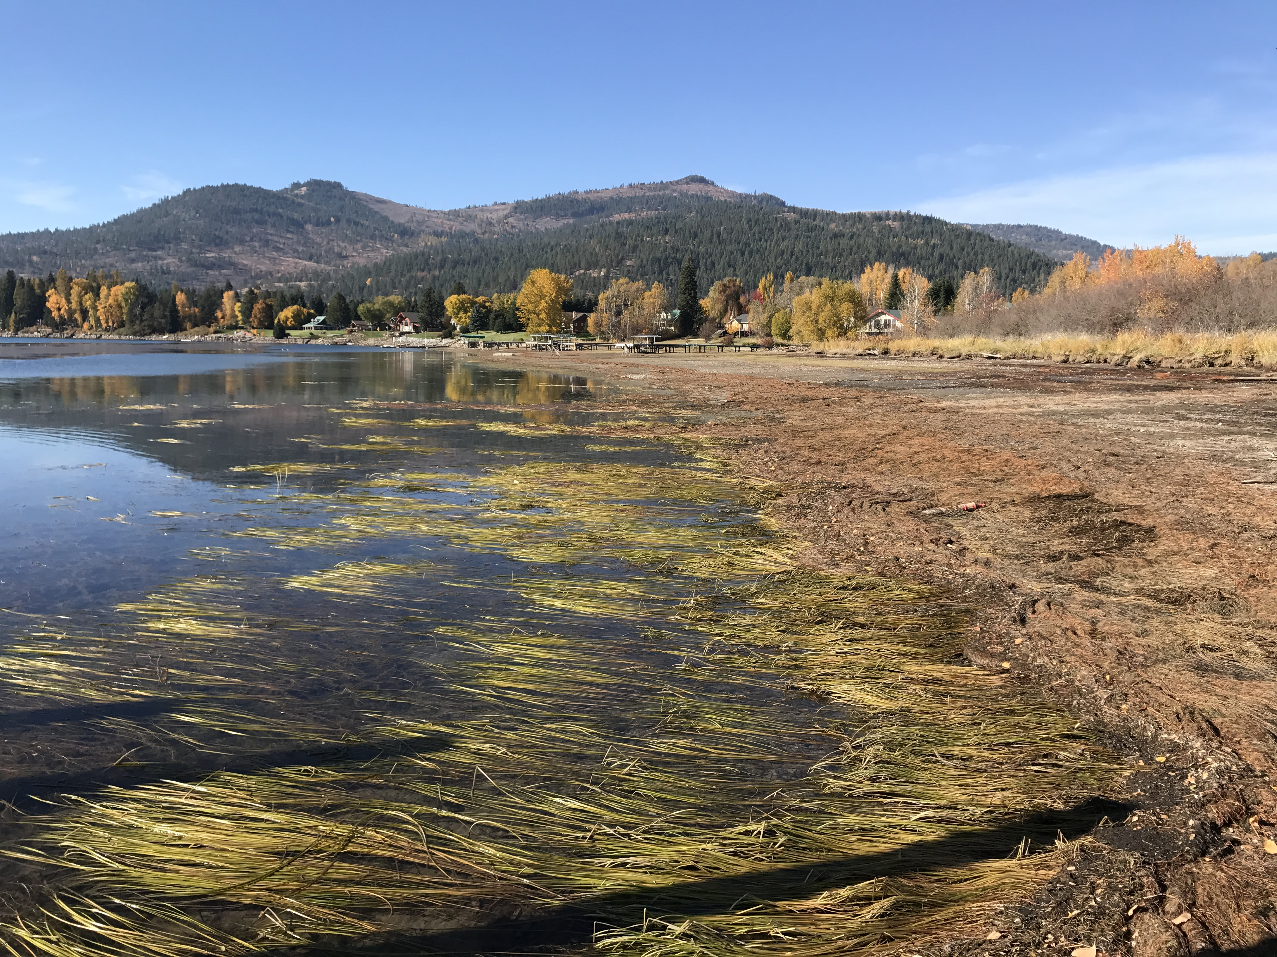
Aquatic Herbicide Application
2025 Flowering Rush Treatments (SUBMERGED and DEWATERED):
April 2025: Treated ~15 acres
August 2025: (LOCATIONS TBD based on pretreatment surveys)
Public Workshop with ISDA and Bonner County hosted in March
Important to Combine Multi-Tiered Approach for Survey, Monitor, and /Treatment Control
Notes:
TAYLOR
Aquastrike & Reward: Flowering Rush
Imazapyr: Bare Ground Flowering Rush/Milfoil

Slide 24
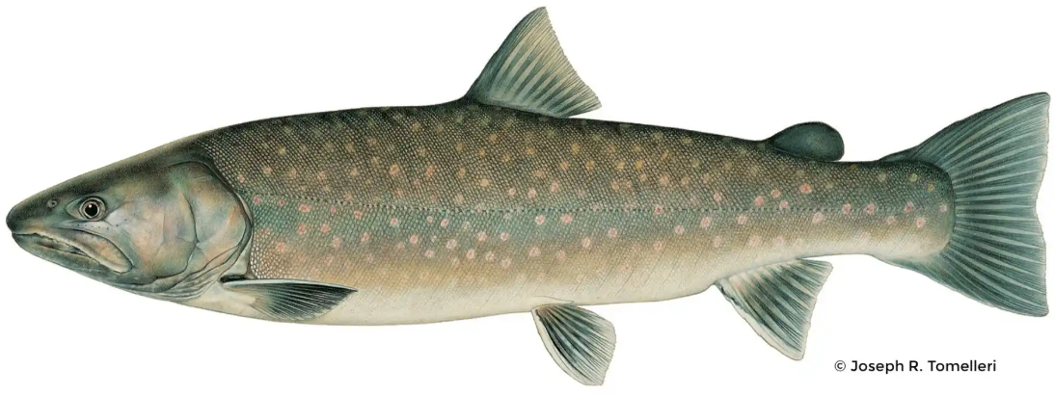
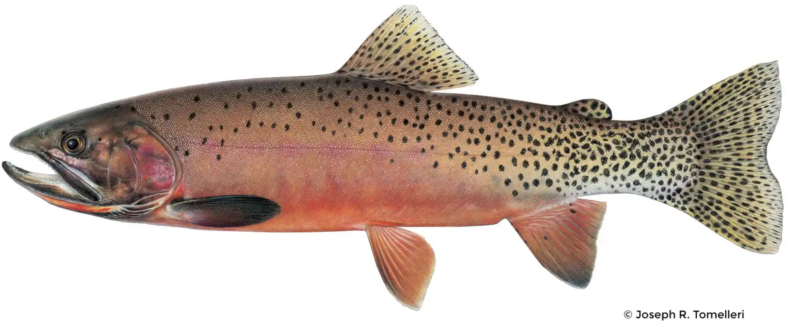
Fish Passage
Goal: Provide sub-adult and adult bull trout passage to habitat upstream of AFD and to reestablish connectivity of bull trout critical habitat upstream and downstream of AFD, as part of a system-wide recovery effort.
Trap and haul: Bull trout
Forebay flume: Westslope cutthroat
Design/build contract anticipated award in September 2025
Potential preconstruction beginning fall 2025
Construction complete 2030
Notes:
TAYLOR

Slide 25
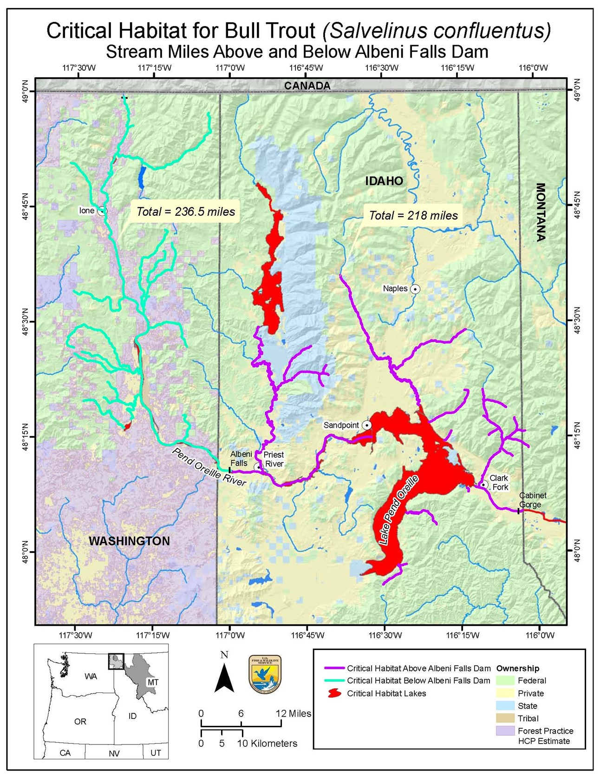
Why fish passage?
Lower Pend Oreille River (Box Canyon Reach) and associated tributaries are currently segmented from the rest of Lake Pend Oreille.
Habitat currently segmented.
Albeni Falls Dam FPF will open over 600 miles of currently blocked/fragmented critical habitat.
Dams with fish passage
(Box Canyon, Cabinet Gorge)
Dams without fish passage
(Boundary, Albeni Falls)
Notes:
TAYLOR

Slide 26
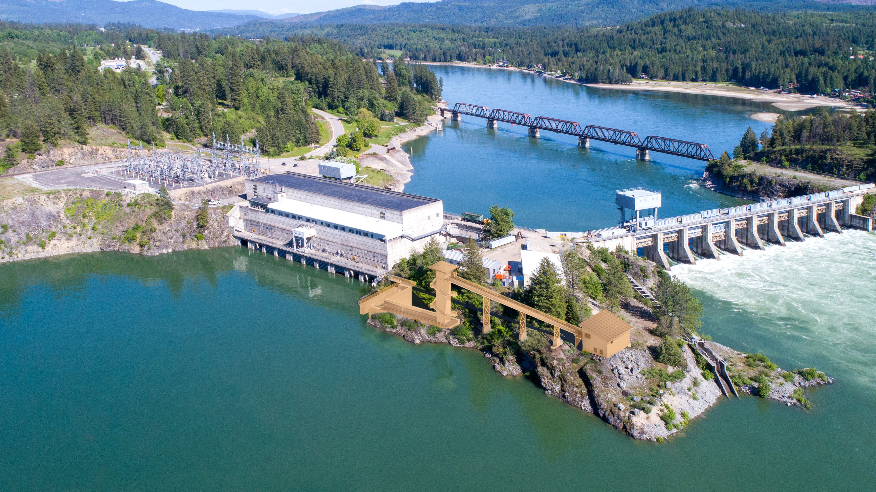
Bull Trout
Westslope Cutthroat Trout
*Preliminary conceptual sketch (not final design)
Notes:
TAYLOR
Note that this is a rough conceptual sketch for a proof of concept. Design build contracts allow for maximum flexibility, innovation, and schedule adherence. Bull trout (BT) will be hauled upstream and westslope cutthroat trout (WCT) will be released into the forebay under the current Biological Opinion (BiOp). At this time: all other fish will be released downstream.

Slide 27
How can YOU stay informed?
Subscribe to receive updates about release changes and lake levels: UpperColumbiaWM@usace.army.mil
Have general questions? Call us at 206-764-3750 or 208-437-3133
Check our district water management data webpage:
  http://www.nwd-wc.usace.army.mil/nws/hh/www/index.html#
Facebook: https://www.facebook.com/AlbeniFallsDam/
Twitter: @SeattleDistrictUSACE
Public website: https://www.nws.usace.army.mil
Recreation One Stop: www.recreation.gov
Expect another public meeting in fall 2025.
Send input on how restricted operations is affecting you to AFDpublicinput@usace.army.mil

Slide 28
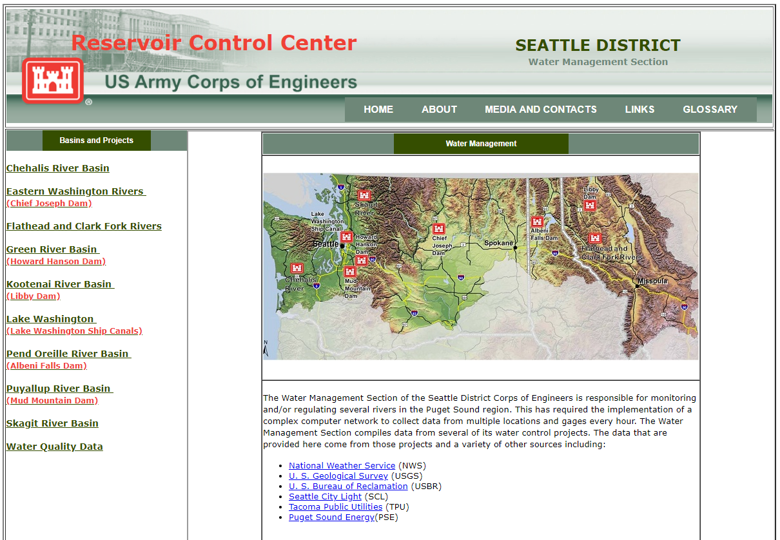
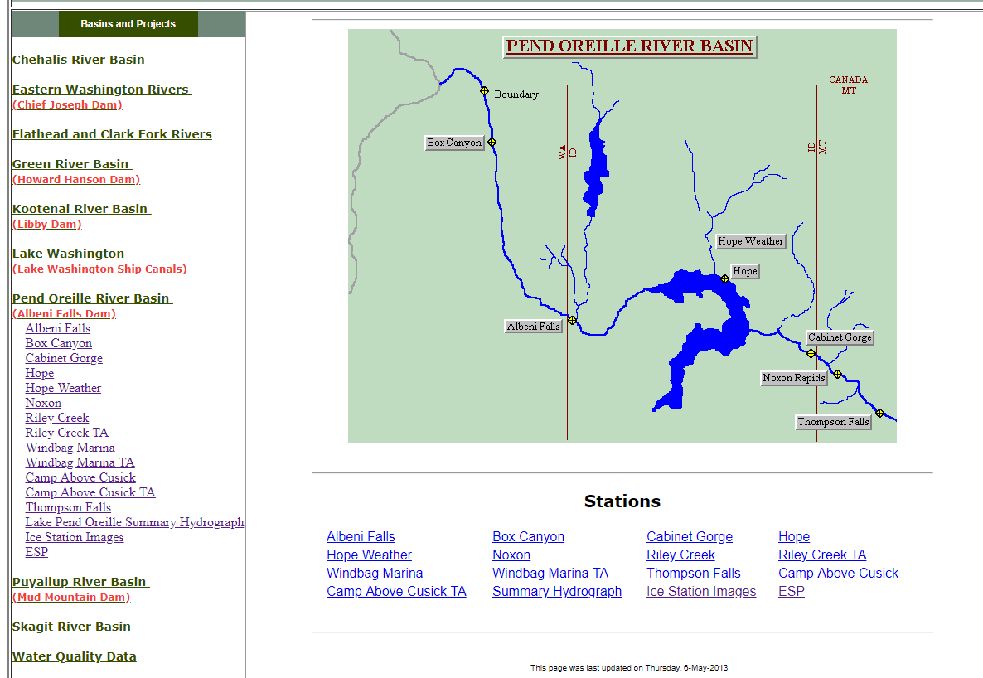
How can YOU stay informed?
More info at our Seattle District water management data website:
http://www.nwd-wc.usace.army.mil/nws/hh/www/index.html#

Slide 29
Q&A

Slide 30
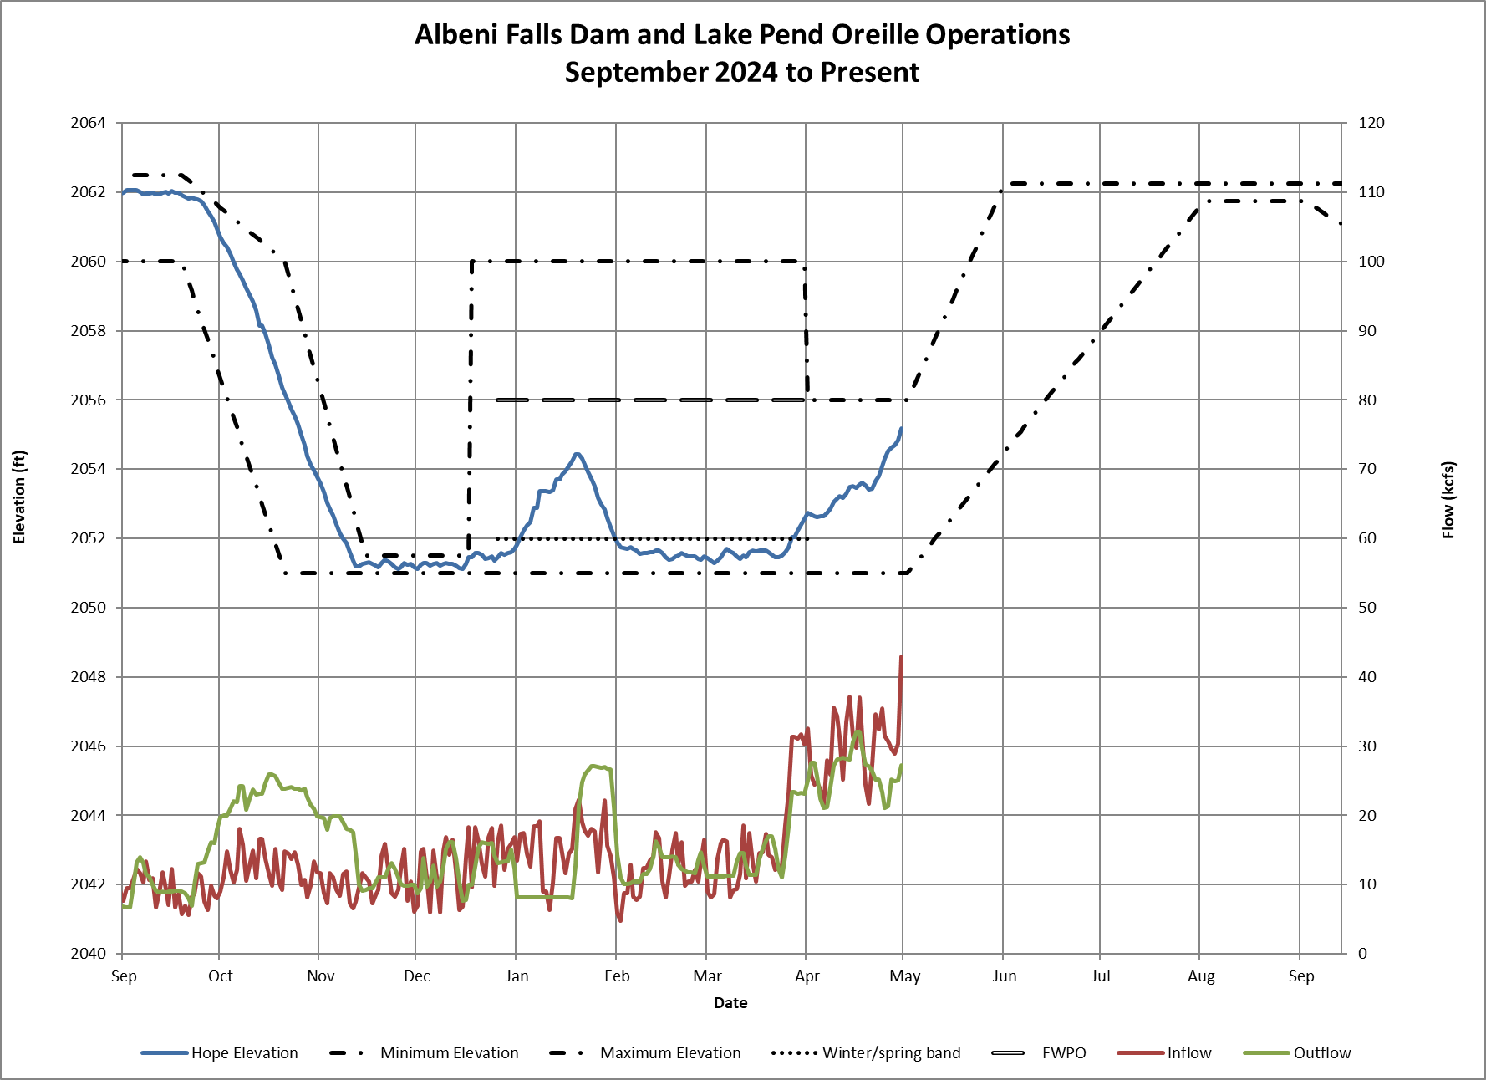
Started Fall Draft Sept 23rd
Finished Fall Draft Nov 11th
Winter Band
2051.0’ – 2052.0’
Flexible Winter Power Operations Dec 31st – Feb 5th
2052’ – 2054.0’
Kept Lake in 2051.0’-2051.5’ band Nov 11th – Dec 17th for Kokanee spawning.

Slide 31
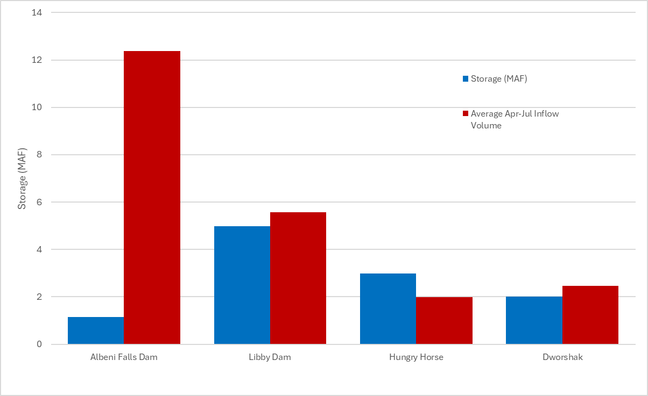
Columbia River Projects Storage vs Spring Runoff
Forecast inflow April-July 2025 (4/30/25)
10.3 Maf – 83% of normal
WY 2024 inflow April-July 8.8 Maf – 66% of normal

