Slide 1

Priest Lake Fishery Update
Rob Ryan – Regional Fishery Biologist
Idaho Department of Fish and Game
Notes:
Introduction – Who am I and what do I do.

Slide 2
2023 Predictions
Status quo:
Lake Trout – abundant; declining condition and flesh quality; mysid density will influence the future; might need to look in new areas to catch fish
Kokanee – low density; good size; inconsistent catch rates
Westslope Cutthroat Trout – moderate density; decent catch rates; quality fish
Smallmouth Bass – abundant; good catch rates; widely distributed; small fish

Slide 3
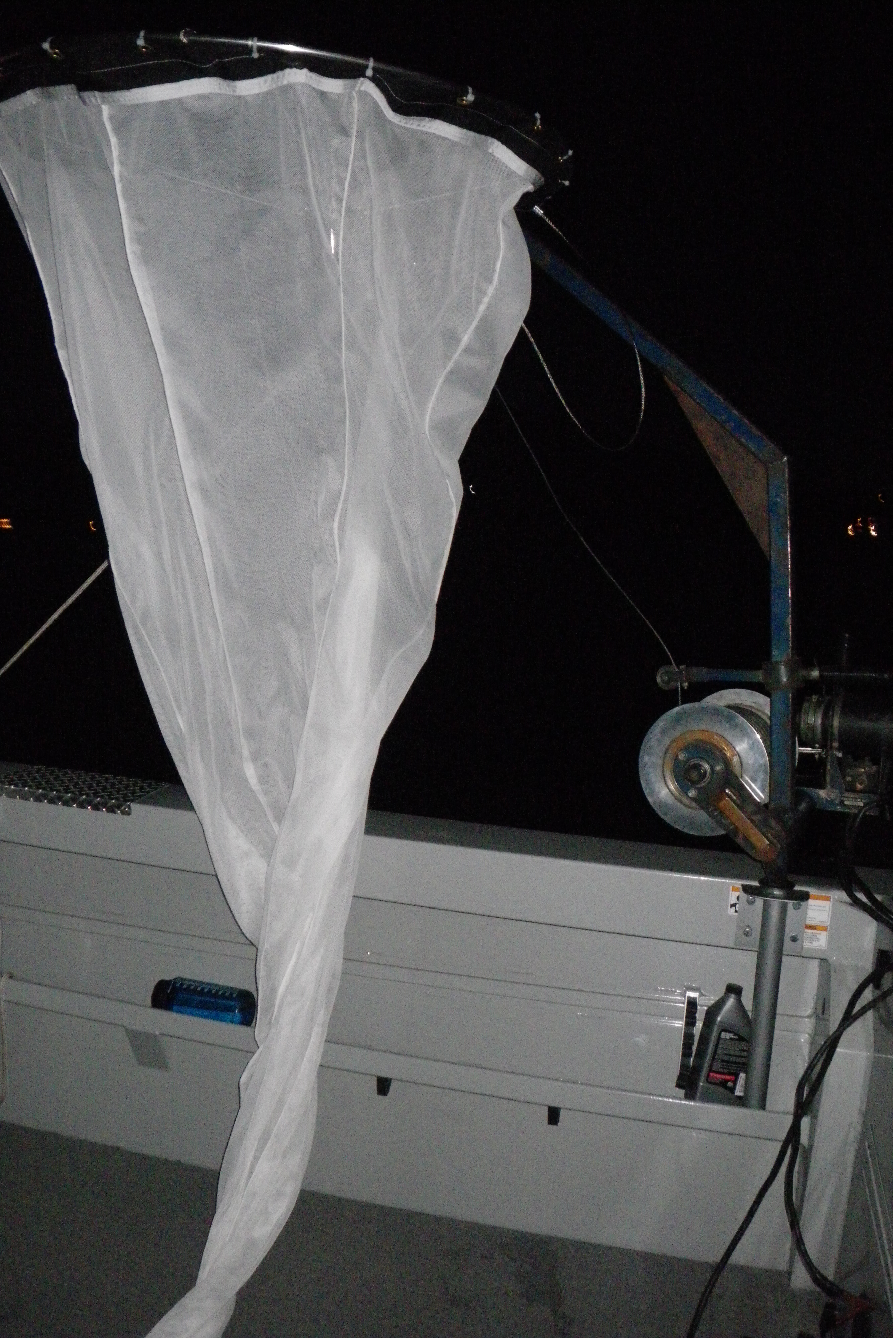
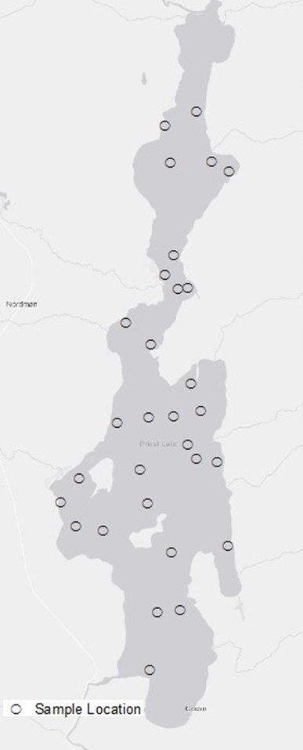
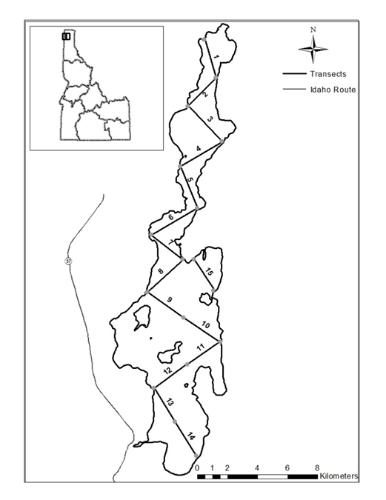
Survey methods
Mysid Shrimp
Lake Trout/cutthroat
kokanee
Notes:
Survey methods used and what they mean.

Slide 4
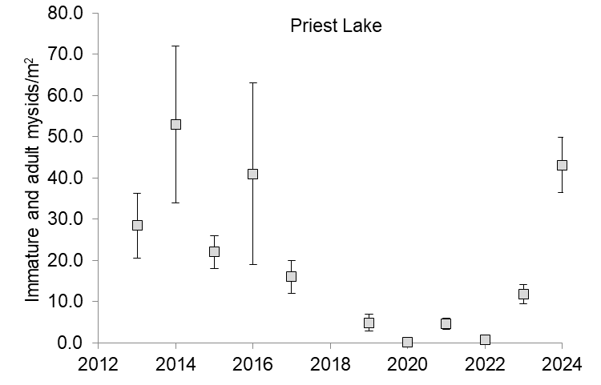
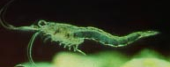
Mysid shrimp
Reference: Recent density >150 I/A mysid/m²
Notes:
My last prediction was that the mysid shrimp population in the lake would shape the future. We continued monitoring mysid shrimp in Priest Lake in 2024 to understand what that future will look like. As I noted, mysid shrimp abundance collapsed in Priest Lake between 2019 and 2022. Fortunately for Lake Trout in the Priest system, we saw mysid densities increase in 2023 and 2024. Mysid density in 2024 was representative of the higher estimates from Priest Lake. As such, we’d expect to see improvements in the Lake Trout population.

Slide 5
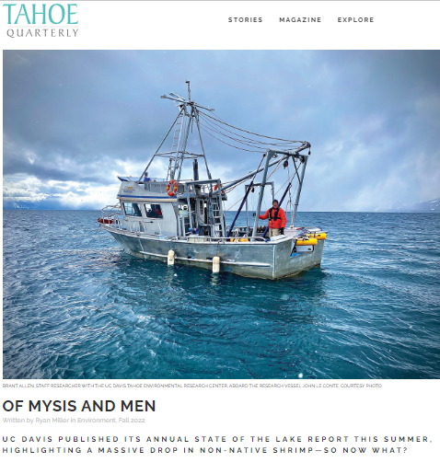
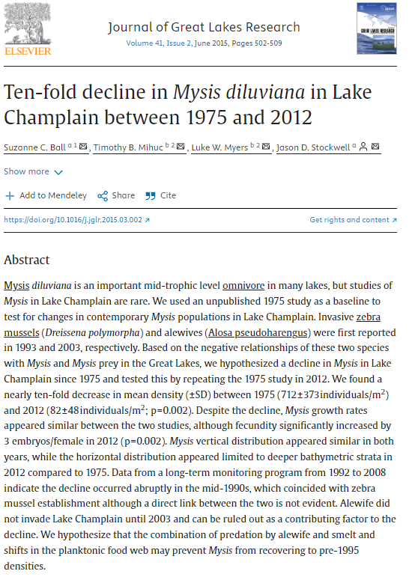
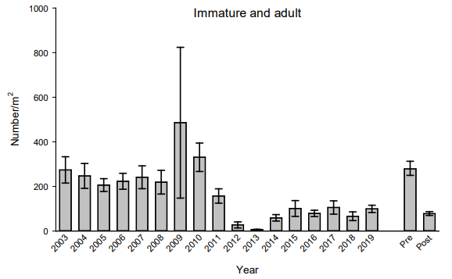
Mysid shrimp
Lake Pend Oreille
Immature and adult mysids
Notes:
I’ve mentioned this in prior Priest Lake fishery updates, but for reference…. Mysid shrimp collapses occur and the drivers of these dramatic changes in abundance really aren’t understood. For example…

Slide 6
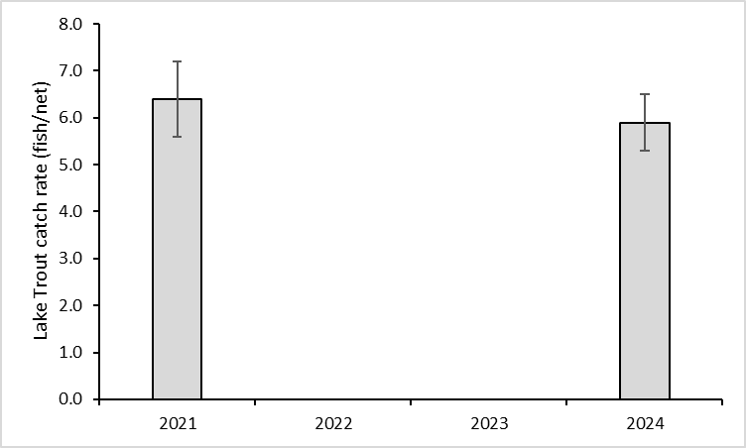
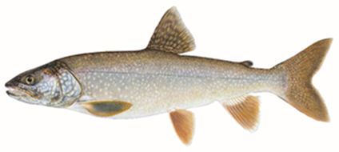


Lake Trout
High relative abundance - stable
Notes:
The primary fishery on Priest Lake is for Lake Trout. Lake Trout fishing or more specifically catch rates were generally poor during the later period of mysid collapse. However, we repeated a survey of lake Trout in Priest Lake in 2024 and our observations suggested Lake Trout abundance in the lake remained high and stable. Note catch rates. In our survey, we also found LKT were widely distributed. Every net we placed caught LKT.

Slide 7
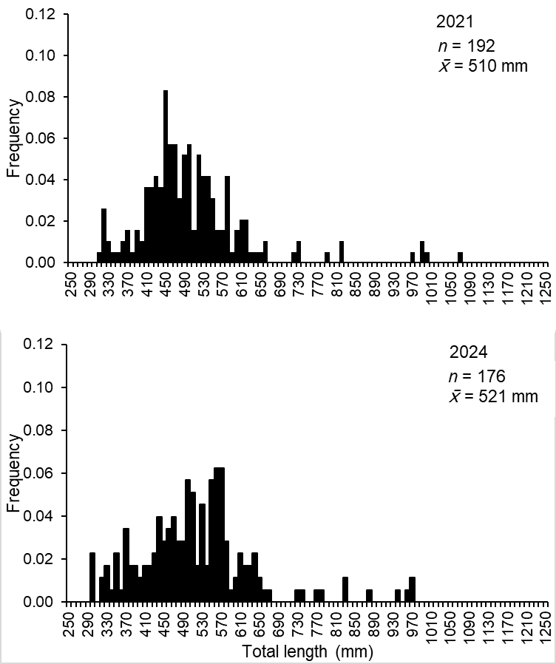
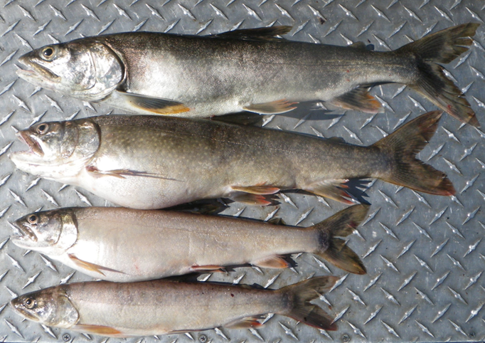
Lake Trout – growth and size structure
Notes:
Highlight that Lake Trout growth is slow and the size distribution of the population reflects that pattern of growth. Size distribution between samples was stable

Slide 8
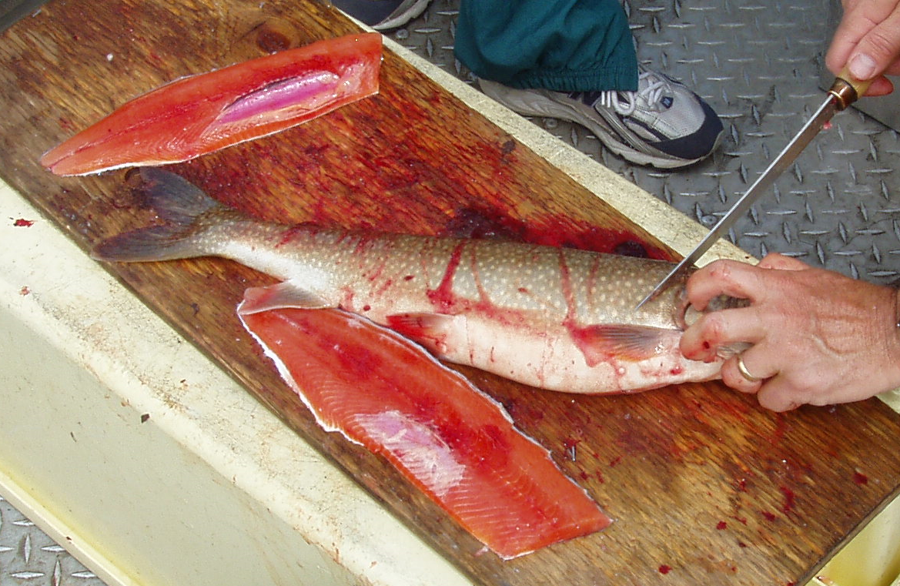
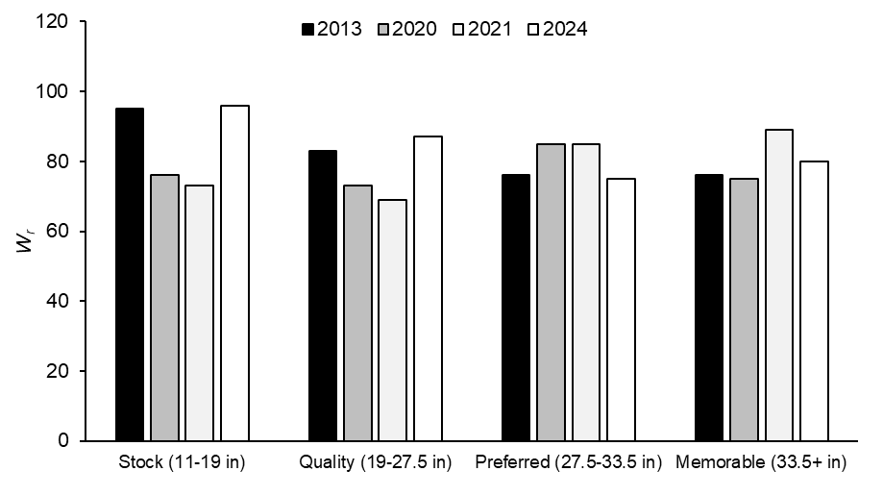
Lake Trout - condition
Notes:
Late in 2024 we conducted a survey of Lake Trout in Priest Lake. We found evidence that increases in mysid abundance positively impacted the Lake Trout. The primary impact noted was an increase in fish condition. In addition, the flesh color was dark relative to recent years. In our prior 60%+ had pale flesh. In 2024, 60%+ had dark orange flesh.

Slide 9
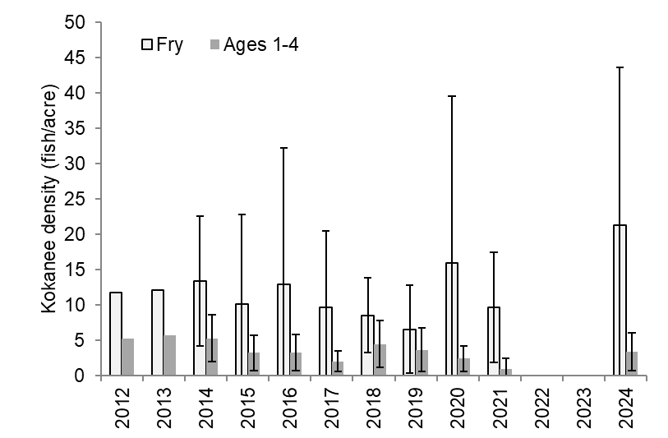
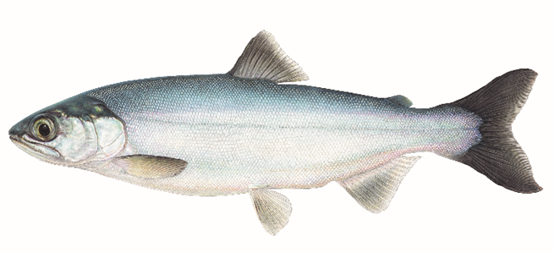

Kokanee
Reference: Lake Pend Oreille >160 kokanee/acre (approximate density ages 1-5)
Notes:
Kokanee historically were a primary target for anglers in Priest Lake. Unfortunately, kokanee abundance significantly declined due to an expanding Lake Trout population (70’s and 80’s). Since that time kokanee remained a component of the Priest Lake fish community, but at a very low abundance. We have a kokanee history on the lake and completed the most recent survey in 2024 to estimate kokanee density. We found kokanee densities were low and while there was variability in our estimates density remained low relative to other waters in the region. For example……..

Slide 10
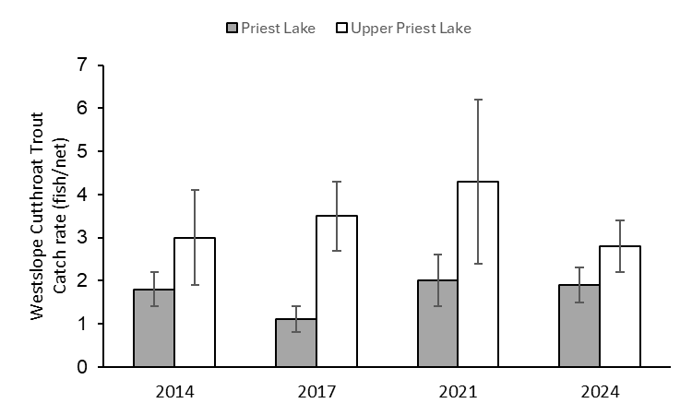
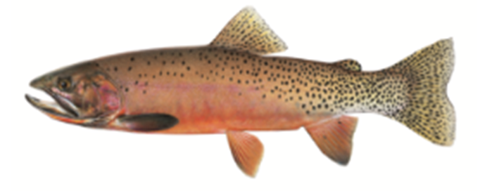
Westslope Cutthroat Trout
Notes:
Westslope Cutthroat Trout are also a component of the Priest Lake fish community and fishery. Although, generally not a species that’s targeted by a large group of anglers. A focused survey of WCT was also completed on Priest Lake most recently in 2024, but previously in 2014, 2017, and 2021. This survey effort was intended to better understand how the WCT populations was performing. Similar to our LKT survey we described abundances as a relative catch rate measure. This figure displays the catch rate as fish per net for each survey completed in both Priest and Upper Priest Lakes. We found moderate catch rates in both lakes in all three surveys, suggesting abundance was relatively stable over time. This observation also suggested WCT were abundant enough to provide good fishing opportunity in both lakes. In general angler reports from folks targeting WCT reflect this expectation. I’ll also worth noting that may be some potential for additional opportunity on WCT such as limited harvest.

Slide 11
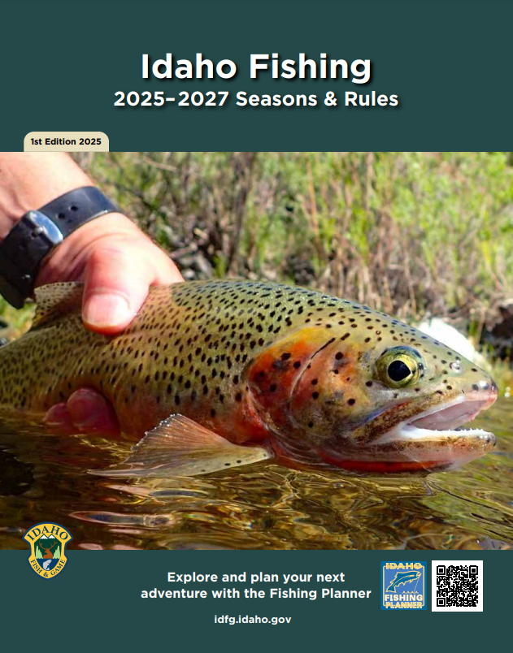

Westslope Cutthroat Trout
Notes:
Reminder of the new regulation allowing WCT harvest on Priest and Upper Priest lakes.

Slide 12
Fishery expectations
Lake Trout – abundant; improving condition, flesh quality, and catch rates
Kokanee – low density; good size; inconsistent catch rates
Westslope Cutthroat Trout – moderate density; decent catch rates; quality fish
Smallmouth Bass – abundant; good catch rates; widely distributed; small fish
Notes:
Combining this information, what can anglers expect to experience on Priest Lake into the future.

