Slide 1
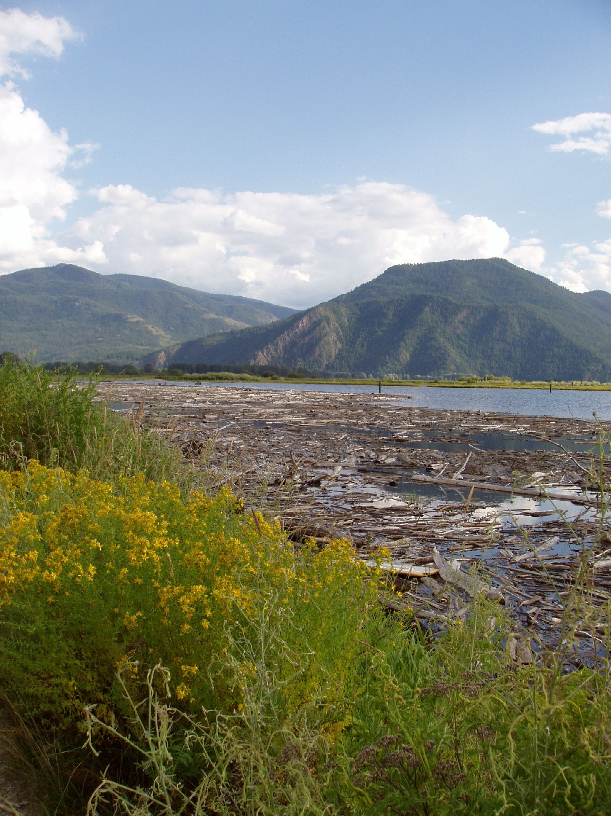
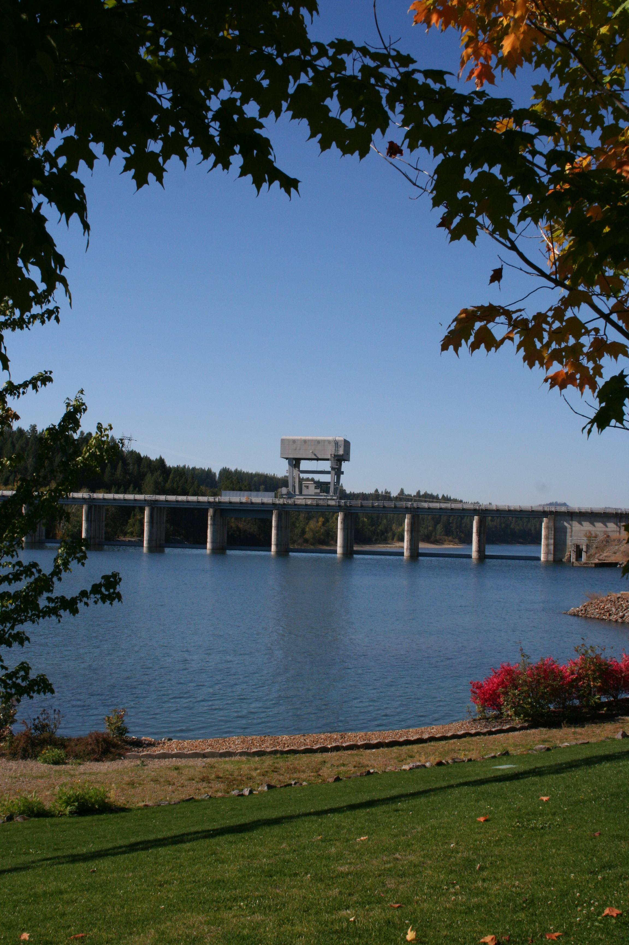
Albeni falls Dam and lake pend Oreille
09 January 2025
Taylor Johnson
Chief, Natural Resources
Leon Basdekas
Upper Columbia Senior Water Manager
Kristian Mickelson
Northwestern Division Water Management
Michael Warner
Seattle District Hydrology Section
Albeni Falls Dam Update

Slide 2
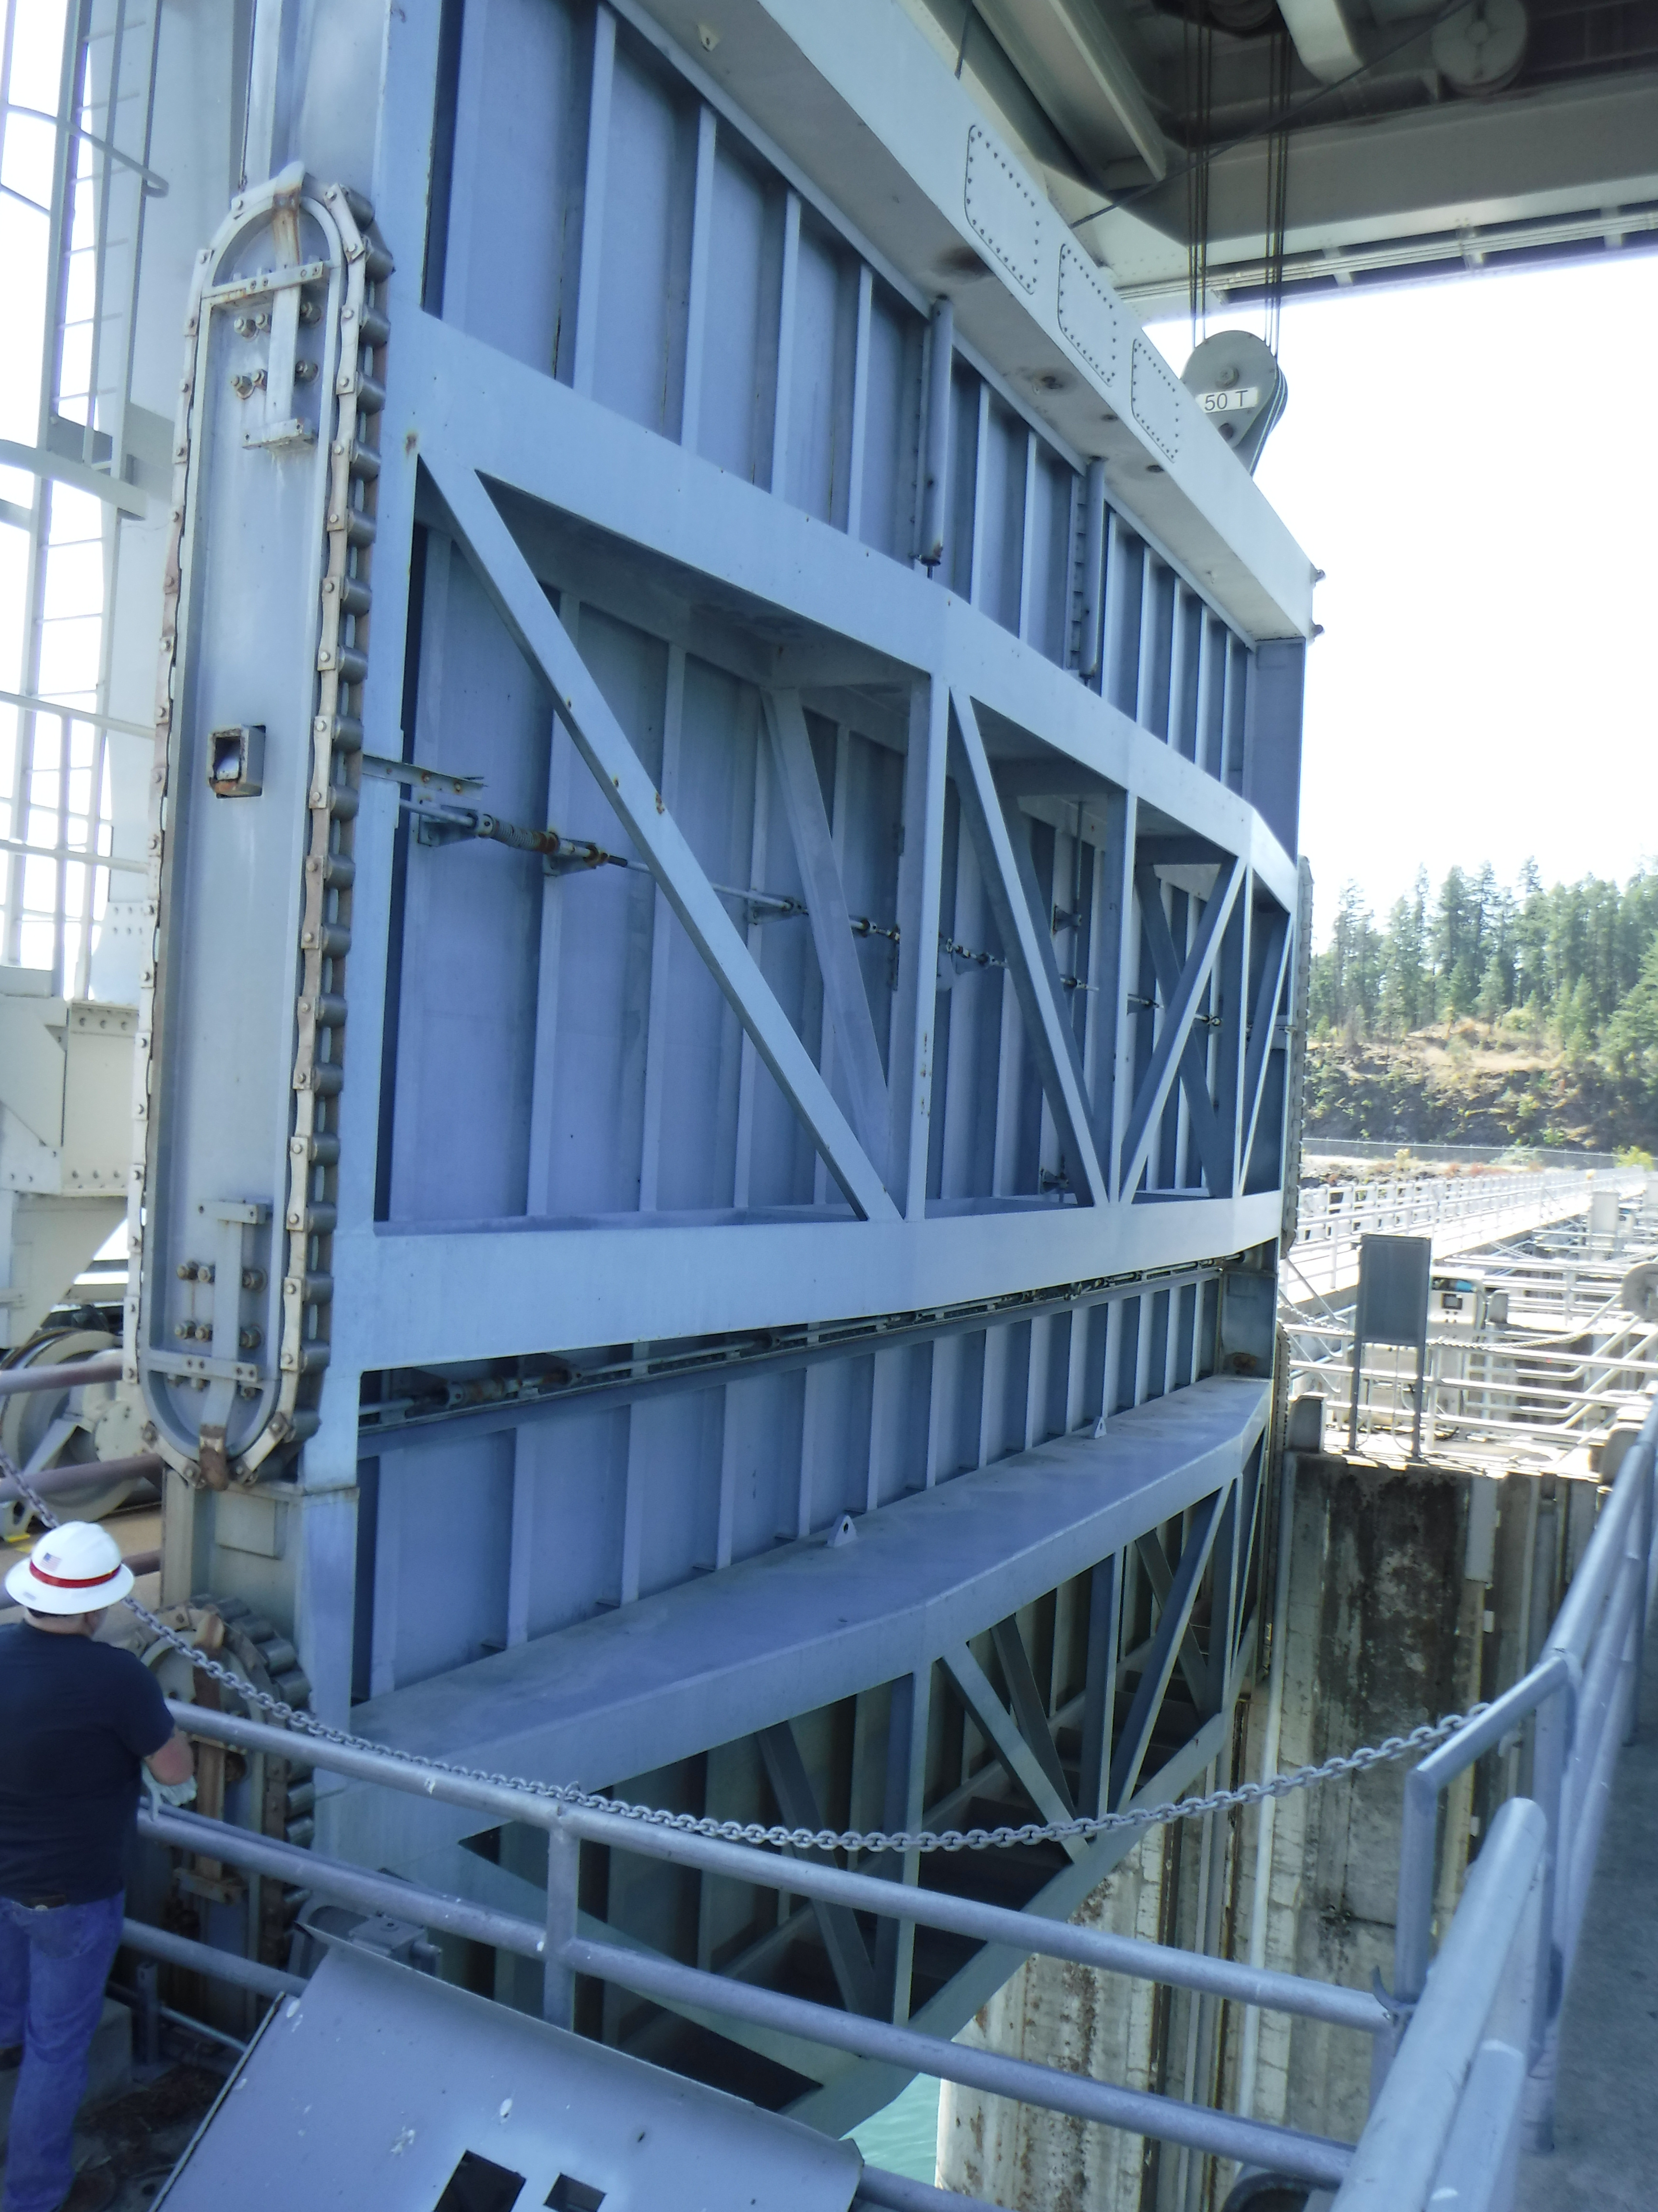
Spillway Gate Restrictions
Spillway gates needed to hold lake level / pass high outflows.
Delaminations in gate discovered in April 2024.
Restrictions on use of spillway gates in place.
Public safety not a concern as a result of these defects.
Notes:
TAYLOR - READ BULLETS
BULLET 1 : Spillway gates needed to hold lake level / pass high outflows to prevent upstream flooding. Generally, outflows below 30k cfs can be managed through the PH.
BULLET 2: Initiated routine rehabilitation contract in 2023, discovered delaminations/cracked welds in April 2024.
BULLET 3: Restrictions on use of gates were put in place which include minimal/no movement of gates with crane, which resulted in a slower refill, but met routine full pool target date. Lowered elevation band 1/2’ from 2062-2062.5 to 2061.75 – 2062.25.
BULLET 4: No public safety concerns as a result of these defects. Concern over movement of gates and potential gate failure, crane/operator/other infrastructure damage which would inhibit our ability to meet our mission.

Slide 3
Spillway Gate Repair / Replacement
Gate 3 Repair
    Gate 3 (removed for repair work) being worked on by contractor. Expected to return this spring for run-off period. Spare gate currently still in use.
    Apply Fiber Reinforced Polymer (FRP) to Gate 3 Spring 2025.
New Spillway Gate Design / Construction
    Design of new spillway gates in progress. Completion expected July 2025.
    Industry Day scheduled 29-30 January (virtual / onsite) www.SAM.gov.
    First gate expected onsite 2027, with remaining 9 gates + 1 spare in 6-month intervals after, dependent on industry capability.
Notes:
TAYLOR
BULLET 2: Apply Fiber Reinforced Polymer (FRP) to Gate 3 Spring 2025, giving us the spare back as contingency.
BULLET 3: Design of new spillway gates in progress. Completion expected July 2025, which has moved up 2 months since our last update.
BULLET 4: We are hosting an Industry Day Jan. 29 and 30 to reach as many possible qualified fabricators as possible. An announcement was issued on www.SAM.gov on Dec. 30 to give all interested parties the opportunity to receive information about the upcoming solicitation and to visit the site. Our intent is to communicate this upcoming fabrication contract as widely as possible, while also soliciting feedback from industry on other potential considerations to streamline the fabrication timeline.

Slide 4
Winter / Spring Operations
Kokanee spawning concluded per IDFG, 17 December.
Typical winter operating band, 2051.0 ft – 2052.0 ft.
FWPO storage was requested by BPA on 31 December.
  Raising the lake up to 3 ft. and then releasing in February.
  Subject to change depending on basin conditions.
Evaluating water management options due to restricted gate operations and watershed conditions.
Notes:
LEON
FWPO – Ability for BPA to raise the lake during periods of cold weather when power prices are high to generate electricity. Ice monitoring will be conducted in advance of request to evaluate conditions.

Slide 5
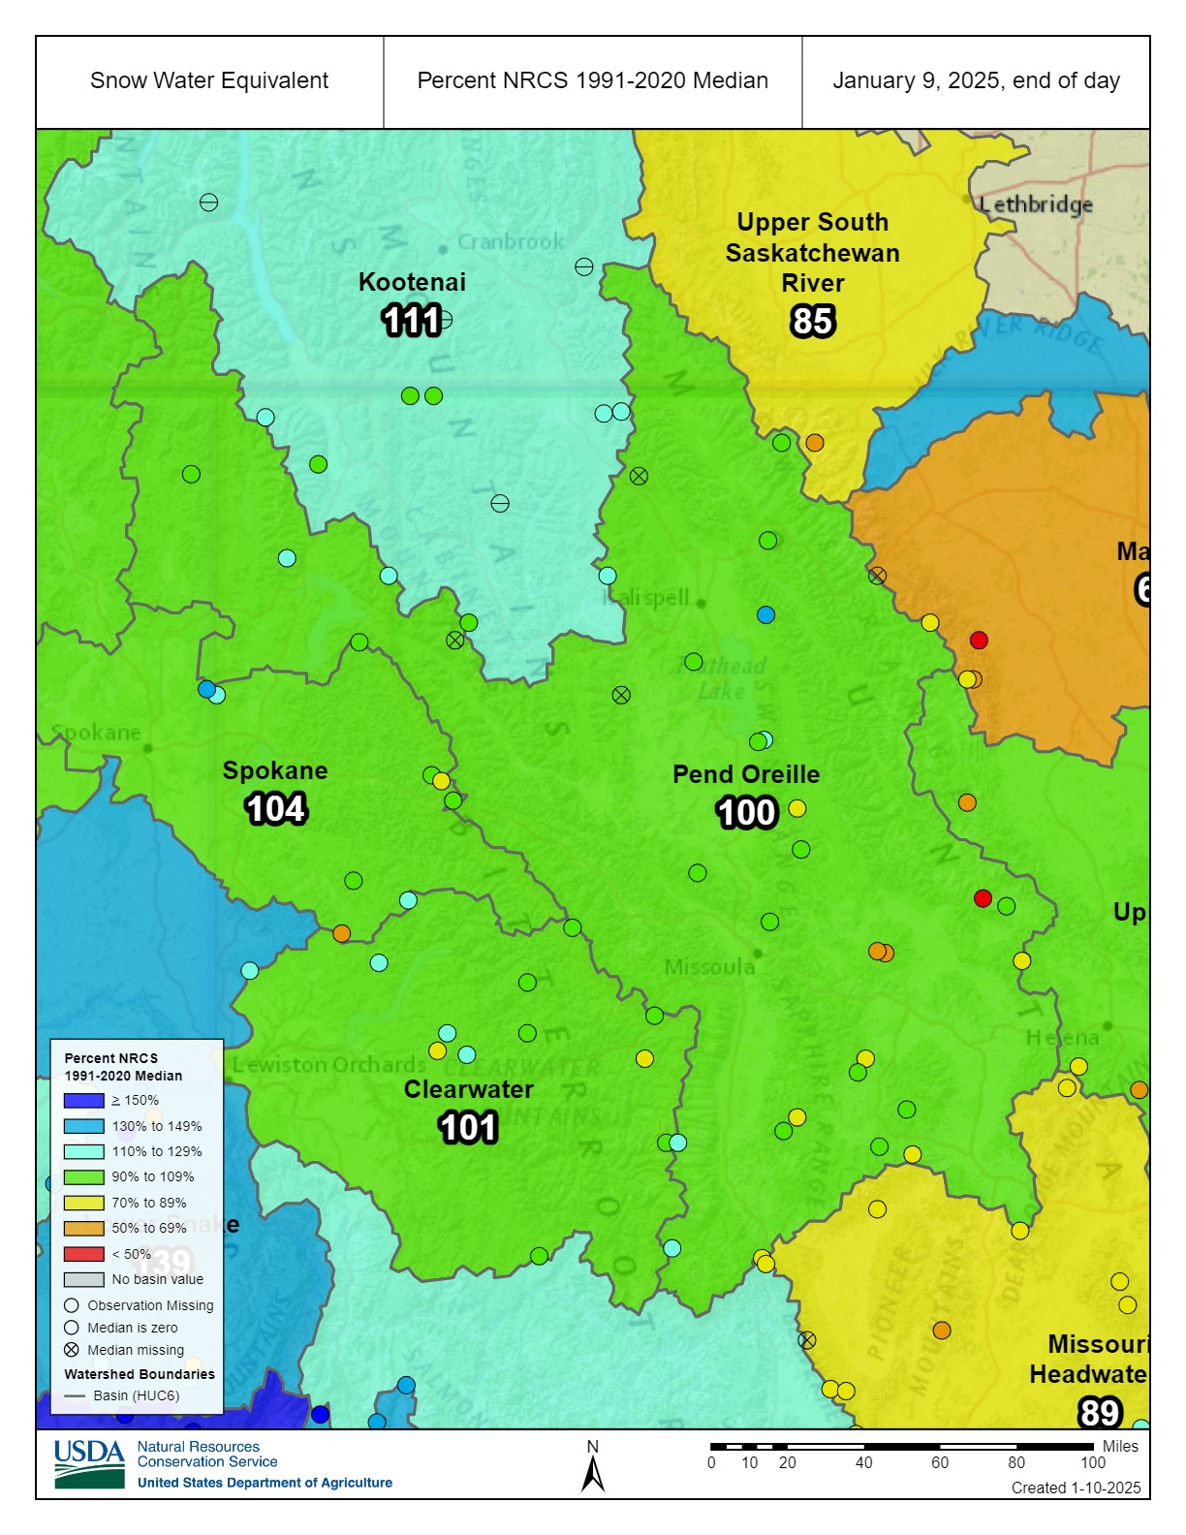
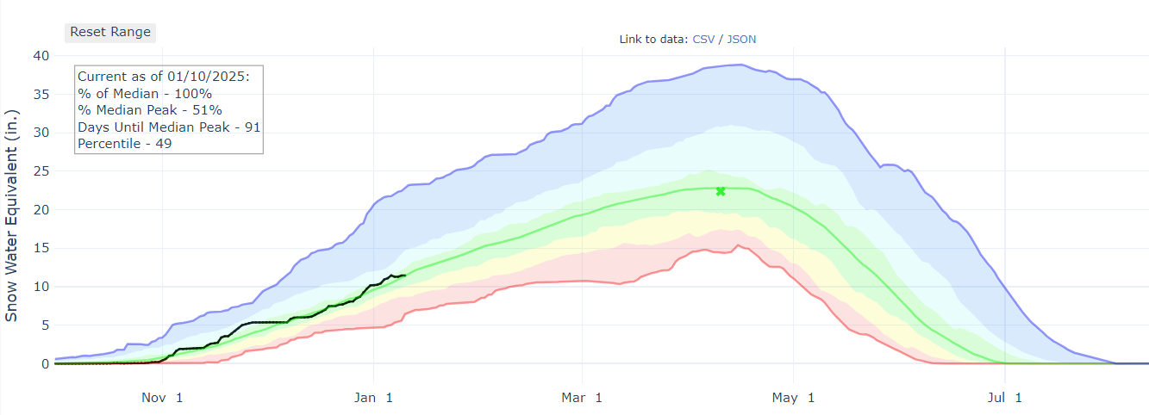
Basin Snow conditions
Notes:
LEON
FWPO – Ability for BPA to raise the lake during periods of cold weather when power prices are high to generate electricity. Ice monitoring will be conducted in advance of request to evaluate conditions.

Slide 6
How can YOU stay informed?
Subscribe to receive updates about release changes and lake levels: UpperColumbiaWM@usace.army.mil
Have general questions? Call us at 206-764-3750 or 208-437-3133
Check our district water management data webpage:
  http://www.nwd-wc.usace.army.mil/nws/hh/www/index.html#
Facebook: https://www.facebook.com/AlbeniFallsDam/
Twitter: @SeattleDistrictUSACE
Public website: https://www.nws.usace.army.mil/Missions/Civil-Works/Locks-and-Dams/Albeni-Falls-Dam/Spillway-Gate-Replacement-Project/
Spring Public Meeting - TENTATIVE
  6pm – April 22nd at Sandpoint HS. April 23rd Camas Center in Usk, WA.
Send input on how restricted operations affected you to AFDpublicinput@usace.army.mil
Notes:
TAYLOR
- Stay in the loop on flow changes, ask general questions, see lake elevations and follow our information pages.
- New Webpage
- Invite you to our Spring Public Meeting April 22 at 6pm at Sandpoint HS. TENTATIVE
- Send input on how restricted operations affected you to AFDpublicinput@usace.army.mil. When we discovered the defects in the spring a lot of decisions had to be made in a short period of time and out of an abundance of caution. With more time to analyze this fall/winter we'll be making adjustments and tweaks to try and have the least amount of impact to the public as possible for the upcoming season.

Slide 7
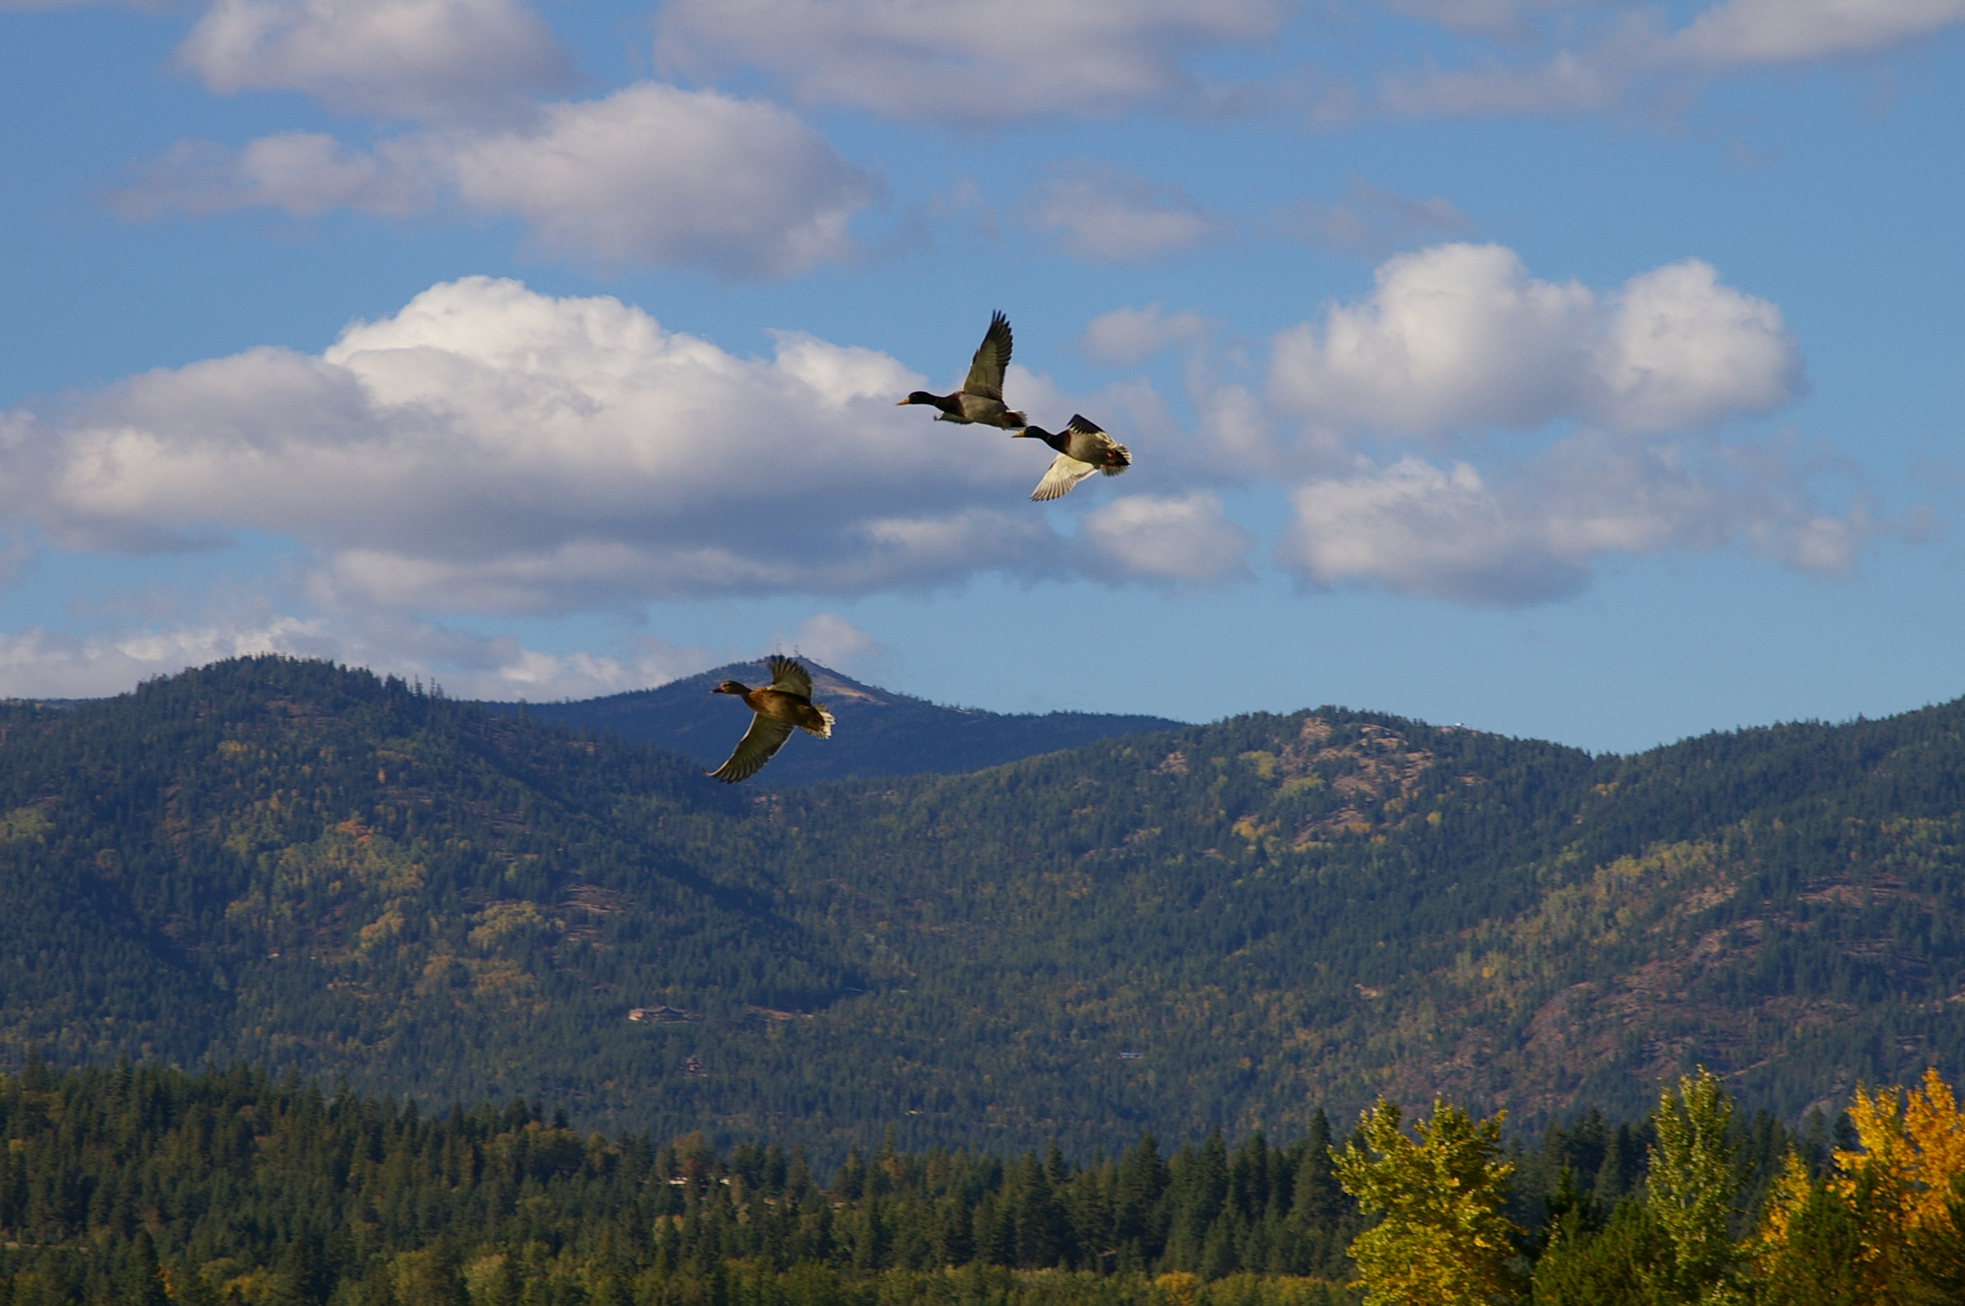
Albeni Falls dam project updates
Taylor Johnson
Chief, Natural Resources
Albeni Falls Dam
Notes:
TAYLOR

Slide 8
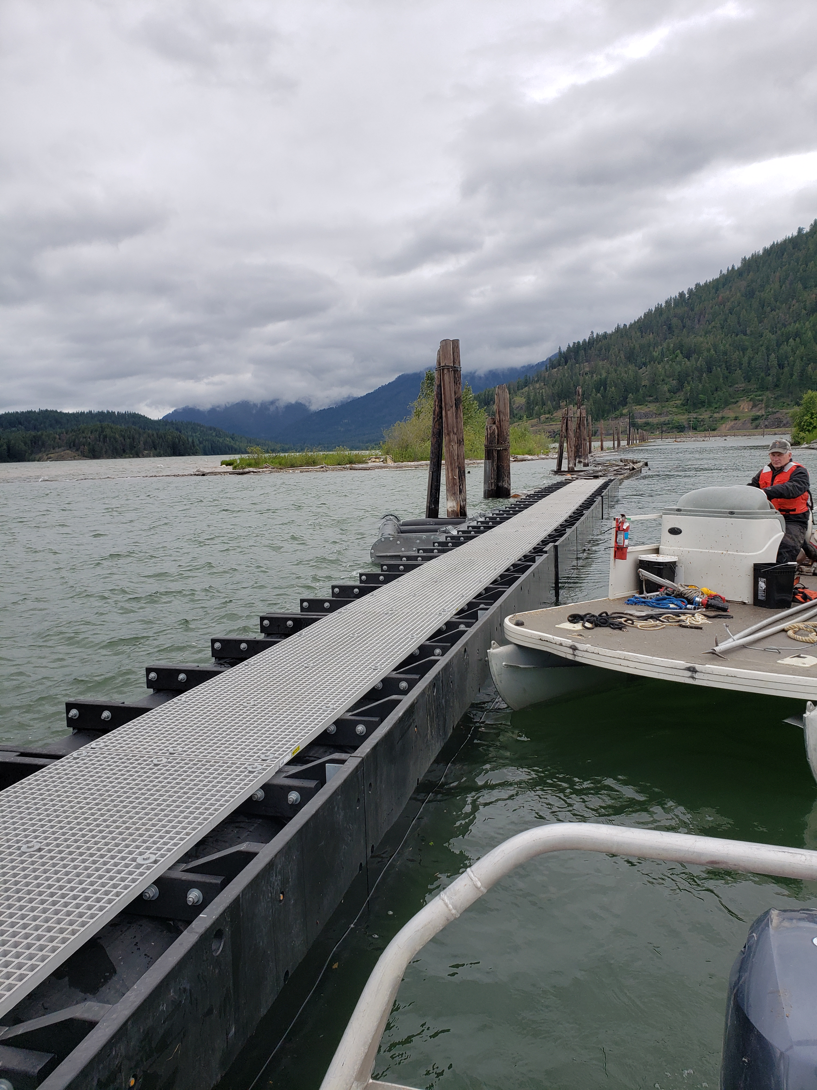
Clark Fork Driftyard
2024
Treated B and C booms for vegetation growth.
Replaced 100’ of A Boom and installed two wing braces.
2025
Awaiting construction / delivery of 150’ of boom section and one wing brace. Anticipate install summer 2025.
Notes:
TAYLOR

Slide 9
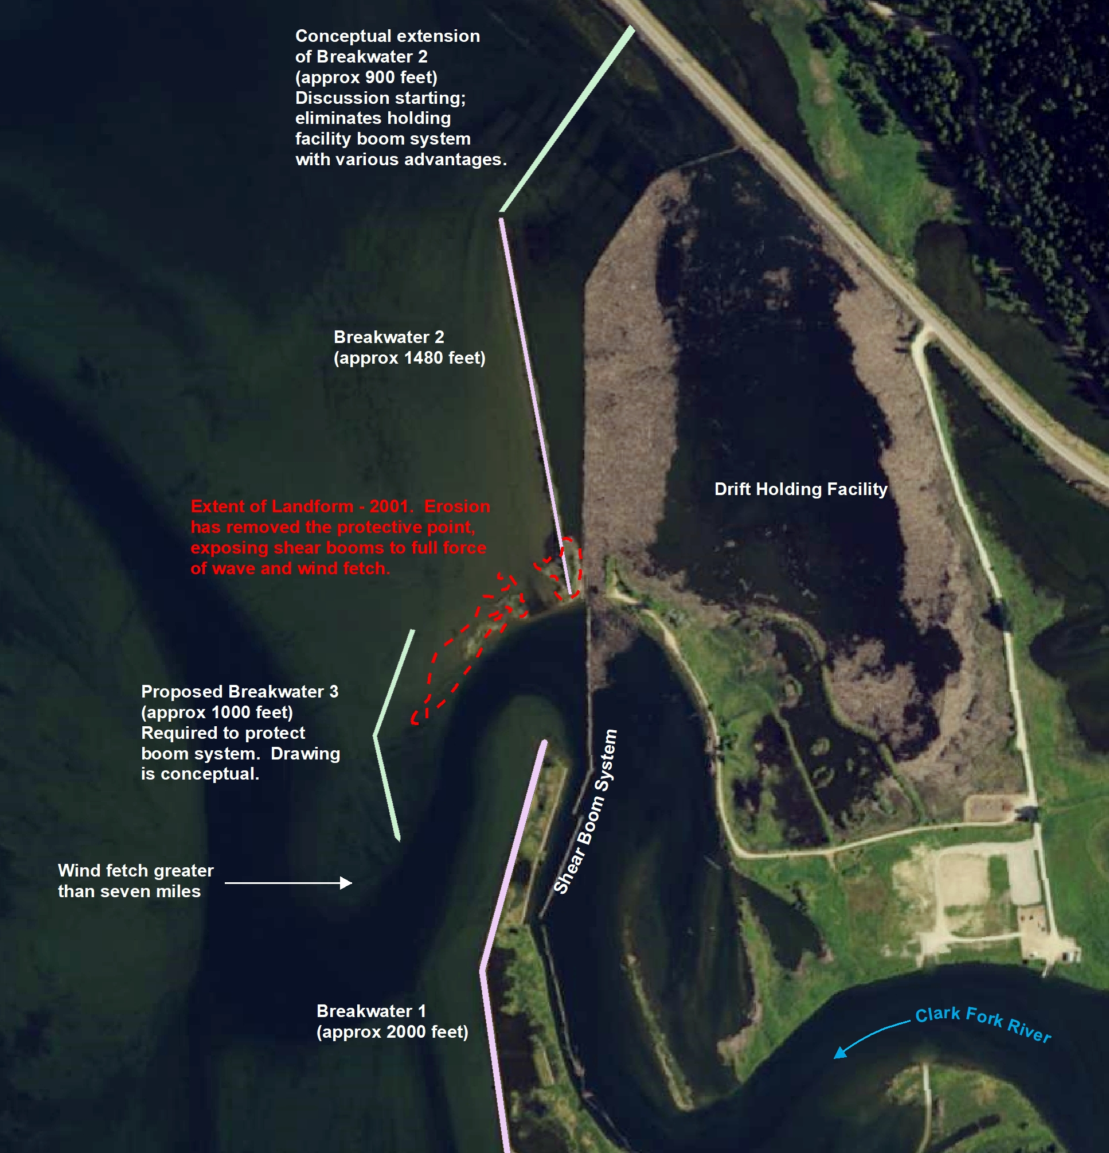
Clark Fork Driftyard
Break discovered in July.
Breakwater Feasibility Study Complete. Project design funded and in-progress. Geotech took place this past week.
Construction (if funded) in 2027.
Notes:
TAYLOR

Slide 10
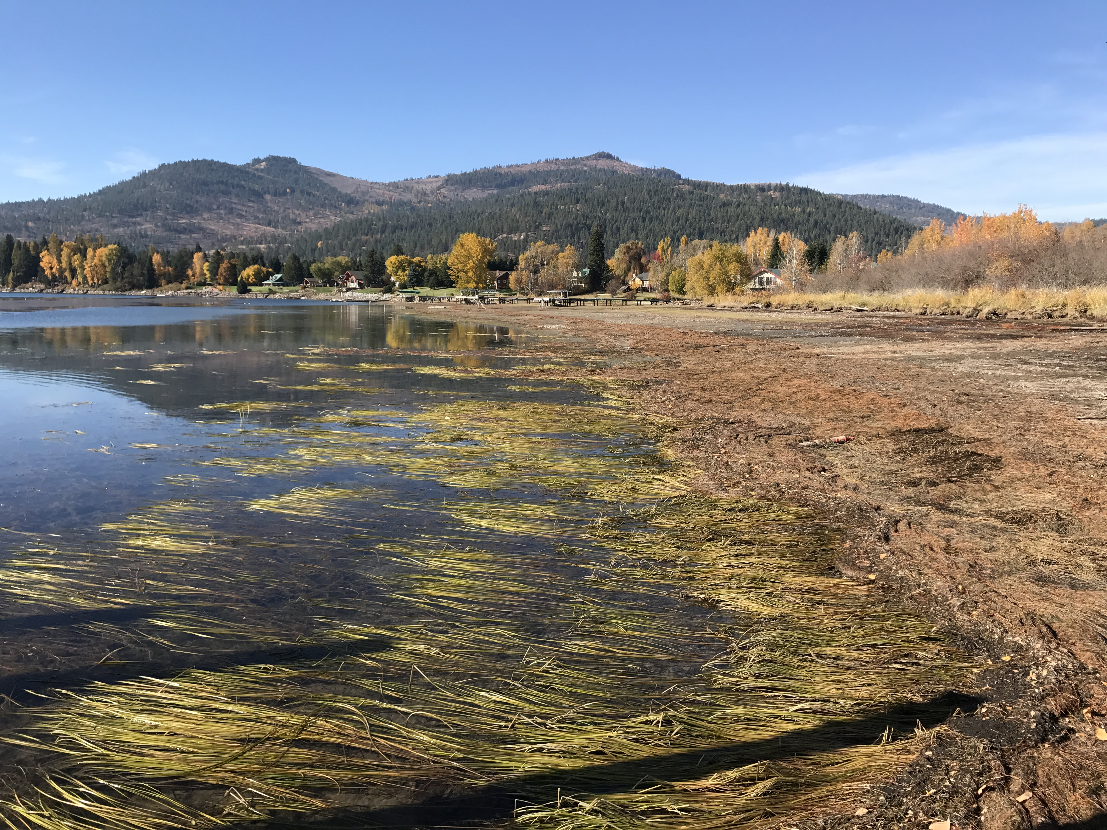
Aquatic Herbicide Application
2024 Flowering Rush Treatments (SUBMERGED and DEWATERED):
April 2024: (7.26 acres Mallard Bay, Hoodoo, CFDY, Oden, and Riley)
August 2024: (45 acres Pack River, Driftyard, Oden Bay, Morton Slough, and Riley Creek)
**April 2025: Proposed ~10 acres**
August 2025: (LOCATIONS TBD based on surveys)
Public Workshop with ISDA and Bonner County tentatively scheduled in March
Important to Combine Multi-Tiered Approach for Survey, Monitor, and /Treatment Control
Notes:
TAYLOR
Aquastrike & Reward: Flowering Rush
Imazapyr: Bare Ground Flowering Rush/Milfoil

Slide 11
Recreation / Natural Resources
  Albeni Cove, Priest River and Springy Point:
  May 17 – September 14 2025
  Riley Creek: May 10 – September 21 2025
  Trestle Creek: April 1 – October 31 2025
  Visitor Center open Mon – Thurs through Memorial Day 2025
  Reservations available through Recreation 1 Stop www.recreation.gov
  Shelters and Campsites by reservation only
  Interested in Volunteering for the 2025 season? www.volunteer.gov
Notes:
TAYLOR
Reservations can be made 6 months in advance from the day you want to camp or same day.

Slide 12
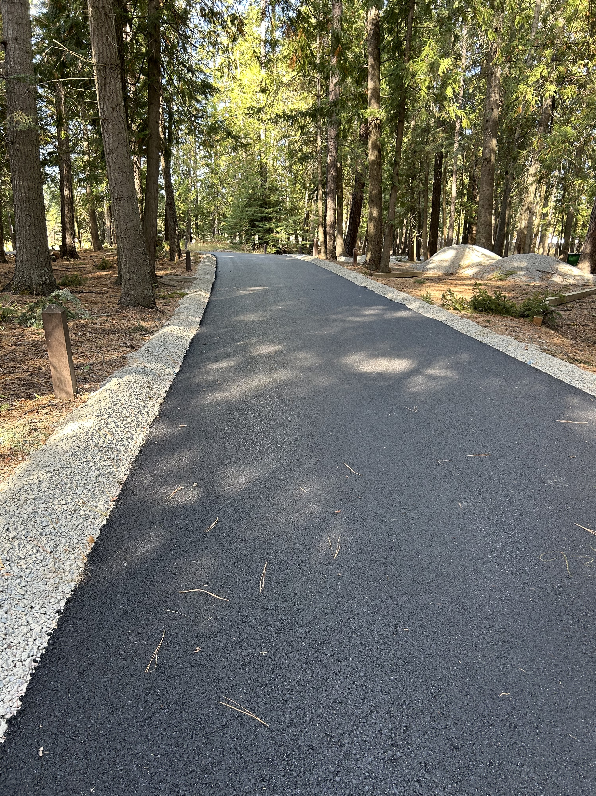
Recreation / Natural Resources
Swim Lessons at
Riley Creek Recreation Area
Paving at Priest River Recreation Area
Master Plan Update
Hiring 2025
Notes:
TAYLOR
Partnership w Pend Oreille River Paddling Association / Long Bridge Swim. Ages 1-17, 134 kids.
Paving / Campsites
Master Plan out for public comment soon. Check our website.
Accepting applications for 2025. Rangers and Maintenance.

Slide 13
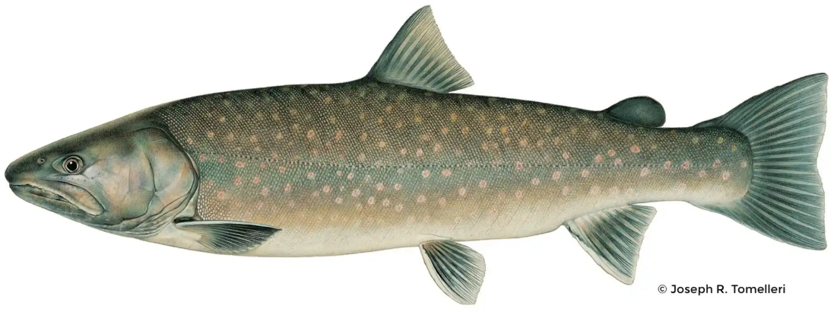
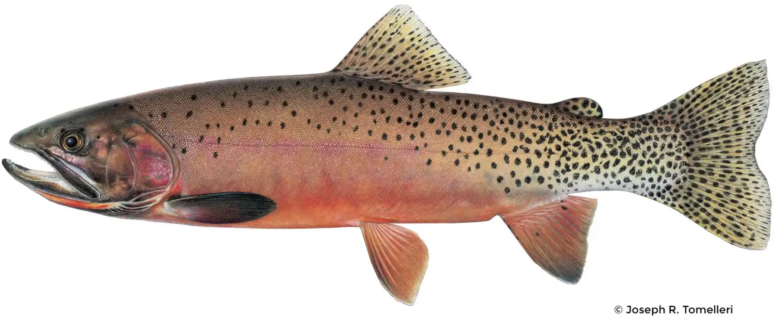
Fish Passage
Goal: Provide sub-adult and adult bull trout passage to habitats upstream of AFD and reestablish connectivity of bull trout critical habitat upstream and downstream of AFD as part of a system-wide recovery effort.
Trap and haul: bull trout
Forebay flume: westslope cutthroat
Design/build contract anticipated award in September 2025
Potential preconstruction beginning fall 2025
Construction complete 2030
Notes:
TAYLOR

Slide 14
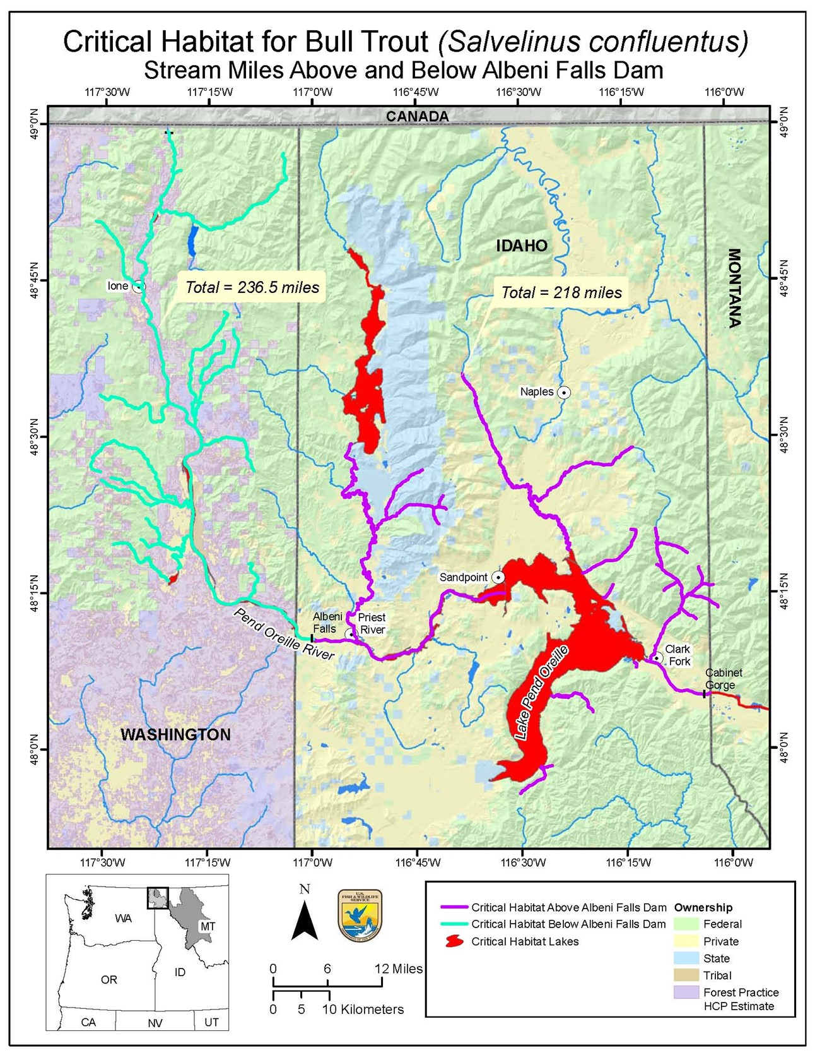
Why fish passage?
Lower Pend Oreille River (Box Canyon Reach) and associated tributaries are currently segmented from the rest of Lake Pend Oreille.
Red stars are dams with fish passage (Box Canyon and Cabinet Gorge) and black stars are dams without fish passage (Boundary Dam and Albeni Falls).
Habitat currently segmented.
Albeni Falls FPF will open over 600 miles of currently blocked/fragmented critical habitat.
Notes:
TAYLOR

Slide 15
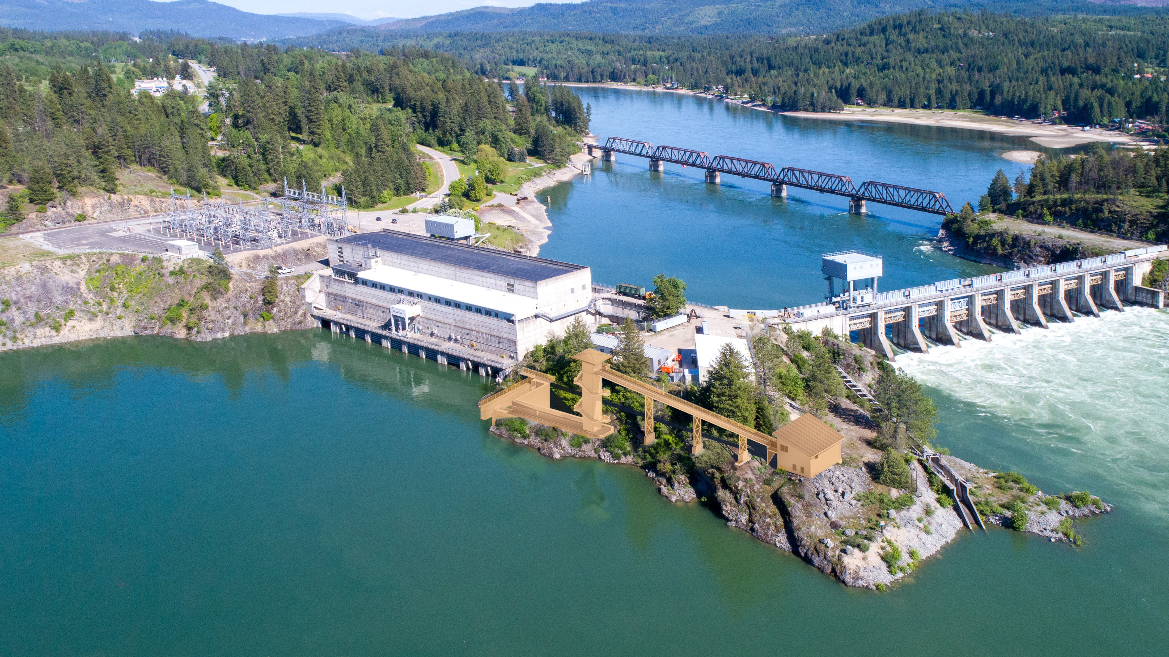
Bull Trout
Westslope Cutthroat
*Preliminary conceptual sketch (not final design)
Notes:
TAYLOR
Note that this is a rough conceptual sketch for a proof of concept. Design build contracts allow for maximum flexibility, innovation, and schedule adherence. Bull trout (BT) will be hauled upstream and westslope cutthroat trout (WCT) will be released into the forebay under the current Biological Opinion (BiOp). At this time: all other fish will be released downstream.

Slide 16
questions? taylor.m.johnson@usace.army.mil

Slide 17
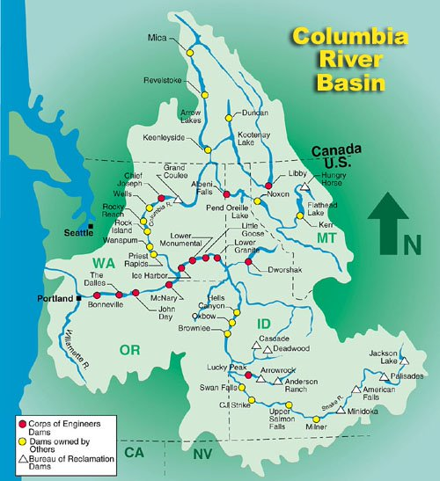
Lakes commission meeting -
Columbia River Treaty update
January 10, 2025
Kristian Mickelson, NWD, CRT FRM Advisor

Slide 18
Treaty operations
The U.S.’s Treaty operation with Canada changed after September 2024.
We have secured an interim FRM agreement for assured FRM space at one Canada CRT dam, Arrow (it used to be all 3).
This agreement is valid for up to 3 years with corresponding payment.
There are on-going discussions to get signed treaty in place.
This new regime will require a lot of coordinated decision-making and possibly more on-demand FRM decisions.

Slide 19
What is a "call"?
Under the Treaty, the U.S. has always had the ability in specific flood events and situations to "call" Canada for additional flood space.
We have not previously exercised this ability.
This ability is durable and continued after 2024. It remains in place, even if the Treaty Power Coordination is ever terminated.

Slide 20
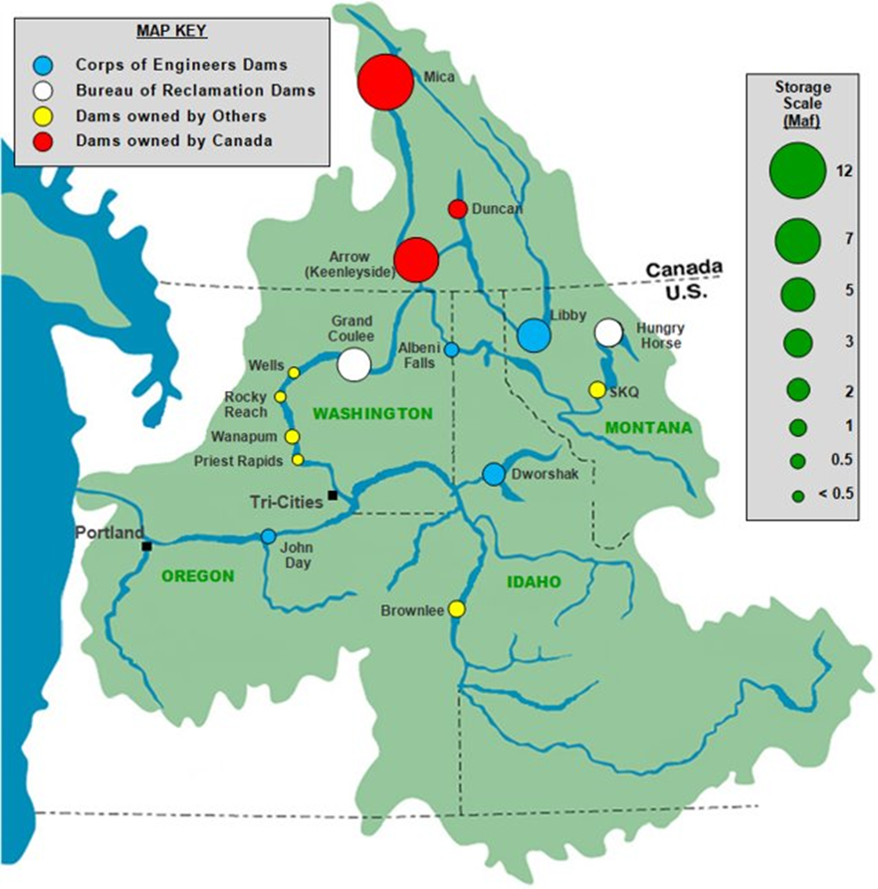
background
Starting in September 2024, we need to use all related space (while meeting their other authorized purposes) in the US before going to Canada.
US Projects authorized for FRM:
  Grand Coulee
  Libby
  Hungry Horse
  Dworshak
  Selis Ksanka Qlispe
  Albeni Falls
  Brownlee/Hells Canyon/Oxbow
  John Day
  Priest Rapids/Wanapum
  Wells
  Rocky Reach
Starting in Sept 2024, if the other US projects cannot maintain a similar level of flood risk in the lower Columbia River, we would request addtl space from JDA, the middle Columbia projects, and Brownlee

Slide 21
Scenario Description
Model Alternative | Flow-Aug | U.S. BiOp operations | AOP | Preplanned FRM Space | Calls to Canada for FRM | Purpose
PA | Yes | Yes | AOP25_C2′ | 8.95 maf | Article IV(2)(b) | Updated Preferred Alternative
RTFRM | Yes | Yes | AOP25_C2′ | 3.6 maf | Article IV(3) | Includes 3.6 maf preplanned FRM at Arrow from the agreement in principle

Slide 22
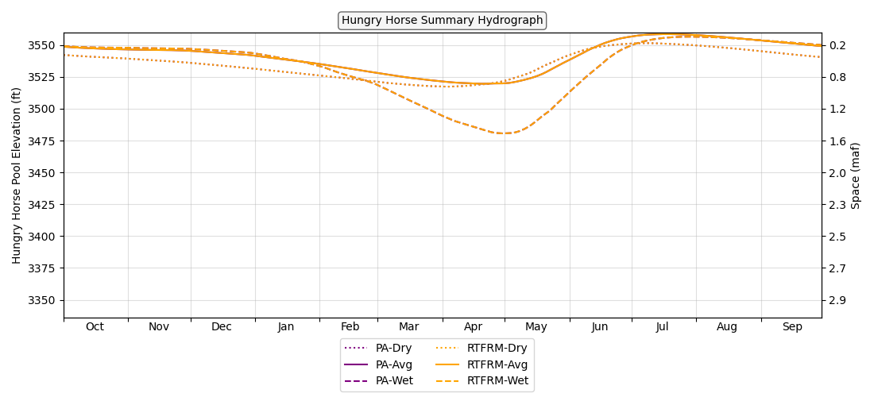
Modeling Results - ResSim
Hungry Horse Elevation

Slide 23
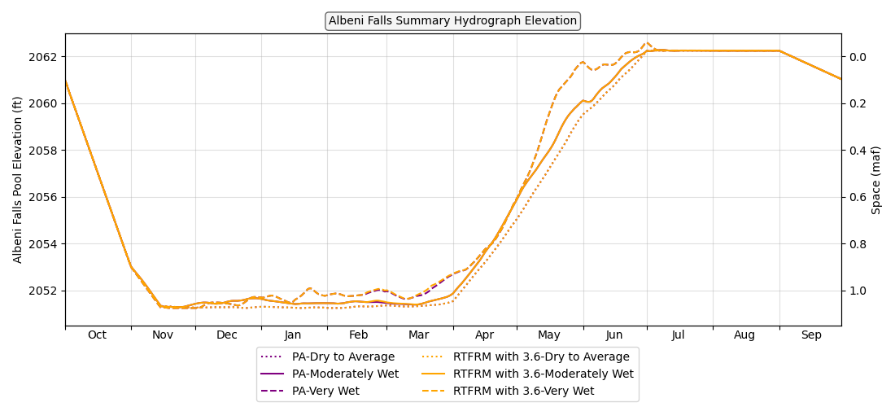
Modeling Results - ResSim
Lake Pend Oreille Elevation

Slide 24
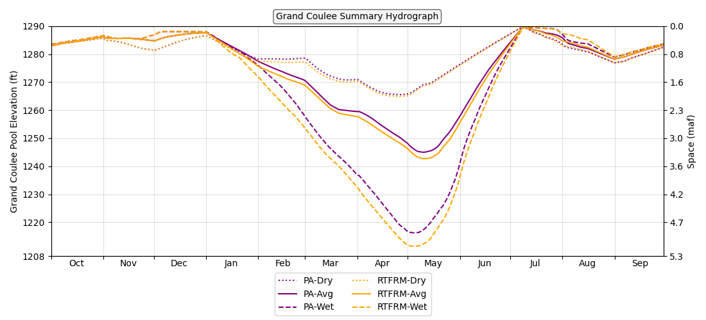
Modeling Results - ResSim
Grand Coulee Elevation

Slide 25
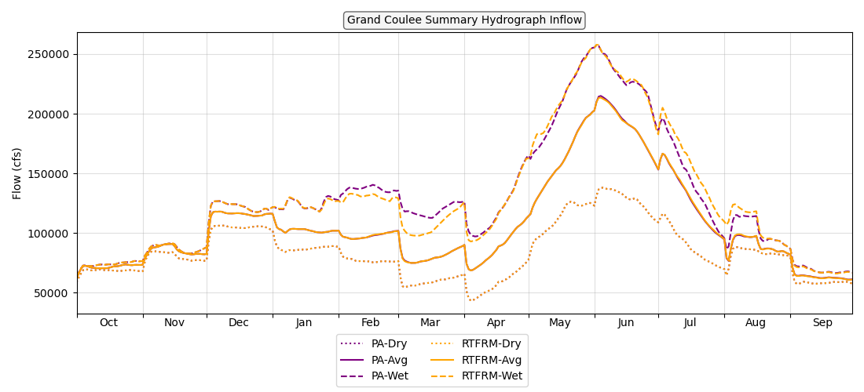
SUPPLEMENTAL Modeling Results - ResSim
Grand Coulee Summary Hydrograph - Inflow

Slide 26
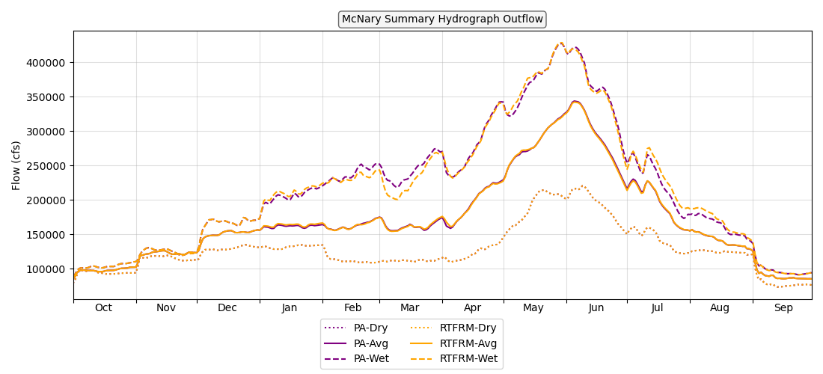
Modeling Results - ResSim
McNary Outflow

Slide 27
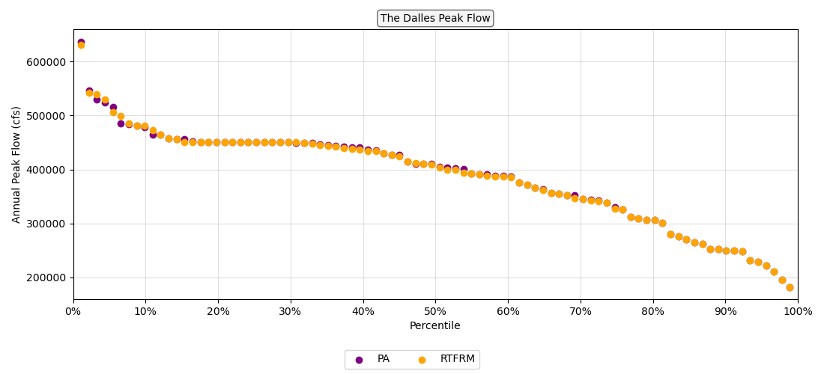
Modeling Results - ResSim
The Dalles – Peak Flow

Slide 28
thank you
General information for Columbia River operations:
https://www.nwd.usace.army.mil/CRWM/Columbia-River-Treaty/
https://www.usbr.gov/pn/
Update on Columbia River Treaty negotiations:
https://www.state.gov/columbia-river-treaty/
Notes:
CORPS

Slide 29
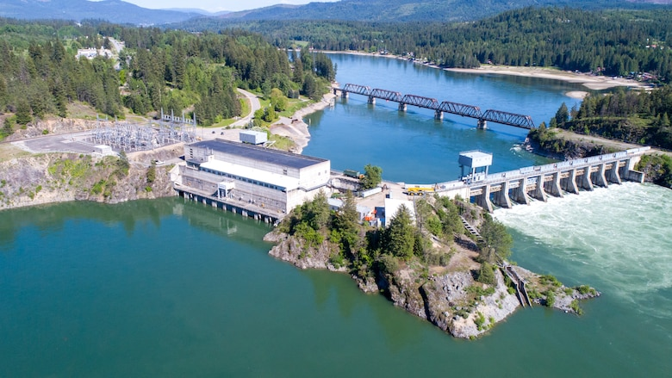
Forecast Informed Reservoir Operations (FIRO) and Albeni Falls Dam
Michael Warner, PhD
Atmospheric Scientist
Hydrology Section
Seattle District
US Army Corps of Engineers
Lakes Commission Meeting
10 January 2025

Slide 30
Forecast Informed Reservoir Operations (FIRO)
The goal of FIRO is to develop, demonstrate, and implement tools and science that enable more effective management of reservoirs by leveraging improvements in weather and water forecasts. FIRO creates a natural linkage between research, applications, technology, reservoir operations and water control manuals to enable continuous improvement based on state-of-the-science.
FIRO is currently being developed and tested as a collaborative effort in the Russian River Basin (Lake Mendocino, Lake Sonoma), the Santa Ana River Basin (Prado Dam, Seven Oaks Dam), the Yuba-Feather River Basins, and the Green River Basin (Howard Hanson Dam)

Slide 31
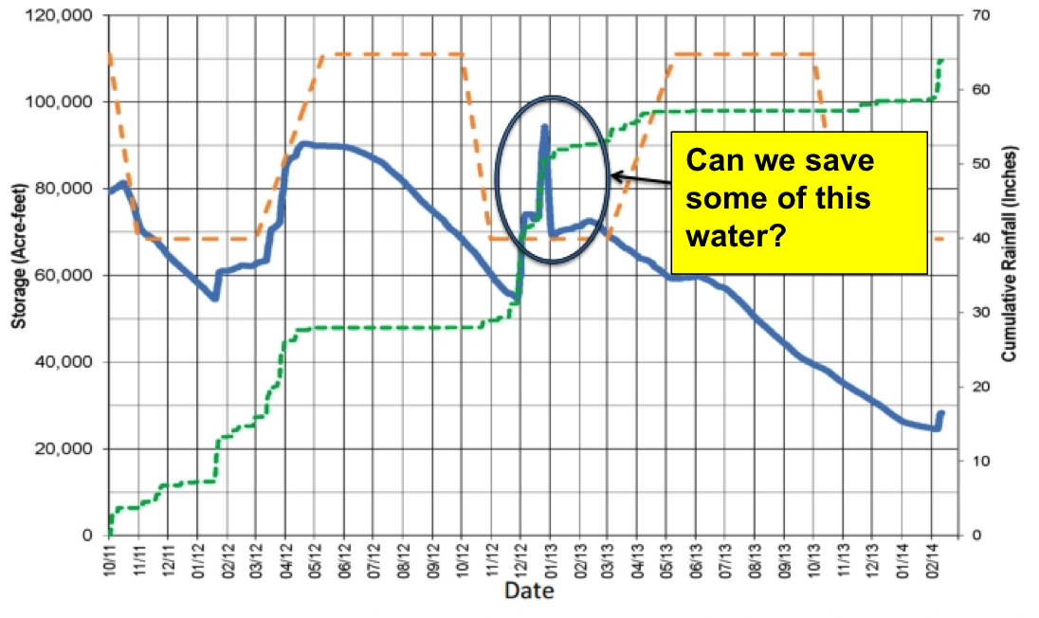
FIRO and Water Supply

Slide 32
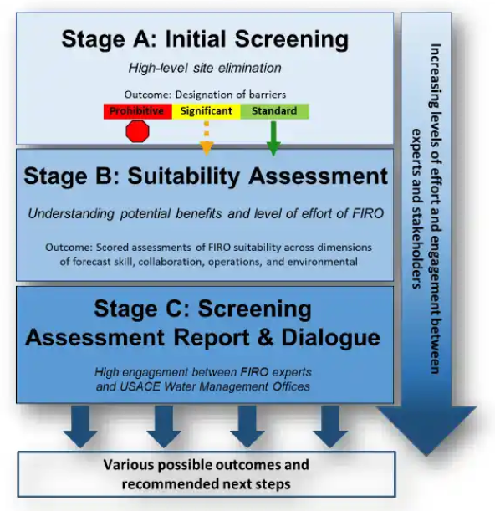
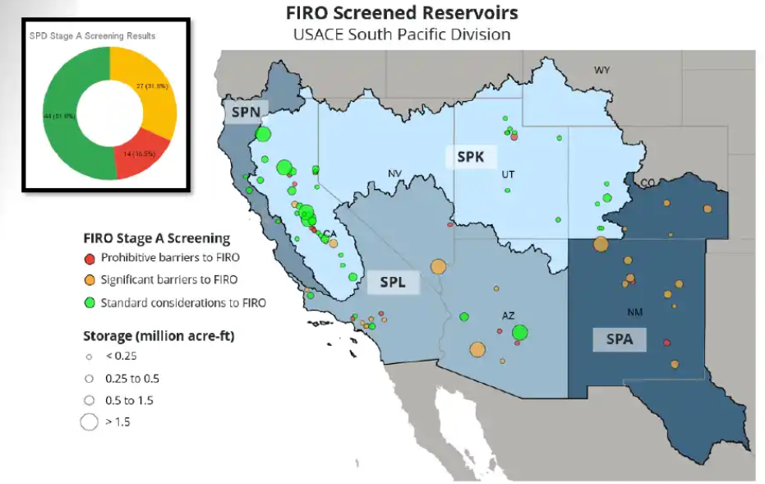
FIRO Phase II

Slide 33
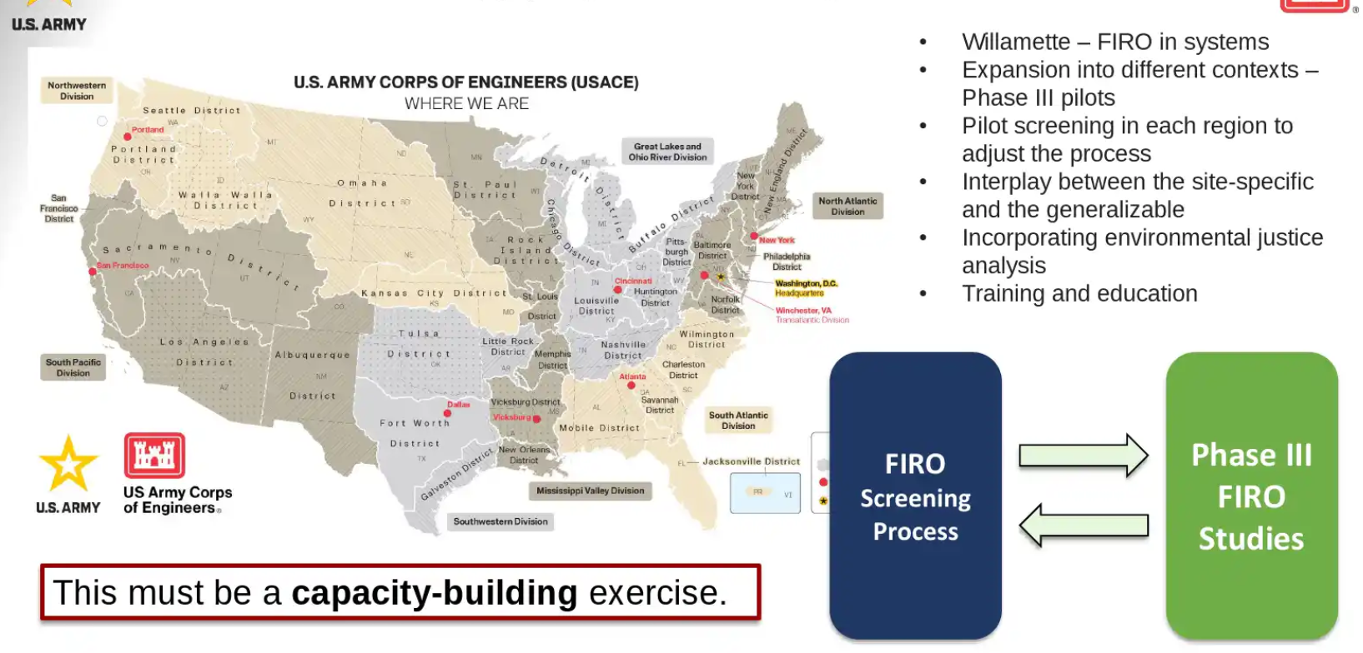
FIRO Phase III

Slide 34
Albeni Falls?
In the initial high-level screening of Albeni Falls Dam, FIRO viability was scored as having “significant barriers” or in the yellow category.
This initial screening is just to weed out projects that are definitely NOT suitable for FIRO and Albeni Falls did not fall into that category.
In the next 12-24 months, Albeni Falls will be more thoroughly screened and more detailed questions about FIRO suitability will be addressed, then ultimately scored with an index. This index will be used to prioritize additional FIRO investigation efforts at the dam.
Some reasons that ALF may not be suitable for FIRO:
Limited ability to improve precipitation forecasts (convective precipitation is difficult to predict)
Relatively narrow operations band and uncertainty in refill targets
How flows respond to rain on snow in the spring and difficulties in predictive hydrology skill

Slide 35
questions? michael.d.warner@usace.army.mil

