Slide 1
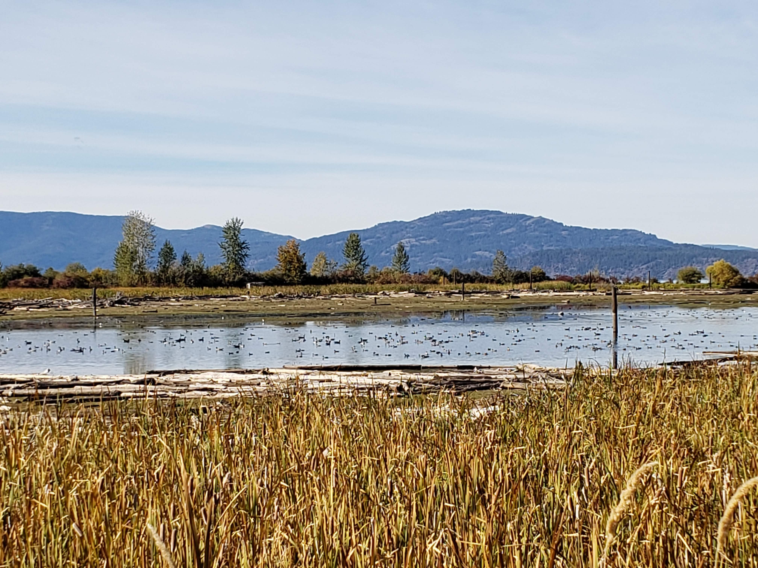




NORTH IDAHO WILDLIFE MITIGATION PROGRAM
PACK RIVER DELTA PHASE 2 PROJECT UPDATE
Pete Rust – Mitigation Staff Biologist - IDFG

Slide 2
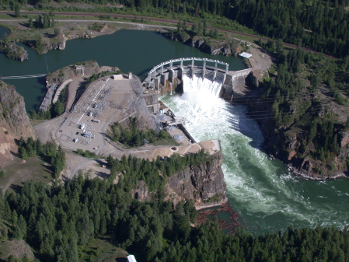
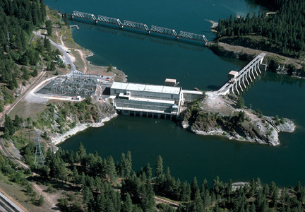
Hydroelectric Projects on Clark Fork and Pend Oreille Rivers, In Idaho
Cabinet Gorge Dam (Avista) – 1952
Albeni Falls Dam (USACE) – 1955
Hydroelectricity
Flood control
Recreation

Slide 3
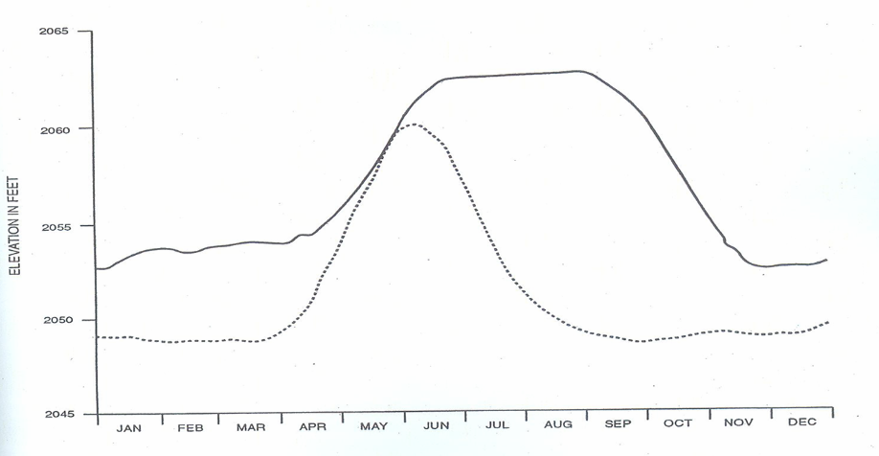
Annual Operations Have Changed
Current Conditions
Falls Dam
Pre-dam
Notes:
3

Slide 4
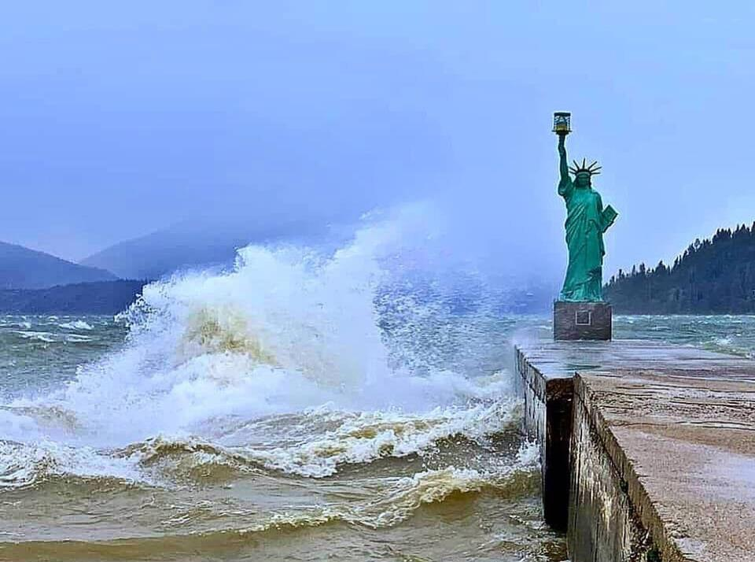
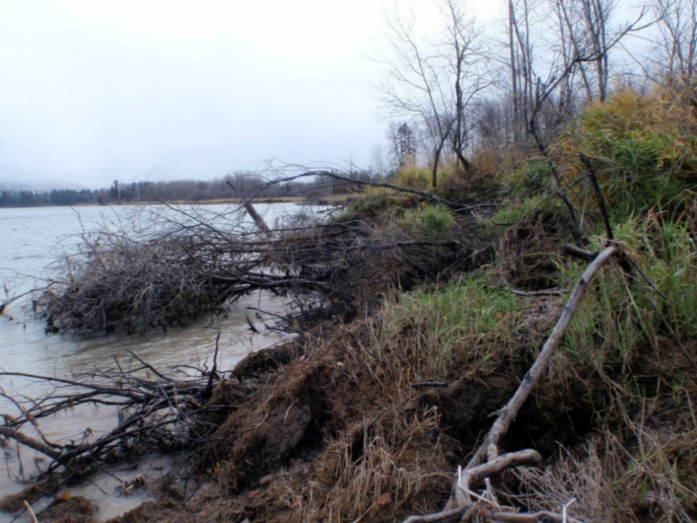
Problem:
Elevated summer water levels (inundation) killed much of the native wetland and riparian vegetation
Elevated summer water levels allow wind generated waves to erode shoreline for longer than natural

Slide 5
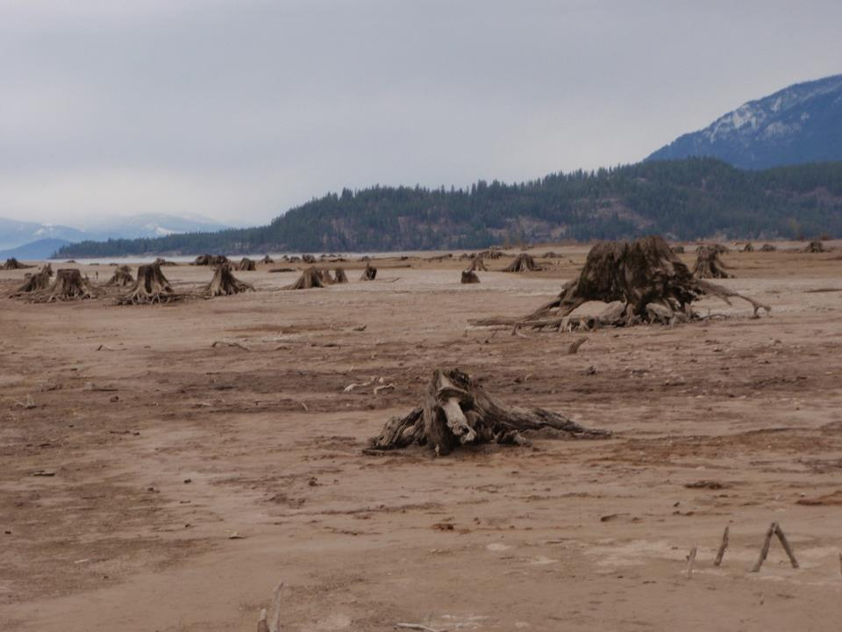
Problem:
Extensive loss of soil, native riparian and wetland vegetation
Lost habitat quantity, quality, and complexity
Vegetation between summer pool and winter pool not available to hold sediments – no perennials from 2051 and 2062.5
CG Dam virtually eliminated sediment inflow and land/delta forming processes
Annual vs Seasonal inundation

Slide 6
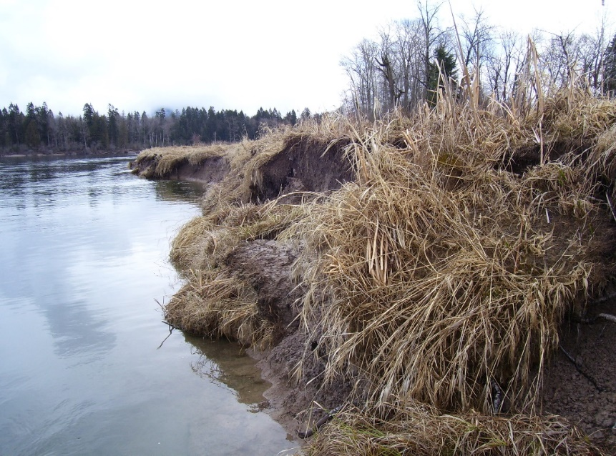
North Idaho Wildlife Mitigation Program:
Take restorative actions where the operational effects occur and recreate the kind of habitat and habitat function that has been adversely affected (NIMOA, 2018)
BPA funded

Slide 7
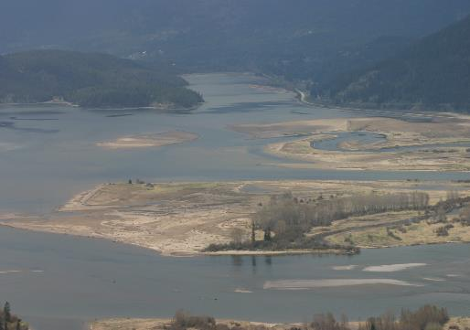
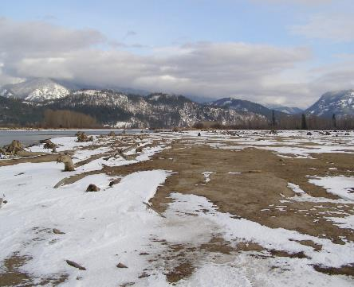
Delta Restoration Project Objectives
  Protect delta shorelines from erosion (breakwaters)
  Protect remnant habitat from erosion and create protective “barrier” island areas
  Raise and restore delta islands that are currently submerged
  Increase wetland habitat diversity
  Create access to restored areas for sportsman

Slide 8
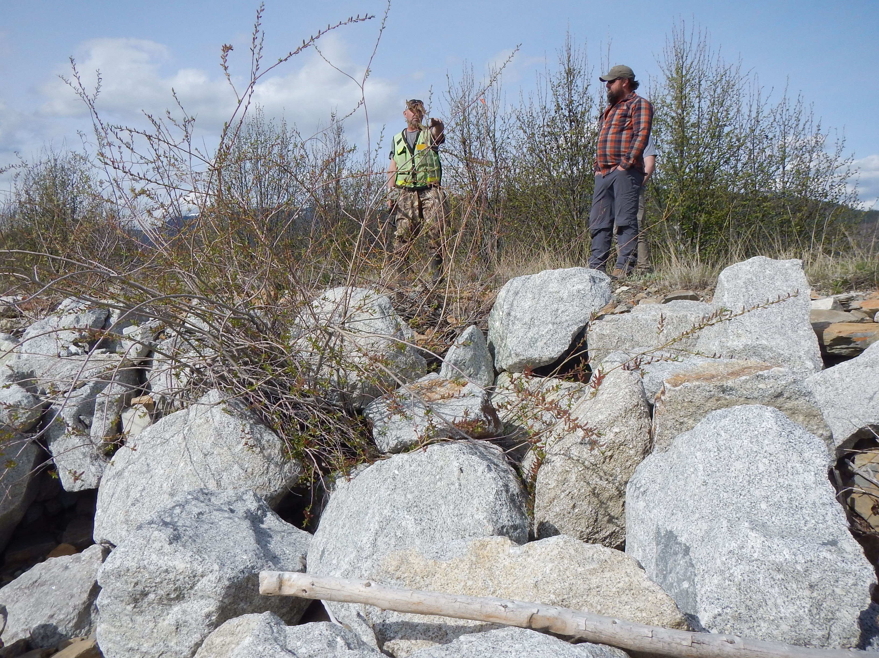
Delta Restoration Process
  Stop the force of the wind and water (add breakwaters)

Slide 9
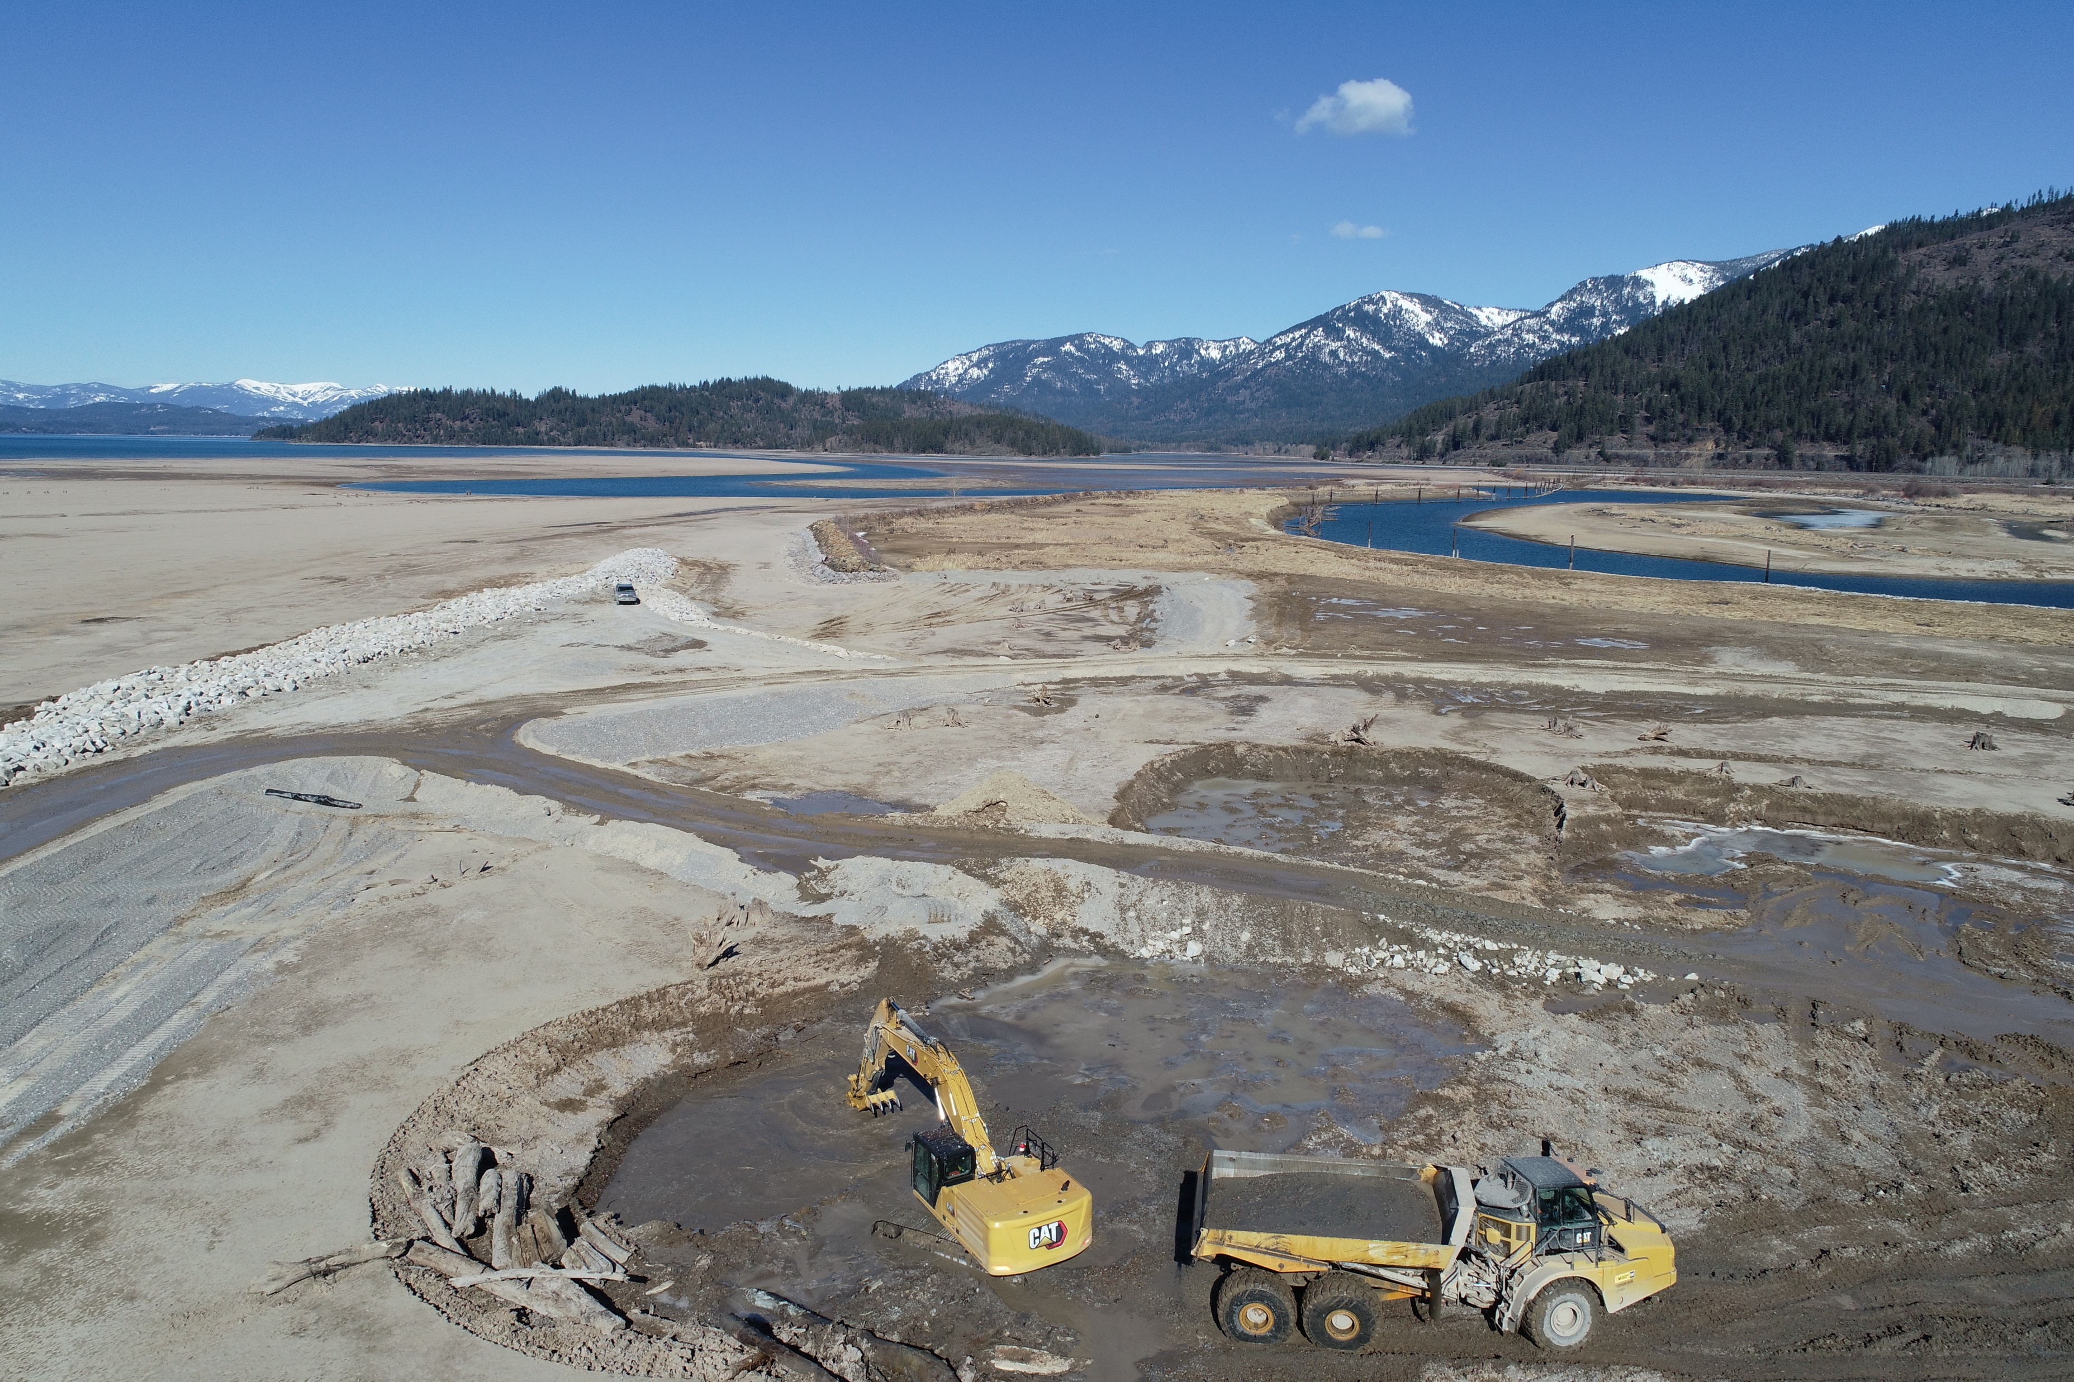
Delta Restoration Process
  Build Islands (new habitat) behind breakwaters

Slide 10
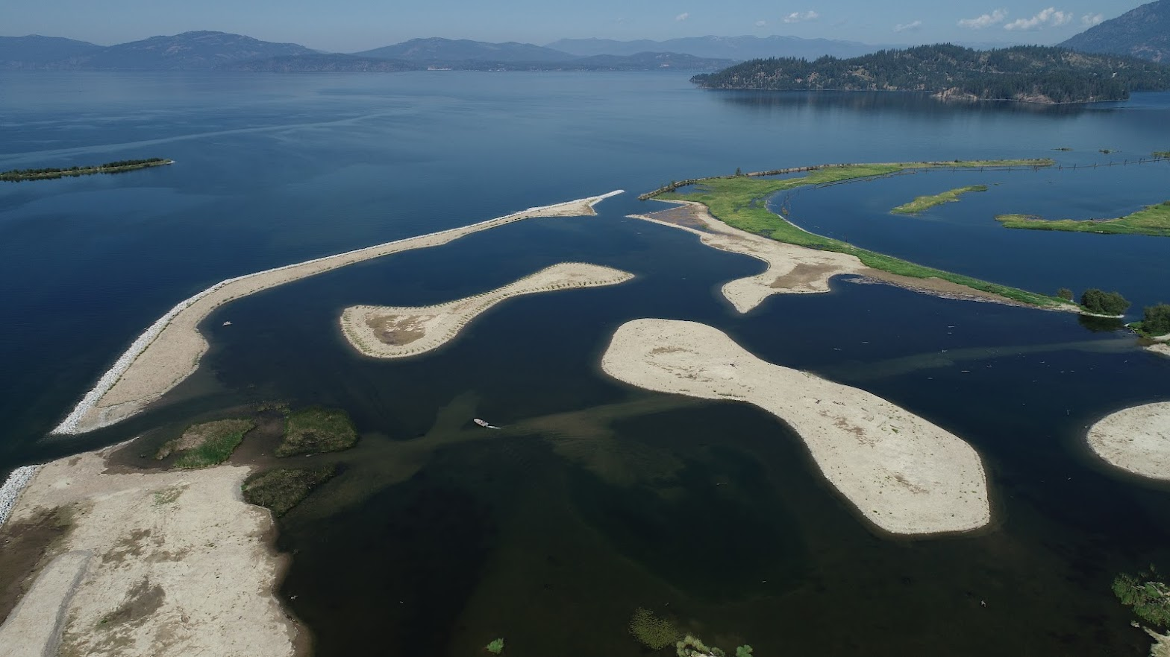
Delta Restoration Process
  Build Islands (new habitat) behind breakwaters

Slide 11
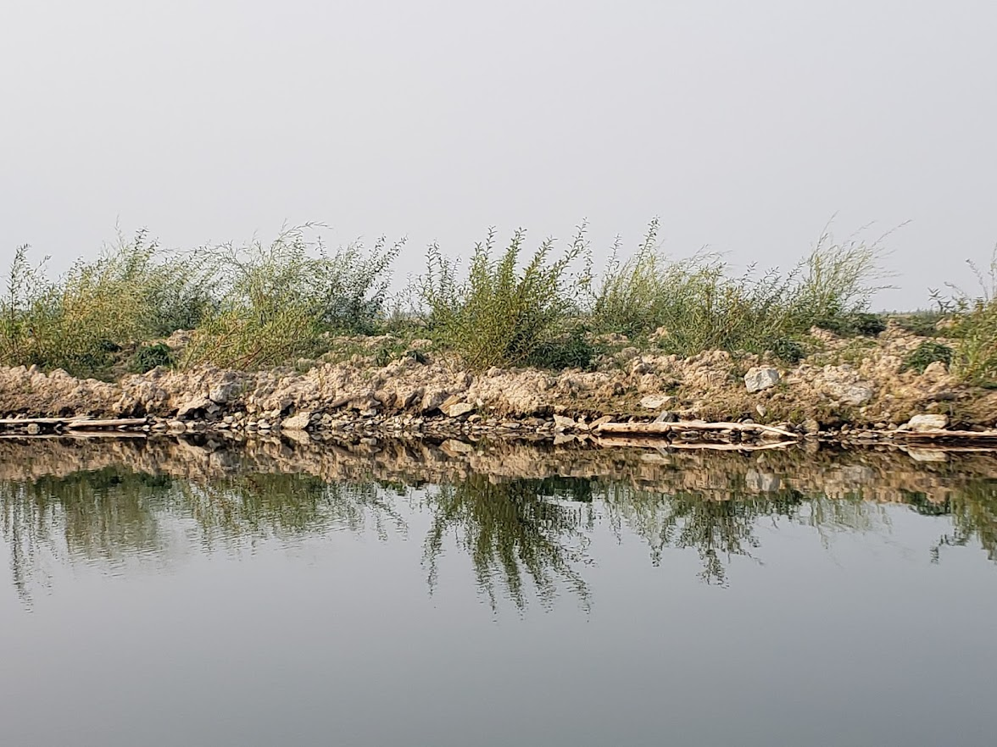
Delta Restoration Process
  Contractor plants willows during construction (habitat and bank protection)

Slide 12
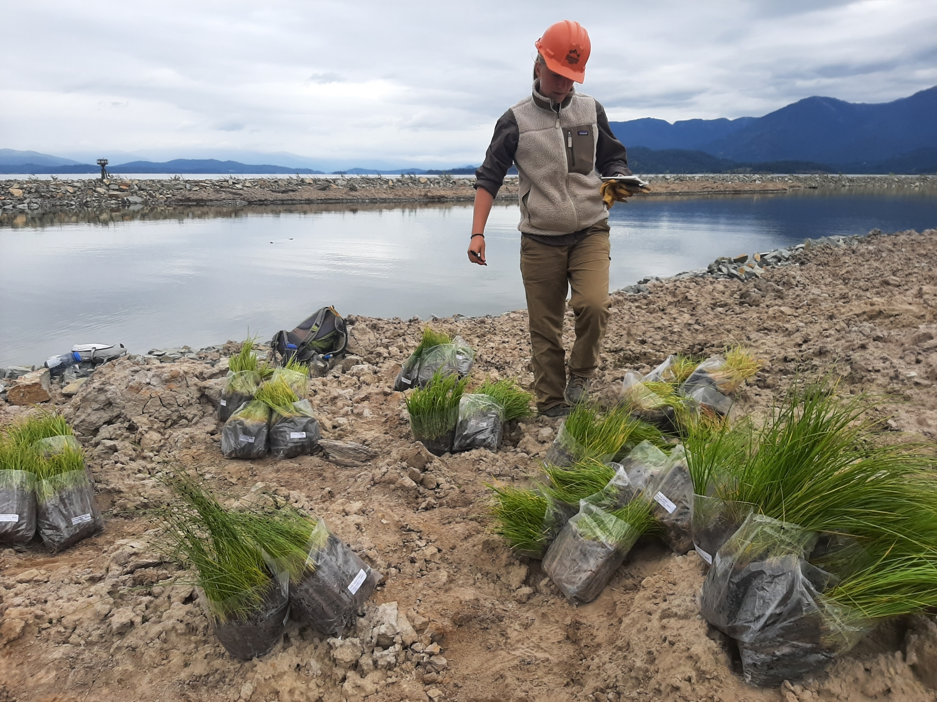
Delta Restoration Process
  Build benches just above full pool and plant/seed extensively

Slide 13
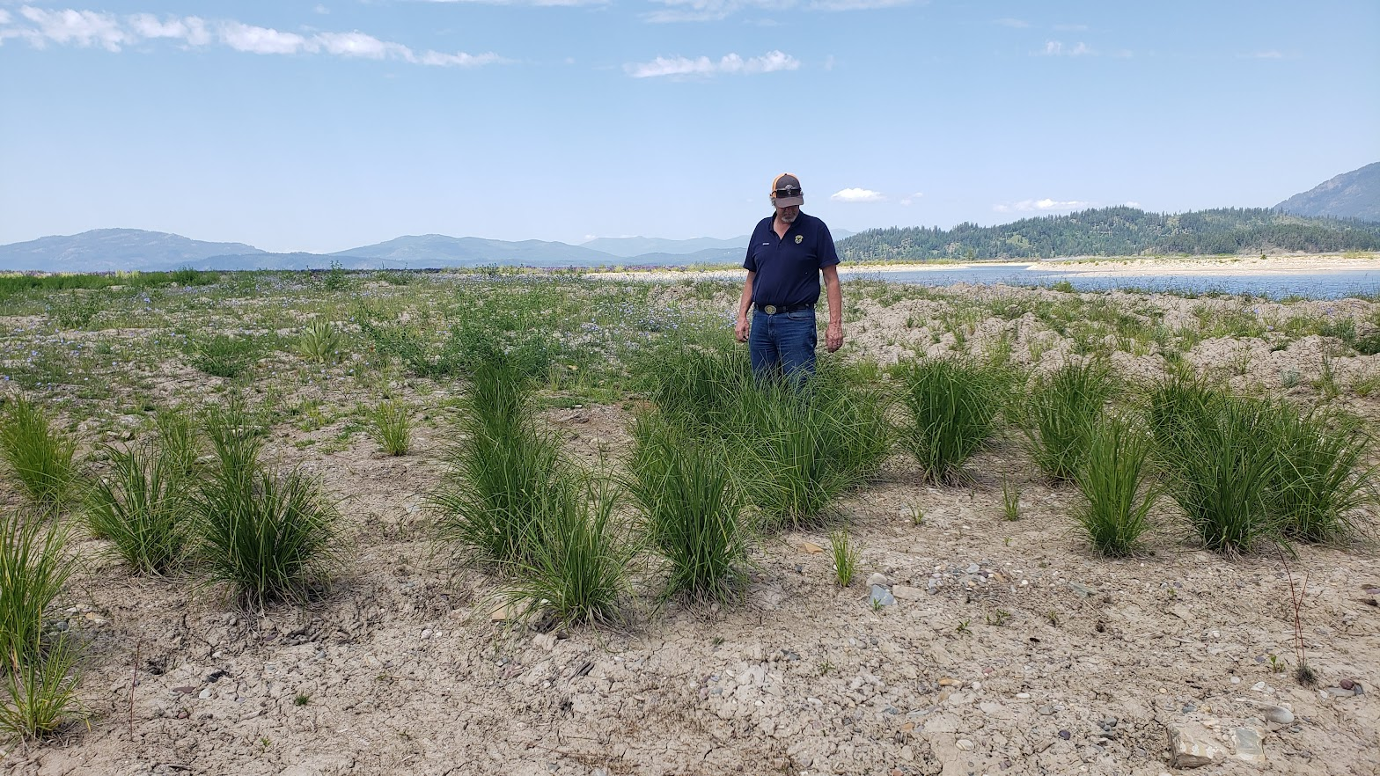
Delta Restoration Process
  Build benches just above full pool and plant/seed extensively

Slide 14
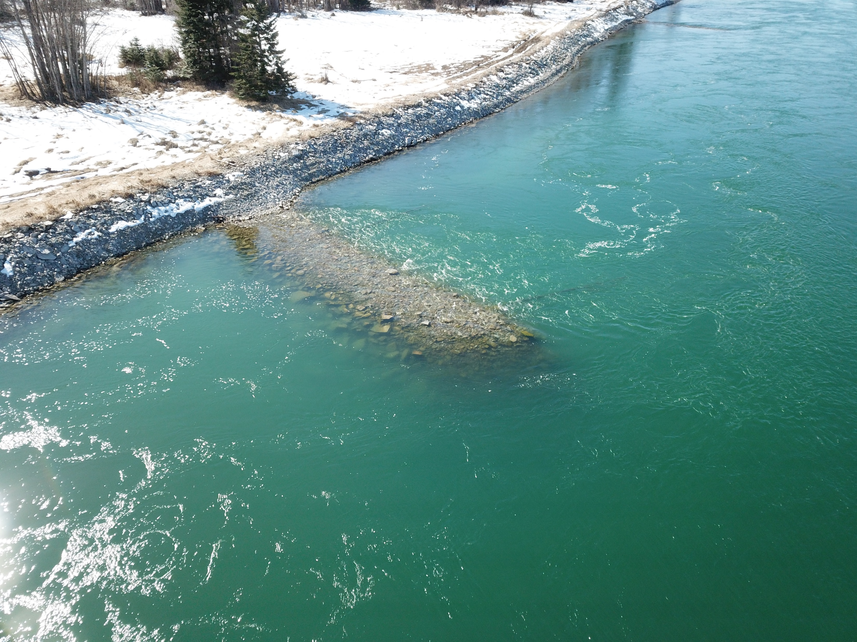
Delta Restoration Process
  Use engineered structures (bendway weirs) to direct flow into the main channel to reduce bank erosion

Slide 15
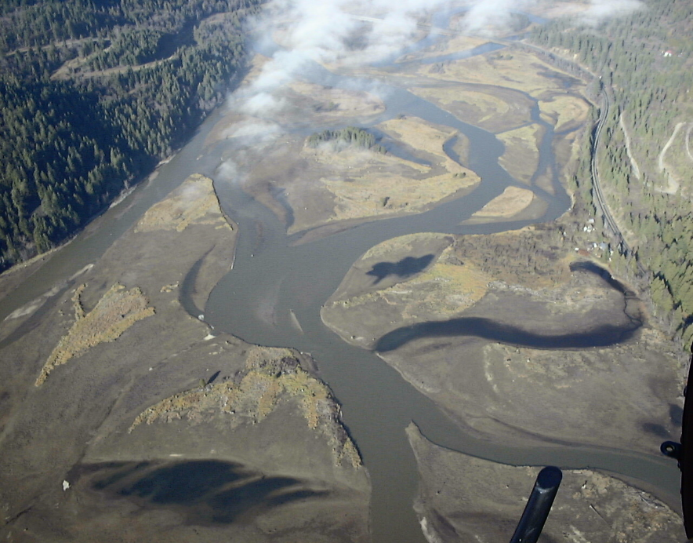
Pack River Delta Restoration Project (a pilot project) - 2009
Address erosion in high priority areas
Determine feasibility of doing large-scale restorations project
Funding:
NAWCA grant (Ducks Unlimited)
AVISTA
Some cost-share BPA funding
Pack River delta 1999 photo

Slide 16
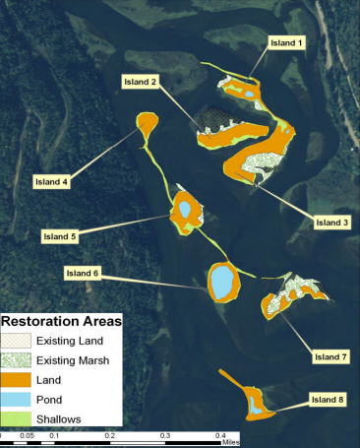
Restoration Results:
Raised 8 Islands
Created 2 breakwaters
Added several ponds
Vegetation planting throughout
1

Slide 17
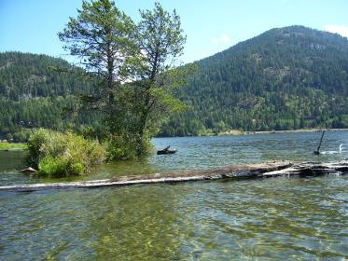
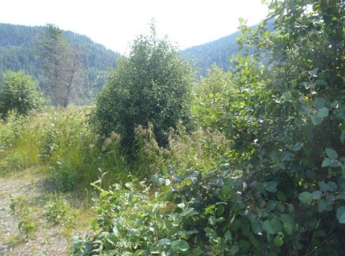
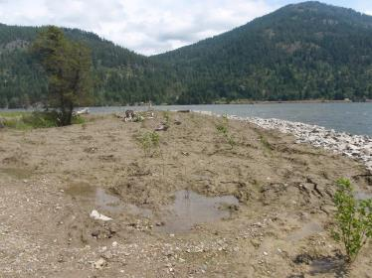
Pack River Results
July 2008
July 2013
July 2009
Restoration Works!

Slide 18
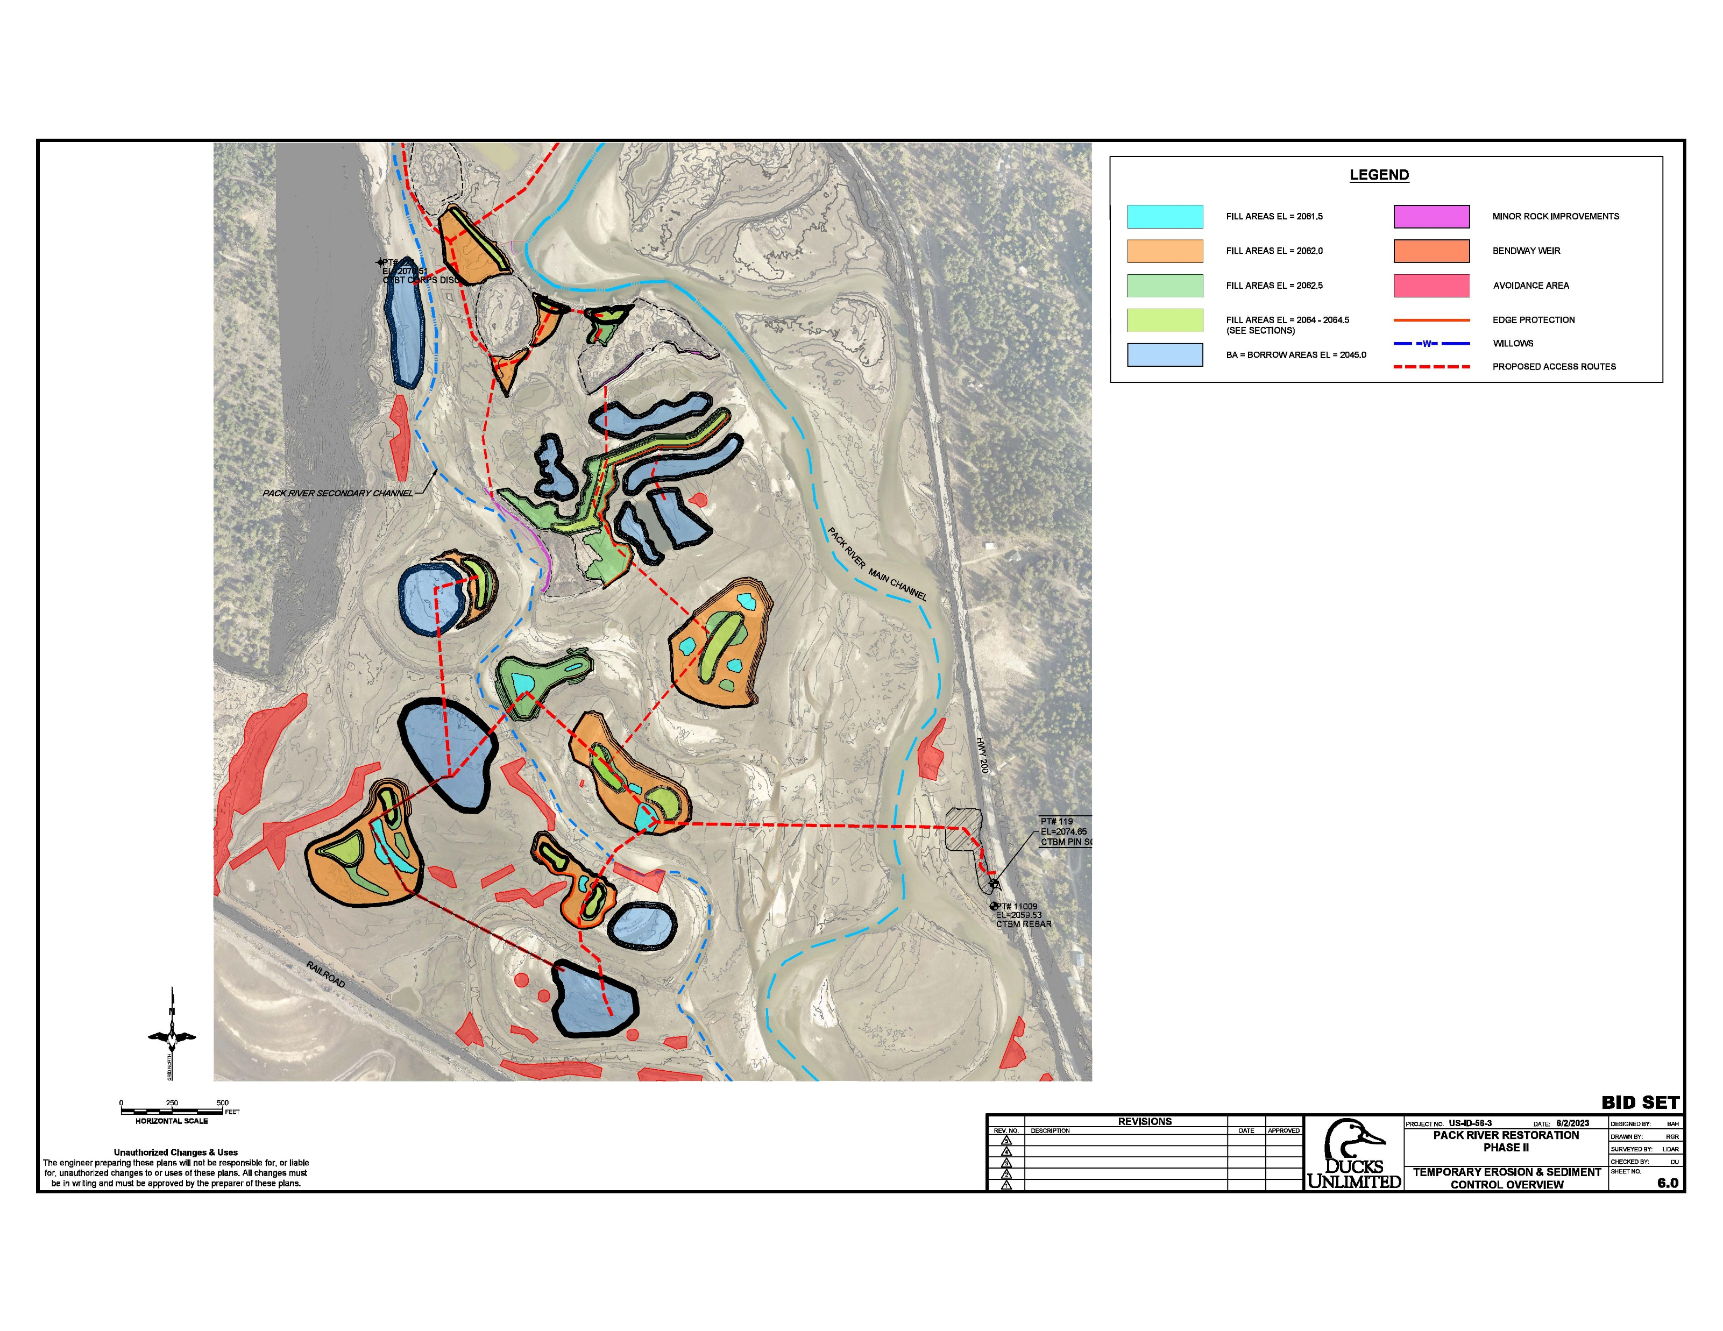
Pack River Delta Restoration – Phase 2
Fall 2023 - Winter 2024 (FY24)
Second project proposed
Access delta off Hwy 200 near ITD pull off and build construction staging pad
Create or modify 9 new Islands
Create 10 new ponds/borrow areas and several new emergent benches
Plant 16,000 emergent plugs, 13,000 woody plants, 33,000 willows
Leave staging area as primitive access for small boats

Slide 19
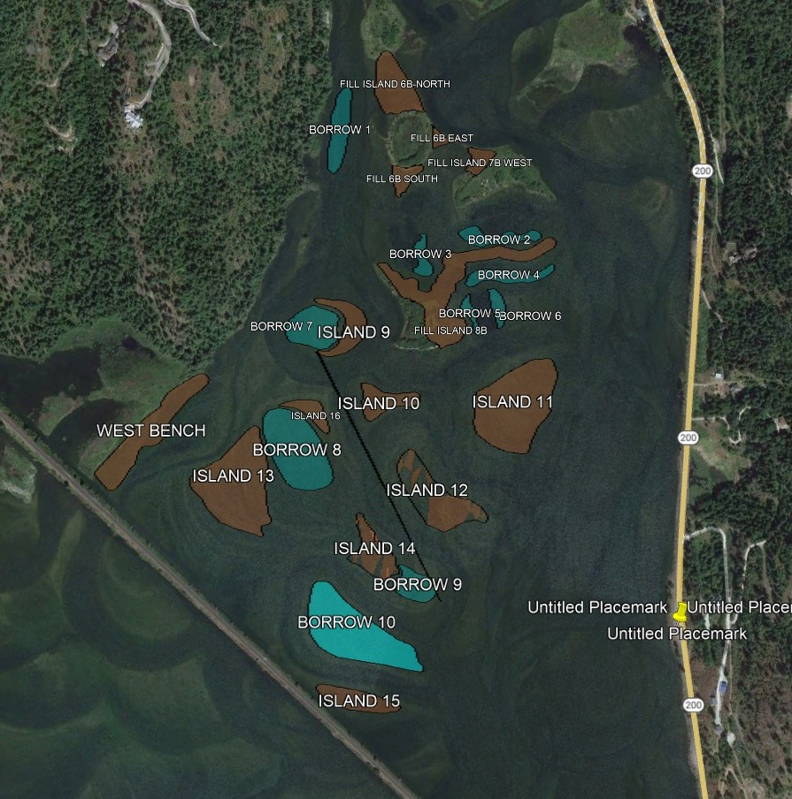
Pack River Phase 2: 2023 (FY24)
Finalizing permits and designs
Dealing with concerns over staging area access after construction
Construction to begin November 2023
Construction completed by March 2024
Planting next summer
Reduce wind driven erosion
Improve wildlife habitat
Increase local waterfowl production and resting habitat
Improve access for sportsman

