Slide 1
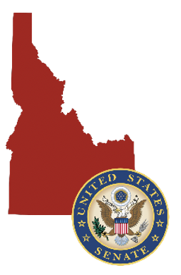
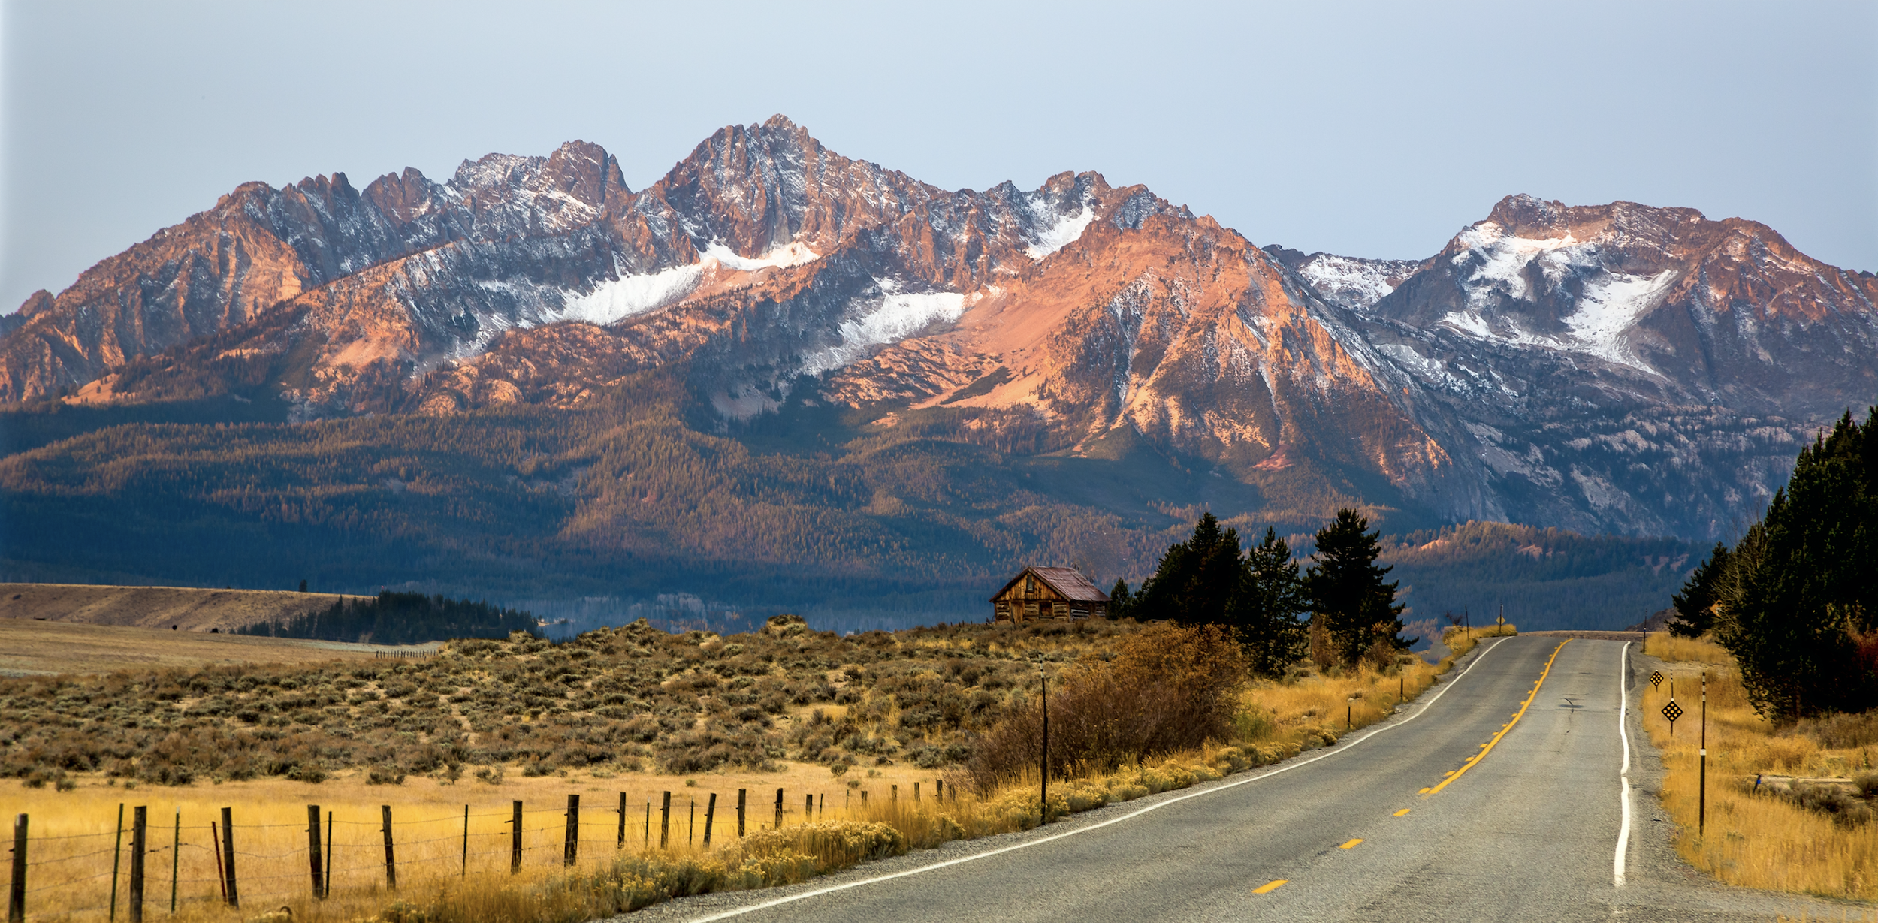

The Columbia River Treaty
The Lakes Commission, September 21, 2023

Slide 2
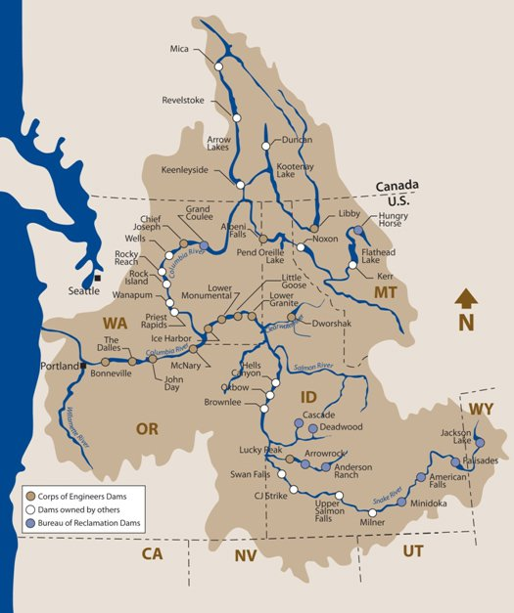

Slide 3
Background on the Treaty

Slide 4
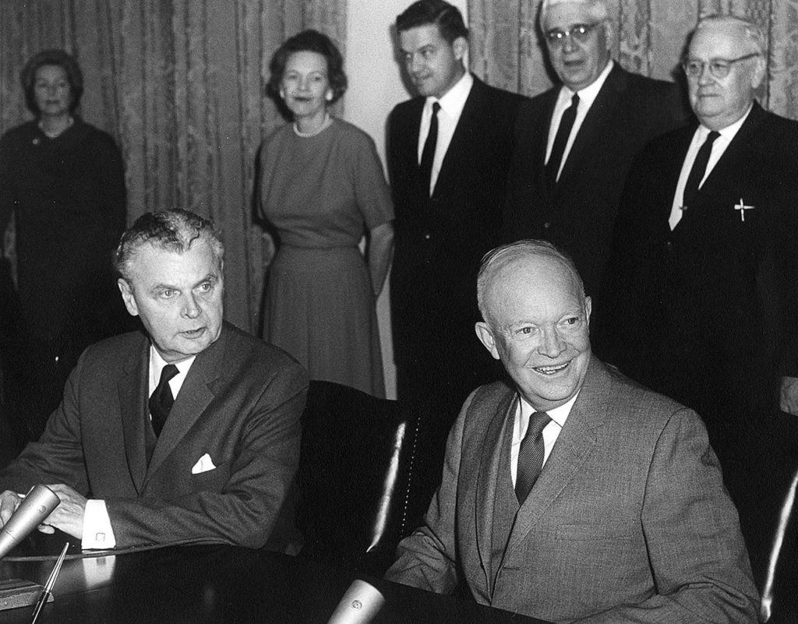
History
Canada & U.S. have been working since the 1940s on Columbia River issues
Treaty signed in 1961, ratified in 1964
Governs hydropower operations and flood risk
In 2024, its flood-risk protections change

Slide 5
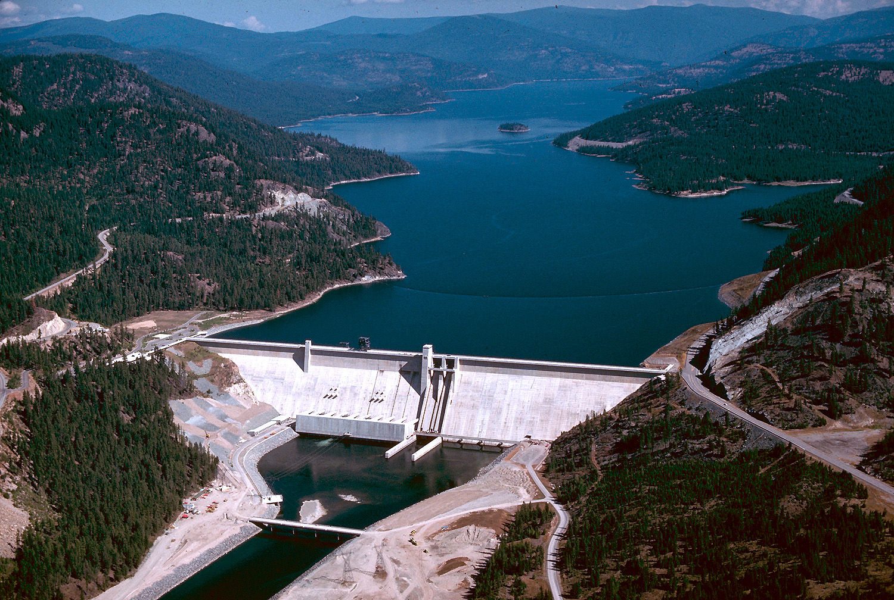
Treaty Projects
Focused on water flowing across the border from three dams:
  Keenleyside/Arrow Dam
  Duncan Dam
  Mica Dam
  Libby Dam
These dams are known as “Treaty Projects”

Slide 6
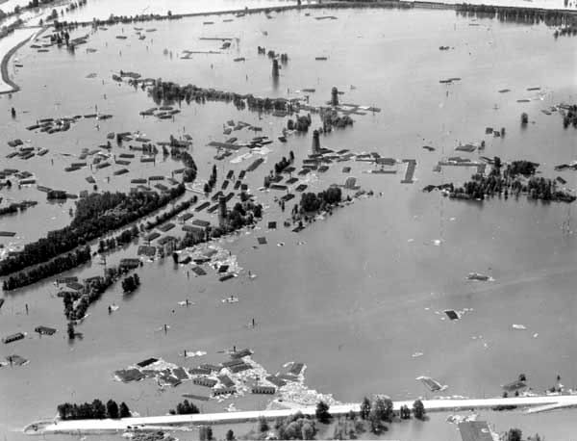
Benefits
Benefits from the treaty:
  Flood control*
  Hydropower*
  Irrigation
  Municipal water use
  Recreation
  Ecological benefits

Slide 7
Current Negotiations

Slide 8
Ongoing Negotiations
Negotiations began in May 2018
There have been 18 rounds of negotiations, the last occurring on August 10-11 in Seattle
No clear timeline for completion

Slide 9
Negotiation Points
Major focus is on flood control storage, which expires in 2024
Other factors being considered:
  Hydropower
  Ecosystem cooperation, especially for fish & wildlife
  Navigation
  Recreation
  Irrigation

Slide 10
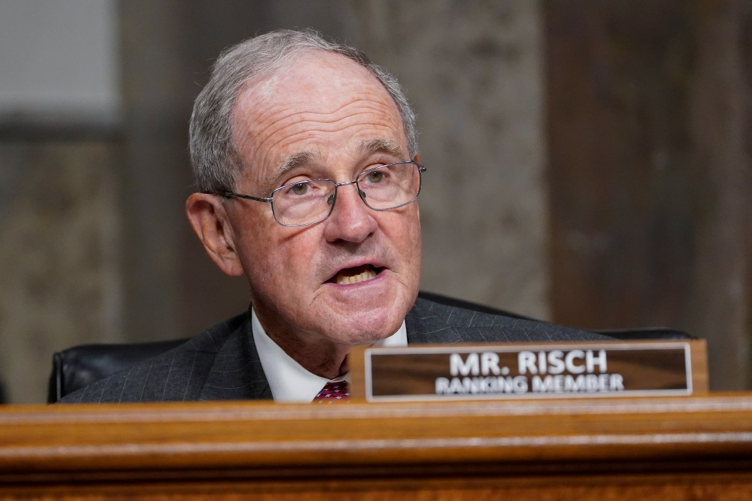
Sen. Risch’s Actions
Once treaty is signed, it will come before the Senate for ratification
It will be assigned to the Senate Foreign Relations Committee
As ranking member, Sen. Risch will play a key role in the Senate deliberations on the treaty

Slide 11
Sen. Risch’s Actions, continued
Currently, Sen. Risch continues to use his role on the Senate Foreign Relations Committee to stay closely involved with the Columbia River Treaty
He meets with treaty negotiators regularly, and has made his concerns about U.S. water and energy abundantly clear
The Senator is steadfast in expressing strongly that while we need a completed deal, it also must be good for the northwest

Slide 12
Sen. Risch’s Actions, continued
Sen. Risch approaches this as a bipartisan issue with Northwest delegation partners
  Working closely with Senator Cantwell in particular
  Working with the new administration to ensure Idaho and Northwest river users get a good deal
He and Senator Cantwell are currently in the process of leading the Northwest delegation in asking that the President make treaty modernization a high priority

Slide 13
Questions or Concerns?
Marc Kilmer
North Idaho Regional Director
208-351-5909
marc_kilmer@risch.senate.gov

