Slide 1
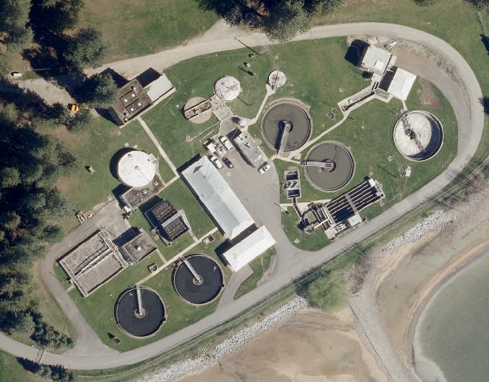
Wastewater Treatment Plant Update
Lakes Commission
April 6, 2023

Slide 2
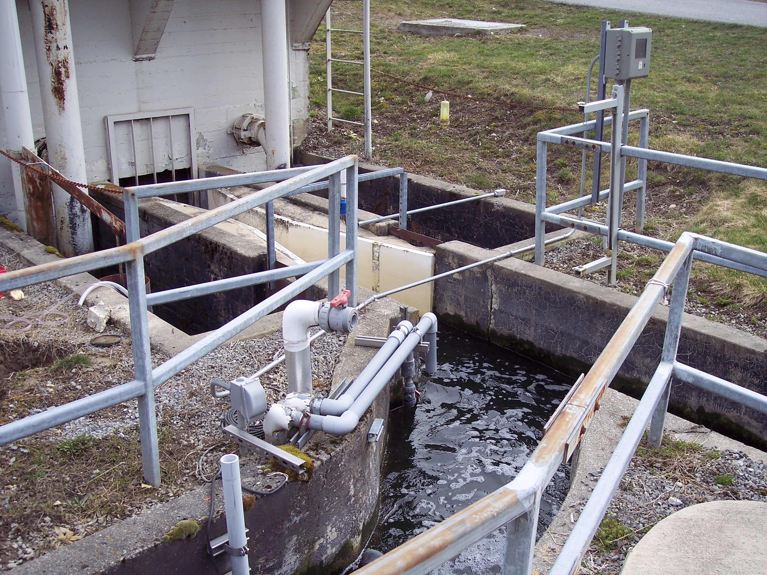
Of Interest…
The Need - Compare/Contrast
History
Finance
Questions

Slide 3
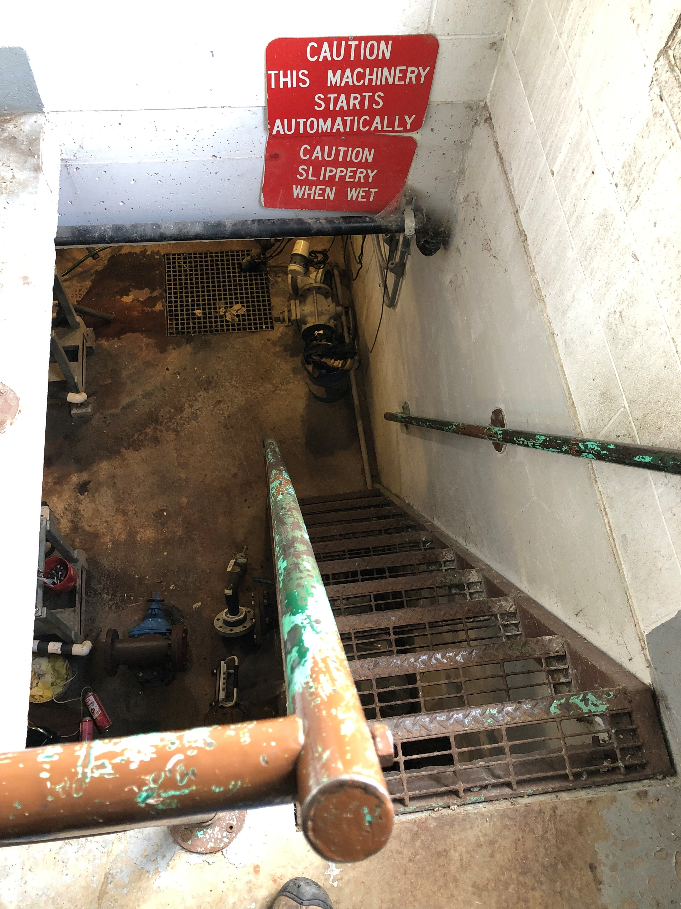
The Need…
  Aging Infrastructure
  Discharge Permit
  Technology & Flow
3
Notes:
Existing plant has been kept going for many years. Minor upgrades in 2008.
Operators are doing a good job of keeping it operational (no permit violations)
…But city will need to do something to meet new permit
…and during permitting process, got indications about future permit requirements the existing plant can’t meet
Infrastructure dates back to Farragut Naval Base equipment (getting old)
Have very high peak flows. Have historically been able to treat peaks differently than base flow, but this will get increasingly difficult
This is an opportunity to determine which direction to take plant over long haul

Slide 4
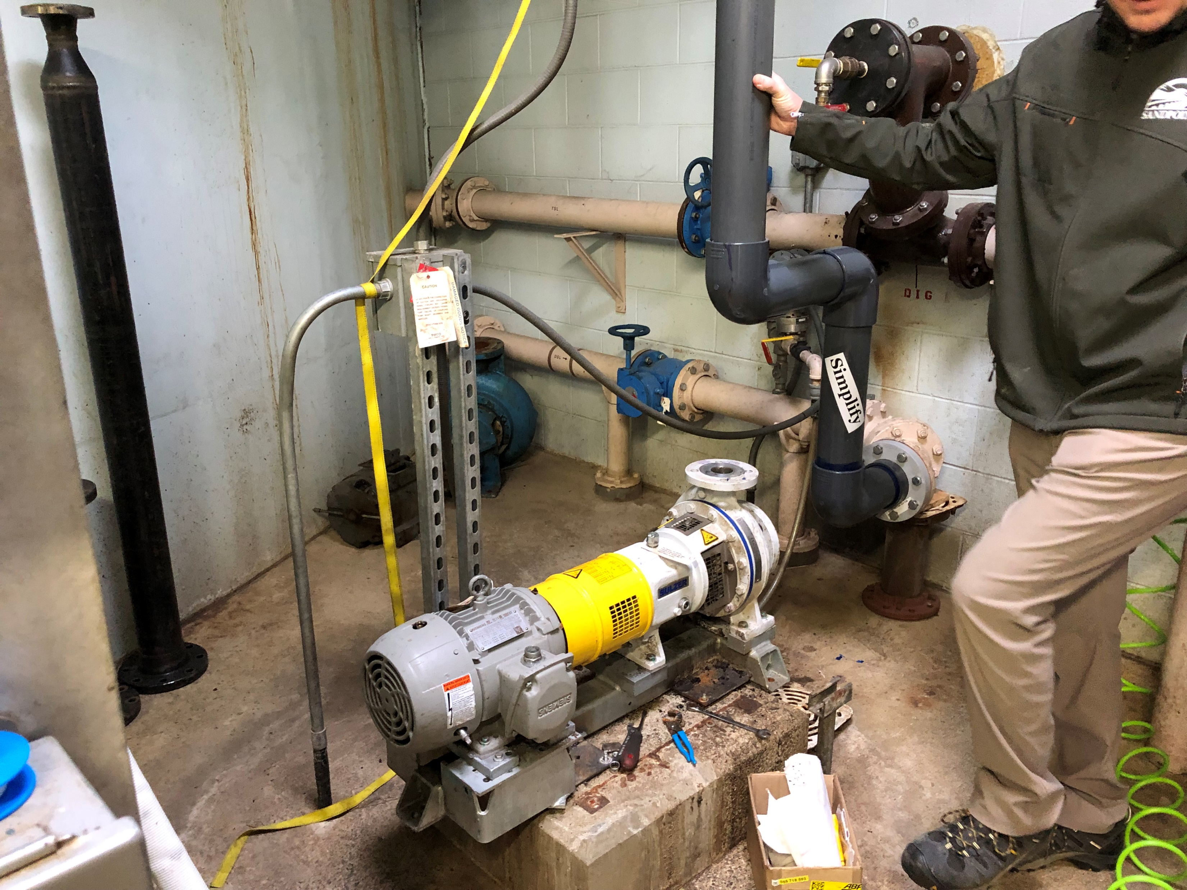
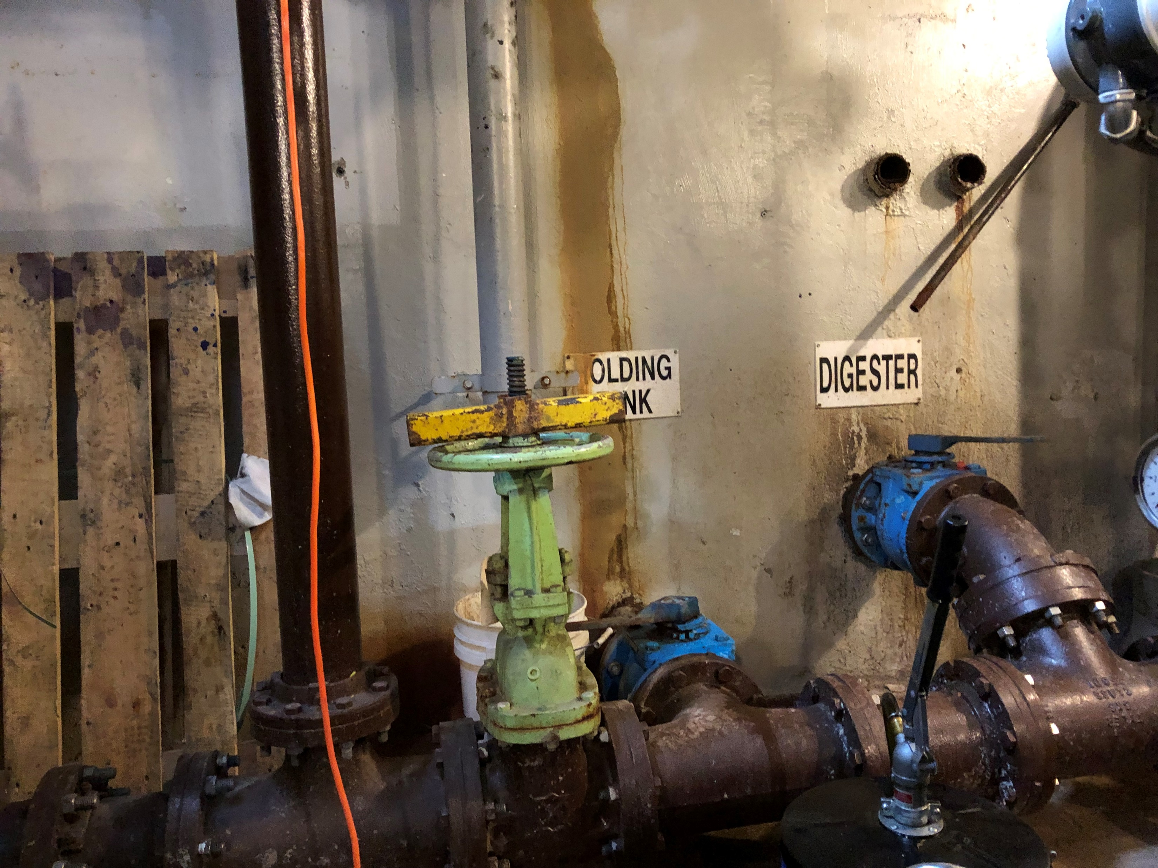
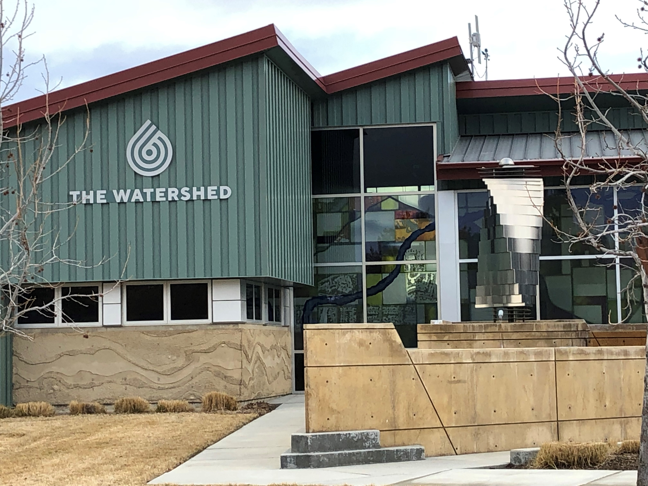
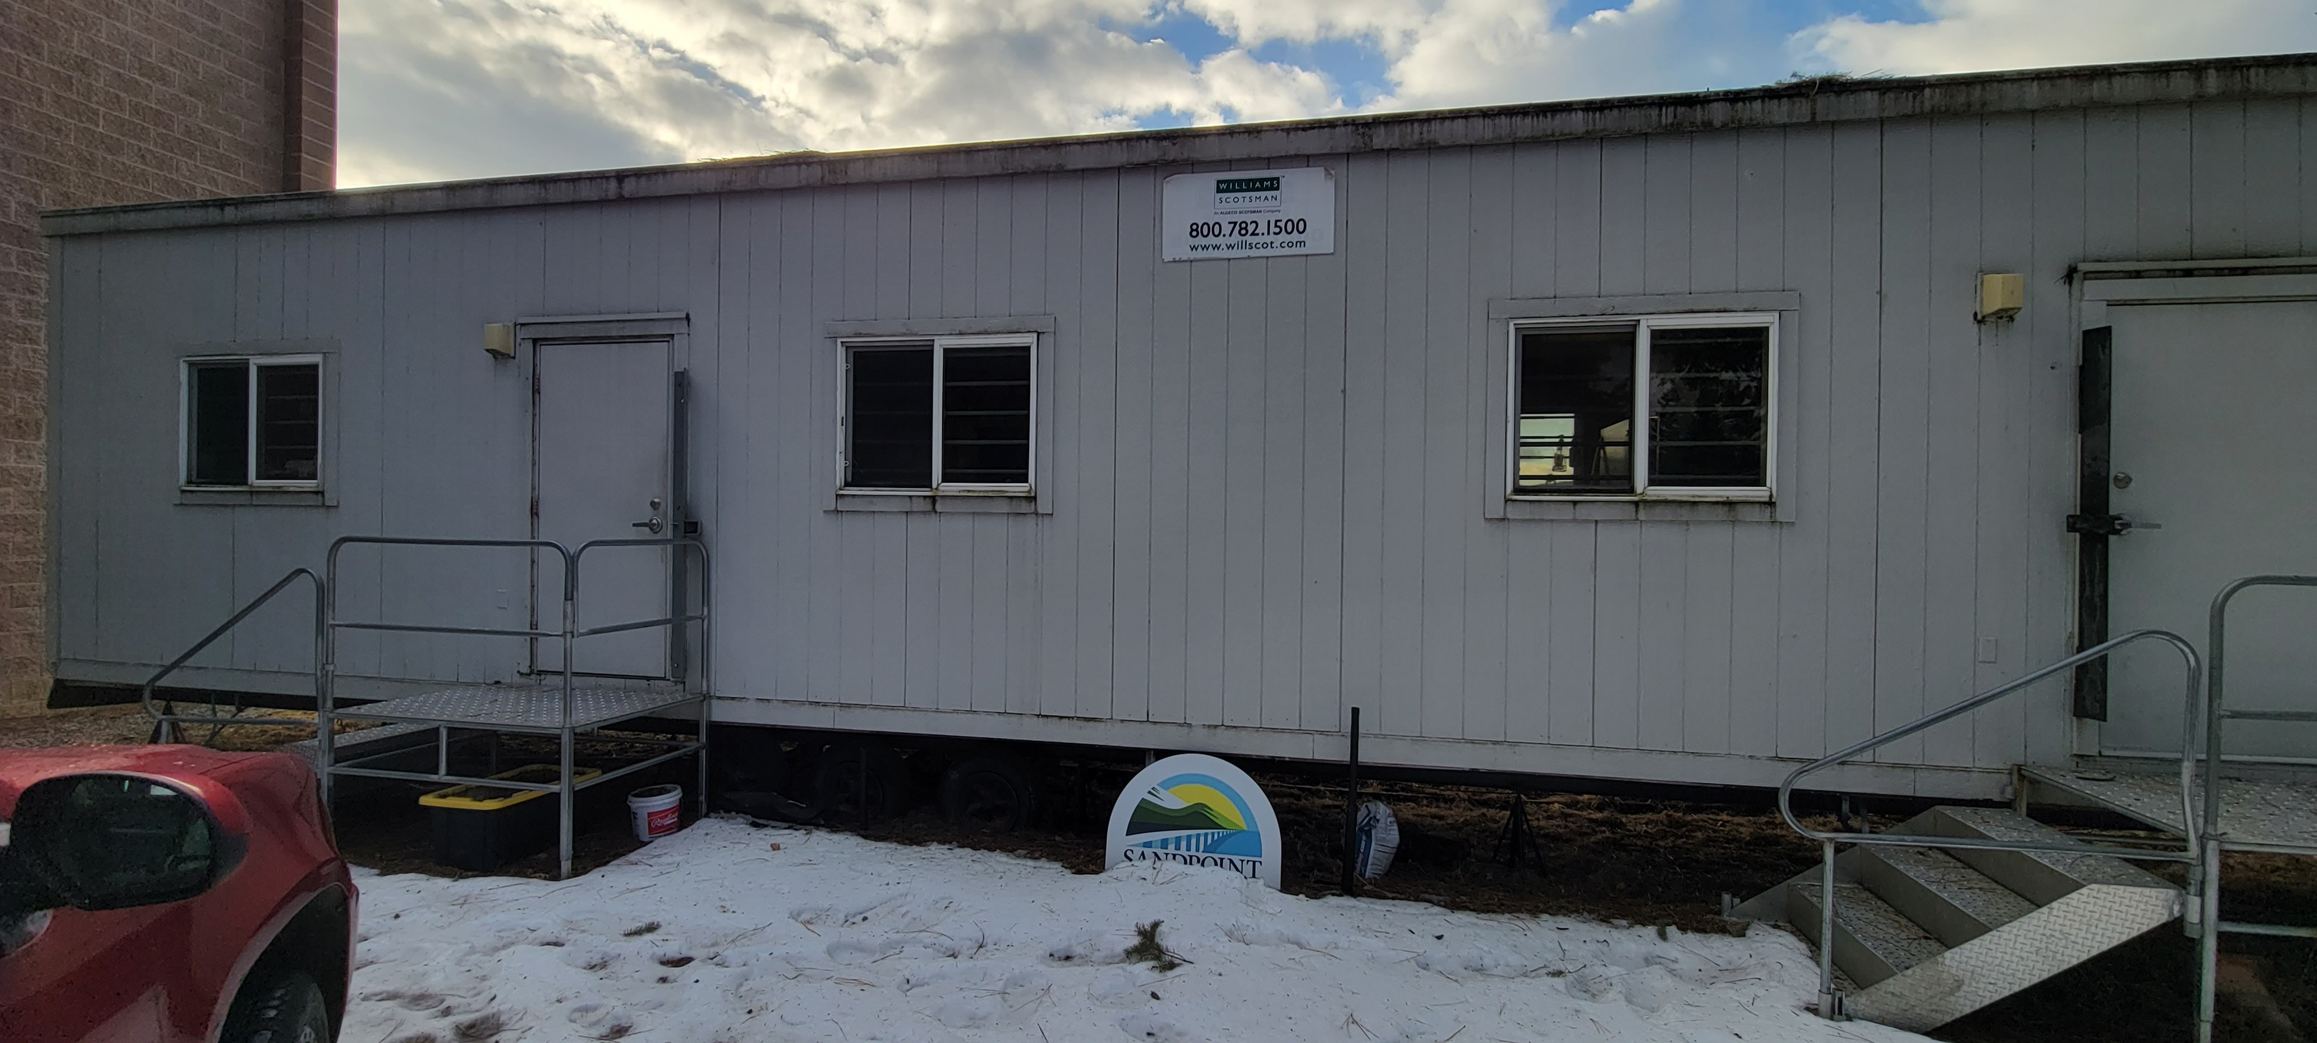
Sludge Handling

Slide 5
‘HOME’

Slide 6
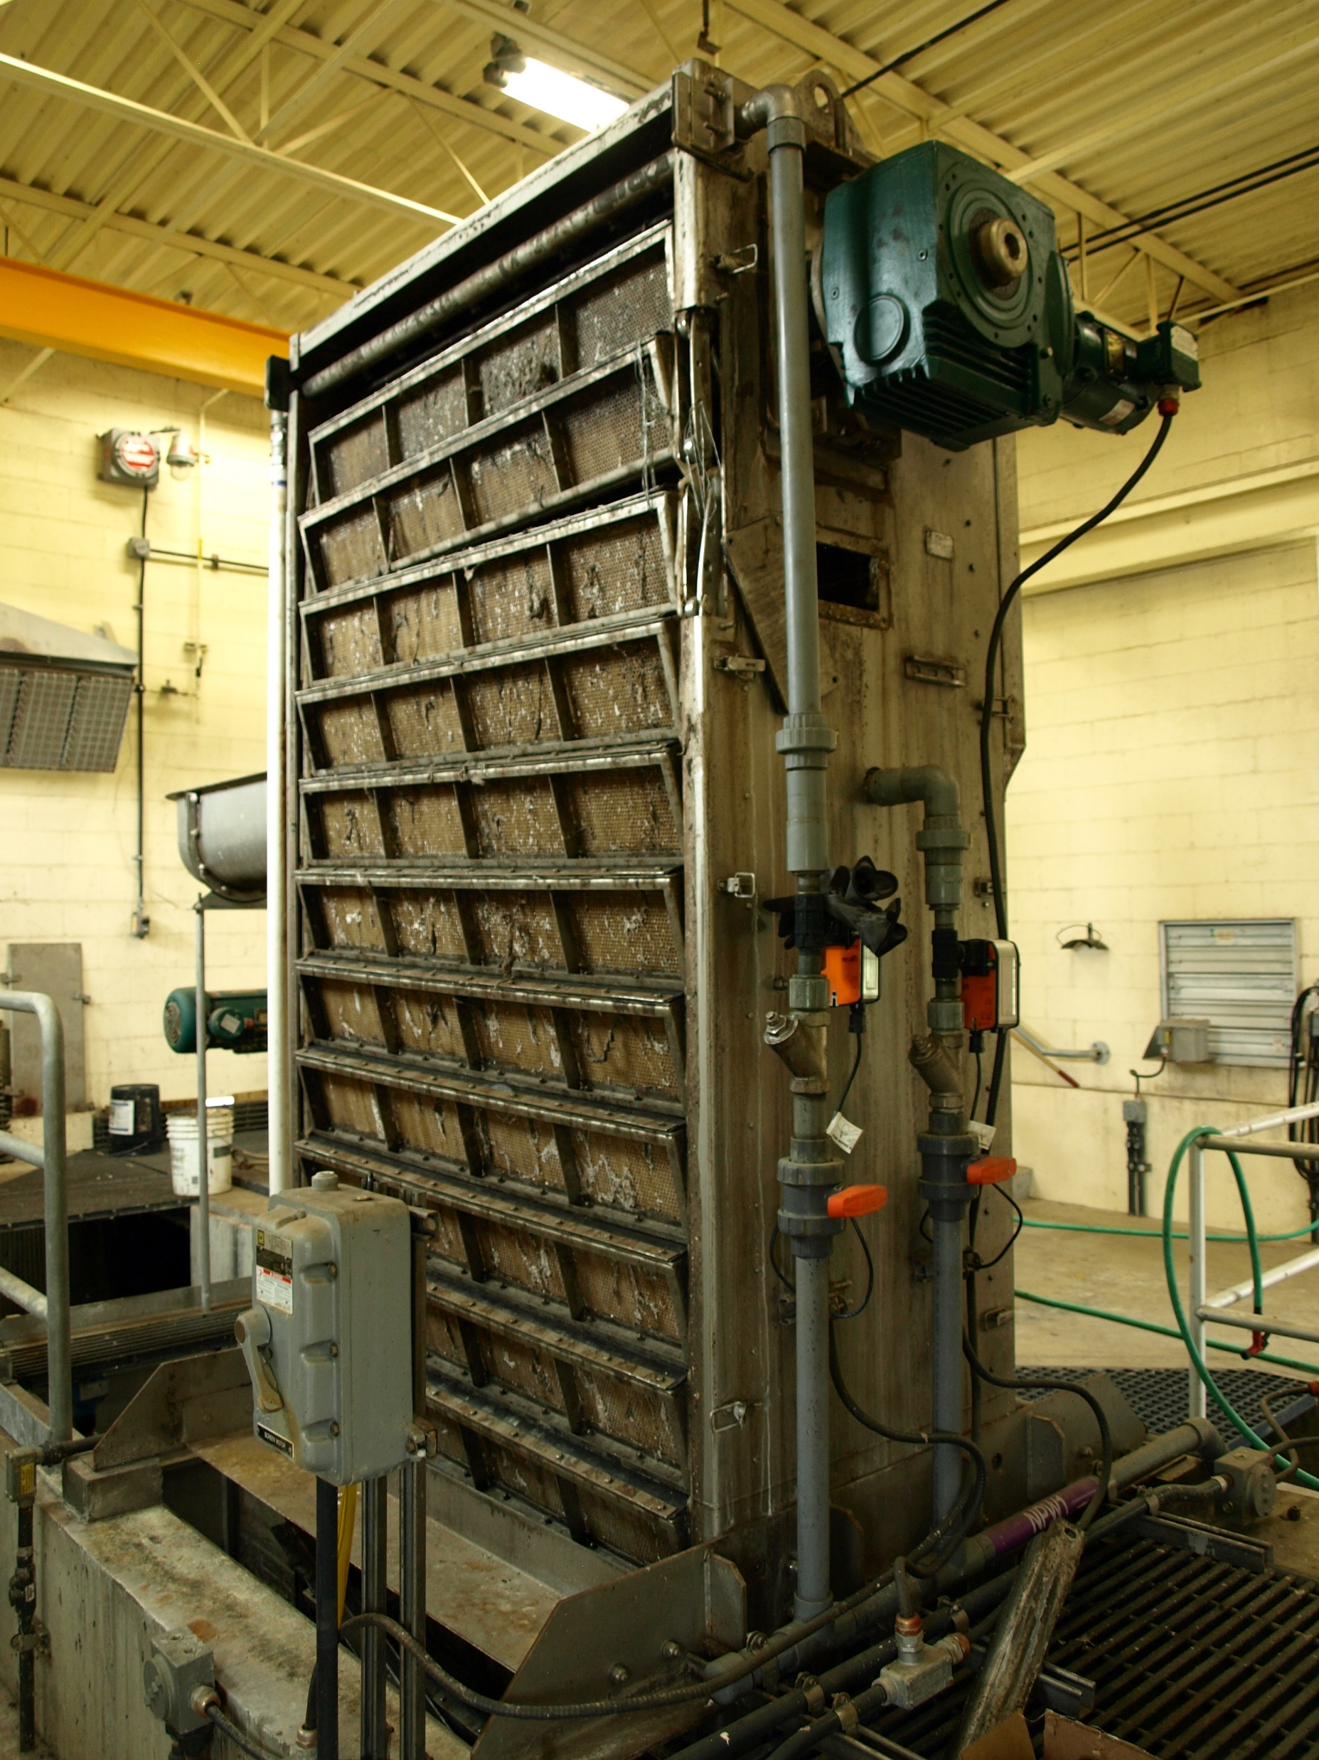
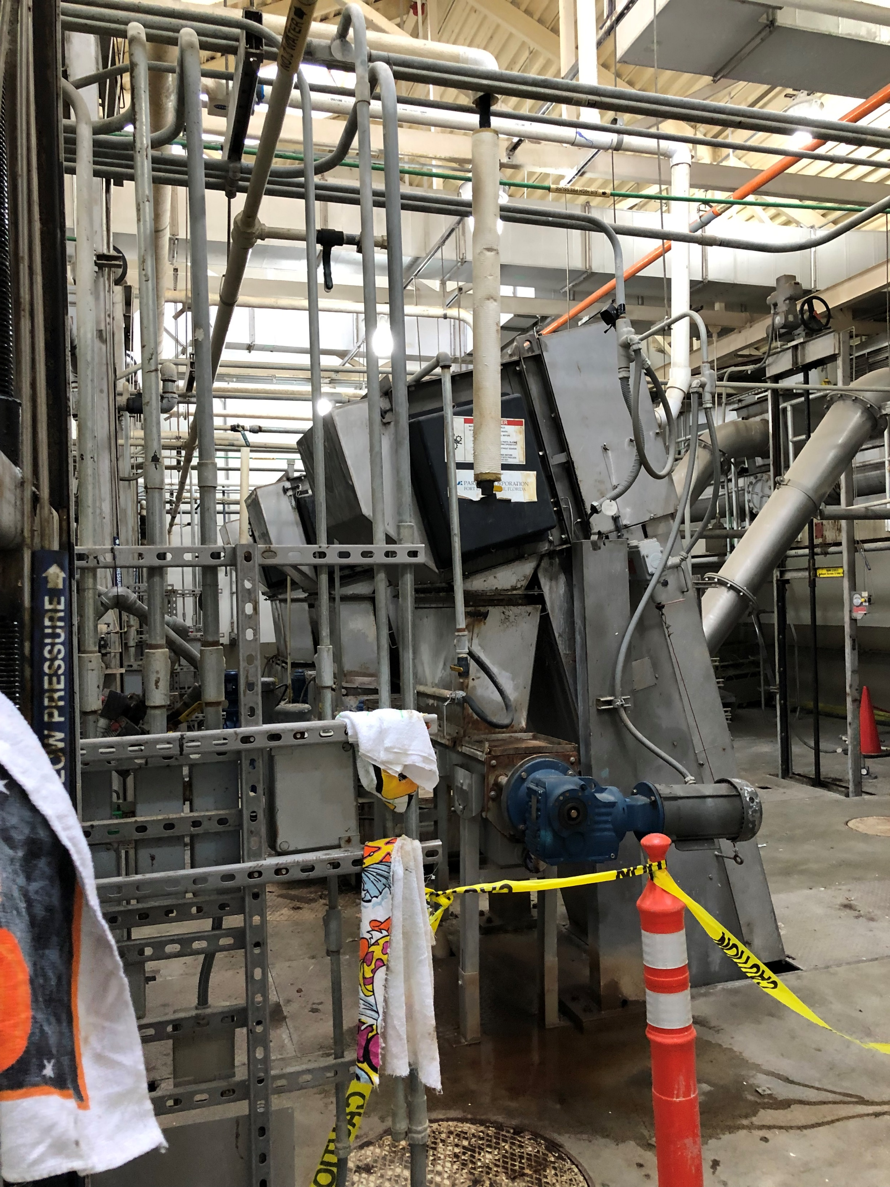
Headworks

Slide 7
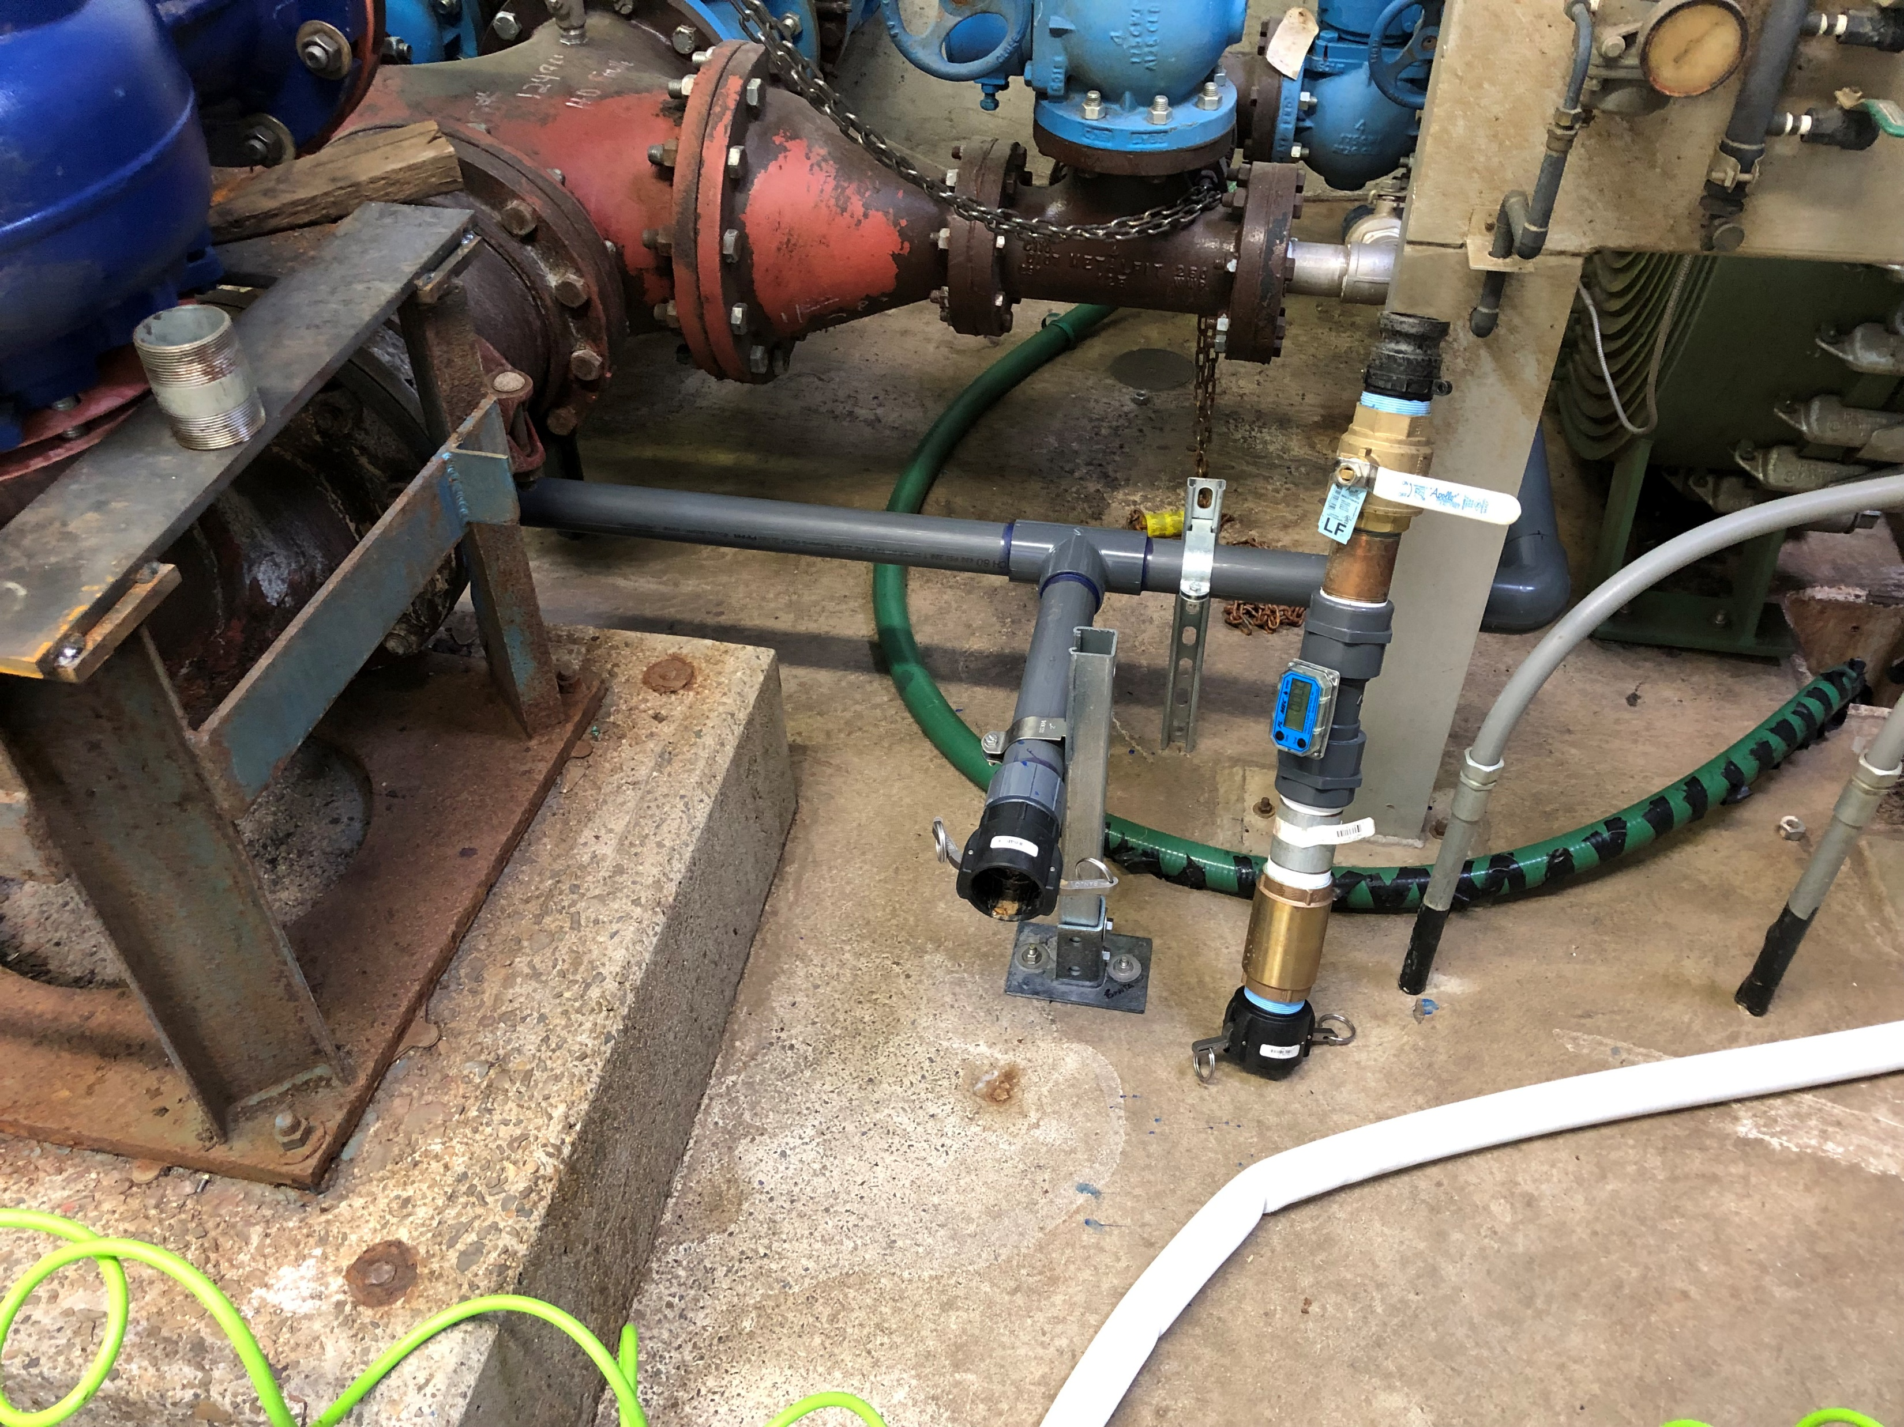
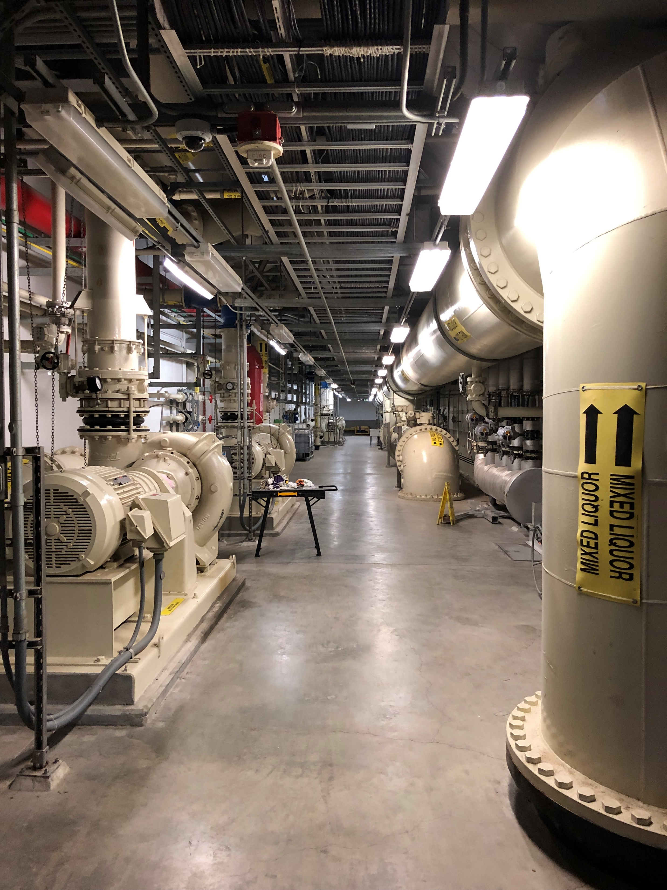
Digester Pumps

Slide 8
History - Alternatives
New Site
Existing Site
Bridge Improvements

Slide 9
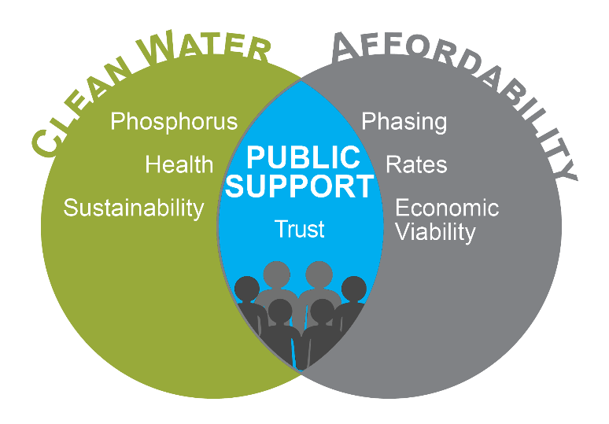
Preferred Alternative
Bridge Improvements
PLUS
New Technology at Existing Site
  Buy time
  Address short term needs

Slide 10
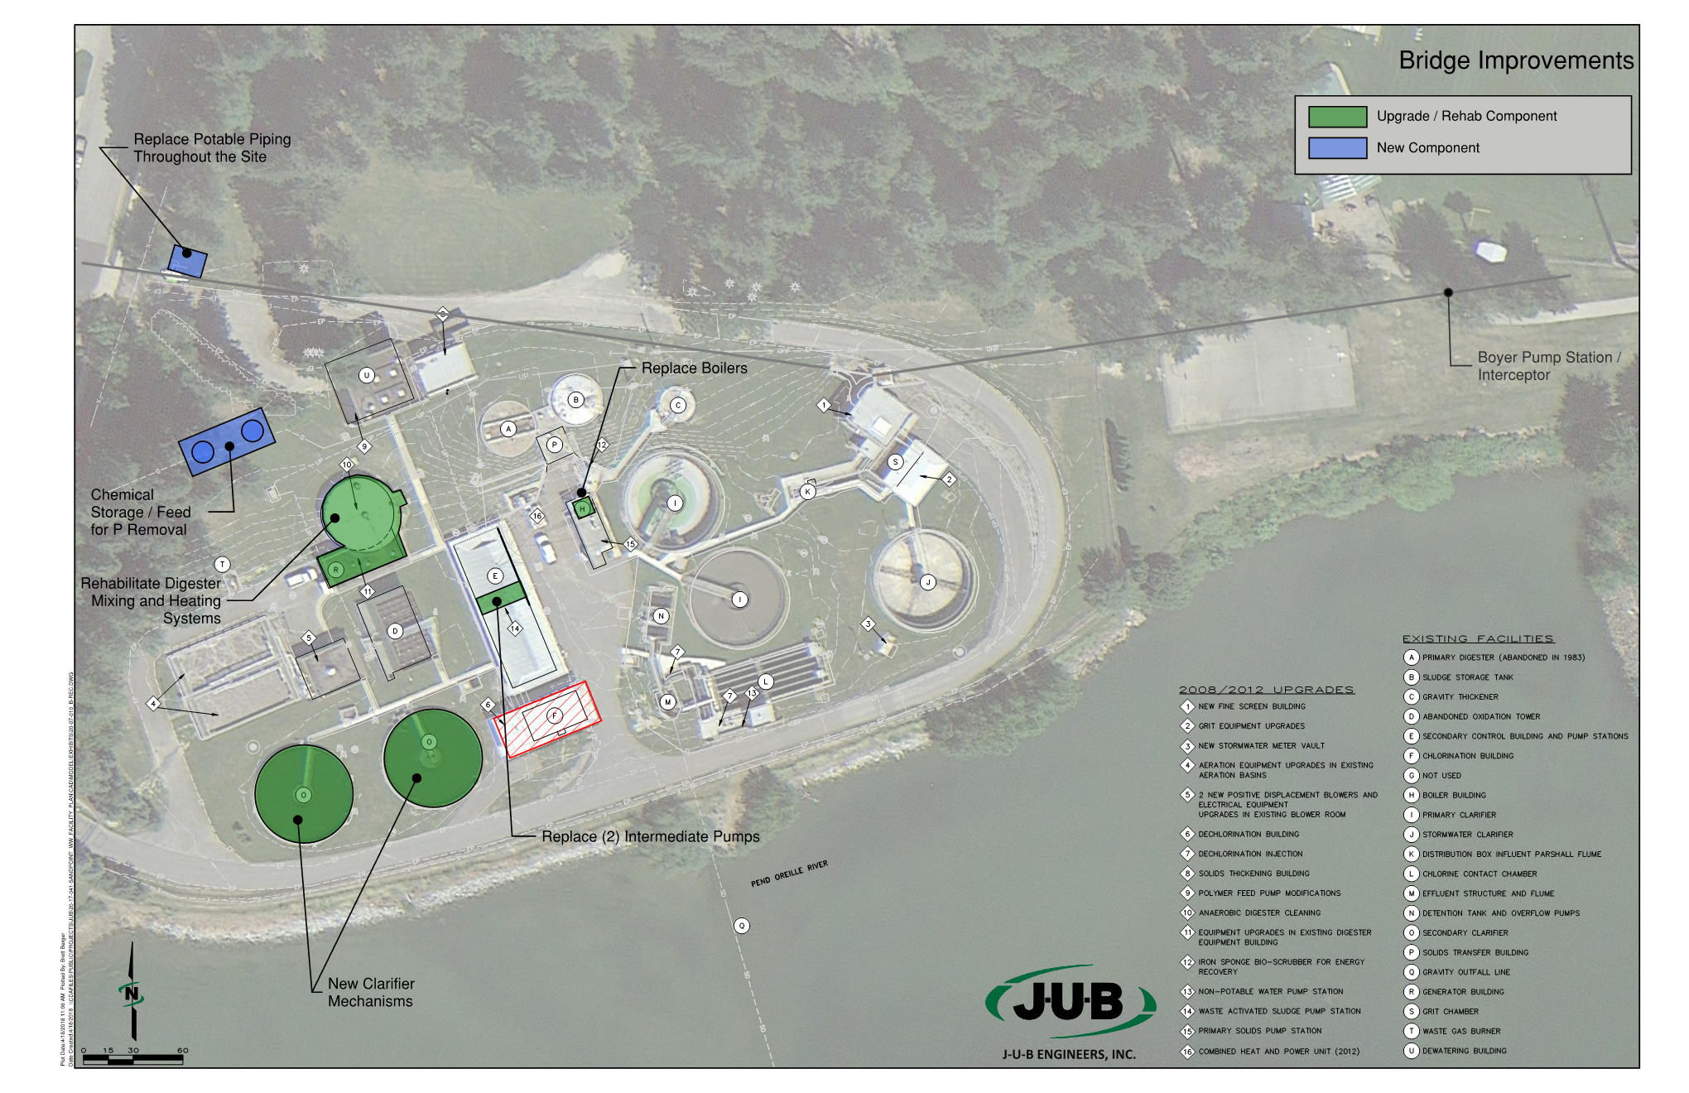
Bridge Improvements
SECONDARY PUMPING
SECONDARY CLARIFIER
DIGESTER HEATING AND MIXING
POTABLE WATER
CHEMICAL FEED

Slide 11
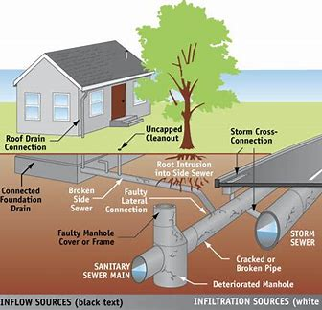
INFLOW & INFILTRATION

Slide 12
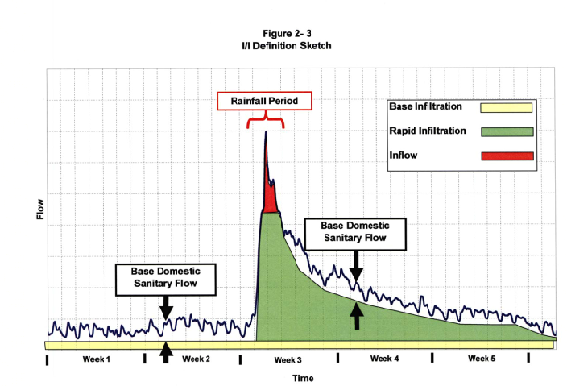
Inflow & Infiltration

Slide 13
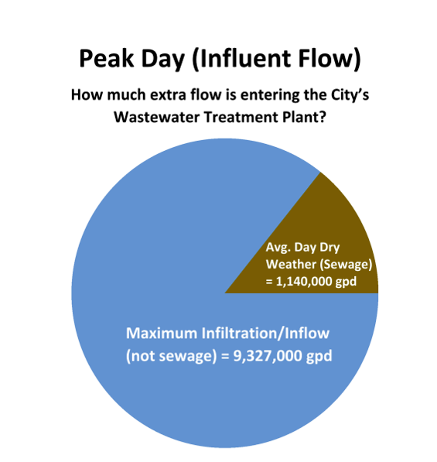
Inflow & Infiltration
  Excess flow equivalent to
  65,684 residents

Slide 14
Capacity = 8 MGD
Budget = $65M

Slide 15
FINANCE
State Revolving Loan Fund (SRF)
Public Health Emergency or Hazard
Regulatory Compliance Issues
Watershed Restoration
Preventing Impacts to Beneficial Uses
Sustainability Infastructure Efforts
Affordability
Current score 180 - 200
Ideal funding range 250 - 300
Maximum points 510

Slide 16
SCHEDULE
2023
LOI due 1/13/23
Funding awarded mid summer
2024
WWTP Design/Construction Start
2025
Construction Continues
2026
Construction continues
2027
Construction ends

Slide 17
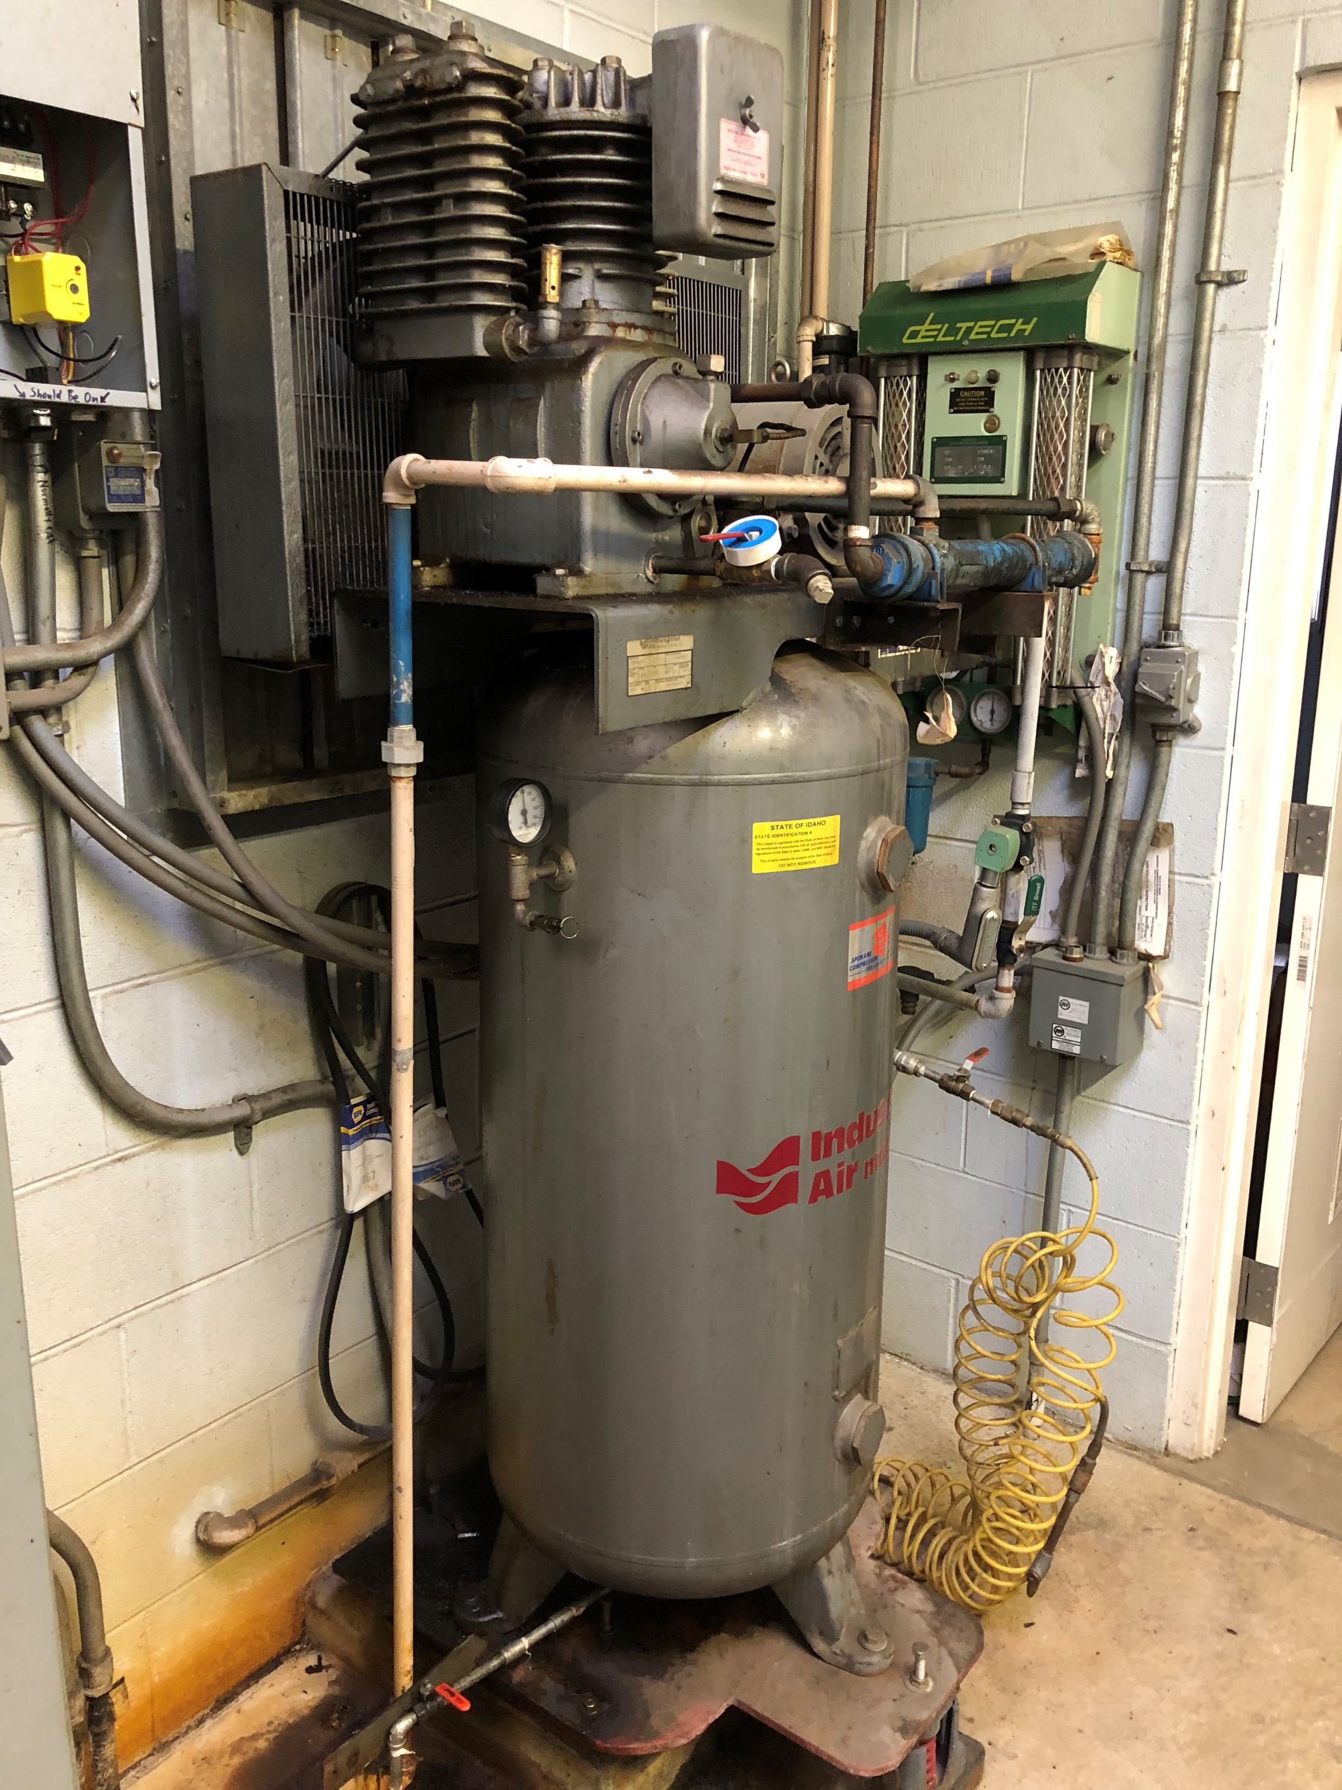
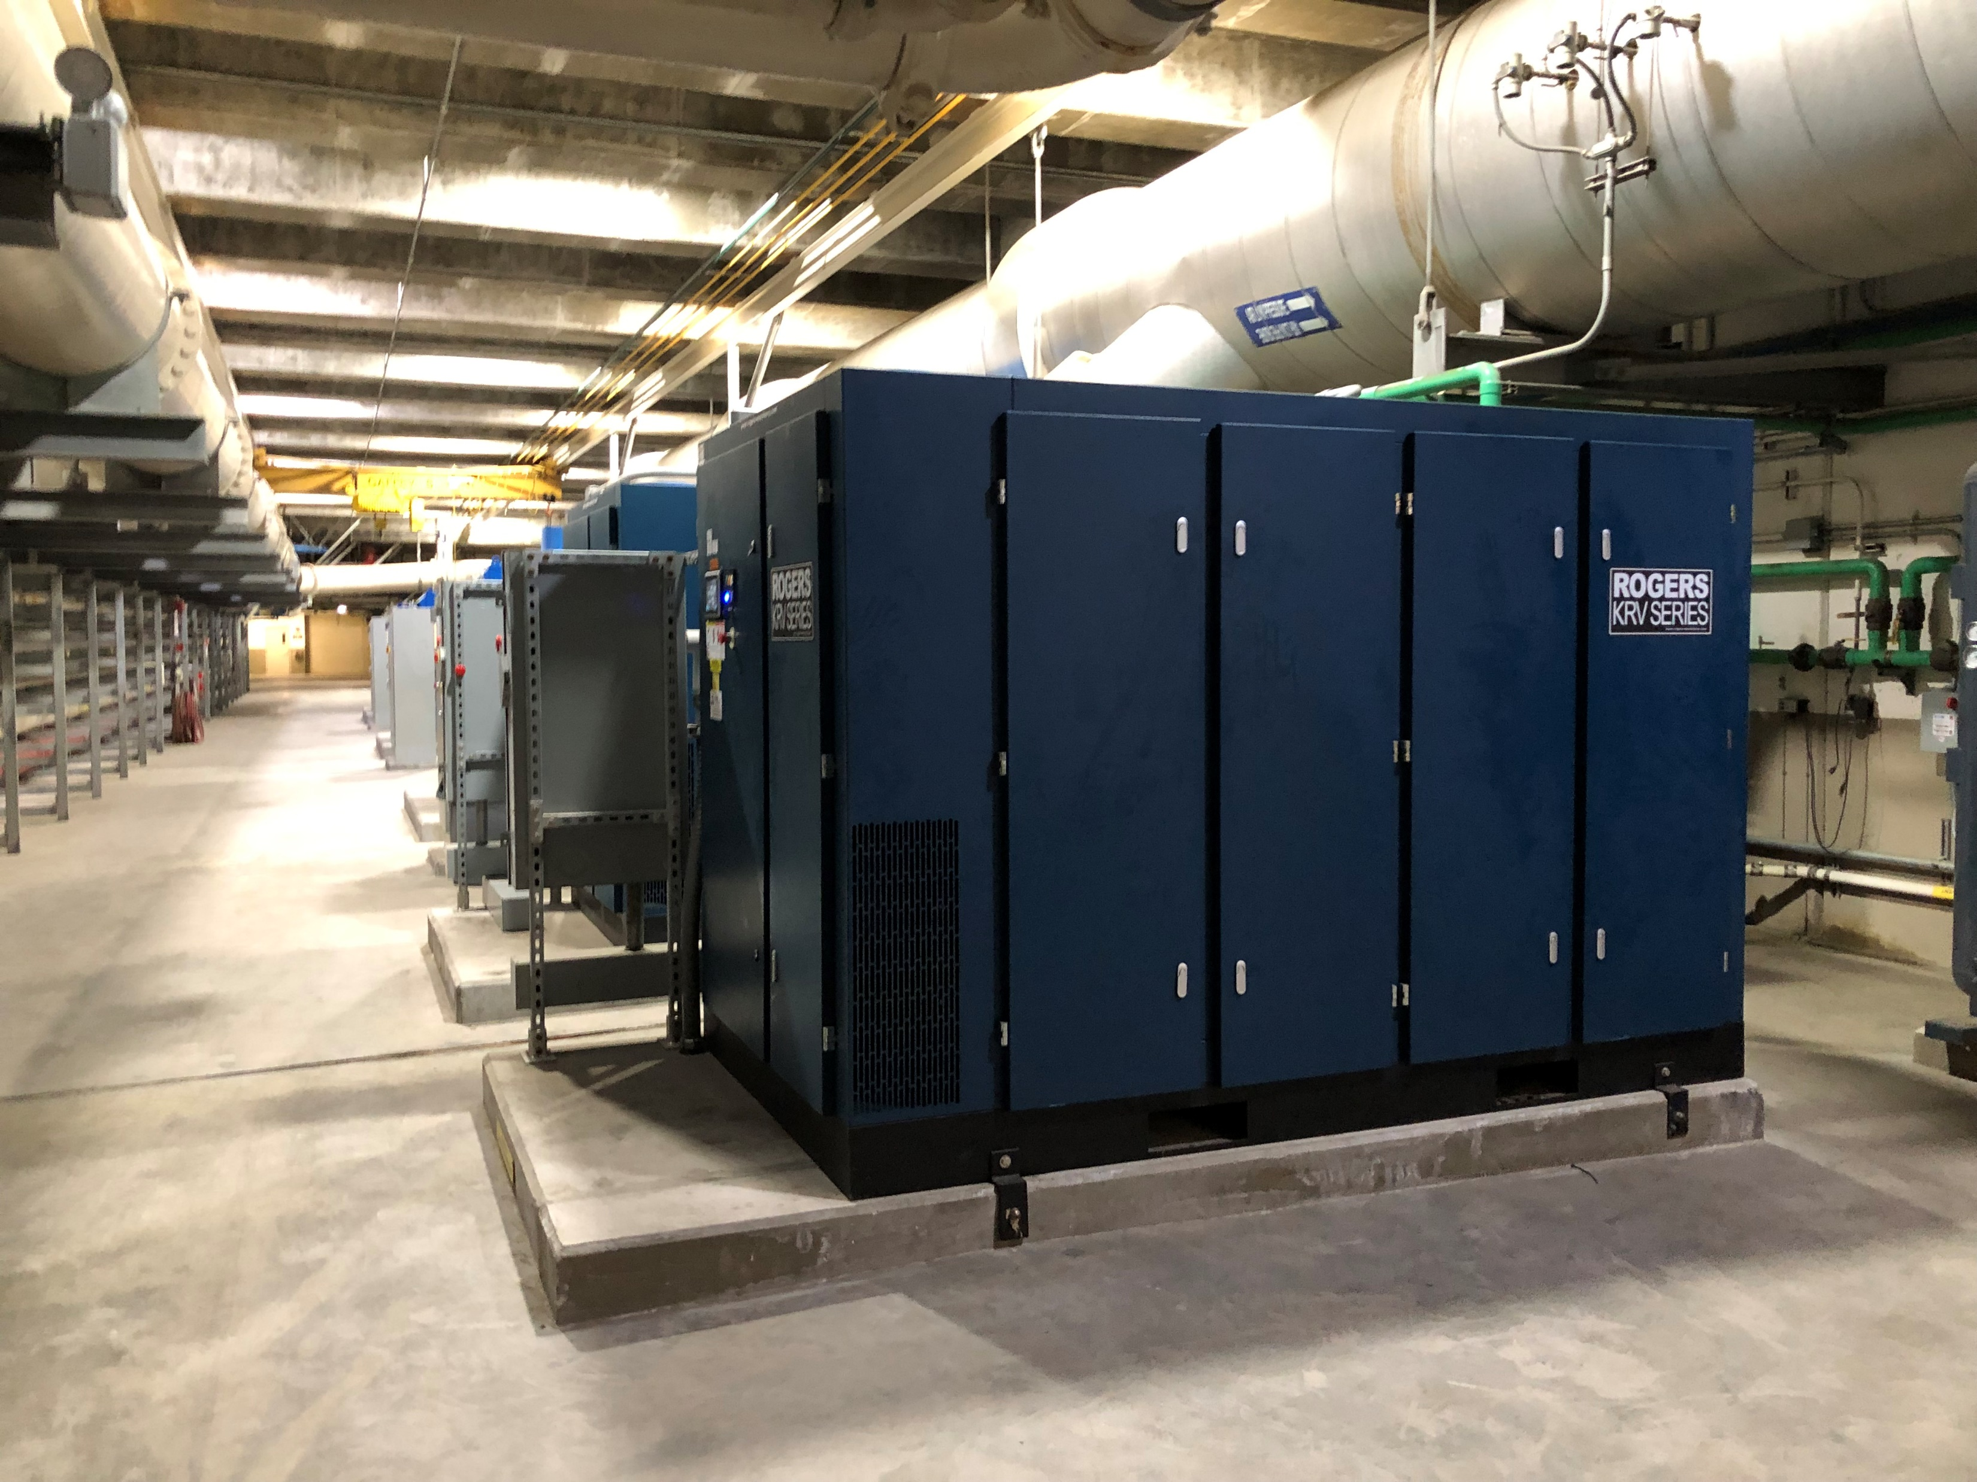
Compressor

Slide 18
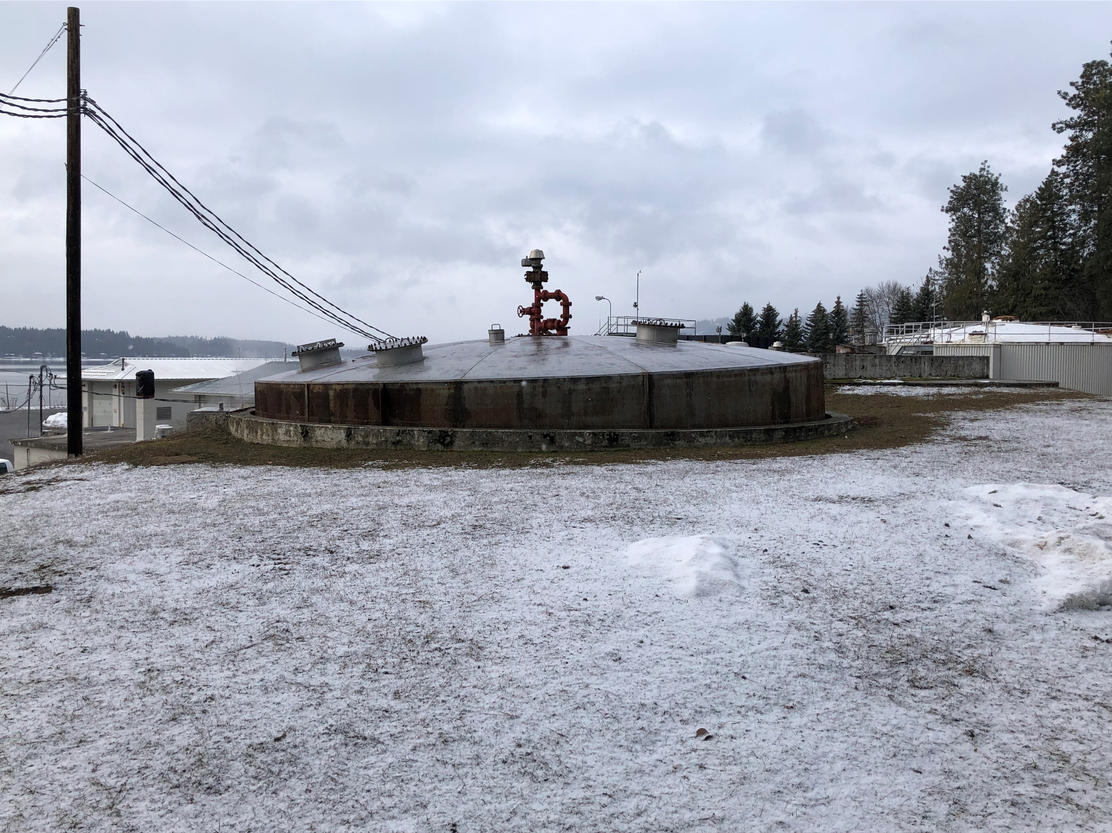
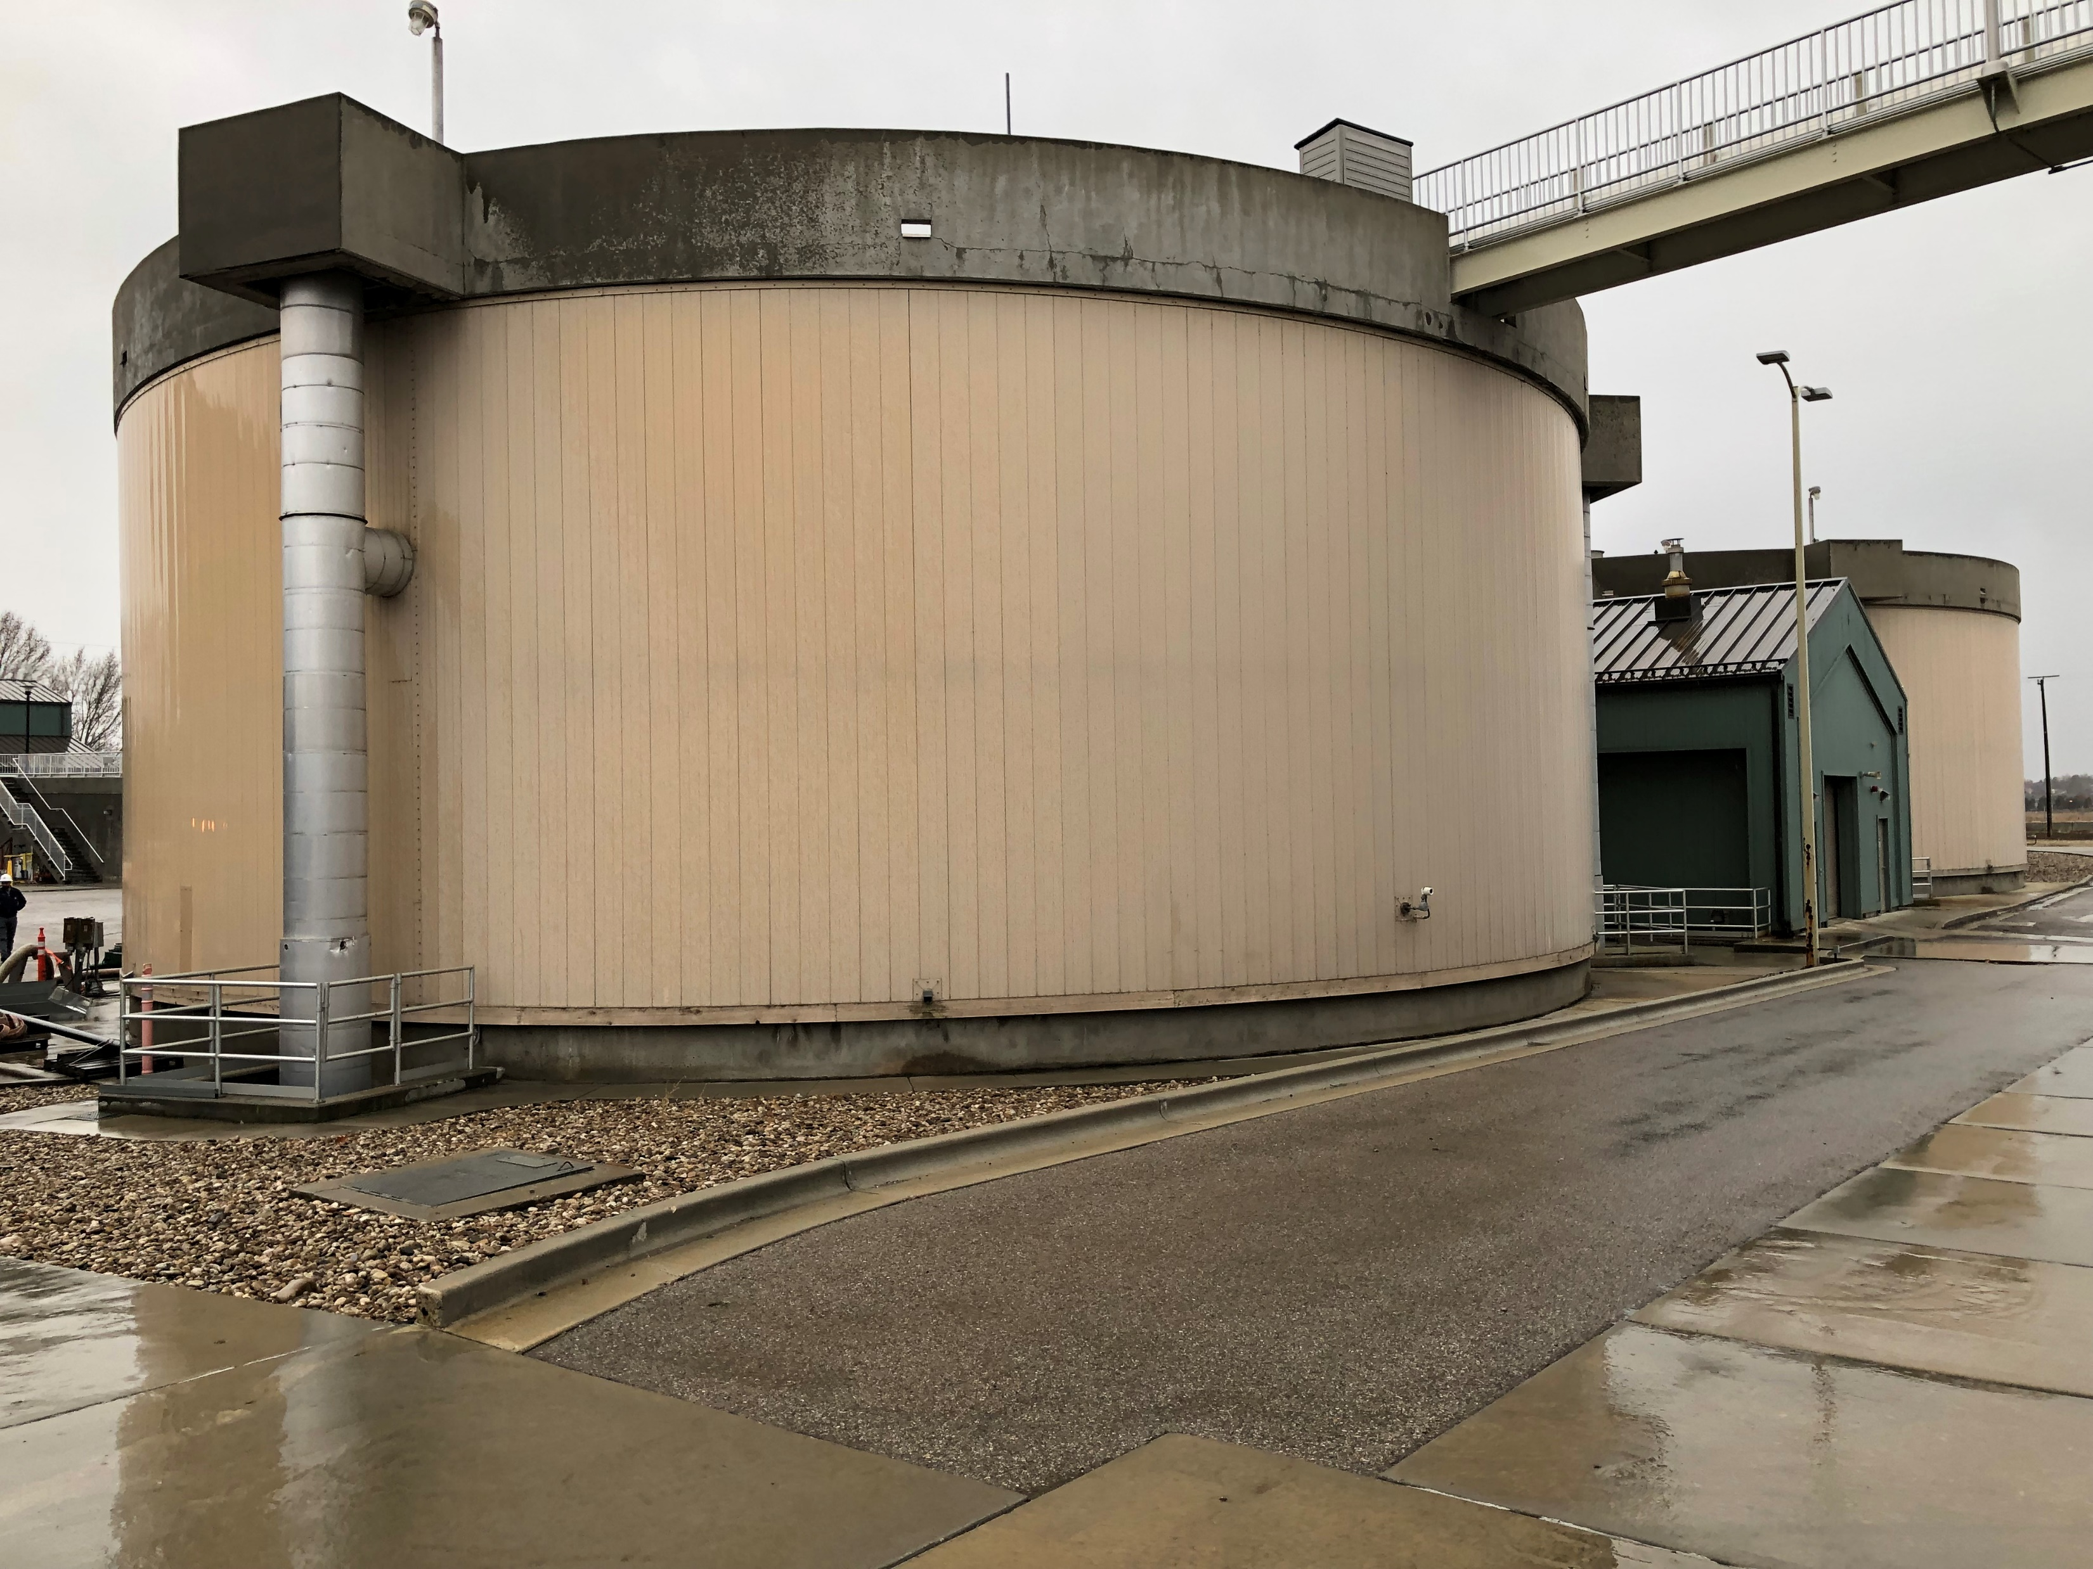
Digester

Slide 19
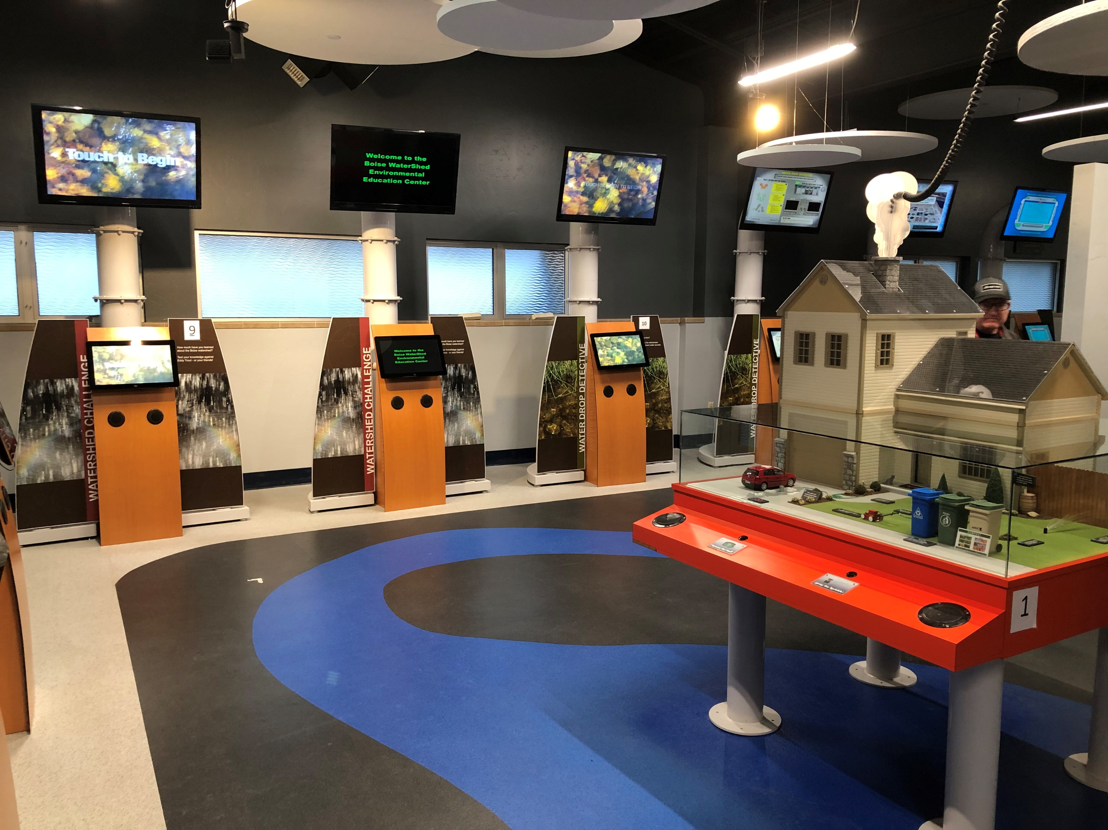
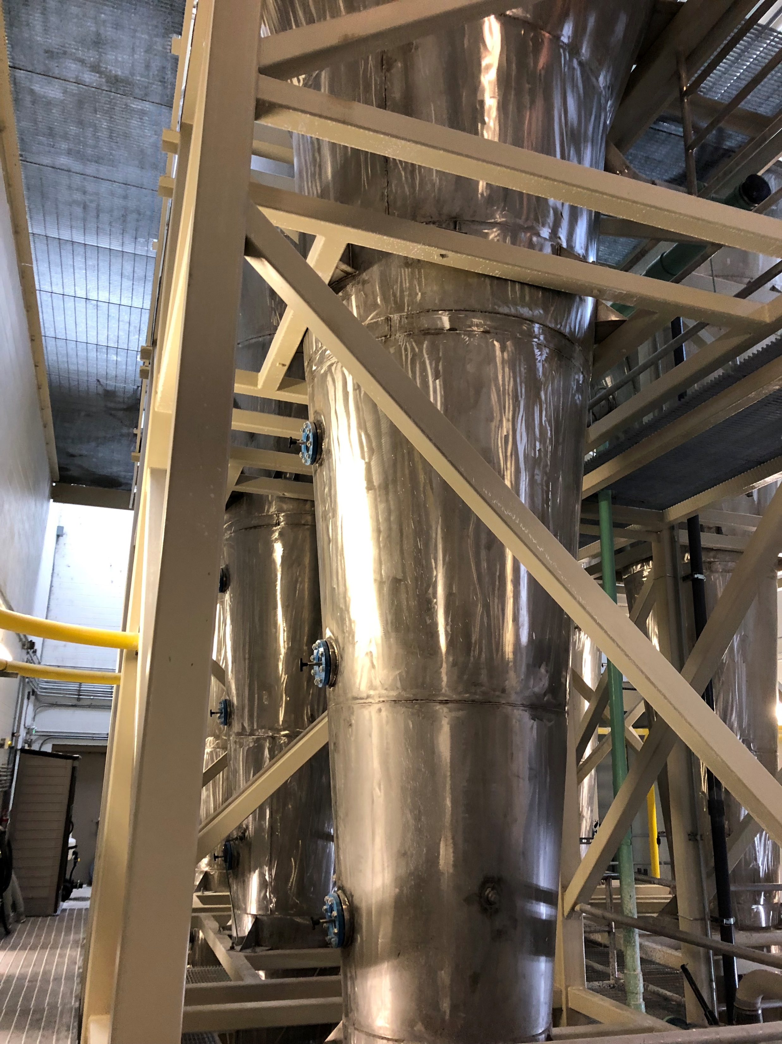
Technology, Education & Outreach

Slide 20
