Slide 1
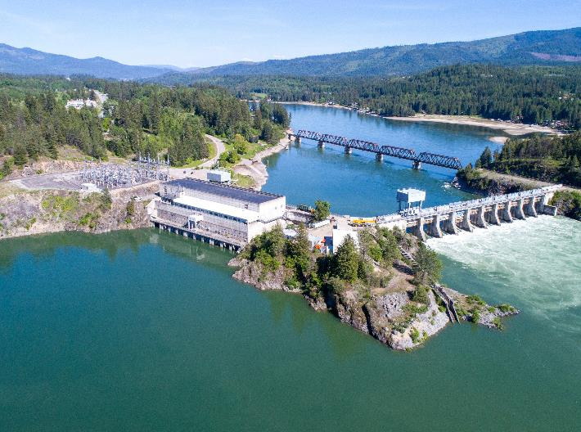
Albeni falls Dam and lake pend Oreille
Spring public meeting
Date: 06 April 2023
Albeni Falls Water Management
Albeni Falls Project Update

Slide 2
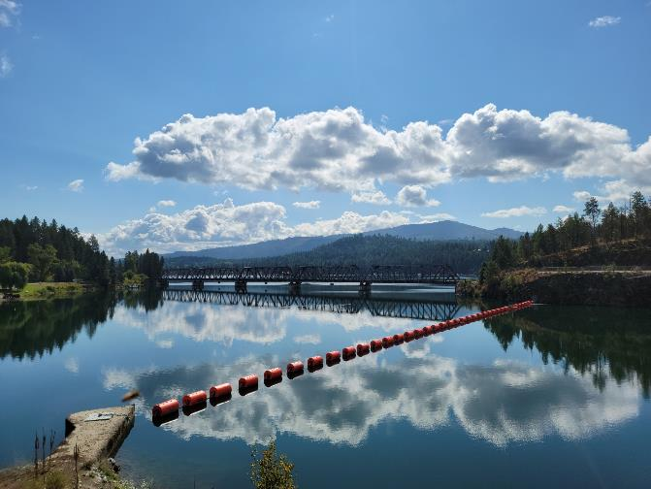
Albeni Falls dam project updates
Amanda Collins
Operating Project Manager
Albeni Falls Dam
Andrew Huddleston
Fisheries Biologist
Albeni Falls Dam

Slide 3
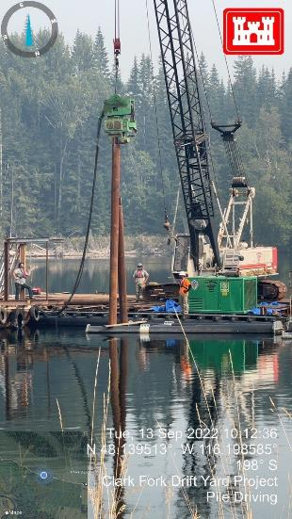
Clark Fork Driftyard Repair Status
Replaced 3 dolphins (two that were damaged, one missing).
Vegetation cleared from all of A boom.
Replaced 200ft of shear boom.
Replaced 750ft of containment logs. 1050tf will be replaced Spring 23.
Projecting to replace another 200ft of shear boom next year.
Breakwater Feasibility Study Complete. Awaiting funding.
Notes:
We continue to make progress on the clark fork driftyard.

Slide 4
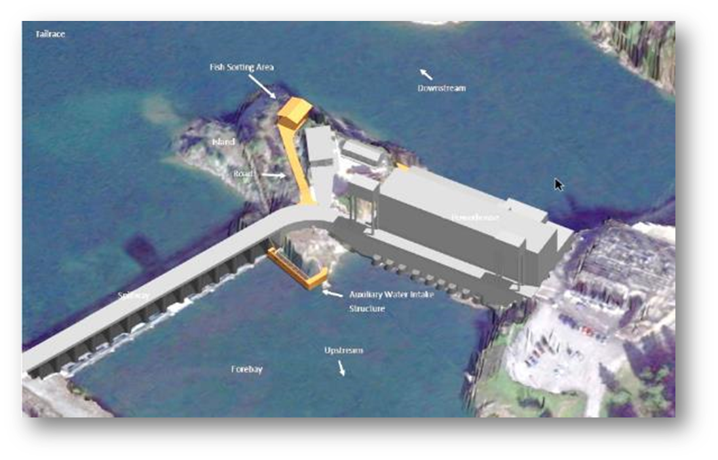
Fish Passage
Goal: Provide sub-adult and adult bull trout passage to habitats upstream of AFD and reestablish connectivity of bull trout critical habitat above/below AFD as part of a system-wide recovery effort.
Design: Design/Build contract anticipated. PDT actively developing proposal for solicitation (estimated winter 2024).
Construction Phase: Estimated construction completion early 2029.
Questions?
Fish Biologist: Andrew Huddleston
Notes:
The purpose of the fish passage project is to reestablish upstream habitat connectivity for bull trout. The population of the downstream stretch of POR (55 miles), between AFD and BCD, is essentially extirpated (no spawning pairs currently existing); however, there are entrained BT found downstream, and the AFD FPF, in addition to other efforts and collaboration with agencies will bring that extirpated population to a recovering status.

Slide 5
2023 Recreation Season
Season Dates: Campsites and Shelters 100% reservable
  Riley Creek: May 06 – September 16, 2023
  Albeni Cove, Priest River and Springy Point:
  May 13 – September 9, 2023
  Trestle Creek: Opened April 1 - Oct 31.
  Visitor Center open Mon–Thurs through Memorial Day 2023.
  Reservations available through Recreation 1 Stop www.recreation.gov

Slide 6
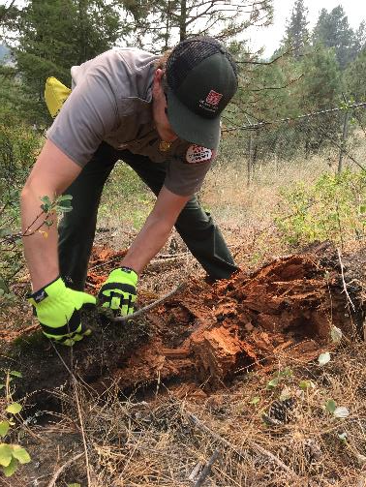
2023 Environmental stewardship
Forest Management/Hazard Tree Contract Underway
Aquatic Herbicide Application – Late Summer 2023. Milfoil/Flowering Rush
Resolving Encroachments

Slide 7
Questions
www.nws.usace.army.mil
Facebook at Albeni Falls Dam
208-437-3133 Main Line (Dam)
208-437-4617 Visitor Center

Slide 8
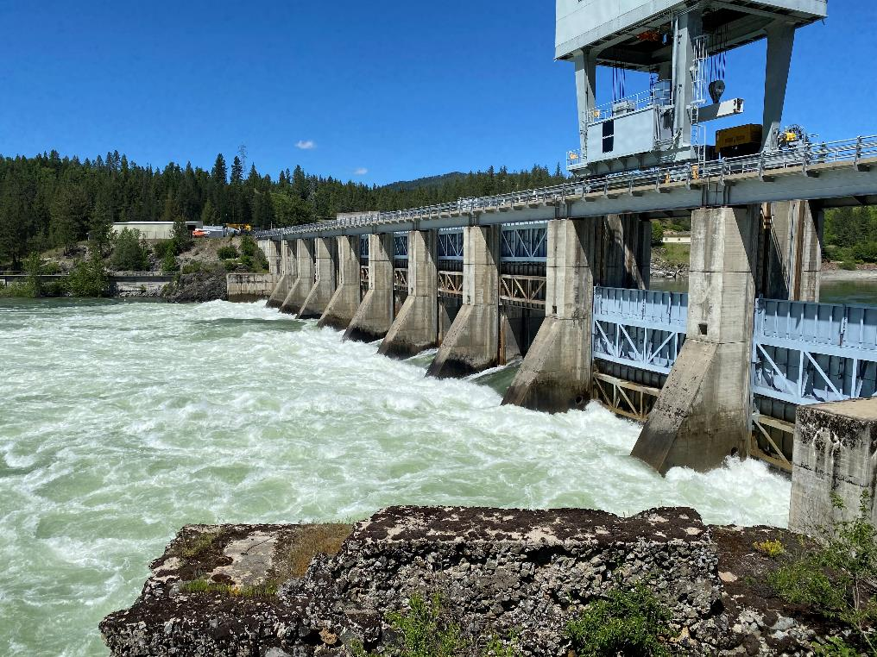
Albeni falls and lake pend Oreille operations
Leon Basdekas, P.E.
Upper Columbia Senior Water Manager
Seattle District, Army Corps of Engineers

Slide 9
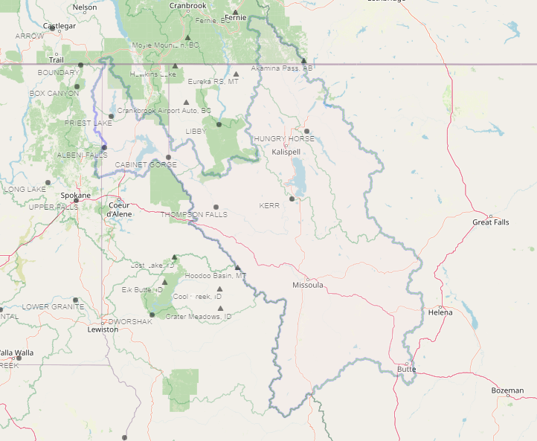
Pend Oreille Basin
Lake Pend Oreille

Slide 10
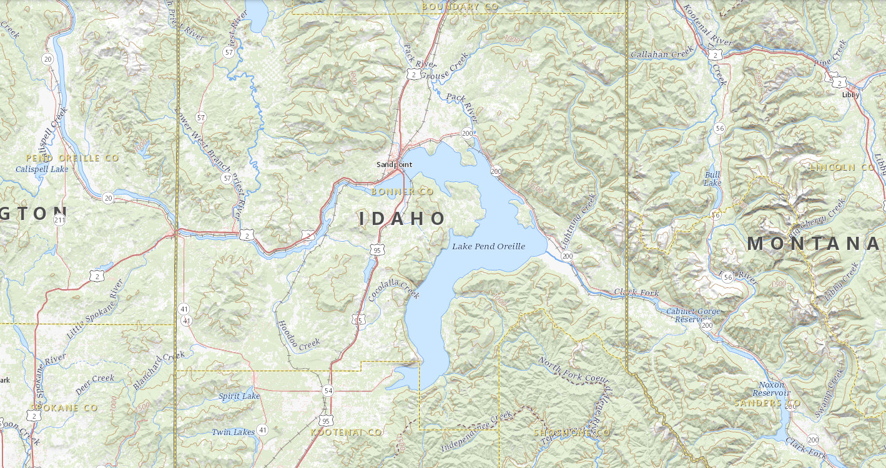
Lake Pend Oreille & ALBENI FALLS DAM
Dover, location of transition from Lake to River.
Hope, where Lake elevation is measured.
Albeni Falls Dam is ~27 miles downstream from Hope.

Slide 11
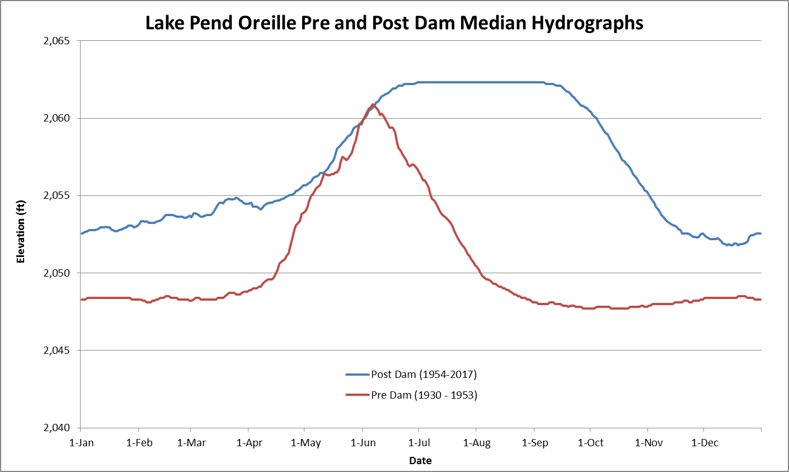
Notes:
Ask Logan.

Slide 12
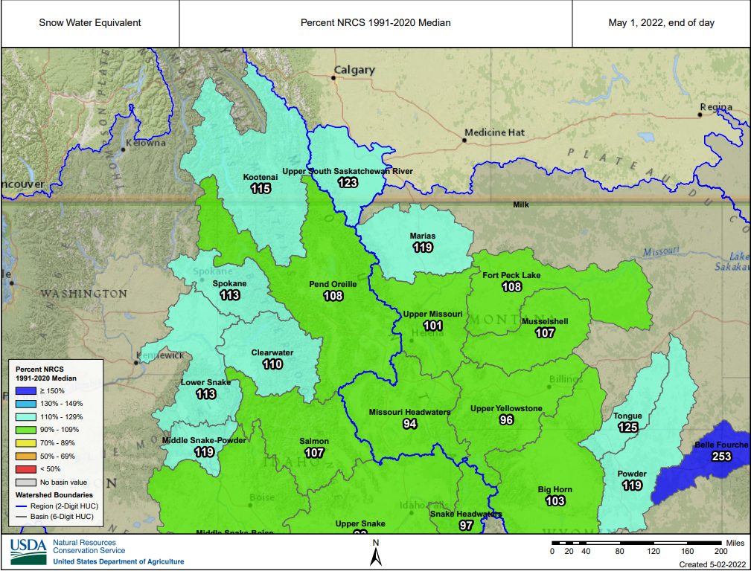
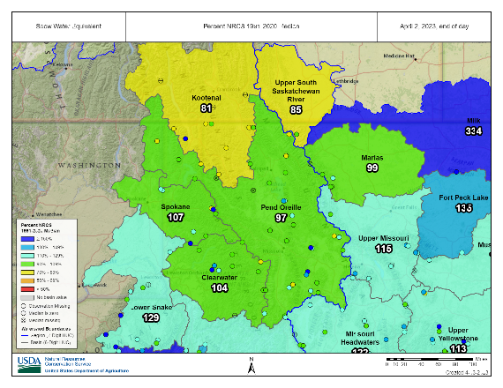
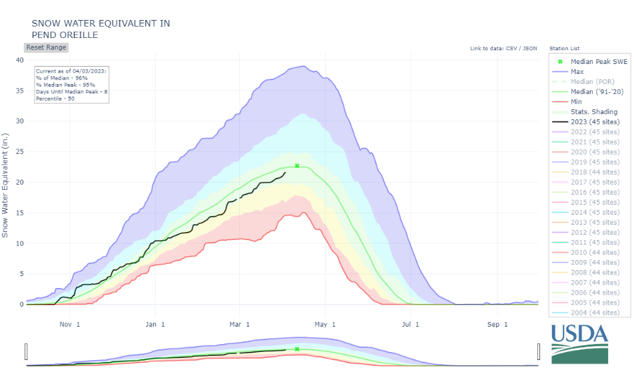
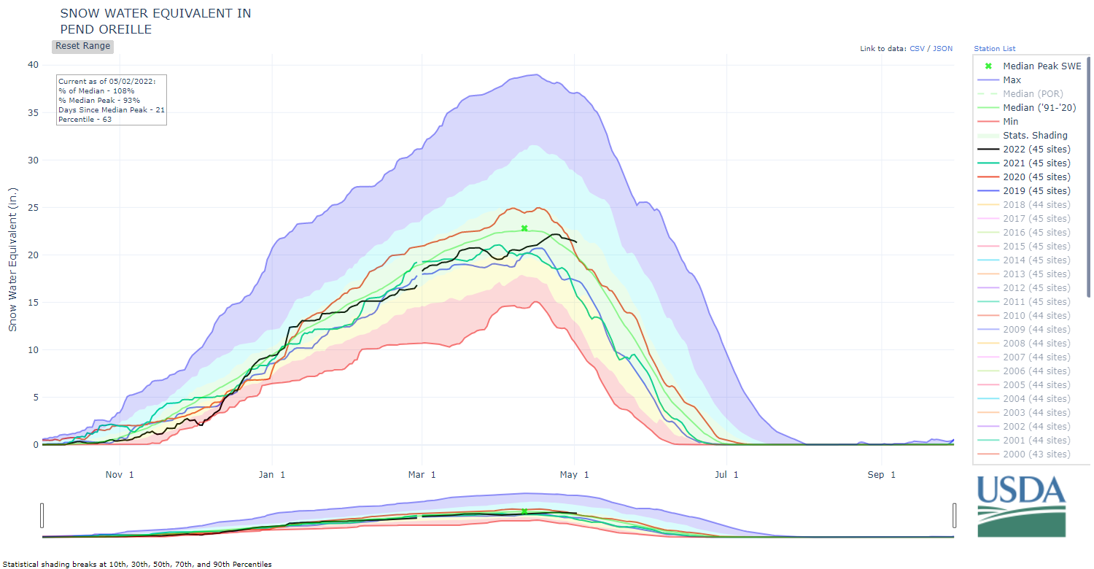
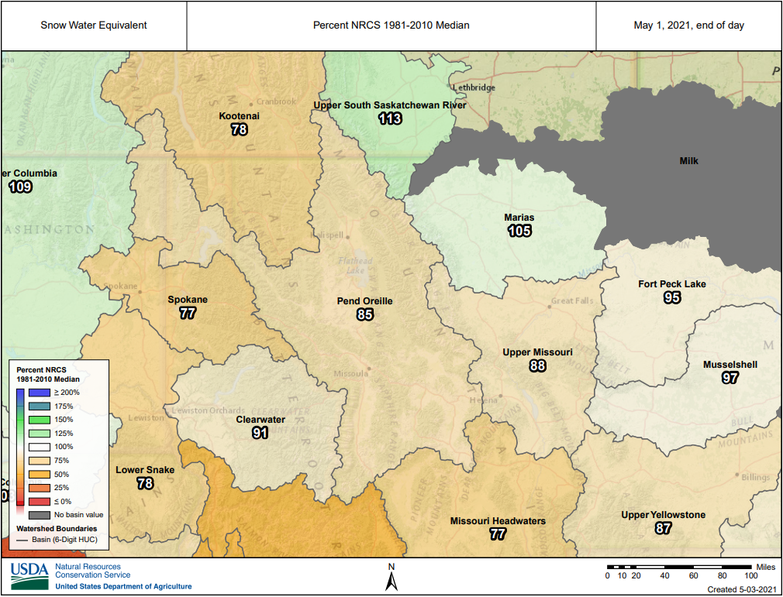
Current conditions
May 1, 2022 Snow – For comparison
April 3, 2023 Snow – Percent of Median
May 1, 2022 Snow – For comparison
May 1, 2021 Snow – For comparison
April 3 snowpack is near average this year (97% of average) and the seasonal peak is expected to keep accumulating.
In addition to snowpack, other factors including spring weather will affect runoff volume and timing such as dry fall, near normal snow pack, and well below average natural flows in the basin.
Notes:
Interactive Map (usda.gov)

Slide 13
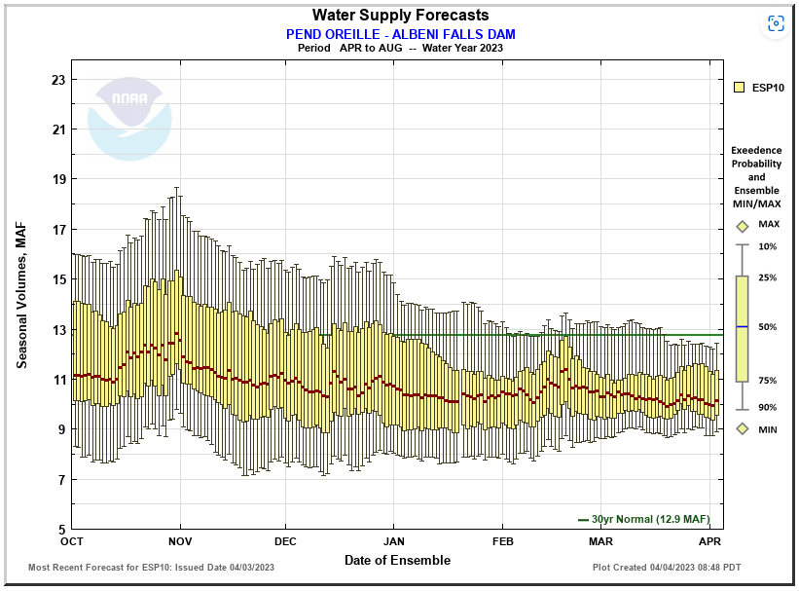
Current conditions
Apr-Jul median forecast inflow volume is about 9.8 Maf or 79% of average

Slide 14
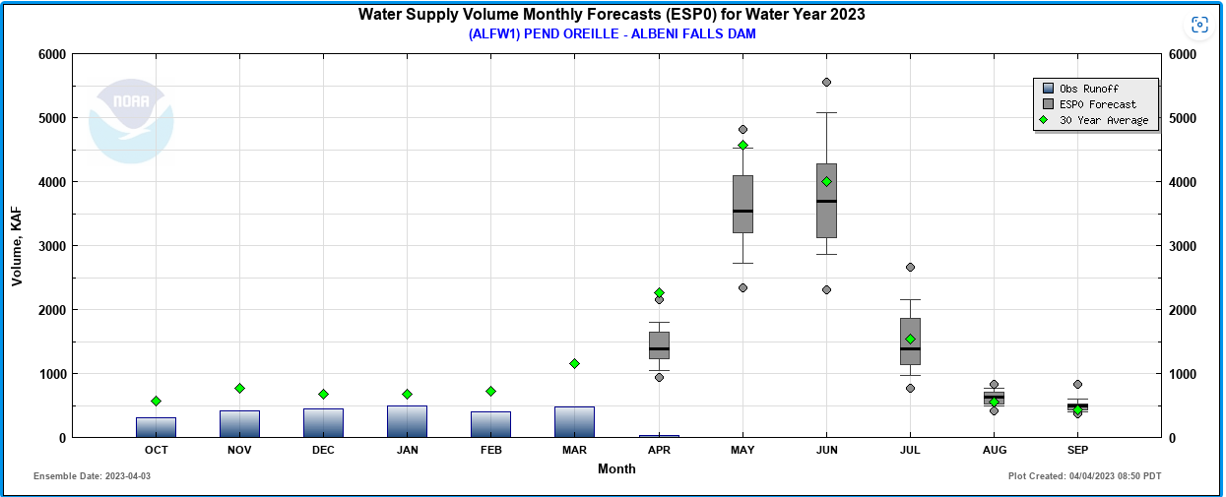
Current conditions
Observed runoff was well below average for March.
Predicted for April and May is well below average.
April 3 snowpack is about 97% of average in the Pend Oreille Basin.
Current water supply forecast is 79% of Average (9.8 MAF) for Apr-Jul.
April-July Forecast 9.8 Maf and 79% average

Slide 15
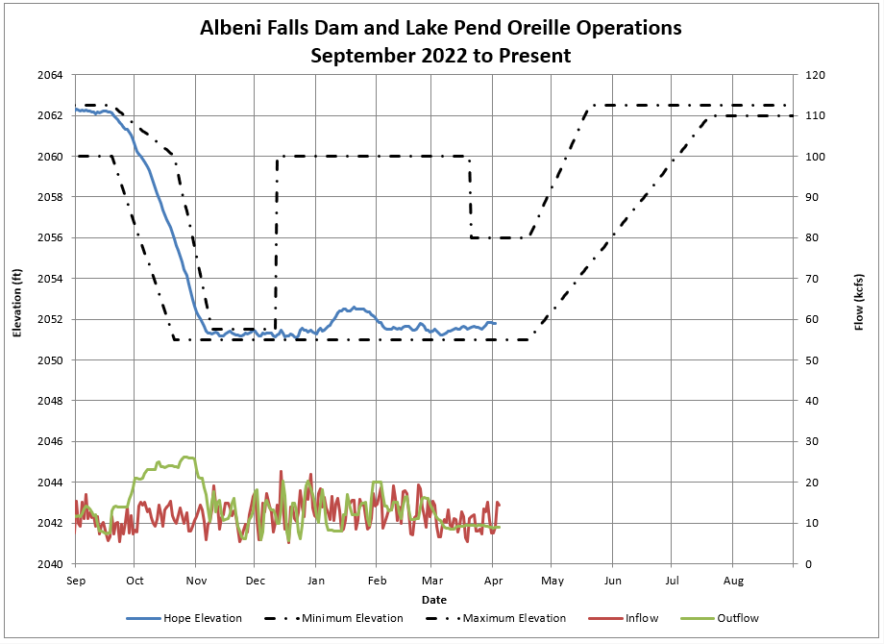
Started Fall Draft Sept 19th
Finished Fall Draft Nov 9th
Winter Band
2051.0’ – 2052.0’
Flexible Winter Power Operations Jan 6th – Feb 4th
2052’ – 2053.0’
Kept Lake in 2051.0’-2051.5’ band Nov 9th – Dec 21st for Kokanee spawning.

Slide 16
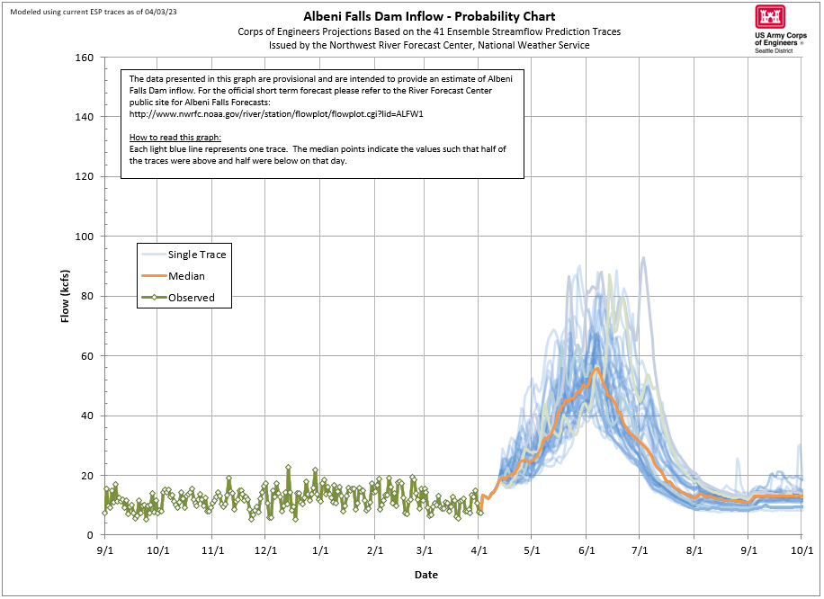

Slide 17
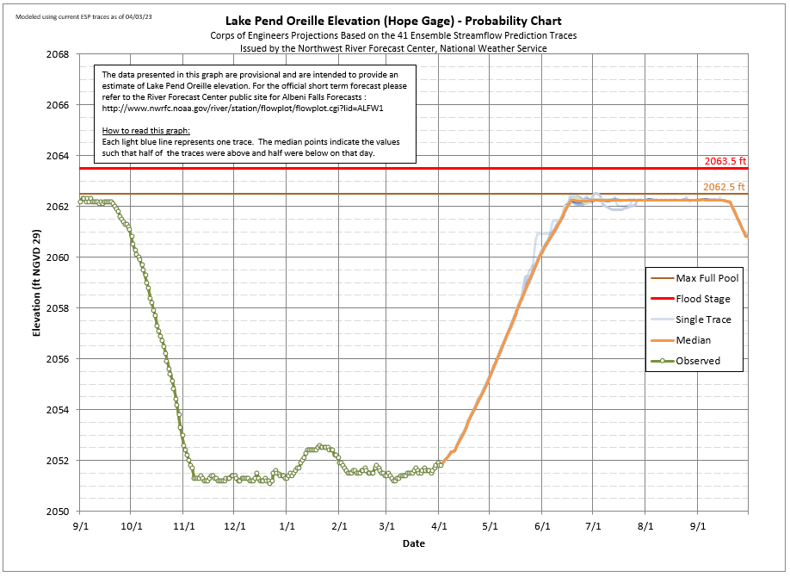

Slide 18
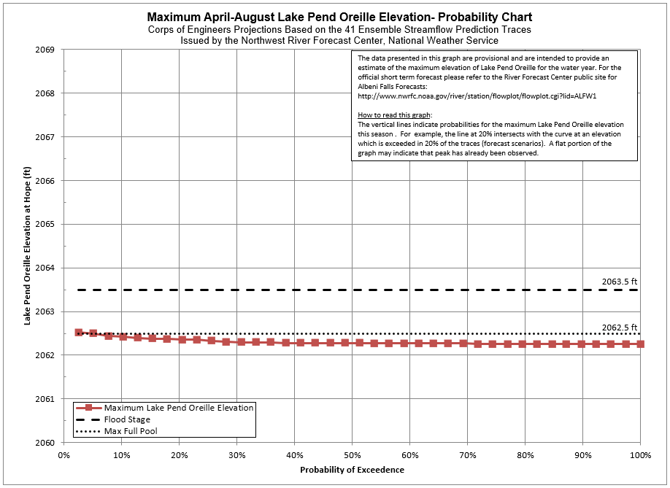
Modeled using current ESP traces as of 04/03/23

Slide 19
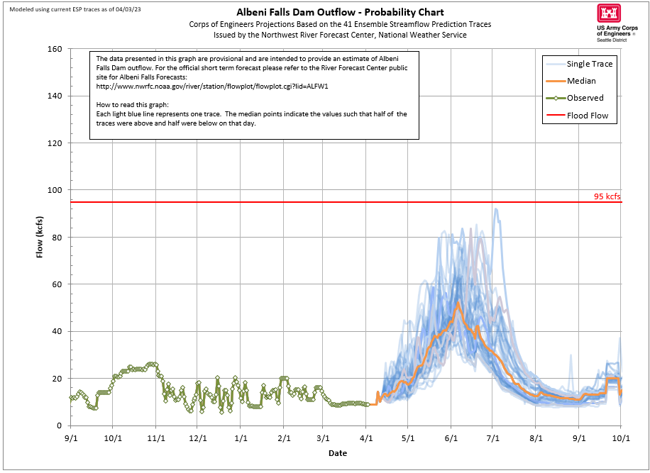

Slide 20
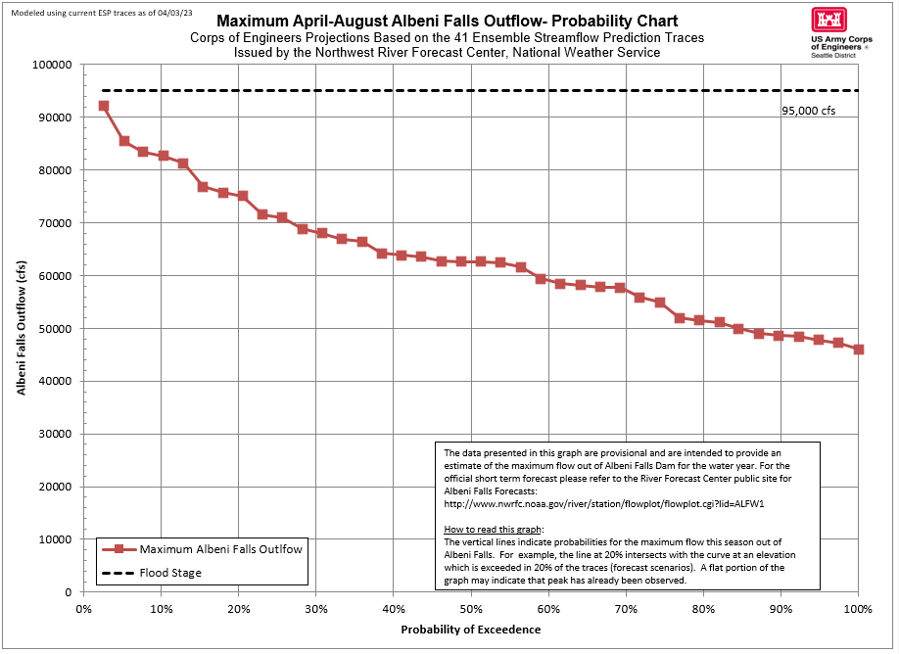

Slide 21
Albeni Falls Control - Summer Example
Half foot water surface elevation difference between Hope and Dam
Clark Fork
Albeni Falls
Dam
Dover
Constriction
Pend Oreille River begins
Hope
Dover Constriction Control - High Spring Outflow Example
10-foot water surface elevation difference between Dover and Dam
Clark Fork
Albeni Falls
Dam
Dover
Constriction
Pend Oreille River begins
Hope

Slide 22
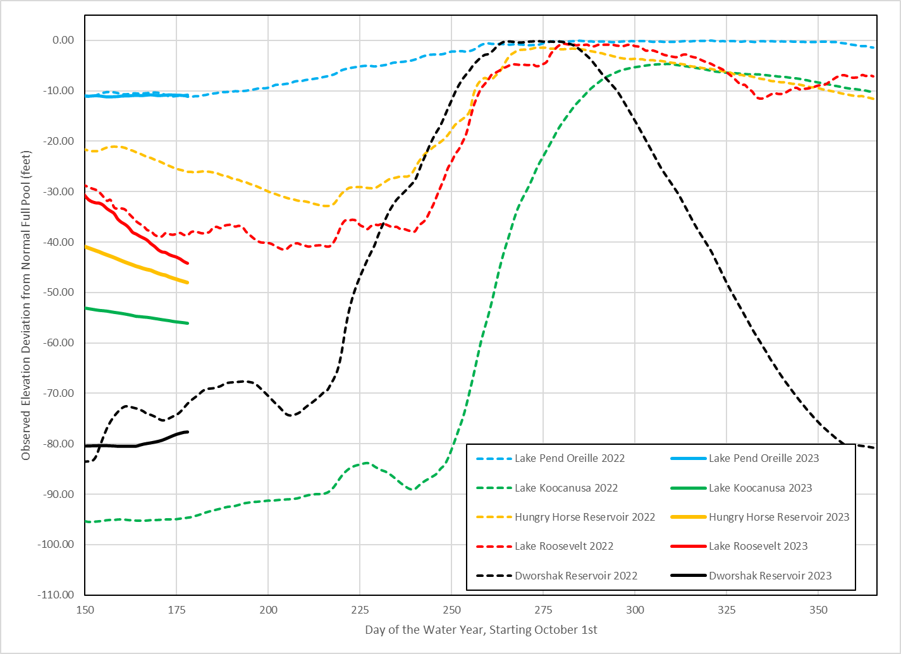
Federal STORAGE Projects – Feet From full

Slide 23
Current and Planned operations
4 April - Hope elevation 2051.90 ft, outflows 9 kcfs
Current plan is to target a Lake Pend Oreille elevation of 2055 ft at the end of April, although actual elevation will depend on inflows
Lake Pend Oreille refill (above 2062 ft) target is mid-June
      Depends on timing and shape of runoff

Slide 24
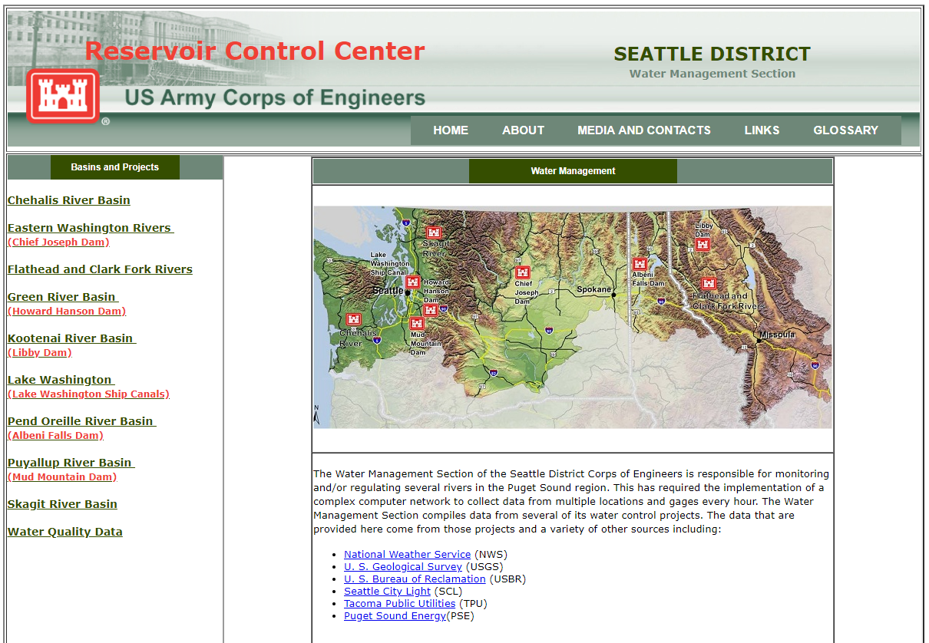
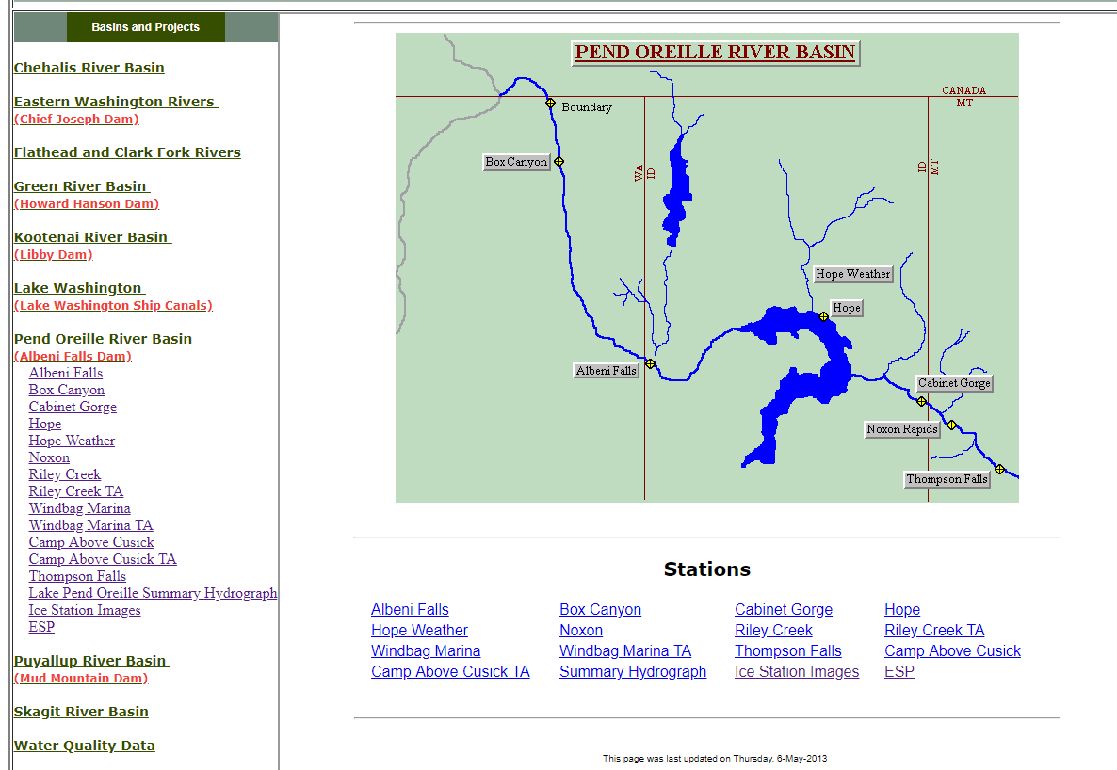
Questions?
For emails regarding release changes and lake level updates email
  UpperColumbiaWM@usace.army.mil
  Leon.Basdekas@usace.army.mil
General Questions call (206) 764-6702
Seattle District water management data website :
http://www.nwd-wc.usace.army.mil/nws/hh/www/index.html#

