Slide 1
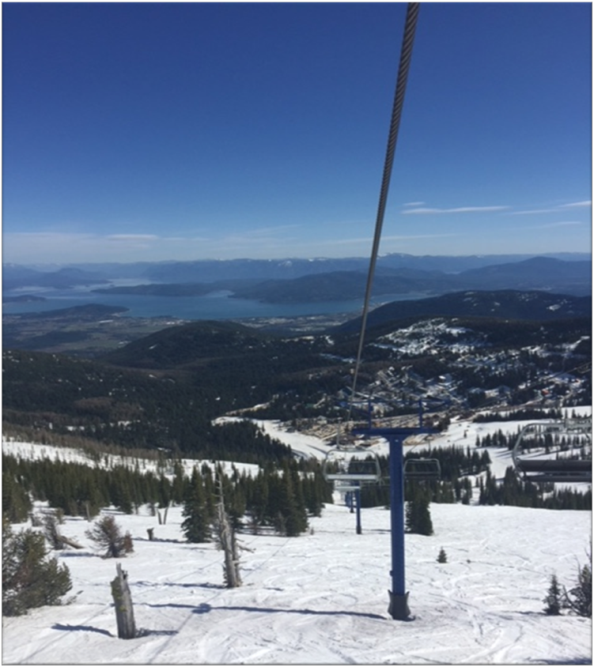
Clark Fork-Pend Oreille River Basin Adjudication Update April 6, 2023
Lakes Commission
April 6, 2023
Craig Saxton for the
Idaho Department of Water Resources
Notes:
Hello, I am Craig Saxton, Adjudication Section Manager with the Department of Water Resources.
I want to thank Ms. McCahon for inviting me to present on the Clark Fork-Pend Oreille River Basin adjudication.
Today I will give a quick update of where we are at in the adjudication process.
25-30 minute update on the CFPO Adjudication and also the timeline and process on the State filing water rights for Lake Pend Oreille and Priest Lake?

Slide 2
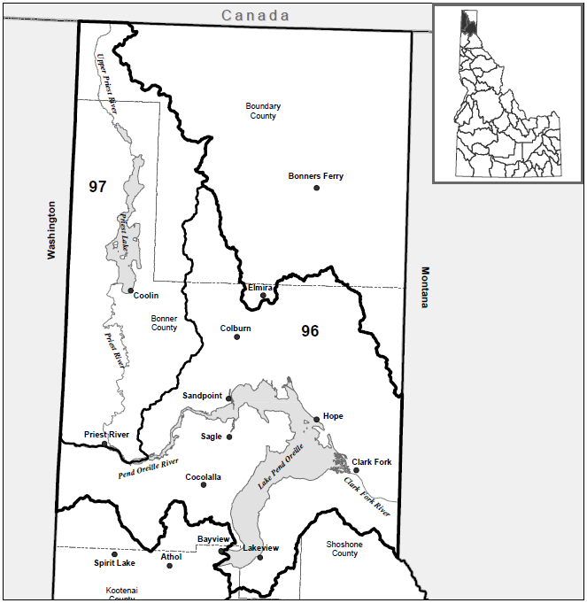
Clark Fork-Pend Oreille River Basin Adjudication
Commencement notice issued on June 15, 2021
IDWR started mailing notice of commencement in September 2021.
Filing deadline for the last group is June 23, 2023.
Notes:
I thought I would start with a quick background on the CFPRBA
On June 15, 2021, the 5th Judicial District Court issued a commencement order for the Clark Fork-Pend Oreille River Basin

Slide 3
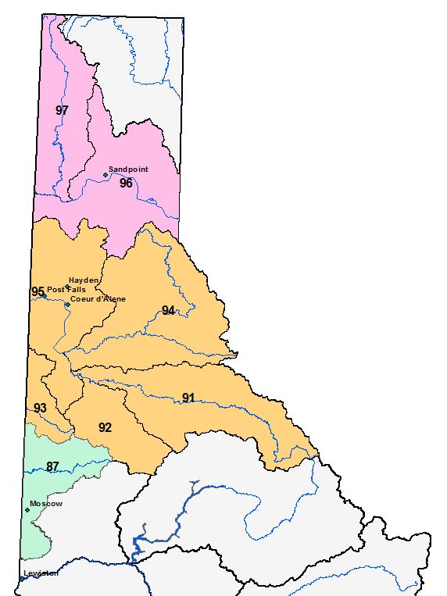
Northern Idaho Adjudications (NIA)
Coeur d’Alene-Spokane River Basin Adjudication (CSRBA)
IDWR Basins 91, 92, 93, 94 and 95
1st phase of the Northern Idaho Adjudications (NIA)
Director’s Reports have been filed in Basins 91, 92, 93, 94, and 95
Objection resolution is ongoing but coming to a close.
Palouse River Basin Adjudication (PRBA)
IDWR Basin 87
2nd phase of the Northern Idaho Adjudications (NIA).
Director’s Report to issued in August 2, 2021.
Objection resolution is ongoing.
Clark Fork-Pend Oreille River Basins Adjudication (CFPRA)
IDWR Basins 96 and 97
3rd phase of the Northern Idaho Adjudications (NIA).
Commencement order issued June 15, 2021.
Currently taking claims.
Notes:
The CFPRBA is Phase 3 of what we refer to as the “Northern Idaho Adjudications”:
CSRBA commenced November 12, 2008
PRBA commenced March 1, 2017
CFPRBA commenced June 15, 2021

Slide 4
Adjudication Process
Legislative Authorization of Adjudication
Petition
File Claims
Hearing
Investigate
District Judge Appointment
Commencement Order
Preliminary Report
Public Meetings
Notice
Director’s Report
Settlement
Water Right Decree
Objections
Responses
Trial
Notes:
Legislative Authorization in 2006
Judge Eric Wildman of the 5 Judicial District Court.
The Attorney Generals office, on behalf of the Director, files a petition with the Judge to commence the adjudication.
Hearing
So far, the Judge has issued a commencement order.
IDWR sends notice
IDWR Investigates
Sends preliminary recommendations to the claimants (Draft)
Public Meetings
Issue Director’s Report the claimants and court

Slide 5

What types of water rights need to be claimed?
Water rights developed prior to the commencement of the Adjudication
  Previous Decree
  Permit process (application, permit*, license)
  Beneficial use (“Grandfather rights”, Statutory claims, Posted Notice).
Optional – Deferrable Domestic and/or Stockwater rights that meet the definition of domestic use as described in 42-111, Idaho Code.
Federal Reserved rights (Water Rights based on Federal Law)
*Any permit where proof has been submitted prior to the commencement of the adjudication.
Notes:
*Any permit where proof has been submitted prior to the commencement of the adjudication.

Slide 6
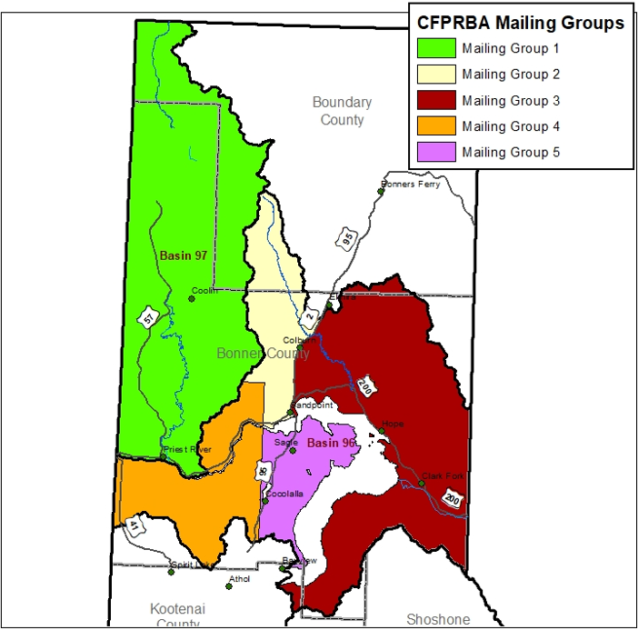
Claim Filing Deadlines
Mailing Group | Date Mailed | Filing Deadline
Group 1 | September 3, 2021 | July 1, 2022
Group 2 | January 19, 2022 | September 2, 2022
Group 3 | March 31, 2022 | October 28, 2022
Group 4 | September 23, 2022 | April 21, 2023
Group 5 | November 29, 2022 | June 23, 2023

Slide 7
CFPRBA Claim Count
Things to take from this:
Notes:
Originally anticipated 9000 claims. We might get close.
87% are domestic and Stockwater Claims

Slide 8
CFPRBA Federal Reserved Claims
USFS claims are for Administrative use in the National Forests
BLM claims are for stockwater use from springs based on Public Water Reserve 107
Notes:
Filing Deadline was negotiated to 3/3/2023.
BLM claims are for stockwater use in Basin 96.
USFS claims are for Administrative use in the national forests in Basin 97. Two Ground water Claims. Format is consistent with federal claims filed in the CSRBA and PRBA.
--On April 17, 1926, PWR 107 was created by Presidential Executive Order which ordered that “every smallest legal subdivision of the public land surveys which is vacant unappropriated unreserved public land and contains a spring or waterhole, and all land within one quarter of a mile of every spring or waterhole located on unsurveyed public land is hereby, withdrawn from settlement, location, sale, or entry, and reserved for public use.”
The Bureau of Land Management 7250 Water Rights Handbook states that “the executive order and reserved right applies to all springs and waterholes on such public lands, regardless of the size or flow rate of the water source. The executive order applies only to naturally occurring springs and waterholes. The uses associated with the reserved right are restricted to domestic and livestock use.” --

Slide 9
Idaho Water Resource Board Claims
9 Minimum Stream Flow claims including Priest Lake
  All claims are for existing licenses
  Minimum stream flow WR in Priest River (97-7380)
2 minimum Lake Level Claims
  License 96-8503 Round Lake
  License 96-8764 Gamble Lake
5 claims filed for storing water in Priest Lake in connection with the operation of the Priest Lake outlet control structure (Idaho Code § 70-507)
Notes:
Priest Lake “70-507” claims were filed with IDWR on Tuesday and I simply haven’t had the opportunity to review them.
IDWR involved in lawsuit over contract work on the outlet.

Slide 10
Priest Lake - Outlet Claims
Basin | Sequence | Suffix | Basis | Priority Date | Source | Water Use | Max Diversion Volume
97 | 9667 |  | Beneficial Use | 12/31/1951 | PRIEST LAKE | LAKE LEVEL MAINTENANCE, RECREATION STORAGE | 1095657
97 | 9668 |  | Beneficial Use | 12/31/1957 | PRIEST LAKE | LAKE LEVEL MAINTENANCE, RECREATION STORAGE | 833874
97 | 9669 |  | Beneficial Use | 12/31/1961 | PRIEST LAKE | LAKE LEVEL MAINTENANCE, RECREATION STORAGE | 1173344
97 | 9670 |  | Beneficial Use | 12/31/1974 | PRIEST LAKE | LAKE LEVEL MAINTENANCE, RECREATION STORAGE | 1500908
97 | 9671 |  | Beneficial Use | 12/31/2018 | PRIEST LAKE | LAKE LEVEL MAINTENANCE, RECREATION STORAGE, STREAMFLOW MAINTENANCE FROM STORAGE, STREAMFLOW MAINTENANCE STORAGE | 915298
Each claim contains a statement that sets a combined use limit for all water rights owned by IWRB for Priest Lake to 1,500,908 AF
Notes:
Claims were received on 4/4/2023

Slide 11
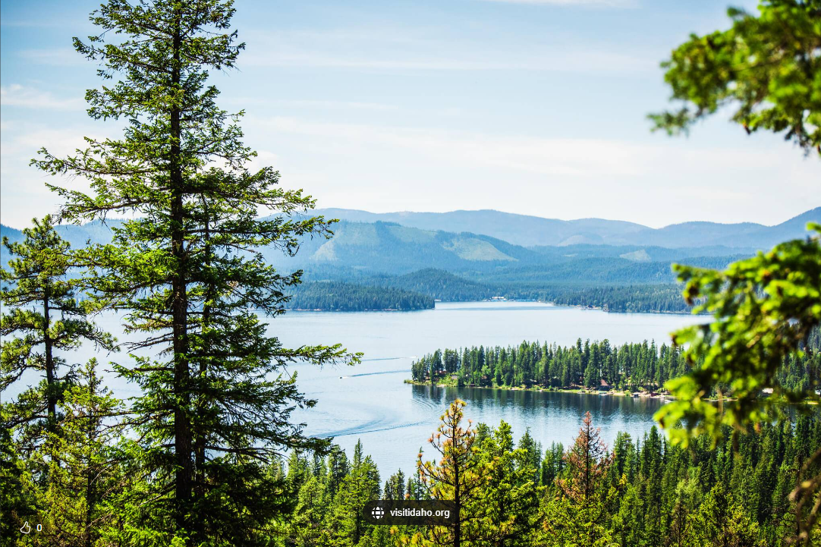
State of Idaho Lake Claims
The State of Idaho, filed a Request for Extension of Time to File Adjudication Claims extending the filing deadline until July 1, 2023.
Currently Licenses:
97-2020 – Priest Lake
97-2056 – Lake Pend Oreille
Notes:
The State of Idaho will file on lake level rights 97-2020 and 97-2056
Lake Pend Oreille (97-2056) 1,615,000 AF
Priest Lake (97-2020) 800,000 AF.
67-4304 – Authorizes the Governor to appropriate in trust waters of Priest and Pend Oreille lakes.

Slide 12
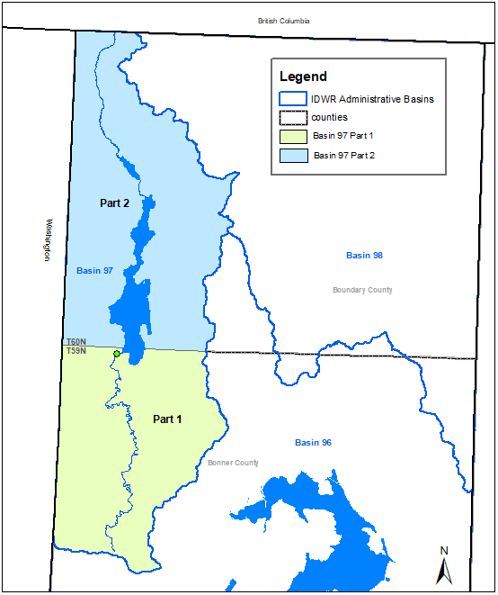
Reporting Plan
Report Basin 97 in two parts.
  Part 1 – 2024
  Part 2 – 2025
IDWR anticipates reporting Basin 96 in multiple parts possibly with a Directors’ report in 2027 and 2030.
Notes:
Part 1 was intended to pick up claims south of the control structure for Priest Lake. Priest River water users downstream of the lake will know what the department has recommended for their water rights at the same time or before the water rights managing the lake level are recommended. This will help them decide if they are going to object or not.

Slide 13
CFPRBA - Long Term Plan
Year | CFPRBA
2023 | Second Round Service
 | Claim Review
2024 | B97 Part 1 Director's Report
2025 | B97 Part 2 Director's Report
2026 | Claim Review
2027 | B96 Part 1 Director's Report
2028 | Claim Review
2029 | Claim Review
2030 | B96 Part 2 Director's Report

Slide 14
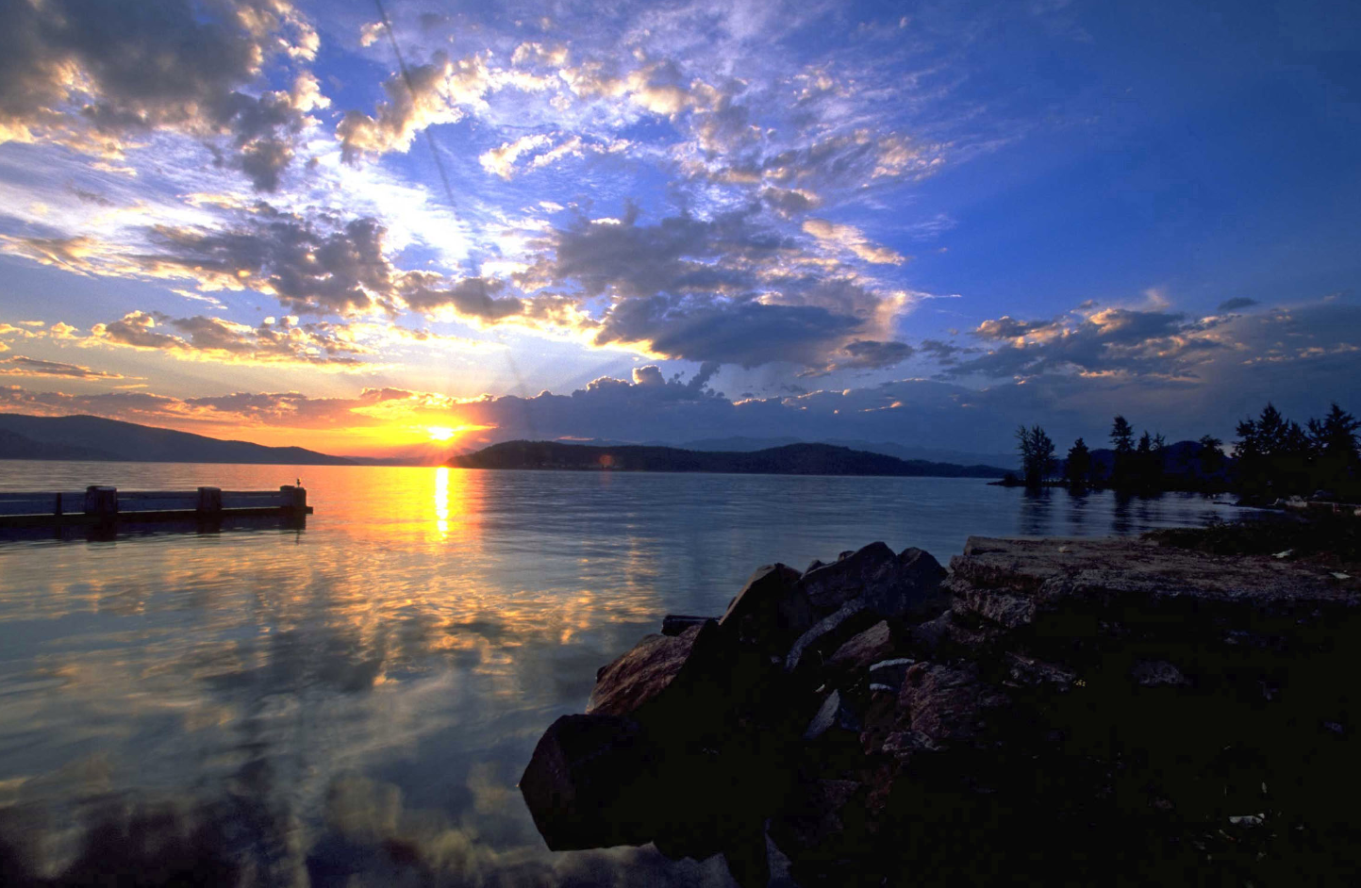
Questions?

