Slide 1
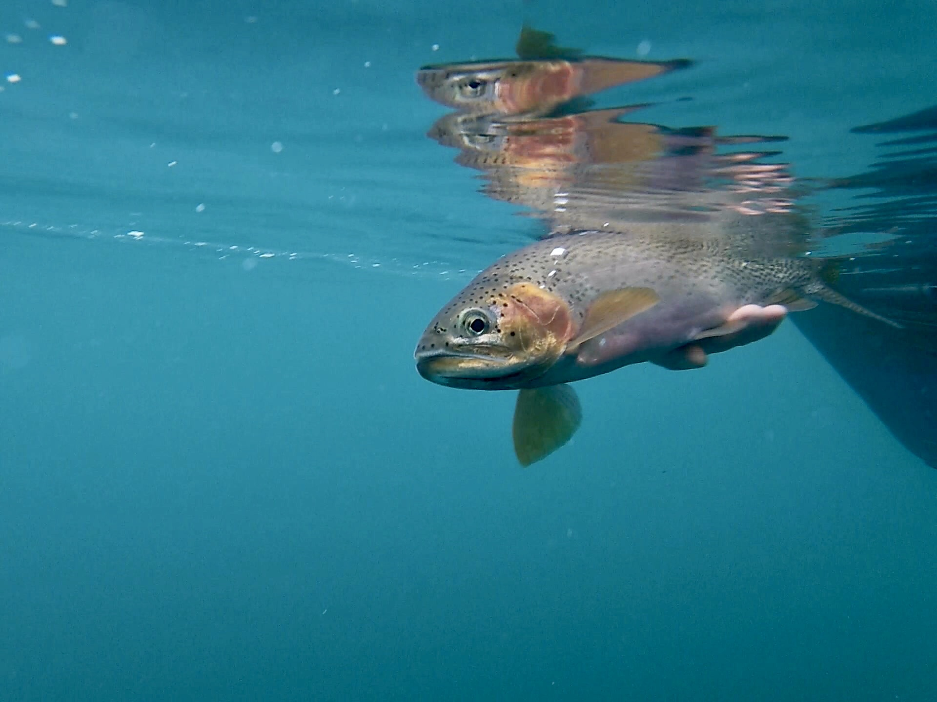
Update on the Formation of the Priest River Watershed Group
October 2022
Erin Plue
Trout Unlimited

Slide 2
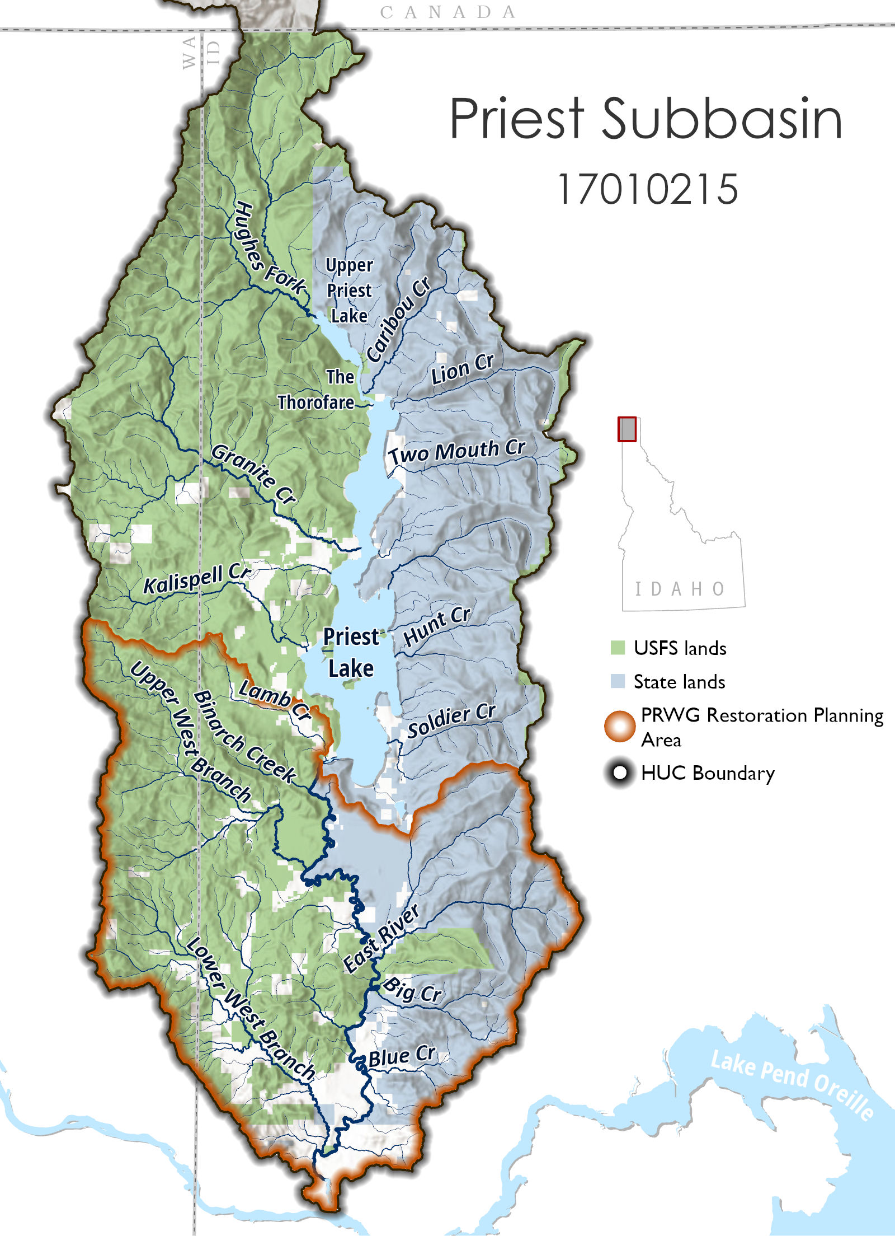
What’s the goal of the PRWG?
Bring together diverse stakeholders from around the Priest Basin
Agree to mission and operating procedures
Learn about the basin and what we don’t know but want to know.
Identify the challenges and outcomes desired for the Priest River
Identify projects in the Lower PR & tributaries.
Develop a “Strategic Plan” for restoration of and access to the Priest River.

Slide 3
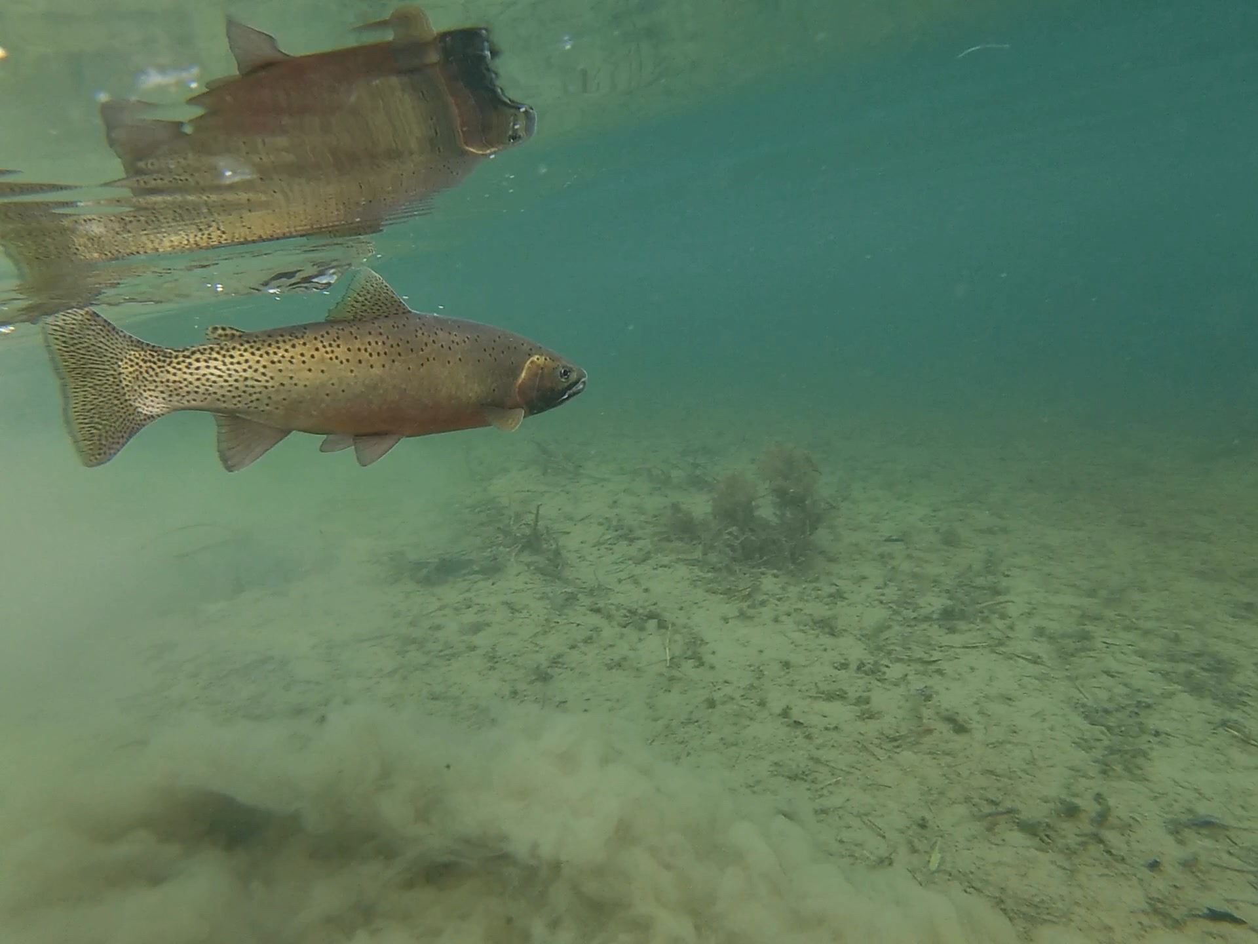


Discussed internally at TU – Fall 2021
Solicited engagement from governmental entities – Winter 21/22
Identified and secured funding opportunities and developed grant proposals – spring 2022
Complete a “Situation Assessment” by third party – Summer 2022
Hire a professional facilitator (funding dependent)
Start meetings – Fall 2022
The Process

Slide 4
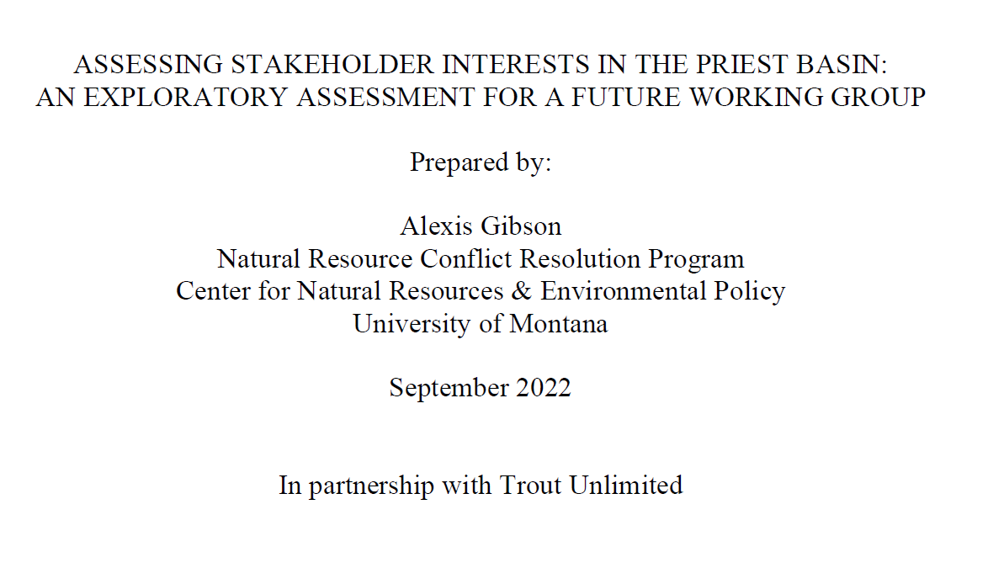
Situation Assessment
Completed during summer 2022
Assessment of social perspectives in the Priest Basin (not a scientific or natural resource assessment)
Involved interviewing 26 community, public agency or private entity individuals AND summarizing their perspectives and concerns.

Slide 5
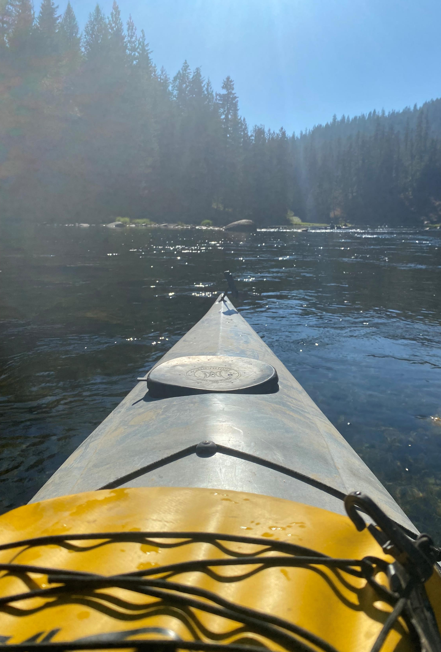
Going Forward
Funding for about 2.5 years of facilitated meetings, field trips and outreach.
Hire and contract with facilitator
Set meeting date for first meeting – end of November/early December

Slide 6
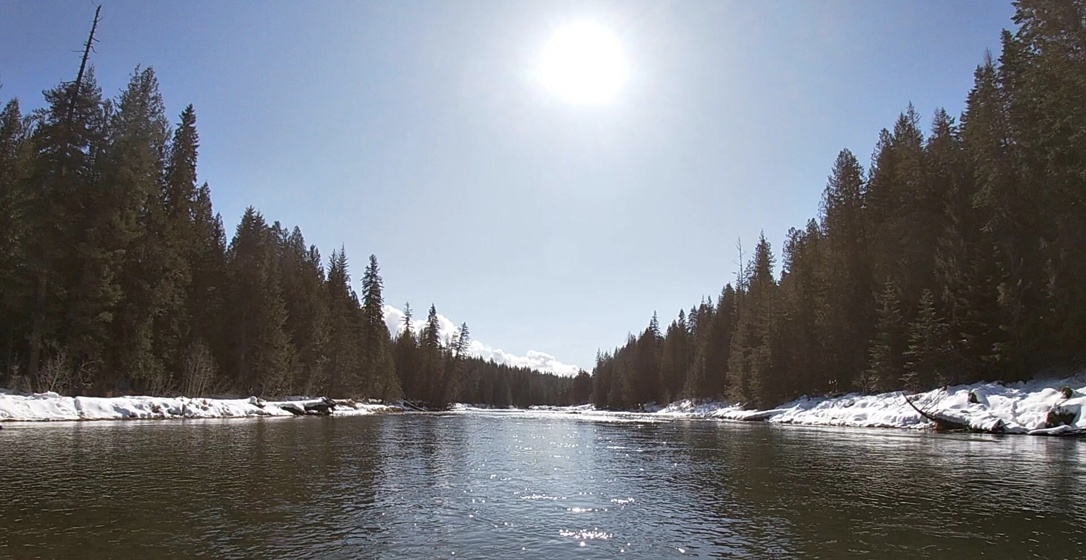
Thank you!
Want to learn more?
Sign up on list or email me.
Erin Plue
Trout Unlimited
Erin.plue@tu.org

