Slide 1
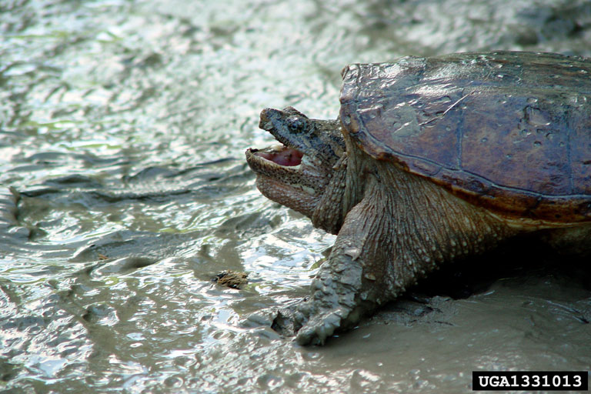
(snapping turtle) Wendy VanDyk Evans, Bugwood.org

Slide 2
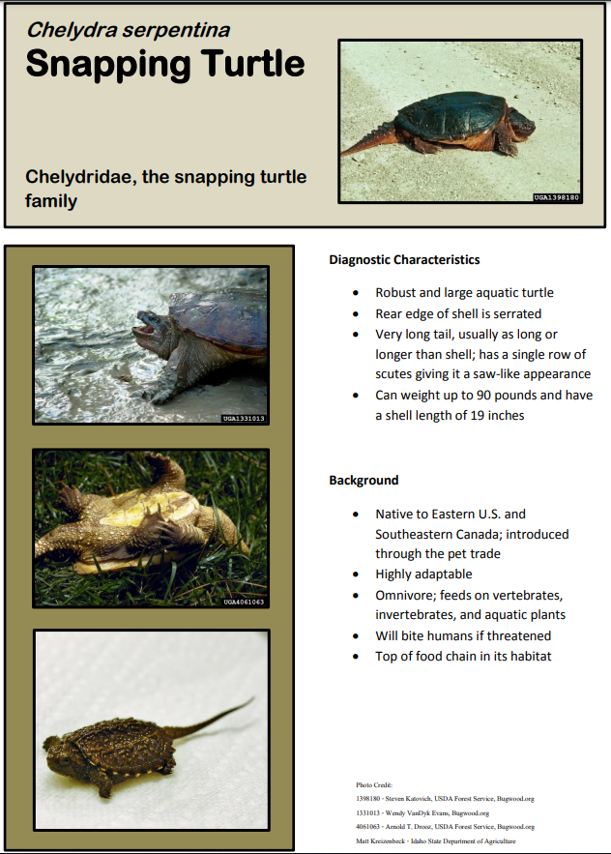

Slide 3
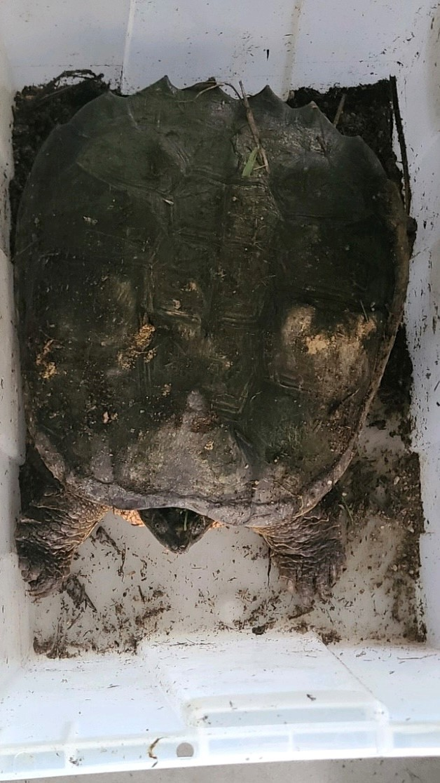
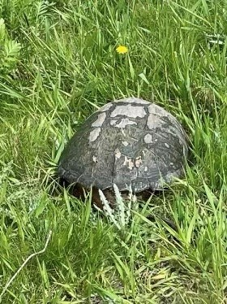
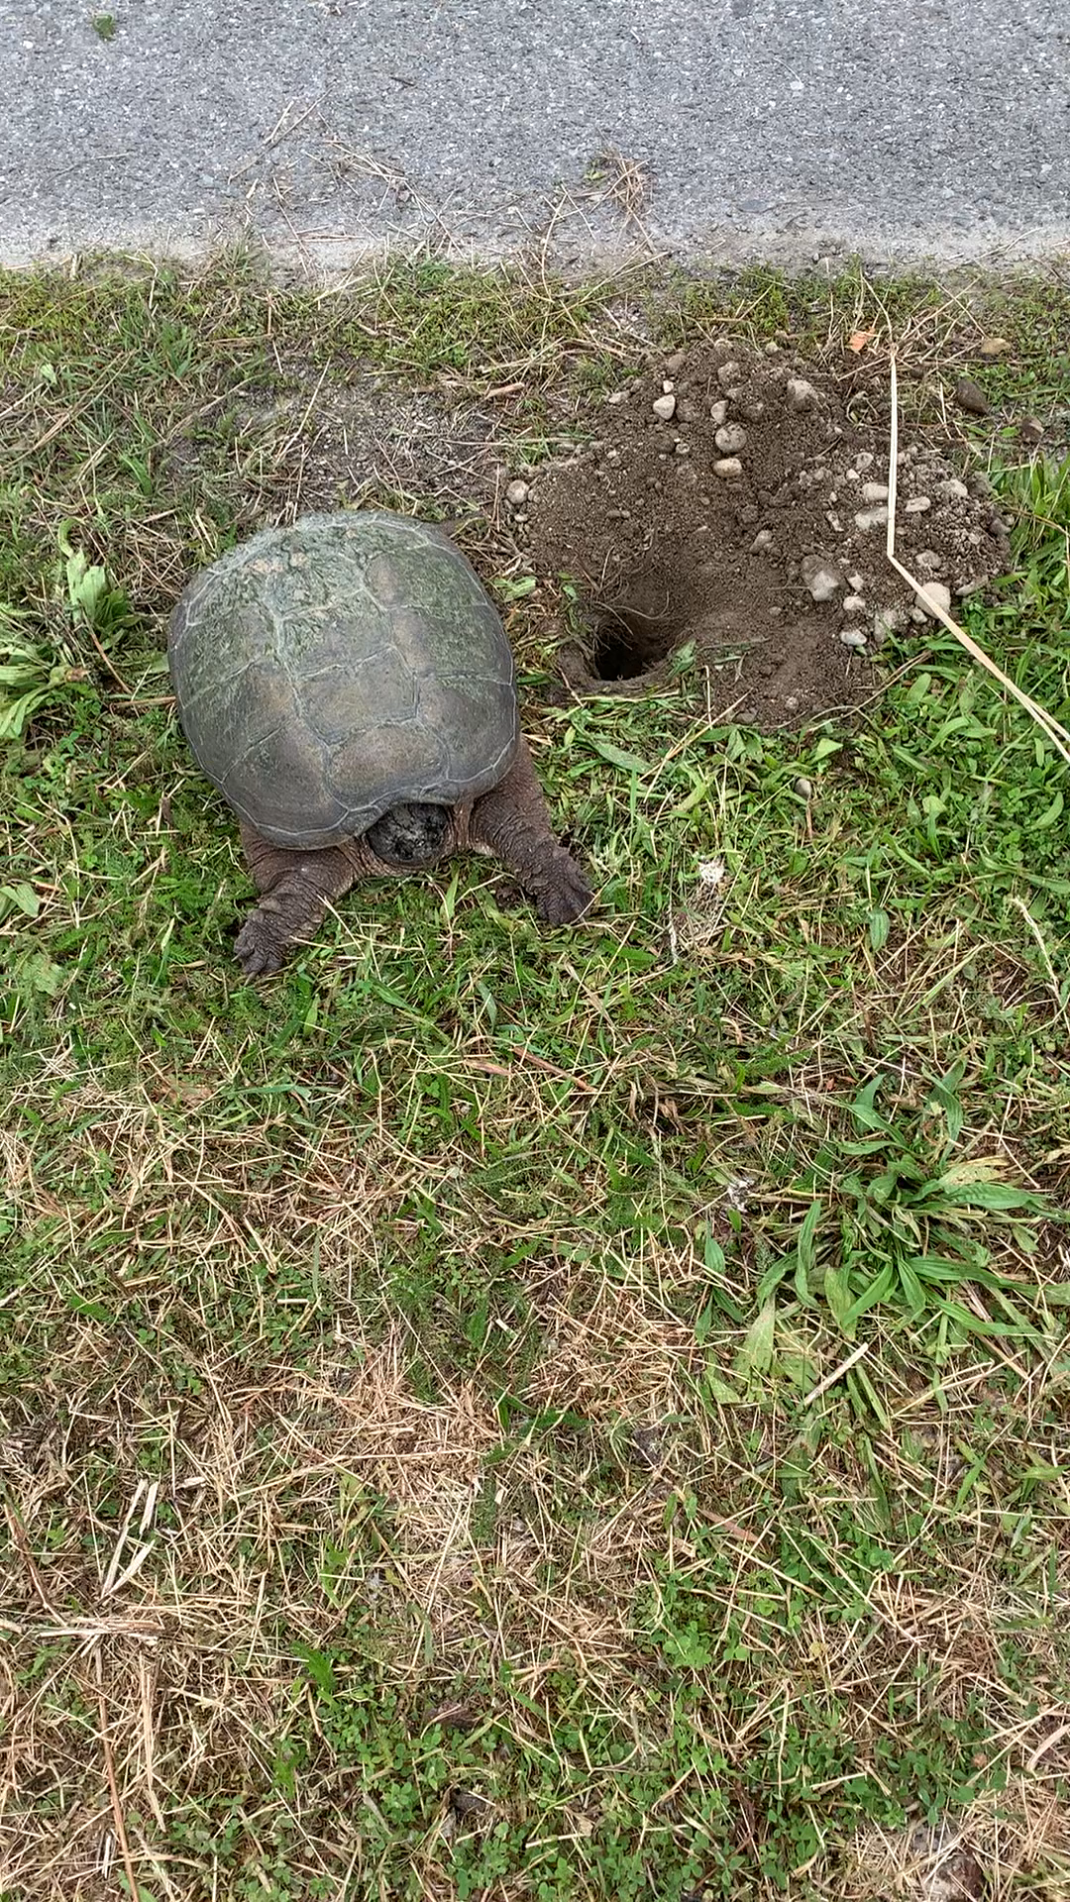
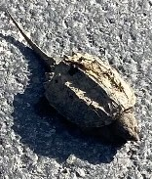
Marian Cummings and Tiffany Camp

Slide 4
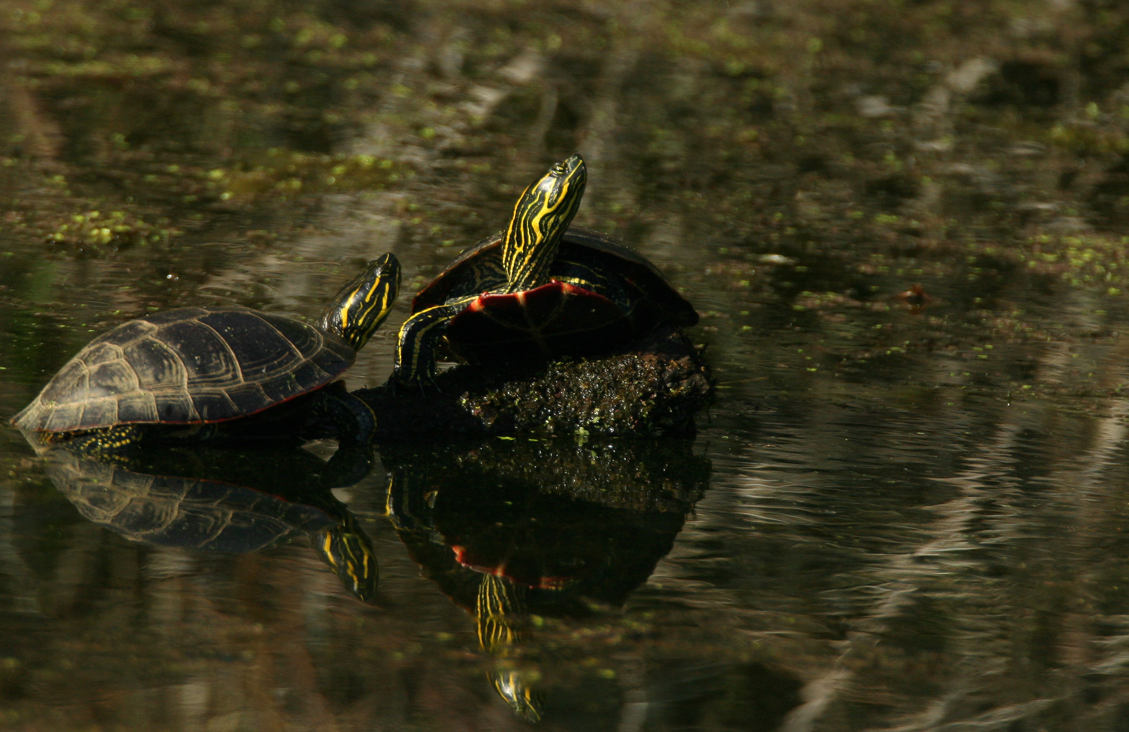
Painted Turtle (Native species)

Slide 5
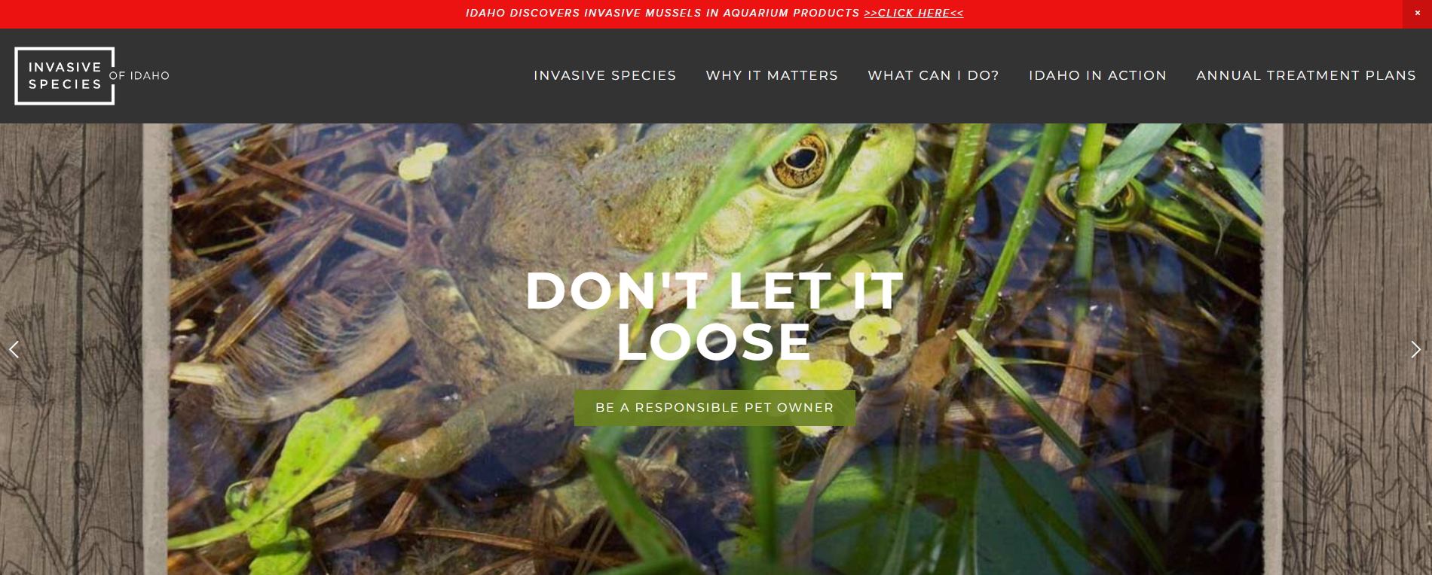

Slide 6
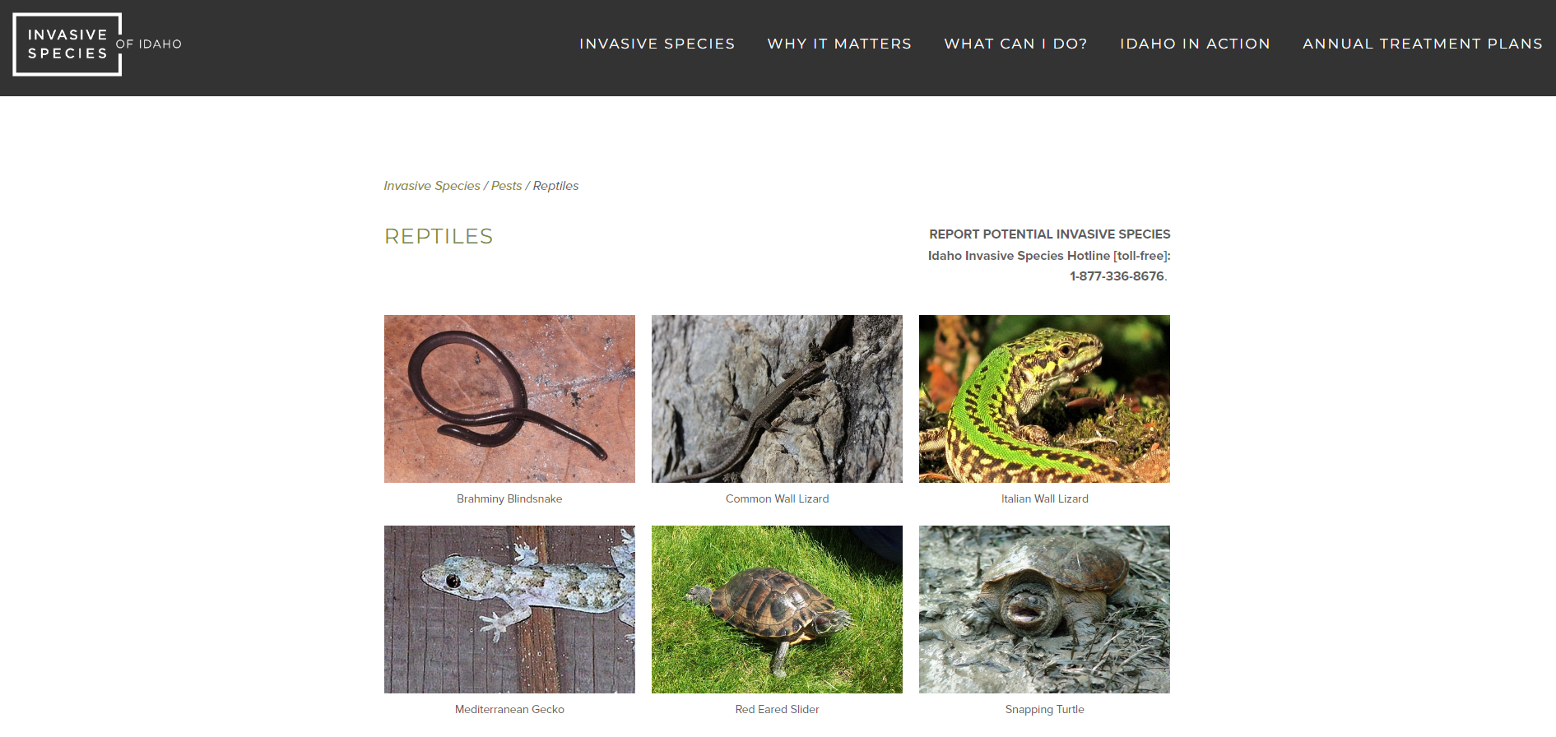


Slide 7
The Idaho Invasive Species Act https://legislature.idaho.gov/statutesrules/idstat/Title22/T22CH19/
To address the concerns about the increasing threat of invasive species by providing policy direction, planning and authority to combat invasive species infestations throughout the state and to prevent the introduction of new species that may be harmful.
Prevention, early detection, rapid response and eradication are the most effective and least costly strategies against invasive species.
Allows for access, inspection, treating, destroying, etc. of any invasive species on public or private property in this state.

Slide 8
Why are they an issue?
Not here originally, likely introduced through the pet trade
Will eat virtually anything they can fit in their mouth: amphibians, reptiles, waterfowl, fish and other native species
Outcompete and displace native species
Potentially aggressive and dangerous to humans and pets
Could cause more issues if allowed to spread

Slide 9
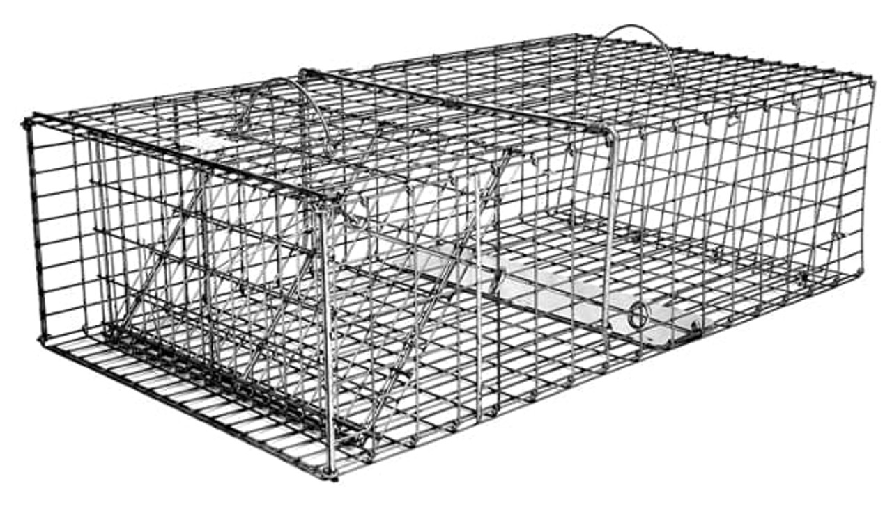
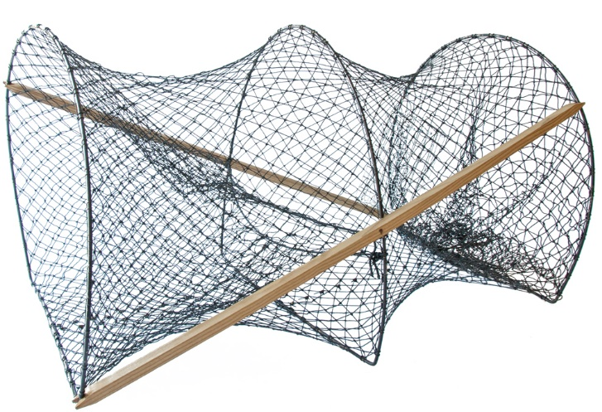
Removal Methods
Public/local Reporting
Catch by hand
Trapping
Draining of ponds to locate and remove
Unprotected wildlife: can be caught/removed by public
Possible other methods

Slide 10
Please Report Turtle Sightings
Idaho Department of Fish and Game
  Coeur d’Alene Office: 208-769-1414
  Casey McCormack: 208-770-3789 casey.mccormack@idfg.idaho.gov
Idaho Invasive Species Hotline [toll-free]: 1-877-336-8676.

