Slide 1
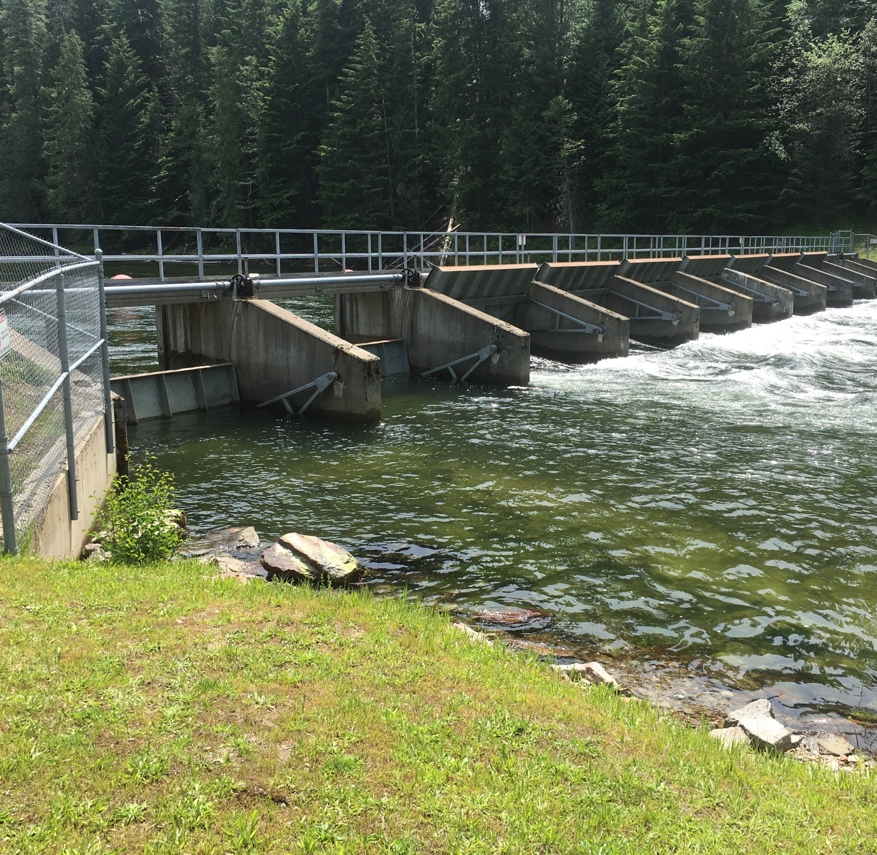
Priest Lake Outlet Dam, Operations Update October 2022
Michelle Richman,
Idaho Department of Water Resources

Slide 2
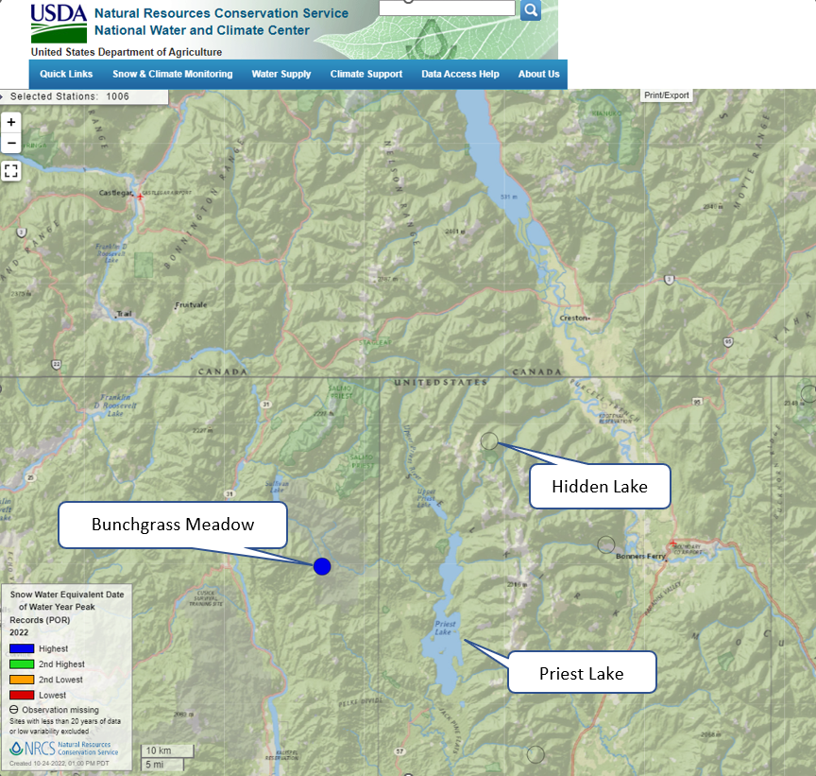
Snotel Sites
Hidden Lake and Bunchgrass Meadow

Slide 3
Snotel Sites
This year broke the record for the latest peak snowpack in the 39 years that Bunchgrass has been recording data

Slide 4
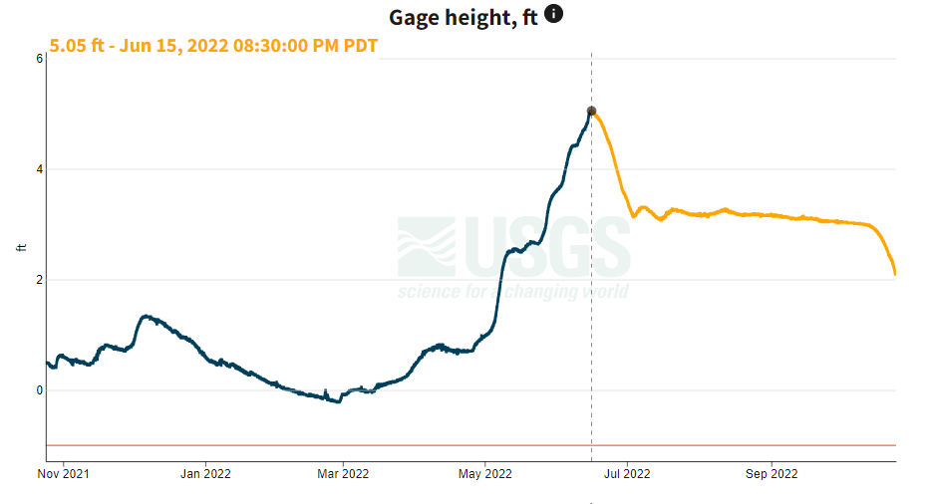
Priest Lake at Outlet 2021-2022

Slide 5
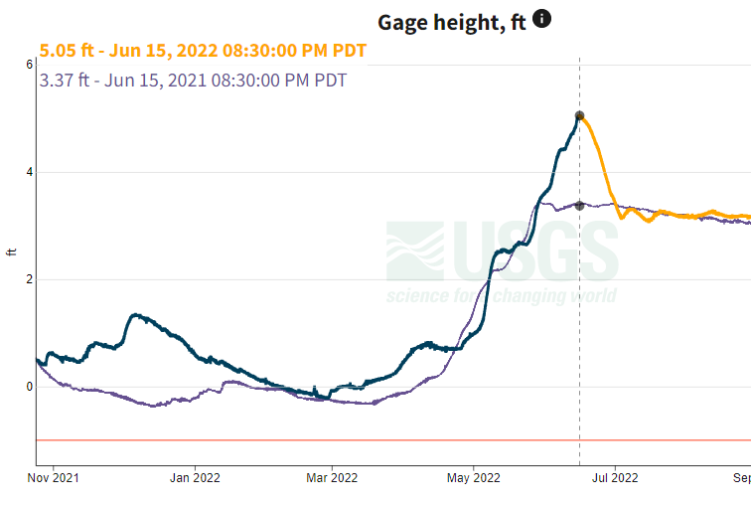
Priest Lake at Outlet Compared to Last Year

Slide 6
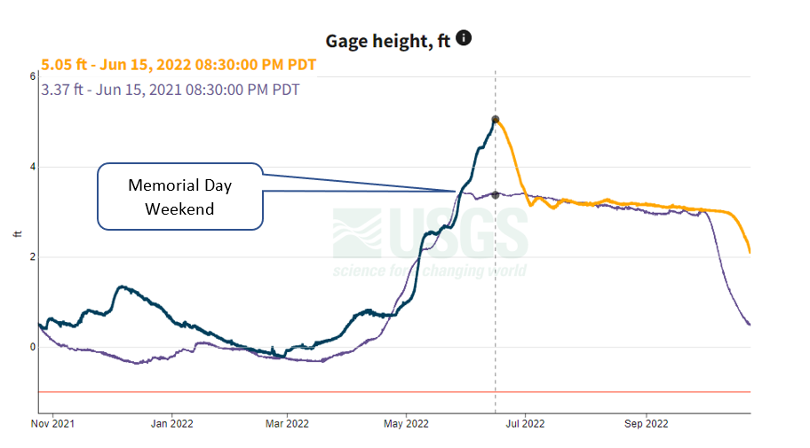
Memorial Day Weekend ahead of Peak!!

Slide 7
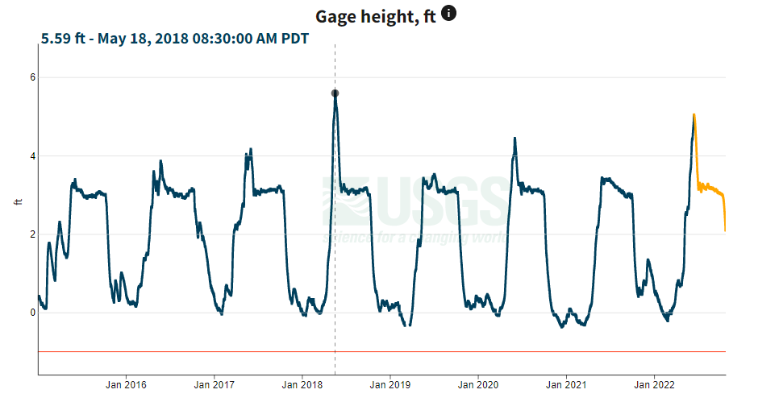
Historical Peak Lake Level - 2018

