Slide 1

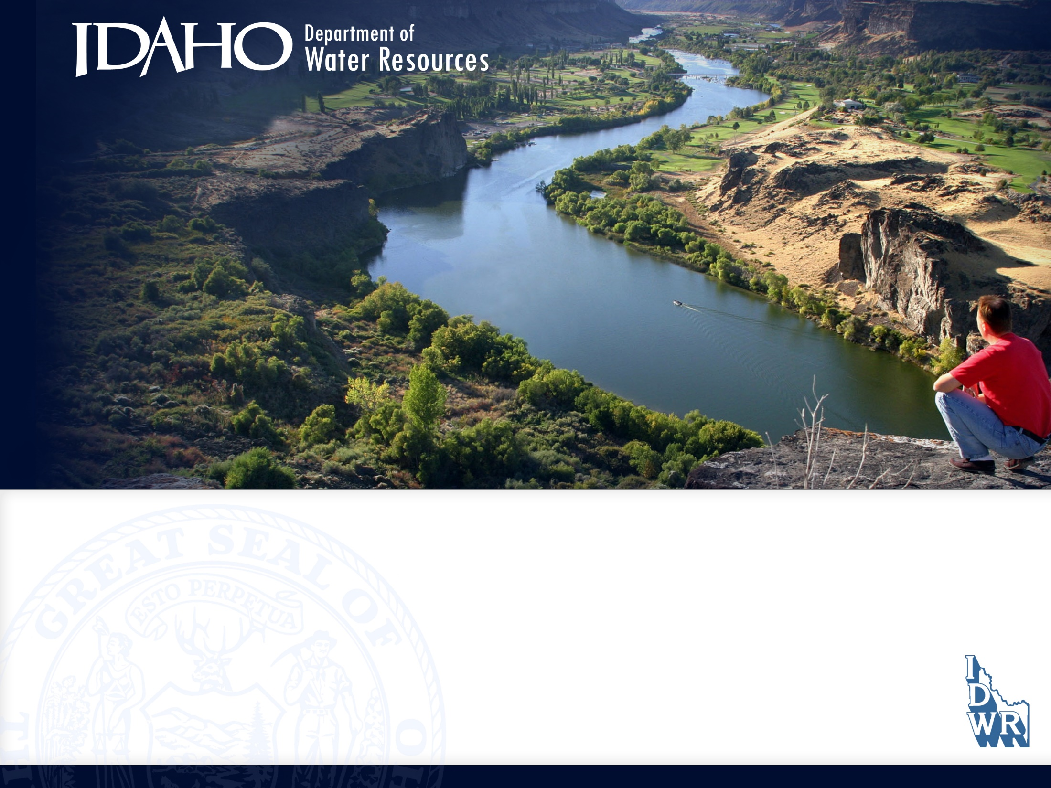
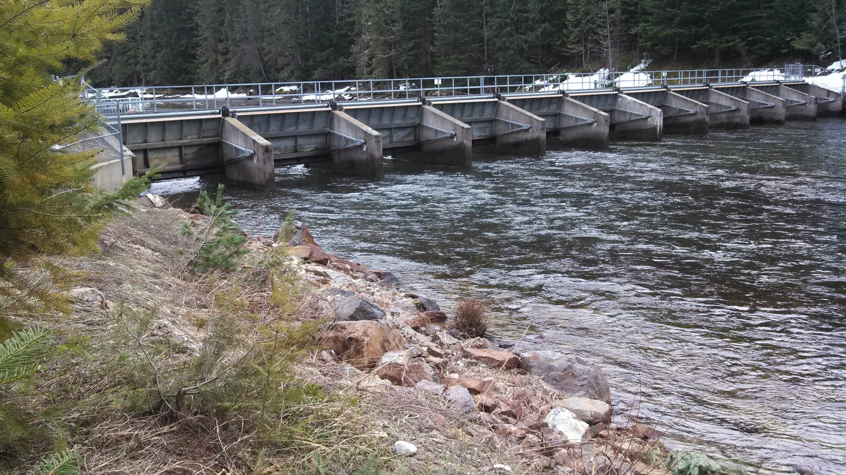

Priest Lake 2022 Water Supply Forecast & Operations Information
Date: May 9, 2022

Slide 2
Overview
Hydrology Report (Kara Ferguson)
  SNOTEL Site Conditions
  Volume Forecast
  Peak Streamflow Timing
Outlet Dam Operations Update (Michelle Richman)
Outlet Dam Construction Update (Neeley Miller)

Slide 3
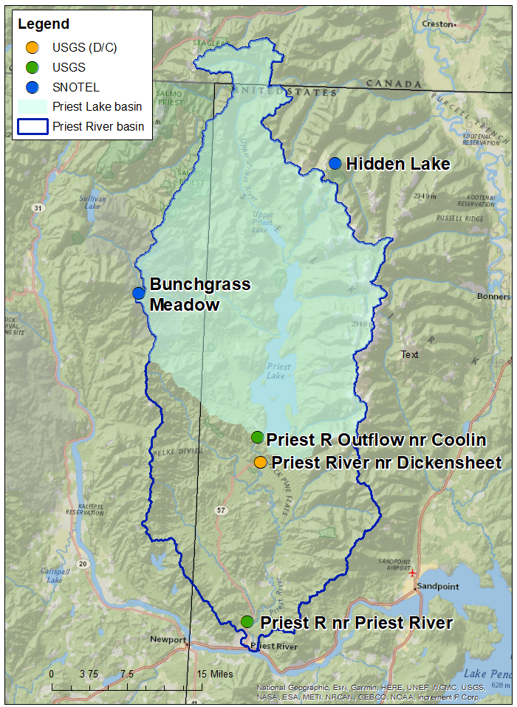
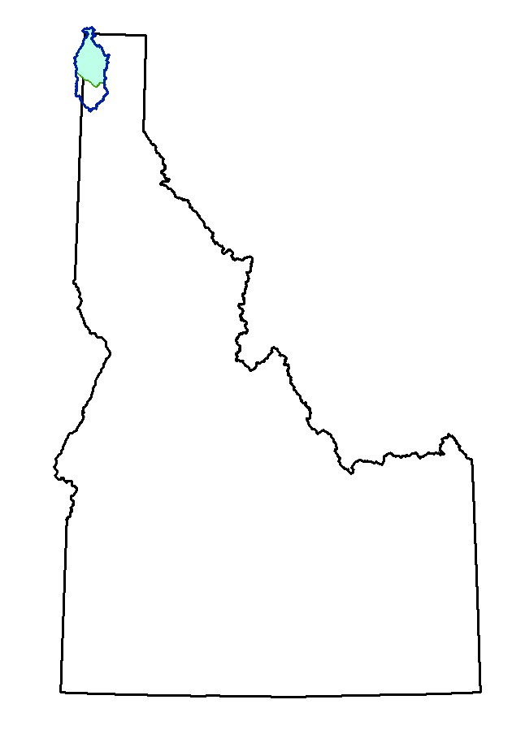
Basin Information
USGS Streamgage Stations:
Priest River Outflow near Coolin
(12393501)
Priest River near Coolin (Dickensheet)
(12394000 – discontinued)
Priest River near Priest River
(12395000)
NRCS SNOTEL Sites:
Bunchgrass Meadow
Hidden Lake

Slide 4
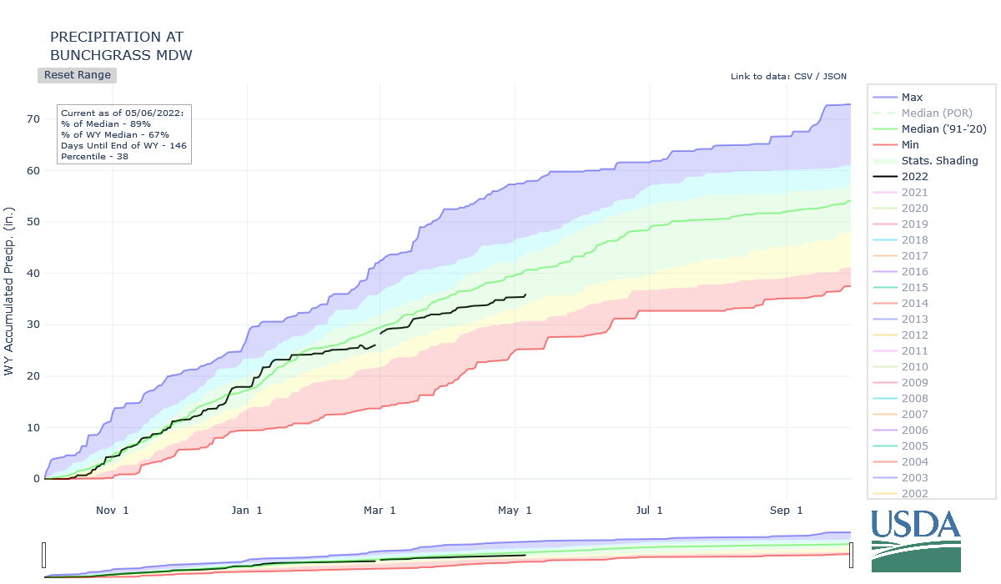
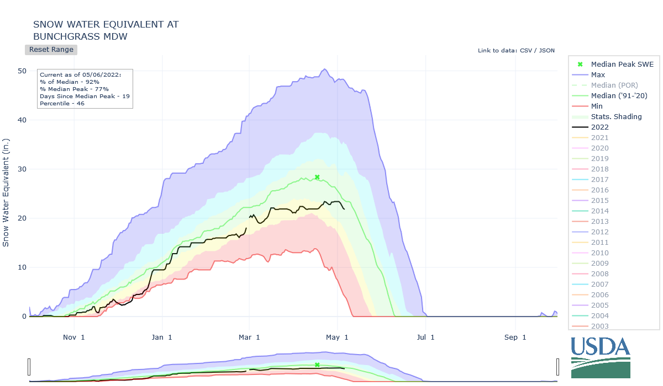
Bunchgrass Meadow SNOTEL
Snow Water Equivalent (SWE)
Precipitation
Nov 1 Jan 1 Mar 1 May 1 Jul 1
Nov 1 Jan 1 Mar 1 May 1 Jul 1
Below Average SWE
  Peak SWE (23.4 in.) on 5/2
  82% of average
Below Average Precipitation
  March – 76% of average
  April – 74% of average

Slide 5
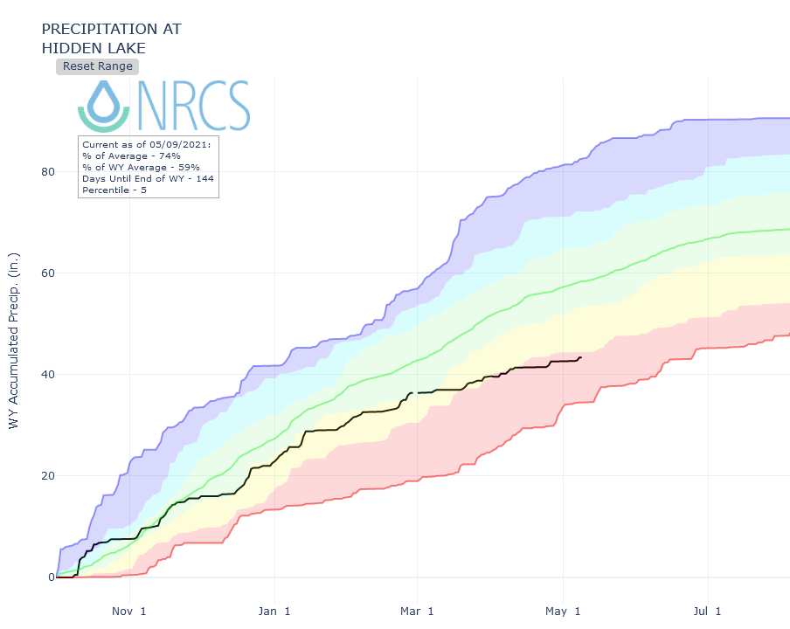
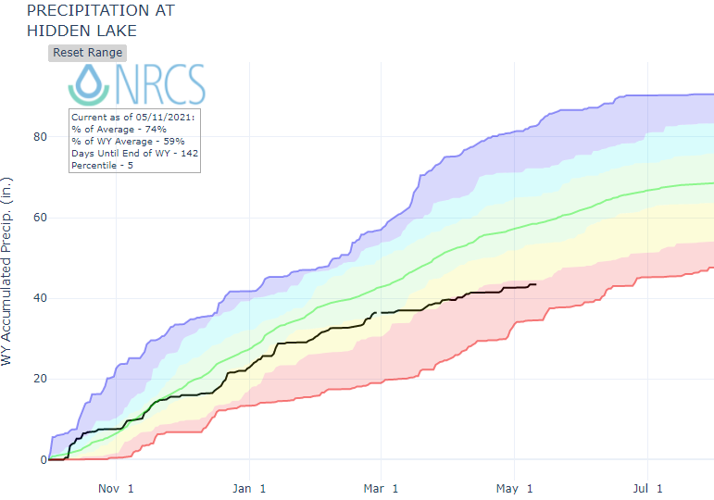
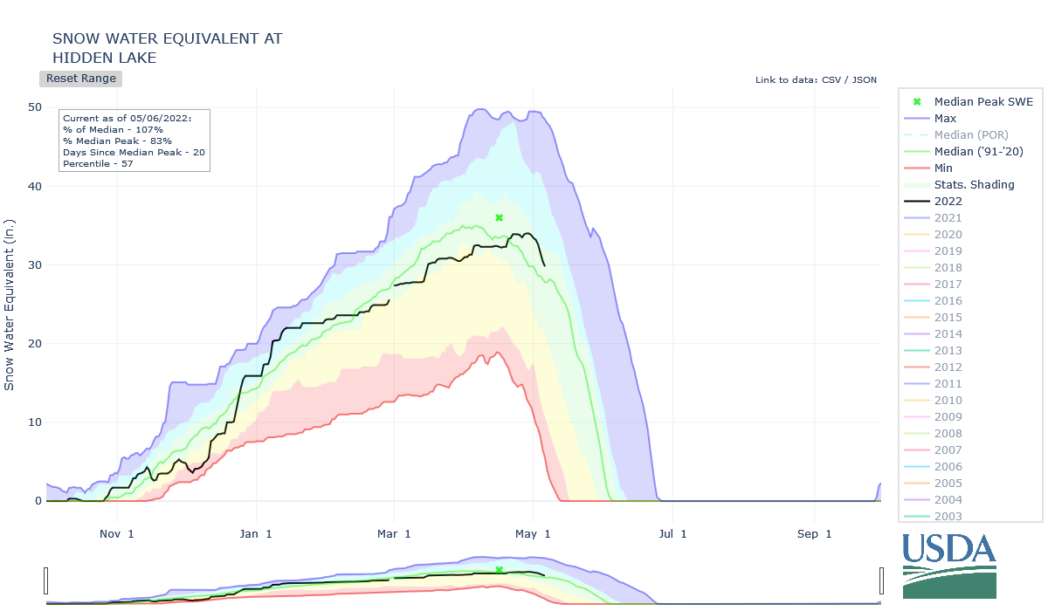
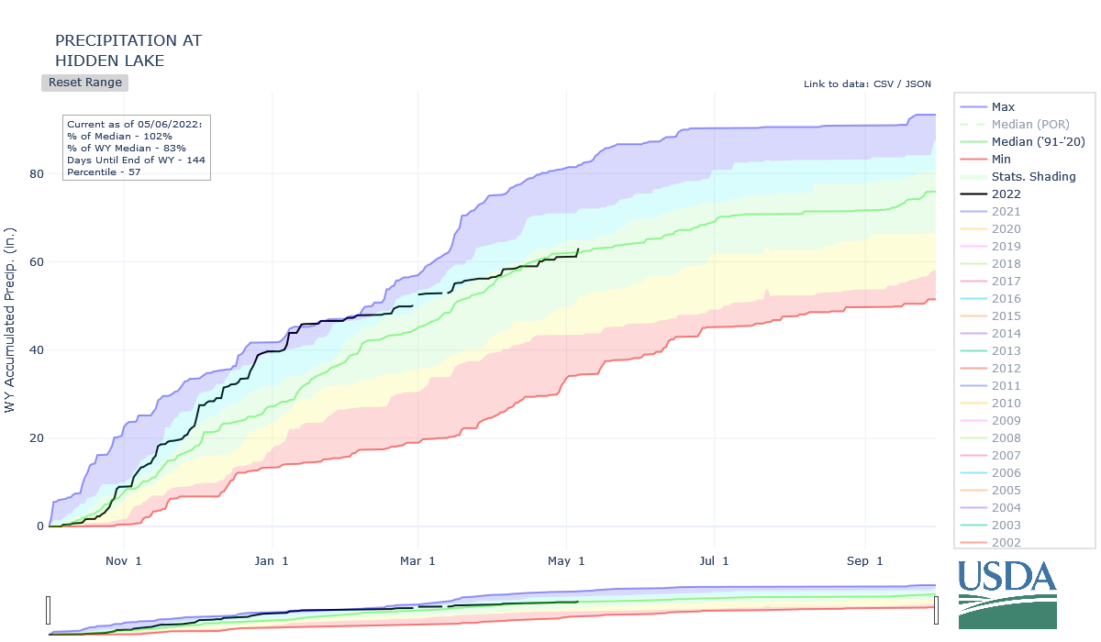
Hidden Lake SNOTEL
Snow Water Equivalent (SWE)
Precipitation
Nov 1 Jan 1 Mar 1 May 1 Jul 1
Nov 1 Jan 1 Mar 1 May 1 Jul 1
Below Average SWE
  Peak SWE (34 in.) on 4/29
  94% of average
Average Precipitation
  March – 47% of average
  April – 75% of average

Slide 6
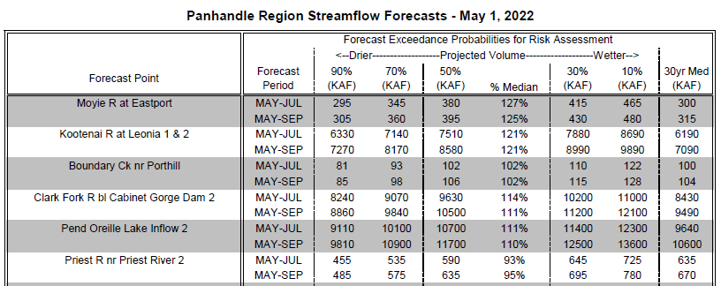
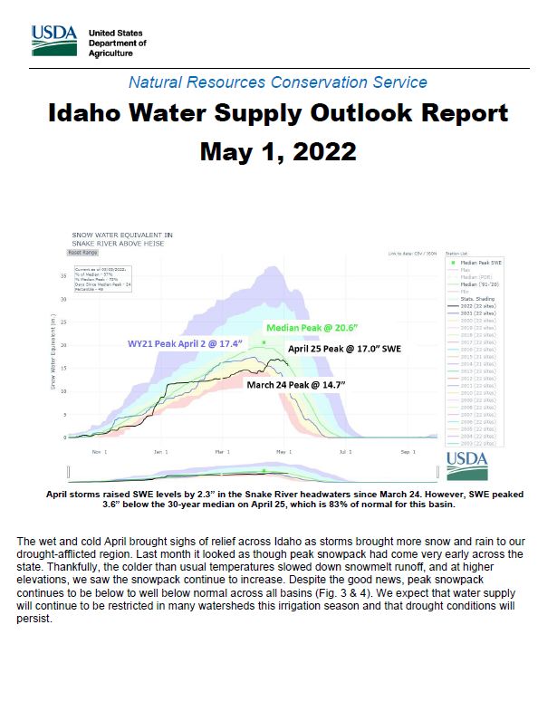
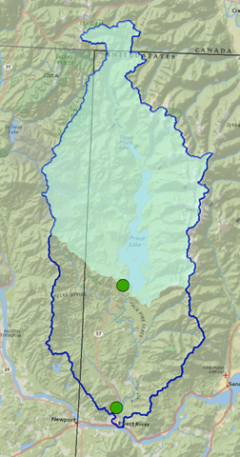
NRCS
May-September Streamflow Volume Forecasts
Priest R Outflow nr Coolin
Priest R nr Priest River

Slide 7
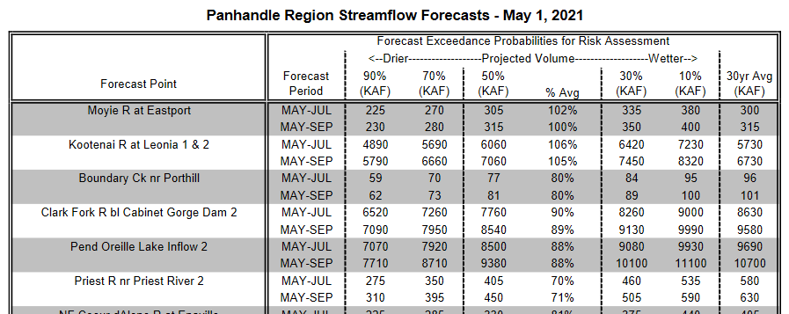
IDWR
May-September Streamflow Volume Forecasts
Priest Lake Outflow nr Coolin
MAY-SEP
385 458
506 105
555 623
481
MAY-SEP
Calculated from linear regression equation and NRCS May 1 Forecast for Priest R nr Priest River
Priest R Outflow nr Coolin
Priest R nr Priest River

Slide 9
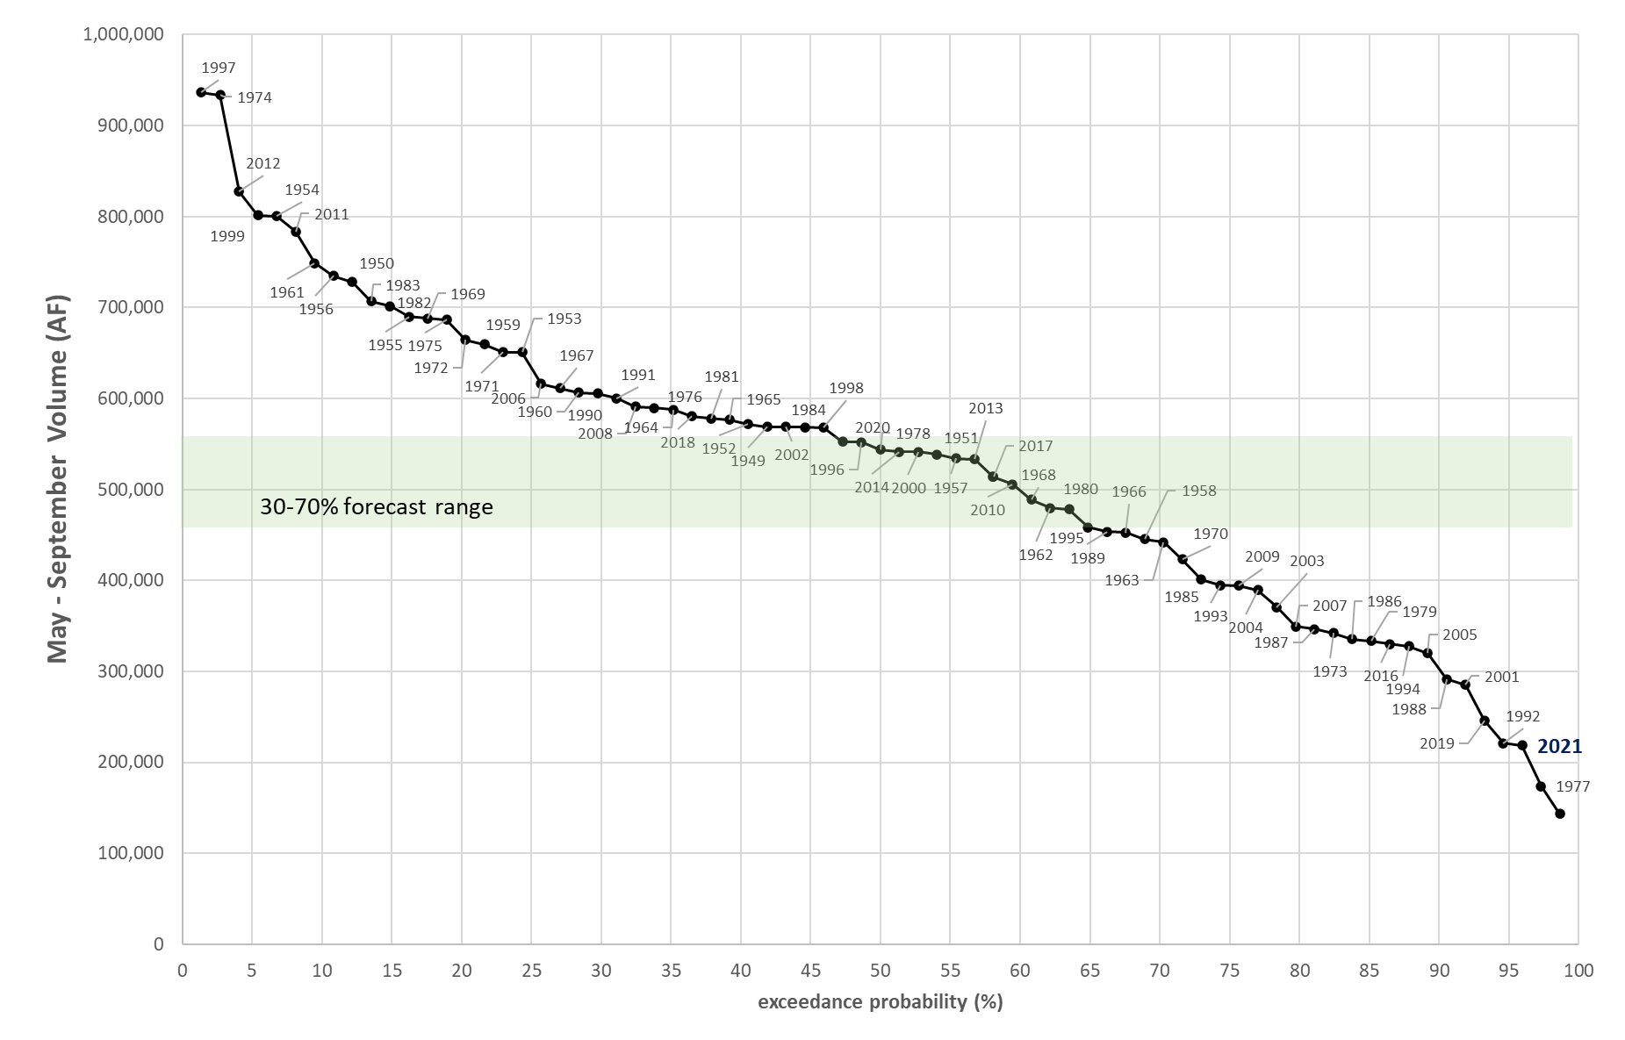
Wet & Normal
Dry
Very Dry

Slide 10
Peak Streamflow Timing
On average, peak flow occurs at 60% melt-out

Slide 11
Outlet Dam Minimum Lake Elevation Operations

Slide 12
Questions?
Contact:
Neeley Miller
Senior Planner, Idaho Department of Water Resources
Email: neeley.miller@idwr.idaho.gov
Phone: 208-287-4831

