Slide 1
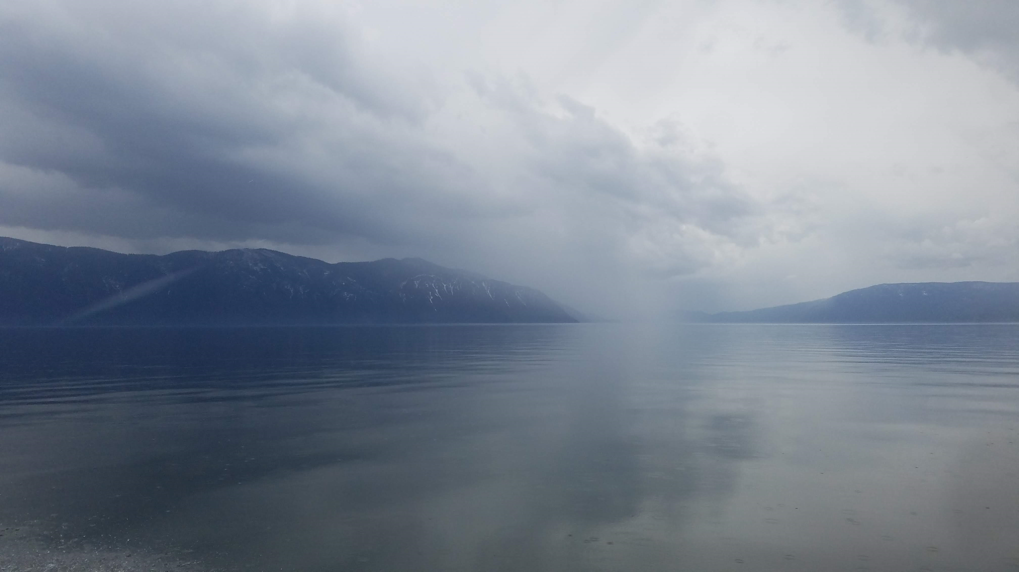
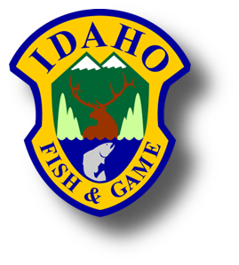
Lake Pend Oreille Fishery Update
Andy Dux
Lakes Commission Meeting
Sandpoint, ID
May 9th, 2022

Slide 2
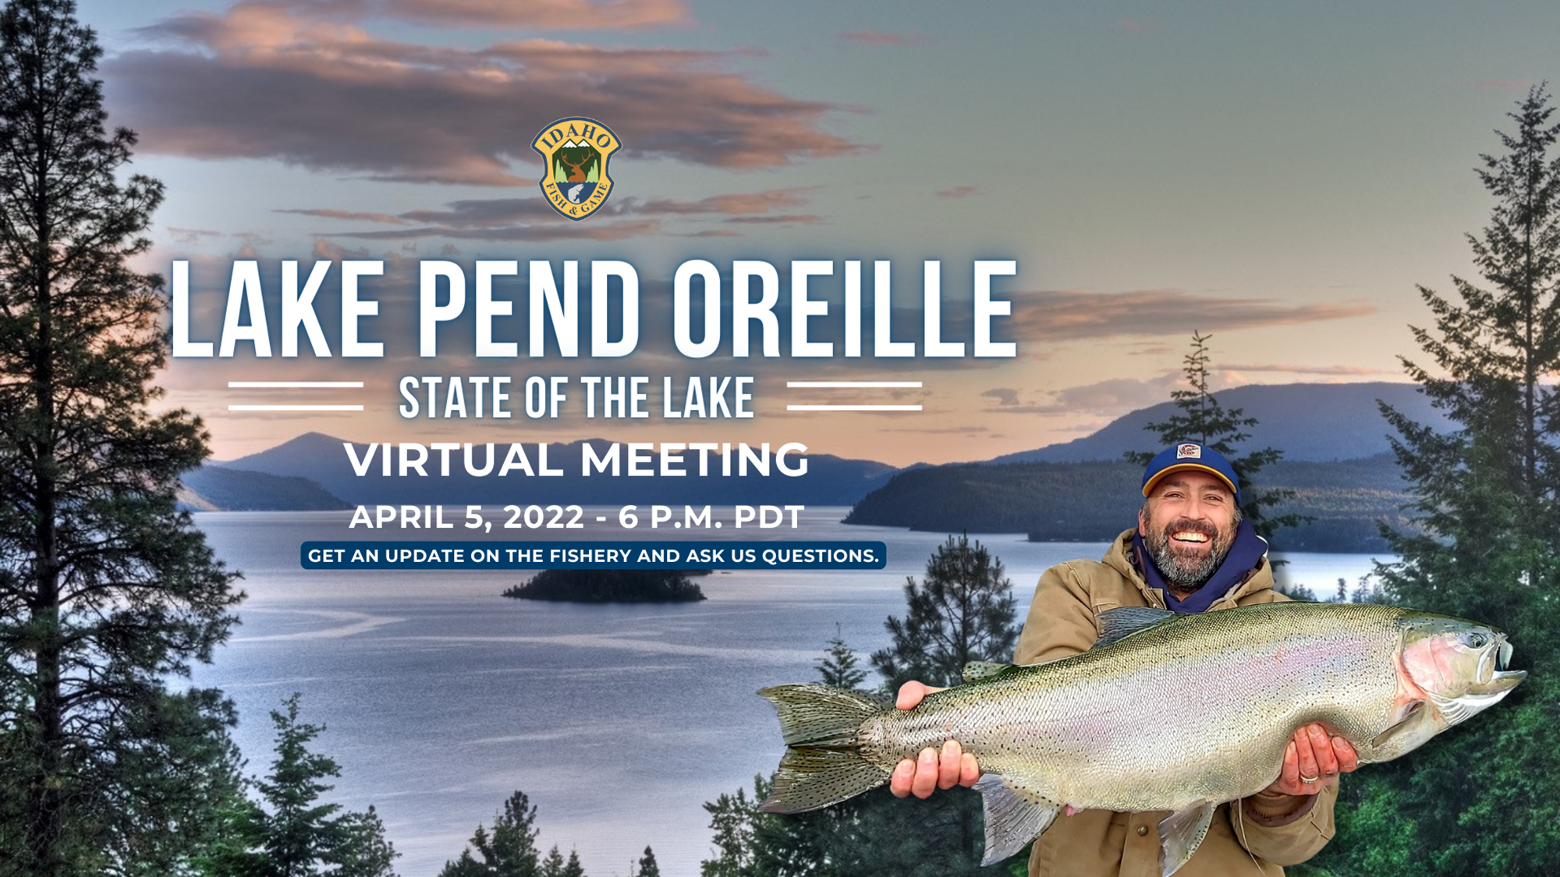

Slide 3
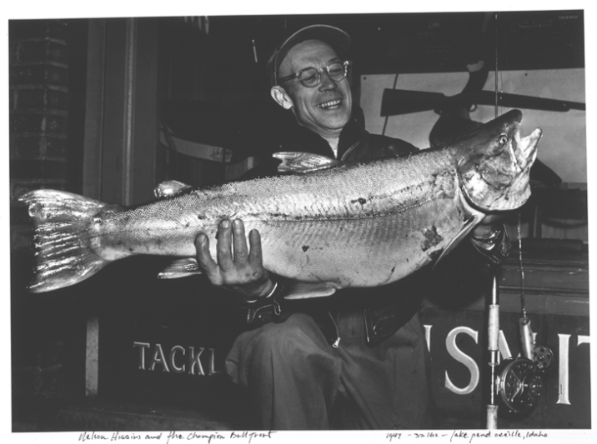
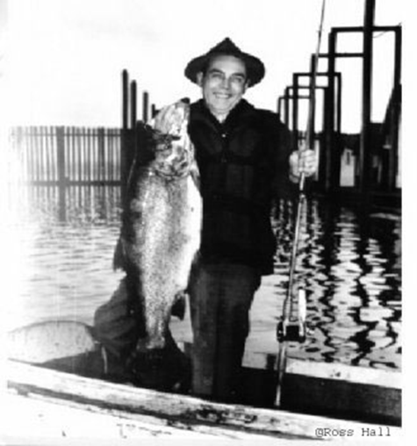
Traditional LPO Fishery
Bull Trout – native (ESA listed)
Westslope Cutthroat Trout - native
Kokanee – established in 1930s
  Historically supported most popular fishery in Idaho
  Primary prey source for predators
Gerrard Rainbow Trout – introduced in 1941
1949 world-record bull trout, 32 lbs.
1947 world-record rainbow, 37 lbs.

Slide 4
Expanded Fishing Opportunity
Numerous non-native species are now established
Most appear compatible with traditional fishery
  Smallmouth Bass, Largemouth Bass, Panfish, Brown Trout, Lake Whitefish, etc.
  Add recreational value to fishery
Three species are a threat to traditional fishery
  Lake Trout, Walleye, Northern Pike
  We manage against these species
Notes:
Fishing has improved greatly in Lake Pend Oreille over the past decade thanks to recovery of the traditional fishery. But fishing opportunity has also expanded over that time frame as a result of additional nonnative species that have become established. One of the challenges that we deal with is determining which nonnative species we can manage for and which species we need to manage against. I think this is often a source of confusion amongst anglers so I like to provide some background on how we approach this. There are some nonnative species that have been established for decades, such as kokanee and rainbow trout. These are species that we have observed can coexist with native species, provide expanded recreational angling opportunity, and allow us to manage for a sustainable fishery over the long term. The good news is that most of the non-native species that are now in the lake are largely compatible with our fishery management goals. In addition to kokanee and rainbow trout, examples included Smallmouth bass, largemouth bass, panfish, brown trout, and lake whitefish. These species add recreational angling diversity to the fishery and that’s a good thing that anglers appreciate. However, there are three nonnatives in the system, lake trout, walleye, and northern pike, that are a threat to the sustainability of the fishery over the long-term. As a result We have to manage against these species. That doesn’t mean these species will go away entirely, they likely will continue to exist and provide fishing opportunity. But, our goal is to keep their populations at low density so they don’t become abundant enough to cause problems and jeopardize sustainability of the fishery.

Slide 5
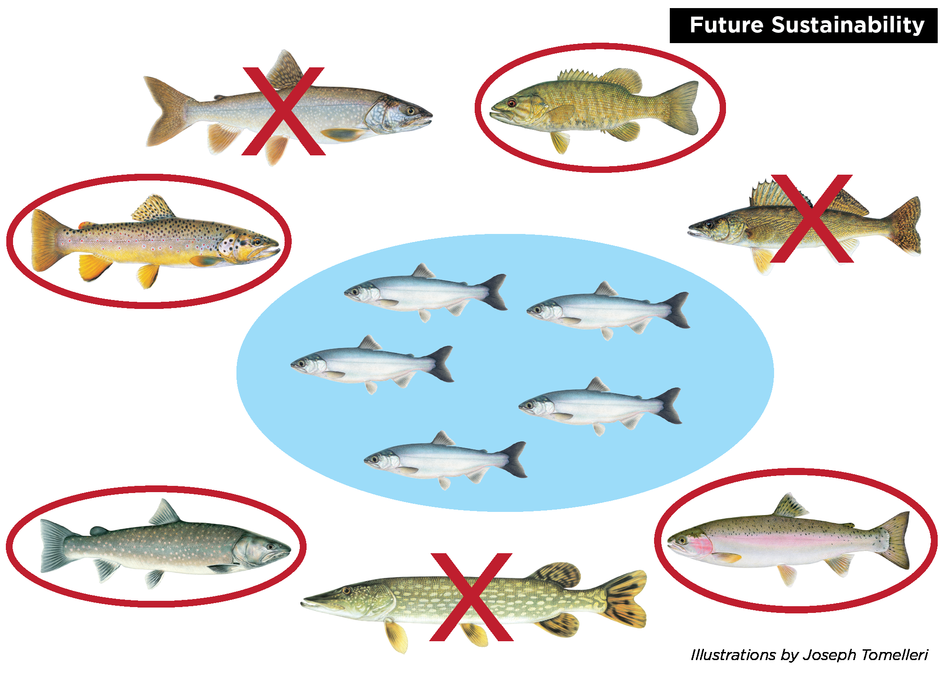
Managing for a Sustainable Fishery

Slide 6
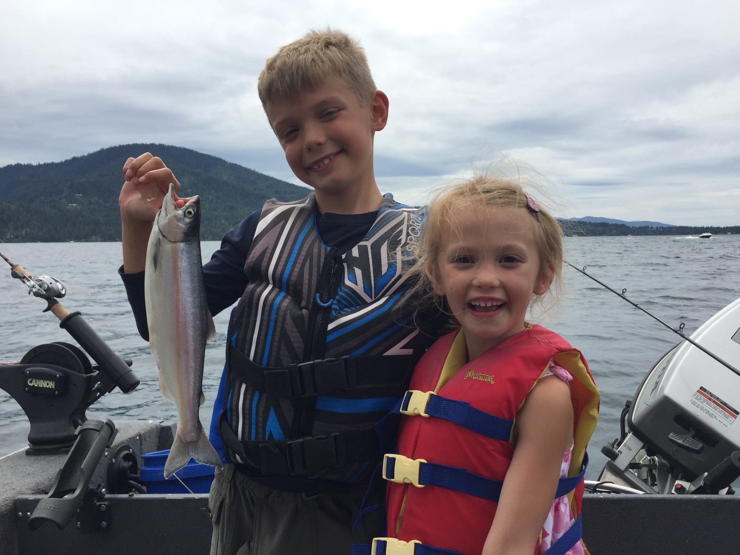
Kokanee Status
Notes:
So I’ll jump right into our status updates for several species in the lake. I do want to again thank our group of dedicated biologists that put a tremendous amount of hard work into collecting the data and developing the metrics that I am about to describe. And those metrics are what we use to manage the lake Pend Oreille Fishery.
So, I’ll start with the kokanee update, because kokanee are the cornerstone of the Lake Pend Oreille Fishery.

Slide 7
Kokanee Abundance Trend
Notes:
Now I want to show everyone a look at the total abundance of kokanee older than fry over the last couple of years. Evaluating total abundance tells us what is available for predatory fishes in the lake. Our surveys show that we continued to see high levels of Kokanee abundance in 2021, and we are sustaining (click) a strong enough population to support growth of predator species and a kokanee fishery.
This is good news because we are in a better situation than we were in years like 2019 when we had very high abundances which resulted in smaller kokanee that did not support a good fishery. One key thing to remember however, is that although high kokanee abundance are not so good for Kokanee fisheries, those years do create phenomenal conditions for growth of critters like Gerrard Rainbow Trout and Bull Trout and several other species in the lake utilize kokanee for at least some of their diet.

Slide 8
Adult Kokanee Size
10 inch fish
Notes:
Part of that was the fact that length and weight of the average fish rebounded some to go along with those higher abundances. In this figure, the orange line is the trend in weight and the blue line is the trend in length of an Age-3 kokanee, which is the typical age at which Lake Pend Oreille Kokanee Mature. The red line represents a 10 inch fish, and is a good goal for the fishery. As you can see we’ve seen some small kokanee in the system, especially from 2017-2020. And as I mentioned before, abundant, small fish are great for predators to eat, but are obviously less desirable to fisherman. We saw average size improve last year in 2021 and we expect it to be at least as good, and likely a bit better, in 2022. So, fisherman should be optimistic that this next year will offer good kokanee fishing with both good catch rates and fish size.

Slide 9
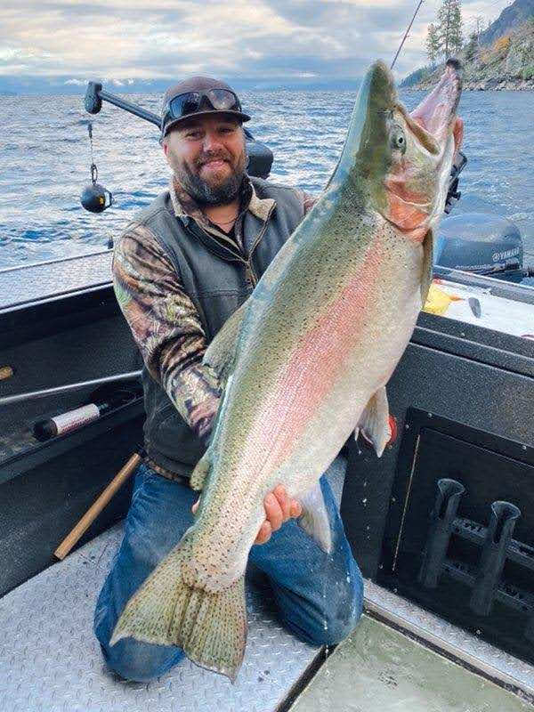
Rainbow Trout Status
Photo credit: Carrie Kedish
Notes:
This was very apparent by some of the information we received this past year when an angler turned in this derby winning fish at nearly 32 lbs and 39 inches in length. We were fortunate enough that the angler allowed us to pull aging structures from this fish and we aged it at 7 years old. This is tremendously fast growth and demonstrates how good the growing conditions are for rainbow trout right now.

Slide 10
Rainbow Trout Growth
28”
24”
Notes:
To show that a different way, in 2011, when kokanee biomass was lower than it is now, it took Rainbow Trout about 6 years to hit 24” it now takes Rainbow trout only around 4.5 years to hit 24”. And under recent conditions, a 6 year old rainbow trout is already exceeding 28”

Slide 11
Rainbow Catch Rates
Notes:
We are also seeing this increase in Rainbows over 30” as suppression netting has taken place. This trend suggests that the number of rainbow trout in the population is likely increasing. As I mentioned earlier, we are using angler logbook information to inform us how these fish are showing up in the fishery.

Slide 12
Rainbow Trout Fishery
Notes:
As another example of improved rainbow trout growth, we worked with Lake Pend Oreille Idaho Club to collect information on the number of “patch fish.”
Patches are a special award given by the club to anglers that catch 25 pound fish in Lake Pend Oreille. If you look here in the early 90’s, there was a great run of these tremendous 25 pound rainbows caught each year. But then there was a long drought and as kokanee abundance dried up so did the number of patch fish. We now see that this fishery has recovered its top-end trophy status, as there is an increasing trend in the number of patch fish that have been awarded in the last several years. In 2021, 11 patches were awarded, which is the 4th highest number in the past 45 years.

Slide 13
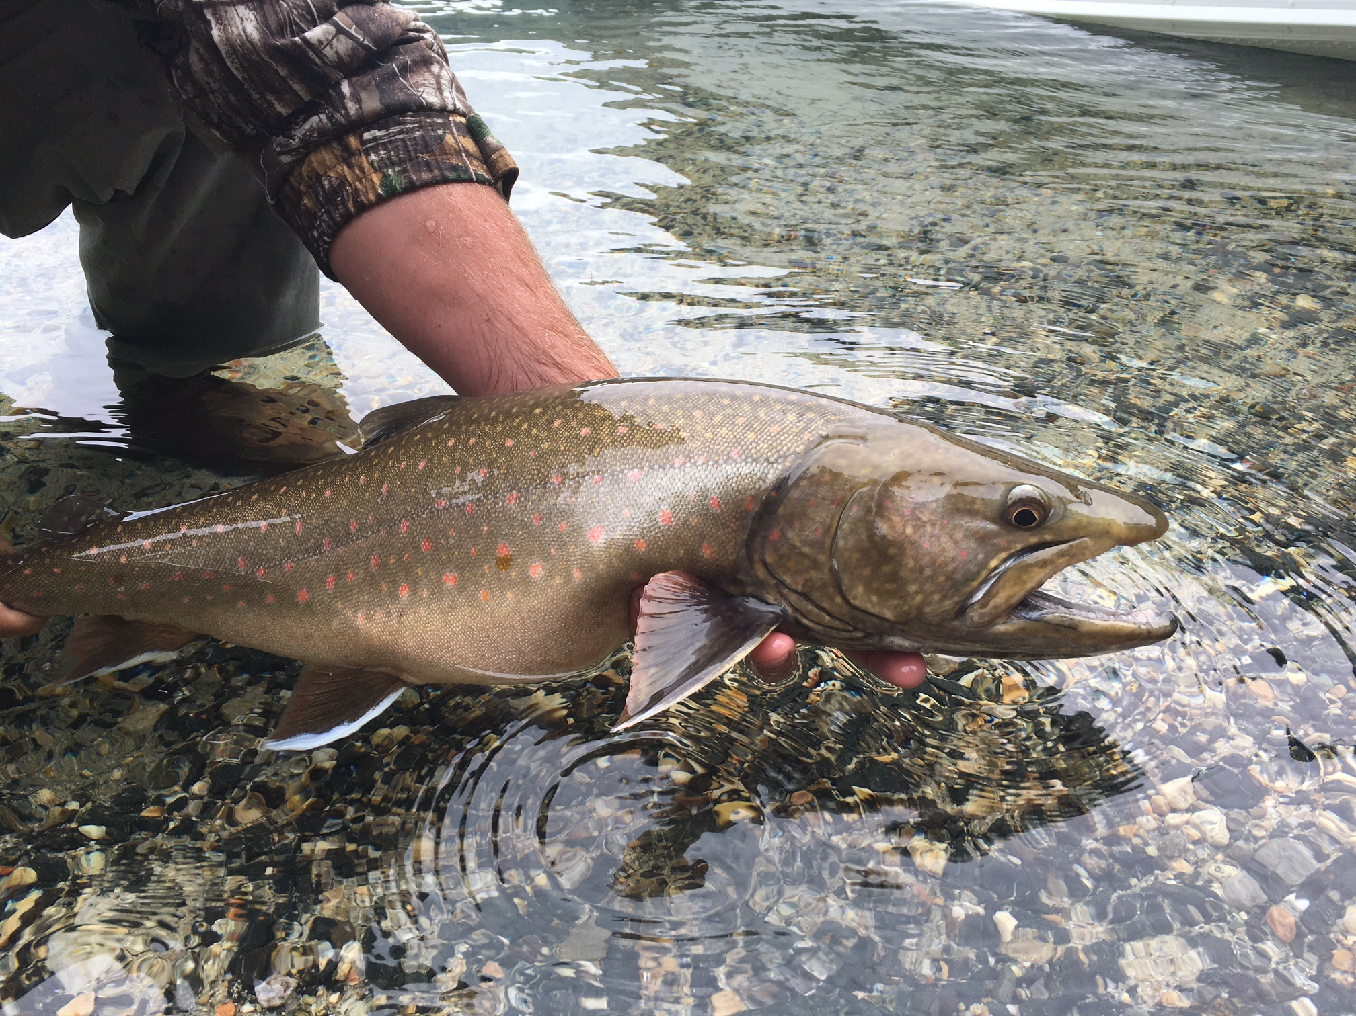
Bull Trout Status
Photo credit: Corey Comstock
Notes:
I’ll switch gears and talk just a minute about Bull Trout. Although they are listed as threatened under the endangered species act, Lake Pend Oreille supports one of the strongest populations in the country. While we don’t currently allow a harvest opportunity for Bull Trout in this system, they do add diversity to the fishery in the form of an outstanding catch and release fishery for a native fish that reaches trophy sizes. In fact, Pend Oreille produced a new state catch and release record Bull Trout last year, a 39” fish that unofficially weighed about 31 pounds. This fish was within a pound of the current world record bull trout, caught from the lake in 1949. As with rainbow trout, these fish can reach tremendous size when there is an abundant kokanee food supply.
Although we still use redd counts, or the number of spawning beds created by adults, as an index of abundance, we are now able to take full advantage of the fact that we can tag every bull trout we catch and release in our netting operations. Every bull trout we catch and release is tagged with a very small Passive Integrated Transponder or PIT tag, which is the same electronic tag technology used to evaluate salmon and steelhead fisheries. Being able to tag hundreds of bull trout annually during netting operations really increases our ability to monitor bull trout. In addition, our tributary monitoring program and Avista programs in Montana also tag bull trout as juveniles. After collecting multiple years of data, we are now able to integrate our redd count data with survival data from PIT tags to estimate abundances of multiple life stages in the fishery.

Slide 14
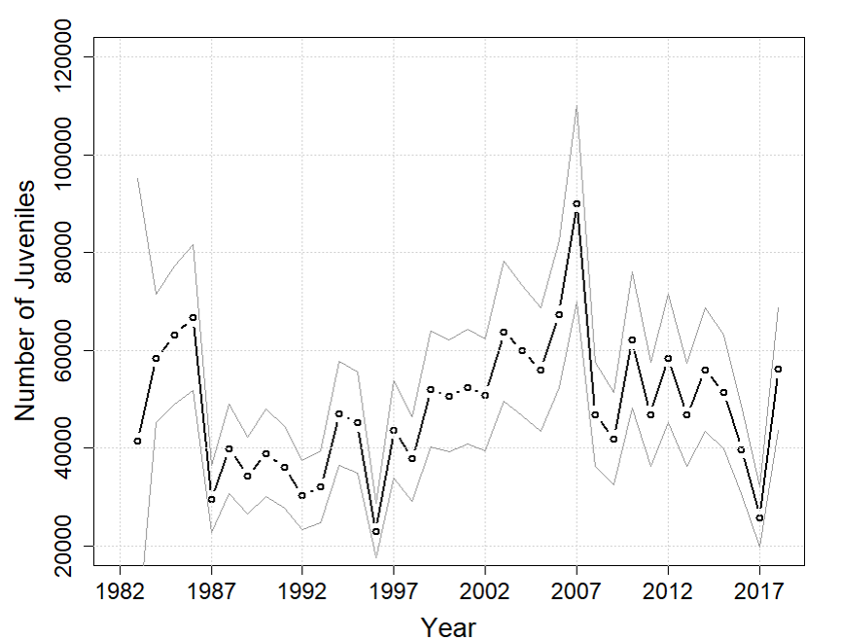
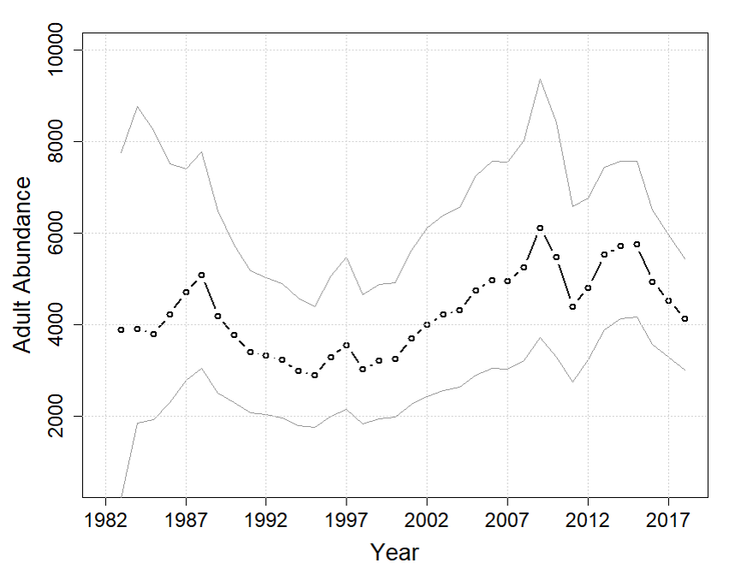
Bull Trout Adult Abundance
Juveniles
Adults
Notes:
The outcome of this analysis shows us that the trend in juvenile abundance (shown in the left figure) and the trend in adult abundance (as seen in the right figure) bounce around from year to year depending on the number of successful spawners or other environmental factors. But in general, the population is quite stable, with the number of adults hovering around 4,000 fish over the long term. These are the results of the model through 2018 and we will be updating this model in this coming year.

Slide 15
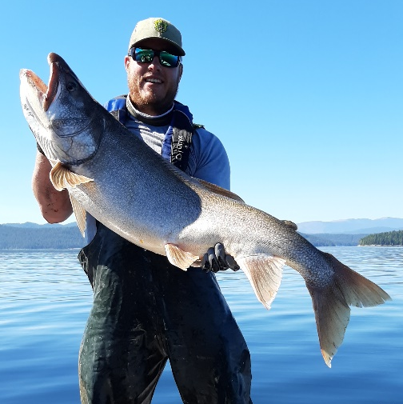
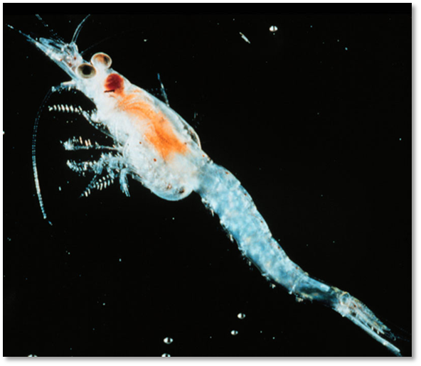
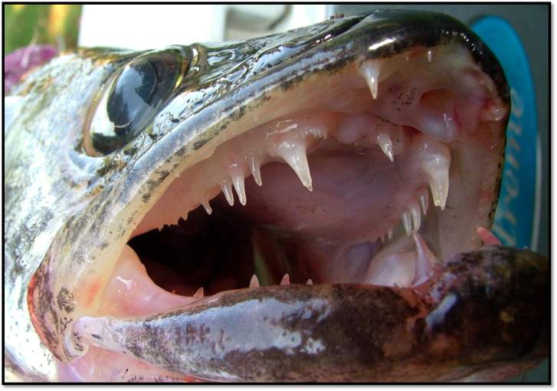
Threats to the Fishery
Notes:
Ok, now we’ll transition to our evaluation and monitoring of some of the threats to the sustainability of the LPO fishery: Lake Trout, Walleye, and Mysis shrimp.

Slide 16
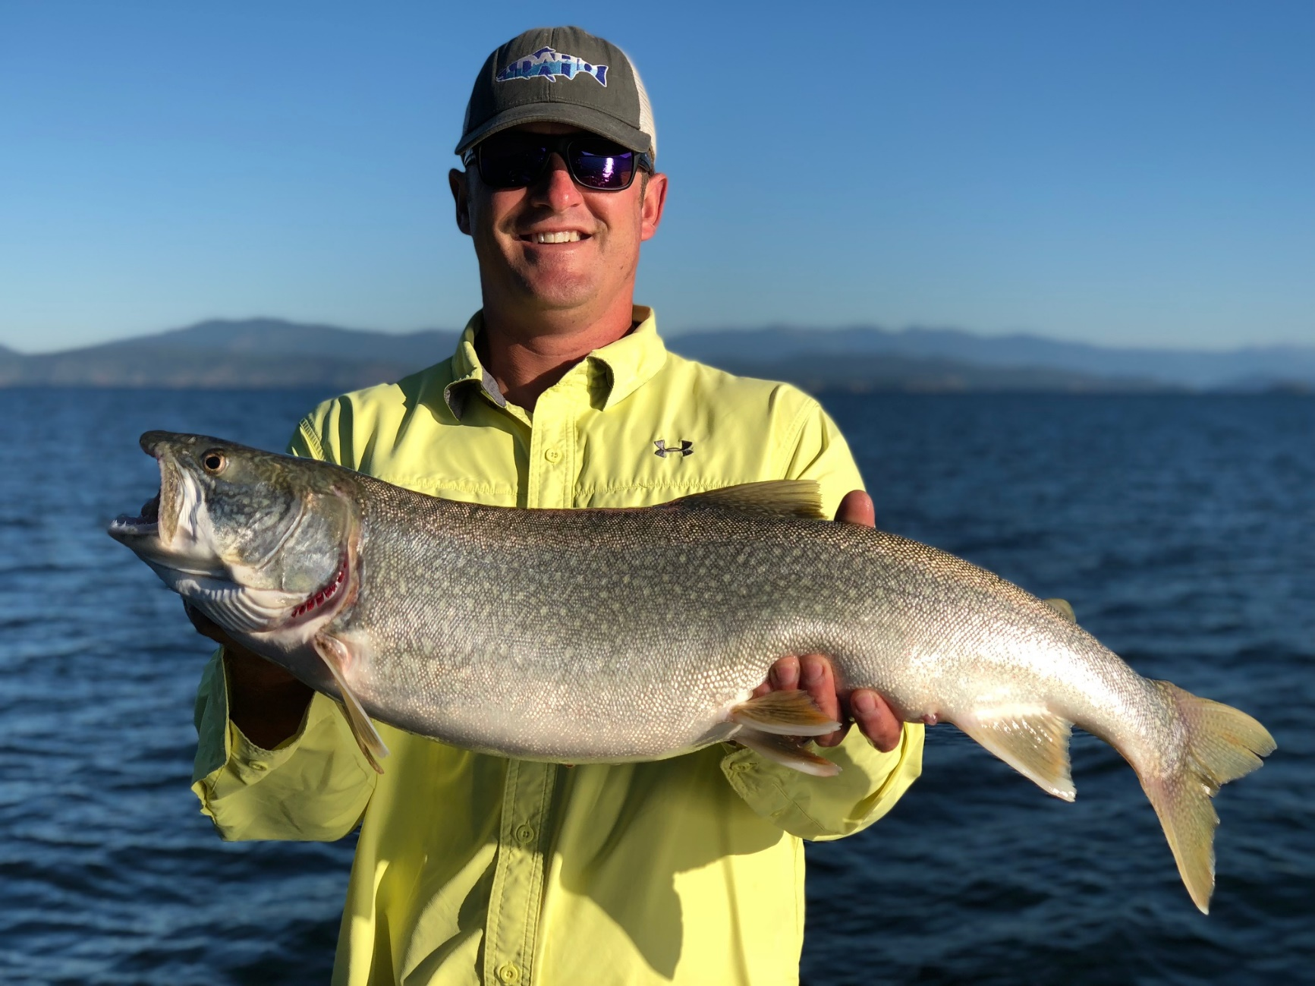
Lake Trout Status
Photo credit: Corey Comstock
Notes:
We’ll start with Lake Trout. We now have a long history of aggressively managing this species, and that management has paid dividends in terms of the quality of the fishing in Lake Pend Oreille. As Andy mentioned earlier, we have removed well over 275,000 Lake Trout to date.

Slide 17
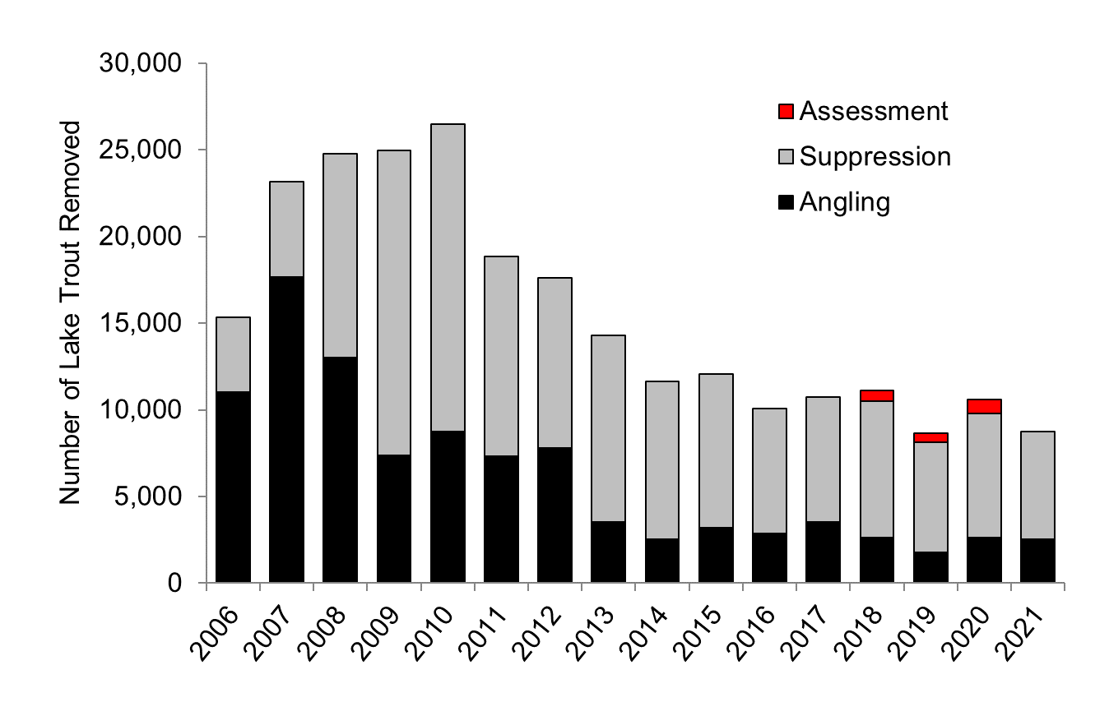
Lake Trout Removed

Slide 18
Lake Trout Abundance
84% Decline
Notes:
And we are seeing this translate into a steady decrease in total abundance in the lake. This figure shows the trend in estimated abundance of spawning-aged lake trout in Lake Pend Oreille through 2019. This model will be updated in 2022 with the most current age structure and survival estimates. As you can see in this figure, the abundance of adults peaked in 2005, and because of the netting efforts, we’ve seen a greater than 80% decline in abundance since that time.

Slide 19
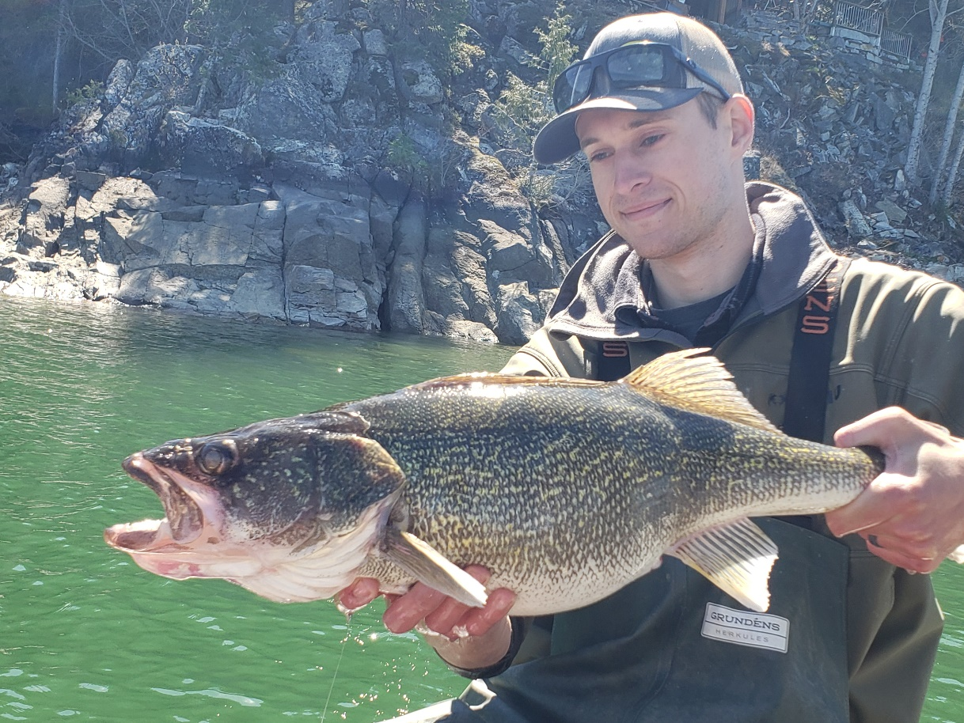
Walleye Status
Photo credit: Tyler Hoyt
Notes:
Now I’ll move from Lake Trout to spend some time updating you all on Walleye. Because we are still in the learning phases of walleye management, ecology, and suppression in Lake Pend Oreille, this is a focus of our research projects right now. Walleye can make it very difficult to manage a fishery, especially a salmonid-based fishery, if they are left to their own devices. Just to remind everyone, we are focusing research on walleye in Lake Pend Oreille and from Cabinet Gorge Dam on the Clark Fork River to Albeni Falls Dam on the Pend Oreille River.
My purpose today is to give a progress report on the suppression program. I’ll start by describing the number, location, size structure, and sex ratio of removals. In addition I’ll spend some time discussing what we’ve learned about distribution and movement.

Slide 20
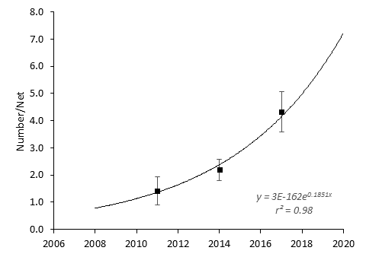
Walleye Population Status
Expectation
Observation
Notes:
As Andy showed earlier, our observation in the 2020 Fall Walleye Index Netting survey was, in fact, very encouraging, suggesting the population had declined to densities similar to those observed in 2014. This represented a 48% decline in mean density from 2017, and the 2020 point estimate is 65% less than what we hypothesized it would be if the population continuted growing. This is great news and a strong indication that the suppression program is working.

Slide 21
How Many Walleyes Removed?
Suppression Netting
Angler Incentive Program
Notes:
To date, the suppression program has resulted in the removal of more than 6800 walleyes since 2018. Catch rates in spring suppression netting have declined each year of the program, but angler removals have been stable. We believe angler contributions have held up because of the incentives offered as well as the fact that we have been putting out blogs with maps identifying the locations of acoustically tagged walleye throughout the lake and rivers. In addition, anglers are gaining experience in catching walleye in this system which also may be playing a roll in sustained catch rates. This should allow anglers to better target walleye. Overall, total removals have averaged 1700 fish per year from netting and angling.

Slide 22
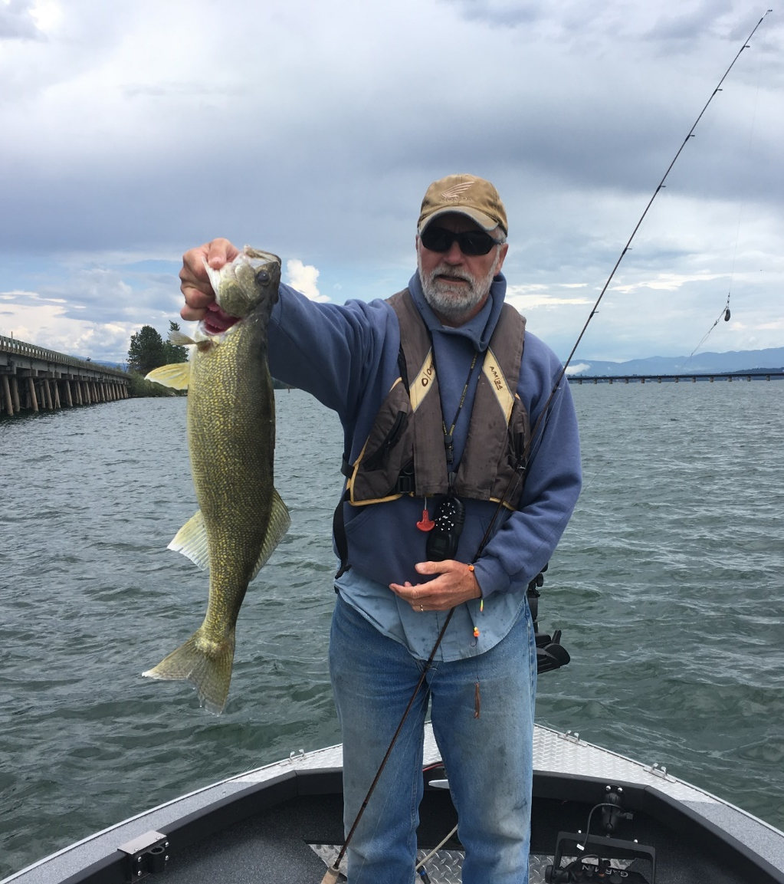
Angler Incentive Program: 2019-2021
~ 160 anglers participated annually
16 CWT fish caught ($1k reward)
$28,000 payout in monthly drawings
Photo credit: Caleb Wilson
Notes:
I wanted to take a quick second to highlight some of the other results of the Angler Incentive program since it began in 2019. About 160 anglers have participated each year. To date, 16 Coded wire tagged fish have been returned for $1,000 rewards. The program has payed out $28,000 in monthly drawings, and $34,000 total.
Our program works to keep coded wire tags in at least 100 fish at any one time and this past year 6 tags were turned in by anglers.

Slide 23
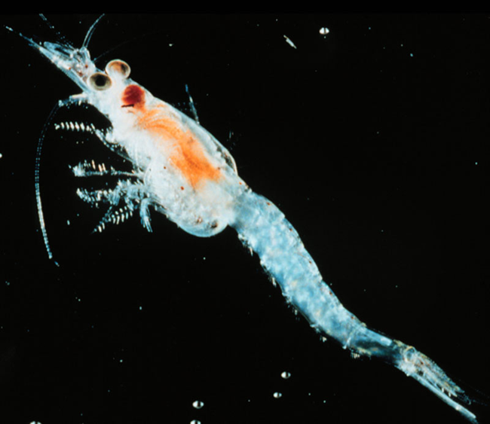
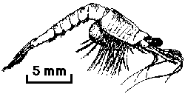
Mysid Shrimp Status
Introduced in LPO from 1966-1969
  Well-established by 1975
  High density sustained until 2011-12
Abundant food source for juvenile lake trout
Compete with kokanee for zooplankton
Notes:
Just to recap on some background on Mysis. They were introduced into the lake in the 1960s and became well established by 1975.
They were introduced into the Lake in the hopes they would be an abundant food source for Kokanee. Unfortunately, this was not the case and they wound up as a great food source for juvenile lake trout and competing with Kokanee for zooplankton.

Slide 24
Mysis Population Trend
Notes:
I’ll cut right to the chase. As of 2020, mysis abundances were still at a low density due to their apparent (click) crash starting in 2012, in the system, which was a very good thing for kokanee, the growth of all those predatory fish, and the fishery in general. The 2020 mysid densities were around 40% of the 1995-2011 trend. So things were optimal for Kokanee production.

Slide 25
Mysis Population Trend
Notes:
Fast forward to 2021, we saw a much higher average density than previous estimates….actually over double from last year and the highest since before the population collapsed in 2011-12. This is a concern and something we will be watching closely moving forward. We’ve been fortunate to have fewer mysis in the system for nearly a decade and this has benefitted kokanee. We expect that a fairly strong kokanee population can be sustained with more mysis present. However, the lake like won’t be able to support as many kokanee if mysis stay at higher densities into the future. This will give us less margin for error in terms of providing enough kokanee to support predator populations and a good kokanee fishery.

Slide 26
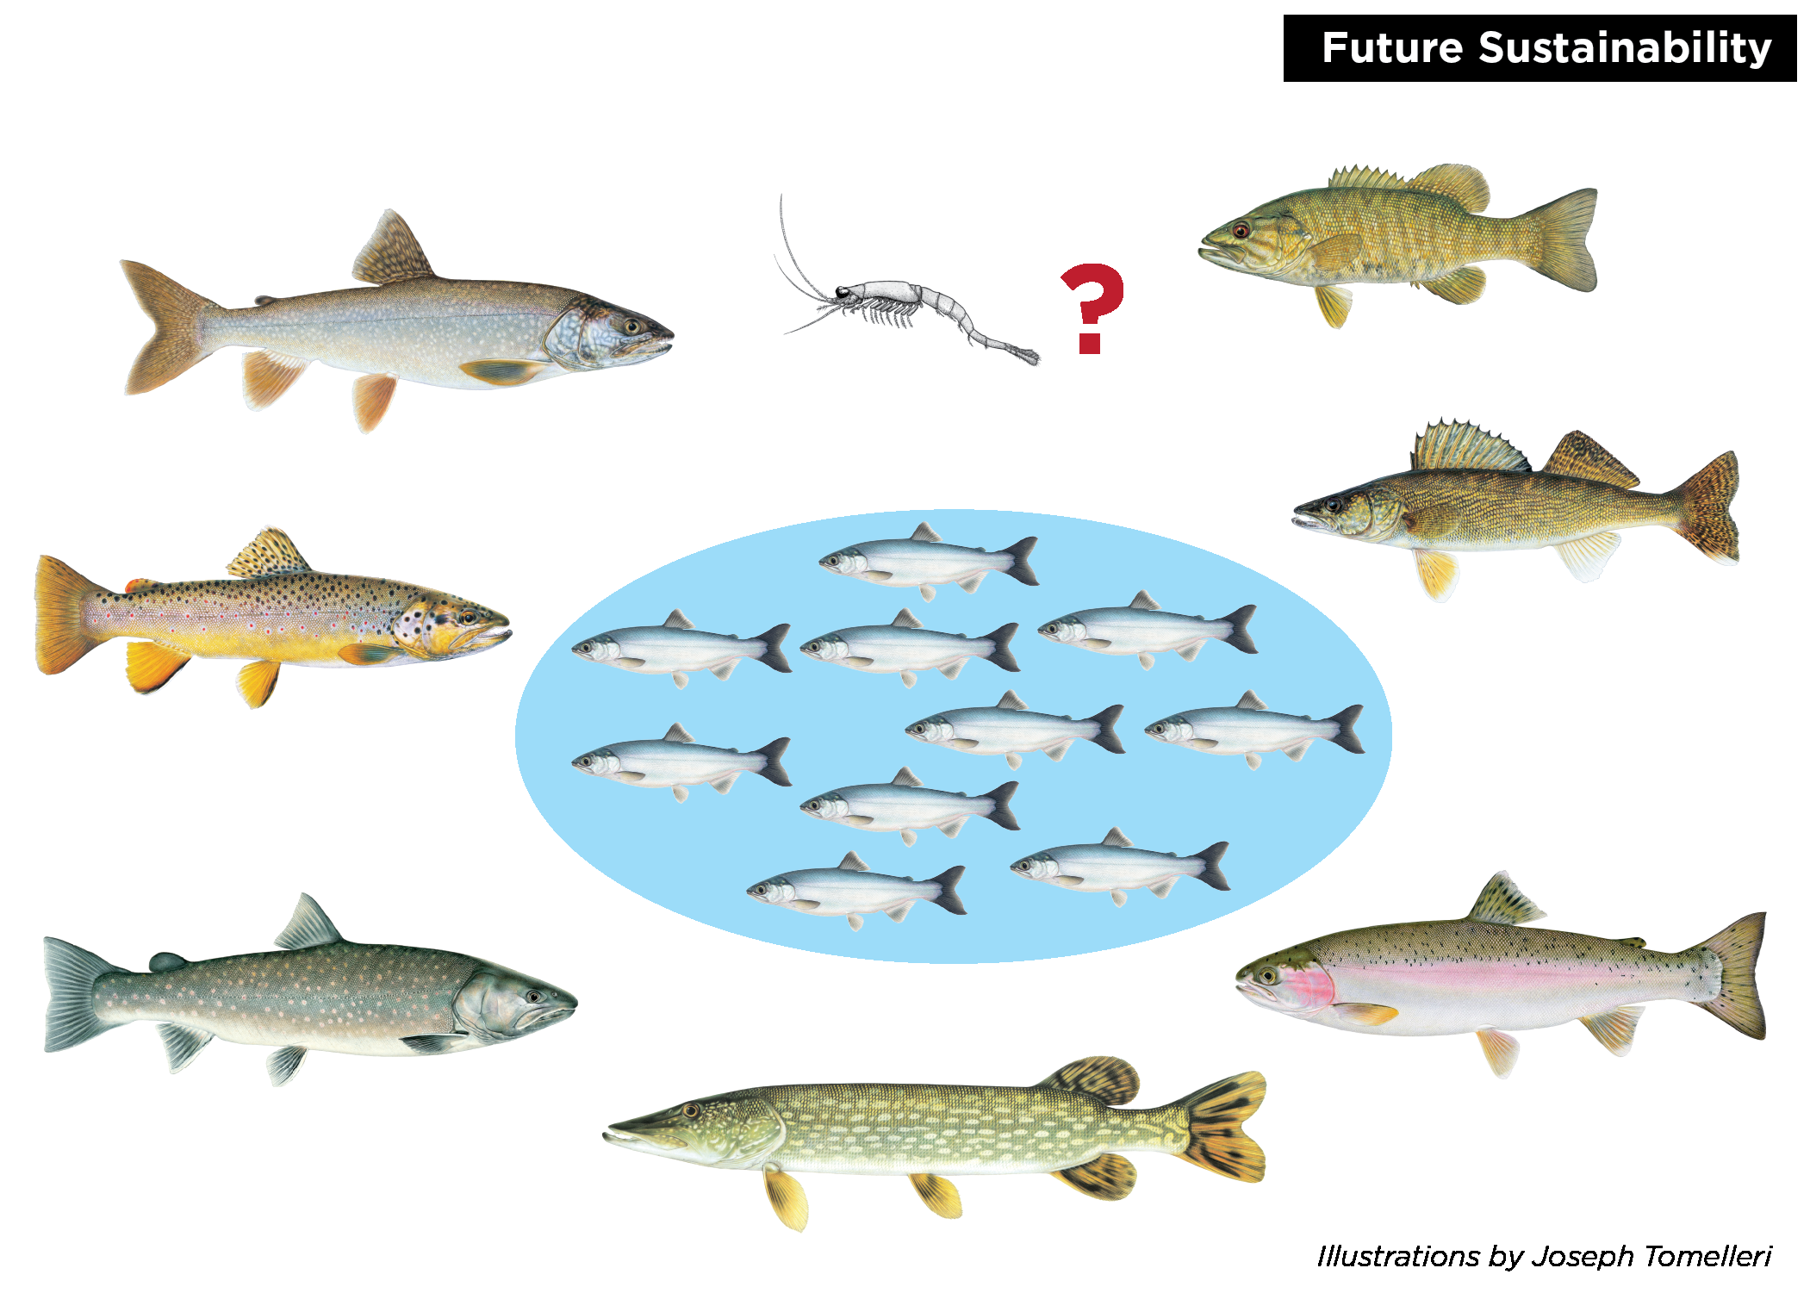
Food Web Implications
Notes:
If kokanee are cycle down when the lake is filled with large, longer-lived predators, it puts us at risk of the kokanee population declining again. If that happens, the trophy potential and abundance of all of these species would suffer, and we’d lose the characteristics of the Lake Pend Oreille fishery that make it special.

Slide 27
Overall Fishery Status
Kokanee population is strong
  Abundant food source for predators
  Providing popular fishing opportunity
Rainbow Trout population is strong
Bull Trout population strong
Lake Trout at low density
Walleye at low density
Mysid shrimp rebounding
Northern Pike trending upward?

Slide 28
Overall Fishery Status
Smallmouth Bass population is strong
Variety of other species contributing to fishery
  Yellow Perch, Brown Trout, Black Crappie, etc.
Fishery is performing at the highest level in decades
  Trophy potential of fishery is exceptional
  Diverse, mixed species fishing opportunity
Sustainability?
  Managing predation is critical

Slide 29
Future Direction
Population monitoring and research for multiple species
Continue Lake Trout suppression
  Netting and Angler Incentive Program
  Maintain level of effort but future reduction anticipated
Continue Walleye suppression
  Netting and Angler Incentive Program
Angler creel survey
Tributary habitat improvement and protection
Kokanee stocking
Continued emphasis on enforcement, education, and outreach

Slide 30

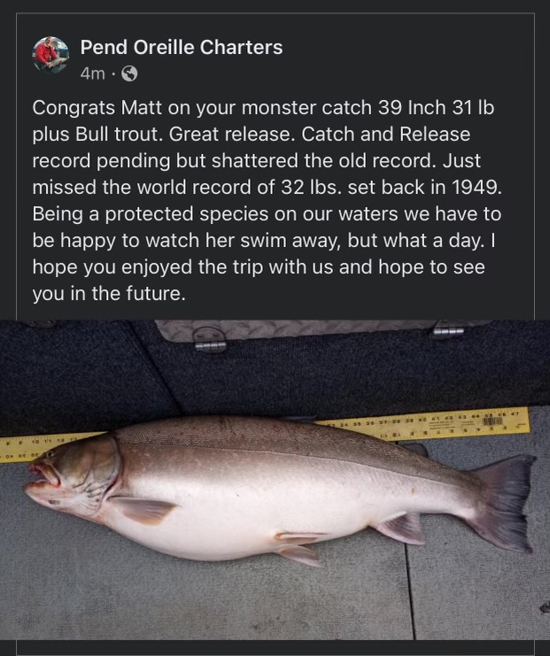
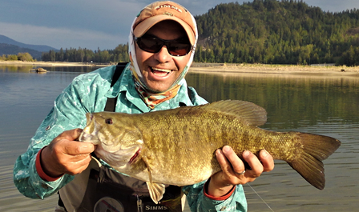
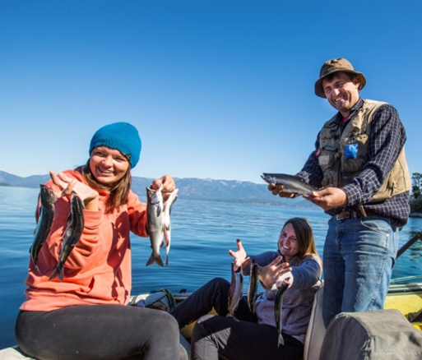
Fishery Performance

