Slide 1
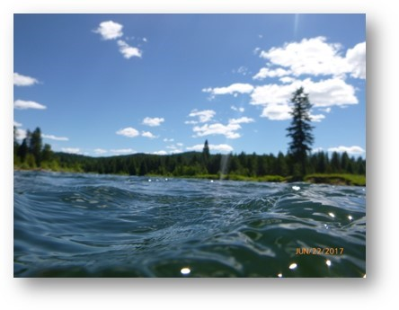
Development of the Priest River Watershed Group
Erin Plue
Trout Unlimited
Coeur d’Alene Project Manager

Slide 2

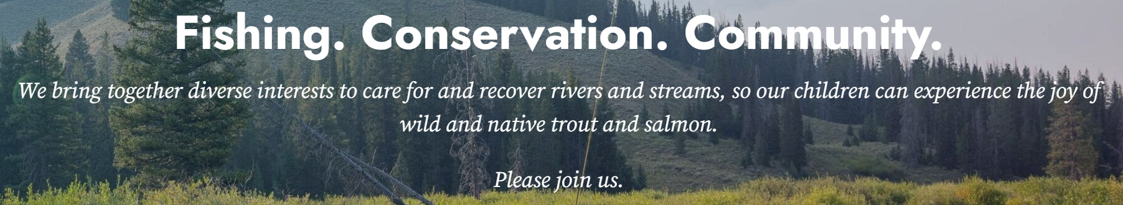
Formed in 1959.
National non-profit with around 300 employees working to enhance & maintain our cold-water fisheries.
Extensive work implementing stream restoration projects.
Often serves to coordinate collaborative planning efforts.

Slide 3
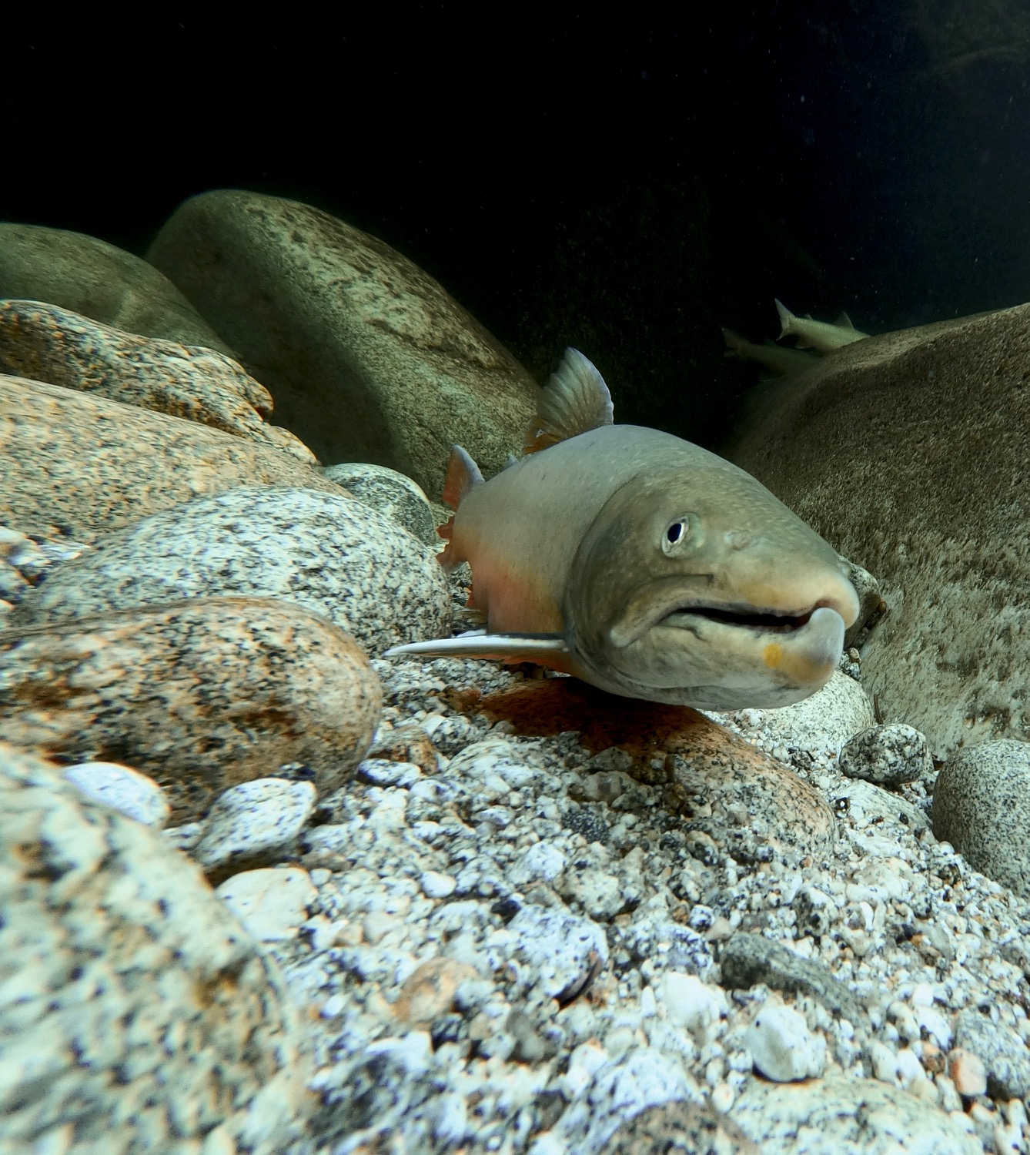
Why the Priest River?
Bull trout and Westslope cutthroat trout
Increasing water temperatures
Fish kills
Extreme low flows (2015 & 2021)
Listed as impaired for temp and sediment
Not meeting minimum instream flow
High State priority
Public outcry
Lots of potential – links to high elevation; a lot of good existing habitat; lots of public lands; there are still bull trout in the system.

Slide 4
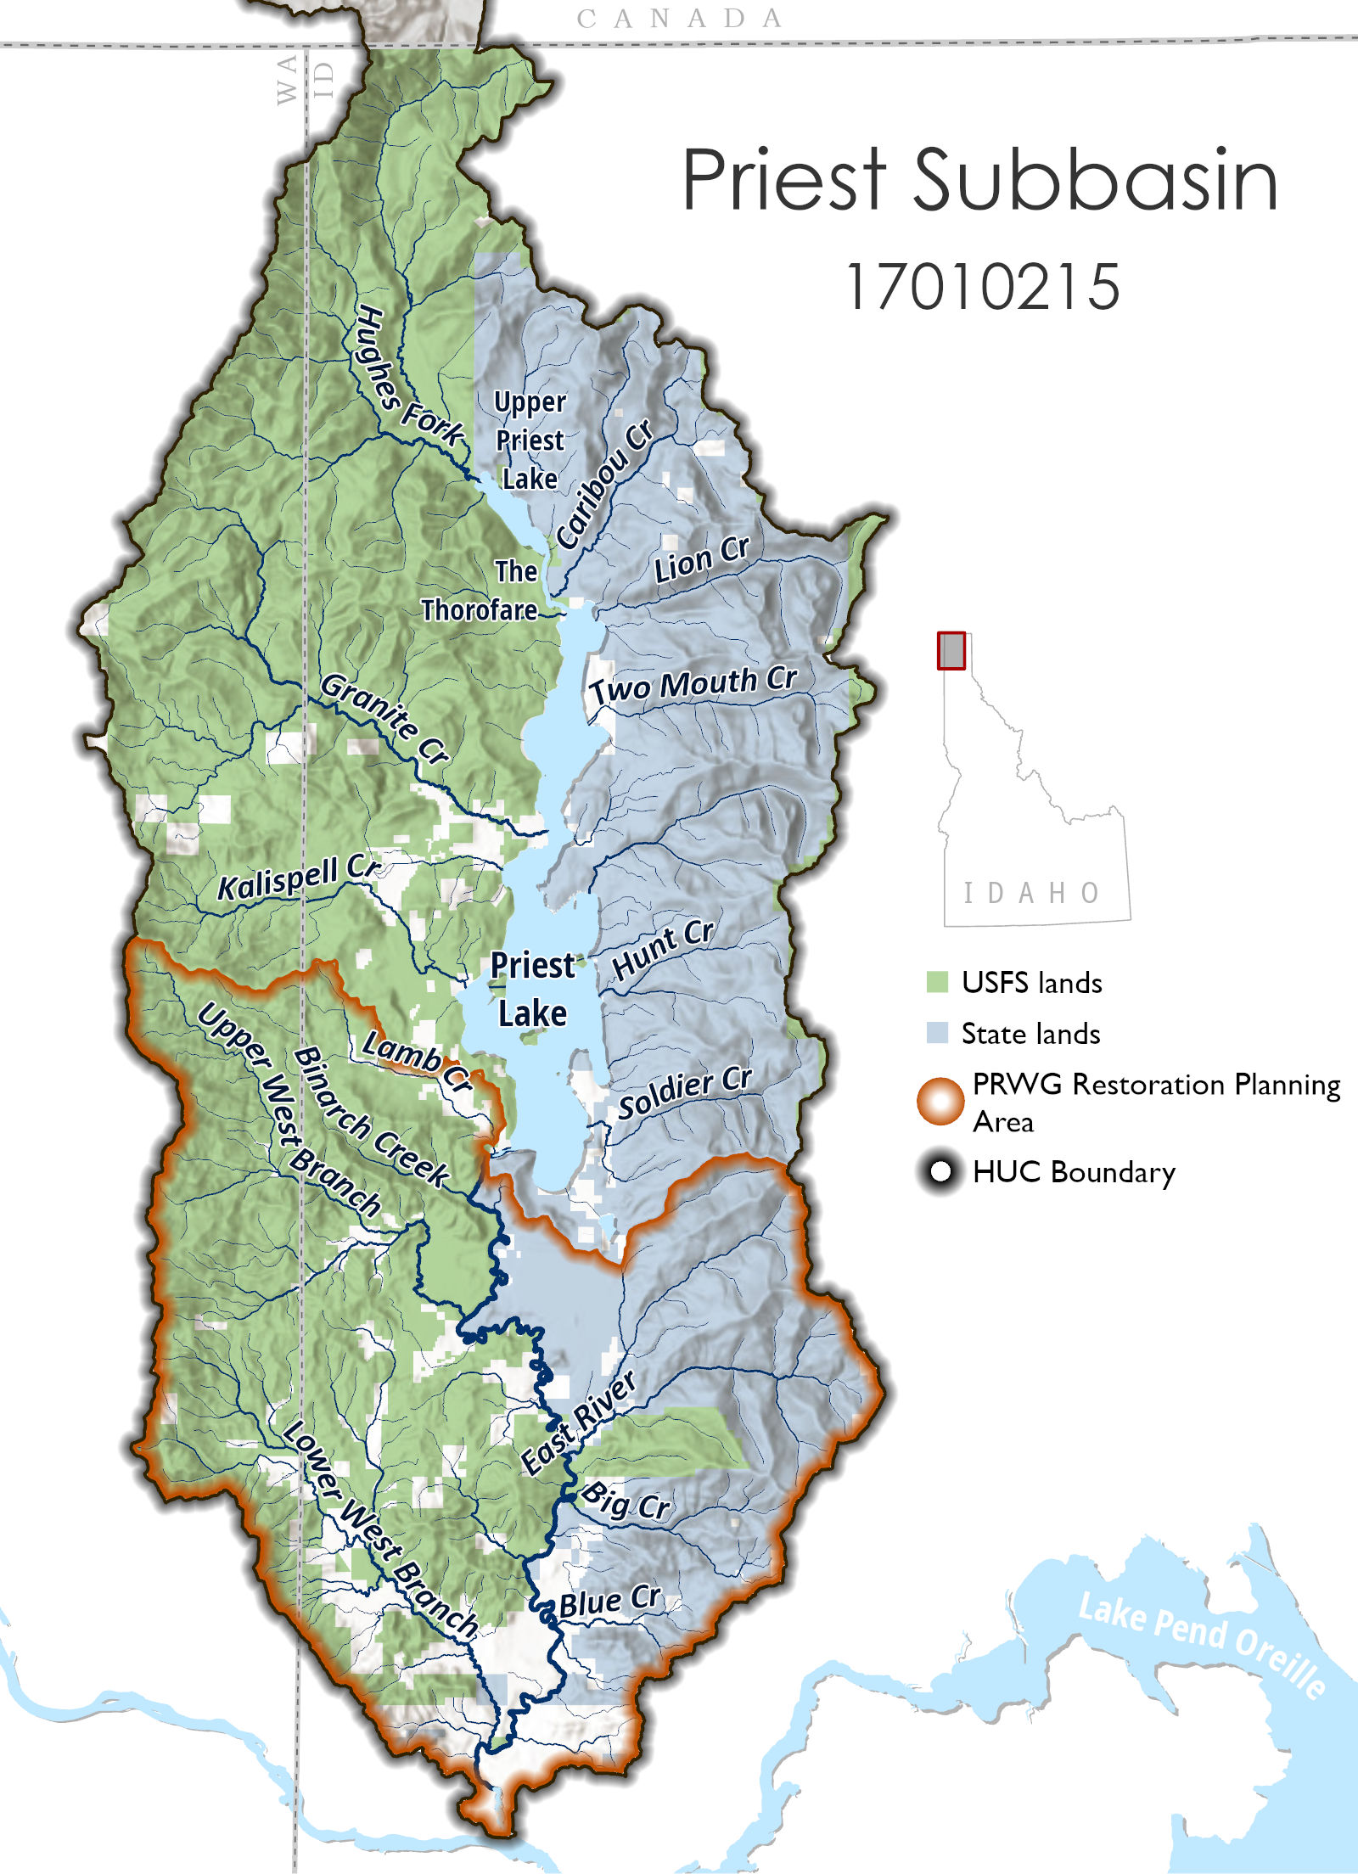
What’s the goal of the PRWG?
To be decided…
Bring together diverse stakeholders from around the Priest Basin
Agree to mission and operating procedures
Learn about the basin
Identify the challenges and outcomes desired for the Priest River
Identify projects in the Lower PR & tributaries.
Develop a “Strategic Plan” for the restoration of the PR and for improving recreational access and facilities.

Slide 5
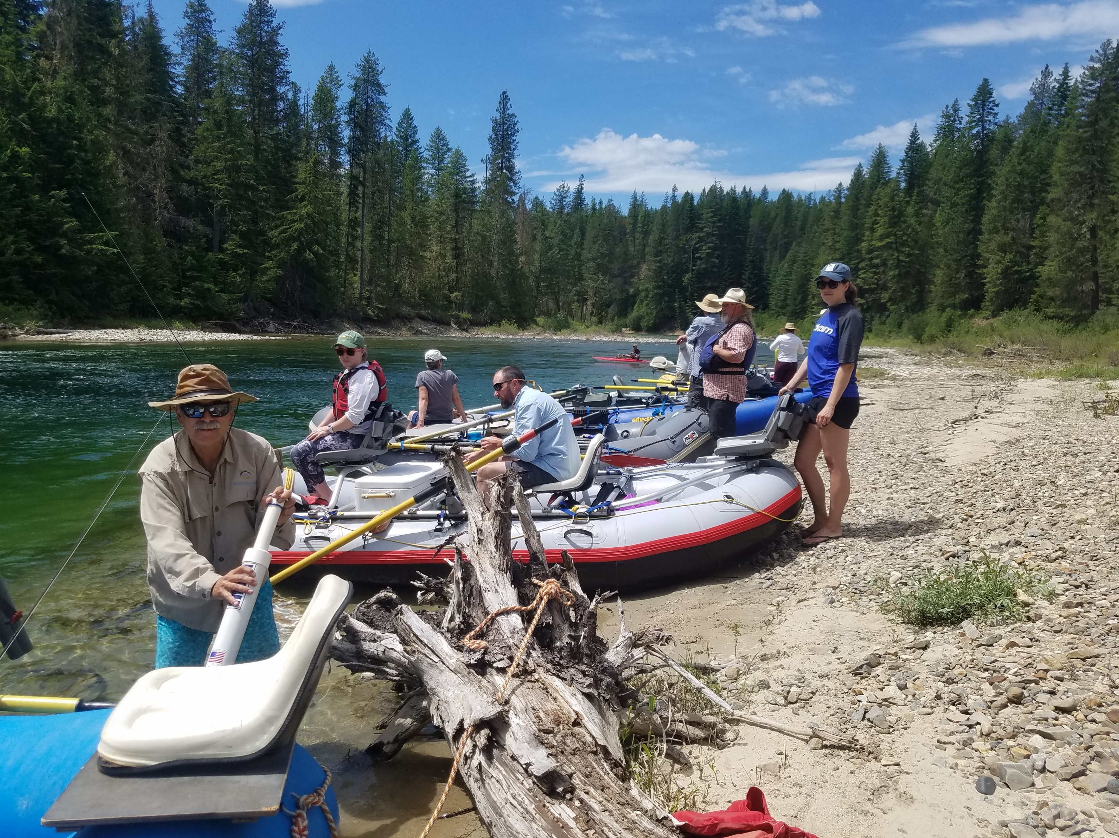

What will this group look like?
It might include you!
Diverse community stakeholders & interests
Agency & expert engagement and technical support
Public participation encouraged
Committed to seeing through this process
Transparent operations
Open minds & dialogue

Slide 6
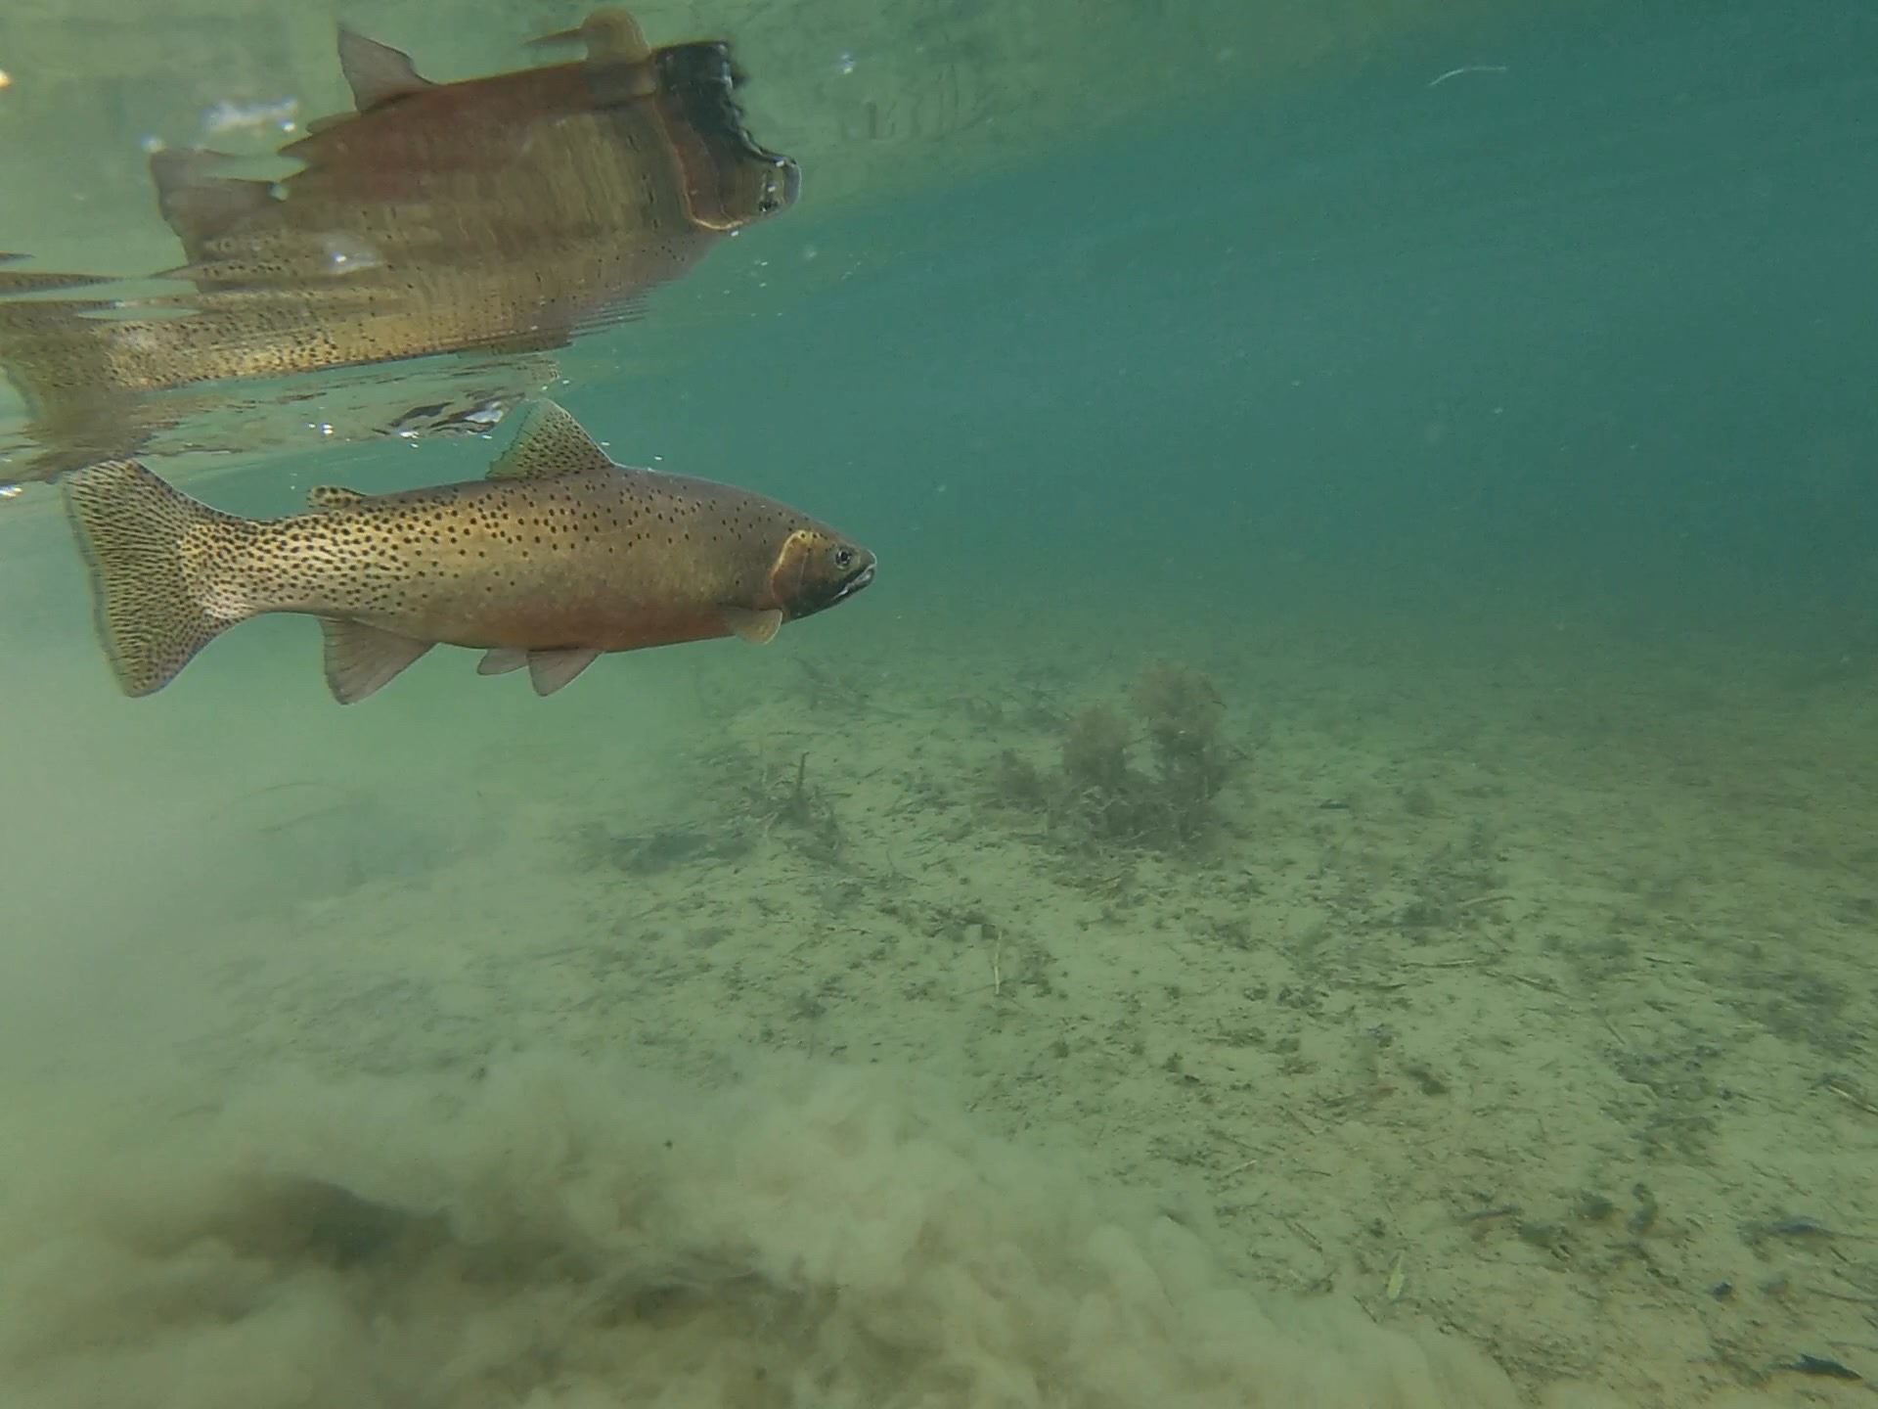
Discussed internally at TU – Fall 2021
Solicited engagement from governmental entities – Winter 21/22
Identified funding opportunities and developed grant proposals – spring 2022
Complete a “Situation Assessment” by third party – Summer 2022
Hire a professional facilitator (funding dependent)
Start meetings – Fall 2022
The Process

Slide 7
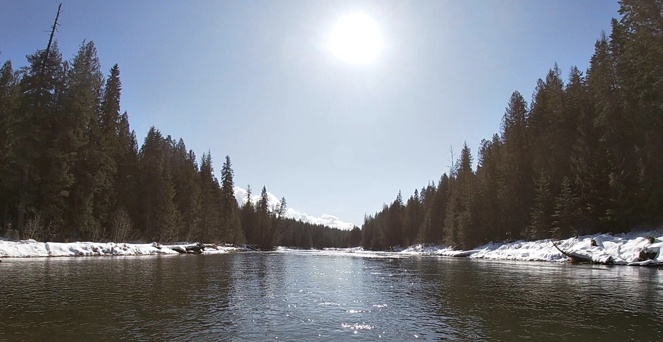
Thank you!
Want to learn more?
Sign up on list or email me.
Erin Plue
Trout Unlimited
Erin.plue@tu.org

