Slide 1
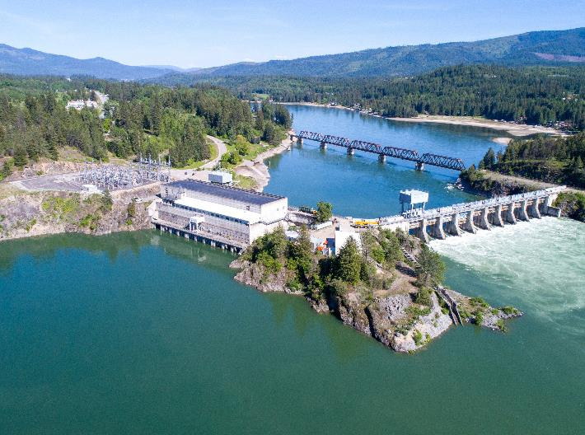
Albeni falls Dam and lake pend Oreille
Spring public meeting
Date: 09 May 2022

Slide 2
Albeni falls Dam and lake pend Oreille
Spring public meeting Agenda
Albeni Falls Water Management – USACE Water Management
Albeni Falls Project Update – USACE Albeni Falls Staff

Slide 3
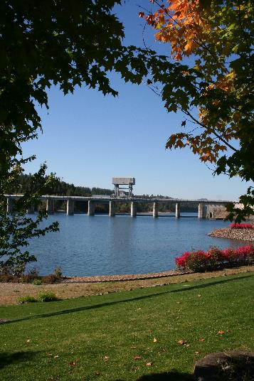
Albeni Falls dam project updates
Amanda Collins
Operating Project Manager
Albeni Falls Dam

Slide 4
2022 Recreation Season
Season Dates: Campsites and Shelters 100% reservable
  Riley Creek: May 07 – September 17 2022
  Albeni Cove, Priest River and Springy Point:
  May 14 – September 10 2022
  Trestle Creek: April 1 – Oct 31 2022.
  Visitor Center open 7 days per week thru Labor Day
  Reservations available through Recreation 1 Stop www.recreation.gov
Notes:
Everything 100% reservable. Can reserve in real time or up to 6 months in advance.
Closure dates include day use areas and boat ramps.
At this time, boat ramps/swim areas are closed until lake levels increase to a safe elevation for utilization of the ramps and deployment of safety equipment.

Slide 5
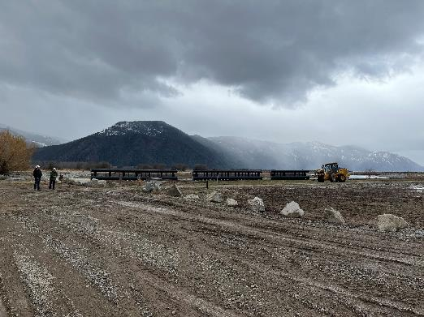
Clark Fork Driftyard Repair Status
APR 2022 - Accepted receipt of 280 ft. of boom. Install slated for July.
Maintenance Contract Awarded. Strategizing options with limited funds available.
Currently studying wave affects on the structure to identify whether a breakwater might be feasible.
Notes:
We continue to make progress on the clark fork driftyard. We will be replacing over 280 feet of boom during the upcoming summer.

Slide 6
Questions
www.nws.usace.army.mil
Facebook at Albeni Falls Dam
208-437-3133 Dam Main Line
208-437-4617 Visitor Center

Slide 7
Albeni falls and lake pend Oreille operations
Leon Basdekas
Senior Water Manager
Seattle District, Army Corps of Engineers

Slide 8
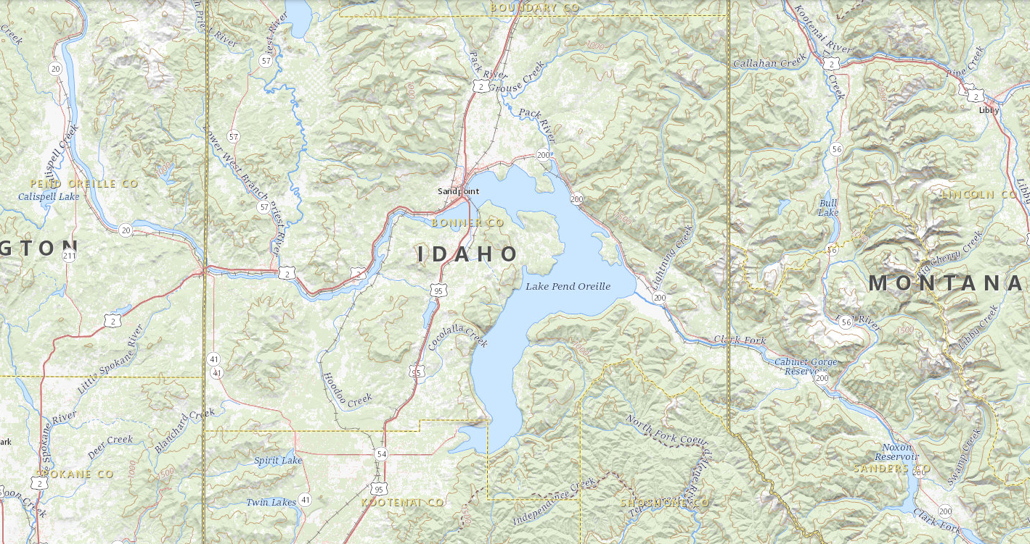
Lake Pend Oreille & ALBENI FALLS DAM
Dover, location of transition from Lake to River.
Hope, where Lake elevation is measured.
Albeni Falls Dam is ~27 miles downstream of the Lake.

Slide 9
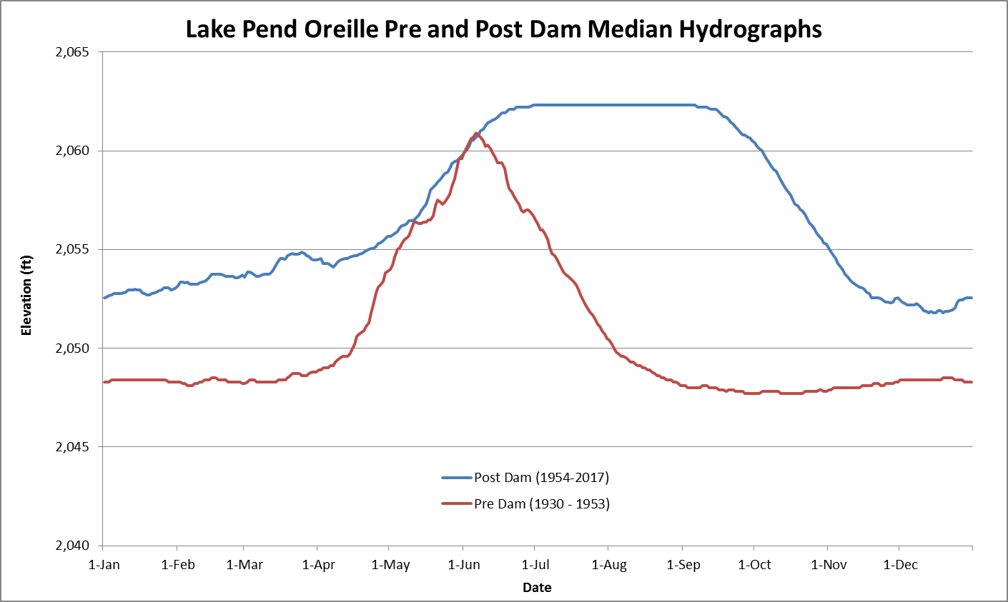
Notes:
Ask Logan.

Slide 10
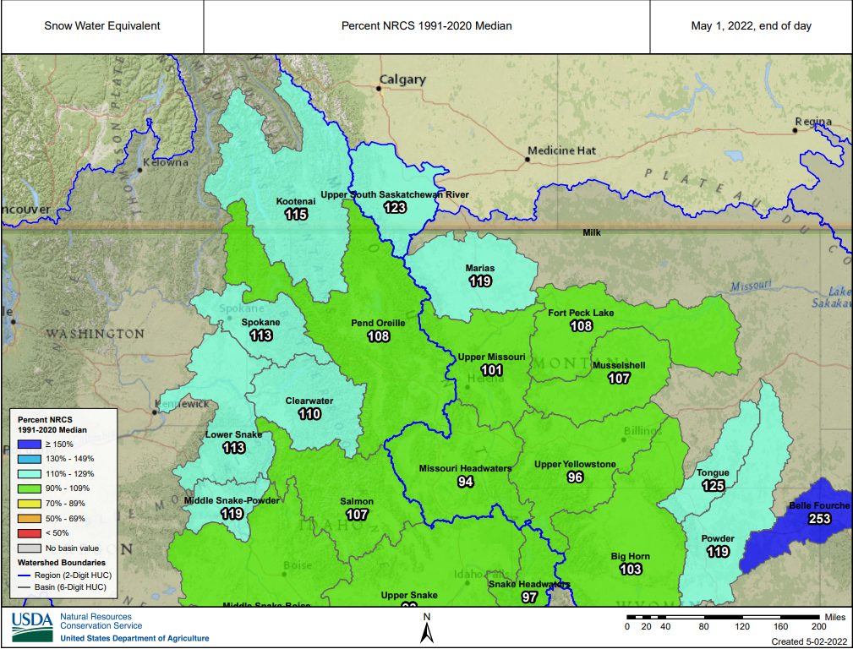
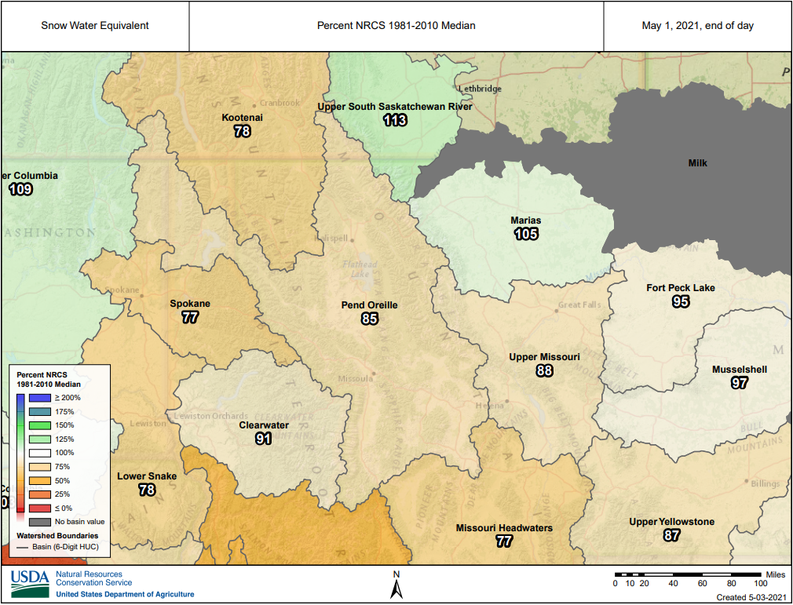
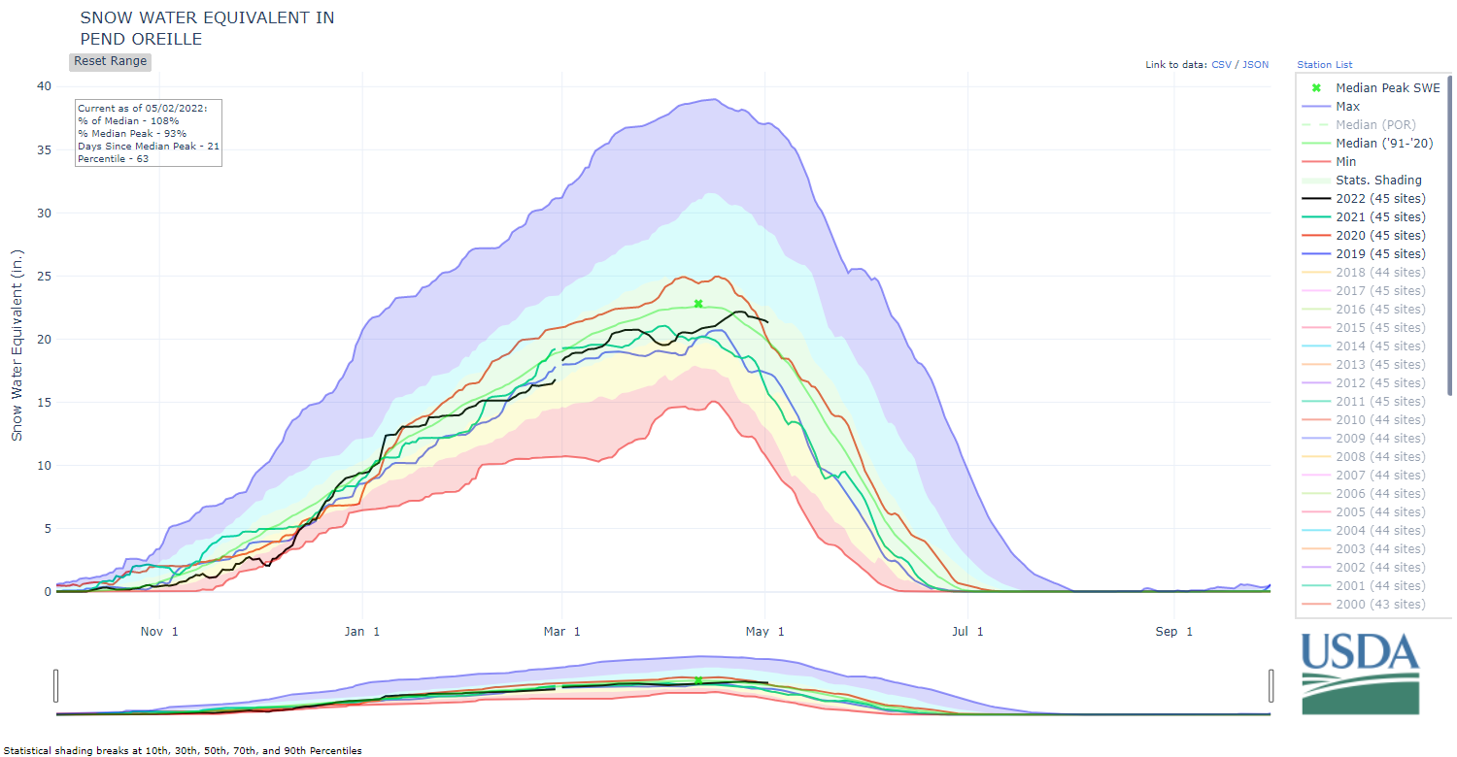
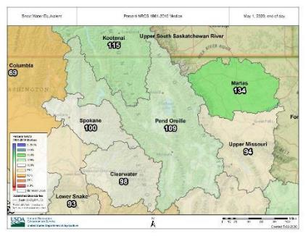
May 1 2022 Snow – Percent of Median
May 1, 2021 Snow – For comparison
May 1, 2020 Snow – For comparison
May 1 snowpack showing above average this year (108% of average). Due to melting later than normal.
The seasonal peak was slightly below average.
In addition to snowpack, other factors including spring weather will affect runoff volume and timing.
Notes:
Interactive Map (usda.gov)

Slide 11
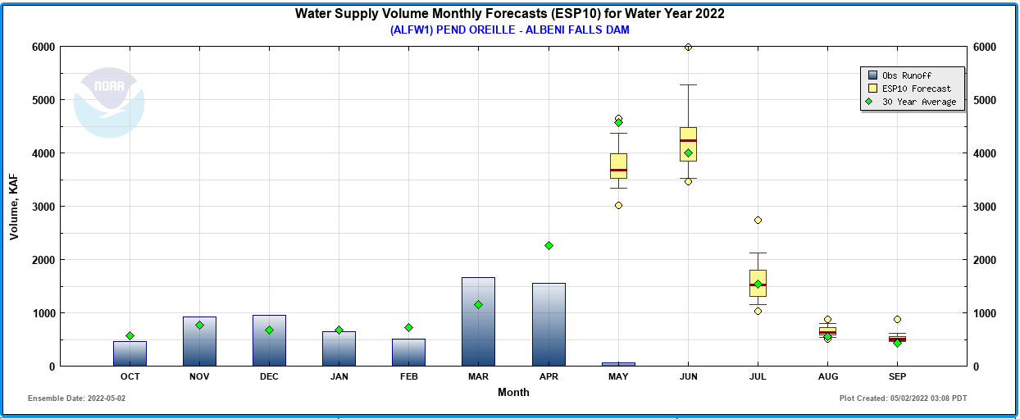
Current conditions
Observed runoff was above average for March and below average for April.
Predicted for May is well above average, and June is slightly below average.
May 1 snowpack was about 108% of average in the Pend Oreille Basin.
Current water supply forecast is 88% of Average (10.4 MAF) for Apr-Jul.
April-July Forecast 10.9 maf and 88% average

Slide 12
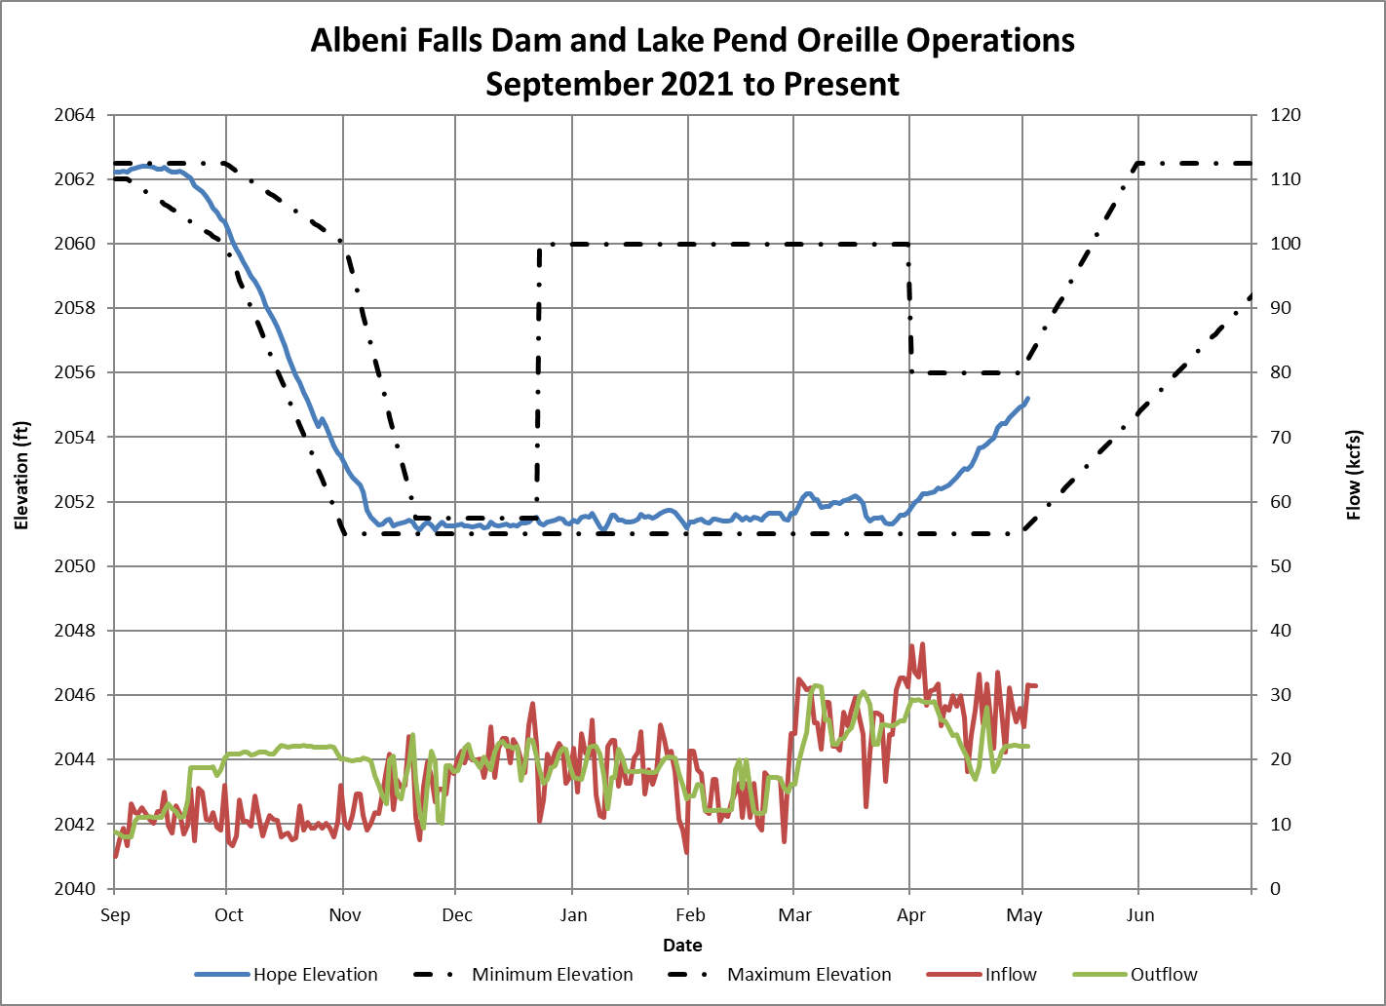
Started Fall Draft Sept 20th
Refill began on April 1st
Finished Fall Draft Nov 10th
Winter Band and Habitat restoration
2051.0’ – 2052.0’
2055.0’ April 30th
Flexible Winter Power Operations Mar 3 - 17
2051.5’ – 2052.5’
Kept Lake in 2051.0’-2051.5’ band Nov 10th – Dec 20th for Kokanee spawning.
Notes:
Spawning ended
Post spawning held winter pool 2051.0 – 2052.0. March 3 – March 17 FWPO 2051.50’ – 2052.50’
March 3 FWPO 2051.5 – 2052.5’. 2052.5’ limit due to IDFG habitat work in Clark Fork delta.

Slide 13
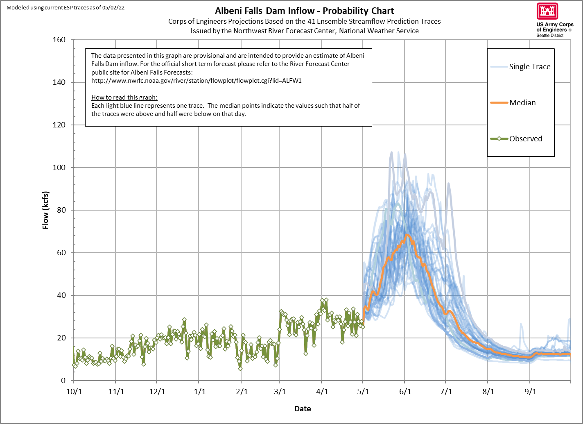

Slide 14
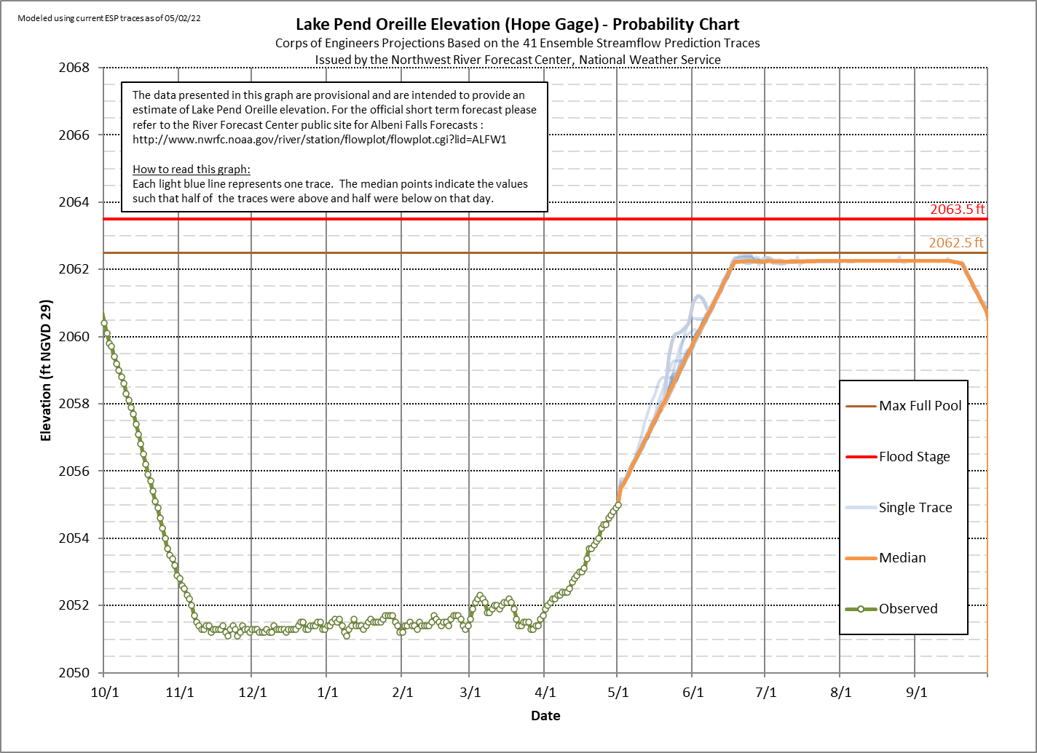

Slide 15
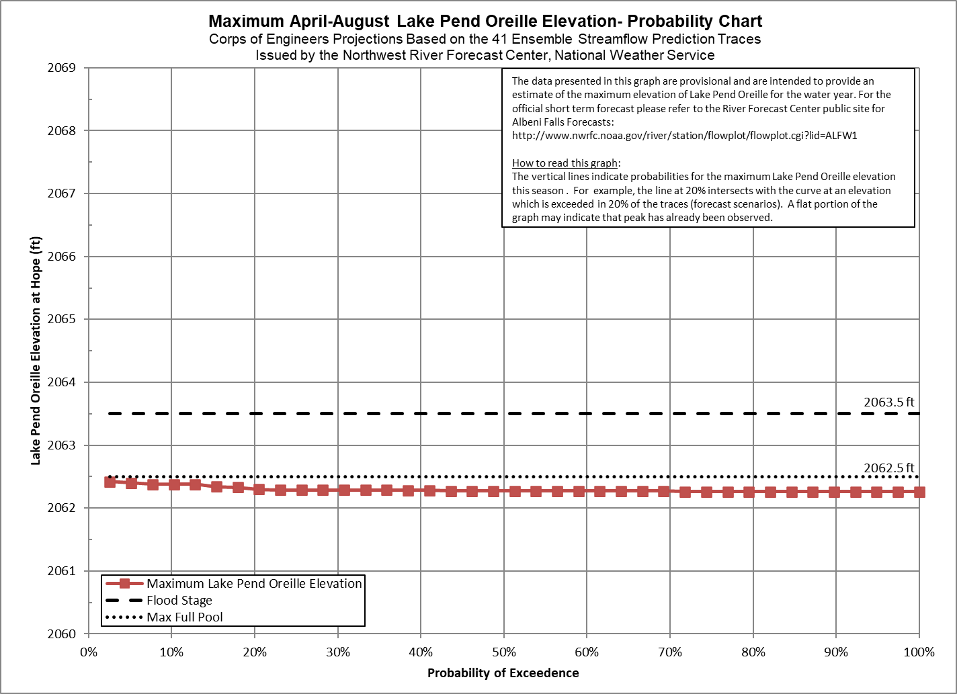
Modeled using current ESP traces as of 05/02/22

Slide 16
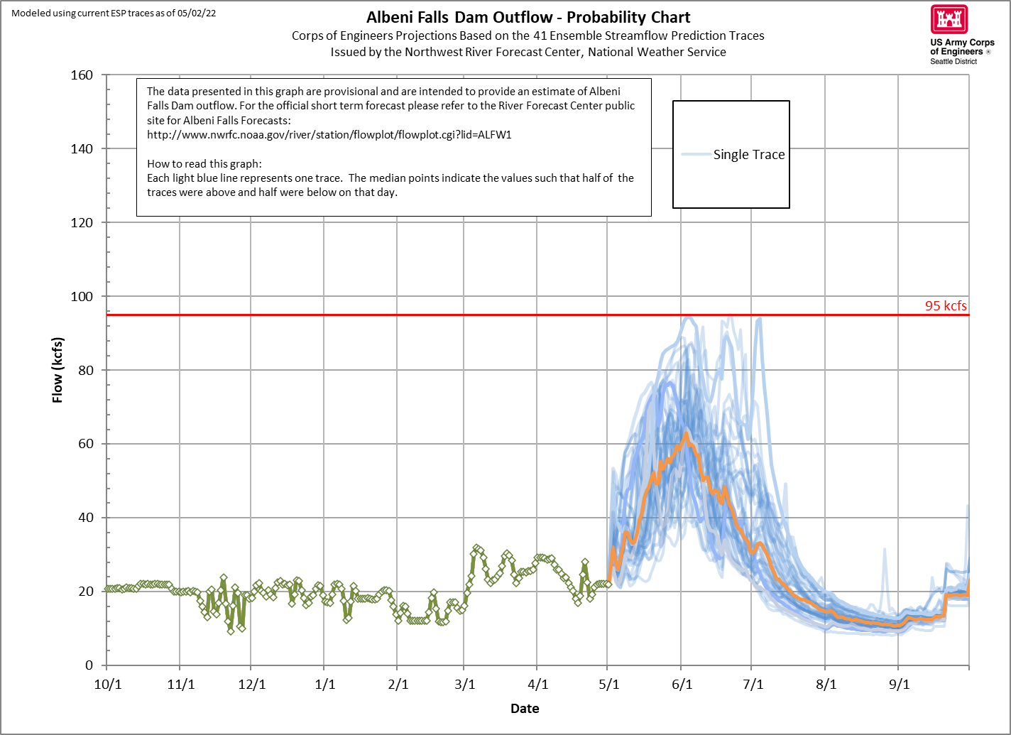

Slide 17
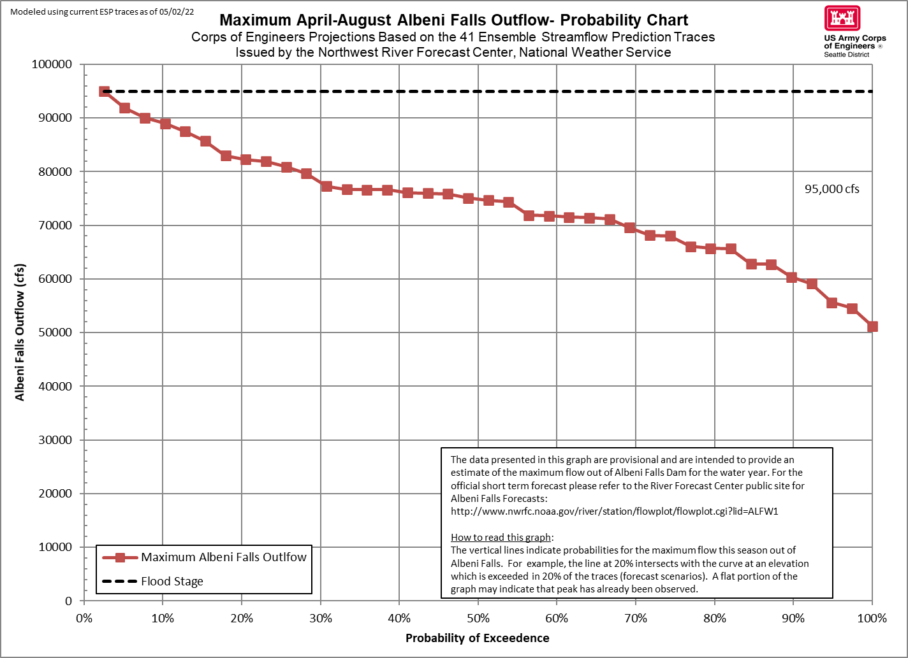

Slide 18
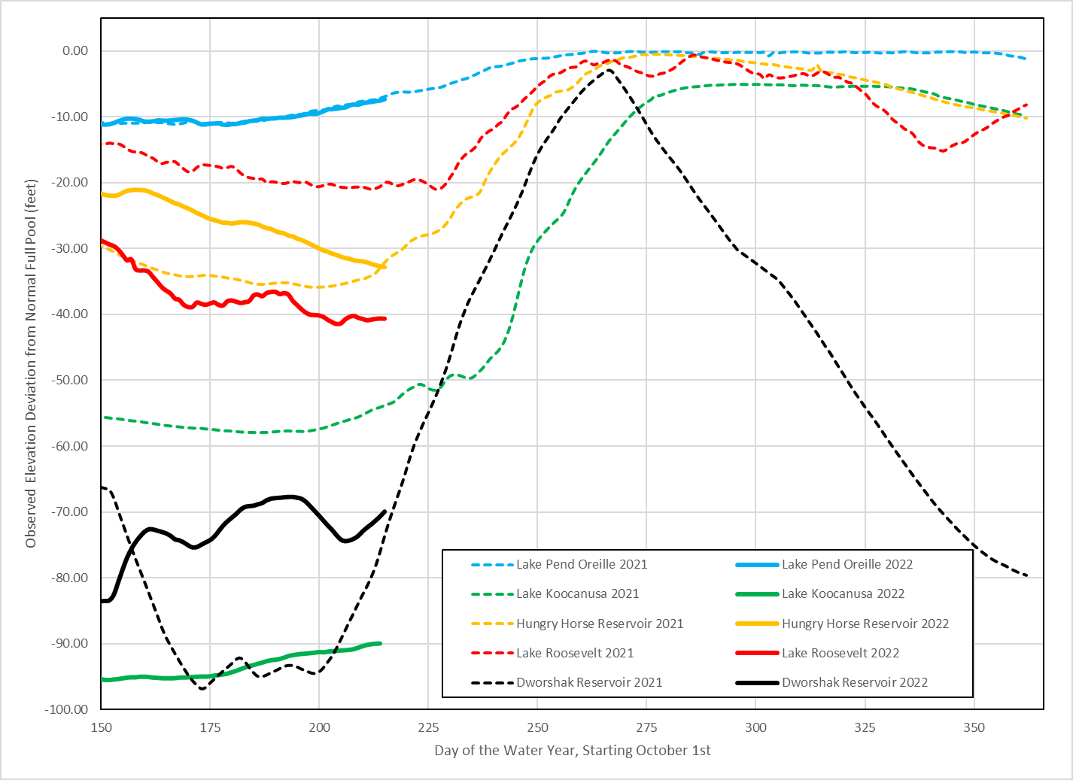
Federal STORAGE Projects – Feet From full

Slide 19
Planned operations
Current plan is to target a Lake Pend Oreille elevation of 2060 ft at the end of May, although actual elevation will depend on inflows
Lake Pend Oreille refill (above 2062 ft) target is mid-June
      Depends on shape of runoff

Slide 20
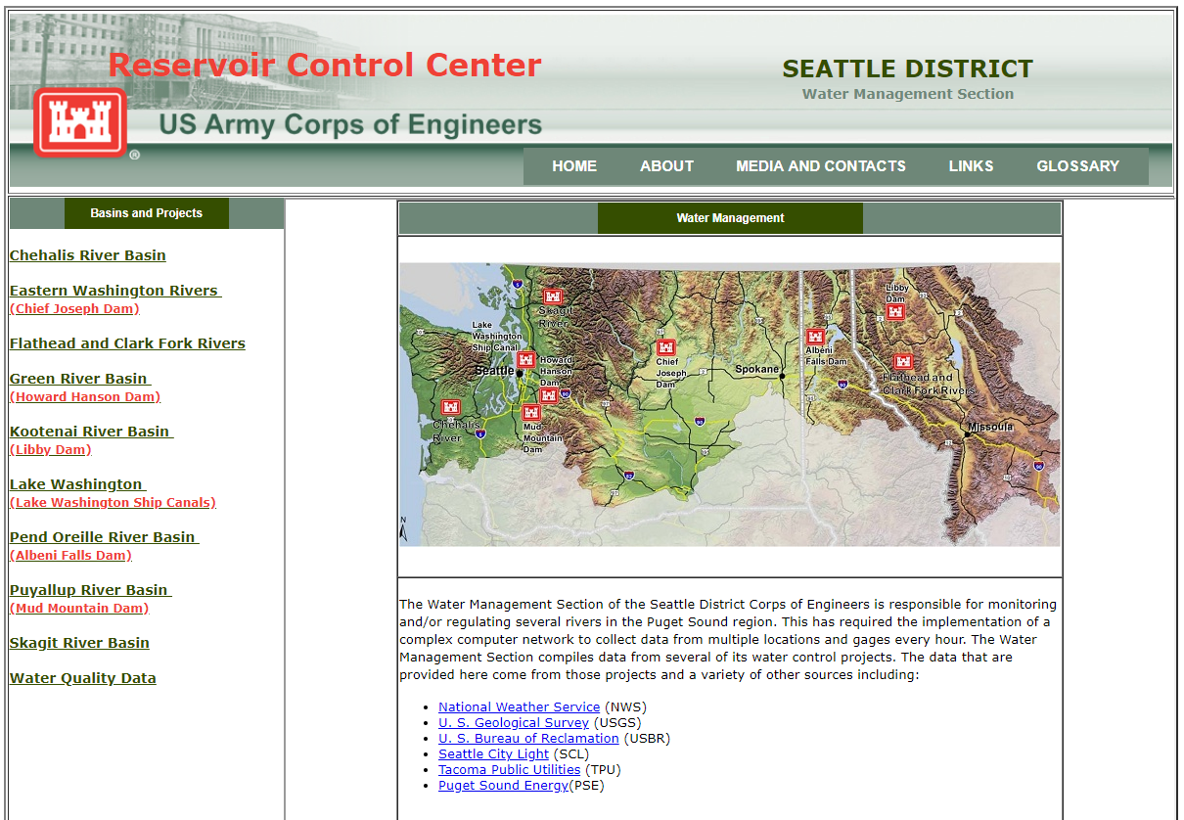
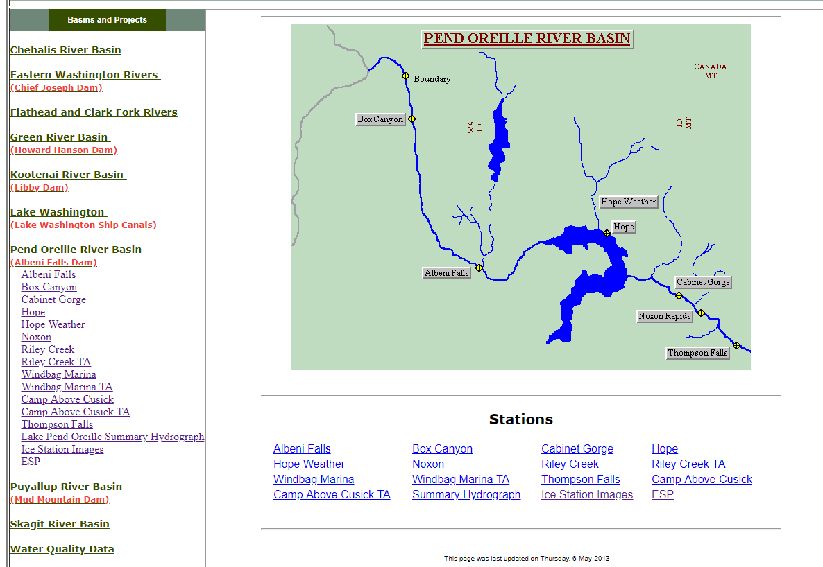
Questions?
For emails regarding release changes and lake level updates email
  UpperColumbiaWM@usace.army.mil
  Leon.Basdekas@usace.army.mil
General Queries call (206) 764-6702
Seattle District water management data website :
http://www.nwd-wc.usace.army.mil/nws/hh/www/index.html#

Slide 21
May 31st, 2016
No freeflow
Hope 2060.0 feet
Forebay 2058.5 feet
Outflow 46.1 kcfs
Dover
Albeni Falls
May 9th, 2018
On freeflow
Hope 2060.0 feet
Forebay 2049.8 feet
Outflow 83.8 kcfs
Notes:
Sub in more recent data by spring

Slide 22
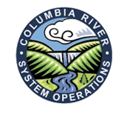
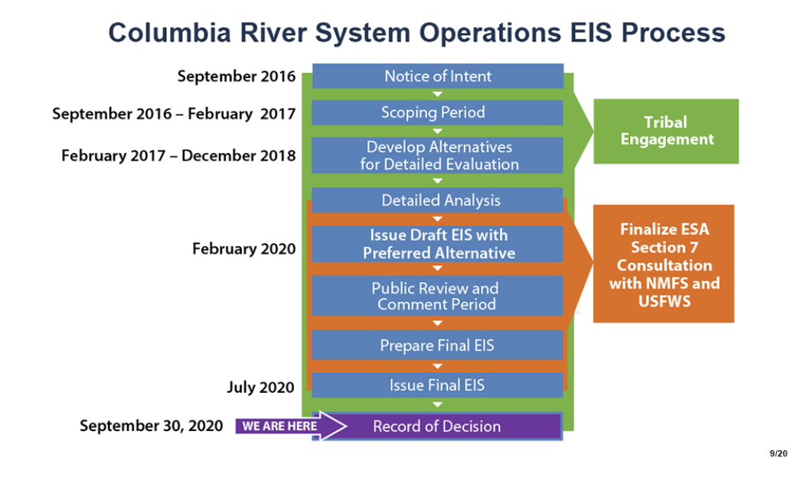
Columbia River Systems operations EIS
To view Final EIS, Record of Decision, and for more information about CRSO, visit: http://crso.info/

