Slide 1
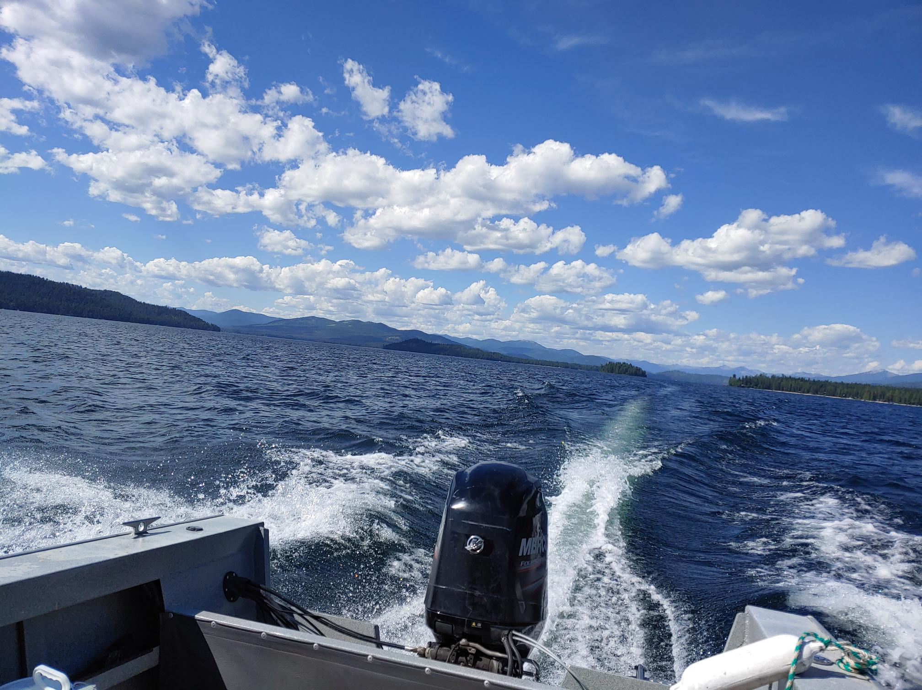

Aquatic Noxious Weed Update- Lakes Commission
Jeremey Varley

Slide 2
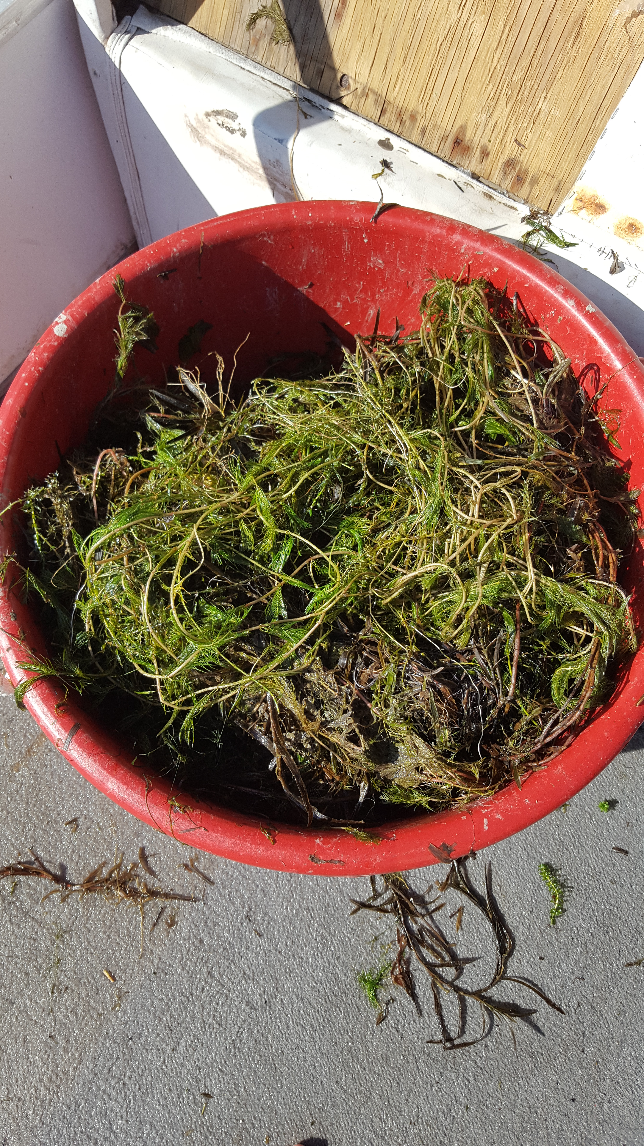
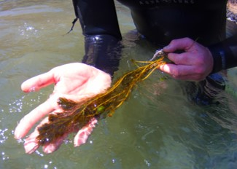
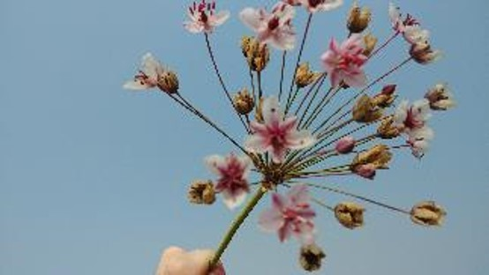
Aquatic noxious weed update
2021 Recap
2022 Survey/Treatment Plans

Slide 3
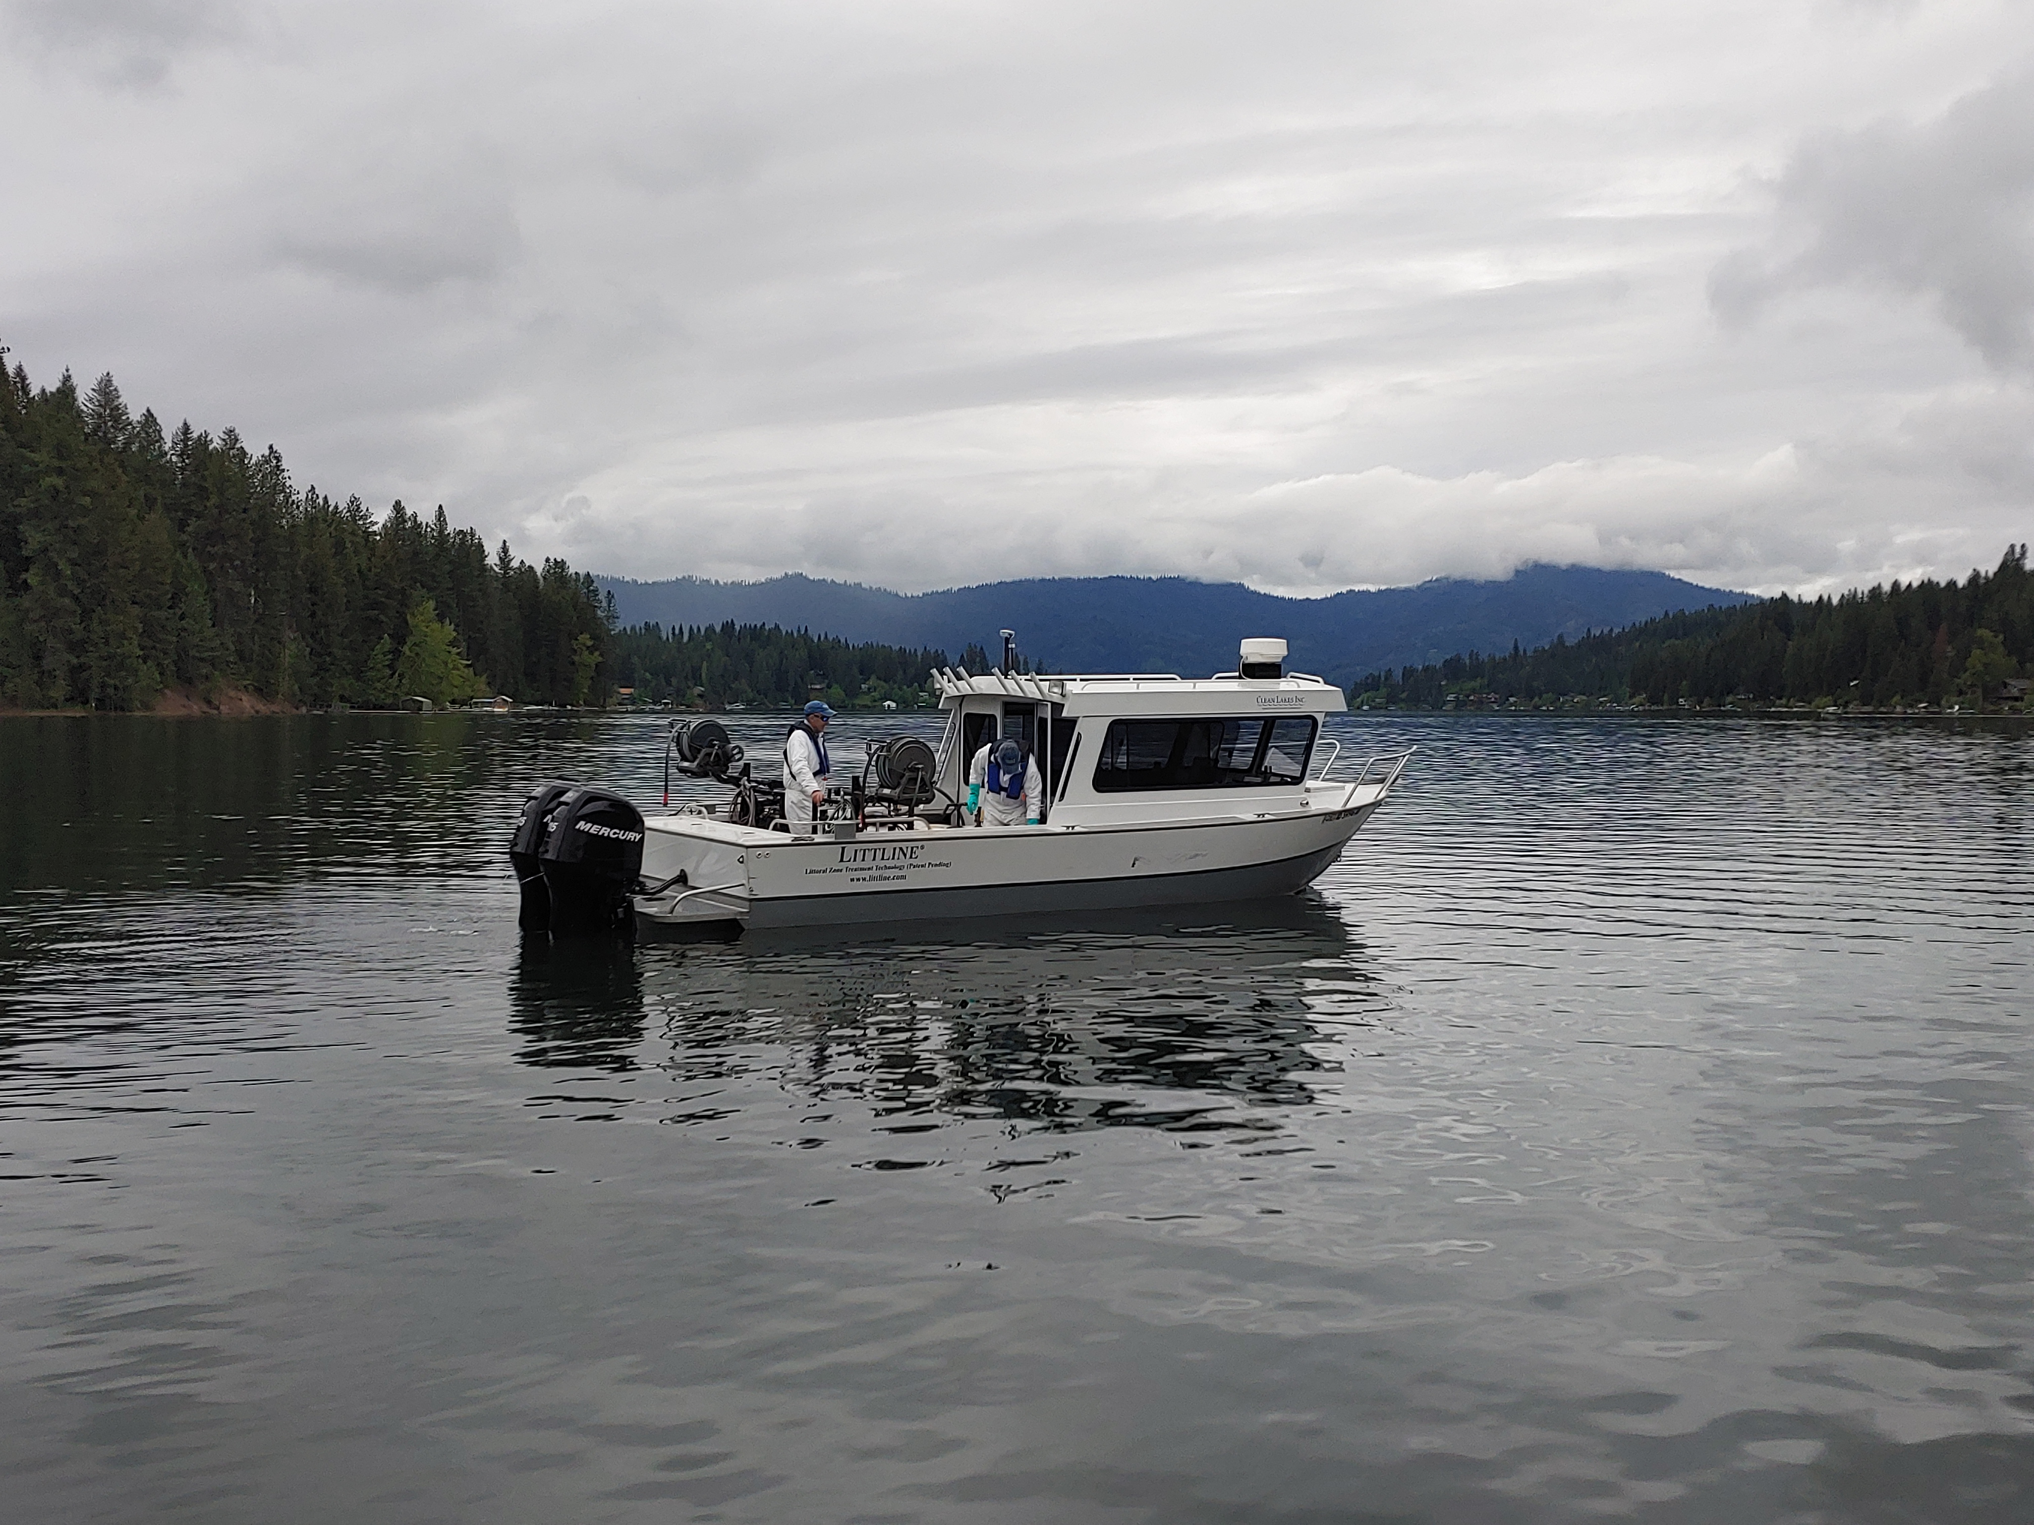

2021 Recap
What all took place in 2021

Slide 4
Aquatic Treatments Herbicide 2021
Eurasian Watermilfoil
Curly Leaf Pondweed
Pend Oreille Lake & River 123.08 acres
Hayden Lake 44.73 acres
Bear Lake 18.4 acres
Hayden Lake 296.4 acres
Lake Coeur d’Alene 8.8 acres
Notes:
Hayden Lake CLP 5/19
Lake CDA 5/20
Hayden lake EWM 7/20

Slide 5
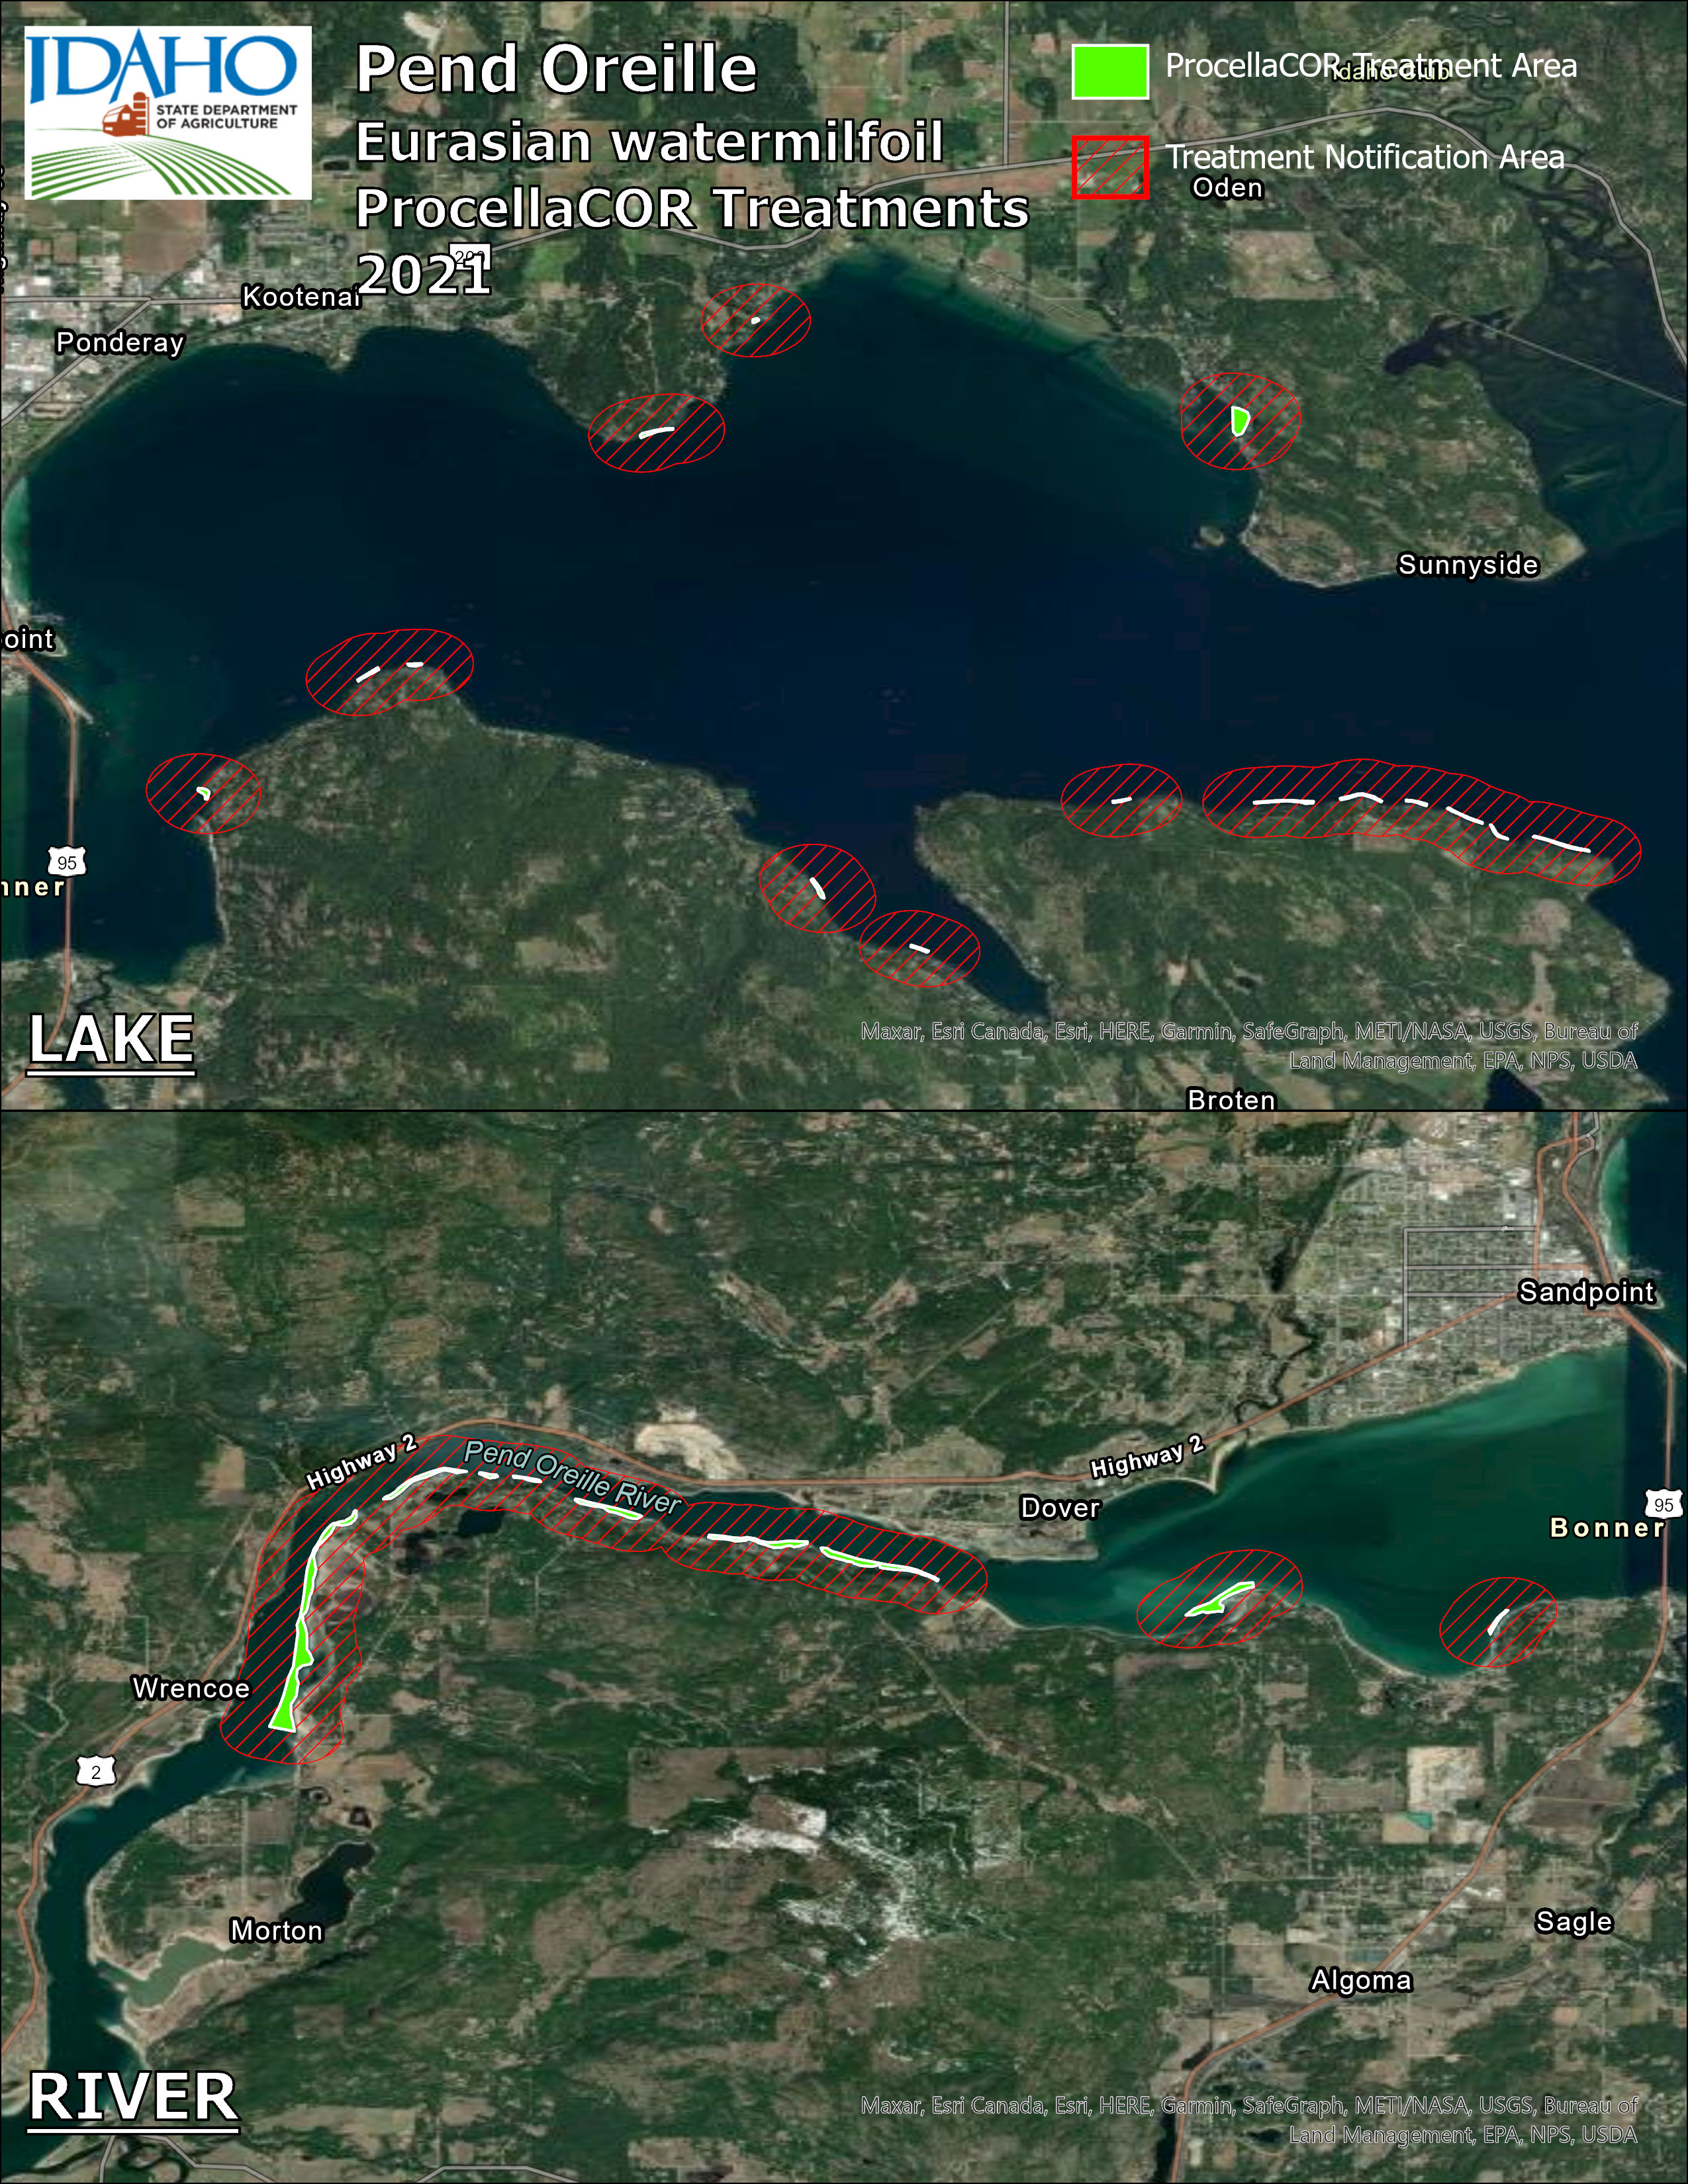

Slide 6
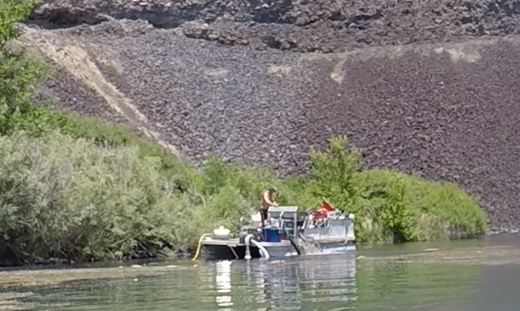

Aquatic Treatments DASH
Eurasian Watermilfoil
Flowering Rush
Priest Lake
Blue Heart Springs
Hayden Lake
Cocolalla Lake
Lake Pend Oreille
Blackfoot Reservoir

Slide 7
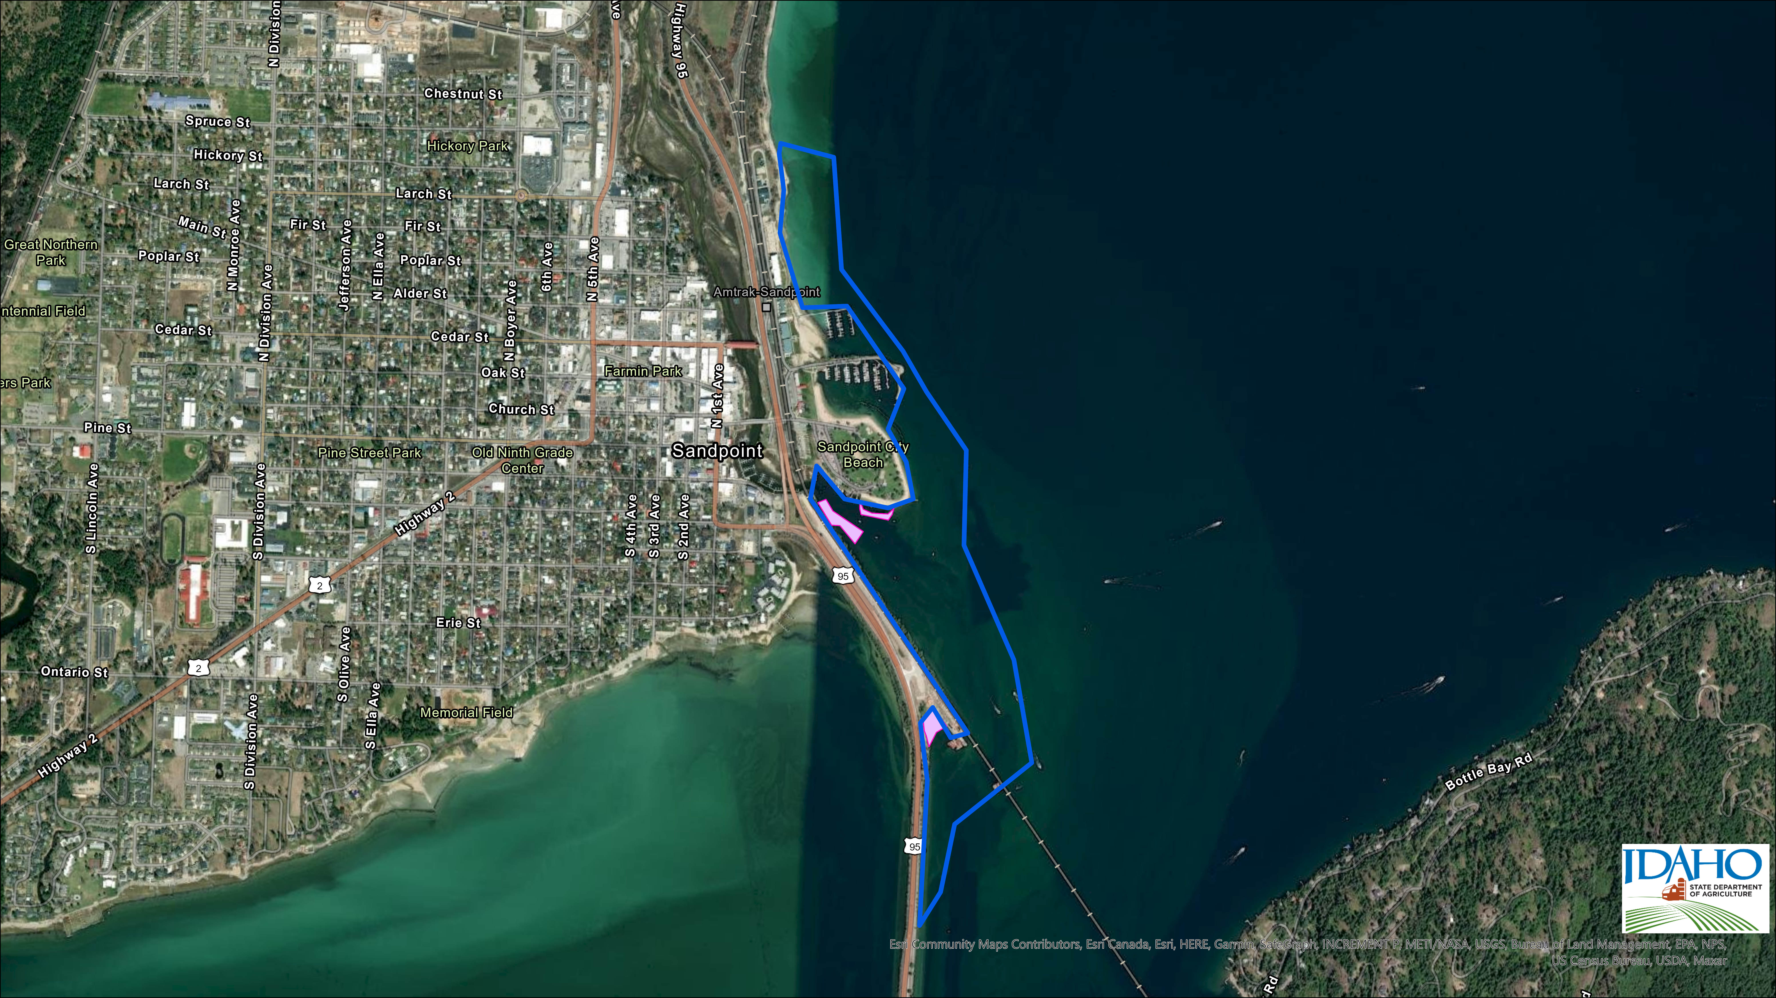

Slide 8
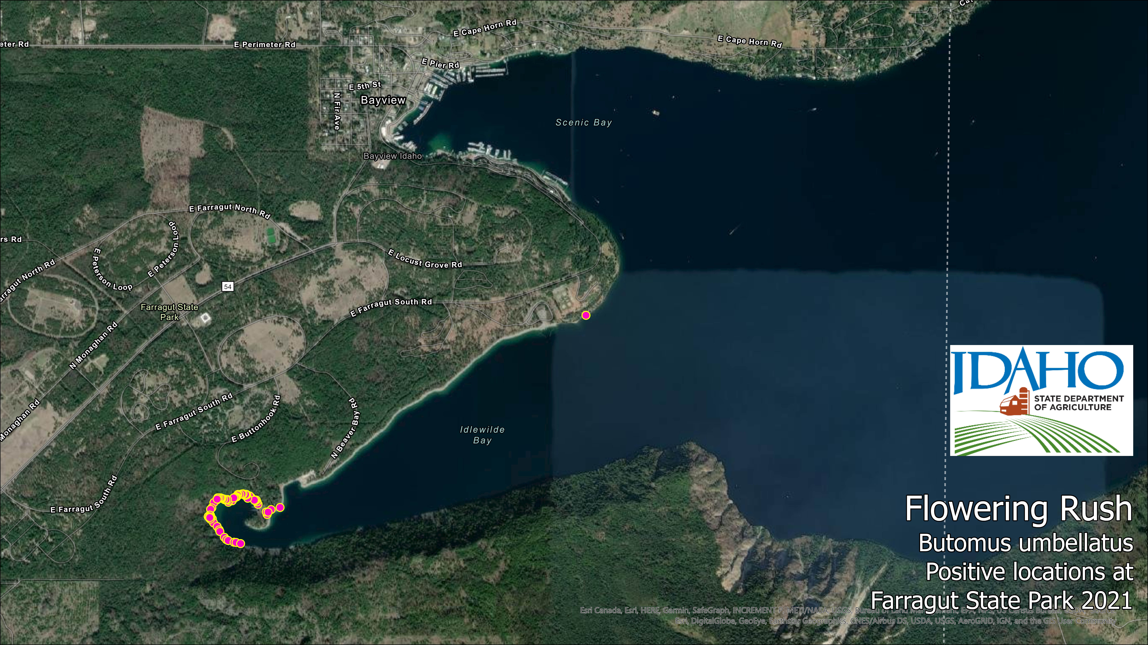
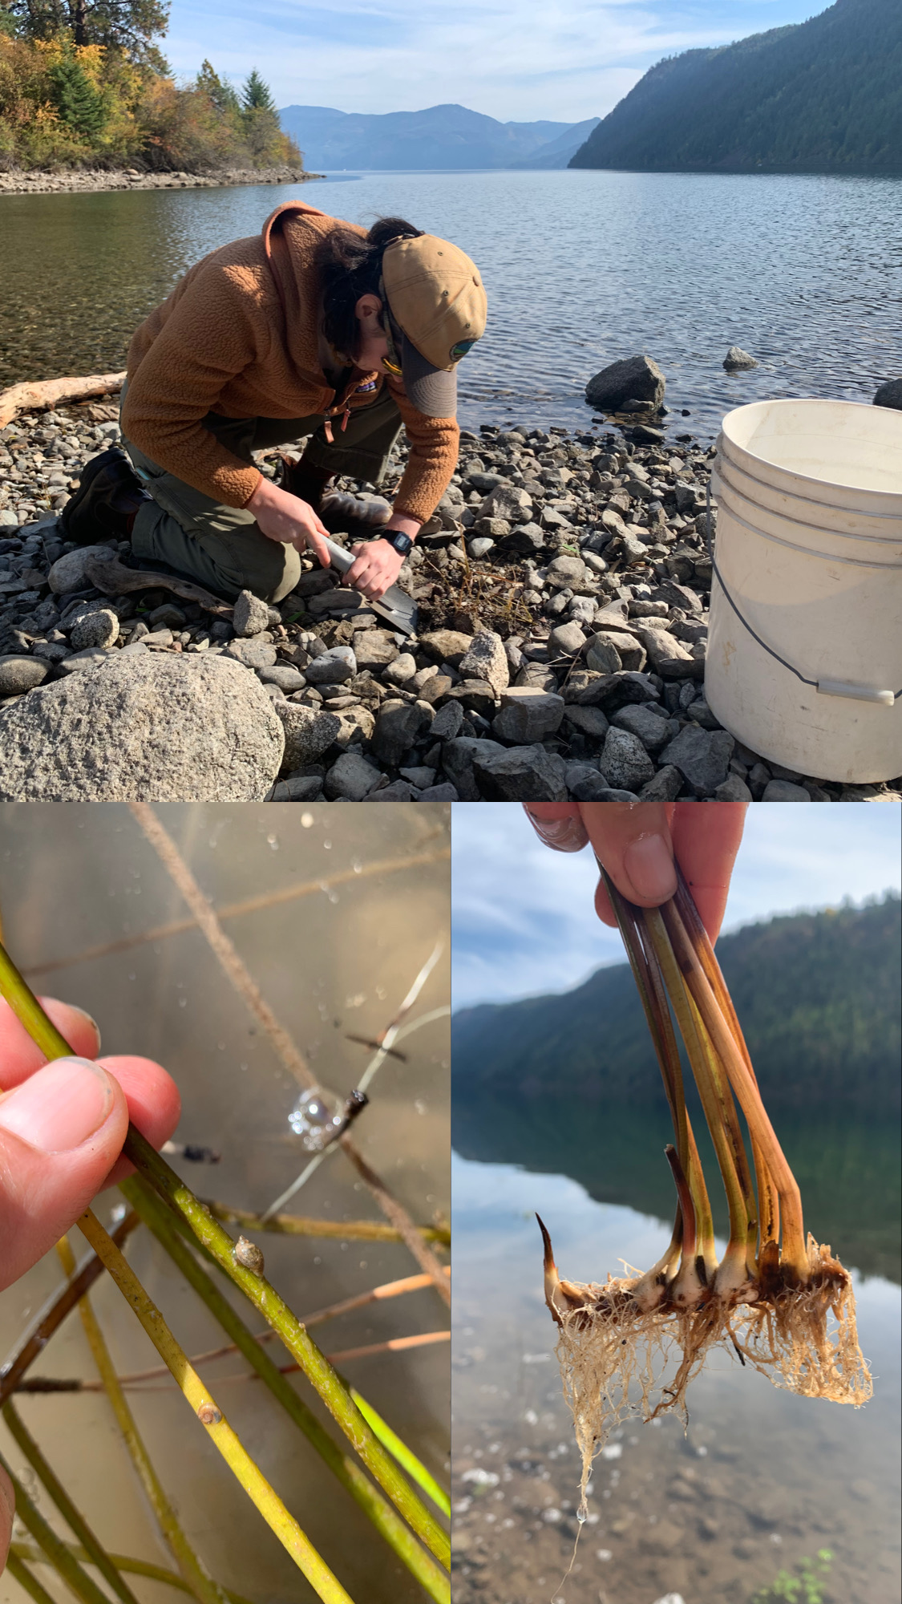

Slide 9
Chart

Slide 10
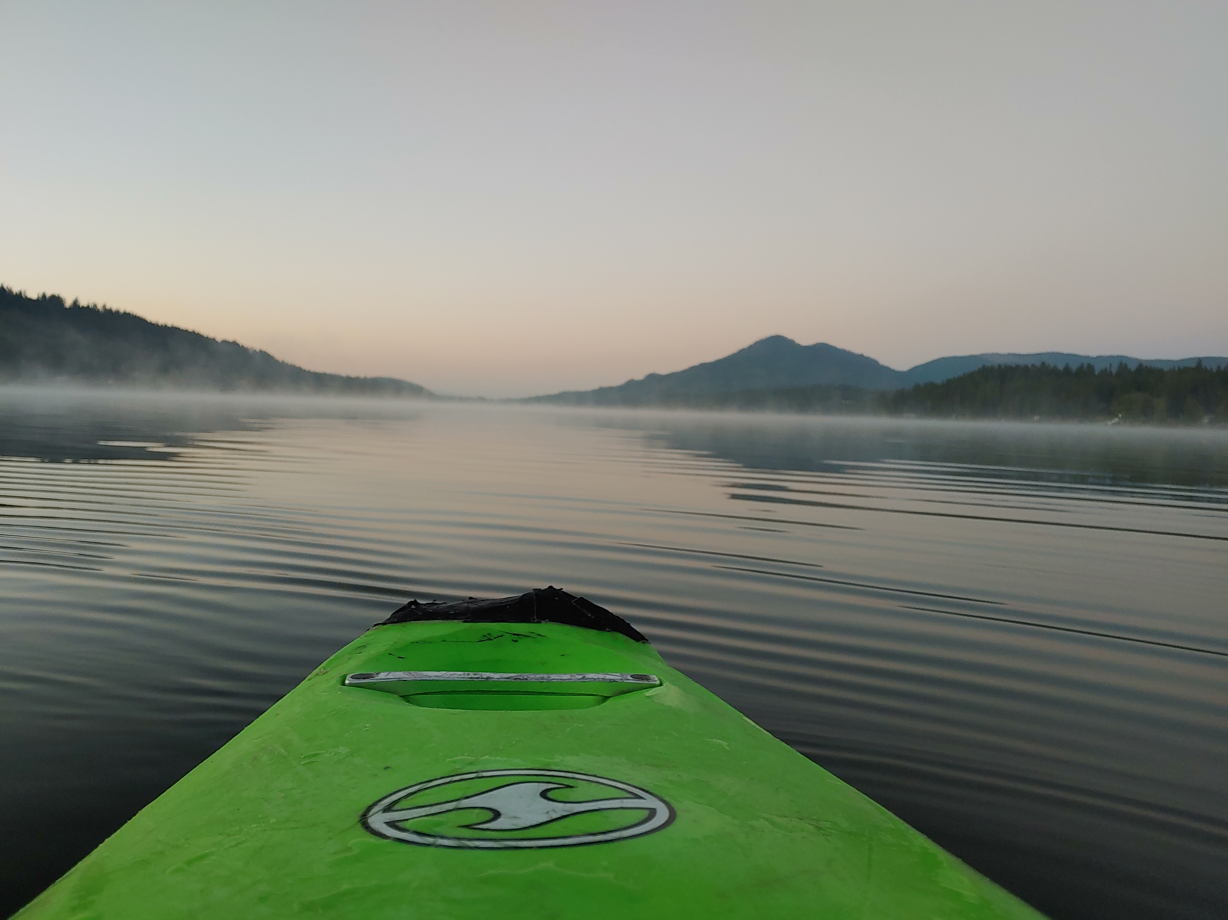
2022 Survey/Treatments
What are the plans for 2022

Slide 11
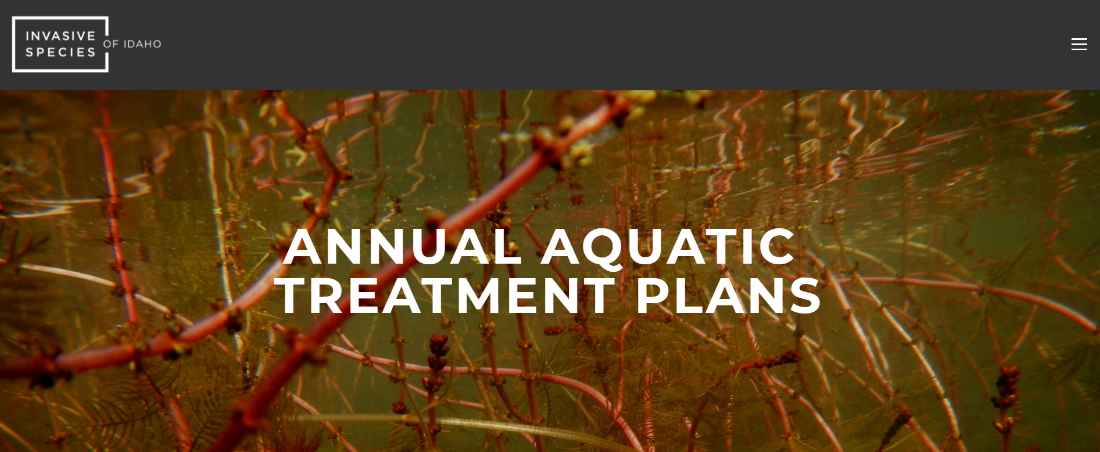
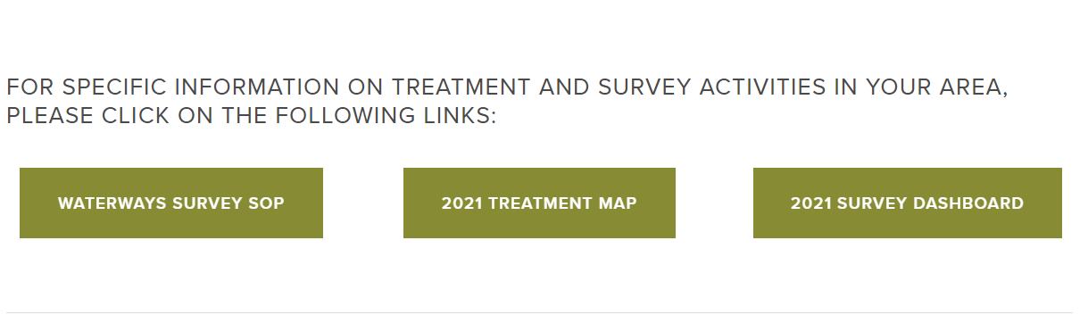
https://invasivespecies.idaho.gov/treatment-plans

Slide 12
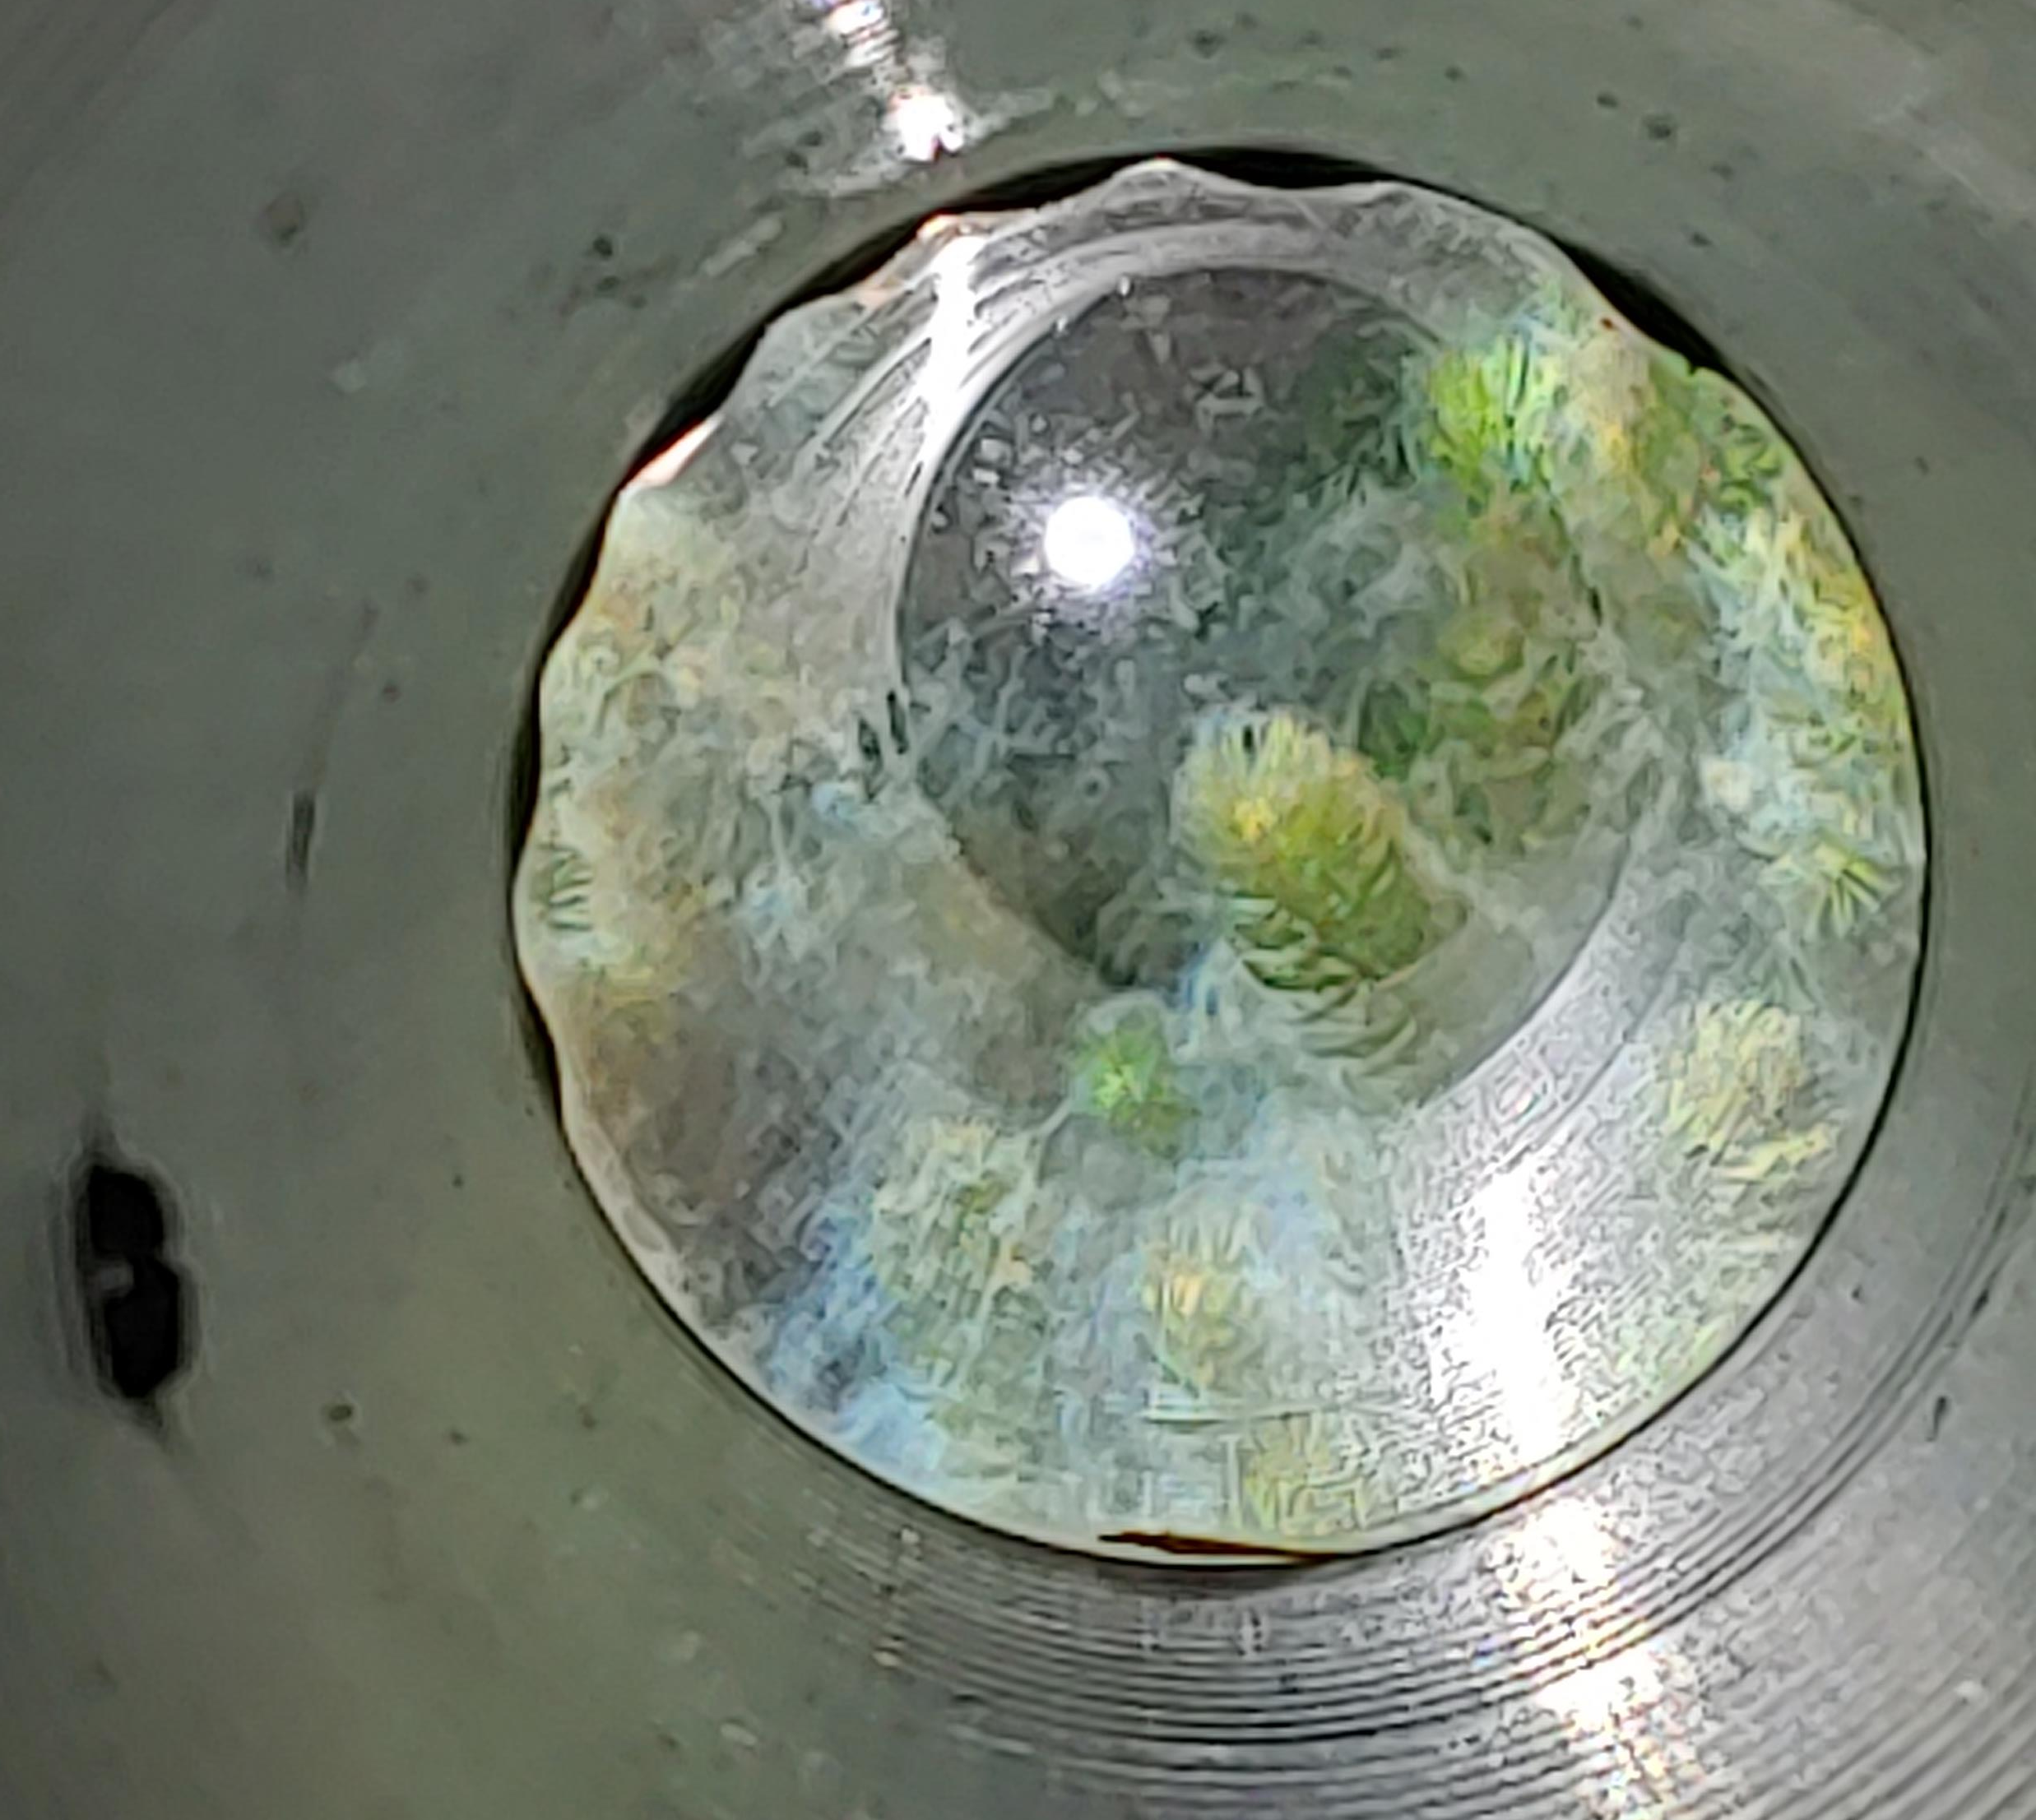
Aquatic Surveys 2022
Order of Priority for all Aquatic Noxious Weed Surveys:
State Listed EDRR Species
Pre-Treatment Surveys for treatment by Contractors (Diver or Applicator)
High Priority waterbodies or surveys of known listed species
Low priority waterbodies with no known establishment of listed species

Slide 13
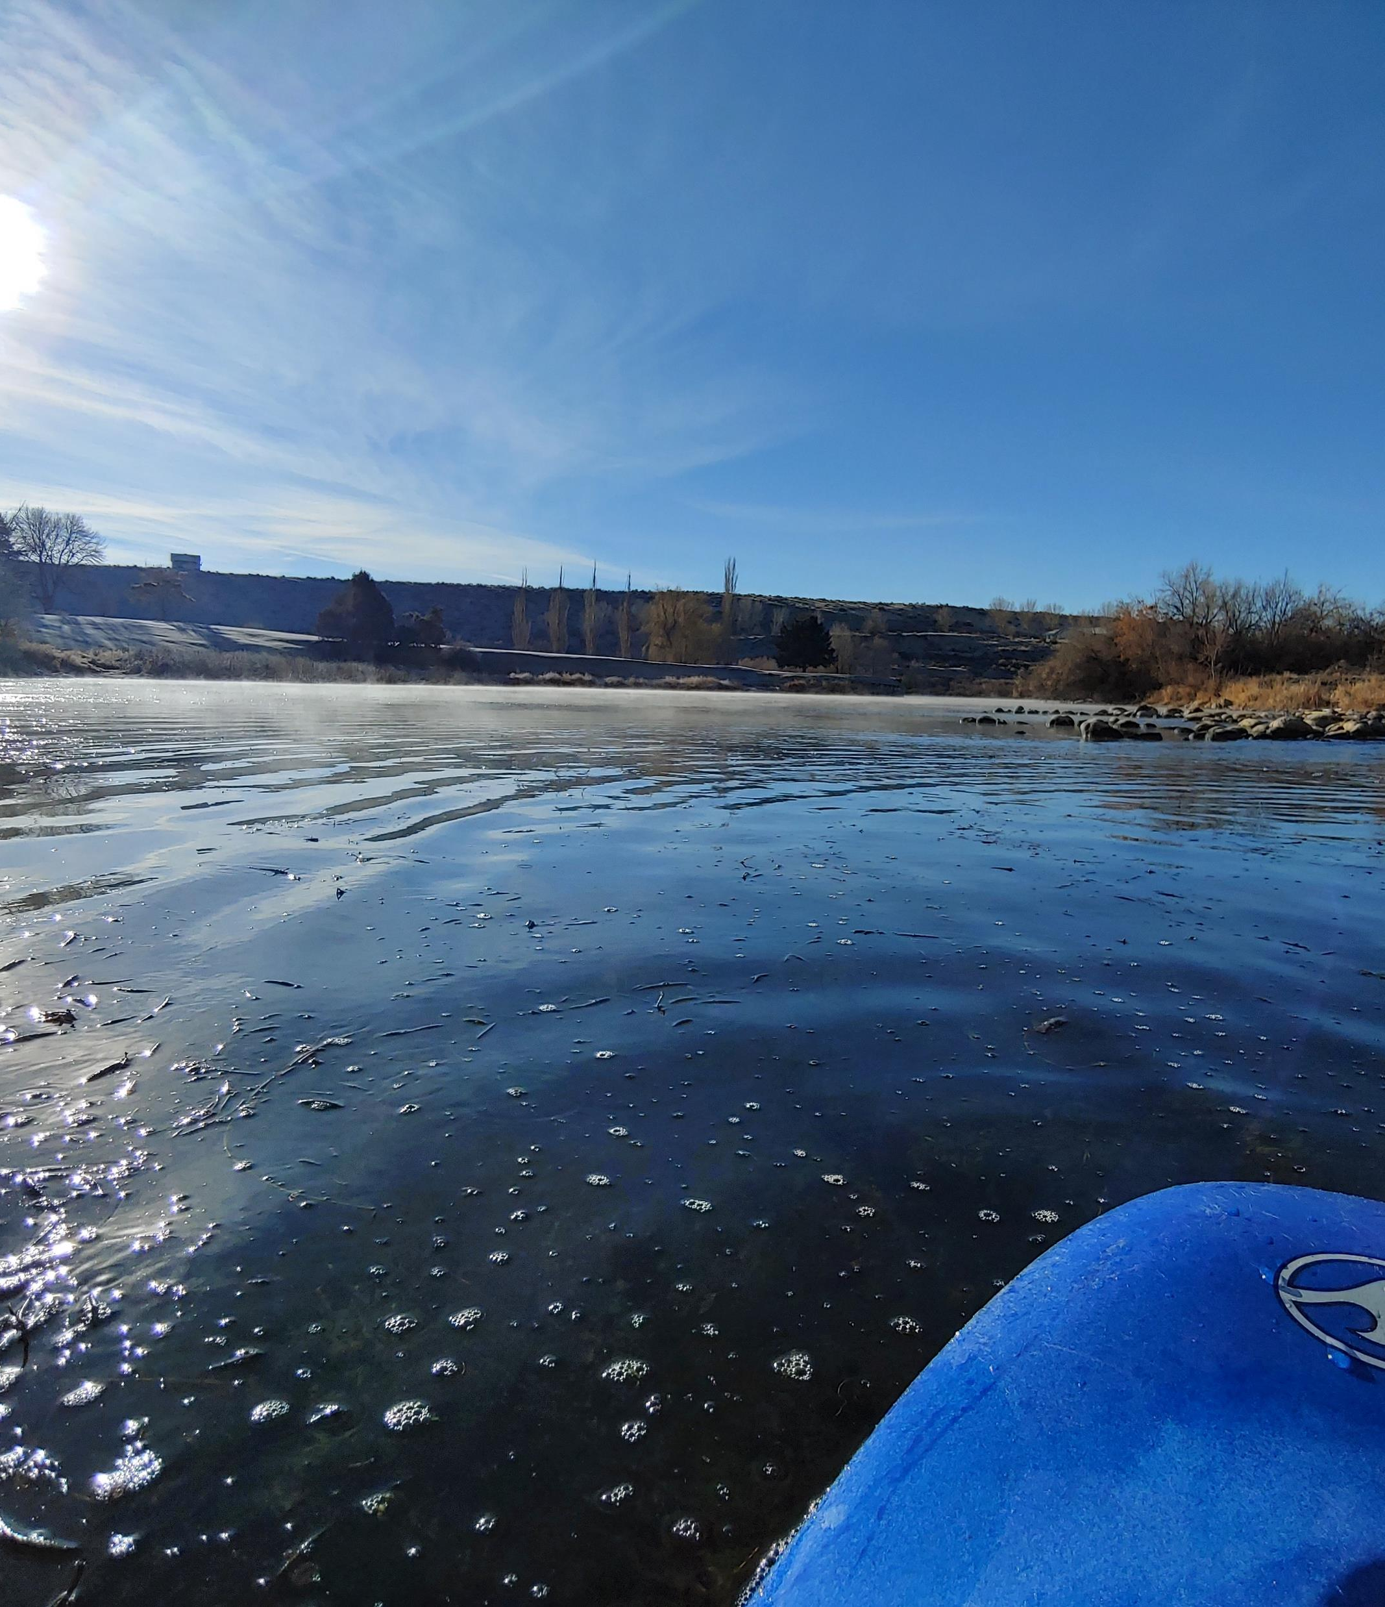
Tentative schedule for surveys – Spring
March-April- Payette River Slough PFM Pre-treatment survey and flow assessment
March-April- Coeur d’Alene CLP Pre-treatment survey
March- April- Hayden Lake CLP Pre-Treatment survey
March- Blue Heart EWM survey and assessment
March- Clear Springs EWM Survey and flow assessment
May- Blackfoot Reservoir FR water level assessment and pre-treatment survey
Notes:
NON EDRR

Slide 14

Tentative schedule for surveys – Summer
June-July- EWM Pre-treatment surveys on Hayden, Cocolalla, Priest, & Pend Oreille
June-July- FR Pre-treatment surveys on Pend Oreille
July-August- EWM Pre-treatment surveys on Bear Lake & River
July- FR Surveys and Treatment on Snake & Blackfoot Rivers
Notes:
NON EDRR

Slide 15
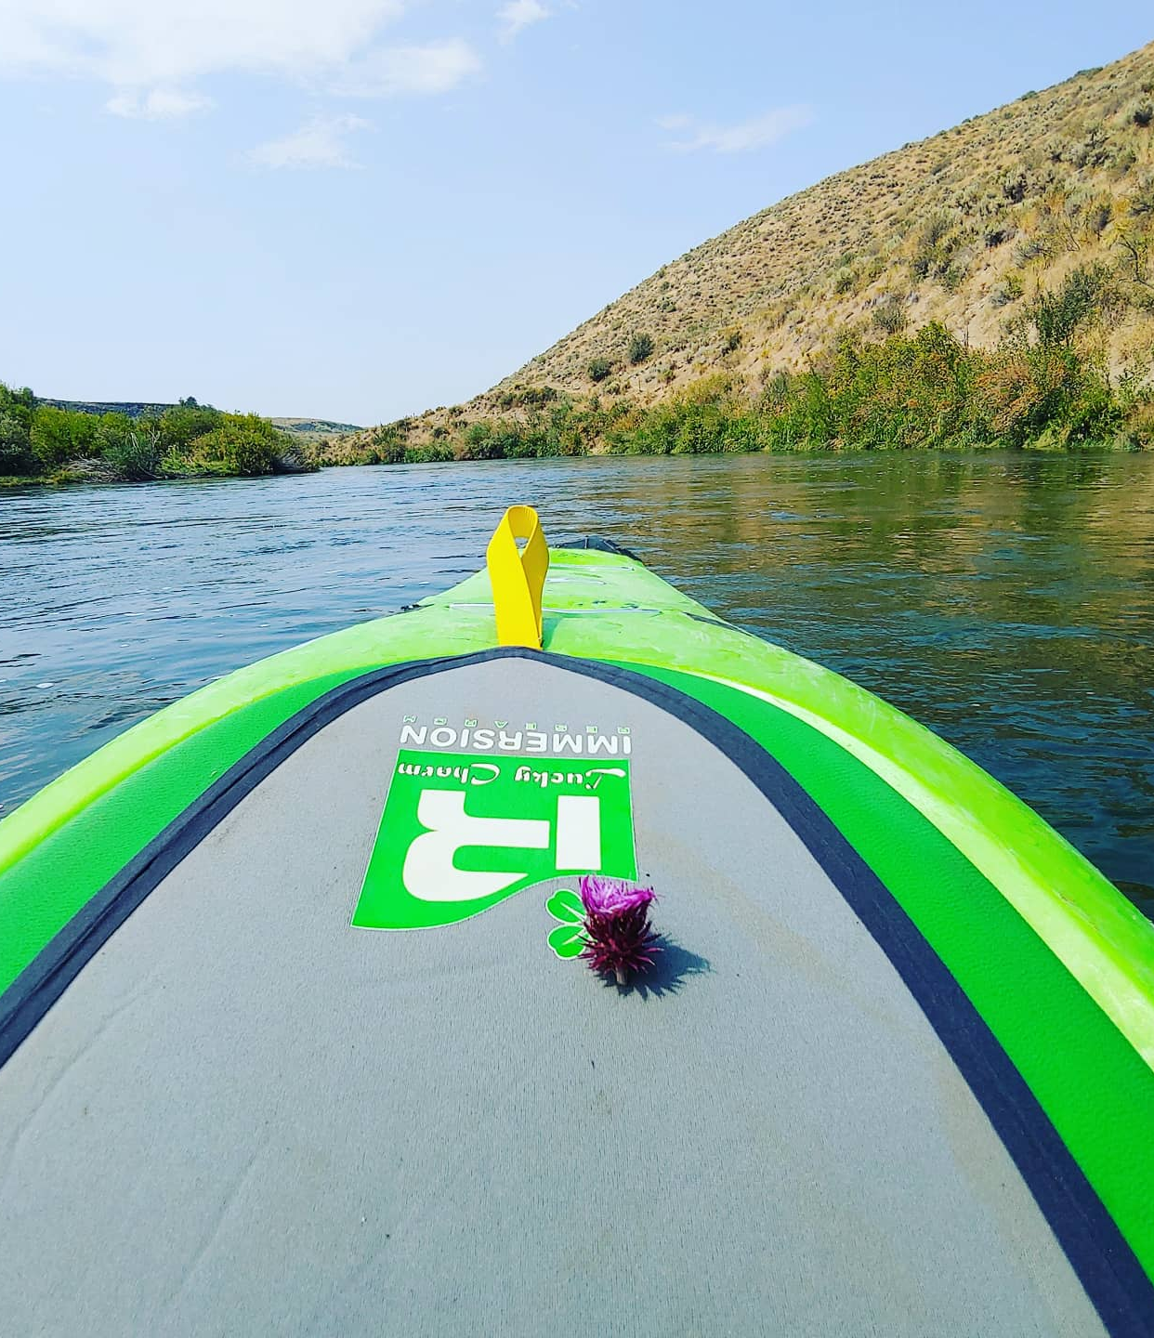
Tentative schedule for surveys – Fall
September-October- FR Blackfoot Reservoir drawdown survey
September- EWM Snake River Test Plot?? Pre-treatment survey
October- CLP Survey Coeur d’Alene Lake
October- CLP Turion survey Hayden Lake
October- FR Pend Oreille drawdown survey
Notes:
NON EDRR

Slide 16
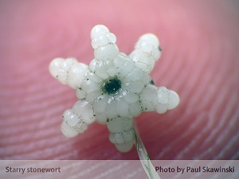
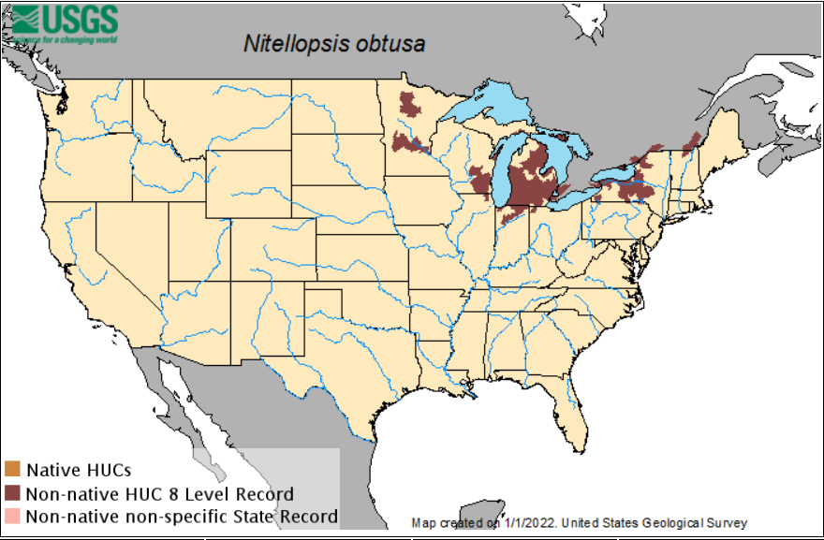
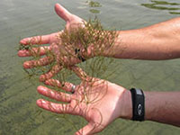

Starry Stonewort
Nitellopsis obtusa EDRR
Annual Macro-algae
Whorls of 4-6 thin bright green branchlets
White star-shaped bulbils about the size of a grain of rice
White filaments anchor algae to sediment
Not currently found in Idaho
Added during rulemaking in 2021
Concern for this species is based on its pattern of spread closely relating to that of dreissenid mussels
Notes:
New listing went into effect in July after completion of negotiated rulemaking

Slide 17
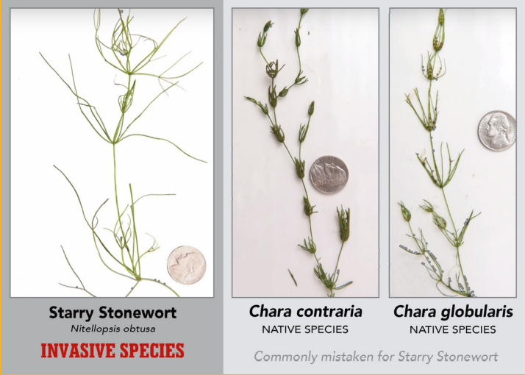

Slide 18
Thank You
Jeremey Varley
Jeremey.varley@isda.Idaho.gov
208-332-8667

