Slide 1
The Idaho Club North Lake Marina And Housing Development
Presented by Brad Smith, Idaho Conservation League
in conjunction with
Steve Holt, Lake Pend Oreille Waterkeeper
Whitney Palmer, Center for Biological Diversity

Slide 2
Topics
Location
Timeline
Project design
Environmental impacts
What should be done?

Slide 3
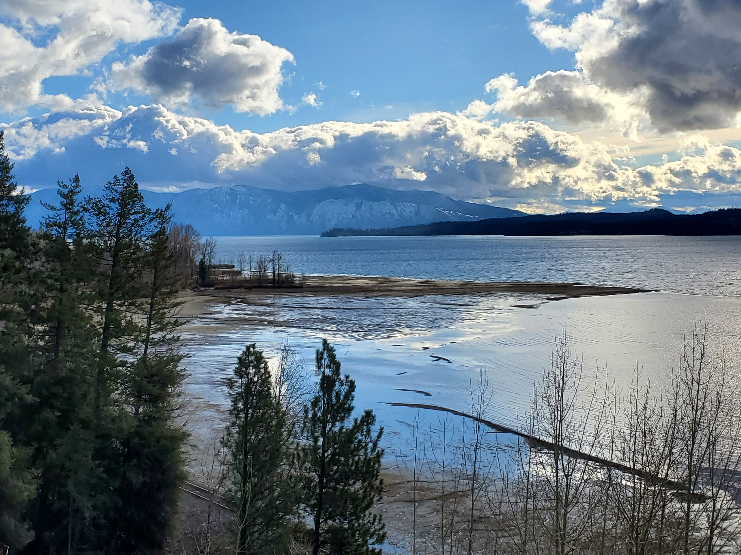

Slide 4
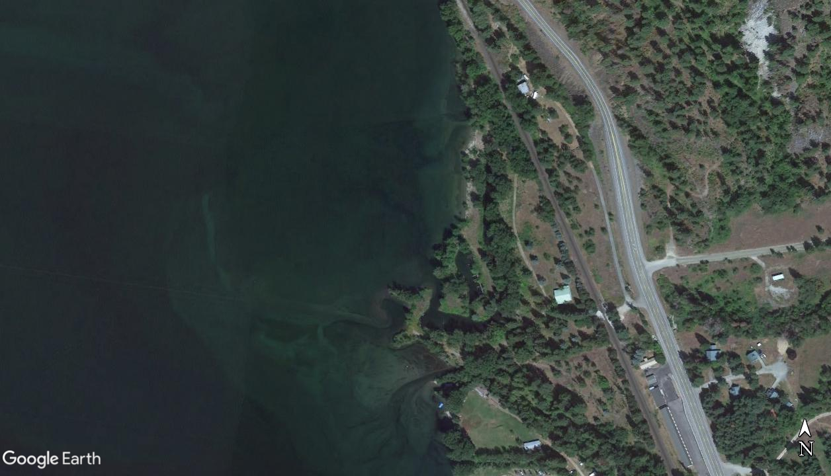

Slide 5
Timeline of events
2007: Original permit applications filed
May 2009: The Army Corps approved a dredge and fill permit for the project.
March 2012: The time limit for completing the work under the original permit was extended to March 2017.
November 2019: A new dredge and fill permit was approved by the Corps.

Slide 6
Timeline of events (continued)
January 2021: Planned Unit Development (PUD) approved by Bonner County
May 2021: The Center for Biological Diversity, Lake Pend Oreille Waterkeeper, and Idaho Conservation League filed a 60-day notice of intent to sue the Fish and Wild Service and Army Corps for violations of the Endangered Species Act (ESA).
July 2021: The Fish and Wildlife Service and Army Corps agreed to reinitiate consultation under the ESA.
Valliant Idaho has not yet submitted a revised proposal to the Corps.

Slide 7
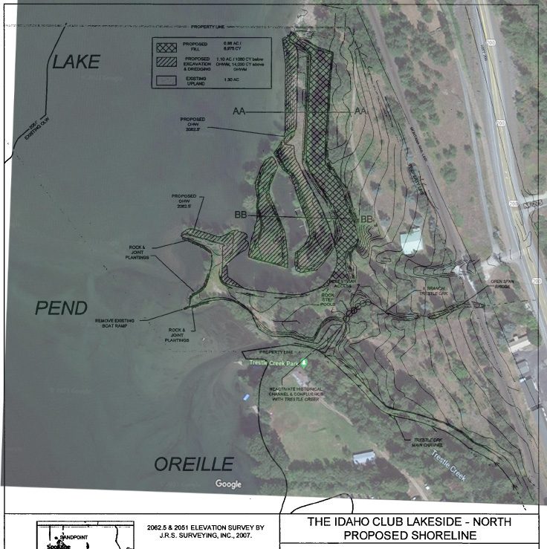
Dredge and fill
Project design
14,000 cubic yards of excavation and dredging
Removal of an island
8,500 cubic yards of fill
Expansion of uplands and realignment of the shoreline
Variance to county code with zero setback from the existing wetland
Reroute of the North Branch of Trestle Creek to flow into the main branch
Notes:
Overlay Map of Proposed Shoreline, showing dredge & fill areas (at high water mark)

Slide 8
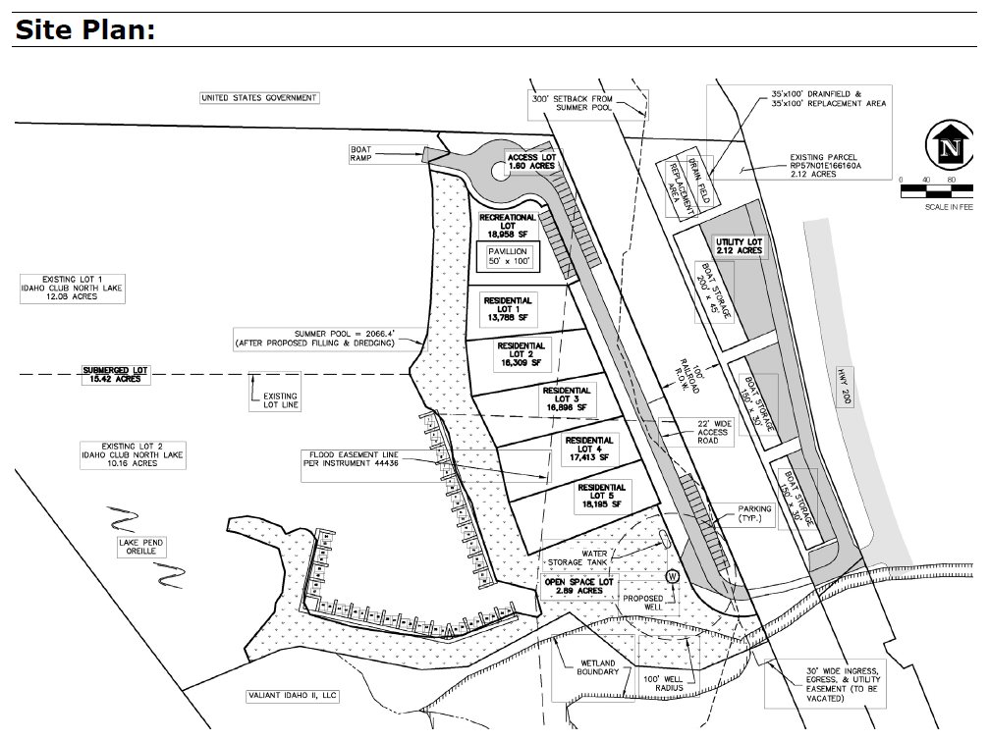
Planned unit development
Project design
5 residential units
50 - 105 boat slips
3 boat storage facilities
Boat ramp
Parking lots
Pavilion
Drain field
Well
1 at grade railroad crossing

Slide 9
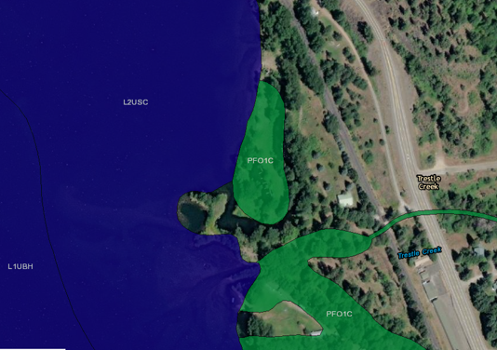
Environmental impacts - wetlands
Notes:
Image from the Fish & Wildlife Service’s National Wetlands Inventory Map – 2.67 acre wetland area will be affected.
The “wetland reconnaissance” performed by Sewell and Associates concludes that the project will not affect wetlands. The Corps simply accepted the this w/o scrutiny.
Because of the determination that the project would not affect wetlands, the County approved a variance to the normal code requirement of having a 40-ft setback from wetlands. [BCRC 12-733(B)].
Should the loss of wetlands be mitigated for?

Slide 10
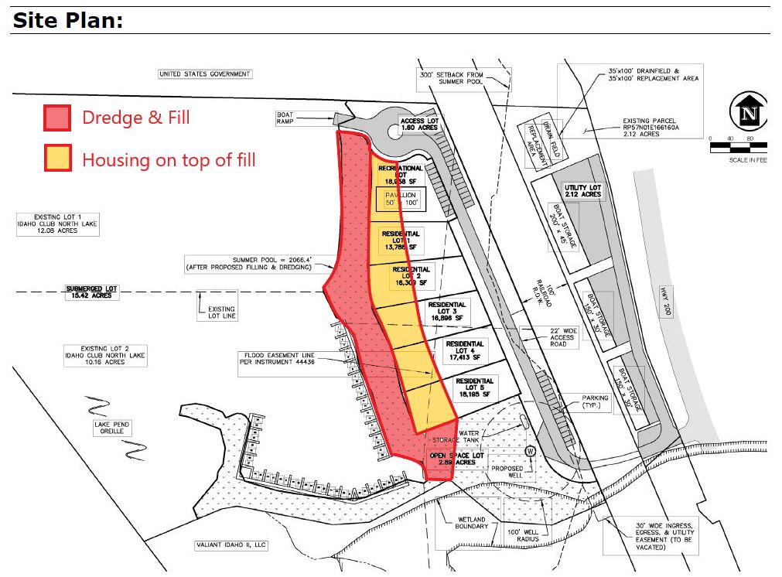
Environmental impacts - wetlands
Notes:
The Corps refused to assess environmental impacts associated with the “upland” development, stating that the development plans for the uplands could proceed whether or not dredging or filling occurs.
Had to create this overlay ourselves by superimposing the drawings from the Corps dredge and fill permit over the site plan submitted to the county.
Fill is clearly required for the residential units to be constructed, and apparently the developer has indicated as such to federal agencies.

Slide 11
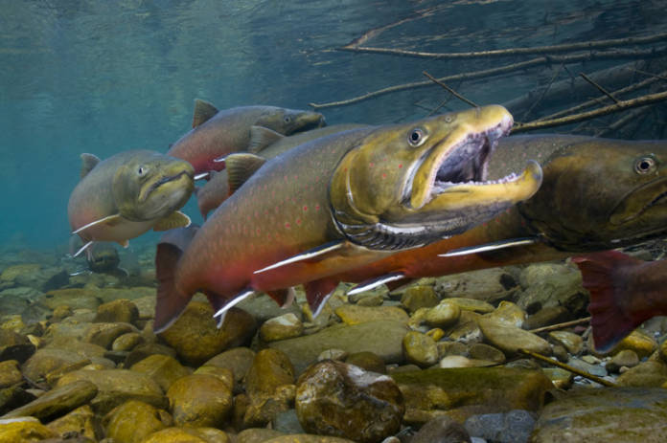
Environmental impacts – bull trout
Trestle Creek supports 30 to 50% of all redds in the Pend Oreille Watershed – nearly twice that of any other stream.
The first 0.8 mile of the stream above its outlet is utilized for migration of adults and resting and rearing of juveniles.
Another 9 miles are used for spawning.
Substantial investments in habitat restoration have been made upstream by the Forest Service, Avista and private land owners
Notes:
Bull trout were listed in 1998
Take and adverse modification of bull trout critical habitat prohibited by the endangered species act
Federal agencies like the Corps must consult with the Fish and Wildlife Service regarding projects that could affect listed species or critical habitat.

Slide 12
Environmental impacts – bull trout
Excavation could overlap with bull trout presence
Marina will create an environment that favors predators and competitors of bull trout
Both branches of the creek will be confined to single-threaded, incised, and uniform/simplified channels
Low pool frequency means few resting places for fish when migrating upstream and little juvenile rearing habitat
Less stream shading and higher stream temperatures
Will “step pools” associated with the North Branch be passible?

Slide 13
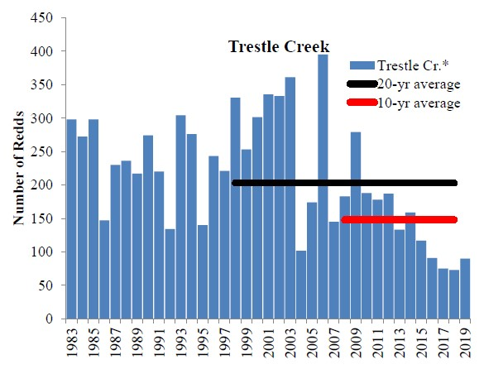
Environmental impacts – bull trout
Notes:
2019 Pend Oreille Basin Bull Trout Redd Monitoring Project Update – Authored by Avista and Idaho Fish and Game
This report was the basis for our NOI – shows that the ten-year average is in decline.
The ESA requires reinitiation of consultation if conditions have changed since prior consultation.
We don’t know what changes are being made to the project plans now, but formal consultation has been requested by Fish and Wildlife Service, which means a more in depth evaluation of impacts to bull trout will be made in a biological opinion with the new development and restoration plans.

Slide 14
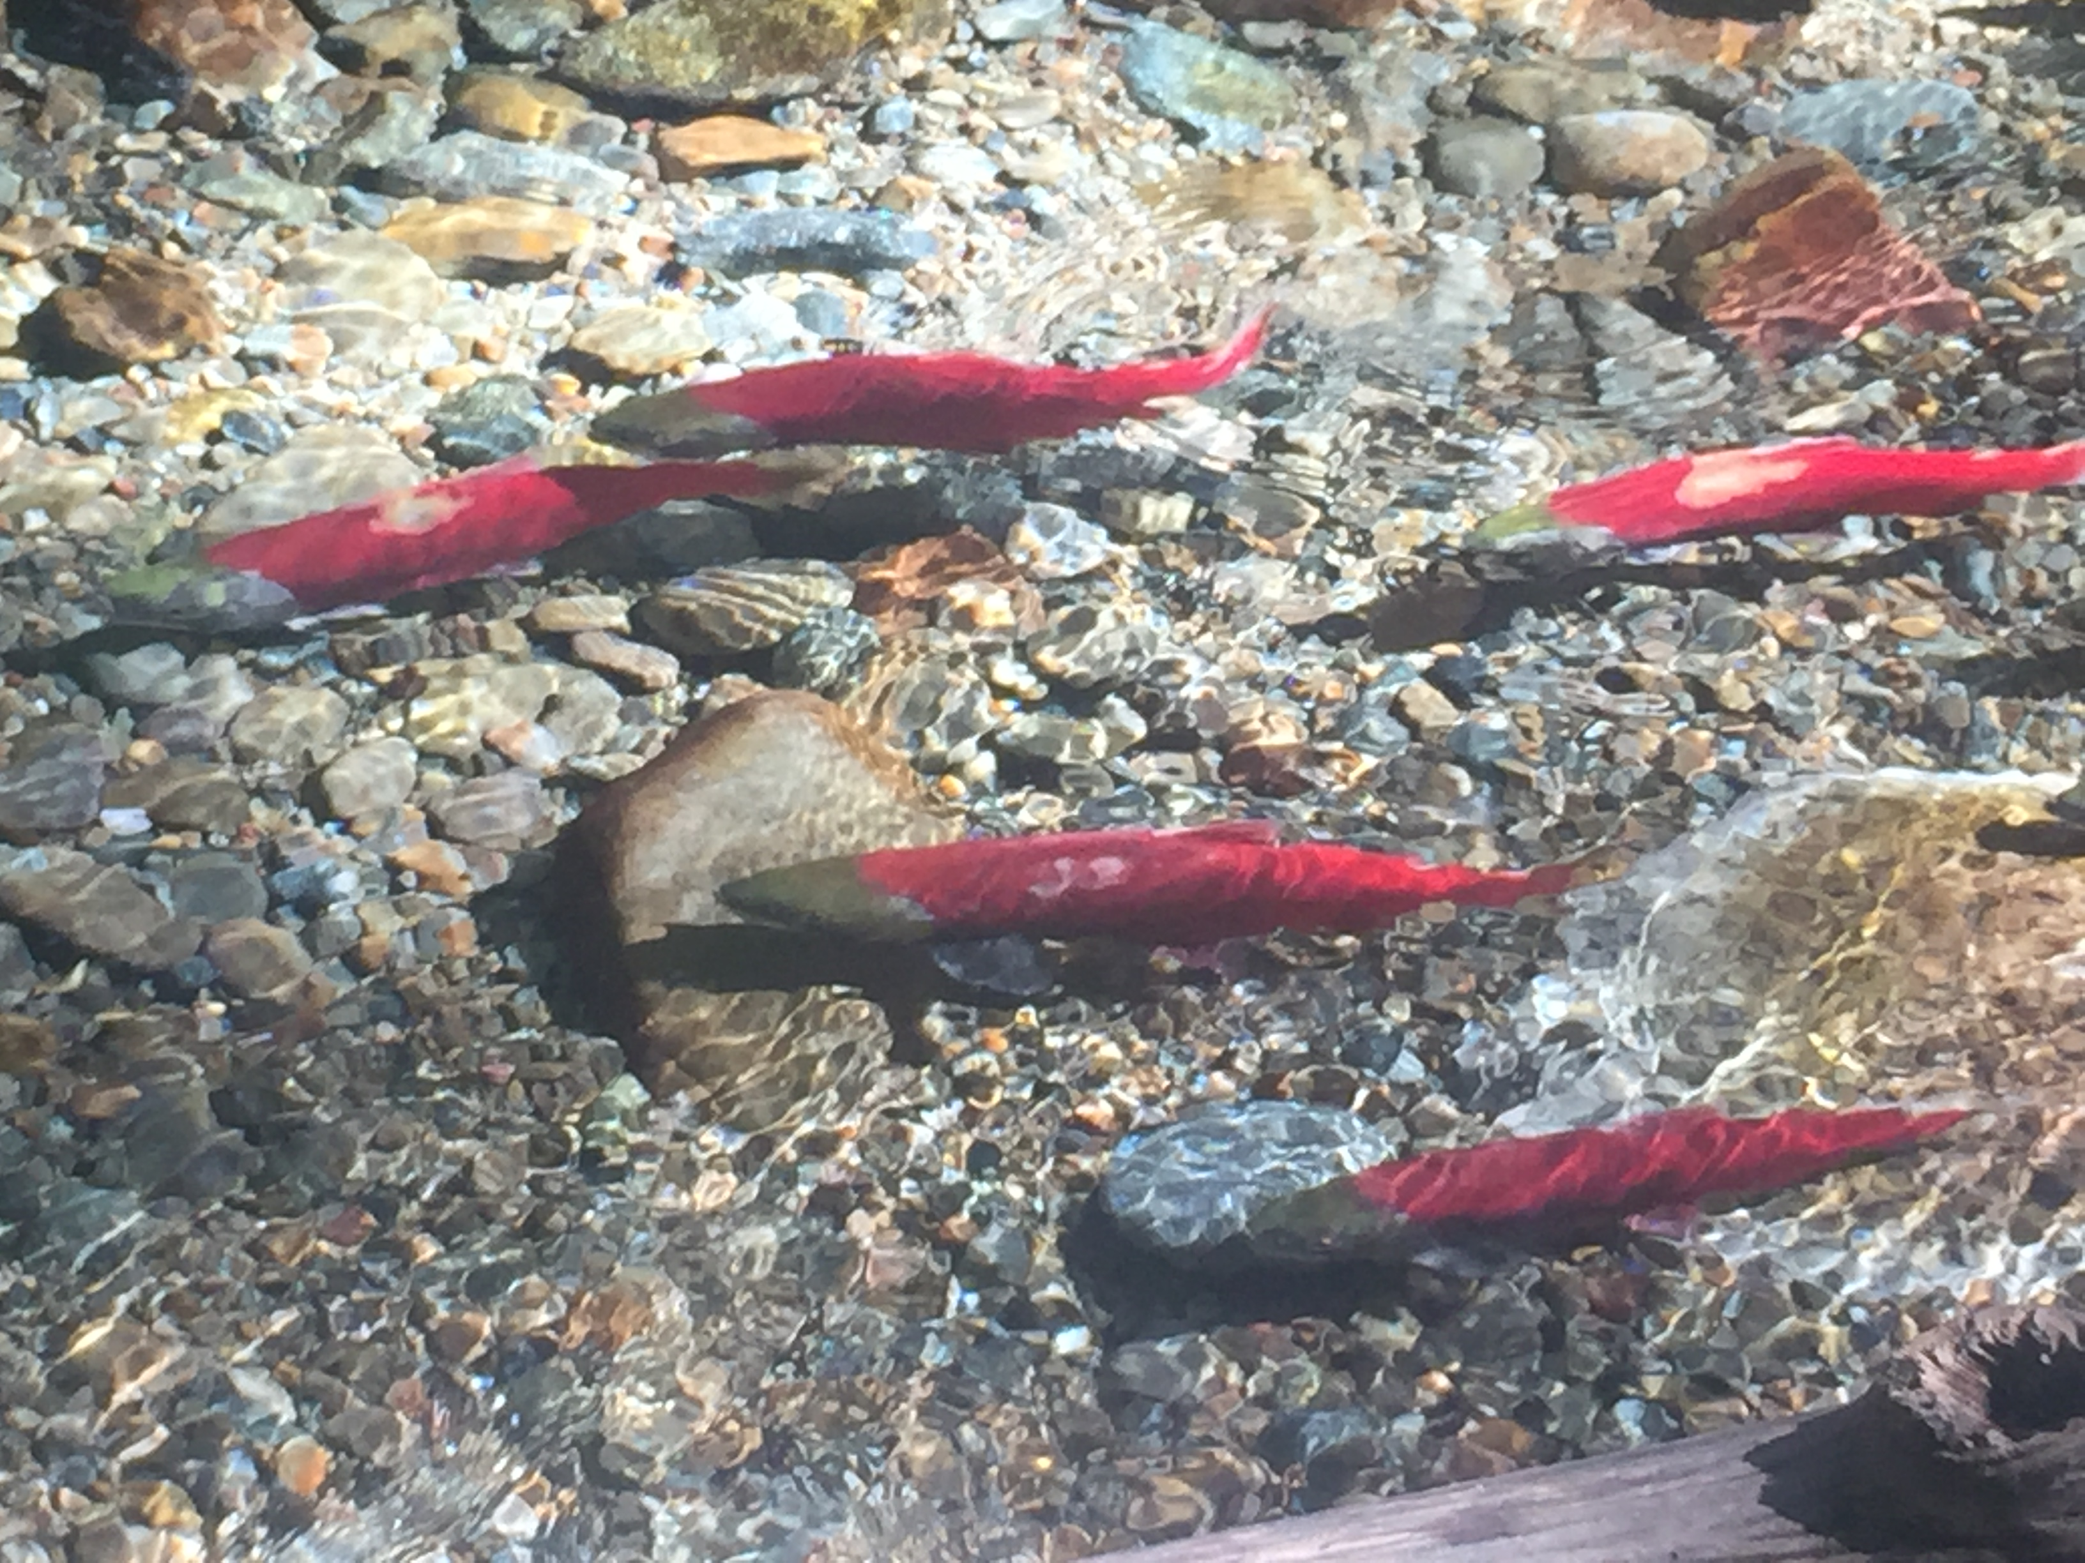
Environmental impacts – other fish and wildlife

Slide 15
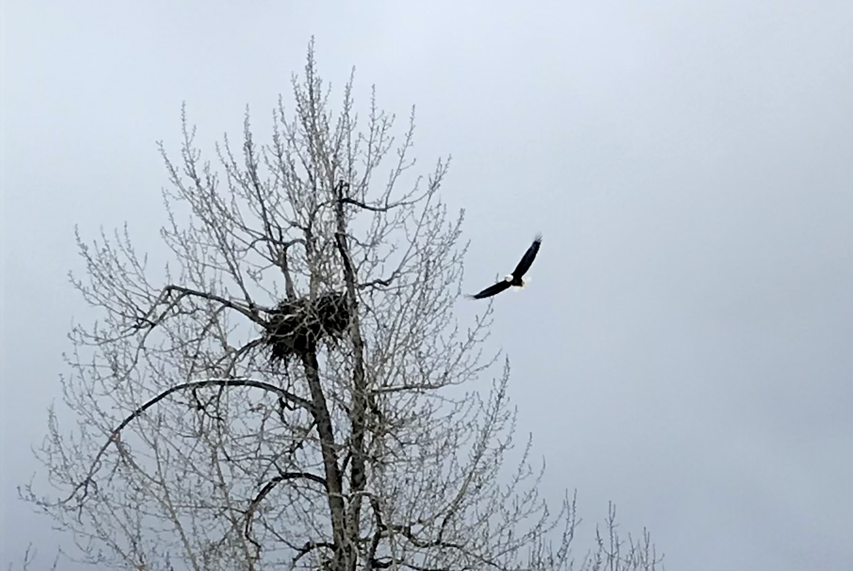
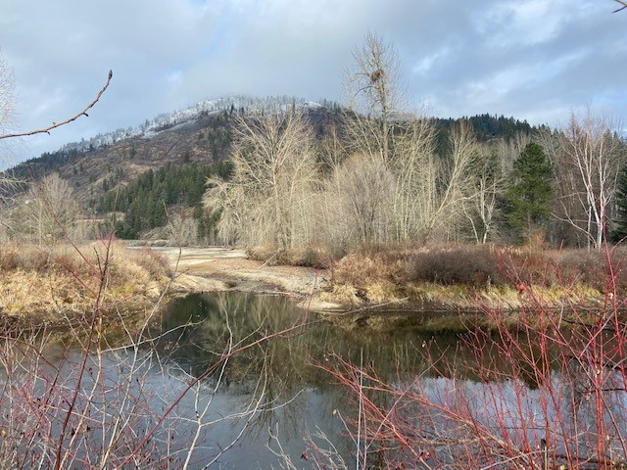
Environmental impacts – other fish and wildlife

Slide 16
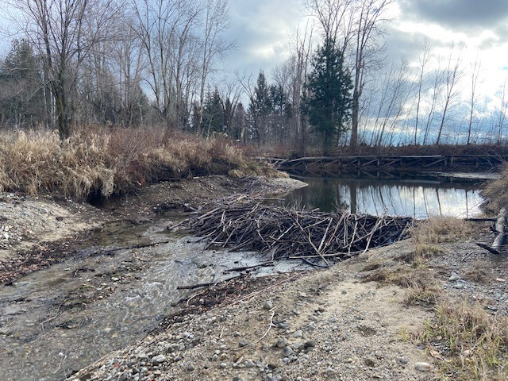
Environmental impacts – other fish and wildlife

Slide 17
Environmental impacts - other
Water quality degradation - nutrient loading, turbidity, sedimentation, pollution from boats
Inadequate shoreline buffers will reduce shade and increase sedimentation, water temperature, and nutrient loads
No wetland mitigation
Bonner County doubled the allowable amount of impervious surfaces on the site to 70%
Loss of aesthetics and reduced public enjoyment
Notes:
Public comments expressing concerns have been submitted to the Army Corps of Engineers through the course of the permit approvals since 2008.
Concerns were voiced by non governmental organizations, including the Lake Pend Oreille Waterkeeper, Idaho Conservation League, Selkirk Conservation Alliance, the Lakes Commission, Trout Unlimited, Bonner County Sportsmen, Clark Fork Coalition, and individual community members with high concerns regarding bull trout. Some of these concerns are outlined above.
The Montana Rail Link has concerns regarding the Railroad crossing. Trains travel at a high speed through the area.
The Sam Owen Fire Department raised concerns about access of fire trucks.
(Excerpts)
ICL (2018):
“Housing development and agricultural practices in the county, among other activities, have led to high levels of nutrient pollution in Lake Pend Oreille, causing excessive and detrimental plant growth in the water. Similar activities have led to reductions in riparian buffers causing higher water temperatures in Trestle Creek.”
“...the northern nearshore portion of Lake Pend Oreille continues to suffer from excessive phosphorus loading, with some of the highest nutrient concentrations recorded near the Trestle Creek confluence. Upstream, the temperature TMDL for Trestle Creek identified a need for an 18-29% reduction in solar load necessary to reduce water temperature. One of the most effective methods for reducing nutrient loading in the lake, as well as decreasing water temperature in Trestle Creek, is protecting and enhancing wetlands in the area.”
“Lake Pend Oreille, and in particular Trestle Creek, provide critical habitat to bull trout, a federally listed species under the Endangered Species Act, as well as to kokanee and other fish species. Trestle Creek is widely regarded as one of the most important bull trout spawning habitats in the Pacific Northwest, with records indicating the creek hosts hundreds of redds annually. Fish spawning in Trestle Creek is so prolific that locals and tourists from around the country make the annual visit to watch the creek turn red with kokanee”
LPOW (2018):
“It is unclear whether the permanent removal of wetland habitat will be mitigated for. While the public notice states that “A vegetation restoration plan will be implemented and monitored for the reconstructed shoreline of Lake Pend Oreille and the riparian areas of Trestle Creek...” it is not clear if the intent of this proposed restoration plan and/or the Trestle Creek Restoration Project is to achieve “no net loss” of wetland habitat specifically through compensatory mitigation.”
“And, if the intent of the proposed restoration project is indeed to mitigate for permanent wetland habitat loss, we respectfully request clarity as to how these measures achieve “no net loss” of wetland habitat. If the proposed measures do not achieve “no net loss” then we request the applicant consider implementing additional measures to do so. Please also consider the cumulative impacts of permanent wetland removal throughout Lake Pend Oreille.”
“Given that Trestle Creek currently holds a temperature TMDL, we request the stream restoration component of the project add and maintain shade-producing trees and shrubs where possible to reduce temperature stress to cold water macroinvertebrates and resident and spawning fish. We request clarity as to whether any large trees or woody shrubs that currently offer shade to Lake Pend Oreille or Trestle Creek will be removed over the course of the proposed project. We also recommend that a long-term monitoring and maintenance schedule is implemented for the reconstructed shoreline in the north project area in order to ensure the preservation of a native grass shoreline buffer.”

Slide 18
Comments of concern
NGOs
Center for Biological Diversity
Lake Pend Oreille Waterkeeper
Idaho Conservation League
Selkirk Conservation Alliance
Agencies
Idaho Fish and Game
Idaho Department of Environmental Quality
Fish and Wildlife Service

Slide 19
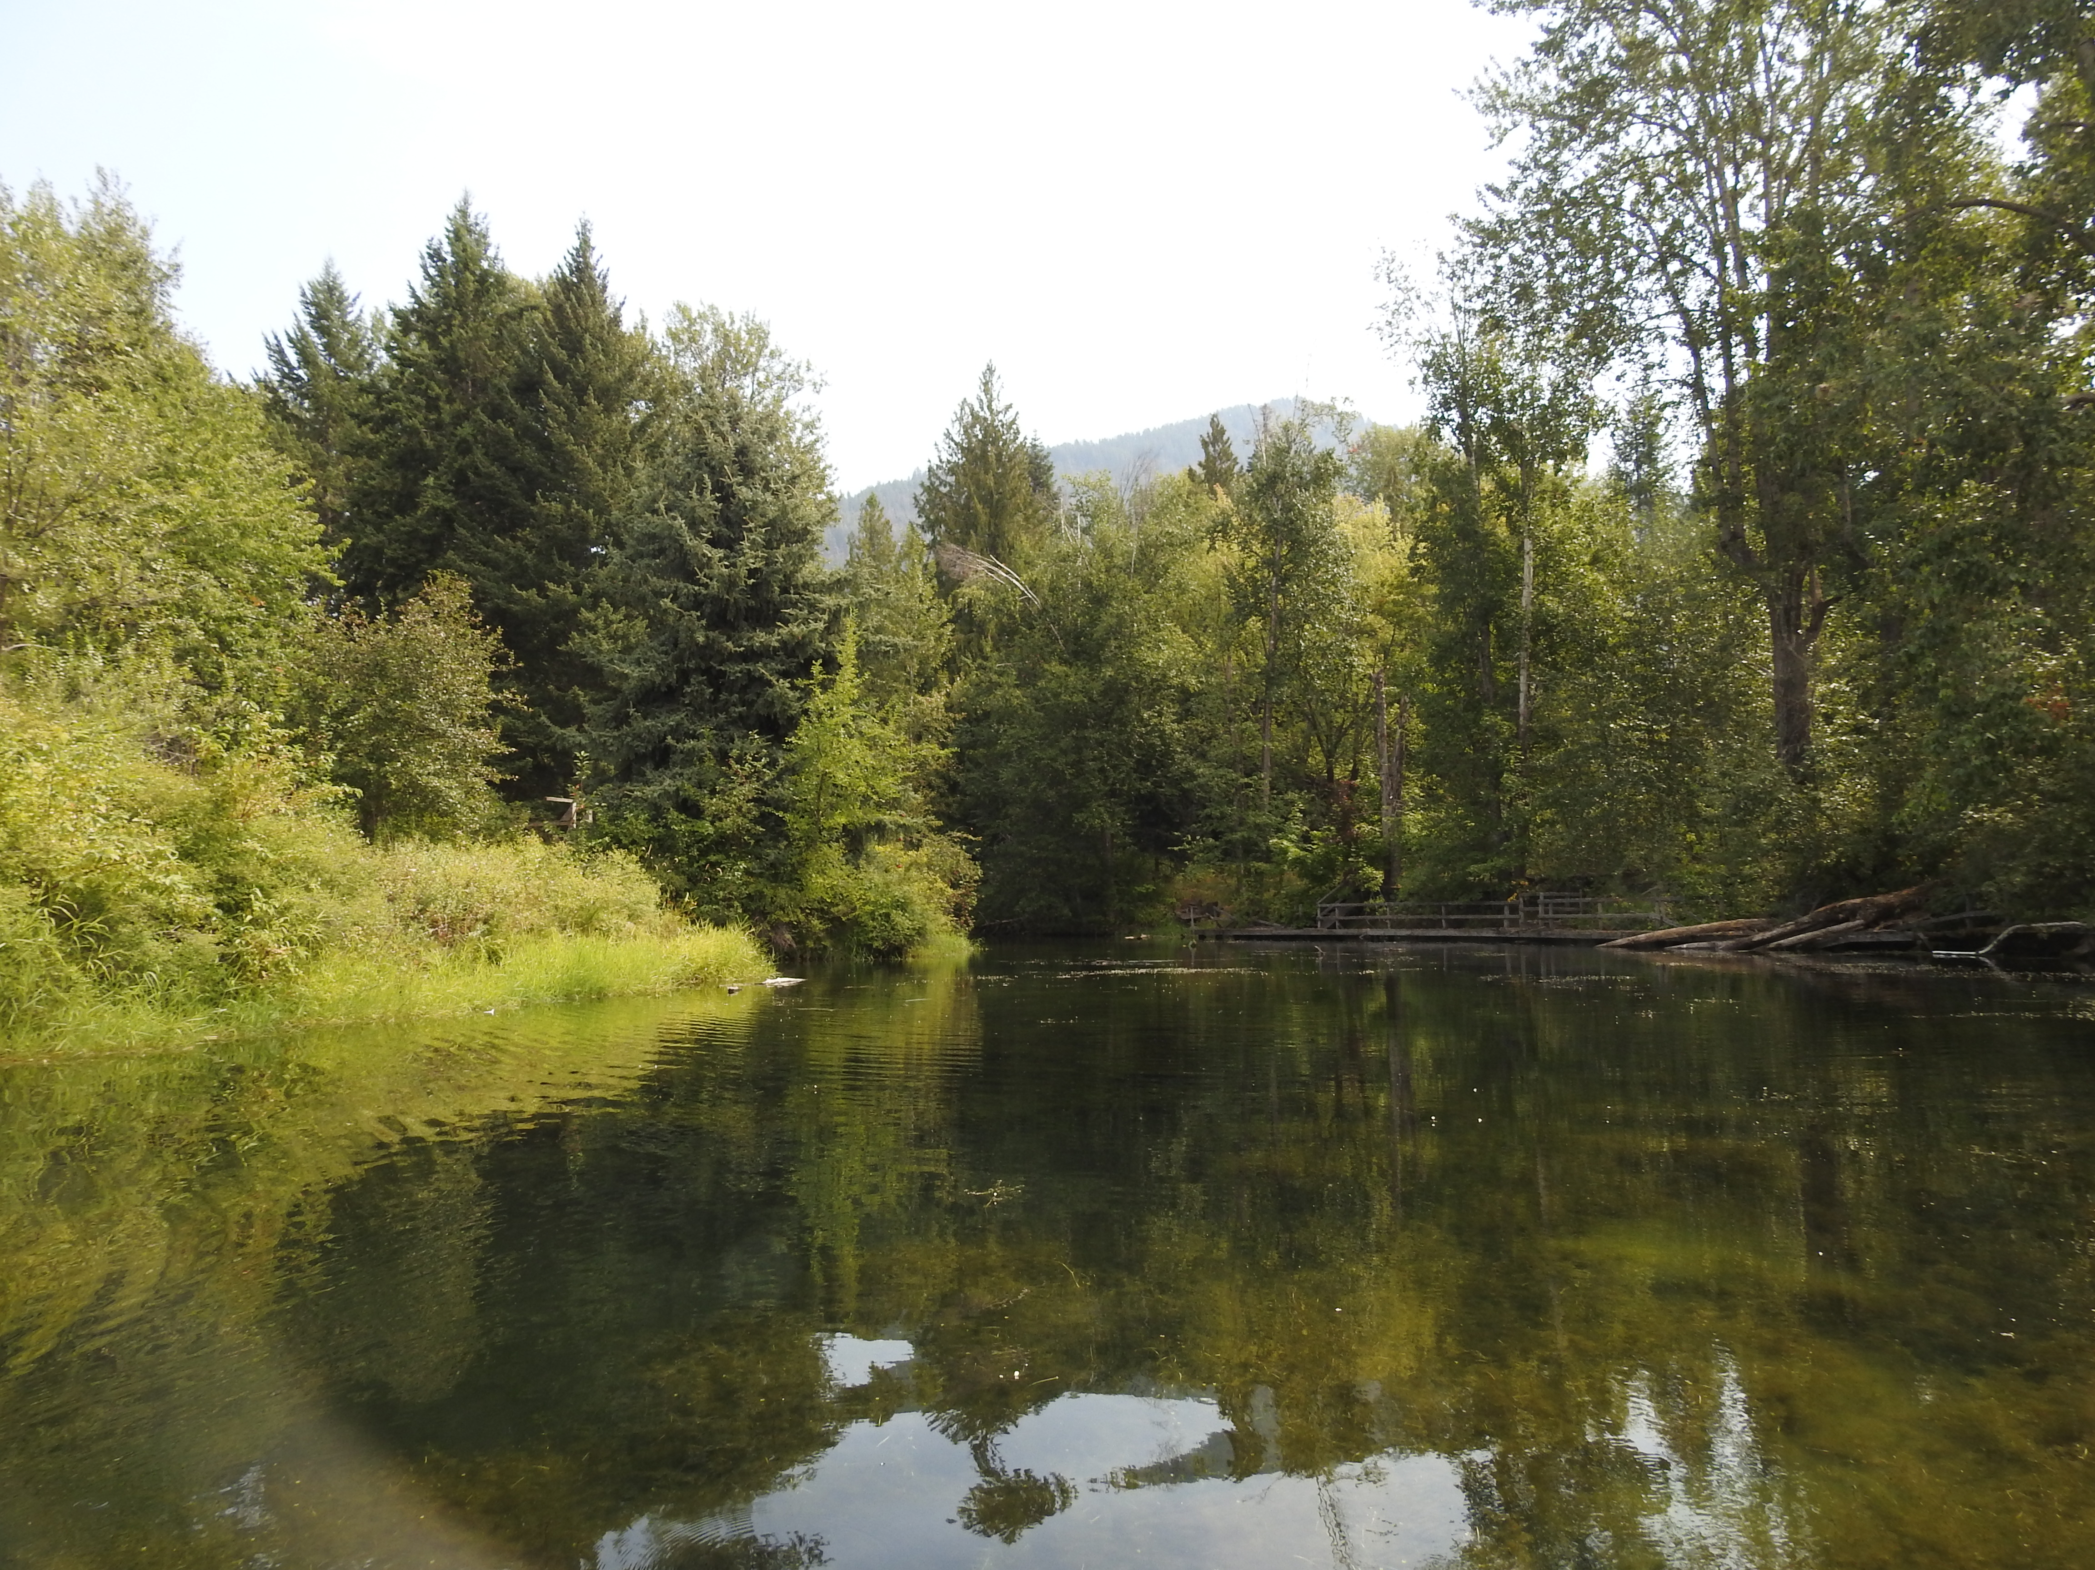
What should be done?
Need a clear up the inconsistencies in the plans
Need to redo the environmental assessment and adequately consider impacts to fish, wetlands, and uplands
Need to properly mitigate if the project is approved
Property should held in trust for the benefit of the public and fish and wildlife
Notes:
Inconsistencies: fill for the housing development, number of boat slips

