Slide 1
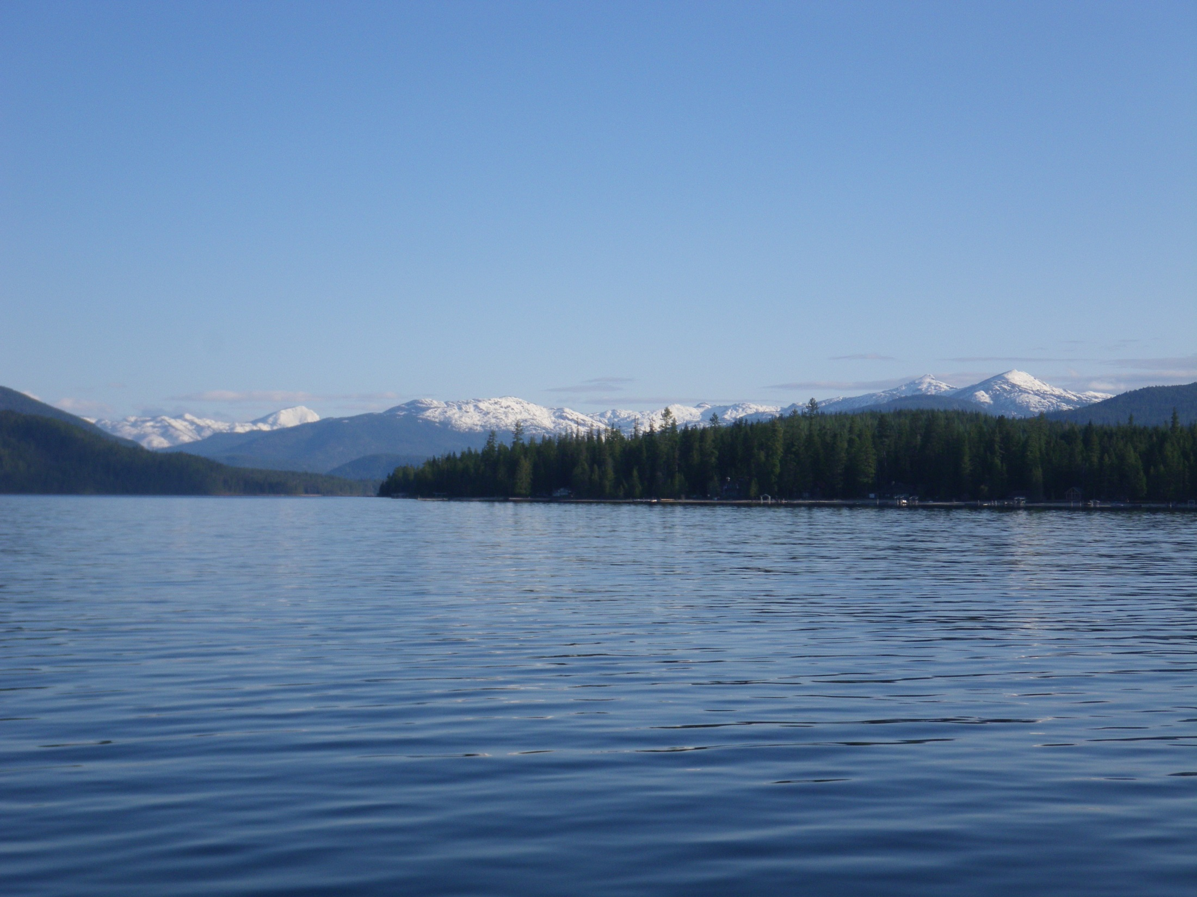
Priest Lake Fishery Update
Lakes Commission Meeting
September 17, 2015
Priest River, Idaho

Slide 2
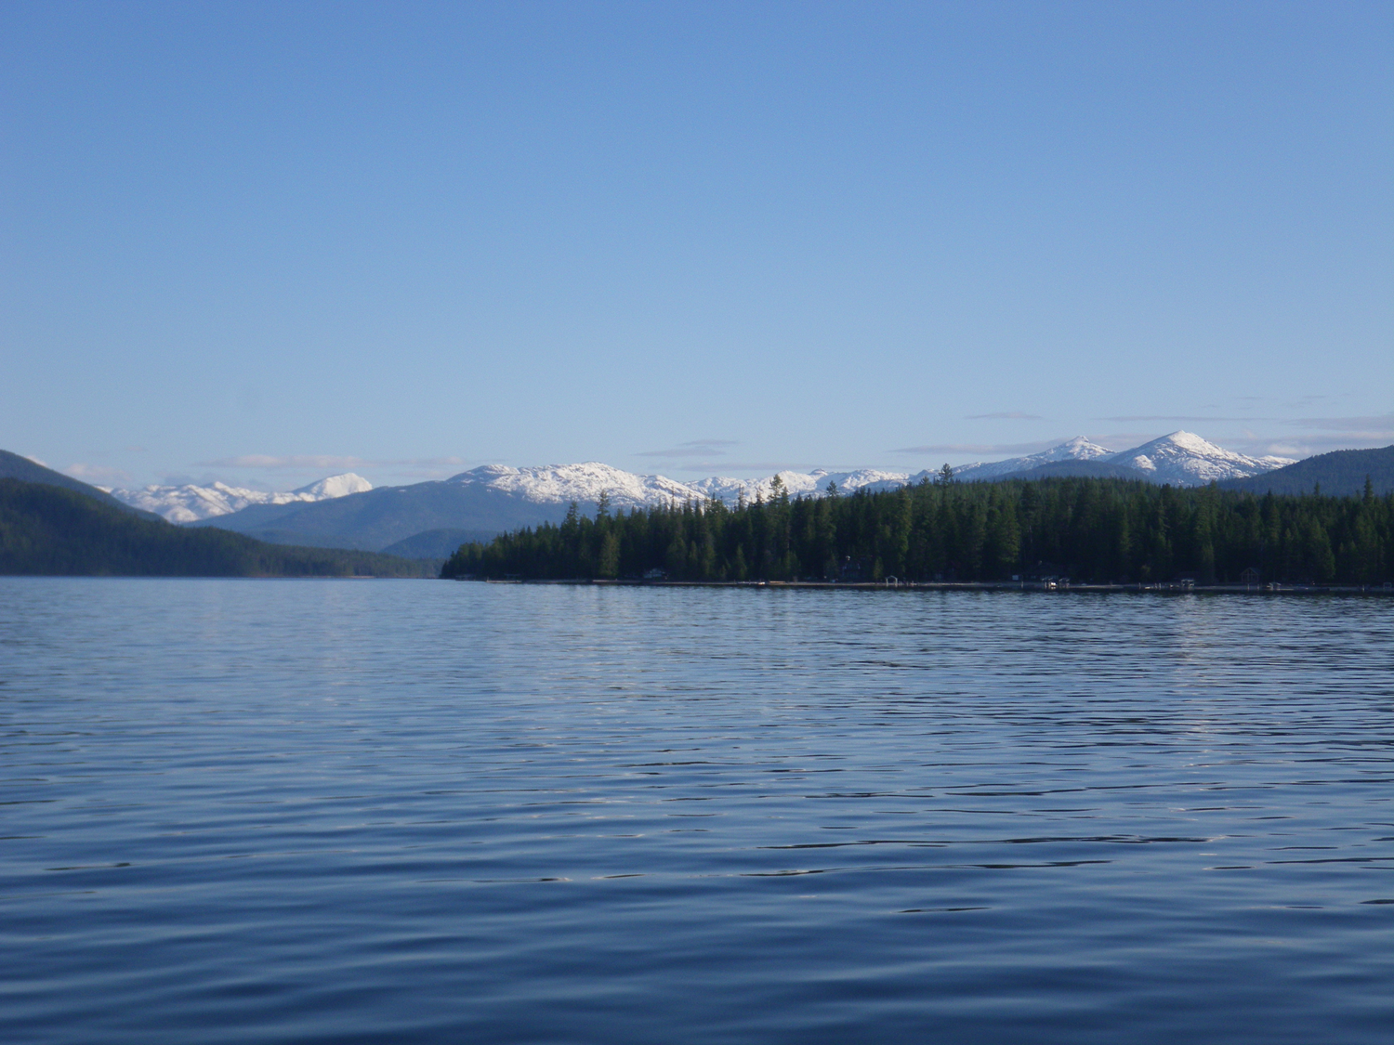
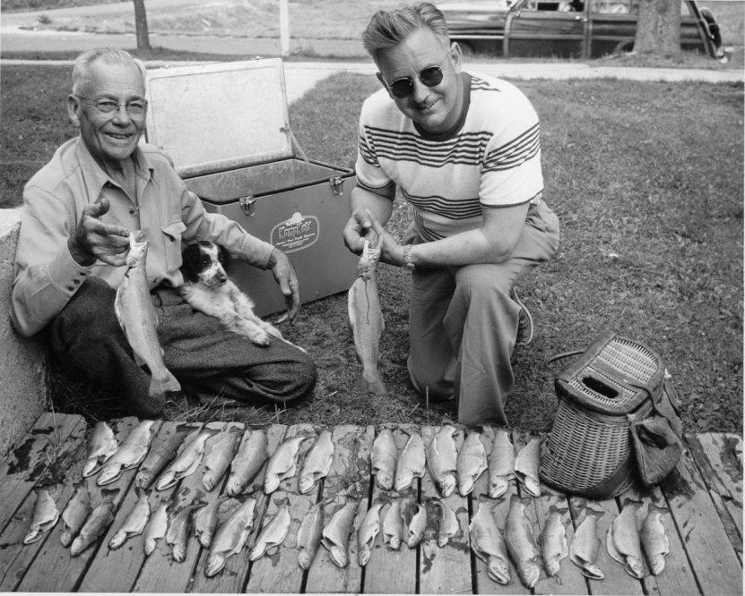
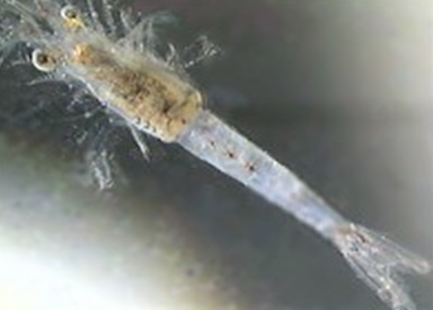
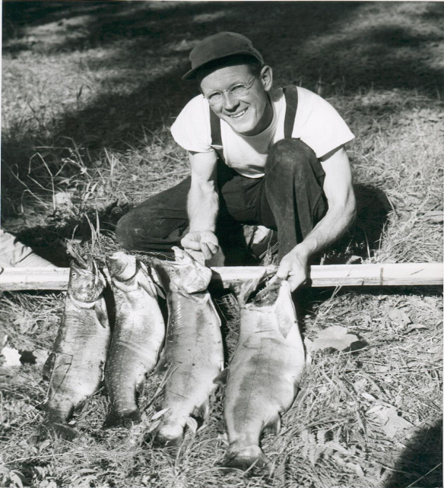
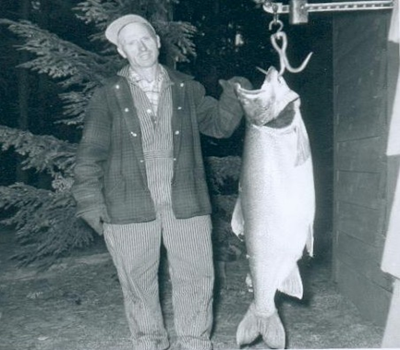
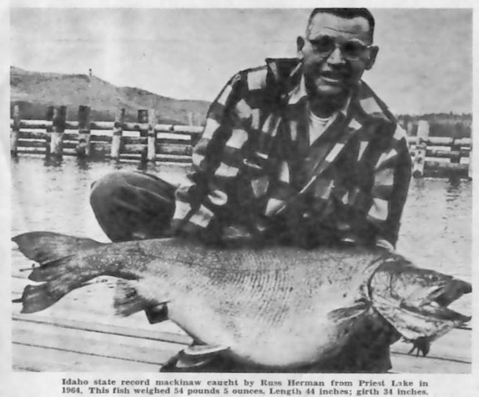
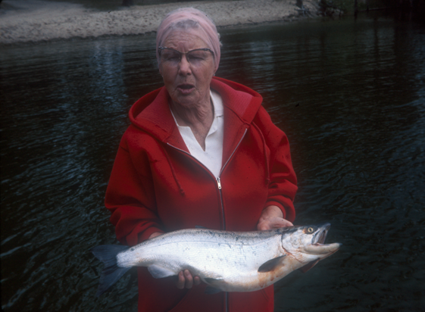
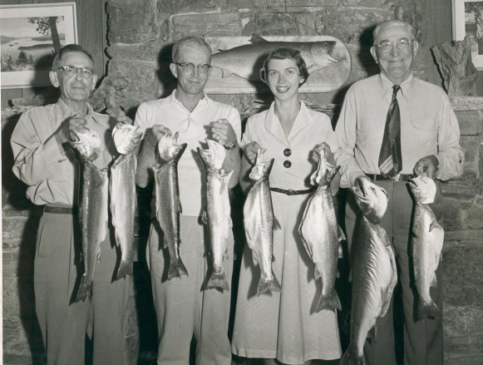
History of Fishery
Cutthroat: World-renowned fishery ‘til 50’s
Bull Trout fishery ‘til late 70’s
Kokanee: Introduced in 1930’s and 40’s
  Annual harvest of 100,000 for 20 years
Lake Trout: Introduced in 1925
  Low density population for decades
  State record 57 ½ pounds
Mysis: introduced in 1965

Slide 3
Priest Lake Fishery - 1956 to 2003

Slide 4
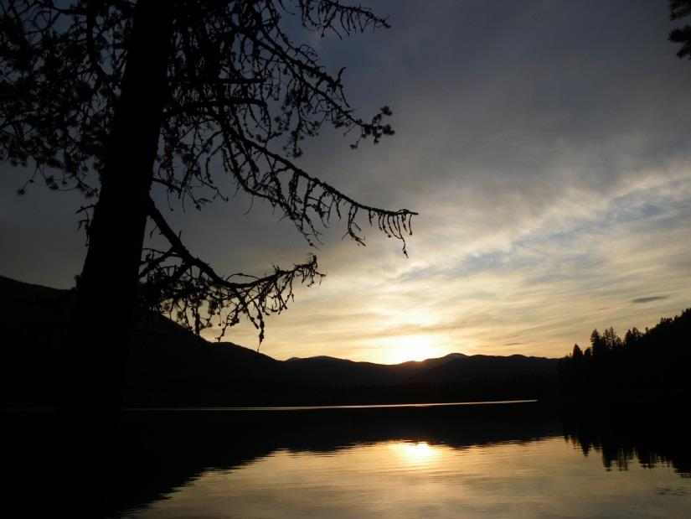
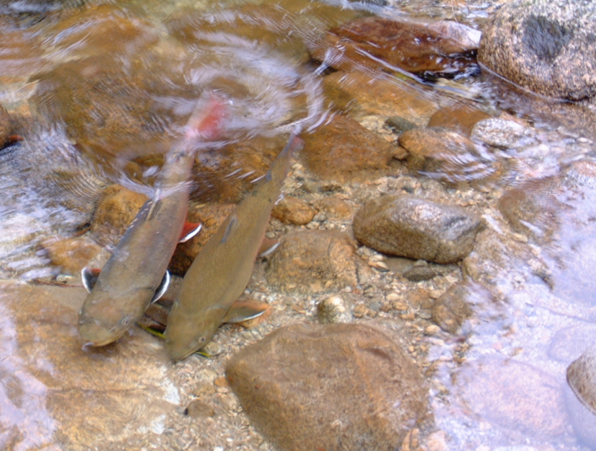
Upper Priest Lake History
Lake trout non-existent in upper lake in 1956
Occasionally caught by 1985 and common by 1993
First experimental removal in 1998
Commercial netting began in 2006
  70-80% of lake trout removed annually
  Re-establish by moving in from main lake

Slide 5
Priest and Upper Priest Options
Discontinue suppression efforts in Upper Priest Lake and allow lake trout to dominate both lakes
  Is the least expensive alternative
  Makes lake trout anglers happy
  Likely means loss of bull trout and major decline in cutthroat trout
Develop a plan and seek funding to aggressively suppress lake trout in Priest Lake
  Would result in a more diverse fishery (kokanee, cutthroat, bull trout)
  Would likely generate more angler effort
  No guarantee of funding
  Effort would take several years

Slide 6

2013-2018 Management Plan
Collect information necessary to make an informed decision on how to manage Priest and Upper Priest lakes into the long-term future.
Work with stakeholders to develop an information based decision making process that will culminate with a decision on how to manage the two lakes

Slide 7
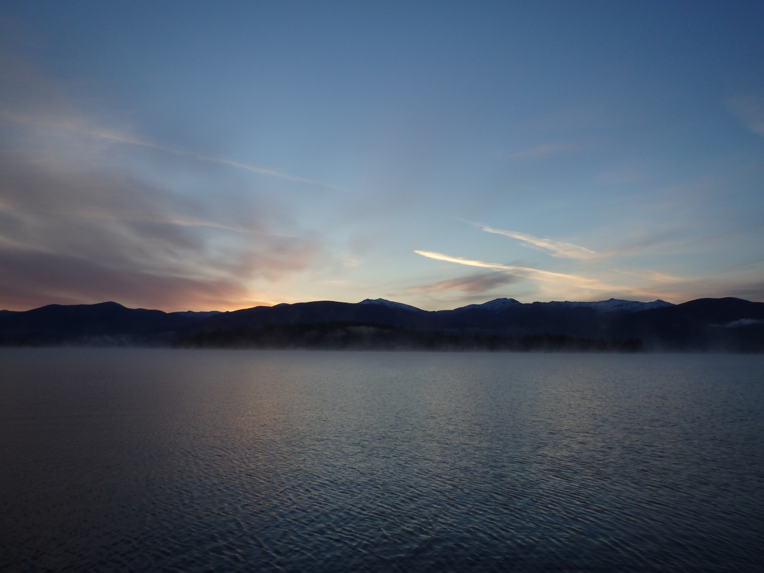


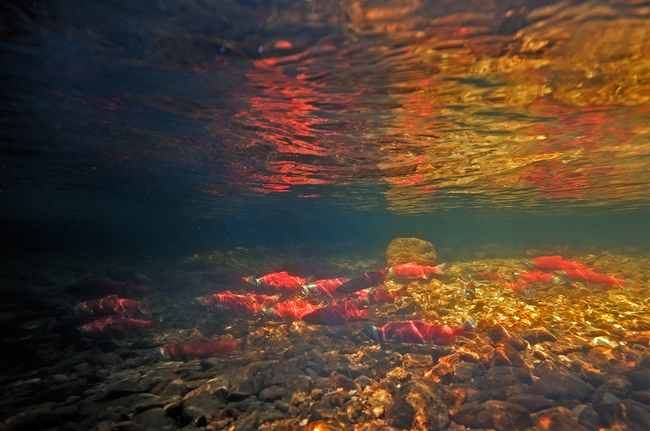
Population Dynamics and Trophic Ecology of Lake Trout in Priest Lake
Elizabeth L. Ng
Idaho Cooperative Fish and Wildlife Research Unit,
Department of Fish and Wildlife Sciences, University of Idaho
Michael C. Quist
U.S. Geological Survey, Idaho Cooperative Fish and Wildlife Research Unit, Department of Fish and Wildlife Sciences, University of Idaho
Notes:
Work completed through coop unit….

Slide 8
1. Describe Lake Trout biology and population dynamics
Notes:
So based on the findings of the first chapter, I wanted to evaluate lake trout trophic ecology as well as potential interactions with other species in Priest Lake

Slide 9
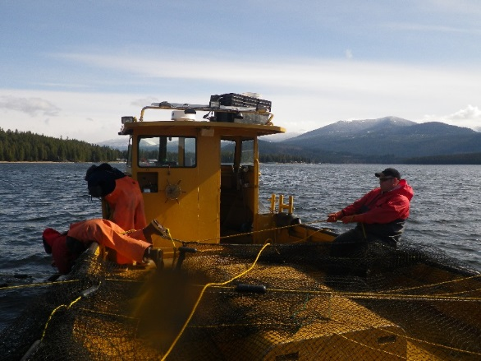
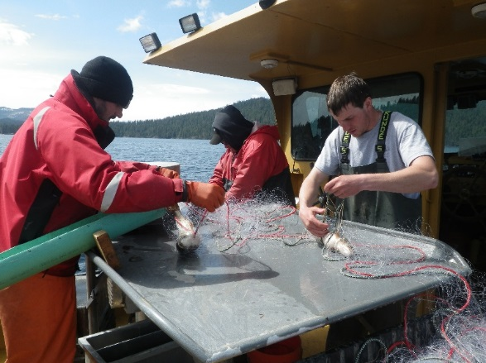
Methods
Spring and fall 2013
Sampling methods
  Monofilament gill nets
  Large trap nets
Tagged all Lake Trout
Notes:
Sampling for this research took place in the spring and fall of 2013. We set monofilament gill nets using a stratified random sampling design. Our nets were composed of eight different mesh sizes randomly arranged into gangs. We also used large trap nets in the spring to capture fish.

Slide 10
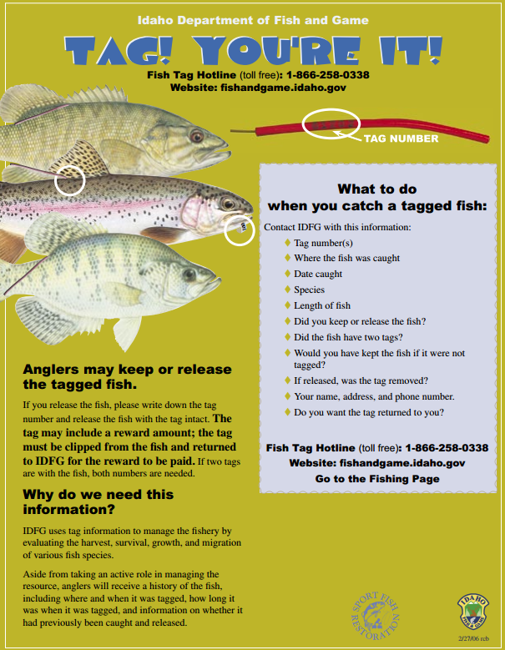
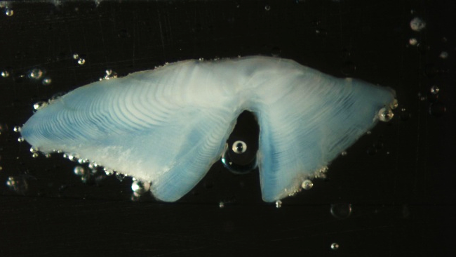
Methods
Population assessment
  Abundance
  Age
  Growth
  Fecundity and maturity
  Survival
    Exploitation
Notes:
We tagged and released lake trout to develop a mark-recapture estimate of abundance.
All Lake Trout were also measured for total length, and otoliths and fin rays were collected for age and growth analysis.
In the fall, we determined maturity status from sacrificed fish, and collected ovaries to estimate fecundity.
Finally, we used catch-age age to estimate annual survival, and used tags returned to the IDFG-tagging hotline to estimate exploitation

Slide 11
Age Distribution
  N : 31,569 – 59,451
  Survival: 85.1%
  Exploitation: 13.6%
Notes:
Used multinomial model to estimate proportion of fish of each size at each length. Applied to gill-net selectivity-corrected length frequency data.

Slide 12
Length at Age
Notes:
10 in is about 250 mm
Asymptotic length is 750 mm or about 30 in (Not many fish get bigger than that)

Slide 13
Length at Age
Notes:
For comparison, I’ve added the length at age for LKT from LPO during a period over very high individual growth rate. At young ages, fish in Priest Lake match or outperform growth by LPO fish. However, by age 9 or 10 they’ve fallen behind, and very few PL fish attain lengths of those in LPO

Slide 14
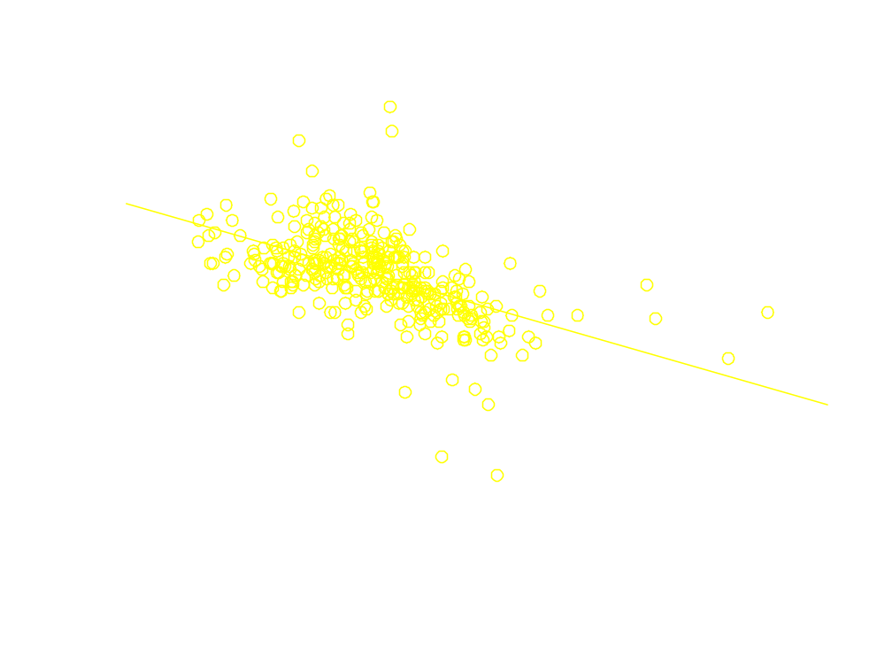
Body Condition
Notes:
Mysids are abundant, but forage fish like kokanee have been at low abundances since the introduction of mysis.
In a study of Lake Trout populations in Wyoming, Hubert and __ found that lake trout populations in oligotrophic lakes with few prey fish had low relative weights.
In contrast, in lakes with higher productivity and abundant prey fish (such as kokanee), not only were Wr higher on average, but they also tended to increase with length.

Slide 15
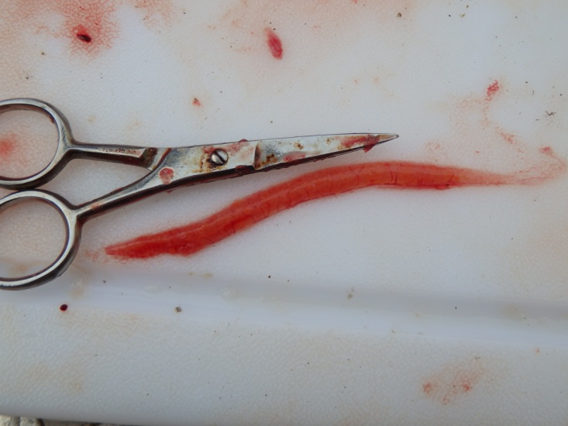
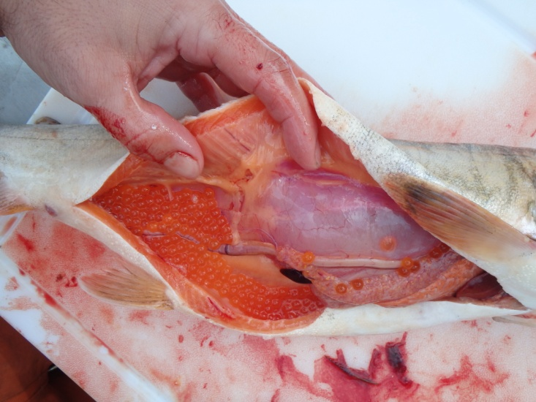
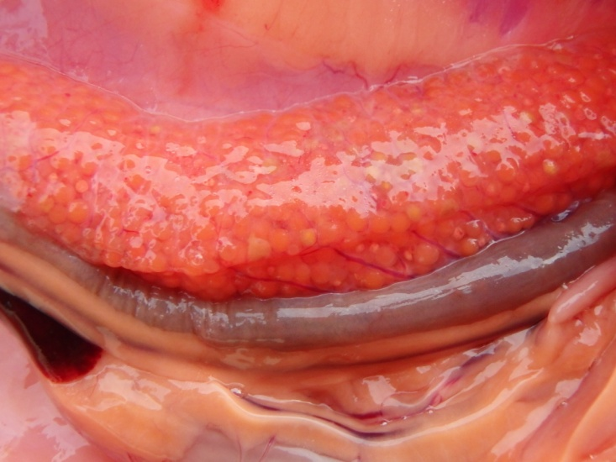
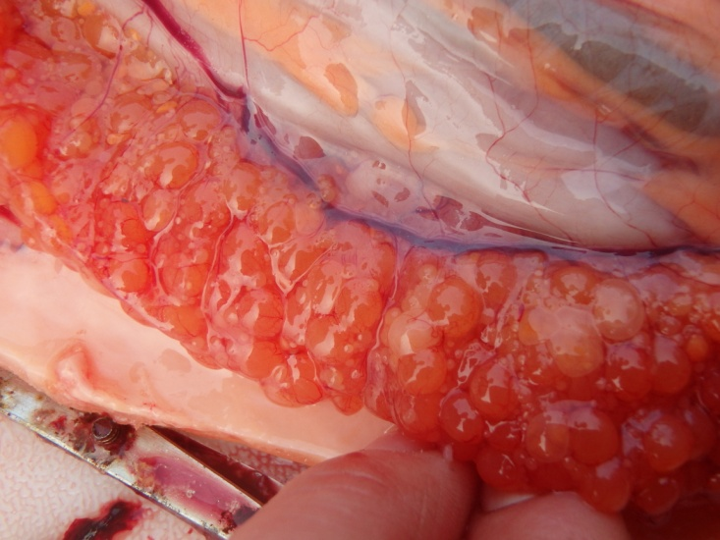
Maturity Status
Immature
Mature
Non-spawning

Slide 16
Spawning
Mature
Spawn
Notes:
We estimated probability of maturity at age for 133 female lake trout (which were aged directly). However, we also saw what is called “skipped spawning”, and that’s where the fish is mature, but not prepared to spawn that year. So we could often determine skipped spawners by their intermediate sized ovaries and the presence of reabsorbed eggs. So in addition to the probability of maturity, we also estimate the probability of spawning in a given year.
Using these biological inputs, we constructed the population model.

Slide 17
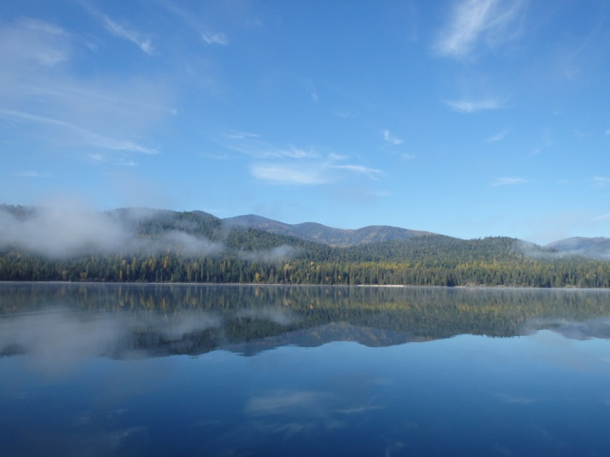
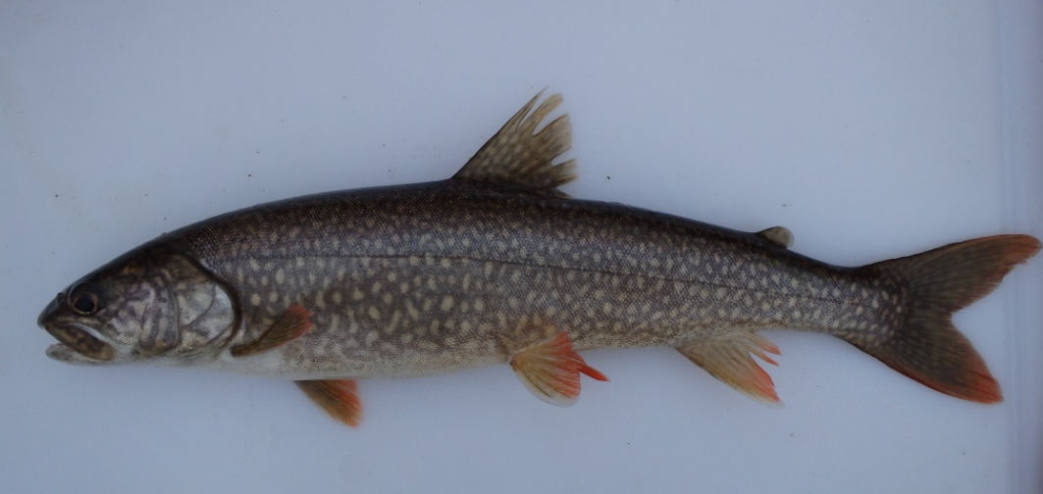
Conclusions
Fast initial growth
  Young age at maturity
  >50% mature by age 8
  Mysis shrimp food source
Notes:
In conclusion, we saw that juvenile growth rates were relatively high, which resulted in a young age at first maturity, and young age at 50% maturity relative to other lake trout populations, potentially because of abundant mysis forage for young lake trout.

Slide 18
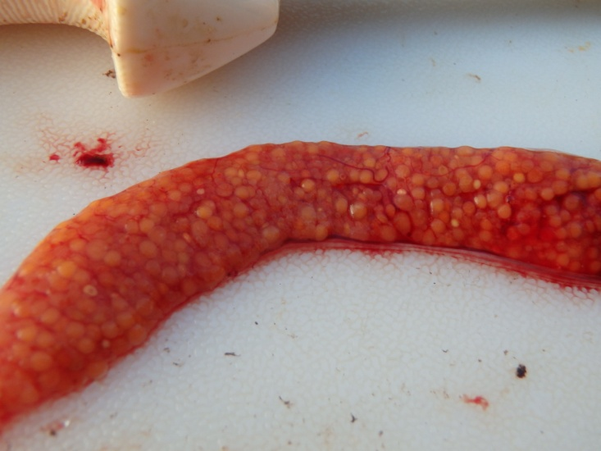
Conclusions
Growth slows after age 9
  Low reproductive rate
  50% mature females do not spawn
  Prey availability
Notes:
A consequence of this slowed growth after age 9 is low reproductive rate. Although PL LKT mature quite early, few it seems can sapwn annually. Instead, over 50% of mature females do not spawn in a given year. This indicates that there is a mismatch in prey availability between small and large lake trout

Slide 19
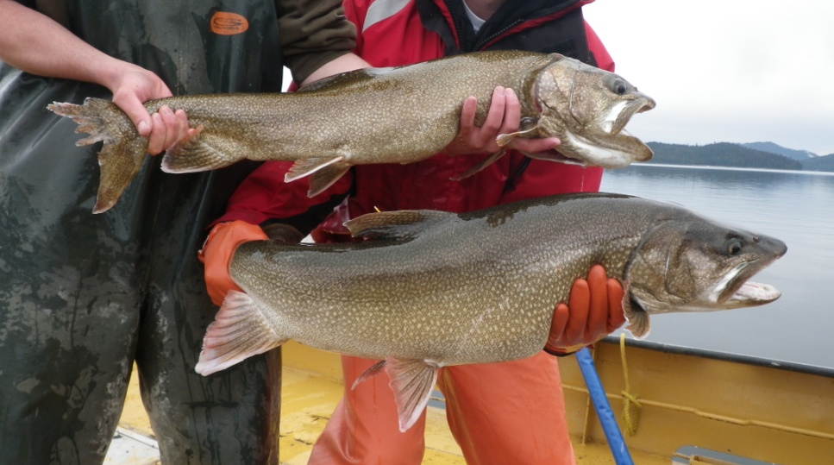
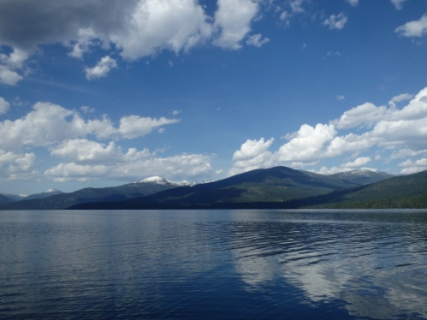
Conclusions
Evidence of density dependence
  Individual growth rates
  Population growth rate
Monitoring is important
Notes:
Our study indicates that the population in priest lake is experiencing density depend effects of low prey availability. This may make some management alternatives, such as eradication, more feasible, while making other management strategies, like producing trophy size fish, less feasible. A balanced approach, such as juvenile removal, may alleviate some density-dependent growth restrictions and improve the quality of the fishery while reducing overall abundance.
However, density dependence is one of the most challenging properties/things to evaluate in fisheries, and any management action should be monitored and re-evaluated to better understand how populations respond to management interventions.

Slide 20
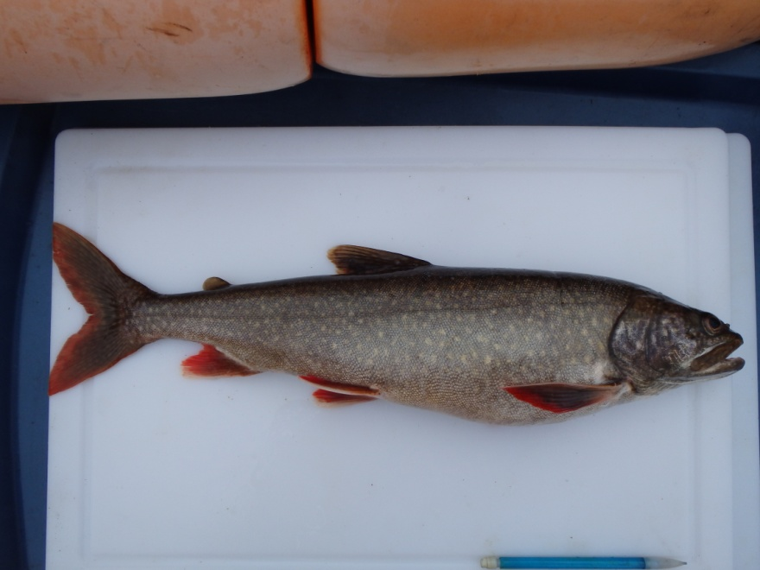
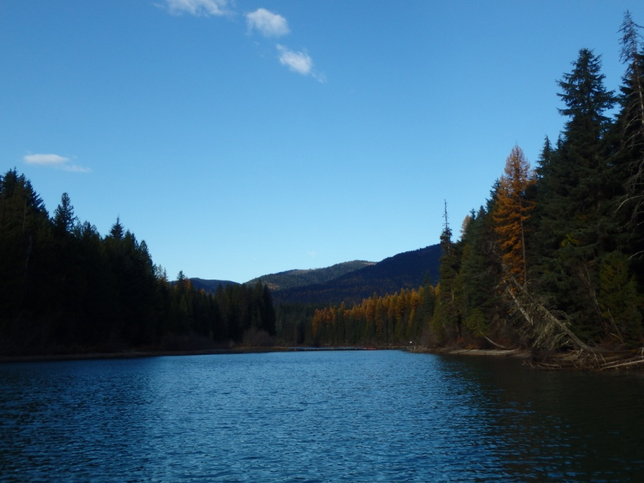
Overall Conclusions
Lake Trout population
  Moderate density
  High survival
  Growth
    Initially fast
    Slows after age 9
  Poor body condition
    Opportunistic feeding
    Low reproductive rate

Slide 21
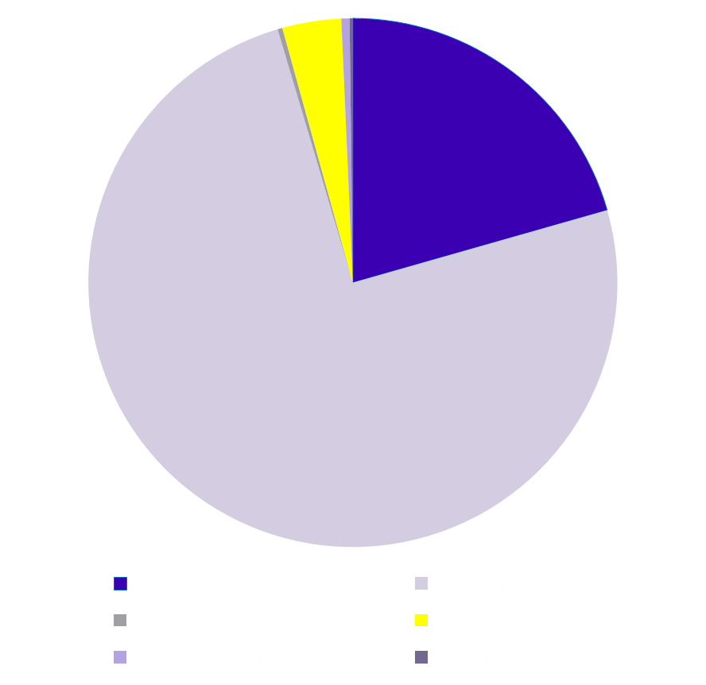
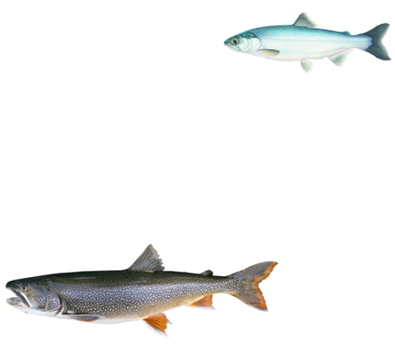
Angler Survey: 2013-14

Slide 22
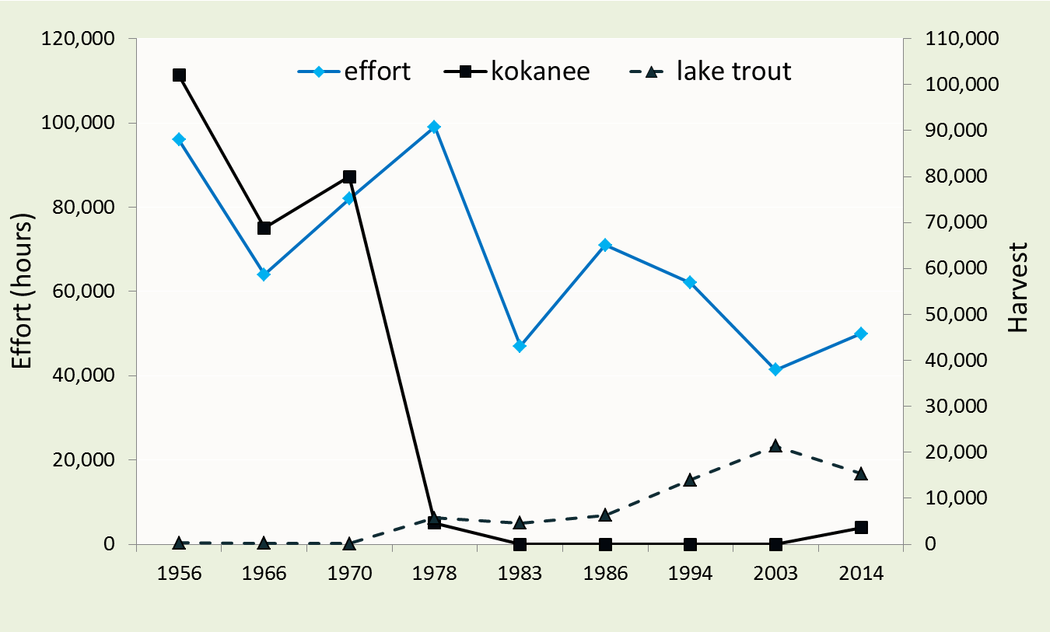
Angler Survey: 2013-14
Total Angler Effort = 49,941 ± 4,600 angler hours

Slide 23
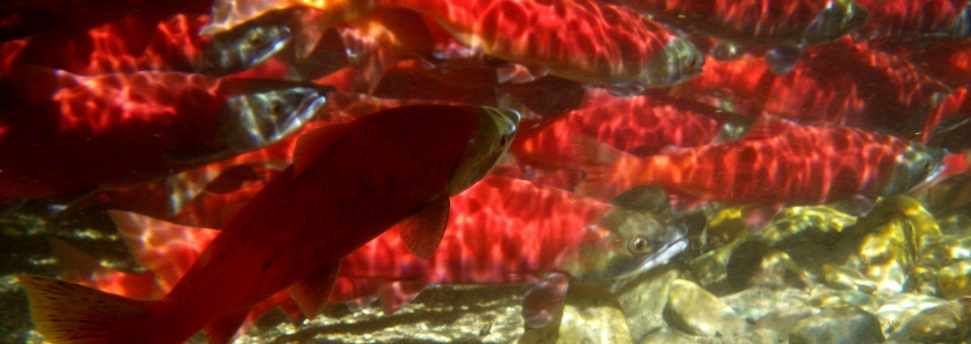
Kokanee Abundance: Spawner Counts

Slide 24
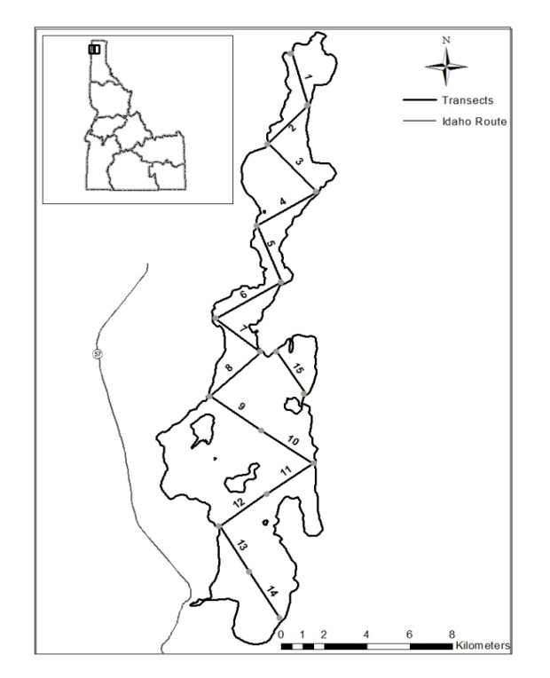
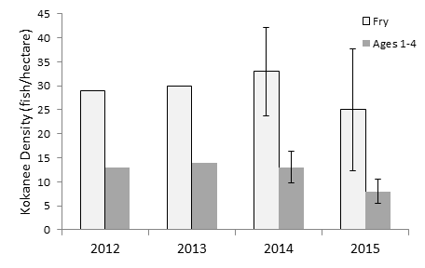
Kokanee Abundance: Acoustics Survey

Slide 25
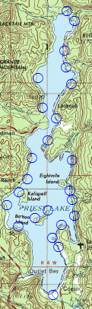
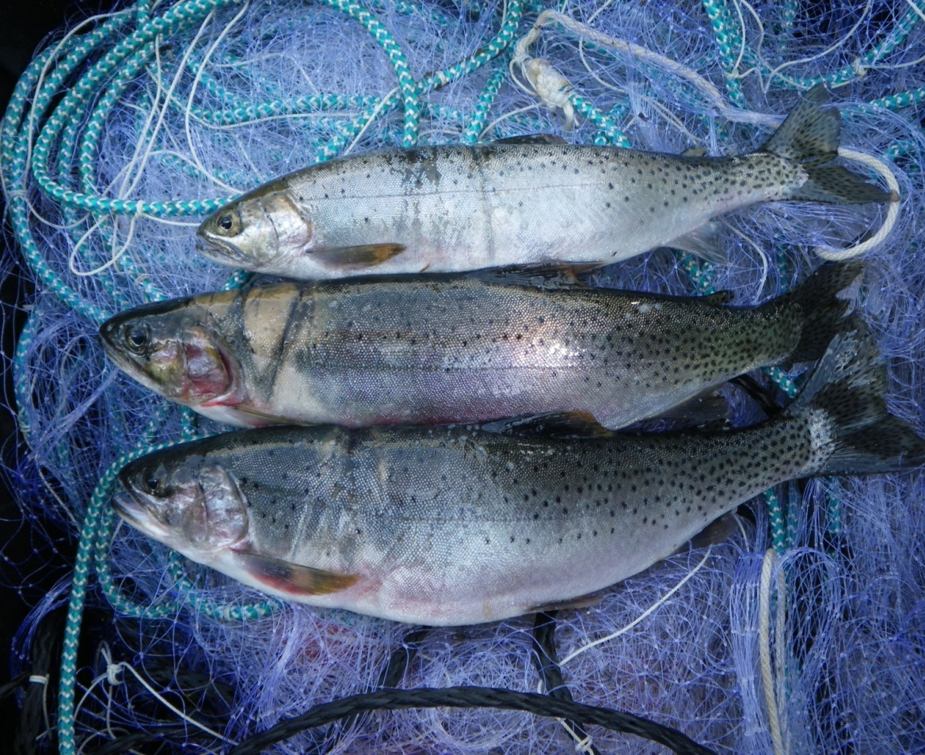
Westslope Cutthroat Trout Survey
Widespread distribution
Low density

Slide 26
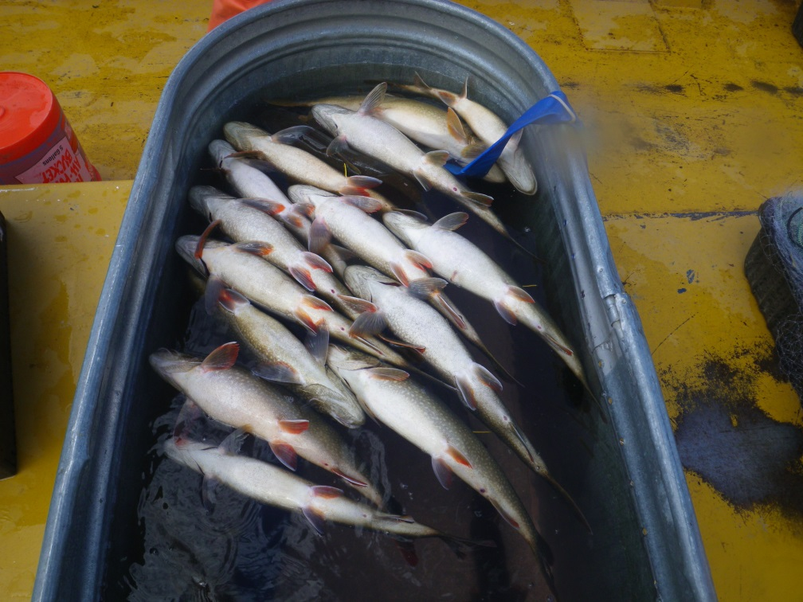
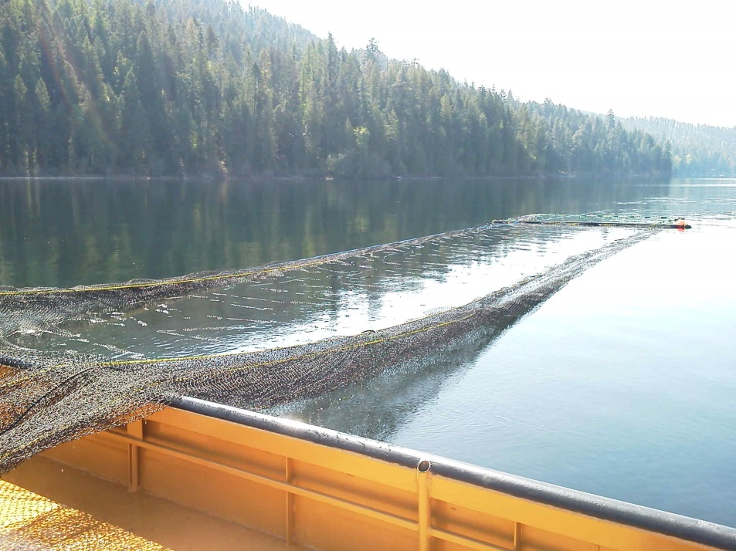
Lake Trout Angling Mortality Study
Tagged/Released 196 Lake Trout
30% Mortality @ 20 Days

Slide 27
Summary
Lake trout population is smaller than originally thought
Lake trout growth conditions are good for younger fish, but poor for older fish
Lake trout reproductive rate is low
Kokanee have increased and add diversity to fishery, but far below historical abundance
Cutthroat are widely distributed, but at low density
Bull trout in Upper Priest drainage are stable or increasing
Angler effort and harvest are fairly stable
Post-release angling mortality contributes to higher “harvest” by anglers than survey indicated

Slide 28
Future Direction
Continue to gather relevant information
Stakeholder group is actively engaged
Long-term management plan will be developed by 2017

Slide 29

Jim Fredericks
Rob Ryan
Many other IDFG staff
Scott Deeds
Elizabeth Ng
Mike Quist
Priest lake Fishery Advisory Committee
Delbert Jepson
Bob Davis
Steve Booth
Kristi Huling
Ken Hagman
Gair Petrie
Rich Lindsey
Rick Horey
Randy Phelps
Grant Brockus
Dave Gillespie
Jason Connor
Notes:
Work completed through coop unit….

